Slide 1
Chapter 8: Serial Communication
電機系
EE2405
嵌入式系統與實驗
Embedded System Lab
Prepared by: Prof. Jing-Jia Liu

Slide 2
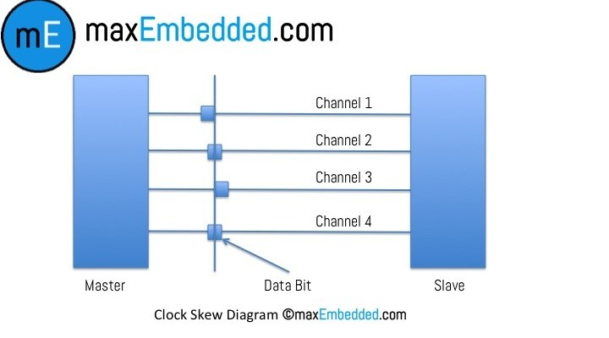
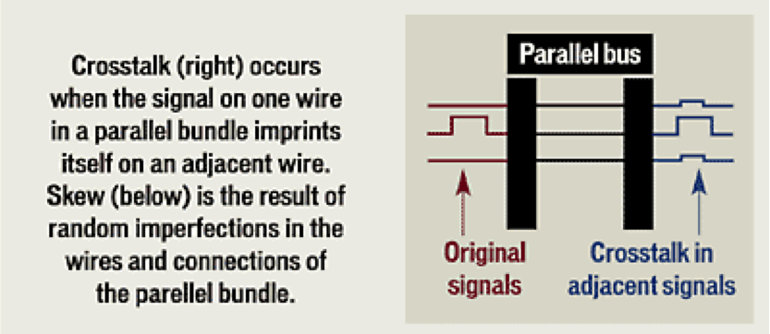
Introduction
Communication between microcontrollers and/or peripherals:
  Parallel communication
    Short-distance data communication
    Higher transfer rate situation
    Restricted by wire cross-talk, size, clock skew
  Serial communication
    Long-distance data communication
    lower transfer rate situations
    Less clock skew induced problem
    Synchronous
    Asynchronous

Slide 3
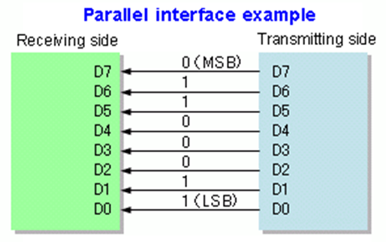
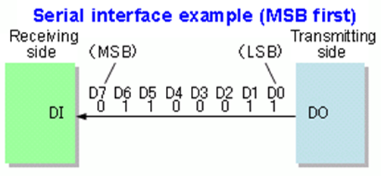
Serial vs. Parallel
Often serial links can be clocked considerably faster than parallel links in order to achieve a higher data rate due to:
  Clock skew between different channels is not an issue (for unclocked asynchronous serial communication links).
  A serial connection requires fewer interconnecting cables (e.g., wires/fibers) and hence occupies less space. The extra space allows for better isolation of the channel from its surroundings.
  Crosstalk is less of an issue, because there are fewer conductors in proximity.

Slide 4
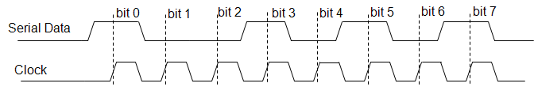
Serial Data Communication
In serial data transfer, one bit of the data is transmitted at a time, along a single interconnection.
  Less wire lead to less PCB tracks, interconnecting wires, and IC pins.
How does the receiver know when each bit begins and ends, and how does it know when each word begins and ends?
Synchronous serial communication --- The data is synchronized to the clock
  To send a clock signal alongside the data, with one clock pulse per data bit.
Synchronous serial data communication

Slide 5
The Basics of Serial Port:
Shift Register
An essential feature of most serial links is a shift register. This is made up of a string of flip-flops, connected so that the output of one is connected to the input of the next. Each flip-flop holds one bit of information.
QA
QB
QC
QD
QE
QF
QG
QH
DIN
D
Q
D
Q
D Q
D
Q
D
Q
D
Q
D
Q
D
Q
DOUT
Clk
An 8-Bit Shift Register – a Possible Receiver and/or Transmitter of Serial Data

Slide 6
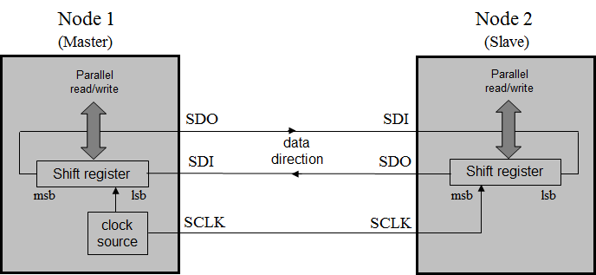
A simple serial link
(shift registers)
A simple (synchronous) serial data link is shown. Node 1 is designated Master; it controls what’s going on, as it controls the clock.
The Slave (Node 2) is similar to the Master, but receives the clock signal from the Master.
Every time the shift register is pulsed by the clock signal, each flip-flop passes its bit on to its neighbor on one side, and receives a new bit from its other neighbor. The one at the input end clocks in data received from the outside world, and the one of the output end outputs its bit.

Slide 7
Serial Peripheral Interface (SPI)
In the early days of microcontrollers, both National Semiconductors and Motorola started introducing simple serial communication, based on the previous slides.
Each formulated a set of rules which governed how these links worked, and allowed others to develop devices which could interface correctly.
These became de facto standards. Motorola called its standard Serial Peripheral Interface (SPI), and National Semiconductors called theirs Microwire. They’re very similar to each other.

Slide 8
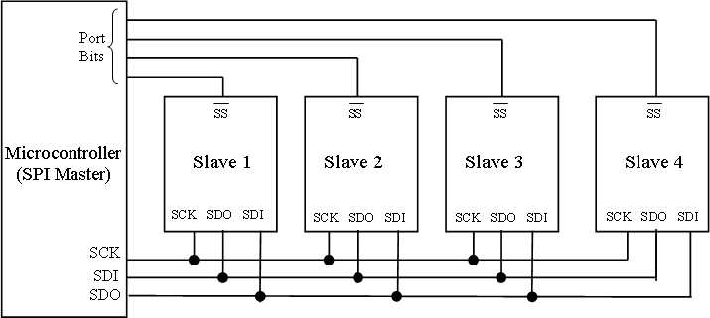
SPI Schematic
PCS[x]
K66
SPI interconnections for multiple Slaves

Slide 9
K66MCU SPI
The K66MCU has
  three SPI modules (SPI0, SPI1, SPI2),
  each supports module configuration register (MCR), two SPI CTAR registers for defining different clock, transfer attribute configurations, and
  can be configured as Master or Slave (MCR.MSTR bit).
Master mode
  allows the module to initiate and control serial communication;
  SCK, SOUT, PCS[x] are controlled by the module and configured as outputs
Slave mode,
  the SCK signal and the PCS0/SS signals are configured as inputs and driven by an SPI bus master.

Slide 10
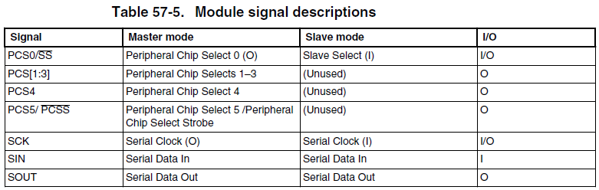
K66 SPI signal descriptions
SCK—Serial Clock
  Master mode: Serial Clock (O)—Supplies a clock signal from the module to SPI slaves.
  Slave mode: Serial Clock (I)—Supplies a clock signal to the module from an SPI master.
SIN(SDI)—Serial Input
  Master or slave mode: Serial Input (I)—Receives serial data.
SOUT(SDO)—Serial Output
  Master or slave mode: Serial Output (O)—Transmits serial data.
PCS0/SS—Peripheral Chip Select/Slave Select
  Master mode: Peripheral Chip Select 0 (O)
  Slave mode: Slave Select (I)

Slide 11
mbed SPI
mbed OS provides SPI API for using (K66F’s) SPI ports.
For master mode: SPI class
For slave mode: SPISlave class
Functions | Usage
SPI | Create a SPI master connected to the specified pins
format | Configure the data transmission mode and data length
frequency | Set the SPI bus clock frequency
write | Write to the SPI Slave and return the response

Slide 12
K66F SPI pin
SPI pins
D11: SPI0 MOSI
D12: SPI0 MISO
D13: SPI0 SCK
//mbed SPI APP
SPI serial_port(D11,D12,D13);
SPI0 Master

Slide 13
SPI mode
The mode is a feature of SPI which allows choice of which clock edge is used to clock data into the shift register (indicated as “Data strobe” in the diagram), and whether the clock idles high or low.
For most applications the default mode, i.e. Mode 0, is acceptable.

Slide 14
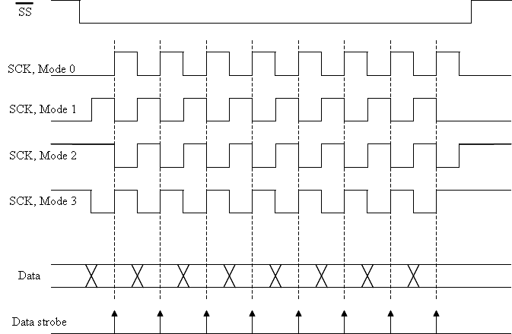
SPI modes
Mode | Polarity | Phase
0 | 0 | 0
1 | 0 | 1
2 | 1 | 0
3 | 1 | 1

Slide 15
Example of SPI Master
/* Program Example 7.1: Sets up the mbed as SPI master, and continuously sends a single byte */
#include "mbed.h”
SPI ser_port (D11, D12, D13); // mosi , miso, sclk
char switch_word ; //word we will send
int main() {
ser_port.format (8,0); // Setup the SPI for 8 bit data, Mode 0
ser_port.frequency (1000000); // Clock frequency is 1MHz
while (1){
switch_word =0xA1; //set up word to be transmitted
ser_port.write ( switch_word ); //send switch_word
wait_us (50);
}
}
It initializes the SPI object with pin D11-D13.
The format( ) function requires two variables: the number of bits, and the mode. This program applies default values, i.e. 8 bits of data, and Mode 0 format.
Output signals can be viewed on the oscilloscope.

Slide 16
SPI Slave API and Example Template
Functions | Usage
SPISlave | Create a SPI slave connected to the specified pins
format | Configure the data transmission format
frequency | Set the SPI bus clock frequency
receive | Polls the SPI to see if data has been received
read | Retrieve data from receive buffer as slave
reply | Fill the transmission buffer with the value to be written out as slave on the next received message from the master.
while(1) {
…
if(ser_port.receive()) {// Check input
recd_val = ser_port.read(); // Read byte from master
ser_port.reply(switch_word); // Send out response
}
}

Slide 17
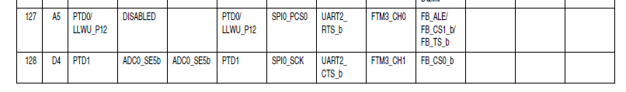
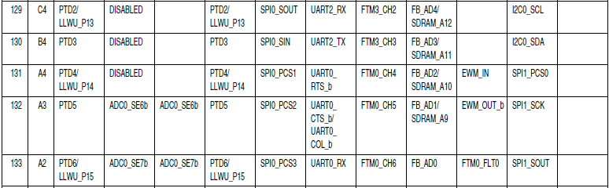
PTD0 = D10: ALT2 SPI0 PCS0
So setting this pin to GND set SPI0 in slave mode.
K66F
Master
K66F
Slave
GND
D10
D13
D12
D11
D10
D13
D12
D11

Slide 18
Master K66F
/*Sets the mbed up as Master, and exchanges data with a slave, sending its own switch positions, and displaying those of the slave. */
#include "mbed.h"
SPI ser_port(D11, D12, D13); // mosi, miso, sclk
DigitalOut red_led(LED1); //red led
DigitalOut green_led(LED2); //green led
DigitalOut cs(D10); //this acts as “slave select”
DigitalIn switch_ip1(SW2);
DigitalIn switch_ip2(SW3);
char switch_word ; //word we will send
char recd_val; //value return from slave
//continued over
//Default settings for SPI Master chosen, no need for further configuration

Slide 19
int main() {
  while (1){
  //Set up the word to be sent, by testing switch inputs
  switch_word=0xa0; //set up a recognisable output pattern
  if (switch_ip1==1)
  switch_word=switch_word|0x01; //OR in lsb
  if (switch_ip2==1)
  switch_word=switch_word|0x02; //OR in next lsb
  cs = 0; //select slave
  recd_val=ser_port.write(switch_word); //send switch_word and receive data
  //cs = 1;
  wait(0.01);
  //set leds according to incoming word from slave
  red_led=0; green_led=0; //preset both to 0
  recd_val=recd_val&0x03; //AND out unwanted bits
  if (recd_val==1) red_led=1;
  if (recd_val==2) green_led=1;
  if (recd_val==3){
  red_led=1;
  green_led=1;
  }
  }
}

Slide 20
Slave K66F
#include "mbed.h"
SPISlave ser_port(D11,D12,D13,D10); // mosi, miso, sclk, ssel
DigitalOut red_led(p25); //red led
DigitalOut green_led(p26); //green led
DigitalIn switch_ip1(p5);
DigitalIn switch_ip2(p6);
char switch_word ; //word we will send
char recd_val; //value received from master
int main() {
//default formatting applied
while(1) {
//set up switch_word from switches that are pressed
switch_word=0xa0; //set up a recognisable output pattern
if (switch_ip1==1) switch_word=switch_word|0x01;
if (switch_ip2==1) switch_word=switch_word|0x02;

Slide 21
if(ser_port.receive()) { //test if data transfer has occurred
recd_val = ser_port.read(); // Read byte from master
ser_port.reply(switch_word); // Make this the next reply
}
//now set leds according to received word
  red_led=0; green_led=0; //preset both to 0
  recd_val=recd_val&0x03; //AND out unwanted bits
  if (recd_val==1)
  red_led=1;
  if (recd_val==2)
  green_led=1;
  if (recd_val==3){
  red_led=1;
  green_led=1;
  }
  }
  }

Slide 22
SPI comments
The SPI is simple and therefore cheap.
There are disadvantages.
  There is no acknowledgement from the receiver, so in a simple system the Master cannot be sure that data has been received.
  There is no addressing. In a system where there are multiple slaves, a separate /SS (chip select) line must be run to each Slave. Therefore we begin to lose the advantage that serial communications should give us, i.e. a limited number of interconnect lines.
  There is no error-checking. Suppose some electromagnetic interference was experienced in a long data link, data or clock would be corrupted, but the system would have no way of detecting this, or correcting for it.

Slide 23
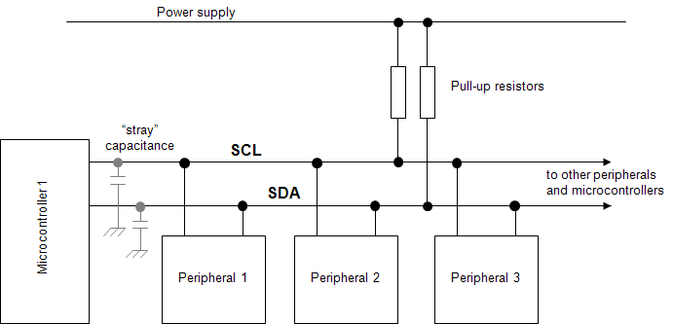
I2C
The name I2C stands for Inter-Integrated Circuit bus.
I2C only uses two physical wires, called serial data (SDA) and serial clock (SCL).
  This means that data only travels in one direction at a time.
Any node can only pull down the SCL or SDA line to Logic 0; it cannot force the line up to Logic 1. This role is played by a single pull-up resistor connected to each line.

Slide 24
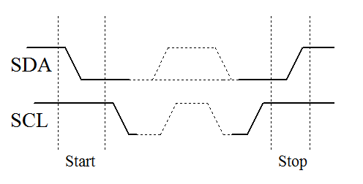
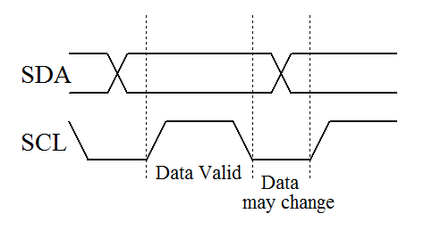
I2C Communications
The device that initiates communication is termed the ‘master’. A device being addressed by the master is called a ‘slave’.
A data transfer is started by the master signaling a Start condition, followed by one or two bytes containing address and control information.
    The Start condition is defined by a high to low transition of SDA when SCL is high.
    A low to high transition of SDA while SCL is high defines a Stop condition
One SCL clock pulse is generated for each SDA data bit, and data may only change when the clock is low.

Slide 25
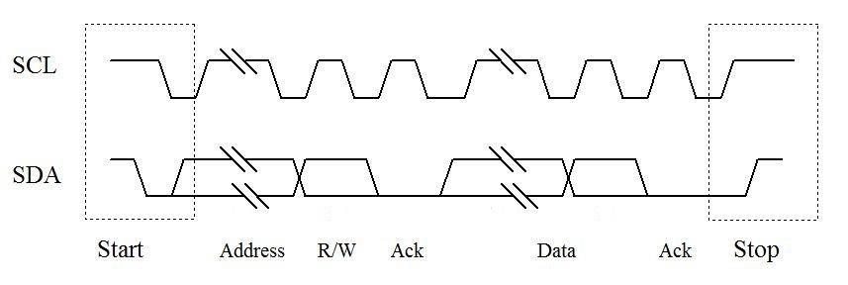
I2C data transfer
I2C has a built-in addressing scheme, which simplifies the task of linking multiple devices together. Each slave has a predefined address. Slaves monitor the bus and respond only to data and commands associate with their own address.
The byte following the Start condition is made up of seven address bits, and one data direction bit (Read/Write).
All data transferred is in units of one byte, with no limit on the number of bytes transferred in one message.
Each byte must be followed by a 1-bit acknowledge from the receiver, during which time the transmitter relinquishes SDA control.
A Complete transfer of one byte in I2C

Slide 26
I2C master and slave API
Functions | Usage
I2C | Create an I²C Master interface, connected to the specified pins
frequency | Set the frequency of the I²C interface
read | Read from an I²C slave
write | Write to an I²C slave
start | Creates a start condition on the I²C bus
stop | Creates a stop condition on the I²C bus
Functions | Usage
I2CSlave | Create an I²C Slave interface, connected to the specified pins
frequency | Set the frequency of the I²C interface
receive | Check to see if this slave has been addressed
read | Read from an I²C master
write | Write to an I²C master
address | Set the the I²C slave address
stop | Reset the slave to a known ready receiving state

Slide 27
FDRMK66F Has 2 mbed I2C ports
Remember to pull up SDA, SCL with 4.7KΩ.
I2C1 pins
I2C0 pins
I2C3 pins
K66F has 4 I2C modules: I2C0(PTB3,PTB2)(PTB1,PTB0)(PTD9,PTD8),
I2C(SDA,SCL) I2C1(PTE11,PTE10)(PTC11,PTC10),
I2C2(?),
I2C3(PTE10,PTE11).

Slide 28
I2C master example (1)
/*Program Example 7.5 I2C Master, transfers switch state to second mbed acting as slave, and displays state of slave's switches on its leds.*/
#include "mbed.h"
I2C i2c_port(D14, D15); // Configure a serial port, pins D14 and D15 are sda, scl
DigitalOut red_led(p25); //red led
DigitalOut green_led(p26); //green led
DigitalIn switch_ip1(p5); //input switch
DigitalIn switch_ip2(p6);
char switch_word; //word we will send
char recd_val; //value return from slave
const int addr = 0x52; // define the I2C slave address, an arbitrary even number
int main() {
while (1) {
Code body in next page …
}
}

Slide 29
I2C master example (2)
switch_word = 0xa0; //set up a recognisable output pattern
if (switch_ip1 == 1) switch_word = switch_word | 0x01; //OR in lsb
if (switch_ip2 == 1) switch_word = switch_word | 0x02; //OR in next lsb
//send a single byte of data, in correct I2C package
i2c_port.start(); //force a start condition
i2c_port.write(addr); //send the address
i2c_port.write(switch_word); //send one byte of data, ie switch_word
i2c_port.stop(); //force a stop condition
wait(0.002);
//receive a single byte of data, in correct I2C package
i2c_port.start();
i2c_port.write(addr | 0x01); //send address, with Read/Write bit set to Read
recd_val = i2c_port.read(addr); //Read and save the received byte
i2c_port.stop(); //force a stop condition
//set leds according to word received from slave
red_led = 0; //preset both to 0
green_led = 0;
recd_val = recd_val & 0x03; //AND out unwanted bits
if (recd_val == 1) red_led = 1;
if (recd_val == 2) green_led = 1;
if (recd_val == 3) {
red_led = 1;
green_led = 1;
}
wait(0.004);

Slide 30
I2C slave example (1)
/*Program Example 7.6 I2C Slave, when called transfers switch state to mbed acting as Master, and displays state of Master's switches on its leds.*/
#include <mbed.h>
I2CSlave slave(D14, D15); //Configure I2C slave DigitalOut red_led(LED1); //red led
DigitalOut green_led(LED2); //green led DigitalIn switch_ip1(SW2);
DigitalIn switch_ip2(SW3);
char switch_word ; //word we will send
char recd_val; //value received from master
Continued over next page...

Slide 31
I2C slave example (2)
int main() {
slave.address(0x52);
while (1) { //set up switch_word from switches that are pressed
switch_word=0xa0; //set up a recognisable output pattern
if (switch_ip1==1) switch_word=switch_word|0x01;
if (switch_ip2==1) switch_word=switch_word|0x02;
slave.write(switch_word); //load up word to send
//test for I2C, and act accordingly
int i = slave.receive();
if (i == 3){ //slave is addressed, Master will write
recd_val= slave.read();
recd_val=recd_val&0x03;
if (recd_val==1) red_led=1;
if (recd_val==2) green_led=1;
if (recd_val==3){ red_led=1; green_led=1;}
} //end of while
} //end of main

Slide 32
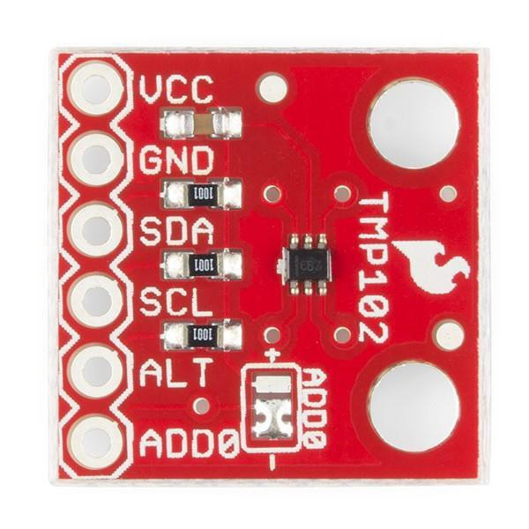
I2C TMP102 sensor
The Texas Instruments TMP102 temperature sensor has an I2C data link.
Note that the TMP102 actually makes use of the SMbus - System Management Bus.
  This was defined by Intel in 1995, and is based on I2C.
  In simple applications the two standards can be mixed; for more advanced applications it is worth checking the small differences which there are.
Please check code example in lab.
Signal | K66F Pin | Notes
VCC (3.3V) | VDD
SDA | 9 | 2.2 kΩ pull-up to 3.3 V
SCL | 10 | 2.2 kΩ pull-up to 3.3 V
GND | GND
ALT (Alert) | GND
ADD0 | GND | Connect to Slave address 0V 0x90 Vcc 0x91 SDA 0x92 SCL 0x93

Slide 33
K66F I2C pin to TMP102
I2C1 pins

Slide 34
/*Program Example 7.7: Mbed communicates with TMP102 temperature sensor, and
scales and displays readings to screen. */
#include "mbed.h“
I2C tempsensor(D14, D15); //sda, sc1
Serial pc(USBTX, USBRX); //tx, rx
const int addr = 0x90;
char config_t[3];
char temp_read[2];
float temp;
int main() {
config_t[0] = 0x01; //set pointer reg to 'config register'
config_t[1] = 0x60; // config data byte1
config_t[2] = 0xA0; // config data byte2
tempsensor.write(addr, config_t, 3);
config_t[0] = 0x00; //set pointer reg to 'data register'
tempsensor.write(addr, config_t, 1); //send to pointer 'read temp'
while(1) {
wait(1);
tempsensor.read(addr, temp_read, 2); //read the two-byte temp data
temp = 0.0625 * (((temp_read[0] << 8) + temp_read[1]) >> 4); //convert data
pc.printf("Temp = %.2f degC\n\r", temp);
}
}

Slide 35
/* Lab mbed I2C for TMP102
*/
#include "mbed.h“
I2C m_i2c(D14,D15);
char m_addr = 0x90;
int main()
{
while(1)
{
const char tempRegAddr = 0x00;
m_i2c.write(m_addr, &tempRegAddr, 1); //Pointer to the temperature register
char reg[2] = {0,0};
m_i2c.read(m_addr, reg, 2); //Read
unsigned short res = (reg[0] << 4) | (reg[1] >> 4);
float temp = (float) ((float)res * 0.0625);
printf("load temp %d,%d\r\n", reg[0], reg[1]);
wait(1.0);
}
}

Slide 36
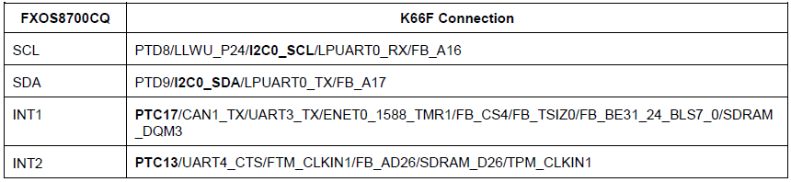
mbed I2C for built-in module FXOS8700CQ
FRDM K66 has An NXP FXOS8700CQ Accelerometer and Magnetometer
  low-power, 6-axis Xtrinsic sensor combines 14-bit accelerometer and 16-bit magnetometer sensors
  interfaced through an I2C bus and two GPIO signals,
  By default, the I2C address is 0x1D (SA0 pulled high and SA1 pulled low).

Slide 37
TextLCD I2C version
This part is for comparison with the textLCD in LAB4.
Recall that in Lab4 we use 12 wires to set up the LCD and control it with each of the port individually, which is troublesome.
Here, we use an I2C LCD to simplify things and show I2C can achieve the same function with only SDA and SDL.
Connect to TextLCD as suggested.
Import & Configure Library
  mbed add https://os.mbed.com/users/wim/code/TextLCD/
Modify TextLCD_Config.h
  Go to line 71, change it from
  #define DEFAULT 1 to #define DEFAULT 0
  Go to line 75, change it from
  #define YWROBOT 0 to #define YWROBOT 1
LCD | mbed
VCC | 5V
GND | GND
SDA | SDA
SCL | SCL

Slide 38
#include "mbed.h"
#include "TextLCD.h"
// Host PC Communication channels
Serial pc(USBTX, USBRX); // tx, rx
// I2C Communication
I2C i2c_lcd(D14,D15); // SDA, SCL
//TextLCD_SPI lcd(&spi_lcd, p8, TextLCD::LCD40x4);
// SPI bus, 74595 expander, CS pin, LCD Type
TextLCD_I2C lcd(&i2c_lcd, 0x4E, TextLCD::LCD16x2);
// I2C bus, PCF8574 Slaveaddress, LCD Type
//TextLCD_I2C lcd(&i2c_lcd, 0x42, TextLCD::LCD16x2, TextLCD::WS0010);
// I2C bus, PCF8574 Slaveaddress, LCD Type, Device Type
//TextLCD_SPI_N lcd(&spi_lcd, p8, p9);
// SPI bus, CS pin, RS pin, LCDType=LCD16x2, BL=NC, LCDTCtrl=ST7032_3V3
//TextLCD_I2C_N lcd(&i2c_lcd, ST7032_SA, TextLCD::LCD16x2, NC, TextLCD::ST7032_3V3);
// I2C bus, Slaveaddress, LCD Type, BL=NC, LCDTCtrl=ST7032_3V3

Slide 39
int main() {
pc.printf("LCD Test. Columns=%d, Rows=%d\n\r", lcd.columns(), lcd.rows());
for (int row=0; row<lcd.rows(); row++) {
int col=0;
pc.printf("MemAddr(Col=%d, Row=%d)=0x%02X\n\r", col, row, lcd.getAddress(col, row));
// lcd.putc('-');
lcd.putc('0' + row);
for (col=1; col<lcd.columns()-1; col++) {
lcd.putc('*');
}
pc.printf("MemAddr(Col=%d, Row=%d)=0x%02X\n\r", col, row, lcd.getAddress(col, row));
lcd.putc('+');
}
// Show cursor as blinking character
lcd.setCursor(TextLCD::CurOff_BlkOn);
// Set and show user defined characters. A maximum of 8 UDCs are supported by the HD44780.
// They are defined by a 5x7 bitpattern.
lcd.setUDC(0, (char *) udc_0); // Show |>
lcd.putc(0);
lcd.setUDC(1, (char *) udc_1); // Show <|
lcd.putc(1);
}

Slide 40
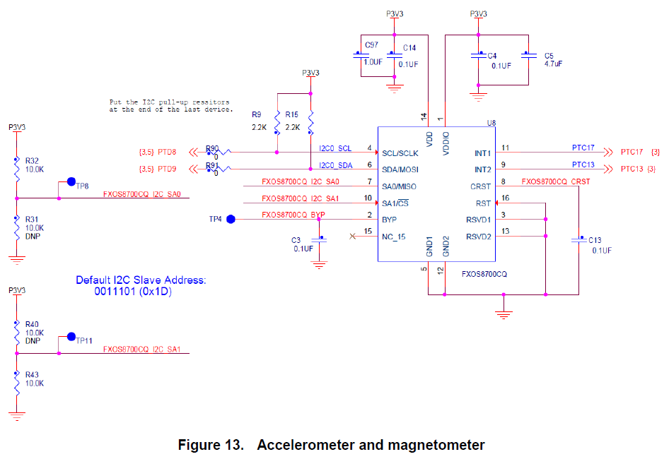
FXOS8700CQ

Slide 41
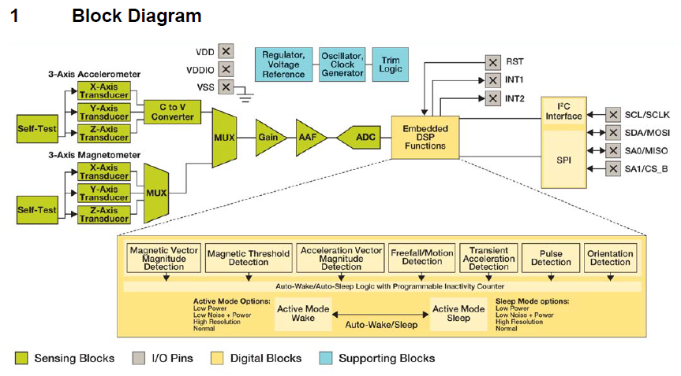
FXOS8700CQ Block Diagram

Slide 42
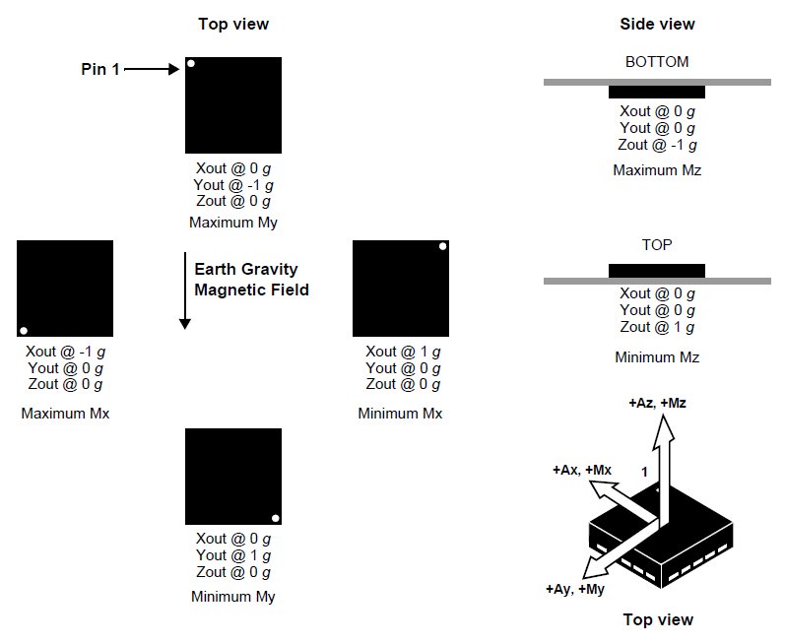
Product orientation and axis orientation

Slide 43
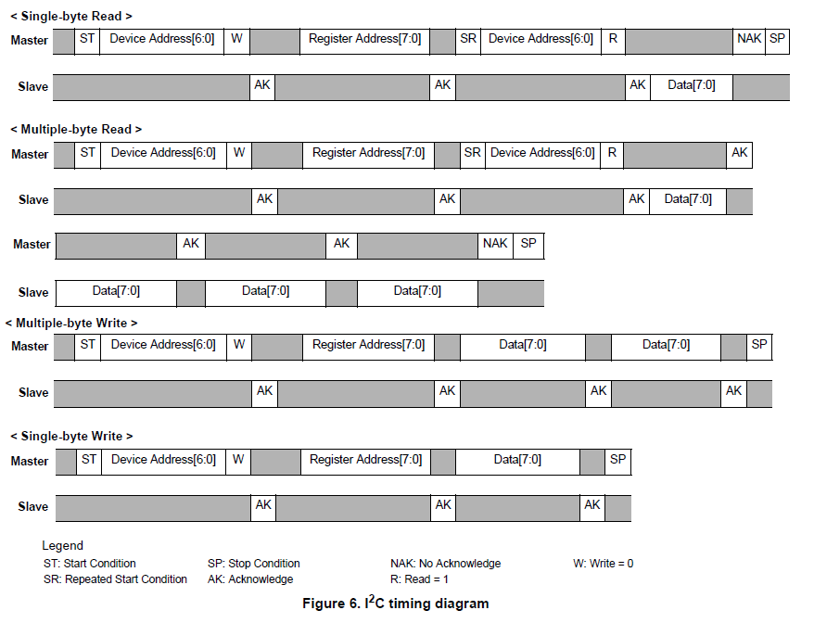

Slide 44
#include "mbed.h"
#include "fsl_port.h" 3
#include "fsl_gpio.h"
#define UINT14_MAX 16383
// FXOS8700CQ I2C slave address
#define FXOS8700CQ_SLAVE_ADDR0 (0x1E<<1) // with pins SA0=0, SA1=0
#define FXOS8700CQ_SLAVE_ADDR1 (0x1D<<1) // with pins SA0=1, SA1=0
#define FXOS8700CQ_SLAVE_ADDR2 (0x1C<<1) // with pins SA0=0, SA1=1
#define FXOS8700CQ_SLAVE_ADDR3 (0x1F<<1) // with pins SA0=1, SA1=1
// FXOS8700CQ internal register addresses
#define FXOS8700Q_STATUS 0x00
#define FXOS8700Q_WHOAMI 0x0D
#define FXOS8700Q_XYZ_DATA_CFG 0x0E
#define FXOS8700Q_CTRL_REG1 0x2A
#define FXOS8700Q_M_CTRL_REG1 0x5B
#define FXOS8700Q_M_CTRL_REG2 0x5C
#define FXOS8700Q_WHOAMI_VAL 0xC7
#define FXOS8700Q_OUT_X_MSB 0x01
#define FXOS8700Q_OUT_Y_MSB 0x03
#define FXOS8700Q_OUT_Z_MSB 0x05
#define FXOS8700Q_M_OUT_X_MSB 0x33
#define FXOS8700Q_M_OUT_Y_MSB 0x35
#define FXOS8700Q_M_OUT_Z_MSB 0x37
// number of bytes to be read from the FXOS8700CQ: status plus 6 channels = 13 bytes
#define FXOS8711CQFXOS8701CQFXOS8700CQ_READ_LEN 13

Slide 45
I2C i2c( D14, D15 );
Serial pc(USBTX, USBRX);
int m_addr = FXOS8700CQ_SLAVE_ADDR1;
void FXOS8700CQ_readRegs(int addr, uint8_t * data, int len);
void FXOS8700CQ_writeRegs(uint8_t * data, int len);
int main()
{ pc.baud(115200);
uint8_t who_am_i, data[2], res[6];
int16_t acc16;
float t[3];
// Enable the FXOS8700Q
FXOS8700CQ_readRegs( FXOS8700Q_CTRL_REG1, &data[1], 1);
data[1] |= 0x01;
data[0] = FXOS8700Q_CTRL_REG1;
FXOS8700CQ_writeRegs(data, 2);
// Get the slave address
FXOS8700CQ_readRegs(FXOS8700Q_WHOAMI, &who_am_i, 1);
pc.printf("Here is %x\r\n", who_am_i);

Slide 46
while (true) {
FXOS8700CQ_readRegs(FXOS8700Q_OUT_X_MSB, res, 6);
acc16 = (res[0] << 6) | (res[1] >> 2);
if (acc16 > UINT14_MAX/2)
acc16 -= UINT14_MAX;
t[0] = ((float)acc16) / 4096.0f;
acc16 = (res[2] << 6) | (res[3] >> 2);
if (acc16 > UINT14_MAX/2)
acc16 -= UINT14_MAX;
t[1] = ((float)acc16) / 4096.0f;
acc16 = (res[4] << 6) | (res[5] >> 2);
if (acc16 > UINT14_MAX/2)
acc16 -= UINT14_MAX;
t[2] = ((float)acc16) / 4096.0f;
printf("FXOS8700Q ACC: X=%1.4f(%x%x) Y=%1.4f(%x%x) Z=%1.4f(%x%x)\r\n",\
t[0], res[0], res[1],\
t[1], res[2], res[3],\
t[2], res[4], res[5]\
);
wait(1.0);
}
}

Slide 47
void FXOS8700CQ_readRegs(int addr, uint8_t * data, int len)
{
char t = addr;
i2c.write(m_addr, &t, 1, true);
i2c.read(m_addr, (char *)data, len);
}
void FXOS8700CQ_writeRegs(uint8_t * data, int len)
{
i2c.write(m_addr, (char *)data, len);
}
Push the reset button on the microcontroller and it will start.
FXOS8700Q ACC: X=-0.0061(ff98) Y=-0.0229(fe84) Z=0.9893(3f50) FXOS8700Q ACC: X=-0.0054(ffa4) Y=-0.0232(fe80) Z=0.9841(3efc) FXOS8700Q ACC: X=-0.0073(ff84) Y=-0.0227(fe88) Z=0.9844(3f0) FXOS8700Q ACC: X=-0.0054(ffa4) Y=-0.0208(fea8) Z=0.9836(3ef4) FXOS8700Q ACC: X=-0.0083(ff74) Y=-0.0227(fe88) Z=0.9849(3f8)

Slide 48
I2C comments
An extra (clock) line needs to go to every data node.
The bandwidth needed for the clock is always twice the bandwidth needed for the data; therefore, it is the demands of the clock which limit the overall data rate.
Over long distances, clock and data themselves could lose synchronization.
No error checking.

Slide 49
Asynchronous serial data communication
Asynchronous communication doesn’t require the clock to be connected between nodes.
Data rate (baud rate) is predetermined – both transmitter and receiver are pre-set to recognize the same data rate. Hence each node needs an accurate and stable clock source, from which the data rate (internal clock) can be generated.
Each byte or word is framed with a Start and Stop bit. These allow synchronization to be initiated before the data starts to flow.
After “Start” bit is received, a double-rate clock starts to sample data to avoid wrong data capture.
An asynchronous serial port is generally called a UART, Universal Asynchronous Receiver/ Transmitter. A UART has one connection for transmitted data, called TX, and another for received data, called RX.

Slide 50
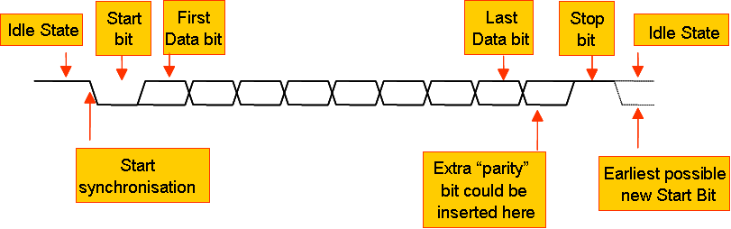
UART data format
Q: A UART is running with a 500 kHz baud rate. How long does it take for a single message containing one data byte to be transmitted? Ensure that you calculate time for the complete message.

Slide 51
K66MCU UARTs
K66MCU contains five UART modules: UART0, UART1, UART2, UART3, UART4.
Standard features of all UARTs:
  RS-485 support
  Hardware flow control (RTS/CTS)
  9-bit UART to support address mark with parity
  MSB/LSB configuration on data
UART0 and UART1 are clocked from the core clock, the remaining UARTs are clocked on the bus clock. The maximum baud rate is 1/16 of related source clock frequency.
IrDA is available on all UARTs
UART0 contains the standard features plus ISO7816
UART0 and UART1 contain 8-entry transmit and 8-entry receive FIFOs
All other UARTs contain a 1-entry transmit and receive FIFOs

Slide 52
mbed Serial API
Functions | Usage
Serial | Create a Serial port, connected to the specified transmit and receive pins
baud | Set the baud rate of the serial port
format | Set the transmission format used by the Serial port
putc | Write a character
getc | Read a character
printf | Write a formatted string
scanf | Read a formatted string
readable | Determine if there is a character available to read
writeable | Determine if there is space available to write a character
attach | Attach a function to call whenever a serial interrupt is generated

Slide 53
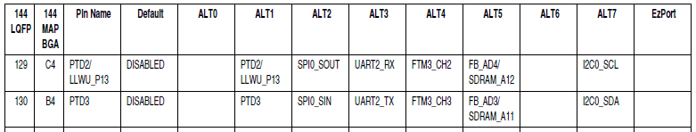
K66F I2C pin
UART3 pins
UART4 pins
UART2
UART1 pins

Slide 54
UART example
#include "mbed.h"
Serial device(D1, D0); // K66 UART1 tx, rx
int main() {
device.baud(19200);
device.printf("Hello World\n");
}
K66F has 5 UARTs : UART(TX,RX)
UART0(PTD7,PTD6),(PTB17,PTB16)(PTA14,PTA15),(PTA2,PTA1)
UART1(PTC4,PTC3),(D1,D0)
    UART2(PTD3,PTD2),(D12,D11)
UART3(PTC17,PTC16)(PTB11,PTB10)
UART4(PTC15,PTC14)(PTE24,PTE25)

Slide 55
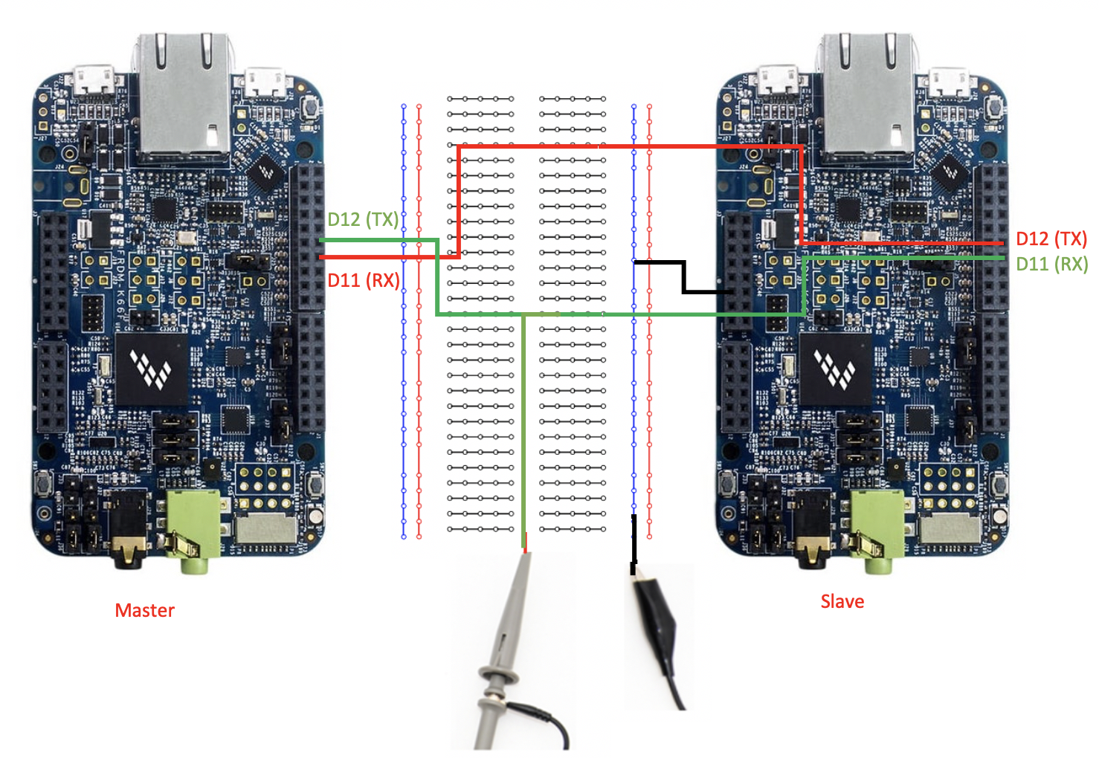
UART Lab

Slide 56
UART Lab-1 (UART sender)
#include "mbed.h“
Serial device(D12, D11); // UART2 tx, rx
DigitalIn button0(SW2);
DigitalIn button1(SW3);
int main() {
char cmd = 0;
while(1) {
cmd = button0<<1 | button1;
device.putc(cmd);
}
}

Slide 57
UART Lab-1 (UART receiver)
#include "mbed.h“
Serial pc(USBTX, USBRX); // tx, rx
Serial device(D12, D11); // tx, rx
DigitalOut red_led(LED1);
DigitalOut green_led(LED2);
char recv;
int main() {
red_led = 1;
green_led = 1;
while(1) {
if(device.readable()) {
recv = device.getc();
red_led = (recv&0x01)?1:0;
green_led = (recv&0x02)?1:0;
}
}
}
Open PC terminal to see the interaction.

Slide 58
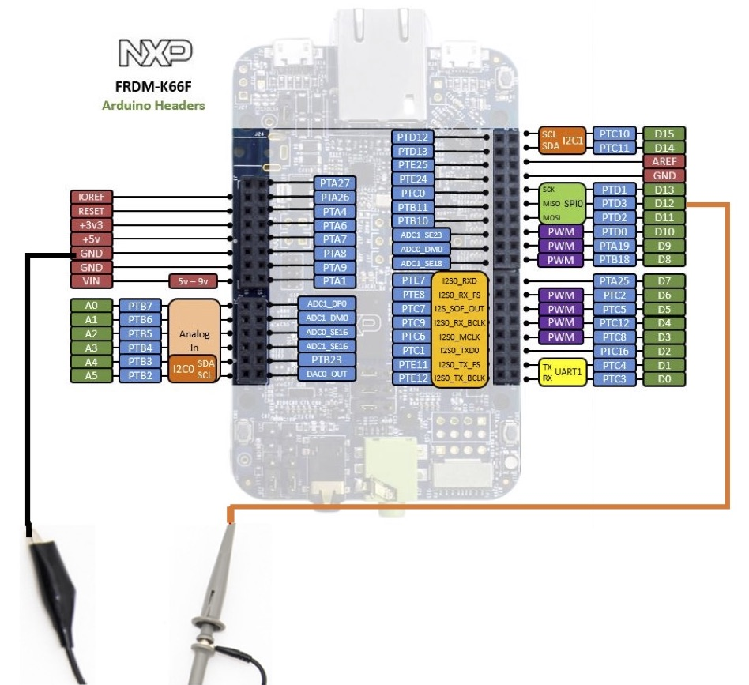
PicoScope UART Decoding

Slide 59
PicoScope UART Decoding
#include "mbed.h“
Serial device(D12, D11); // UART2 tx, rx
DigitalIn button0(SW2);
DigitalIn button1(SW3);
int main() {
char cmd[10] = “PicoScope”;
int i = 0;
while(1) {
device.baud(9600);
device.putc(cmd[i]);
++i;
if(i==10)i=0;
}
}

Slide 60
Serial pass-through between the PC and an external UART
#include "mbed.h"
Serial pc(USBTX, USBRX); // tx, rx
Serial device(D1, D0); // tx, rx
int main() {
while(1) {
if(pc.readable()) {
device.putc(pc.getc());
}
if(device.readable()) {
pc.putc(device.getc());
}
}
}

Slide 61
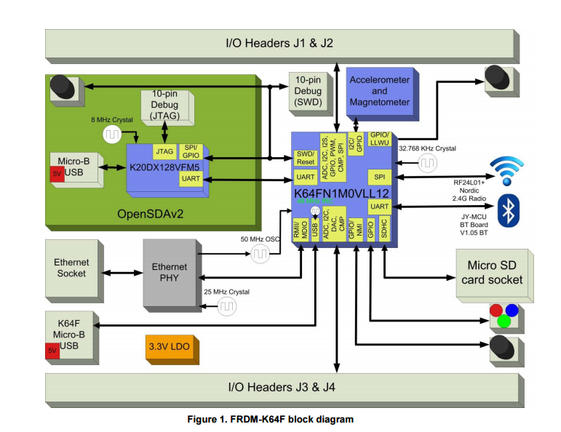
Host virtual UART
K66F create a virtual UART for communication with the USB link
The related hardware can be seen in the block diagram below.
This UART acts just like any of the others, in terms of its use of the API. The mbed compiler use USBTX and USBRX as identifiers to set up this connection, as in the line:
Serial pc(USBTX, USBRX);

Slide 62
Chapter Review
Serial data links provide a simple and economical means of communication between microcontroller and peripherals, and/or between microcontrollers.
SPI is a simple synchronous standard with serial input, output, clock and enable pins.
  Limited by the enable pins.
The I2C has a more sophisticated protocol than SPI
  I2C runs on a 2-wire bus which includes addressing and acknowledgement in the protocol.
  I2C allows multi-master configurations.
  Lack of error correction standards.
Many sensors communicate through SPI and I2C.
UART is an asynchronous protocol.
  We have used an virtual UART communication link with the host computer via USB.
The USB protocol is even more versatile, yet it requires complex protocols on both hardware and software drivers.

Slide 63
Checkpoints
Know how to transfer data via UART.
Configure the UART setting, like baud rate.
Know how to send command to I2C module.

