Slide 1
Chapter 7:Interrupts,
Timers and Tasks
電機系
EE2405
嵌入式系統與實驗
Embedded System Lab
Prepared by: Prof. Jing-Jia Liu

Slide 2
Tasks: Event-Triggered and Time-Triggered
In almost all embedded programs, the program has to undertake a number of different activities. We call these distinct activities tasks.
Once a program has more than one task, we enter the domain of multi-tasking.
Task categories:
  Event-triggered: occur when a particular external event happens, at a time which is not predictable;
  Time-triggered: happen periodically, at a time determined by the microcontroller.
As a simple example, a room temperature controller tasks:
Task | Event or time-triggered
Measure temperature | Time (every minute)
Compute and implement heater and fan settings | Time (every minute)
Respond to user control | Event
Record and display temperature | Time (every minute)
Orderly switch to battery backup in case of power loss | Event

Slide 3
How to process hardware event?
Hardware events:
  Digital in: push button, switch, digital input pin
  Analog device: ADC completion
  Serial port: data byte received / transmit
  Counter/timer: overflow, counter reaching count,
  …, etc.
How to know of and process them?
  Polling:
    Write a program loop to keep checking hardware events one by one, respond if any occurs.
  Interrupt-driven
    Let the hardware notify CPU of event occurring.

Slide 4
Polling
One way of programming for an event-triggered activity, like a button push, is to continuously test that external input by polling.
  As illustrated, a program is structured as a continuous loop (super loop).
There are two main problems with polling:
  The processor can’t perform any other operations during a polling routine
  All inputs are treated as equal; the urgent change has to wait its turn before it’s processed by the computer.

Slide 5
Checking Two Buttons by Polling
Response task
for button1
Is button1
pressed?
Y
N
Response task
for button2
Is button2
pressed?
Y
N
Perform other
tasks

Slide 6
Interrupt
CPU detects an interrupt
complete current instructions
main
running
With an interrupt, the hardware is designed so that the external variable can stop the CPU in its tracks, and perform a pre-defined task for the external event on demand.
ISR (interrupt service routine) is a predefined task for an interrupt located at a fixed memory address.
Save register context + PC
to Stack
latency
Find ISR address (vector)
Jump to ISR
Interrupt ISR execution
ISR
running
End of ISR?
Load register context from
Stack and continue main
main
resume

Slide 7
K66F Interrupt Sources
K66F CPU core has nested vector interrupt controller (NVIC) with 16 priority levels to handle interrupts.
The interrupt source assignments table:
  Vector number — the value stored on the stack when an interrupt is serviced.
  IRQ number — non-core interrupt source count, which is the vector number minus 16.
  Source module/description
    DMA, I2C, SPI, UART, ADC, DAC, CMP, RTC, PIT, Port pin detect (Port A, B, C, D, E), CAN, ethernet, USB, software interrupt

Slide 8
InterruptIn
The mbed API exploits only a small subset of the interrupt capability of the K66F microcontroller for each pin can interrupt.
InterruptIn API
Function | Usage
InterruptIn | Create an InterruptIn connected to the specified pin
rise | Attach a function to call when a rising edge occurs on the input
fall | Attach a function to call when a falling edge occurs on the input
mode | Set the input pin mode: PullUp, PullDown, PullNone, PullDefault

Slide 9
Example of InterruptIn
/* Program Example 9.1: Simple interrupt example. SW2 causes interrupt to turn LED1 on or off on demand. */
#include "mbed.h"
InterruptIn button(SW2);
DigitalOut led(LED1);
void ISR1(){
led = !led;
}
int main(){
button.rise(&ISR1);
while(1){
}
}
SW2
LED1

Slide 10
More on interrupt
To deal with more complex interrupt applications, most processors contain several important mechanisms.
  Note that mbed InterruptIn only implement the simplest scheme. For following capability, please check a RTOS.
Interrupts can be prioritized, - some can be defined as more important than others. If two occur at the same time, then the higher priority one executes first.
Interrupts can be masked, i.e. switched off, if they are not needed, or are likely to get in the way of more important activity. This masking could be just for a short period, for example while a critical program section completes.
Interrupts can be nested. This means that a higher priority interrupt can interrupt one of lower priority. Working with nested interrupts increases the demands on the programmer, and is strictly for advanced players only.
The location of the ISR in memory can be selected, to suit the memory map and programmer wishes.
Usually a specialized interrupt controller is implemented in hardware to assist above mechanisms.

Slide 11
Testing Interrupt Latency
Interrupt latency can be observed with this program by observing on an oscilloscope a square wave input, and on the other beam the interrupt response, i.e. the output at “led”. The latency is the delay between the two.
Rising edge trigger interrupt
ISR generate a single pulse
Interrupt latency

Slide 12
Testing Interrupt Latency
/* Tests interrupt latency. External input causes interrupt, which pulses external LED while LED flashes continuously. */
#include "mbed.h"
InterruptIn squarewave(D2); //Connect input square wave here to intr (D2,D3)
DigitalOut led(D7); //to external led
DigitalOut flash(LED1);
void pulse() { //ISR sets external led high for fixed duration
led = 1; wait(0.01); led = 0;
}
int main() {
squarewave.rise(&pulse); // attach the address of the pulse function
// to the rising edge
while(1) { // interrupt will occur within this endless loop
flash = !flash; wait(0.25);
}
}

Slide 13
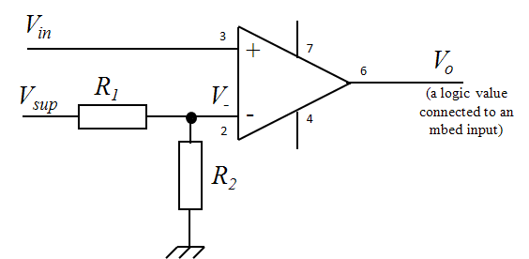
Interrupts from analog inputs
Aside from digital inputs, it is useful to generate interrupts when analog signals change, for example if an analog temperature sensor exceeds a certain threshold.
One way to do this is by applying a comparator, as shown.

Slide 14
Digital Counter
Counters are useful in counting events. We can use a counter to set a threshold of an event count, e.g. 10 people passing a gate, and generate an interrupt.
Counters can count up or down.
We can also design a counter to read or load the current value (and reset to zero).
An n-bit counter can count from 0 to (2^{n} – 1). For example, an 8-bit counter can count from 0000 0000 to 1111 1111, or 0 to 255 in decimal.
  If a counter reaches its maximum value, and the input clock pulses keep on coming, then it overflows back to zero, and starts counting up all over again.

Slide 15
Four-bit Asynchronous Up Counter
More counter designs can be found at http://www.learnabout-electronics.org/Digital/dig56.php

Slide 16
Timer
Assume we have a clock of 10MHz as input to a counter.
Assume also we set the event count to 1024.
We can calculate the time duration to count from 0 to 1024 = 1/10MHz * 1024 = 0.1us * 1024 =0.1024ms
Therefore, a timer can be designed with a counter + a known clock source.

Slide 17
Counting and Timing – Interrupt on Overflow
Many microcontroller counters cause an interrupt as the counter overflows; this interrupt can be used to record the overflow, and the count can continue in a useful way. The effective range of the counter has been extended.
If the counter is just free-running with a continuous clock signal, then the “interrupt on overflow” occurs repeatedly, as shown below. This becomes very useful where a periodic interrupt is needed.

Slide 18
Timer
mbed Timer uses timer hardware in K66F to track times.
Function | Usage
Timer | Create a Timer object
start | Start the timer
stop | Stop the timer
reset | Reset the timer to 0
read | Get the time in seconds
read_ms | Get the time in milli-seconds
read_us | Get the time in micro-seconds
Note: K66F has FlexTimer Module (FTM), Periodic Interrupt Timer (PIT), Low-Power Timer (LPTMR), Timer/PWM Module (TPM), and Real Time Clock (RTC)

Slide 19
Example of Timer
/* Program Example 9.3: A simple Timer example, from mbed web site.
Activate Tera Term terminal to test.
*/
#include "mbed.h"
Timer t;
Serial pc( USBTX, USBRX );
int main(){
t.start();
pc.printf("Hello from the other side\n");
t.stop();
pc.printf("The time taken was %f seconds\n", t.read());
}

Slide 20
Multiple Timers
/*Program Example 9.4: Program which runs two time-based tasks */
#include "mbed.h"
Timer timer_fast, timer_slow; // define Timers with name "timer_fast" and "timer_slow"
DigitalOut redLED(LED1);
DigitalOut greenLED(LED2);
int main(){
timer_fast.start();
timer_slow.start();
while(1){
if(timer_fast.read() > 2){//test Timer value
redLED = !redLED;
timer_fast.reset(); //and reset the Timer
}
if(timer_slow.read() > 0.2){//test Timer value
greenLED = !greenLED;
timer_slow.reset();
}
}
}
This program creates two Timers, timer_fast and timer_slow. The main program starts these running, and tests when each exceeds a certain number. When the time value is exceeded, a function is called, which flips the associated led.

Slide 21
Timeout
Timeout sets up an interrupt to call a function after a specified delay.
Function | Usage
Timeout | Create a Timeout object
attach | Attach a function to be called by the Timeout, specifying the delay in seconds
attach | Attach a member function to be called by the Timeout, specifying the delay in seconds
attach_us | Attach a function to be called by the Timeout, specifying the delay in microseconds
attach_us | Attach a member function to be called by the Timeout, specifying the delay in microseconds
detach | Detach the function

Slide 22
Example of Timeout
/*Program Example 9.6: Demonstrates Timeout,
by triggering an event a fixed duration after a button press. */
#include "mbed.h"
Timeout tout; //create a Timeout, and name it “tout"
DigitalIn button(SW2);
DigitalOut redLED(LED1);
void blink(){//this function is called at the end of the Timeout
redLED = 0;
wait(0.5);
redLED = 1;
}
int main(){
for( redLED=1; ; ){
if(button==0){
tout.attach( &blink, 2.0);
//attach blink function to tout, to occur after 2 seconds
}
wait(0.2);
}
}
This example causes an action to be triggered a fixed period after an external event. If the button is pressed, the blink( ) function gets attached to the tout Timeout.

Slide 23
Ticker
The mbed Ticker sets up a recurring interrupt, which can be used to call a function periodically, at a rate specified by the programmer.
Function | Usage
Ticker | Create a Ticker object
attach | Attach a function to be called by the Timeout, specifying the interval in seconds
attach | Attach a member function to be called by the Timeout, specifying the interval in seconds
attach_us | Attach a function to be called by the Timeout, specifying the interval in microseconds
attach_us | Attach a member function to be called by the Timeout, specifying the interval in microseconds
detach | Detach the function

Slide 24
Example of Ticker
/* Program Example 9.9: Simple demo of "Ticker". Replicate behaviour of first led flashing program.
*/
#include "mbed.h"
Ticker time_up; //define a Ticker
DigitalOut redLED(LED1);
void blink(){ // the function that Ticker will call
redLED = !redLED;
}
int main(){
time_up.attach( &blink, 0.2 ); //initialize the ticker
while(1); //sit in a loop doing nothing, waiting for Ticker interrupt
}
This program switches the LED every 200ms, using Timeout rather than a wait( ) function. This is a more efficient way to program an embedded system.

Slide 25
The real time clock
The Real Time Clock (RTC) is an ultra-low-power peripheral on the K66F.
The RTC is a timing/counting system which is used to maintain a calendar and time-of- day clock, with registers for seconds, minutes, hours, day, month, year, day of month and day of year.
It can also generate an alarm for a specific date and time.
It runs from its own 32 kHz crystal oscillator, and can have its own independent battery power supply. It can thus be powered, and continue in operation, even if the rest of the microcontroller is powered down.
The mbed API doesn’t create any C++ objects, but just implements standard functions from the standard C library.

Slide 26
RTC API
Function | Usage
time() | Get the current time
set_time | Set the current time
mktime | Converts a tm structure (a format for a time record) to a timestamp
localtime | Converts a timestamp to a tm structure
ctime | Converts a timestamp to a human-readable string
strftime | Converts a tm structure to a custom format human- readable string

Slide 27
Example of real time clock
#include "mbed.h"
int main() {
set_time(1256729737); //Set RTC time to Wed, 28 Oct 2009 11:35:37
while (true) {
time_t seconds = time(NULL);
printf("Time as seconds since January 1, 1970 = %u\n", (unsigned int)seconds);
printf("Time as a basic string = %s", ctime(&seconds));
char buffer[32];
strftime(buffer, 32, "%I:%M %p\n", localtime(&seconds));
printf("Time as a custom formatted string = %s", buffer);
wait(1);
}
}

Slide 28
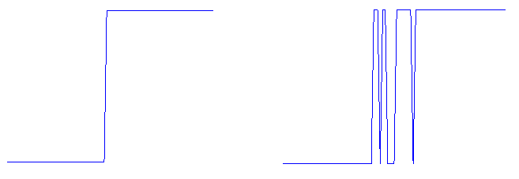


An application --- debouncing
The mechanical contacts of a switch literally bounce together, as the switch closes. This lasts for a few milliseconds, and can cause a digital input to swing wildly between Logic 0 and Logic 1 for a short time after a switch closes, as illustrated:
Ideal switch response
Actual switch response
Demonstrating switch bounce

Slide 29
Event driven LED Switching with Switch Debounce
/* Program Example 9.12: Event driven LED switching with switch debounce */
#include "mbed.h"
Timer debounce; //define debounce timer
InterruptIn button(SW2); //Interrupt on digital pushbutton input SW2
DigitalOut redLED(LED1);
void toggle(){
if(debounce.read_ms()>1000){//only allow toggle if debounce timer has passed 1s
redLED = !redLED;
debounce.reset();//restart timer when the toggle is performed
}
}
int main(){
debounce.start();
button.rise(&toggle);// attach the address of the toggle
while(1);
}
This program solves the switch bounce issue by starting a timer on a switch event, and ensuring that 10 ms has elapsed before allowing a second event to be processed.

Slide 30
Tasks in Real Time OS
A program written for an RTOS is structured into tasks or threads.
  Each task is written as a self-contained program module.
  The tasks can be prioritized.
The RTOS performs three main functions for tasks:
  It decides which task/thread should run and for how long.
  It provides communication and synchronization between tasks.
  It controls the use of resources shared between the tasks, for example memory and hardware peripherals.

Slide 31
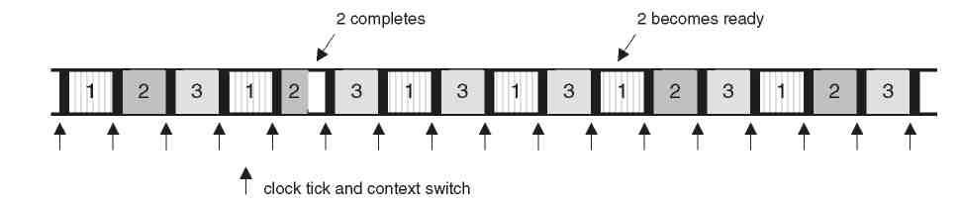
RTOS Scheduling
An important part of the RTOS is its scheduler, which decides which task runs and for how long.
A simple example is the Round Robin scheduler, as illustrated.
  The scheduler synchronizes its activity to a clock tick.
At every clock tick, the scheduler determines if a different task should be given CPU time.
  In Round Robin scheduling, the task is switched in order.
Round robin scheduling for three tasks

Slide 32
Chapter Review
Signal inputs can be repeatedly tested in a loop, a process known as polling.
  It consumes controller power just checking ready signals.
An interrupt allows an external signal to interrupt the action of the CPU, and start code execution to serve the external request.
  More efficient than polling.
Generally, multiple interrupt inputs are possible, which adds considerably to the complexity of both hardware and software.
  Need a good software framework like mbed or RTOS.
Given a clock signal of known and reliable frequency, a counter can readily be used as a timer.
  A counter is simply digital logic to increment with input pulses or clocks.
  Micro-controller usually have several timers.
  Timers can generate interrupts periodically.

Slide 33
Demo & Checkpoints
You need to know how to write an interrupt service routine.
You need to know how to run a function at a designated time.
You need to know how to run a function periodically.
You need to know how to measure the latency between an interrupt event and an output signal.
Create a new project to write for the following function. Switches the LED every 500 ms (don't use wait() function)
Please explain how 4.9 Application -- Debounce code works.

