Slide 1
Chapter 6: Liquid Crystal Displays
電機系
EE2405
嵌入式系統與實驗
Embedded System Lab
Prepared by: Prof. Jing-Jia Liu

Slide 2
Liquid crystal display technology
LCD is the most common display technology.
It uses light modulating properties of liquid crystal and polarization of light
  Both electric and magnetic fields are vibrating perpendicular to the direction of propagation of light.
  Most of the light sources are unpolarized.
Vertical and Horizontal Polaroid filters
https://electrosome.com/lcd-display-fundamentals/

Slide 3
Polarization of Light
Polarization: the process of converting unpolarized light to polarized light
  Electric fields in polarized lights will vibrate only in a specific pattern
  A vertical polarizer will pass only vertical components of the lights and horizontal components will be absorbed by it.

Slide 4
Liquid Crystal
Exists in a state between crystalline (solid) and isotropic (liquid) state, which can be controlled by electric field.
ON Pixel
OFF Pixel
The polarisation of light changes when it passes through liquid crystal without electric field.
No change in the polarization of light when it passes through liquid crystal in an electric field.

Slide 5
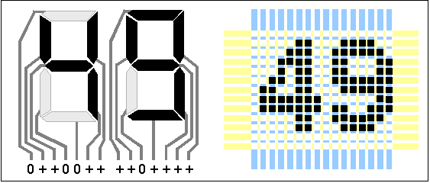
Segments or Pixels
Segments or Pixels are the smallest building blocks of a display.
Pixel is an abbreviation of Picture Element, which is a term commonly used in digital imaging, in which each image is constructed by a set of pixels.
While segments are the smallest building block of customized displays like seven segment display which can display only numbers.

Slide 6
Transmissive Displays
See dark pixel
(no voltage)
(apply voltage)
This displays allows the use of back lights, commonly known as Backlit LCDs.
We can also use ambient light as the source as used in the device shown below.

Slide 7
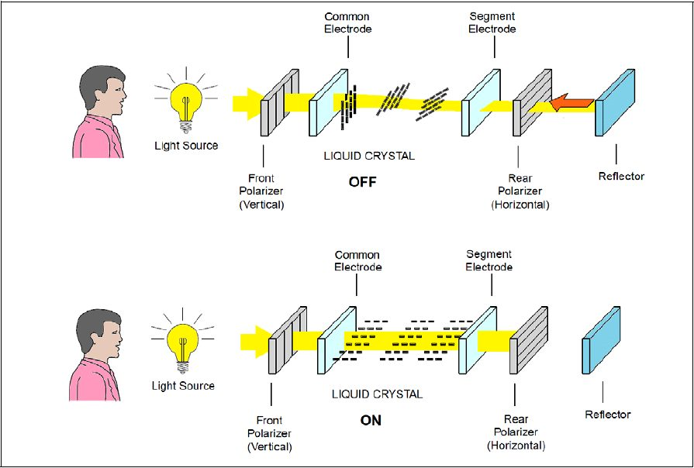
Reflective Displays
(no voltage)
See dark pixel
(apply voltage)
The working is similar to the transmissive displays except that the light source and the observer are in the same side.
There is a reflector on the other side which will reflect back the light from the front side.

Slide 8
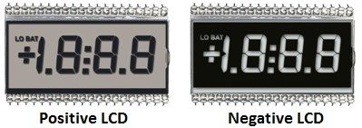
Positive and Negative LCDs
These LCD displays are capable of creating both positive and negative images as shown in the below image.
A positive image is created by dark pixels or segments on white background. In this kind of displays front and rear polarizers are perpendicular to each other.
A negative image is created by light pixels or segments on dark background. In this kind of displays both front and rear polarizers are aligned to each other.

Slide 9
LCD pixels
A pixel is the basic element of a display.
Each pixel of a color LCD will have 3 sub pixels producing Red, Green and Blue colors.

Slide 10
Liquid crystal character displays
A popular form of LCD is the character display.
  These are widely available from one line of characters to four or more
  Seen on photocopiers, burglar alarms or DVD players, etc.
Driving this complex array of tiny LCD dots is far from simple, so such displays always contain a hidden microcontroller, customized to drive the display.
  Most controllers are compatible to Hitachi HD44780.

Slide 11
HD44780 programming interface
The HD44780 contains an 80-byte RAM (Random Access Memory) to hold the display data, and a ROM (Read Only Memory) for generating the characters.
It has a simple instruction set, including instructions for initialization, cursor control (moving, blanking, blinking), and clearing the display.
For HD44780 command, see http://www.dinceraydin.com/lcd/commands.htm
Communication with the controller is made via an 8-bit data bus (it also provides 4-bit mode), 2 control lines, and an enable/strobe line (E).
The HD44780 communication lines are shown below.

Slide 12
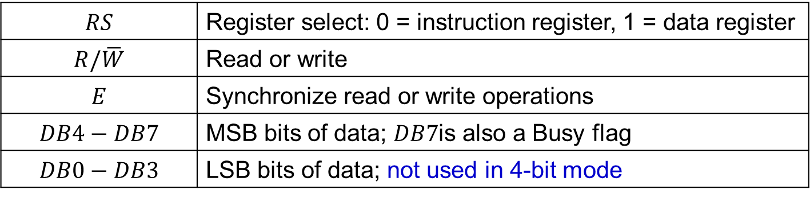
HD44780 signals
$$RS$$ | Register select: 0 = instruction register, 1 = data register
$$R/\overline{W}$$ | Read or write
$$E$$ | Synchronize read or write operations
$$DB4−DB7$$ | MSB bits of data; $DB7$is also a Busy flag
$$DB0−DB3$$ | LSB bits of data; not used in 4-bit mode

Slide 13
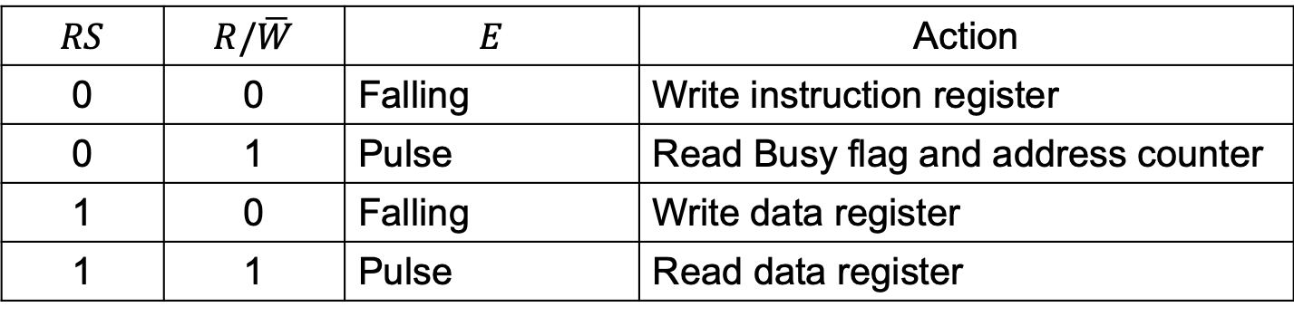
Write/read registers
$$RS$$ | $$R/\overline{W}$$ | $$E$$ | Action
0 | 0 | Falling | Write instruction register
0 | 1 | Pulse | Read Busy flag and address counter
1 | 0 | Falling | Write data register
1 | 1 | Pulse | Read data register

Slide 14
Data written to the HD44780 controller is interpreted either as instruction or as display data, depending on the state of the RS (Register Select) line.
The controller can be set up to operate in 8-bit or 4-bit mode.
In 4-bit mode only the four most significant bits of the bus are used, and two write cycles are required to send a single byte.
In both cases the most significant bit doubles as the Busy flag when a Read is undertaken.

Slide 15
Using QC1602A LCD display
We can interface K66F to an external LCD (QC1602A) to display messages.
QC1602A FEATURES:
  Display Mode: STN, BLUB
  Display Format: 16 Character x 2 Line
  Viewing Direction: 6 O’Clock
  Input Data: 4-Bits or 8-Bits interface available
  Display Font : 5 x 8 Dots
  Power Supply : Single Power Supply (5V±10%)
  Driving Scheme : 1/16Duty,1/5Bias
  Backlight（Side）：LED（Yellow）

Slide 16
Using QC1602A LCD display
We can interface K66F to an external LCD (QC1602A) to display messages.
Interfacing an LCD requires a few steps:
  Hardware integration: connect the LCD to the correct mbed pins.
  Modular coding: define LCD functions in modular files.
  Initializing the LCD: a specific sequence of control signals must be sent to the LCD to initialize it.
  Outputting data: understand how the LCD converts control data into legible display data.

Slide 17
QC1602A LCD block diagram

Slide 18
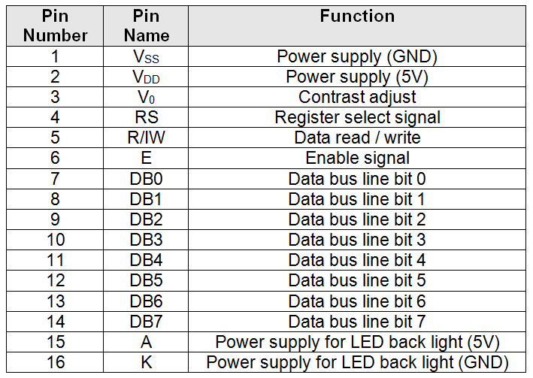
QC1602A LCD pins
Compared with HD44780, there are a few additional pins, but control signals are the same.

Slide 19
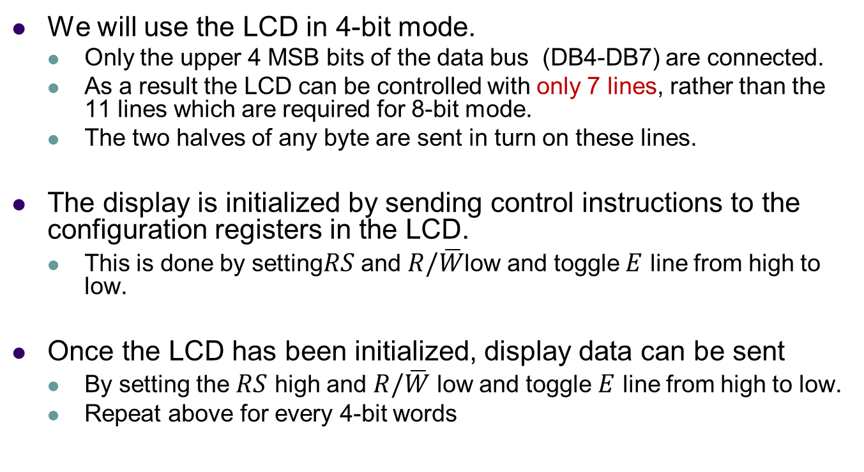
QC1602A programming

Slide 20
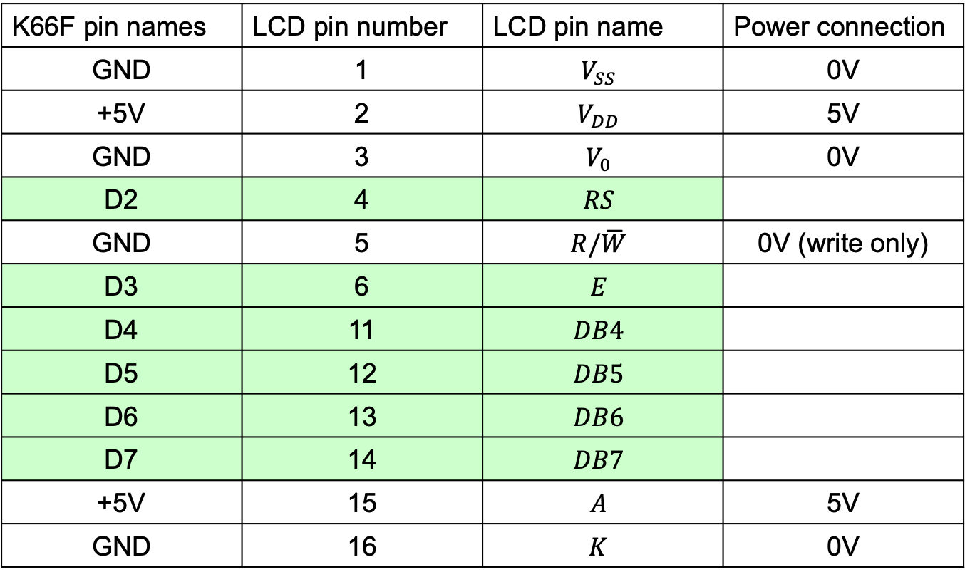
K66F to QC1602A connections
K66F pin names | LCD pin number | LCD pin name | Power connection
GND | 1 |  | 0V
+5V | 2 |  | 5V
GND | 3 |  | 0V
D2 | 4
GND | 5 |  | 0V (write only)
D3 | 6
D4 | 11
D5 | 12
D6 | 13
D7 | 14
+5V | 15 |  | 5V
GND | 16 |  | 0V
If the $R/\overline{W}$ line is tied to ground, then a 1ms delay between data transfers is adequate to ensure that all internal processes can complete before the next transfer.

Slide 21
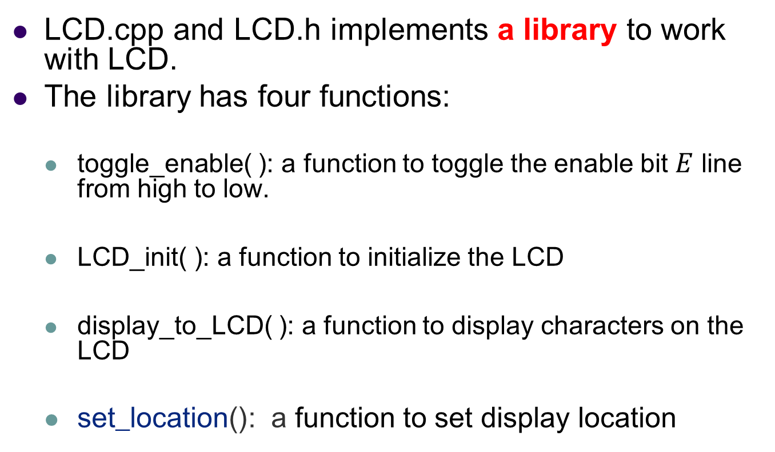
Code structure for LCD display
LCD.cpp and LCD.h implements a library to work with LCD.
The library has four functions:
  toggle_enable( ): a function to toggle the enable bit $E$ line from high to low.
  LCD_init( ): a function to initialize the LCD
  display_to_LCD( ): a function to display characters on the LCD
  set_location(): a function to set display location

Slide 22
Homemade QC1602A LCD code: lcd.h
/* Program Example 8.1: LCD.h header file */
#ifndef LCD_H
#define LCD_H
#include "mbed.h"
void toggle_enable(void); //function to toggle/pulse the enable bit
void LCD_init(void); //function to initialize the LCD
void display_to_LCD(char value); //function to display characters
void set_location(char location);//function to set display location
#endif

Slide 23
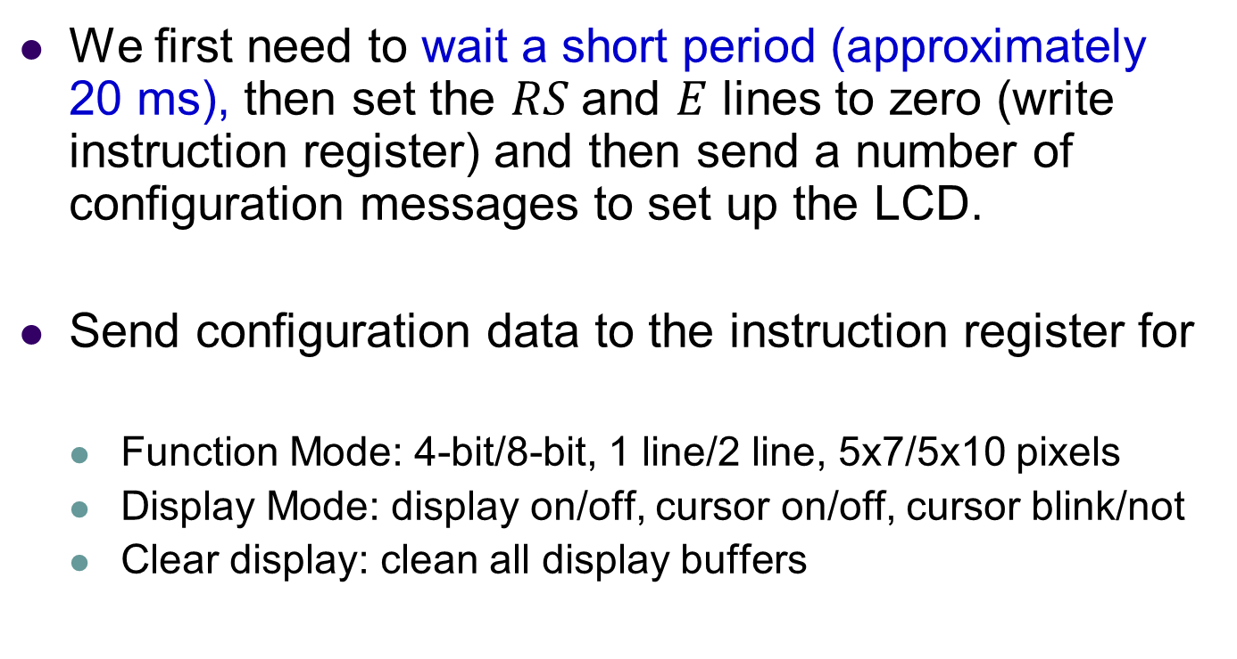
Initializing the display
We first need to wait a short period (approximately 20 ms), then set the $RS$and $E$ lines to zero (write instruction register) and then send a number of configuration messages to set up the LCD.
Send configuration data to the instruction register for
  Function Mode: 4-bit/8-bit, 1 line/2 line, 5x7/5x10 pixels
  Display Mode: display on/off, cursor on/off, cursor blink/not
  Clear display: clean all display buffers

Slide 24
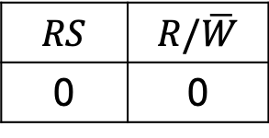
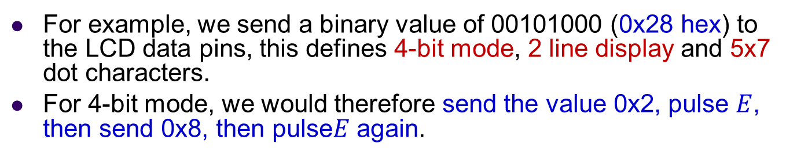
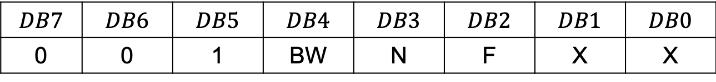
Function mode
$$RS$$ | $$R/\overline{W}$$
0 | 0
$$DB7$$ | $$DB6$$ | $$DB5$$ | $$DB4$$ | $$DB3$$ | $$DB2$$ | $$DB1$$ | $$DB0$$
0 | 0 | 1 | BW | N | F | X | X
BW=0 → 4-bit mode | N=0 → 1-line mode | F=0 → 5x7 pixels
BW=1 → 8-bit mode | N=1 → 2-line mode | F=1 → 5x10 pixels
X= don’t care, 0 or 1
For example, we send a binary value of 00101000 (0x28 hex) to the LCD data pins, this defines 4-bit mode, 2 line display and 5x7 dot characters.
For 4-bit mode, we would therefore send the value 0x2, pulse $E$, then send 0x8, then pulse$E$ again.

Slide 25
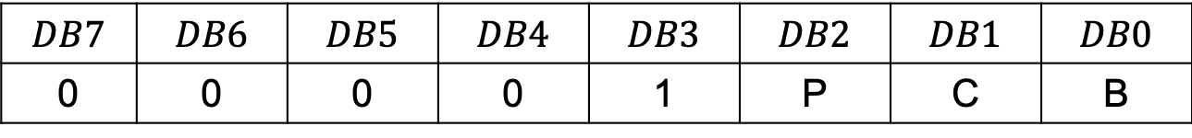
Display mode
$$RS$$ | $$R/\overline{W}$$
0 | 0
$$DB7$$ | $$DB6$$ | $$DB5$$ | $$DB4$$ | $$DB3$$ | $$DB2$$ | $$DB1$$ | $$DB0$$
0 | 0 | 0 | 0 | 1 | P | C | B
P=0 → display off | C=0 → cursor off | B=0 → cursor no blink
P=1 → display on | C=1 → cursor on | B=1 → cursor blinking

Slide 26
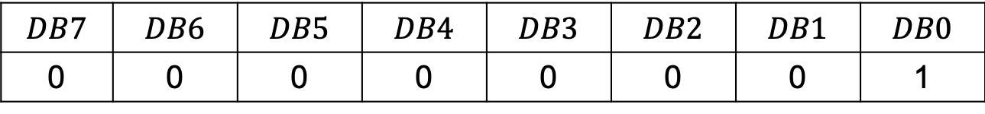
Clear display
$$RS$$ | $$R/\overline{W}$$
0 | 0
$$DB7$$ | $$DB6$$ | $$DB5$$ | $$DB4$$ | $$DB3$$ | $$DB2$$ | $$DB1$$ | $$DB0$$
0 | 0 | 0 | 0 | 0 | 0 | 0 | 1
Before data can be written to the display, the display must be cleared, and the cursor reset to the first character in the first row (or any other location that you wish to write data to).

Slide 27
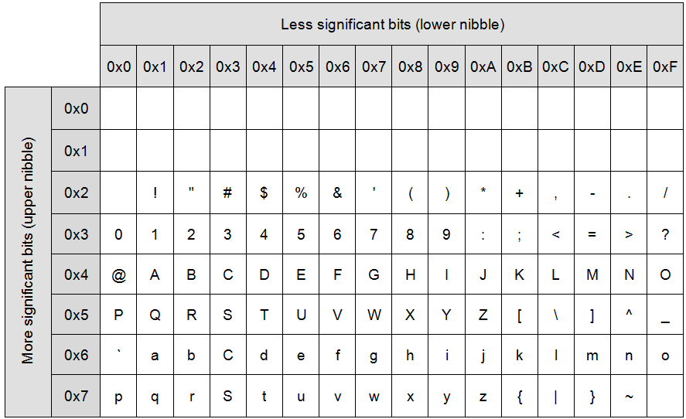
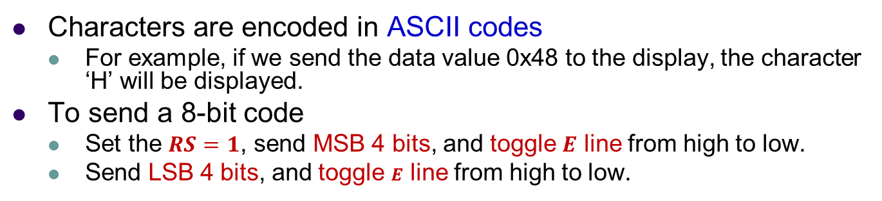
Display characters
Characters are encoded in ASCII codes
  For example, if we send the data value 0x48 to the display, the character ‘H’ will be displayed.
To send a 8-bit code
  Set the $RS=1$, send MSB 4 bits, and toggle $E$ line from high to low.
  Send LSB 4 bits, and toggle $E$ line from high to low.

Slide 28
Homemade HD44780 LCD: lcd.cpp --- LCD_init()
/* Program Example 8.2: Declaration of objects and functions in LCD.cpp file */
#include "LCD.h"
DigitalOut RS(D2);
DigitalOut E(D3);
BusOut data(D4, D5, D6, D7);
//initialize LCD function
void LCD_init(void)
{
wait(0.02); // pause for 20 ms
RS = 0; // set low to write control data
E = 0; // set low
//function mode
data = 0x2; // 4 bit mode (packet 1, DB4-DB7)
toggle_enable();
data = 0x8; // 2-line, 7 dot (packet 2, DB0-DB3)
toggle_enable();
continue to next page

Slide 29
Homemade HD44780 LCD: lcd.cpp --- LCD_init()
//display mode
data = 0x0; // 4 bit mode (packet 1, DB4-DB7)
toggle_enable();
data = 0xF; // display on, cursor on, blink on
toggle_enable();
//clear display
data = 0x0;
toggle_enable();
data = 0x1; // clear
toggle_enable();
}

Slide 30
Homemade HD44780 LCD: lcd.cpp --- toggle_enable()
void toggle_enable(void)
{
E = 1;
wait(0.001); //1 ms
E = 0;
wait(0.001);
}

Slide 31
Homemade HD44780 LCD: lcd.cpp --- display_to_LCD()
//display function
void display_to_LCD(char value)
{
RS = 1; // set high to write char data
data = value >> 4; // shifted right 4 =upper nibble
toggle_enable();
data = value; //bitmask with 0x0F =low nibble
toggle_enable();
}

Slide 32
Homemade HD44780 LCD: lcd.cpp --- set_location()
//set LCD location
void set_location(char location)
{
RS=0;
data=(location|0x80)>>4; // upper nibble
toggle_enable();
data=location&0x0F; // lower nibble
toggle_enable();
}

Slide 33
Homemade HD44780 LCD: main.cpp
/* Program Example 8.3 Utilizing LCD functions in the main.cpp file
*/
#include "LCD.h"
int main()
{
LCD_init(); // call the initialize function
display_to_LCD(0x48); // 'H'
display_to_LCD(0x45); // 'E'
display_to_LCD(0x4C); // 'L'
display_to_LCD(0x4C); // 'L'
display_to_LCD(0x4F); // 'O'
for (char x = 0x30; x <= 0x39; x++)
{ // display numbers 0-9
display_to_LCD(x);
}
}

Slide 34
mbed TextLCD library
There is an mbed library which makes use of an alphanumeric LCD much simpler and quicker to program.
The mbed TextLCD library is also more advanced than the simple functions we have created, in particular the TextLCD library performs the laborious LCD setup routine for us.
The TextLCD definition also tells the LCD object which pins are used for which functions.

Slide 35
mbed TextLCD library
Simple printf( ) statements are used to display characters on the LCD screen.
The printf( ) function allows formatted print statements to be used. This means we are able to send text strings and formatted data to a display, meaning that a function call is not required for each individual character.
When using the printf( ) function with the mbed TextLCD library, the display object’s name is also required.
so if the TextLCD object is defined with the object name lcd, then a “Hello World” string can be written as follows:
lcd.printf("Hello World!");

Slide 36
Import mbed TextLCD library
// Hello World! for the TextLCD
#include "mbed.h"
#include "TextLCD.h”
TextLCD lcd(D2, D3, D4, D5, D6, D7); // RS, E, DB4-DB7
int main() {
lcd.printf("HELLO");
for (char x = 0x30; x <= 0x39; x++)
{ // display numbers 0-9
lcd.printf(x);
}
}
$ mbed new 4_2_textLCD
$ cd 4_2_textLCD
$ sudo apt install mercurial
$ mbed add https://os.mbed.com/users/wim/code/TextLCD/
https://os.mbed.com/components/HD44780-Text-LCD/

Slide 37
Another mbed TextLCD example
/* Program Example 8.6: LCD Counter example: The example below displays a count variable on the LCD display. The count variable increments every second.*/
#include "mbed.h"
#include "TextLCD.h"
DigitalOut led(LED_RED);
TextLCD lcd(D2, D3, D4, D5, D6, D7); //// RS, E, DB4-DB7
int x = 0;
int main()
{
lcd.printf("Hello World!\n");
while (1) {
led = !led; // toggle led
lcd.locate(5, 1);
lcd.printf("%5i", x); //conuter display
wait(1);
x++;
}
}

Slide 38
mbed TextLCD example to display ADC values
/*Program Example 8.7: Display analog input data */
#include "mbed.h"
#include "TextLCD.h"
TextLCD lcd(D2, D3, D4, D5, D6, D7);
AnalogIn Ain(A0);
float percentage;
int main() {
while (1) {
percentage = Ain * 100;
lcd.printf("%1.2f", percentage);
wait(0.002);
lcd.cls();
}
}

Slide 39
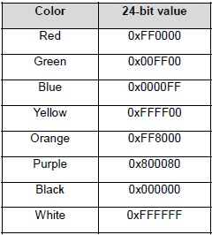
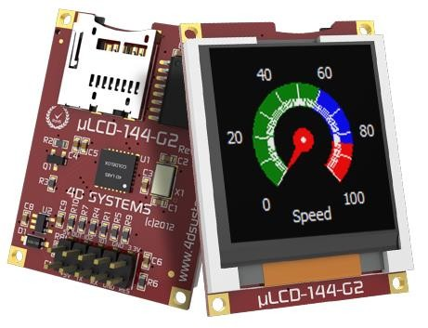
Color LCD display --- 4D Systems uLCD-144-G2
For color displays, each pixel is made up of three subpixels for red, green and blue.
  Each pixel is a 24-bit value = (8-bit Red, 8-bit Green, 8-bit Blue)
  Each subpixel can be set to 256 different shades of its color, so it is therefore possible for a single LCD pixel to display 256* 256 * 256 = 16.8 million different colors.
uLCD-144-G2: 128x128 RGB

Slide 40
Color LCD display --- 4D Systems uLCD-144-G2
1.44” LCD TFT screen. Driven by the GOLDELOX processor, the uLCD-144G2 is the compact display solution for any application requiring a small embedded screen.
128xRGBx128 resolution, 65K true to life colours, LCD-TFT screen.
1.44" diagonal size, 43 x 31 x 6.4mm. Active Area: 25.5mm x 26.5mm.
Easy 10 pin interface to any external device: 3.3Vout, IO2, GND, IO1, RESET, GND, RX, TX, +5V, 5V OUT.
10K bytes of flash memory for user code storage and 510 bytes of RAM for user variables (255 x 16bit vars).
1 x Asynchronous hardware serial port, TTL interface, with 300 baud to 600K baud.
On-board micro-SD memory card adaptor for storing of icons, images, animations, etc.

Slide 41
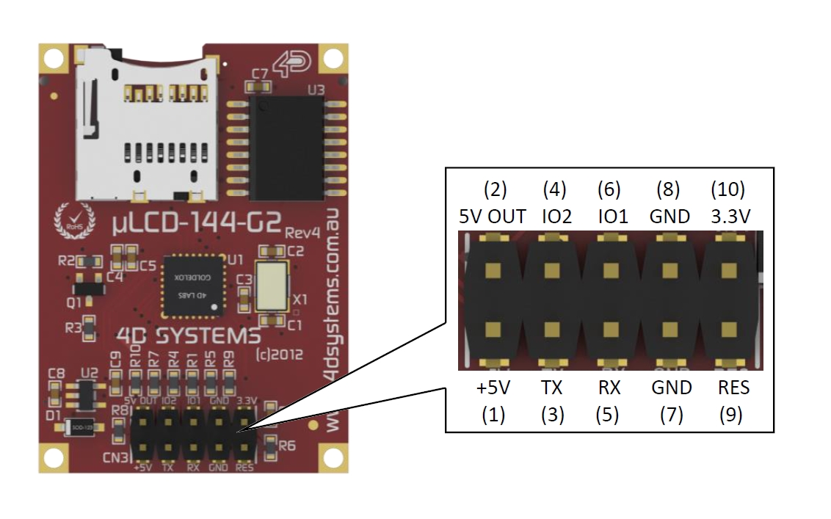
經轉接板排線對接
Null Modem Connection
LCD腳位 | 排線腳位 | mbed
+5V (1 ) | +5V | 5V
TX (3) | RX | D1 (TX)
RX (5) | TX | D0 (RX)
GND (7) | GND | GND
RES (9) | RES | D2
uLCD.RX → K66F.TX (D1)
uLCD.TX → K66F.RX (D0)

Slide 42
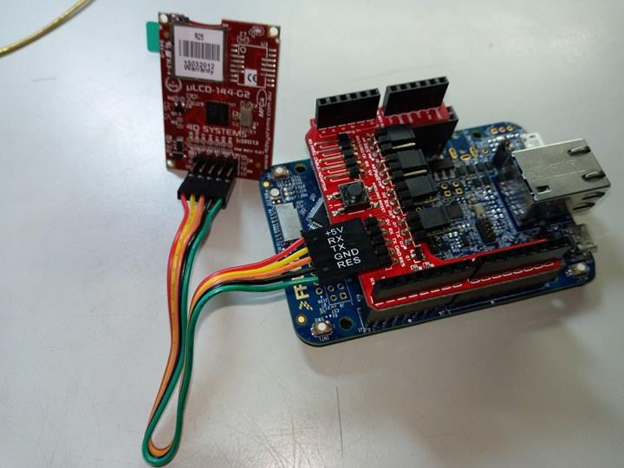
轉接板

Slide 43
mbed Library for uLCD-144-G2
The module uses UART serial port (to be discussed later)
  uLCD_4DGL(Tx pin, Rx pin, rst pin);
The library has six types of commands:
  General : clear screen, reset screen, set background color…
  Graphic : draw circle, line, triangle, set pen size…
  Text: set font, set text color, locate, underline…
  Media: display image, display video…
  Screen data: get hardware information
  Text data: get text information
https://os.mbed.com/components/4D-Systems-uLCD-144-G2/

Slide 44
4DGL-uLCD-SE library commands
General functions
  uLCD.cls() clears the entire screen using the background color.
  uLCD.reset() wipes the entire screen.
  uLCD.background_color(int color) changes the background color.
    Ex. uLCD.background_color(0xFFFFFF) // white
  uLCD.textbackground_color(int color)
  uLCD.baudrate(int speed)

Slide 45
Graphic functions
These functions draws simple shapes.
  uLCD.circle(int x , int y , int radius, int color)
  uLCD.filled_circle(int x , int y , int radius, int color)
  uLCD.rectangle(int x1, int y1, int x2, int y2, int color)
  uLCD.filled_rectangle(int x1, int y1, int x2, int y2, int color)
  uLCD.triangle(int x1, int y1, int x2, int y2, int x3, int y3, int color)
  uLCD.line(int x1, int y1 , int x2, int y2, int color)

Slide 46
Text functions
  uLCD.set_font(char mode).
    ex. uLCD.set_font(FONT_7X8)
    This function set the size of the font(width=7, height=8).
  uLCD.locate(char col, char row).
    ex. uLCD.locate(0, 0)
    This function sets the location of the cursor. Then we can put our text anywhere we want to.
  uLCD.color(int)
  uLCD.putc(char)
  uLCD.puts(char &)

Slide 47
Media
  This type of command is for displaying video or image from SD card.
Screen data
  We can get LCD hardware information via this type of command.
  Ex. int a=uLCD.type;
Text data
  We can get text information via this type of command.
  Ex. Get cursor location:
  char column=uLCD.current_col;

Slide 48
Example : Hello uLCD
#include "mbed.h"
#include "uLCD_4DGL.h"
uLCD_4DGL uLCD(D1, D0, D2);
int main()
{
uLCD.printf("\nHello uLCD World\n"); //Default Green on black text
wait(30);
}
$ cd ~/ee2405/mbed04
$ mbed new 4_4_uLCD_demo1
$ cd 4_4_uLCD_demo
$ mbed add https://os.mbed.com/users/4180_1/code/4DGL-uLCD-SE/
$ code main.cpp

Slide 49
Example : Countdown
#include "mbed.h"
#include "uLCD_4DGL.h"
uLCD_4DGL uLCD(D1, D0, D2); // serial tx, serial rx, reset pin;
int main() {
uLCD.printf("\nHello uLCD World\n"); //Default Green on black text
uLCD.printf(" \n Starting Demo... ");
uLCD.text_width(4); //4X size text
uLCD.text_height(4);
uLCD.color(RED);
for (int i = 10; i >= 0; --i) {
uLCD.locate(1, 2);
uLCD.printf("%2D", i);
wait(.5);
}
//uLCD.cls();
}
$ cd ~/ee2405/mbed04
$ mbed new 4_4_uLCD_demo
$ cd 4_4_uLCD_demo
$ mbed add https://os.mbed.com/users/4180_1/code/4DGL-uLCD-SE/
$ code main.cpp

Slide 50
Demo and Checkpoints
Show your student ID number and a 30 second count down on QC1602A.
Show your student ID number, a 30 second count down, and a random background color on uLCD-144G2-AR.

Slide 51
Chapter Review
Liquid Crystal Displays (LCDs) use a liquid crystal which can polarize and block light when an electric field is introduced.
Many types of LCDs are available and, when interfaced with a microcontroller, they allow digital control of alphanumeric character displays and high resolution color displays.
The QC1602A is a 16 column by 2 row character display.
The mbed TextLCD library can be used to simplify working with LCDs using the printf( ) function.
uLCD-144-G2 color LCDs transfer data through a serial interface with each pixel given a 24-bit color setting.

