Slide 1
Chapter 5: Analog Input
電機系
EE2405
嵌入式系統與實驗
Embedded System Lab
Prepared by: Prof. Jing-Jia Liu

Slide 2
Analog & Digital Signal Processing Systems
Analog signal processing
environment
Sensor/transducer
Instrumentation
Measurement
Analog electronic
circuitry
Output
y(t)
Y(jΩ)
Input
x(t)
X(jΩ)
h(t)
H(jΩ)
Electric analog signal
Digital signal processing
environment
Input
x(t)
Output
y*(t)
Sensor
AF
A/D
DSP
D/A
IF
x[n]
X(e^{jω})
h[n]
H(e^{jω})
y[n]
Y(e^{jω})
Sensor/transducer
Instrumentation
Measurement

Slide 3
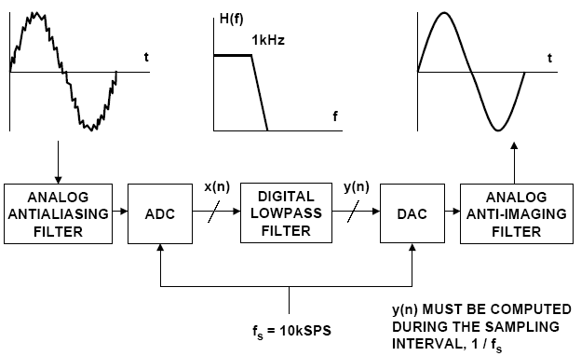
Digital Filtering

Slide 4
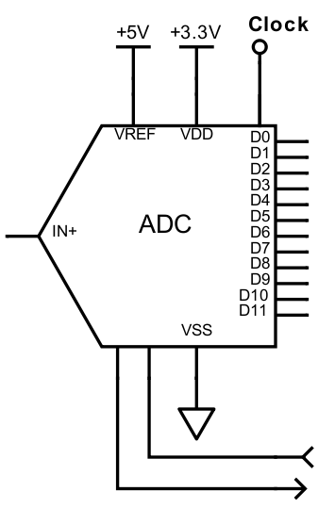
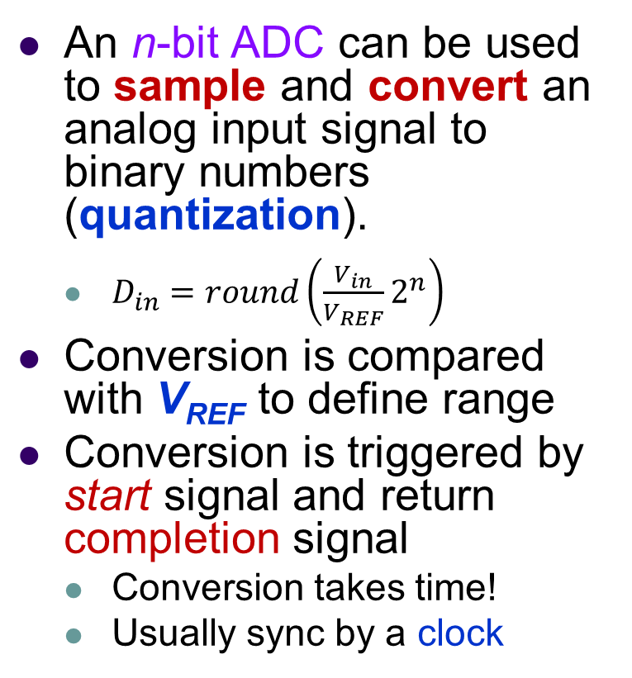
Analog to digital converter (ADC)
An n-bit ADC can be used to sample and convert an analog input signal to binary numbers (quantization).
  $D_{in}=round\left(\frac{V_{in}}{V_{REF}}2^{n}\right)$
Conversion is compared with V_{REF} to define range
Conversion is triggered by start signal and return completion signal
  Conversion takes time!
  Usually sync by a clock
Vin
Din
(to uC)
Start
Complete

Slide 5
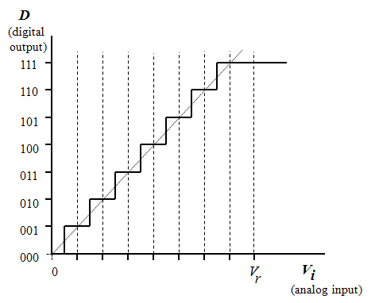


ADC conversion curve
n-bit ADC
Code = $0 ⋯2^{n}−$1
Resolution = $\frac{V_{REF}}{2^{n}−1}$
Range = max V_{REF}- min V_{REF} = V_{r}

Slide 6
Sampling frequency
We can use samples to represent the original signal.
The more samples we take within a period (higher sampling frequency), the more “accurate” (in terms of representing the original signal) the sampled data will be.

Slide 7
Aliasing
When sampled at lower then f_{s}
  Any frequency component above f_{s}/2 is indistinguishable from a lower-frequency component -- aliasing
For example,
  The samples of the following two sine waves can be identical when at least one of them is at a frequency above half the sample rate

Slide 8
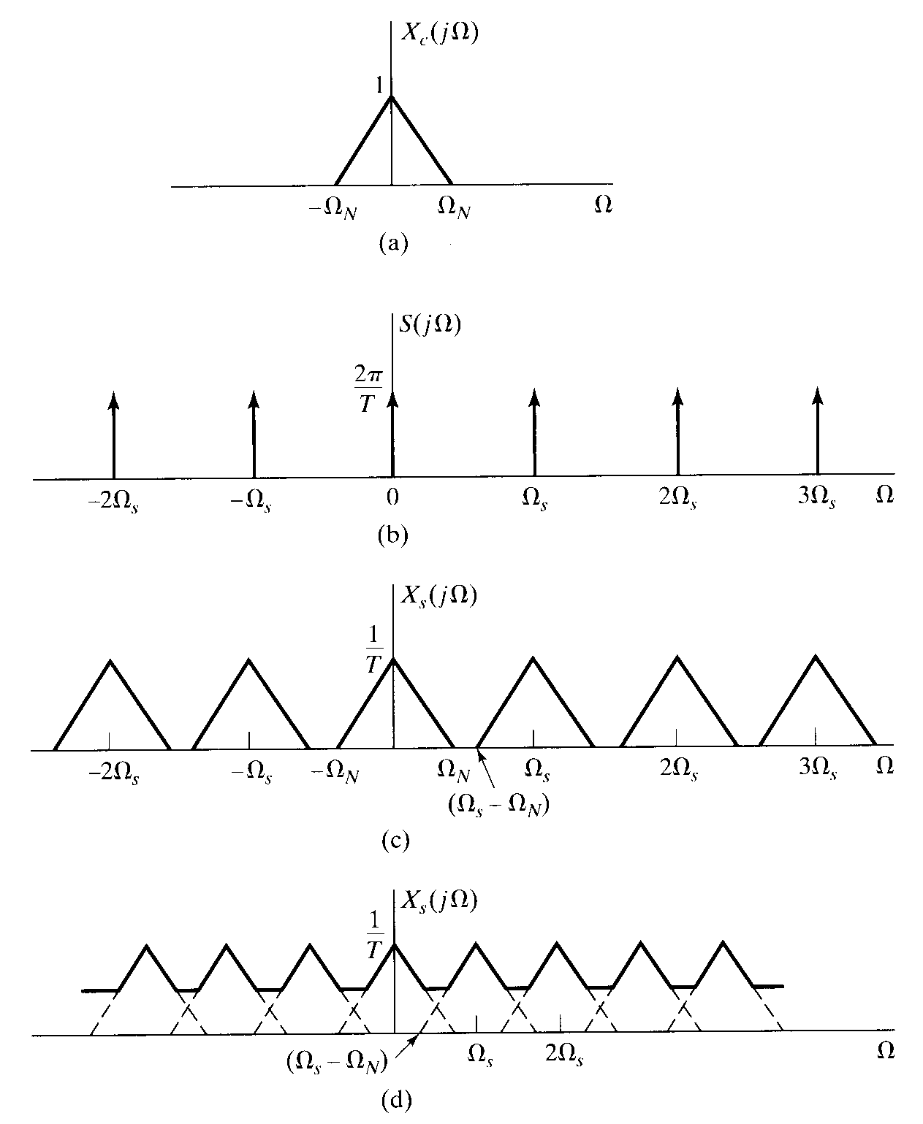
Aliasing
Ω_{S} > 2Ω_{N}. No aliasing
Ω_{S} < 2Ω_{N}. Aliasing

Slide 9
Sampling theorem
In order for a bandlimited signal (one with a frequency spectrum between 0 and f_{max}) to be reconstructed fully, it must be sampled at a rate of f_{s} > 2 f_{max}, (Sampling theorem)
  f_{max} is the Nyquist frequency. f_{s} is the Nyquist rate

Slide 10
ADC Concept
If the conversion time of an ADC is found to be 5.0 us. The ADC is set to convert repeatedly, with no other programming requirements. What is the maximum frequency of signal it can digitize?
1/5.0us = 200k Hz
  f_{s} = 200k > 2 f_{max}
  ∴ f_{max} < 100k

Slide 11
AnalogIn
K66F has two on-chip ADCs (ADC0 and ADC1)
  Providing upto 4-pairs of differential and 24 single-ended analog inputs.
  Linear successive approximation algorithm with up to 16-bit resolution
Mbed offers ADC API: AnalogIn
AnalogIn API
Functions | Usage
AnalogIn | Create an AnalogIn object, connected to a specified pin
read() | Read the input voltage, represented as a float in the range (0.0 - 1.0)
read_u16() | Read the input voltage, represented as an unsigned short in the range (0x0 - 0xFFFF)

Slide 12
K66F ADC pin
ADC pins
16-bit SAR ADCs with a multiplexer to select from A0 to A5.
Reference voltage is 3.3V Vdd.

Slide 13
Displaying ADC values on computer screen
/*Program Example 5.4: Reads input voltage through the ADC, and transfers to PC terminal
*/
#include "mbed.h"
Serial pc( USBTX, USBRX ); //Enable serial port which links to USB
AnalogIn Ain(A0);
float ADCdata;
int main(){
while(1){
ADCdata = Ain; //send an opening text message
wait(0.5);
pc.printf("%1.3f\r\n", ADCdata);
//send data to the terminal
}
}
printf( ) function sends data to the remote PC terminal connected by USB.

Slide 14
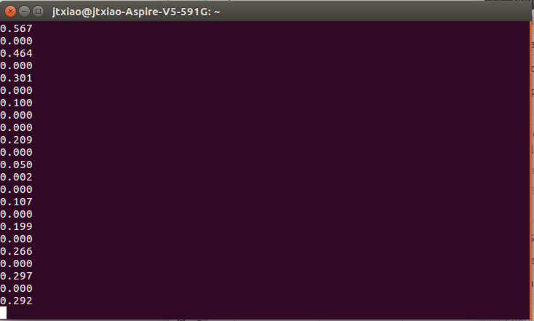
Linux terminals
We can use “screen” command in Linux to display ADC values sent from K66F:
  $ screen /dev/ttyACM
  /dev/ttyACM0 is the device interface in Linux for the USB serial port connected to K66F

Slide 15
Averaging ADC data to filter noise
A very simple example of digital signal processing.
Other filters can be applied
  ADCdata=0;
  for (int i=0;i<=9;i++) {
  ADCdata=ADCdata + Ain * 3.3;//sum 10 samples
  }
  ADCdata=ADCdata/10.0;//divide by 10

Slide 16
4.3 Control LED by AnalogOut
AWG
by picoscope
ADC
K66F
DAC
picoscope to generate a square wave
LED
#include "mbed.h"
AnalogOut Aout(DAC0_OUT);
AnalogIn Ain(A0);
int main(){
while(1){
Aout = Ain;
}
}
Picoscope
As OSC scope

Slide 17
4.4 Control LED by PwmOut
AWG
by picoscope
ADC
K66F
PWM
picoscope to generate a sine wave
#include "mbed.h“
PwmOut PWM1(D6);
AnalogIn Ain(A0);
int main(){
while(1){
PWM1.period(0.5);
PWM1 = Ain;
wait(0.1);
}
}
LED
Picoscope
As OSC scope

Slide 18
4.5 Display Values on the Computer
AWG
by picoscope
ADC
K66F
USB
PC
picoscope to generate a sine wave
#include "mbed.h"
Serial pc( USBTX, USBRX );
AnalogIn Ain(A0);
float ADCdata;
int main(){
while(1){
ADCdata = Ain;
wait(0.5);
pc.printf("%1.3f\r\n", ADCdata);
}
}
PC side need terminal

Slide 19
4.6 AnalogIn with FFT analysis
USB
ADC
K66F
PC
AWG
by picoscope
DAC
picoscope to generate a sine wave @30Hz, 1V
#include "mbed.h"
Serial pc( USBTX, USBRX );
AnalogOut Aout(DAC0_OUT);
AnalogIn Ain(A0);
int sample = 128; int i; float ADCdata[128];
int main(){
for (i = 0; i < sample; i++){
Aout = Ain;
ADCdata[i] = Ain;
wait(1./sample);
}
for (i = 0; i < sample; i++){
pc.printf("%1.3f\r\n", ADCdata[i]);
wait(0.1);
}
}
LED
PC side need terminal + python program for FFT display

Slide 20
4.7 Measure the conversion timing
AWG
by picoscope
ADC
K66F
DAC
picoscope to generate a square/sine wave
#include "mbed.h"
AnalogOut Aout(DAC0_OUT);
AnalogIn Ain(A0);
float ADCdata;
int main(){
while(1){
ADCdata = Ain;
Aout = ADCdata;
wait(2);
}
}
LED
Picoscope
As OSC scope
Change the sampling rate (via wait(time)) and observe the difference between each wave

Slide 21
5 Demo and Checkpoints
Demo the breathing LED.
Show all the results you recorded above.

Slide 22
Chapter Review
An ADC can be used to digitize analog input signals.
It is important to understand ADC characteristics, in terms of input range, resolution, and conversion time.
Nyquist’s sampling theorem: sampling frequency must be at least twice that of the highest frequency component in the sampled analog signal.
Aliasing occurs when the Nyquist criterion is not met, this can introduce false frequencies to the data.
Aliasing can be avoided by introducing an anti-aliasing filter to the analog signal before it is sampled.
There are numerous sensors available which have an analog output.

