Slide 1
Chapter 4: Analog Output
電機系
EE2405
嵌入式系統與實驗
Embedded System Lab
Prepared by: Prof. Jing-Jia Liu

Slide 2
Data conversion
Microcontrollers compute and store in digital domain, but we need to handle analog signals.
For example, from a microphone or temperature sensor, we have to convert them into digital form.
  Analog to digital conversion (ADC)
After processing the data, they may then need to convert digital data back to analog form, for example to drive a loudspeaker or dc motor.
  Digital to analog conversion (DAC)

Slide 3
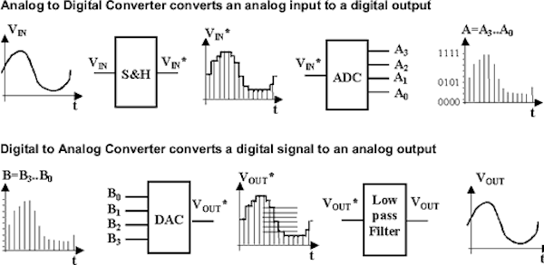

Slide 4
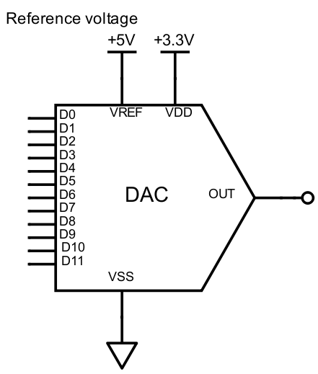



Digital to Analog converter
A digital-to-analog converter (DAC) converts a binary input number into an analog output.
  Vref is used to define
  output range
  Output voltage:
  D is the n-bit binary
  number of D11-D0
$$D$$
$$V_{o}$$
$$V_{o}=\frac{D}{2^{n}}V_{REF}$$

Slide 5



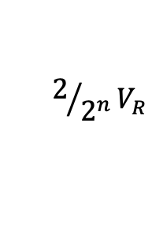


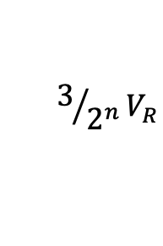

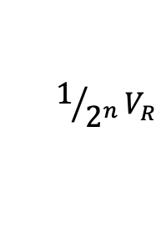

DAC conversion curve
K66F has a 12-bit DAC; there will therefore be 2¹² steps in its output characteristic, i.e. 4096. Normally it uses its own power supply voltage, i.e. 3.3 V, as voltage reference. The step size, or resolution, will therefore be 3.3/4096, i.e., 0.806 mV.
Output Voltage
$$V_{R}$$
$${{{(2}^{n}−1)}/{2^{n}}V}_{R}$$
$${{{(2}^{n}−2)}/{2^{n}}V}_{R}$$
$${3/{2^{n}}V}_{R}$$
$${2/{2^{n}}V}_{R}$$
$${1/{2^{n}}V}_{R}$$
D: Input Binary number
$000 001 010$ 011
$$2^{n}−2$$
$$2^{n}−1$$
$$2^{n}$$
0x000
0xFFF

Slide 6
Piecewise constant output of a conventional DAC lacking a reconstruction filter. In a practical DAC, a filter or the finite bandwidth of the device smooths out the staircase-like waveform into a continuous curve.

Slide 7
K66F 12-bit DAC
1. Settling within ±1 LSB
2. The INL is measured for 0 + 100 mV to VDACR −100 mV
3. The DNL is measured for 0 + 100 mV to VDACR −100 mV
4. The DNL is measured for 0 + 100 mV to VDACR −100 mV with VDDA > 2.4 V

Slide 8
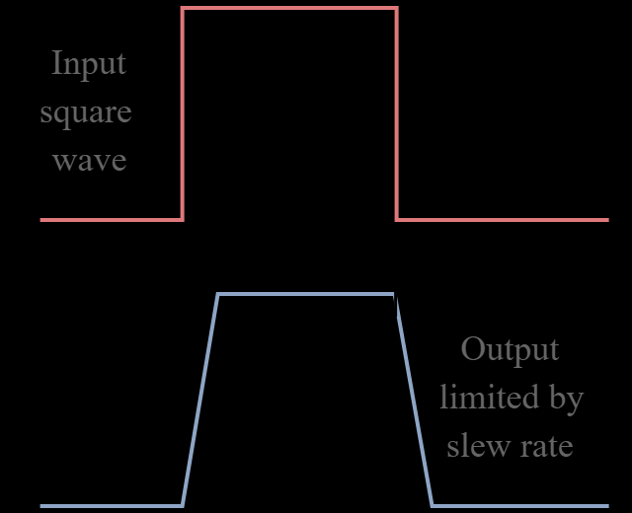

Slide 9
AnalogOut
AnalogOut API
Function | Usage
AnalogOut | Create a AnanlogOut connected to the specified pin
write | Set the output voltage, specified as a percentage (float)
write_u16 | Set the output voltage, specified as an unsigned short in the range [0x0, 0xFFFF]
read | Return the current output voltage, measured as a percentage (float)
operator = | A operator shorthand for write()

Slide 10
K66F DAC pin
DAC0_OUT

Slide 11
K66F DAC example code
/*Program Example 4.1: Three values of DAC are output in turn on DAC0_OUT. Use a voltage meter to measure the output.
*/
#include "mbed.h“
AnalogOut Aout(DAC0_OUT); // Output voltage specified as a percentage in float
int main(){
while(1){
Aout = 0.25; // actual voltage = 0.25 * 3.3 = 0.825 v
wait(2);
Aout = 0.5; // 0.50 * 3.3 = 1.650 v
wait(2);
Aout = 0.75; // 0.75 * 3.3 = 2.475 v
wait(2);
}
}

Slide 12
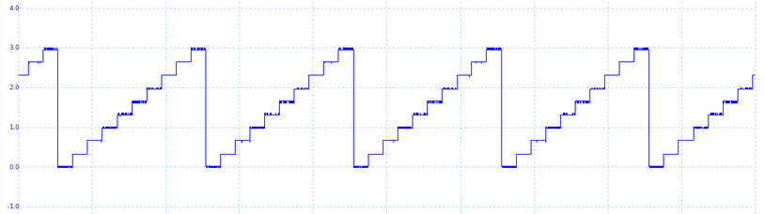
Generating a sawtooth waveform
/*Program Example 4.2: Sawtooth waveform on DAC output.
*/
#include "mbed.h"
AnalogOut Aout(DAC0_OUT);
int main(){
float i;
while(1){
for( i=0; i<1; i+=0.1 ){
Aout = i;
wait(0.001);
}
}
}

Slide 13
Generating a sine waveform
/*Program Example 4.2: Sine waveform on DAC output.
*/
#include "mbed.h"
AnalogOut Aout(DAC0_OUT);
int main(){
float i;
while(1){
for( i=0; i<2; i+=0.05 ){
Aout = 0.5 + 0.5*sin(i*3.14159);
//sine value plus half the range
wait(0.001);
//Controls the sine wave period
}
}
}
Here we apply the sin( ) function, part of the C standard library.
We add 0.5 (50%) DC to generate only positive output voltages.

Slide 14
Generating a sine waveform using DDS
/*Program Example 4.3: Sine waveform on DAC output by DDS. */
#include "mbed.h"
AnalogOut Aout(DAC0_OUT);
int main(){
float sintable[40];
int i;
for( i=0; i<40; i++){
sintable[i] = 0.5 + 0.5*sin(i*3.14159*0.05);
}
i = 0;
while(1){
Aout = sintable[i];
i = i+1;
i %= 40;
wait(0.001);
//Controls the sine wave period, sin period = 0.001*40=0.04 sec
}
}
Here we apply the sin( ) function, part of the C standard library.
We add 0.5 (50%) DC to generate only positive output voltages.

Slide 15
Direct Digital Synthesis
Can be used to generate (periodic) arbitrary waveform
First construct a waveform table with size L.
Select step size s when reading the waveform table. (the equivalent waveform samples in one period becomes L/s)
Select the period p of consecutive DACs
The period of the generated waveform would be p * (L/s), or the frequency is s/(L*p).

Slide 16
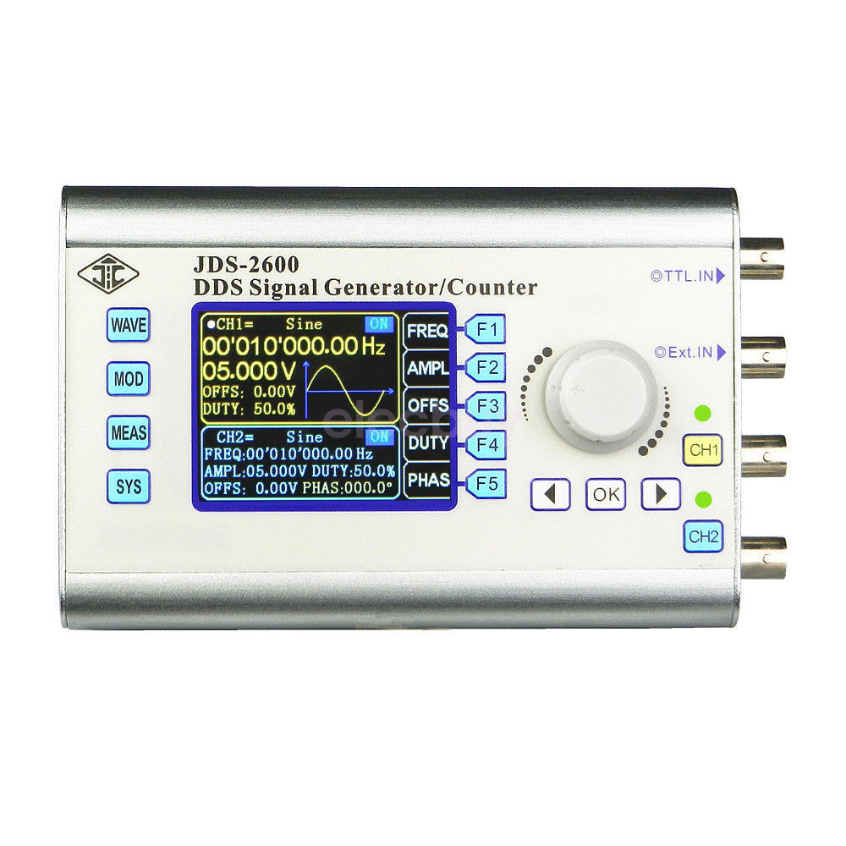

Slide 17
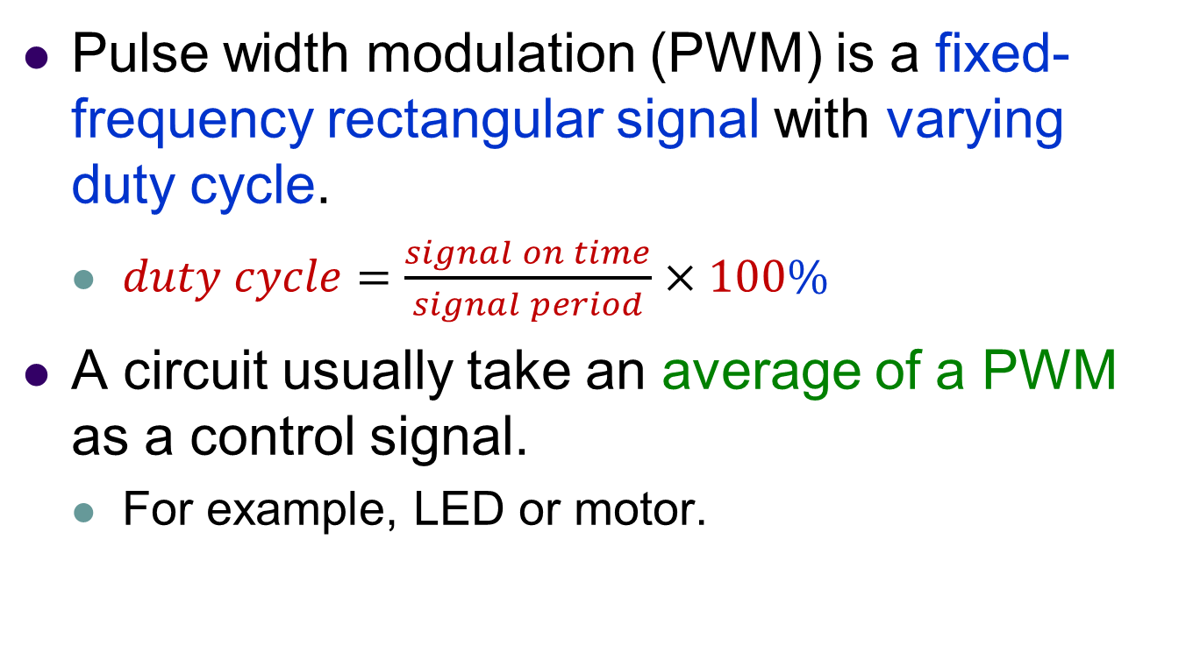
Pulse Width Modulation (PWM)
Pulse width modulation (PWM) is a fixed-frequency rectangular signal with varying duty cycle.
  $duty cycle=\frac{signal on time}{signal period}×100\%$
A circuit usually take an average of a PWM as a control signal.
  For example, LED or motor.
脈寬調變(PWM)是利用數位輸出來對類比電路進行控制的一種非常有效的技術，廣泛應用在從測量、通訊到功率控制與變換的許多領域中

Slide 18
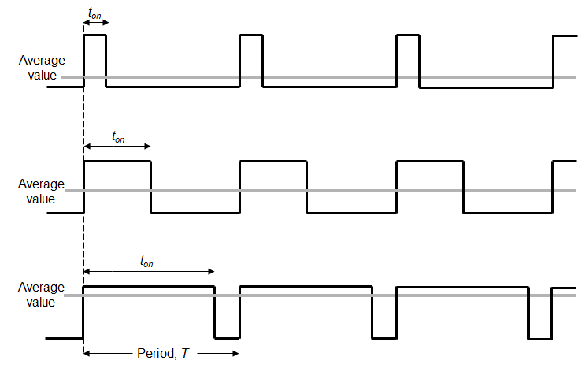
PWM Examples
PWM pulsewidth
PWM period

Slide 19
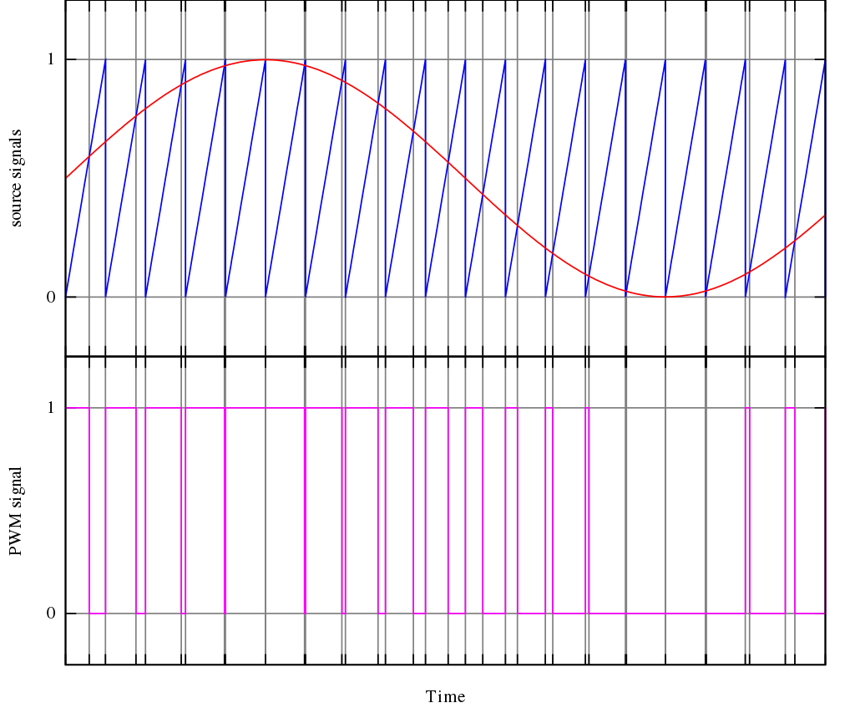
PWM Examples

Slide 20
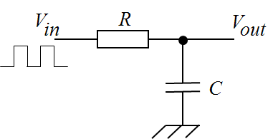
Simple averaging circuits
The average PWM value can be extracted from the PWM stream in a number of ways.
We can use a low-pass filter, like the resistor-capacitor combination below. In this case, and as long as PWM frequency and values of R and C are well- chosen, V_{out} becomes an analog output, with a bit of ripple, and. the combination of PWM and filter acts just like a DAC
1st order or 1 pole lowpass filter
Resistor-capacitor low-pass filter

Slide 21
Simple averaging circuits
Alternatively, if we switch the current flowing in an inductive load, below, then the inductance has an averaging effect on the current flowing through it. This is important, as the windings of any motor are inductive, so we can use this technique for motor control.
MOS power switch
V_{S}
S
Physical inductor current cannot change abruptly.
PWM output
R
D
L
I
An inductive load

Slide 22
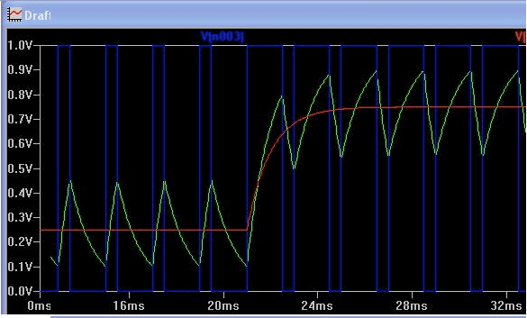
PWM filtering example
One pole Low-pass with PWM Step Change from D=0.25 to
D = 0.75 compared to a second filter with an input step from 0.25V to 0.75V
http://ltwiki.org/images/8/82/PWM_Filters.pdf

Slide 23
PwmOut
PwmOut API
Functions | Usage
PwmOut | Create a PwmOut object connected to the specified pin
write | Set the output duty-cycle, specified as a normalised float (0.0 – 1.0)
read | Return the current output duty-cycle setting, measured as a normalised float (0.0 – 1.0)
period | Set the PWM period, specified in seconds (float), keeping the duty cycle the same.
period_ms | Set the PWM period, specified in milliseconds (int), keeping the duty cycle the same.
period_us | Set the PWM period, specified in microseconds (int), keeping the duty cycle the same.
pulsewidth | Set the PWM pulse width, specified in seconds (float), keeping the period the same.
pulsewidth_ms | Set the PWM pulse width, specified in milliseconds (int), keeping the period the same.
pulsewidth_us | Set the PWM pulse width, specified in microseconds (int), keeping the period the same.
operator = | An operator shorthand for write().

Slide 24
K66F PWM pin
PWM pins
D3,D4,D5,D6,D8,D9,D10

Slide 25
Generating a PWM waveform
/*Sets PWM source fixed frequency and duty cycle.
*/
#include "mbed.h"
PwmOut PWM1(D6);
int main() {
PWM1.period(0.01); // set PWM period
PWM1 = 0.5; // set duty cycle (0.0~1.0)
}
This program generates a 100 Hz pulse with 50% duty
cycle, i.e. a perfect square wave, appearing on pin D6.

Slide 26
Generating a raised sine waveform by PWM
/*Sets PWM source fixed frequency and duty cycle. */
#include "mbed.h"
PwmOut PWM1(D6);
int main() {
float sintable[40],dutycycle;
int i;
for( i=0; i<40; i++){
sintable[i] = 0.5 + 0.5*sin(i*3.14159*0.05);
}
i = 0;
PWM1.period(0.0001); // set PWM period
while(1){
dutycycle = sintable[i]; i++; //normalized duty cycle
i %= 40;
PWM1 = dutycycle ; // set PWM duty cycle
wait(0.001);
}
}

Slide 27
Chapter Review
A digital-to-analog converter (DAC) converts an input binary number to an output analog voltage, which is proportional to that input number.
DACs are widely used to create continuously varying voltages, for example to generate analog waveforms.
Pulse Width Modulation (PWM) provides a way of controlling certain analog quantities, by varying the pulse width of a fixed frequency rectangular waveform.
PWM is widely used for controlling flow of electrical power, for example led brightness or motor control.

