Slide 1
Chapter 3: Digital Input and Output
電機系
EE2405
嵌入式系統與實驗
Embedded System Lab
Prepared by: Prof. Jing-Jia Liu

Slide 2
The first program
/*Program Example 2.1: A program which flashes mbed LED1 on and off. Demonstrating use of digital output and wait functions. Taken from the mbed site.
*/
#include "mbed.h"
DigitalOut myled(LED1); // create a DigitalOut object myled to control LED1 pin
int main(){
while(1){
myled = 1; //set LED1 pin to high == myled.write(1)
wait(0.2); //wait for 0.2 second
myled = 0;
wait(0.2);
}
}
The (mbed API) library approved by the ARM mbed team is sometimes called the official mbed library. This is accessed through the header file mbed.h
myled != myled; //toggle LED1
wait(0.2); //wait for 0.2 second

Slide 3
DigitalOut
DigitalOut is a C++ class
Function | Usage
DigitalOut | Create a DigitalOut connected to the specified pin
write | Set the output, specified as 0 or 1 (int)
read | Return the output setting, represented as 0 or 1 (int)
operator = | A shorthand for write (overload operator)
operator int() | A shorthand for read (overload operator)

Slide 4
wait functions
Note data types in each function parameter
Function | Action
wait | waits for the number of seconds specified (float)
wait_ms | waits for the number of milliseconds specified (int)
wait_us | waits for the number of microseconds specified (int)

Slide 5
Another program
/*Program Example 3.1: Demonstrates use of while loops. No external connection
required */
#include "mbed.h"
DigitalOut myled(LED1);
DigitalOut yourled(LED4);#include "mbed.h"
int main(){
char i=0; //declare variable i, and set to 0
while(1){ //start endless loop
while(i<10) { //start first conditional while loop
myled = 1;
wait(0.2);
myled = 0;
wait(0.2);
i = i+1; //increment i
} //end of first conditional while loop
while(i>0) { //start second conditional loop
yourled = 1;
wait(0.2);
yourled = 0;
wait(0.2);
i = i-1;
}
} //end infinite loop block
} //end of main

Slide 6
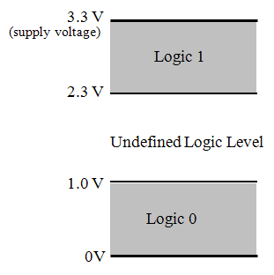
Logic values and voltages
Logic values are represented as electrical voltages:
  Logic 0 == 0 - 1.0V
  Logic 1 == 2.3-3.3V
In this example, both logic 0
and 1 has a margin of 1V.
  To provide noise margin to
  tolerate variations and
  environment changes.

Slide 7
All numbered pins (PT_XX) can be used as DigitalIn or DigitalOut.

Slide 8
K66F mbed pin names
Arduino Revision 3 (R3) standard.
LED (RGB)
LED_RED = PTC9
LED_GREEN = PTE6
LED_BLUE = PTA11
mbed original LED naming
LED1 = LED_RED
LED2 = LED_GREEN
LED3 = LED_BLUE
LED4 = LED_RED
Push buttons
SW2 = PTD11
SW3 = PTA10
USB Pins
USBTX = PTB17
USBRX = PTB16
Arduino Headers
D0 = PTC3
D1 = PTC4
D2 = PTC16
D3 = PTC8
D4 = PTC12
D5 = PTC5
D6 = PTC2
D7 = PTA25
D8 = PTB18
D9 = PTB19
D10 = PTD0
D11 = PTD2
D12 = PTD3
D13 = PTD1
D14 = PTC11
D15 = PTC10
A0 = PTB7
A1 = PTB6
A2 = PTB5
A3 = PTB4
A4 = PTB3
A5 = PTB2
I2C pins
I2C_SCL = D15
I2C_SDA = D14
DigitalOut/PWM
DigitalOut/DigitalIn
The I/O headers on the FRDM-K66F are arranged to allow compatibility with peripheral boards (known as shields) that connect to Arduino and Arduino-compatible microcontroller boards.
DigitalIn
AnalogIn
https://os.mbed.com/teams/NXP/wiki/FRDM-K66F-Pinnames

Slide 9
Additional pin out of K66F

Slide 10
Light Emitting Diode (LED)
A LED is a semiconductor light source that emits light when current flows through it.
  Electrons in the diode recombine with electron holes, releasing energy in the form of photons (electroluminescence)
Vd=1.7 ~ 2.2V
to emit lights

Slide 11
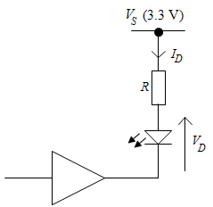
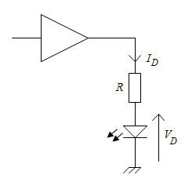

Drive a LED with a logic pin
Pinout of a K66F include a buffer and a series resistor.
$$I_{D}\sim \frac{(Vdd−1.7)}{R}$$
$=\frac{(3.3−1.7)}{100}=$1.6mA
Gate output sinking
current from LED load
Gate output sourcing
current to LED load

Slide 12
LED driver circuit
The BJT transistor represents a part of the buffer.
BJT sinking current from LED load
BJT sourcing current to LED load

Slide 13
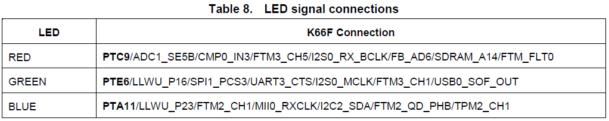
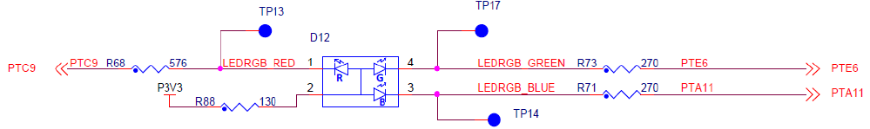
Tri-color LED
Common anode tri-color LED. Gate output sinking current from LED load.

Slide 14
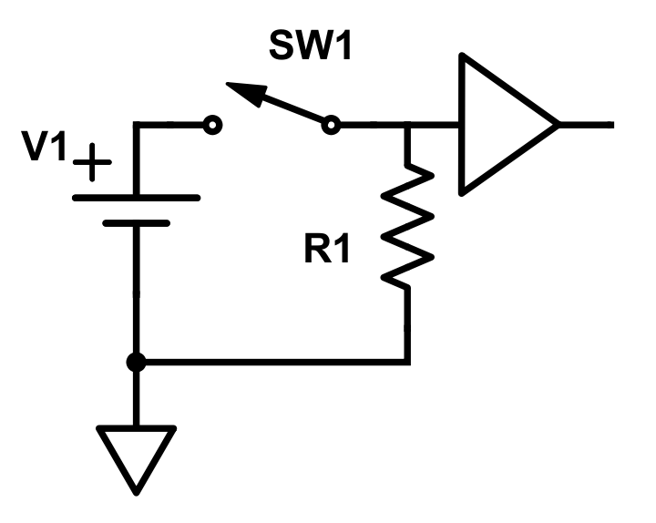
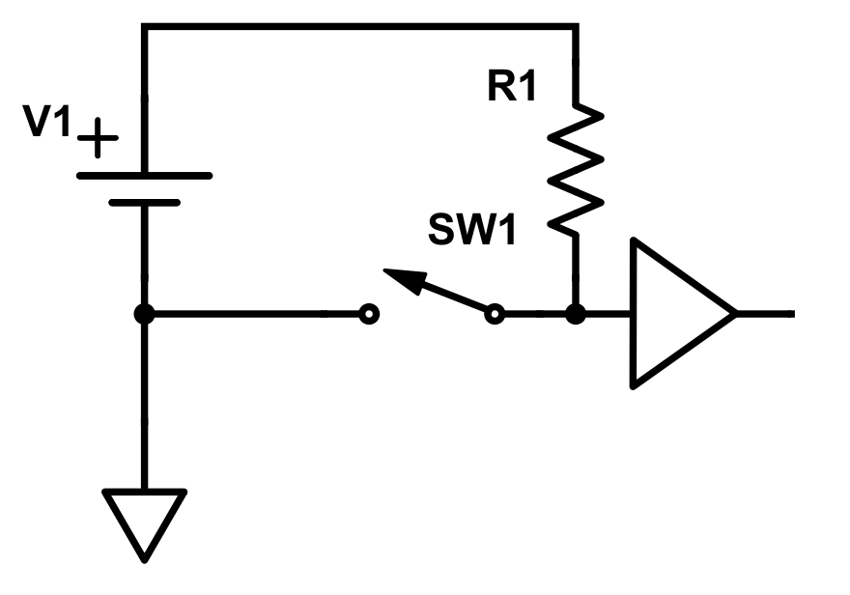
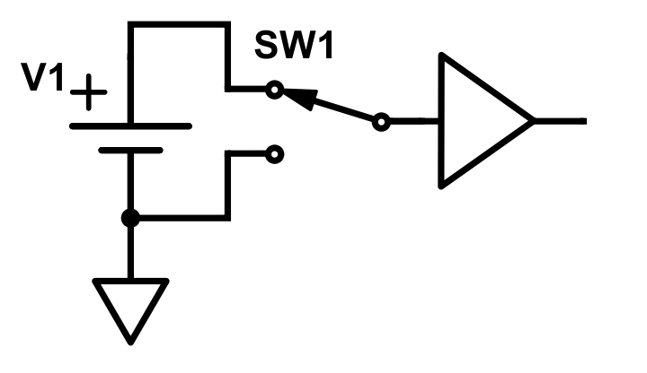
Switches as inputs
We can use electromechanical switches to input logic levels:
Single-pole double-throw (SPDT) connection.
Single-pole single-throw (SPST) with pull-up resistor.
SPST with pull-down resistor
(a)
(b)
(c)
Note: the diagrams show a logic buffer, which can in each case be a microcontroller/mbed input.

Slide 15
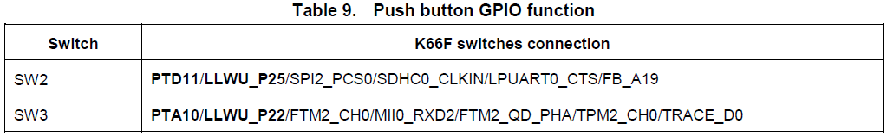
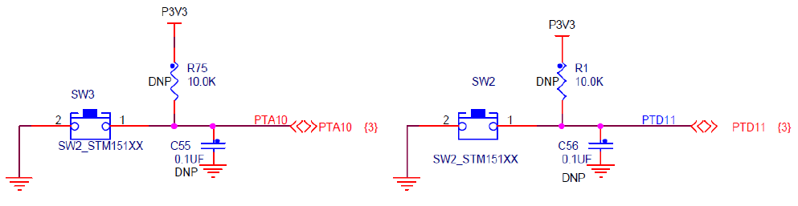
FRDM K66F Switch Inputs
release
pressed
release

Slide 16
DigitalIn
Note that use of DigitalIn enables by default the internal pull-down resistor, i.e. the input circuit is configured as Figure (c) in previous slide. This can be disabled, or an internal pull-up enabled, using the mode( ) function.
Functions | Usage
DigitalIn | Create a DigitalIn connected to the specified pin
read | Read the input, represented as 0 or 1 (int)
mode | Set the input pin mode, with parameter chosen from: PullUp, PullDown, PullNone, OpenDrain
operator int() | A shorthand for read()

Slide 17
Example of DigitalIn
/*Program Example 3.3: Flashes one of two LEDs, depending on the state of a 2-way switch */
#include "mbed.h"
DigitalOut redLED(LED1);
DigitalOut greenLED(LED2);
DigitalIn Switch(SW2);
int main() {
while(1) {
if (Switch == 1) { //test value of Switch
//execute following block if Switch is 1
greenLED = 0;
redLED = 1;
wait(0.2);
redLED = 0;
wait(0.2); }//end of if
else {//here if Switch is 0
redLED = 0;
greenLED = 1;
wait(0.2);
greenLED = 0;
wait(0.2);
}//end of else
}//end of while(1)
}//end of
SW2

Slide 18
Example of DigitalIn
Simple optosensors input
reflective optosensor
transmissive optosensor
Can connect the optosensor to a digital input:
0: no object
1: object block the light
simple drive circuit for optosensor
DigitalIn opto(D1);

Slide 19

Example of DigitalIn
Joystick button input
The mbed API allows grouping of digital input and output, with two useful utilities, BusIn and BusOut.
BusIn group a set of digital inputs into one bus, so that you can read a digital word direct from it. The equivalent output is Busout.
BusIn joystick(p15,p12,p13,p16);

Slide 20
BusIn
With the BusIn API, you can combine number of DigitalIn pins to read them at once. This abstraction is useful for checking multiple inputs together as single interface instead of individual pins.
You can use any of the numbered Arm Mbed pins as a DigitalIn in the BusIn.
You can have up to 16 pins in a Bus.
The order of pins in the constructor is the reverse order of the pins in the byte order. So if you have BusIn(a,b,c,d,e,f,g,h), then the order of bits in the byte would be hgfedcba with a being bit 0 and h being bit 7.

Slide 21
BusIn class reference
 | Public Member Functions
 | BusIn (PinName p0, …, PinName p15) | Create an BusIn, connected to the specified pins.
 | BusIn (PinName pins[16]) | Create an BusIn, connected to the specified pins.
int | read () | Read the value of the input bus.
void | mode (PinMode pull) | Set the input pin mode.
int | mask () | Binary mask of bus pins connected to actual pins (not NC pins) If bus pin is in NC state make corresponding bit will be cleared (set to 0), else bit will be set to 1.
 | operator int () | A shorthand for read()
DigitalIn& | operator[] (int index) | Access to particular bit in random-iterator fashion.

Slide 22
#include "mbed.h"
BusIn nibble(D0, D1, D2, D3); // Change these pins to buttons on your board.
int main()
{ // Optional: set mode as PullUp/PullDown/PullNone/OpenDrain
nibble.mode(PullNone);
while(1)
{ // check bits set in nibble
switch(nibble & nibble.mask())
{ // read the bus and mask out bits not being used
case 0x0: printf("0b0000, D3,D2,D1,D0 are low \n\r");break;
case 0x1: printf("0b0001, D0 is high \n\r");break;
case 0x2: printf("0b0010, D1 is high \n\r");break;
case 0x3: printf("0b0011, D1,D0 are high \n\r");break;
case 0x4: printf("0b0100, D2 is high \n\r");break;
case 0x5: printf("0b0101, D2, ,D0 are high \n\r");break;
case 0x6: printf("0b0110, D2,D1 are high \n\r");break;
case 0x7: printf("0b0111, D2,D1,D0 are high \n\r");break;
case 0x8: printf("0b1000, D3 is high \n\r");break;
// ...
case 0xF: printf("0b1111, D3,D2,D1,D0 are high \n\r");break;
}
wait(1);
}
}

Slide 23
BusOut
Use the BusOut interface to combine a number of DigitalOut pins to write them at once. This API is useful for writing to multiple pins together as single interface instead of individual pins.
You can use any of the numbered Arm Mbed pins as a DigitalOut in the BusOut.
You can have up to 16 pins in a Bus.
The order of pins in the constructor is the reverse order of the pins in the byte order. So if you have BusOut(a,b,c,d,e,f,g,h), then the order of bits in the byte would be hgfedcba with a being bit 0 and h being bit 7.

Slide 24
BusOut class reference
 | Public Member Functions
 | BusOut (PinName p0, …, PinName p15) | Create an BusOut, connected to the specified pins.
 | BusOut (PinName pins[16]) | Create an BusOut, connected to the specified pins.
void | write (int value) | Write the value to the output bus
int | read () | Read the value currently output on the bus.
int | mask () | Binary mask of bus pins connected to actual pins (not NC pins) If bus pin is in NC state make corresponding bit will be cleared (set to 0), else bit will be set to 1.
BusOut & | operator= (int v) | A shorthand for write()
DigitalOut& | operator[] (int index) | Access to particular bit in random-iterator fashion.

Slide 25
#include "mbed.h"
BusOut myleds(LED1, LED2, LED3, LED4);
int main()
{
while(1)
{
for(int i=0; i<16; i++)
{
myleds = i;
wait(0.25);
}
}
}

Slide 26
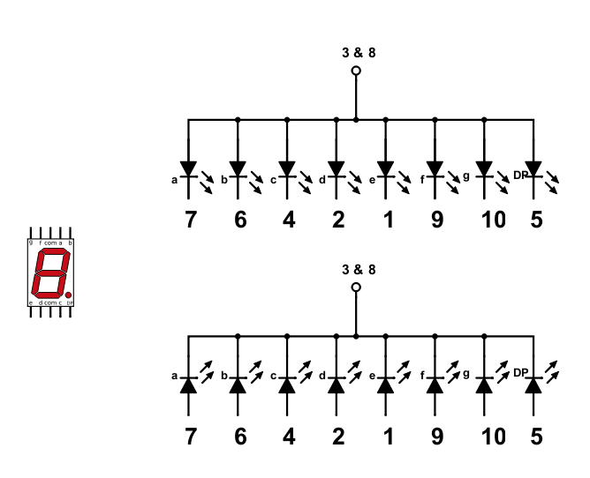
Seven Segment Display
LEDs arranged in the following to display alphanumerical values (plus dot, DP).
Vcc
Common anode
10 9 8 7 6
GND
Common cathode
1 2 3 4 5

Slide 27
Example codes of display
Digit | Display | gfedcba | abcdefg | a | b | c | d | e | f | g
0 |  | 0x3F | 0x7E | on | on | on | on | on | on | off
1 |  | 0x06 | 0x30 | off | on | on | off | off | off | off
2 |  | 0x5B | 0x6D | on | on | off | on | on | off | on
3 |  | 0x4F | 0x79 | on | on | on | on | off | off | on
4 |  | 0x66 | 0x33 | off | on | on | off | off | on | on
5 |  | 0x6D | 0x5B | on | off | on | on | off | on | on
6 |  | 0x7D | 0x5F | on | off | on | on | on | on | on
7 |  | 0x07 | 0x70 | on | on | on | off | off | off | off
8 |  | 0x7F | 0x7F | on | on | on | on | on | on | on
9 |  | 0x6F | 0x7B | on | on | on | on | off | on | on
A |  | 0x77 | 0x77 | on | on | on | off | on | on | on
b |  | 0x7C | 0x1F | off | off | on | on | on | on | on
C |  | 0x39 | 0x4E | on | off | off | on | on | on | off
d |  | 0x5E | 0x3D | off | on | on | on | on | off | on
E |  | 0x79 | 0x4F | on | off | off | on | on | on | on
F |  | 0x71 | 0x47 | on | off | off | off | on | on | on
Common cathode connection as shown in the next slides
https://en.wikipedia.org/wiki/Seven-segment_display

Slide 28
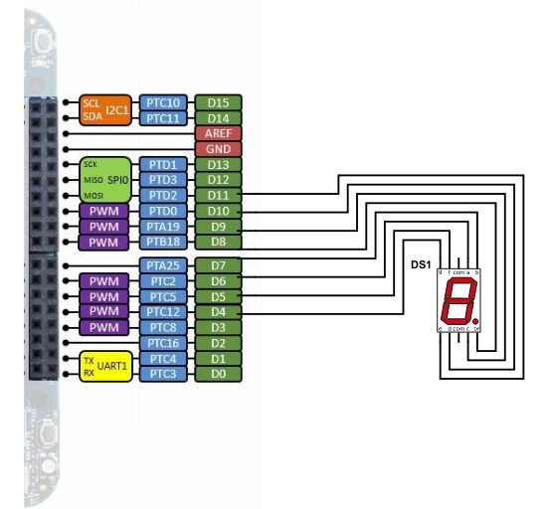
Connect K66F to 7-segment display
Connection | pin
D4 → 10 | g
D5 → 9 | f
D6 → 7 | a
D7 → 6 | b
D8 → 5 | DP
D9 → 4 | c
D10 → 2 | d
D11 → 1 | e
GND → 3, 8
10 9 8 7 6
1 2 3 4 5
Common cathode connection

Slide 29
mbed code example for 7-segment display
/*Program Example 3.7: Simple of 7-segment display. Display demonstration digits 0 to 9 in turn. */
#include "mbed.h"
BusOut display(D6, D7, D9, D10, D11, D5, D4, D8);
char table[10] = {0x3F, 0x06, 0x5B, 0x4F, 0x66, 0x6D, 0x7D, 0x07, 0x7F, 0x6F}; //The table contains 0-9
int main(){
while(1){
for (int i = 0; i<10; i = i+1){
display = table[i];
wait(1);
}
}
}
Note: BusOut is a collection of DigitalOut

Slide 30
Chapter Review
Logic signals, expressed mathematically as 0 or 1, are represented in digital electronic circuits as voltages. One range of voltages represents 0, another represents 1.
LEDs can be driven directly from the mbed digital outputs. They are a useful means of displaying a logic value, and of contributing to a simple human interface.
Electromechanical switches can be connected to provide logic values to digital inputs.
Multi-coloured LEDs can be made by enclosing several individual LEDs of different colors in the same housing. The mbed application board contains one of these.
A range of simple opto-sensors have almost digital outputs, and can with care be connected directly to mbed pins as digital inputs.
Where the mbed pin cannot provide enough power to drive an electrical load directly, interface circuits must be used.

