Slide 1
HSPICE and Waveform

Slide 2
Outline
Login method
  MobaXterm
Elements and Device Models
Input Sources
Analysis Types
Simulation Step and Graphic Tools
  Run HSPICE & Waveform explorer

Slide 3
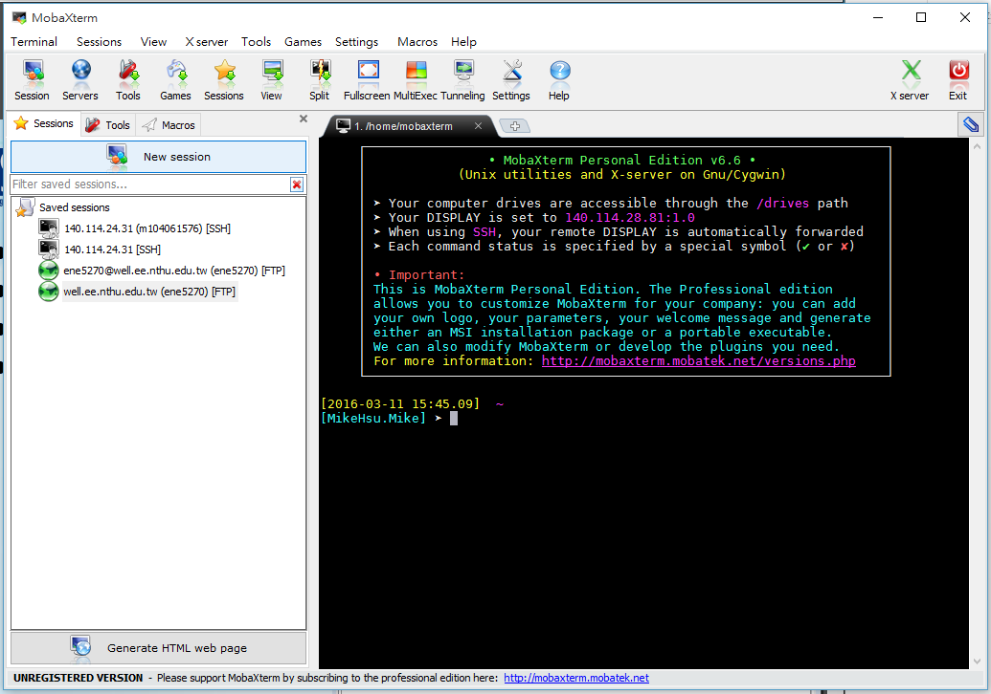
Login Method
Use MobaXterm for example
Download website：
  http://mobaxterm.mobatek.net/download-home-edition.html
  Download the free version
  Execute the .exe file

Slide 4
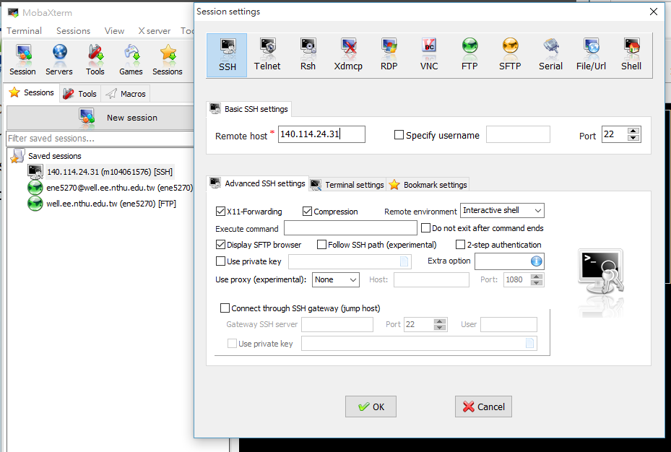
Login Method
Session 🡪 SSH 🡪 Remote host 140.114.24.31

Slide 5
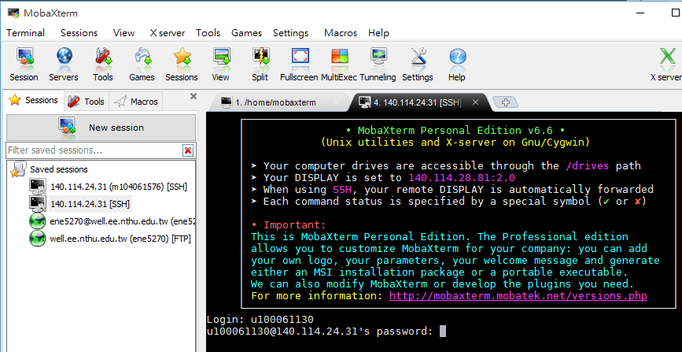
Login Method
Login：<your account>
Password：<your password>
Ex.

Slide 6
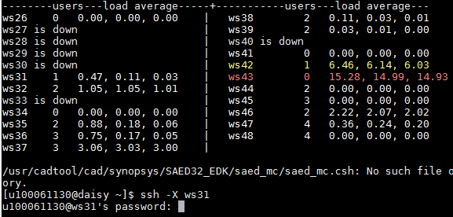
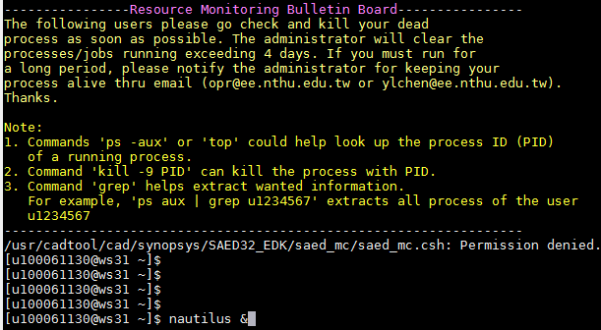
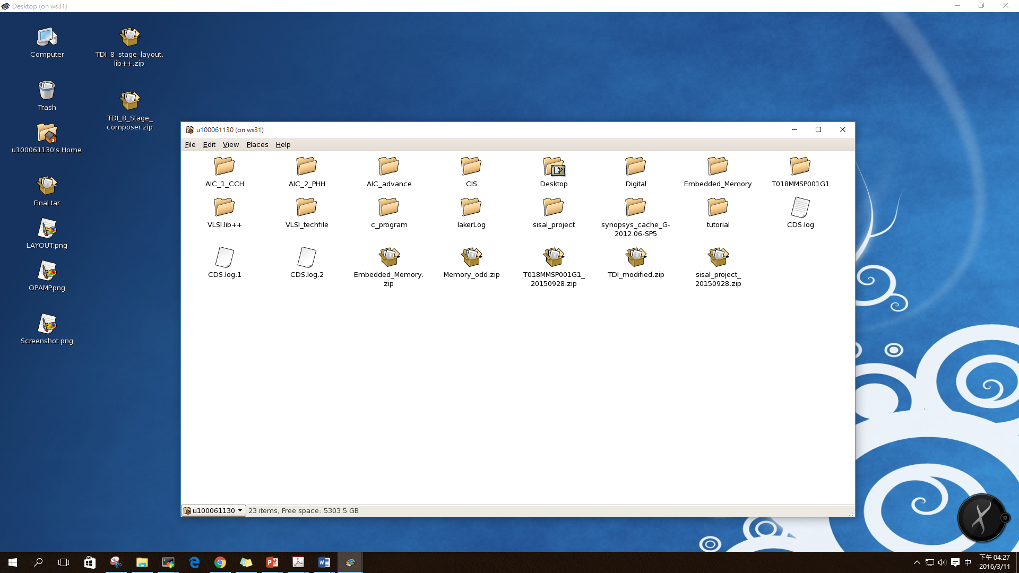
Login Method
Type ssh -X ws31
  (Note：X need to be capital)
  ws：choose the workstation from the list
Type your password
Enter the host ws31….
When using your PC… You can use remote desktop by typing：nautilus &
Ex.

Slide 7
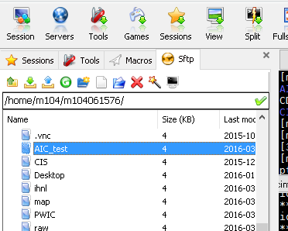
Download & Upload files

Slide 8
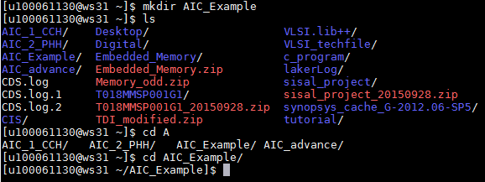
Create a New Directory
mkdir #### (新增”####”資料夾)
ls (查看當前目錄下之檔案)
cd #### (進入”####”資料夾)

Slide 9
Prepare for simulation in Synopsys HSPICE
Library file：cic018.l
  SPICE model
  Syntax: .lib “cic018.l” TT/SS/FF/SF/FS
Simulation file：XXX.sp (a netlist from schematic tool, ex: Composer)
  Setup
  Main circuit
    Can include another netlist by using .inc ‘XXX.spi’.
  Analysis

Slide 10
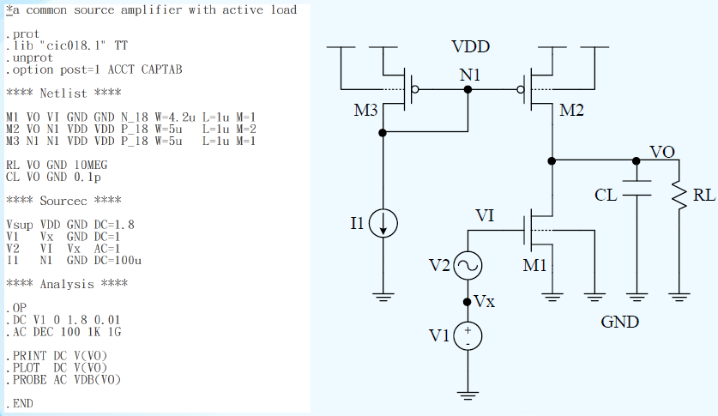
SPICE Netlist Example
setup
Different lib. has different MOS model name.
Main ckt
Analysis

Slide 11
The first line is always a comment.
library
.prot/.unprot
Things btw will not appears in results file
Simulation options
註解方式
可用”******”(限單行開頭)
或”$”(行中)
不分大小寫
(0, GND, GND!)Always refer to global ground
.op 分析節點偏壓
Always “.end”

Slide 12
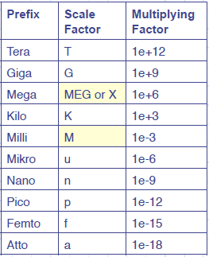
Scale Factor

Slide 13
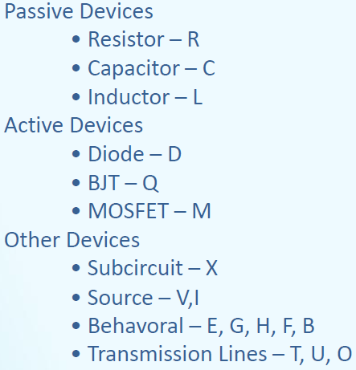
Device
Rx node1 node2 value
Cx node1 node2 value
Lx node1 node2 value
*m_name: model name
P_18/N_18 in cic018.l
Qx C B E m_name
Mx D G S B m_name W=value L=value m=value
Xx node1 node2 … nodeN name

Slide 14
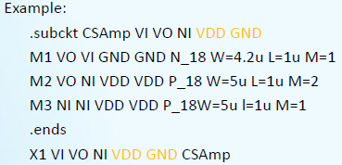
Subcircuits
Use hierarchical structure to simplify complex connection
Definition with .subckt and .ends
Use X<subckt_nanme> to call subcircuit.
Access nodes of subcircuits by “(.)” extension
Ex：.print V(X1.node)
subckt_name
注意subckt_name位置
Call subckt

Slide 15
Input Source
Independent source elements --- DC/AC
  Syntax：
  Ex：
  DC sweep range is specified in .DC analysis statement.
  AC frequency sweep range is specified in .AC analysis statement.
Vxx n1 n2 <DC=dcval> <AC=acval>, <ac.phase>
Ixx n1 n2 <DC=dcval> <AC=acval>, <ac.phase>
V1 net1 net2 DC=1.8v
V2 net3 net4 3.3
I3 net5 net6 1uA
Vinp Vinp 0 DC common AC 0.5 0
Vinn Vinn 0 DC common AC 0.5 180
*而外定義 common mode
.param common=0.9

Slide 16

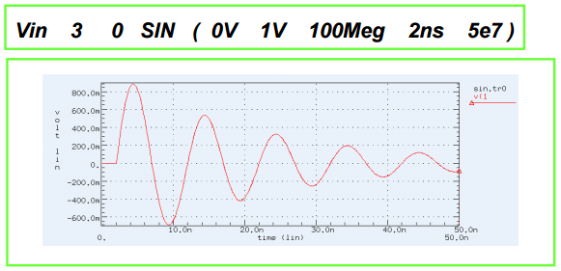
Independent source elements
Independent source elements --- Transient
  SIN：
  Example：

Slide 17
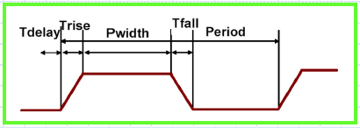
Independent source elements
  PULSE (pulse waveform)：

Slide 18


Independent source elements
  PWL (piece-wise linear waveform)：
  Example：

Slide 19
Analysis Types
.OP：Operating point analysis
  In .tran simulation, resulting DC operating point is initial estimate)
  syntax： .OP
  Example：.OP
.DC：sweep parameter, source and temperature values
  syntax： .DC <var1> <start> <stop> <step>
  Example： .DC Vin 0 1.8 0.1
.AC：sweep frequency
  syntax： .AC <DEC/LIN> <np> <start> <stop>
  Example： .AC DEC 10 1kHz 10MHz
.Tran：sweep time
  syntax： .TRAN <step> <stop>
  Example： .TRAN 1ns 10us

Slide 20
Analysis Types
.Probe：probe the observation will not show in the result file but can be seen at waveform
  syntax： .probe V(net) I(device)
  Example：.probe V(Vout) or .probe I(MCS)
.Print：Print the observation in result file
  syntax： .print V(net) I(device)
.Plot：plot the observation in the result file
  syntax： .plot V(net) I(device)

Slide 21
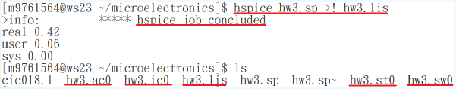
Simulation Step and Graphic Tools
Running HSPICE：
  .l file (library)
  .sp file
  Make sure all files are in the same folder.
指令：
  Type hspice XXX.sp >! XXX.lis at terminal
  Hspice job concluded 🡪 circuit run correctly
  Hspice job aborted 🡪 circuit has error (error will show in .lis file)

Slide 22
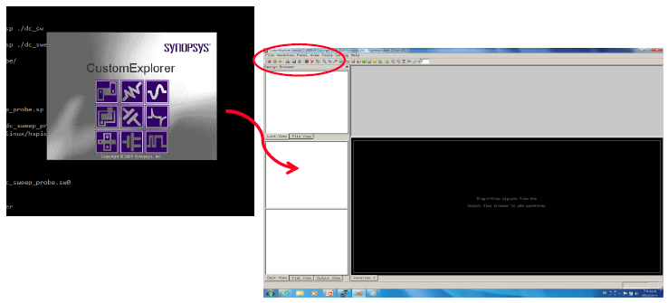
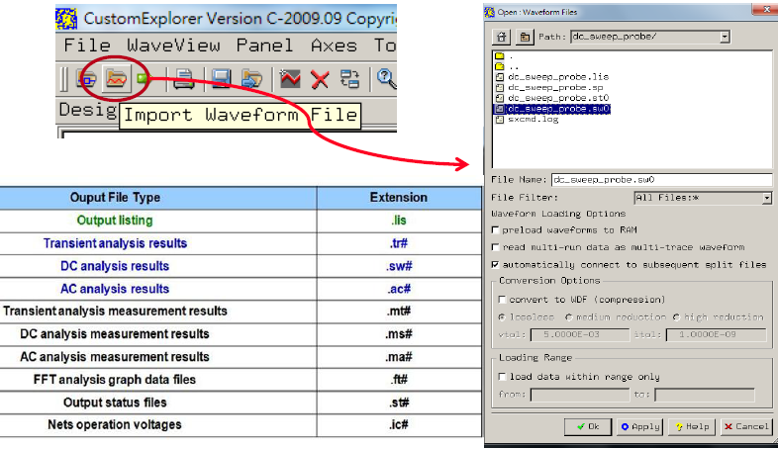
Simulation Step and Graphic Tools
SPICE explorer
  Type wv & at terminal
  Or sx &
  Open result files

Slide 23
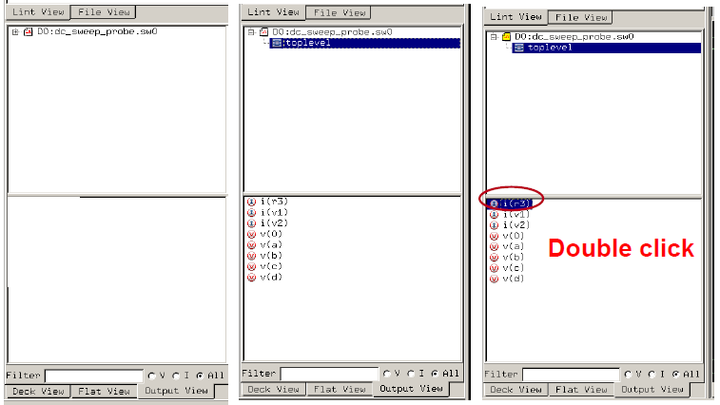
Choose the node

Slide 24
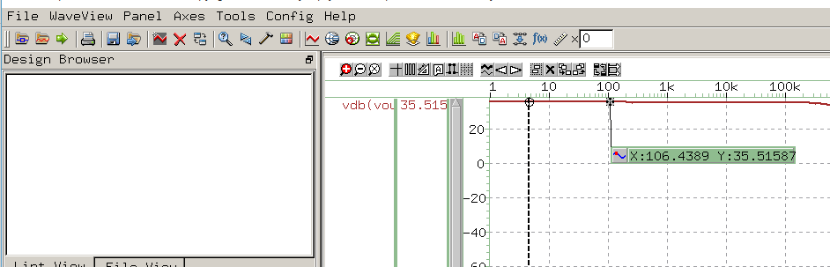
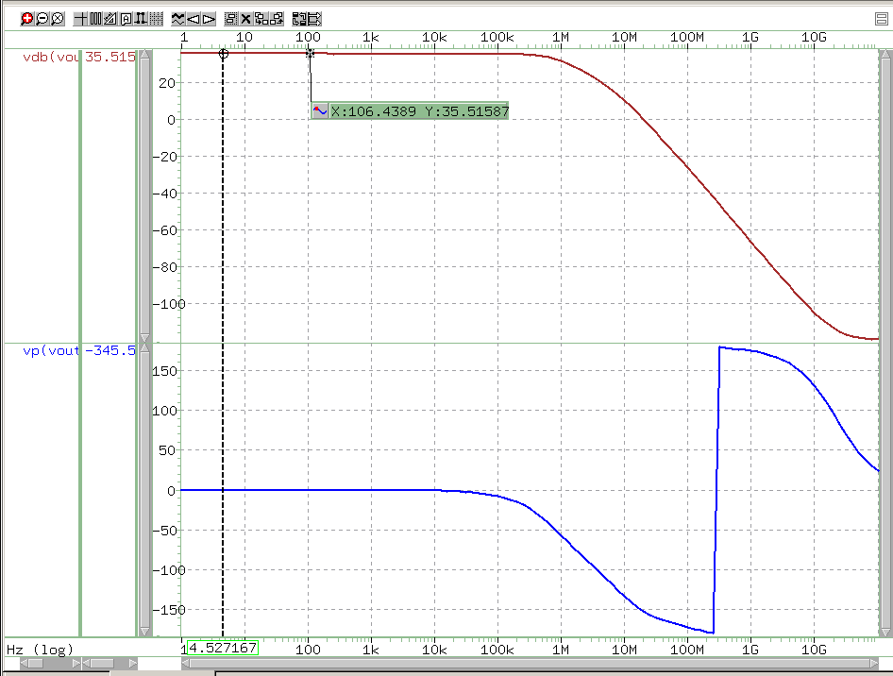
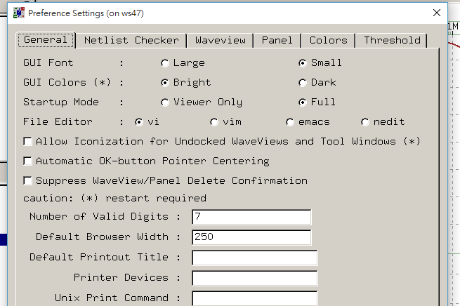
Tools
functions
update
Cursor/monitor/meter
monitor
meter
Cursor

Slide 25
Analysis Type - OP
.OP statement prints out the following items in xxx.lis file.
  Node voltage
  Source current
  Power dissipation
  Device information
  …..
Specify time at which operating point is to be calculated
  .OP at 3us (show the operating point at 3us in transient simulation)

Slide 26



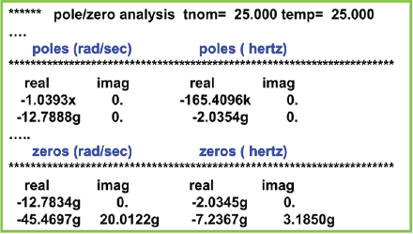
Analysis Type - DC
Sweep for param/temp/supply voltage…
Syntax：
Example：
Syntax：
Results：

Slide 27




Analysis Type – AC & Transient
Syntax：
Example：
Syntax：
Example：
Frequency sweep 10 point per decade
from 1kHz to 100MHz

Slide 28
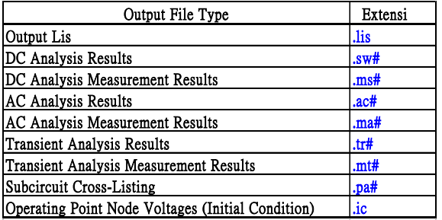
Simulation output and controls
Output commands
  .PRINT – print numeric analysis results in .lis file
  .PLOT
  .PROBE – Allows save output variables only into graphic data files
  .MEAS – Print numeric results of measured specifications
Output file type

Slide 29

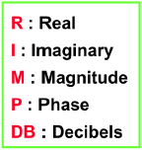

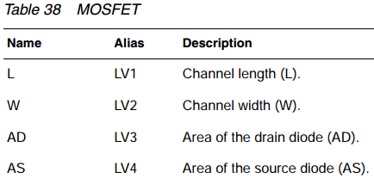
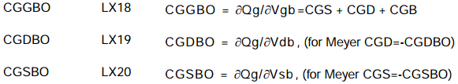
Output variable Example
DC and Transient analysis：
AC analysis：
Element templates：(see HSPICE simulation and Analysis user guide)
*Hint for HW1
*Need another .option DCCAP

