Slide 1
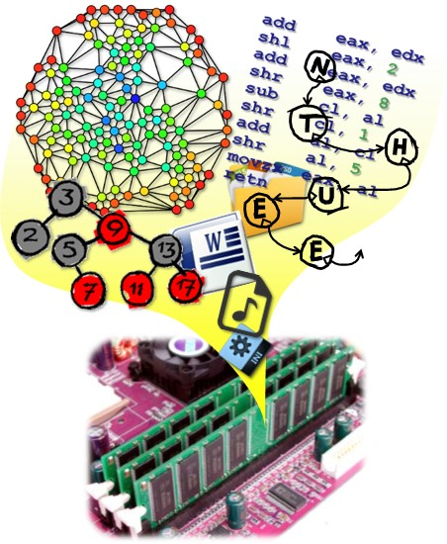
Data
Structures
CH3 Stacks & Queues
Prof. Tai-Lang Jong
Office: Delta 928
Tel: 42577
email: tljong@mx.nthu.edu.tw
Spring 2021

Slide 2
Outline
3.1 Templates in C++
3.2 The stack ADT
3.3 The queue ADT
3.4 Subtyping and inheritance in C++
3.5 A mazing problem
3.6 Evaluation of expressions

Slide 3
Observations
Many codes look the same for different types
  Sorting functions that handle
    32-bit integers
    64-bit integers
    float
    …
  Sparse matrix classes that handle
    32-bit integers
    64-bit integers
    float
    …
quickSort(int a[], int lo, int hi);
quickSort(float a[], int lo, int hi);
quickSort(double a[], int lo, int hi);
class MatrixTerm {
friend SparseMatrix;
private:
int row, col;
int value;
};
class MatrixTerm {
friend SparseMatrix;
private:
int row, col;
float value;
};

Slide 4
Non-Template Solutions
Implement the same behavior over and over
  Hard to maintain code
  Hard to globally modify code
Write general code for a common base type
  Lose the benefits of compiler's type checking
  Incurs overhead
Use macros (#define)
  Sacrifice readability
  Sacrifice debuggability

Slide 5
Template
Template can be instantiated to any data type
  So called "parameterized types“
  The simple idea is to pass data type as a parameter so that we don’t need to write the same code for different data types.
  Templates are expanded at compile time.
  Compiler does type checking before template expansion
C++ language supports
  Template functions
  Template classes
quickSort(int a[], int lo, int hi);
quickSort(float a[], int lo, int hi);
quickSort(double a[], int lo, int hi);
template<typename T>
quickSort(T a[], int lo, int hi){…}
quicksort<double>(a,0,100);

Slide 6
Function Template
We write a generic function that can be used for different data types.
Examples of function templates are sort(), max(), min(), printArray().
#include <iostream>
using namespace std;
// One function works for all data types. This would work
// even for user defined types if operator '>' is overloaded
template <typename T>
T myMax(T x, T y)
{ return (x > y)? x: y; }
int main(){
cout << myMax<int>(3, 7) << endl; // Call myMax for int
cout << myMax<double>(3.0, 7.0) << endl; // call myMax for double
cout << myMax<char>('g', 'e') << endl; // call myMax for char
return 0;
}

Slide 7
Template Function Example
void SelectionSort (int *a , const int n )
{
for (int i = 0 ; i < n ; i++ )
{
int k = i;
for ( int j = i + 1 ; j < n ; j++ )
if ( a[j] < a[k] ) k = j;
swap ( a[i], a[k] );
}
}
template <class T>
void SelectionSort (T *a , const int n )
{
for (int i = 0 ; i < n ; i++ )
{
int j = i;
for ( int j = i + 1 ; j < n ; j++ )
if ( a[j] < a[k] ) k = j;
swap ( a[i], a[k] );
}
}
SelectionSort(a, 5); //invoking
template <class T> is identical to template <typename T>
It is a convention to use "T", but one can use any other name

Slide 8
Template Function Example
Can have more than one arguments to templates
Can specify default value for template arguments
template <class T>
int anotherFunctionWithNoT(){}
void SelectionSort (T *a , const int n )
{
for (int i = 0 ; i < n ; i++ )
{
int j = i;
for ( int k = i + 1 ; k < n ; k++ )
if ( a[k] < a[j] ) j = k;
swap ( a[i], a[j] );
}
} //error
template <typename T, class U>
void someFunct (T *a , U n )
{
//…..
} //OK
template <typename T, class U=int>
void someFunct (T *a , U n )
{
//…..
}

Slide 9
Template Function Example
Can pass nontype parameters to templates
template <class T, int max>
int arrMin(T arr[], int n)
{
int m = max;
for (int i = 0; i < n; i++)
if (arr[i] < m) m = arr[i];
return m;
}
int main()
{
int arr1[] = {10, 20, 15, 12};
int n1 = sizeof(arr1)/sizeof(arr1[0]);
char arr2[] = {1, 2, 3};
int n2 = sizeof(arr2)/sizeof(arr2[0]);
// Second template parameter to arrMin
// must be a constant
cout << arrMin<int, 10000>(arr1, n1) << endl;
cout << arrMin<char, 256>(arr2, n2);
return 0;
}

Slide 10
Class Template
Like function templates, class templates are useful when a class defines something that is independent of the data type.
Can be useful for classes like LinkedList, BinaryTree, Stack, Queue, Array, etc.
#include <iostream>
using namespace std;
template <typename T>
class Array {
private:
T *ptr;
int size;
public:
Array(T arr[], int s);
void print();
};
template <typename T>
Array<T>::Array(T arr[], int s)
{
ptr = new T[s];
size = s;
for(int i = 0; i < size; i++)
ptr[i] = arr[i];
}
template <typename T>
void Array<T>::print()
{ for (int i = 0; i < size; i++)
cout<<" "<<*(ptr + i);
cout<<endl;
}
int main() {
int arr[5] = {1, 2, 3, 4, 5};
Array<int> a(arr, 5);
a.print();
return 0;
}

Slide 11
Class Template
More than one arguments to templates
Specify default value to template
#include<iostream>
using namespace std;
template<class T, class U = char>
class A {
T x;
U y;
public:
A() { cout<<"Constructor Called"<<endl; }
};
int main() {
A<char, char> a; A<char> b;
A<int, double> c;
return 0;
}

Slide 12
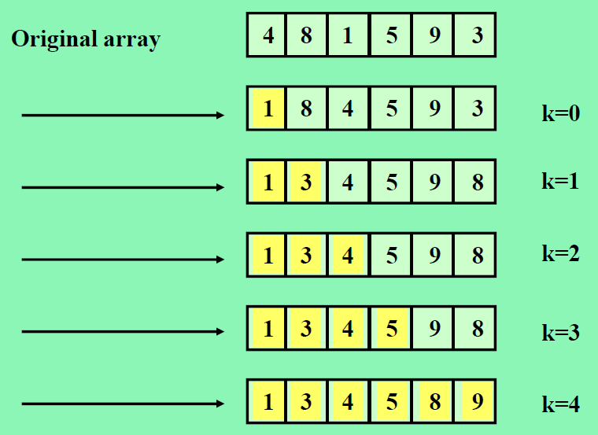
Example of Selection Sort

Slide 13
Selection Sort Using Template
1. template <class KeyType>
2. void sort (KeyType *a, int n)
3. // sort the n KeyType a[0] to a[n-1] into nondecreasing order
4. {
5. for(int k=0; k < n; k++){
6. int smallest = k;
7. // find the smallest KeyType in a[k] to a[n-1]
8. for (int j = k+1; j < n; j++){
9. if(a[j] < a[smallest]) smallest = j;
10. }
11. KeyType temp = a[k];
12. a[k] = a[smallest];
13. a[smallest] = temp;
14. }
15. }

Slide 14
Selection Sort Using Template (cont.)
16. main(){
17. float real_array[100];
18. int int_array[250];
19. . …
20. // assume that the arrays have been initialized
21. sort(real_array, 100);
22. sort(int_array, 250);
23. . …
24. }

Slide 15
Array Resizing Using Template
template <class T>
void ChangeSize1D ( T*& a, const int oldSize, const int newSize )
{
if ( newSize < 0 ) throw “New length must be >=0”;
T* temp = new T [ newSize ]; // new array
int number = min ( oldSize, newSize ); // number to copy
copy (a, a + number, temp);
delete [] a; // deallocate old memory
a = temp;
}
a
a
a
a

Slide 16
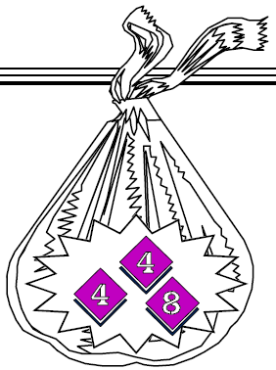
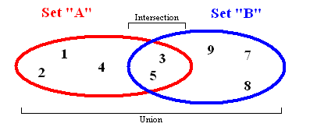
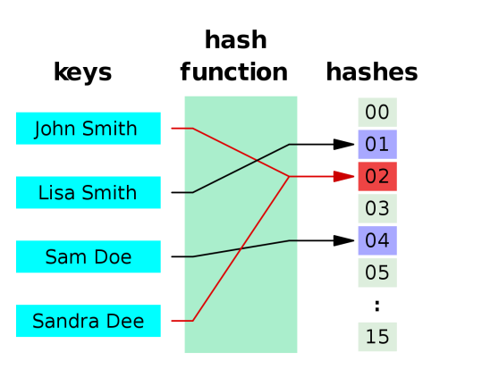
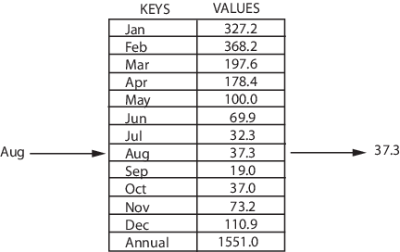
Container Class
A container class is a class that represents a data structure that contains or stores a number of data objects.
Container examples:
  List
  Bag (Multiset)
  Set
  Map (Dictionary)
  Multimap

Slide 17
Bag Class
A Bag: unordered collection of objects that may have duplicates, where the order of insertion is completely irrelevant, e.g., a bag of marbles.
Operations you can do with a bag include
  Inserting a new value, (Push)
  Removing a value, (Pop)
  Testing to see if a value is held in the collection (IsIn),
  Determining the number of elements in the collection.
  Sometimes the ability to loop over the elements in the container

Slide 18
Set Class
A Set extends the Bag in two important ways.
  First, the elements in a set must be unique;
    Adding an element to a set when it is already contained in the collection will have no effect.
  Second, the set adds a number of operations that combine two sets to produce a new set:
    Set union
    Set intersection
    Set difference

Slide 19
Bag Class Implementation
class Bag
{
public:
Bag ( int bagCapacity = 10 ); // constructor
~Bag( ); // destructor
int Size( ) const; // return number of elements in bag
bool IsEmpty() const;
int Element( ) const;//return an element that is in the bag
void Push(const int);// add an integer into the bag
void Pop(); // delete an integer in the bag
private:
int *array; // dynamic array for Bag
int capacity; // capacity of array
int top;// array position of top element
};
const member function
Specifies that the function does not modify the object for which it is called.
const Bag emptyBag;
emptyBag.size(); //valid
emptyBag.push(1); //error

Slide 20
Bag Class (for integers)
Initialization list
Bag::Bag (int bagCapacity)
:capacity ( bagCapacity )
{
if ( capacity < 1 )
throw "Capacity must be > 0";
array = new int [ capacity ];
top = -1; // empty
}
Bag::~Bag ( )
{ delete [] array; }
inline int Bag::Size( ) const
{ return top + 1; }
bool Bag::IsEmpty() const
{
return (Size() == 0);
}
initialize member variables when they are created rather than afterwards

Slide 21
Bag Class (for integers)
inline int Bag::Element ( ) const
{
if ( IsEmpty ( ) )
throw “Bag is empty”;
return array [0]; // always return 0th element
}
void Bag::Push (const int x)
{
if (capacity == top + 1) // array is full
{
ChangeSize1D (array, capacity, 2 * capacity);
capacity *= 2;
}
array[++top] = x;
}

Slide 22
Bag Class (for integers)
void Bag::Pop ()
{
if (IsEmpty()) throw “Bag is empty, cannot delete”;
int deletePos = top/2; // always delete top/2th element
copy(array + deletePos + 1, array + top + 1,
array + deletePos);
top--;
}
Container classes are particularly suitable for implementation using templates, because the algorithms for basic container class operations are usually independent of the type of objects that container class contains.

Slide 23
Template Class for Bag
template<class T>
class Bag
{
public:
Bag( int bagCapacity = 10 ); // constructor
~Bag( ); // destructor
int Size( ) const; // return number of elements in bag
bool IsEmpty() const;
T& Element( ) const; // return an element that is in the bag
void Push(const T&); // add an integer into the bag
void Pop();
private:
T *array;
int capacity; // capacity of array
int top; // array position of top element
};

Slide 24
Template Bag
template<class T>
Bag<T>::Bag(int bagCapacity) : capacity (bagCapacity)
{
if (capacity < 1)
throw “Capacity must be > 0”;
array = new T [capacity];
top = -1;
}
template <class T>
Bag<T>::~Bag( )
{delete [] array;}
template <class T>
inline int Bag<T>::Size( ) const
{ return top + 1; }

Slide 25
Template Bag
template <class T>
bool Bag<T>::IsEmpty() const
{
return (Size() == 0);
}
template <class T>
T& Bag<T>::Element( ) const
{
if ( IsEmpty() )
throw “Bag is empty”;
return array [0];
}

Slide 26
Template Bag
template <class T>
void Bag<T>::Push(const T& x)
{
if (capacity == top + 1) {
ChangeSize1D (array, capacity, 2 * capacity);
capacity *= 2;
}
array [++top] = x;
}
template <class T>
void Bag<T>::Pop( )
{
if ( IsEmpty() ) throw “Bag is empty, cannot delete”;
int deletePos = top/2;
copy(array+deletePos+1, array+top + 1, array + deletePos);
array[top--].~T(); // destructor for T
}

Slide 27
Use of the Template Bag
int main()
{
Bag<int> myIntBag;
myIntBag.Push(1);
myIntBag.Push(9);
cout << myIntBag.Size() << endl;
cout << myIntBag.Element();
Bag<float> myFloatBag;
for(int i=0; i<10; i++)
myFloatBag.Push(1.0/i);
Bag<Bag<int> > myManyIntBag;
myManyIntBag.Push(myIntBag);
…
return;
}

Slide 28
Outline
3.1 Templates in C++
3.2 The stack ADT
3.3 The queue ADT
3.4 Subtyping and inheritance in C++
3.5 A mazing problem
3.6 Evaluation of expressions

Slide 29
A Simple Summary
A collection of data objects organized sequentially
  List, linear list, ordered list: A = (a₀, a₁,…, a_{n-1})
  Stack: Last In First Out (LIFO)
  Queue: First In First Out (FIFO)
    Array implementation
    Linked list implementation
A collection of unordered data objects
  Bag (Multiset): can have duplicate data objects
  Set: data object must be unique
A collection of <key, value> pair data objects
  Map (Dictionary): key-value mapping must be unique
  Multimap: one key –to-multiple values mapping

Slide 30
List
front
rear
Insert x at position 5
1 | 2 | 3 | 4 | 5 | 6 | 7 | 8
a | b | c | d | e | f | g | h
O(n)
1 | 2 | 3 | 4 | 5 | 6 | 7 | 8 | 9
a | b | c | d | x | e | f | g | h
Delete data at position 3
1 | 2 | 3 | 4 | 5 | 6 | 7 | 8 | 9
a | b | c | d | x | e | f | g | h
O(n)
1 | 2 | 3 | 4 | 5 | 6 | 7 | 8 | 9
a | b | d | x | e | f | g | h

Slide 31
Stack
Ordered List (linear list)
  Suppose A = (a₀, a₁,…, a_{n-1}), where n≧0
  a_{i} is called an atom, or an element
Stack: Last-In First-Out (LIFO)
  is a special case of ordered list
  One end is called top, the other end called bottom
  the additions and deletions are made at the top end only
Example
  Given a stack S = (a₀, a₁,…, a_{n-1})
  a₀ is the bottom element
  a_{n-1} is the top element

Slide 32
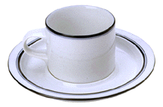
Stack of Cups
top
F
top
E
E
D
D
C
C
B
B
bottom
bottom
A
A
Add a cup to the stack.
Remove a cup from new stack.
A stack is a LIFO list.

Slide 33
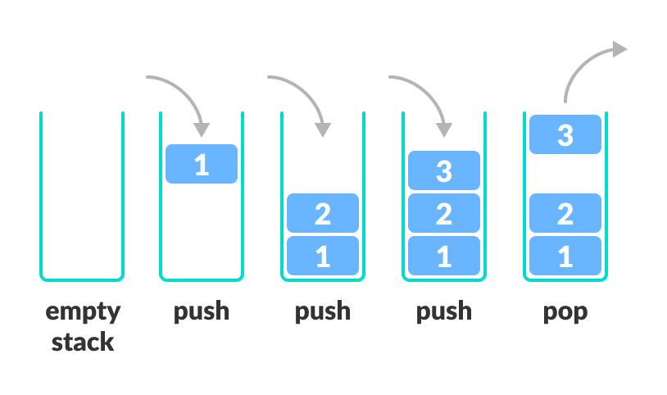
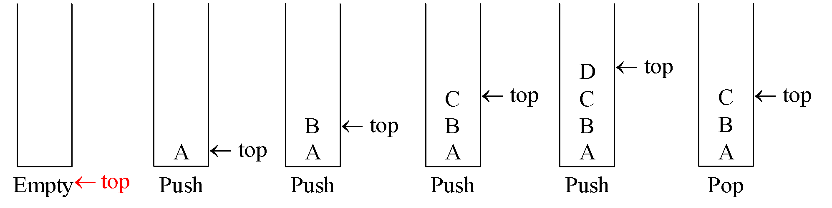
Stack

Slide 34
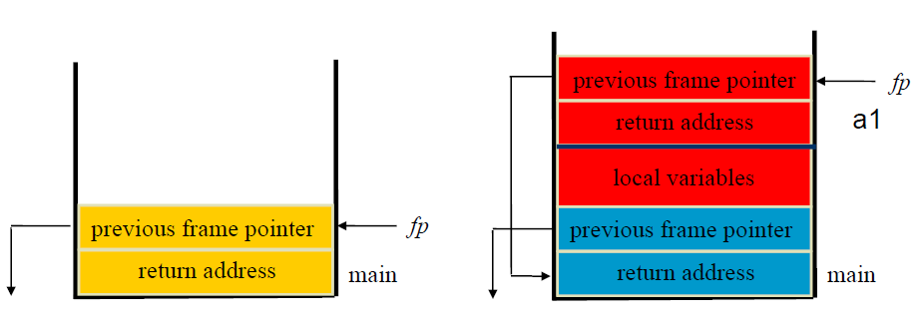
Applications of Stack:
Stack Frame of Function Call
System stack after function call

Slide 35
Parentheses Matching
(((a+b)*c+d-e)/(f+g)-(h+j)*(k-l))/(m-n)
  Output pairs (u,v) such that the left parenthesis at position u is matched with the right parenthesis at v.
    (2,6) (1,13) (15,19) (21,25) (27,31) (0,32) (34,38)
(a+b))*((c+d)
  (0,4)
  Right parenthesis at 5 has no matching left parenthesis
  (8,12)
  Left parenthesis at 7 has no matching right parenthesis

Slide 36
Parentheses Matching
Scan expression from left to right
When a left parenthesis is encountered, add its position to the stack
When a right parenthesis is encountered, remove matching position from stack

Slide 37
Example
(((a+b)*c+d-e)/(f+g)-(h+j)*(k-l))/(m-n)
2
1
0

Slide 38
Example
(((a+b)*c+d-e)/(f+g)-(h+j)*(k-l))/(m-n)
15
1
0
(2,6)
(1,13)

Slide 39
Example
(((a+b)*c+d-e)/(f+g)-(h+j)*(k-l))/(m-n)
21
1
0
(2,6)
(1,13)
(15,19)

Slide 40
Example
(((a+b)*c+d-e)/(f+g)-(h+j)*(k-l))/(m-n)
27
1
0
(2,6)
(1,13)
(15,19)
(21,25)

Slide 41
Example
(((a+b)*c+d-e)/(f+g)-(h+j)*(k-l))/(m-n)
1
0
(2,6)
(1,13)
(15,19)
(21,25)
(27,31)
(0,32)
and so on

Slide 42
Towers of Hanoi/Brahma
4
3
2
1
A
B
C
64 gold disks to be moved from tower A to tower C
Each tower operates as a stack
Cannot place big disk on top of a smaller one

Slide 43
Stacks
  Standard operations:
  IsEmpty … return true iff stack is empty
  Top … return top element of stack
  Push … add an element to the top of the stack
  Pop … delete the top element of the stack
Implementation:
  Use a 1D array to represent a stack.
  Stack elements are stored in stack[0] through stack[top].

Slide 44
Stack ADT
template < class T >
class Stack
{//a finite ordered list w. ≥0 elem
public:
Stack (int stackCapacity = 10);
bool IsEmpty( ) const;
void Push(const T& item);
// add an item into the stack
void Pop( );
// delete an item
T& Top() const;
// return top element of stack
private:
int top, capacity;
T* stack;
};

Slide 45
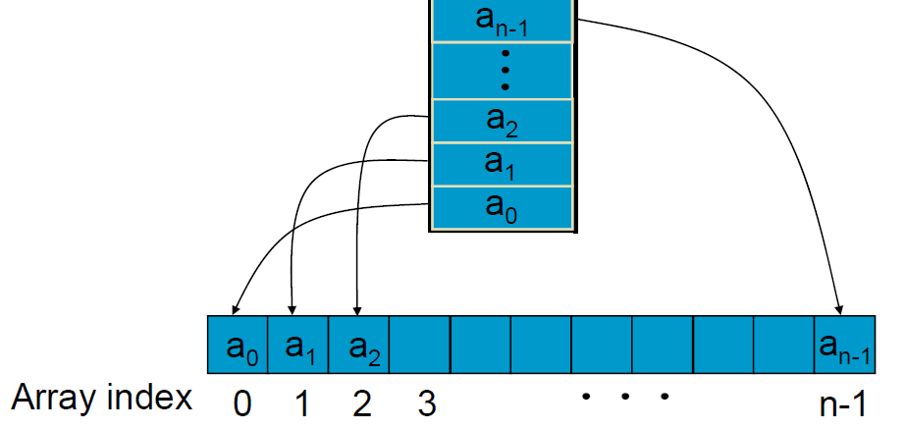
Implementation of Stack by Array
bottom
top
How to check whether a stack is full or empty? – top, capacity

Slide 46
Stacks
a
b
c
d
e
0
1
2
3
4
5
6
top
Stack top is at element e
IsEmpty() => check whether top >= 0
O(1) time
Top() => If not empty return stack[top]
O(1) time

Slide 47
Stacks
a
b
c
d
e
0
1
2
3
4
5
6
top
Push(theElement) =>
If array is not full => O(1) time
If array full (top == capacity – 1) increase capacity and
then add at stack[top+1] => O(capacity) time when full;
Pop() => if not empty, delete from stack[top]
O(1) time

Slide 48
Stack
C
C
top
B
top
B
B
top
A
top
A
A
A
top
push A
push B
push C
pop
Time complexity
push(): Θ(1)
pop(): Θ(1)

Slide 49
Template Stack Implementation
template <class T>
Stack<T>::Stack(int stackCapacity=10):capacity(stackCapacity)
{
if (capacity < 1) throw “Stack capacity must be > 0”;
stack = new T[capacity];
top = -1; // indicate empty stack
}
template <class T>
inline bool Stack<T>:: IsEmpty() const
{ return top == -1;}
template <class T>
inline T& Stack<T>:: top() const
{
if ( IsEmpty() ) throw “Stack is empty”;
return stack[top];
}

Slide 50
Template Stack Implementation
template <class T>
void Stack<T>::Push(const T& x)
{// add x to stack
if (top == capacity - 1) {
ChangeSize1D (stack, capacity, 2 * capacity);
capacity *= 2;
}
stack[++top] = x;
}
template <class T>
void Stack<T>::Pop( )
{
if ( IsEmpty() ) throw “Bag is empty, cannot delete”;
int deletePos = top/2;
stack[top--].~T(); // destructor for T
}

Slide 51
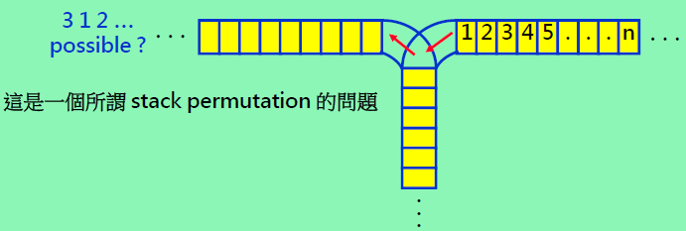
Railroad Switching System
Switching Rule
  Initial: train 1, 2, …, n in the top right track segment
  Movement:
    (1) from top-right to the vertical segment one at a time
    (2) from the vertical to the top-left segment one at a time
    (3) The vertical segment operates like a stack
Question: What output permutations are not possible?

Slide 52
Outline
3.1 Templates in C++
3.2 The stack ADT
3.3 The queue ADT
3.4 Subtyping and inheritance in C++
3.5 A mazing problem
3.6 Evaluation of expressions

Slide 53
Queue
A Queue
  Is an ordered (linear) list
  One end called front
  The opposite end called rear
  Insertions take place at the rear only
  Deletions take place from the front only
  Is also called First-In First-Out (FIFO)
Example
  Given a queue Q = (a₀, a₁,…, a_{n-1})
  a₀ is the front element, a_{n-1} is the rear element
  a_{i} is behind a_{i-1} for 1≦i≦n
  Delete at front, insert at rear

Slide 54
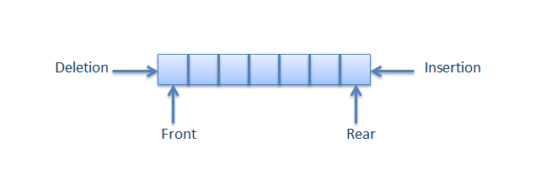







Queue
(Dequeue)
(Enqueue)
Bus Stop Queue
Bus Stop
front
rear
rear
rear
rear
rear

Slide 55

Bus Stop
front
rear
rear
rear
rear
rear
Bus Stop
rear
rear
rear
front
rear
Bus Stop
rear
rear
front
rear
rear

Slide 56
Queue Operations
IsEmpty … return true iff queue is empty
Front … return front element of queue
Rear … return rear element of queue
Push … add an element at the rear of the queue
Pop … delete the front element of the queue

Slide 57
List, Stack, and Queue
Stack & Queue are two frequently used data structures
They are special cases of the more general data structure type, lists
List
(Random add/del)
Stack
(Last In First Out)
Queue
(First In First Out)

Slide 58
Queue in an Array
Use a 1D array to represent a queue
Suppose queue elements are stored with the front element in queue[0], the next in queue[1], and so on.
a
b
c
d
e
0
1
2
3
4
5
6
rear
Pop => remove queue[0], shift left queue one place.
  O(queue size) time
Push => if there is capacity, add at right end
  O(1) time

Slide 59
Queue (Single Pointer)
2
C
rear
1
B
rear
B
C
rear
0
A
rear
A
A
B
rear
Pop
A
push A
push B
push C
pop
rear = -1 => queue empty
the last element in queue[rear]
The front element in queue[0]
Time complexity
push(): Θ(1) (exclusive of array resizing time)
pop(): Θ(size)

Slide 60
Queue (Dual Pointers)
E
rear
D
front
C
rear
C
rear
F
rear
B
B
front
E
A
front
D
front
rear
front
A
C
B
push A, B, C
pop
…
Push F
The last element in queue[rear]
The front element in queue[front]
Time complexity
push(): O(size) (when no array resizing needed)
  When the rear pointer reaches the boundary and a push occurs, data need to be moved
pop(): Θ(1)

Slide 61
Queue (Dual Pointers)
E
rear
D
C
rear
C
rear
front
F
rear
B
B
E
A
front
D
rear
front
front
front
A
C
B
push A, B, C
pop
…
Push F
The last element in queue[rear]
The front element in queue[front+1]
Time complexity
push(): O(size) (when no array resizing needed)
  When the rear pointer reaches the boundary and a push occurs, data need to be moved
pop(): Θ(1)

Slide 62
O(1) Pop and Push
To perform each operation in O(1) time (excluding array doubling), we use a circular representation – circular queue
Use a 1D array queue
Circular view of array
queue[]
[2]
[3]
[1]
[4]
[0]
[5]

Slide 63
Circular Queue
Permit the queue to wrap around the end space
E
rear
E
E
D
D
D
front
front
front
G
rear
F
rear
F
rear
front
Push F
Push G
Time complexity
push(): Θ(1)
pop(): Θ(1)
Note that in this version of circular buffer, the position that the front pointer points to is a dead space. A slot is deliberately unused.
Otherwise, we cannot determine whether the queue is empty or full.

Slide 64
Circular Queue (Circular Illustration)
A
f
r
f
f
r
A
F
G
B
B
E
E
r
C
C
D
B
D
C
r
r
f
f
push A, B, C
pop
…
push F, G
Use integer variables front (f) and rear (r)
front is one position counterclockwise from first element
rear gives position of last element

Slide 65
Push An Element (1/2)
Move rear one clockwise.
[2]
[3]
A
B
front
rear
[1]
C
[4]
[0]
[5]

Slide 66
Push An Element (2/2)
Move rear one clockwise.
Then put into queue[rear].
[2]
[3]
A
B
front
[1]
C
[4]
D
[0]
[5]
rear

Slide 67
Pop An Element (1/2)
Move front one clockwise.
[2]
[3]
A
B
front
rear
[1]
C
[4]
[0]
[5]

Slide 68
Pop An Element (2/2)
Move front one clockwise.
Then extract from queue[front].
front
[2]
[3]
A
B
rear
[1]
C
[4]
[0]
[5]

Slide 69
Moving rear Clockwise
rear++;
if (rear = = capacity) rear = 0;
[2]
[3]
A
B
front
rear
[1]
C
[4]
[0]
[5]
rear = (rear + 1) % capacity;

Slide 70
Empty That Queue (1/4)
[2]
[3]
rear
front
C
[1]
[4]
B
A
[0]
[5]

Slide 71
Empty That Queue (2/4)
[2]
[3]
rear
C
[1]
[4]
B
[0]
[5]
front

Slide 72
Empty That Queue (3/4)
[2]
[3]
rear
C
[1]
[4]
[0]
[5]
front

Slide 73
Empty That Queue (4/4)
[2]
[3]
rear
[1]
[4]
front
[0]
[5]
When a series of removes causes the queue to become empty, front = rear.
When a queue is constructed, it is empty.
So initialize front = rear = 0.

Slide 74
A Full Tank Please (1/4)
[2]
[3]
rear
front
C
[1]
[4]
B
A
[0]
[5]

Slide 75
A Full Tank Please (2/4)
rear
[2]
[3]
D
front
C
[1]
[4]
B
A
[0]
[5]

Slide 76
A Full Tank Please (3/4)
[2]
[3]
rear
D
E
front
C
[1]
[4]
B
A
[0]
[5]

Slide 77
A Full Tank Please (4/4)
[2]
[3]
D
E
front
C
F
[1]
[4]
B
A
rear
[0]
[5]
When a series of adds causes the queue to become full, front = rear.
So we cannot distinguish between a full queue and an empty queue!

Slide 78
Ouch!!!!! Remedies
Don’t let the queue get full.
  When the addition of an element will cause the queue to be full, increase array size.
  This is what the text does.
Define a boolean variable lastOperationIsPush.
  Following each push set this variable to true.
  Following each pop set to false.
  Queue is empty iff (front == rear) && !lastOperationIsPush
  Queue is full iff (front == rear) && lastOperationIsPush
Define an integer variable size.
  Following each push do size++.
  Following each pop do size--.
  Queue is empty iff (size == 0)
  Queue is full iff (size == arrayLength)
Performance is slightly better when first strategy is used.

Slide 79
Queue ADT
template < class T >
class Queue
{
public:
Queue (int queueCapacity = 0);
bool IsEmpty( ) const;
void Push(const T& item);
// add an item into the queue
void Pop( );
// delete an item
T& Front() const;
// return top element of stack
T& Rear() const;
// return top element of stack
} ;

Slide 80
Template Queue Implementation
template < class T >
class Queue{
public:
Queue (int queueCapacity = 0);
bool IsEmpty( ) const;
void Push(const T& item);
// add an item into the queue
void Pop( );
// delete an item
T& Front() const;
// return top element of stack
T& Rear() const;
// return top element of stack
private:
T* queue;
int front,
rear,
capacity;
} ;

Slide 81
Template Queue Implementation
template < class T >
Queue<T>::Queue(int queueCapacity = 10):capacity(queueCapacity)
{
if (capacity < 1) throw “Queue capacity must be > 0”;
queue= new T[capacity];
front = rear = 0; // indicate empty stack
}
template <class T>
inline bool Queue<T>:: IsEmpty() const
{
return front == rear;
}

Slide 82
Template Queue Implementation
template <class T>
inline T& Queue<T>:: Front() const
{
if ( IsEmpty() ) throw “Queue is empty. No front element.”;
return queue[(front + 1) % capacity];
}
template <class T>
inline T& Queue<T>:: Rear() const
{
if ( IsEmpty() ) throw “Queue is empty. No rear element.”;
return queue[rear];
}

Slide 83
Template Queue Implementation
template <class T>
void Queue<T>::Push(const T& x)
{// add x to stack
if ((rear + 1) % capacity == front)
{ T* newQu = new T[2*capacity];
int start = (front+1) % capacity;
if(start<2)
copy(queue +start, queue+start+capacity-1, newQu);
else{
copy(queue +start, queue+capacity, newQu);
copy(queue, queue+rear+1,newQu+capacity-start);
}
front = 2*capacity – 1;
rear = capacity -2;
delete[] queue;
queue = newQu;
}
rear = (rear+1)%capacity; queue[rear] = x;
}

Slide 84
Template Queue Implementation
template <class T>
void Queue<T>::Pop( )
{
if ( IsEmpty() ) throw “Queue is empty, cannot delete”;
front = (front + 1) % capcity;
front].~T(); // destructor for T
}

Slide 85
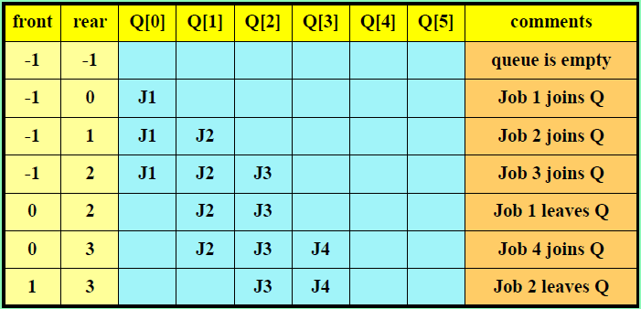
Example: Job Scheduling
In Operating System
  jobs are processed in the order they enter the system if no priority is set on jobs

Slide 86
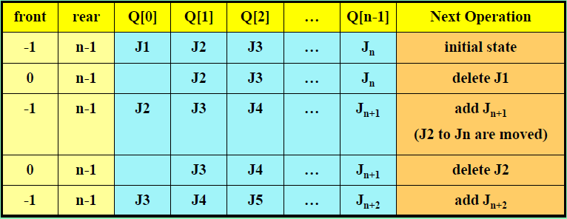
Worst-Case Scenario
In the above job scheduling, it takes n-1 steps to add a new job

Slide 87
DeQue
Definition
  A double-ended queue (Deque) is a linear list in which additions and deletions may be made at either end
Practices
  Design a data representation that maps a deque into a one-dimensional array
  Write algorithms to add and delete elements from either end of the queue

Slide 88
Outline
3.1 Templates in C++
3.2 The stack ADT
3.3 The queue ADT
3.4 Subtyping and inheritance in C++
3.6 Evaluation of expressions
3.5 A mazing problem

Slide 89
Relationships Between Things
We abstract things on two key dimensions
  IS-A relationship
  HAS-A relationship
Real world examples
  iPhone is a smartphone. iPhone has a battery
  NTHU is a university. NTHU has a Math department
ADT examples
  Rectangle is a Polygon. Rectangle has a height dimension
  Stack is a Bag. Stack has a top pointer
    Stack is a specialized bag that requires elements to be deleted in the LIFO order

Slide 90
Subtype / IS-A / Subclass
Subtype
  Equivalent concept to the IS-A relationship
    Rectangle is a subtype of Polygon
  Since C++ use classes to denote data types, subtypes are also widely referred to as subclasses
Subtype is conceptual relationship between ADT specifications
  "Stack IS A Bag" is true regardless of the implementation

Slide 91
Inheritance
Use
  Express IS-A relationships between classes
  Derive a new class (derived class / sub type / sub class) from an existing class (base class)
Objective
  Eliminate redundant implementation
    Members (data and functions) are by default inherited from a base class to a derived class
Different inheritance styles
  Public inheritance
    Access levels (public/protected/private) of the members are also inherited
  Protected inheritance
  Private inheritance
Shape
Polygon
Ellipse
Triangle
Rectangle

Slide 92
Effects of Inheritance
Stack inherits from Bag
  Stack must redefine its constructors and destructors
  Stack can redefine its unique data and functions (pop and top)
  Stack inherits all the other data and functions of Bag
Class Bag
{
public:
Bag (int bagCapacity = 10);
virtual ̃Bag( );
virtual int Size( ) const;
virtual bool IsEmpty( ) const;
virtual int Element( ) const;
virtual void Push(const int);
virtual void Pop( );
protected:
int *array;
int top;
};
class Stack : public Bag
{
public:
Stack (int stackCapacity = 10);
~Stack( );
int Top( ) const;
void Pop( );
protected:
};

Slide 93
Usage Example of Derived Classes
Bag b(4); // invoke Bag constructor
Stack s(7); // invoke Stack constructor, which also invokes Bag constructor
b.Push(2017); // use Bag::Push()
s.Push(330); // Stack does not contains a specialized Push(), so use Bag::Push
b.Pop(); // use Bag::Pop()
s.Pop(); // Stack contains a specialized Pop() overriding Bag::Pop(), so use Stack::Pop()
Class Bag
{
public:
Bag (int bagCapacity = 10);
virtual ̃Bag( );
virtual int Size( ) const;
virtual bool IsEmpty( ) const;
virtual int Element( ) const;
virtual void Push(const int);
virtual void Pop( );
protected:
int *array;
int top;
};
class Stack : public Bag
{
public:
Stack (int stackCapacity = 10);
~Stack( );
int Top( ) const;
void Pop( );
protected:
};

Slide 94
Syntax of Implementing Derived Classes
Stack::Stack(int stackCapacity)
: Bag(stackCapacity)
// explicitly call to the Bag constructor that has arguments
{
// here is code specifically for creating a stack, if any
}
int Stack::Stack( )
{ // here is code specifically for destroying a stack, if any
}
//Bag destructor is automatically called when a stack is destroyed
int Stack::Top( ) const
{
if (IsEmpty( )) throw "Stack is empty.";
return array[top];
}
void Stack::Pop( )
{
if (IsEmpty( )) throw "Stack is empty. Cannot delete.";
top--;
}

Slide 95
Outline
3.1 Templates in C++
3.2 The stack ADT
3.3 The queue ADT
3.4 Subtyping and inheritance in C++
3.5 A mazing problem
3.6 Evaluation of expressions

Slide 96
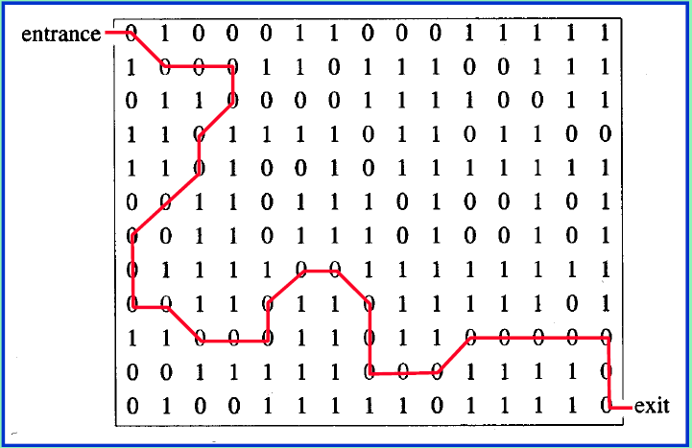
An Example Maze
15 x 12 maze

Slide 97
How a Computer Traverses a Maze
(0, 0)
(0, 0)
(1, 0)
(2, 0)
右
下
(0, 1)
(1, 1)
(2, 1)
(0, 1)
(1, 0)
右
右
(0, 2)
(1, 2)
(2, 2)
(1, 1)
(2, 0)
右
右 > 下 > 上 > 左
(2, 1)
下
(2, 1)

Slide 98
A Mazing Problem
j
1 | 1 | 1 | 1 | 1 | 1 | 1 | 1 | 1 | 1 | 1 | 1 | 1
1 | 0 | 0 | 1 | 0 | 1 | 1 | 0 | 1 | 0 | 1 | 1 | 1
1 | 1 | 1 | 0 | 1 | 0 | 0 | 0 | 1 | 0 | 1 | 1 | 1
1 | 1 | 0 | 1 | 0 | 1 | 0 | 1 | 0 | 1 | 0 | 1 | 1
1 | 1 | 1 | 1 | 0 | 0 | 0 | 1 | 0 | 1 | 1 | 1 | 1
1 | 1 | 0 | 1 | 1 | 0 | 1 | 1 | 1 | 0 | 1 | 1 | 1
1 | 1 | 1 | 0 | 1 | 0 | 1 | 1 | 1 | 0 | 1 | 1 | 1
1 | 1 | 0 | 0 | 1 | 1 | 0 | 0 | 1 | 1 | 0 | 0 | 1
1 | 1 | 1 | 1 | 1 | 1 | 1 | 1 | 1 | 1 | 1 | 1 | 1
i
Maze
  Is represented as a two-dimensional array maze[i][j]
  maze[i][j]=0: location that can be passed through
  maze[i][j]=1: blocked location
  Entrance: maze[1][1]
  Exit: maze[m][p]
To model border condition
  The array is declared as maze[m+2][p+2]
  i.e., the original maze array is surrounded by a border of ones
NW | N | NE
W |  | E
SW | S | SE

Slide 99
A Mazing Problem
1 | 1 | 1 | 1 | 1 | 1 | 1 | 1 | 1 | 1 | 1 | 1 | 1
1 | 0 | 0 | 1 | 0 | 1 | 1 | 0 | 1 | 0 | 1 | 1 | 1
1 | 1 | 1 | 0 | 1 | 0 | 0 | 0 | 1 | 0 | 1 | 1 | 1
1 | 1 | 0 | 1 | 0 | 1 | 0 | 1 | 0 | 1 | 0 | 1 | 1
1 | 1 | 1 | 1 | 0 | 0 | 0 | 1 | 0 | 1 | 1 | 1 | 1
1 | 1 | 0 | 1 | 1 | 0 | 1 | 1 | 1 | 0 | 1 | 1 | 1
1 | 1 | 1 | 0 | 1 | 0 | 1 | 1 | 1 | 0 | 1 | 1 | 1
1 | 1 | 0 | 0 | 1 | 1 | 0 | 0 | 1 | 1 | 0 | 0 | 1
1 | 1 | 1 | 1 | 1 | 1 | 1 | 1 | 1 | 1 | 1 | 1 | 1
Allowable moves
  Non-blocked squares of the
  eight neighboring squares
How can a program get
through the maze?
NW | N | NE
W |  | E
SW | S | SE

Slide 100
Strategy of Searching
As a rat walks through the maze
  (1) He picks a valid move from the current position
    e.g., starting from north and looking clockwise
  (2) Put the selected move into a stack
    So that he can return from a dead path
  (3) He learns not to make the same mistake twice
    Avoid getting into a cell visited before
    A 2-dimensional array, mark[m+2][p+2] is used
    The mark array records the cells visited before

Slide 101
Allowable Moves
j
q |  | move[q].di | move[q].dj
0 | N | −1 | 0
1 | NE | −1 | 1
2 | E | 0 | 1
3 | SE | 1 | 1
4 | S | 1 | 0
5 | SW | 1 | −1
6 | W | 0 | −1
7 | NW | −1 | −1
i
NW | N | NE
W |  | E
SW | S | SE

Slide 102
Algorithm (Pseudo Code)
The coordinates of the next move is computed by the following data structure
struct Offsets
{
int di, dj;
}
enum directions {N, NE, E, SE, S, SW, W, NW};
Offsets move[8];
struct Items
{
int x, y, dir;
}
q | move[q].di | move[q].dj
N | −1 | 0
NE | −1 | 1
E | 0 | 1
SE | 1 | 1
S | 1 | 0
SW | 1 | −1
W | 0 | −1
NW | −1 | −1
NW | N | NE
W |  | E
SW | S | SE

Slide 103
Algorithm ()
initialize a stack // remember the point to retract
add the starting point, (0, 1, E), to the stack
while (the stack is not empty) { // there are still unexplored points
(i, j, dir) = the top of the stack;
remove the top of the stack;
while(there are more move from (i, j)){
(g, h) = nextPoint((i, j), dir);
if ((g == m) && (h == p)) return success;
if ((!maze [g][h]) && (!mark [g][h])) {
dir = Next(dir);
add (i, j, dir) to the stack; // prepare for a dead end
(i, j, dir) = (g, h, N); // move to (g, h), start from dir N
mark[i][j] = 1;
}
}
}
cout << "No path in maze." << endl;
Each position can be visited at most once.
At most eight valid moves from each position
🡪 O(size of the array) time

Slide 104
Use a Stack to Keep Pass History
What is the maximal size of the stack?
  A maze is represented by a two dimensional array maze[m][p]
  Since each position is visited at most once, at most m×p elements can be placed in the stack
typedef struct {
int x;
int y;
int dir;
} Item;
Item mazestack[m*p];
#include <stack>
typedef struct {
int x;
int y;
int dir;
} Item;
stack<Item> mazestack;

Slide 105
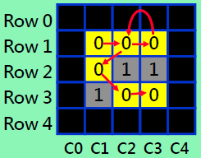
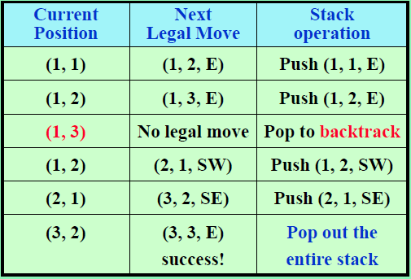
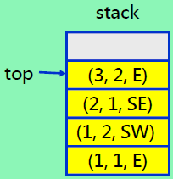
Example: A Mazing Problem
Complete path:
(3, 3) ← (3, 2, E) ← (2, 1, SE) ← (1, 2, SW) ← (1, 1, E)
stack right before success

Slide 106
Algorithm (Pseudo Code)
void driver()
{
if (findPath(0, 1))
cout << “Success" << endl;
else
cout << "No path in maze." << endl;
return;
}
bool findPath(int i, int j) // find a path starting from (i, j)
{
for (all eight directions) { // explore all directions
(g, h) = (i, j) + direction;
if ((g == m) && (h == p)) return true;
if ((!maze [g][h]) && (!mark [g][h])) {
findPath(g, h); // keep finding a path…
}
}
return false;
}

Slide 107
Program 3.16
void Path(const int m, const int p)
{// 輸出迷宮的一個路徑（如果有的話）； maze[0][i] = maze[m+1][i] =
// maze[j][0] = maze[j][p+1] = 1, 0 ≤ i ≤ p+1, 0 ≤ j ≤ m+1。
// 從 (1, 1) 開始
mark[1][1] = 1;
Stack<Items> stack(m*p);
Items temp(1, 1, E);
// 設定 temp.x、temp.y、與temp.dir
Stack.Push(temp);
while (!stack.IsEmpty( ))
{ // 堆疊不是空的
temp = stack.Top( );
stack.Pop( ); // 彈出
int i = temp.x; int j = temp.y; int d = temp.dir;

Slide 108
while (d < 8) // 往前移動
{
int g = i + move[d].di; int h = j + move[d].dj;
if ((g = = m) && (h = = p)) { // 抵達出口
{
cout << stack; // 輸出路徑
cout << i << " " << j << endl; // 路徑上的上兩個方塊
cout << m << " " << p << endl;
return;
}
if ((!maze [g ][h]) && (!mark [g ][h])) // 新位置
{ mark[g][h] = 1;
temp.x = i; temp.y = j; temp.dir = d+1;//try new direction
stack.Push(temp); // 加入堆疊
i = g; j = h; d = N; // 移到 (g, h)
}
else d++; // 試下一個方向
}
}
cout << "No path in maze." << endl;
}

Slide 109
Stack Provided by C++ Library
#include <iostream>
#include <stack>
using namespace std;
int main()
{
stack<int> s;
for(int i=0; i < 5; i++){
s.push(i);
}
while(!s.empty())
{
cout << s.size() << " ";
cout << s.top() << endl;
s.pop();
}
}
output
5 4
4 3
3 2
2 1
1 0
Reference of STL's Stack
http://en.cppreference.com/w/cpp/container/stack

Slide 110
Outline
3.1 Templates in C++
3.2 The stack ADT
3.3 The queue ADT
3.4 Subtyping and inheritance in C++
3.5 A mazing problem
3.6 Evaluation of expressions

Slide 111
Types of Expression
Arithmetic Expression
  For example: X = A/B – (C + D * E – A * C)
  The evaluation of this expression is critical in enabling high level programming
  An expression consists of
    Operands: A, B, C, D, E
    Operator: plus, minus, multiply, and divide
    Delimiter: like parenthesis “(“, “)”
Boolean Expression (relational + logical + compound)
  The result is TRUE or FALSE
  Use relational and logical operators
    Relational operator: <, <=, >, >=, ==, !=,
    Logical operator: &&, ||, !

Slide 112
Evaluation of Expressions
Arithmetic expressions
  X = (A / B) – C + D * E – A * C
Boolean expressions
  X = (A == B) || !(C>D)
Expressions are made up of
  Operands: A, B, C, D, E
  Operators:
    Binary arithmatic operators: +, -, *, /, %
    Unary arithmatic operators: -
    Relational operators: <, <=, ==, !=, >=, >
    Binary logical operators: &&, ||
    Unary logical operators: !
  Delimiters: (, )

Slide 113
Evaluation of Expressions
Let's focus on an arithmetic expression
  X = A / B – C + D * E – A * C
Order of evaluation matters
  Let A = 4, B = C = 2, D = E = 3
  Interpretation 1:
  ((4/2)–2)+(3*3)–(4*2) = 0 + 9 – 8 = 1
  Interpretation 2:
  (4/(2–2+3))*(3–4)*2 = (4/3)*(–1)*2 = -2.666…
How can computers uniquely define the order of evaluation of an expression?
operator precedence (priority) rule + associative rule

Slide 114
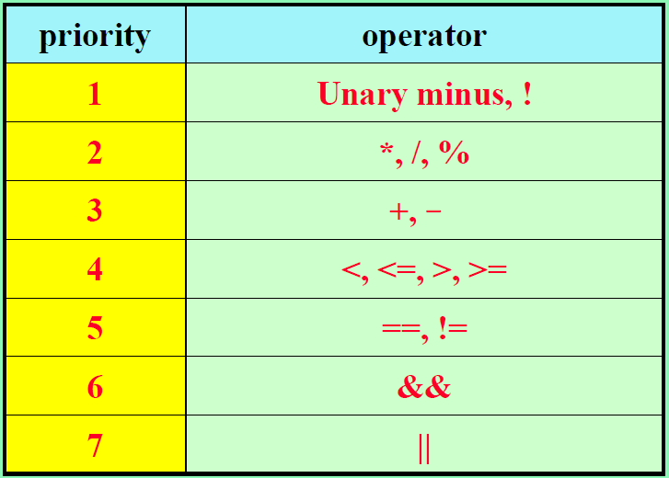
Priority of Operators
Evaluation of operators of the same priority will proceed from left to right, e.g., A/B*C → (A/B) * C

Slide 115
Priority of Operators (cont.)
Priority is introduced to help defining the order
    Tie break rule: left to right
  Example
    A / B – C + D * E – A * C 🡪 (A/B) – C + (D*E) – (A*C)
    A/B*C/D 🡪 ((A/B)*C)/D Tie-break rule
Two operators compete for one operand
'/' and '*' win

Slide 116
Infix, Prefix, and Postfix Notations
Infix
  Each Binary operators come in-between their operands
  e.g., 2*3, A*B/C
Postfix
  Binary operators appear after their operands
  e.g., 23*, AB*C/
Prefix
  Binary operators appear before their operands
  e.g., *23, /*ABC
Compiler
  Translates an expression into a sequence of machine codes
  It first re-writes the expression into a form called postfix notation, and then evaluate postfix notation.

Slide 117
Evaluation of Expressions
user
computer
Infix | Postfix
2+3*4 | 234*+
a*b+5 | ab*5+
(1+2)*7 | 12+7*
a*b/c | ab*c/
(a/(b-c+d))*(e-a)*c | abc-d+/ea *c*
a/b-c+d*e-a*c | ab/c-de*+ac*-
Postfix & prefix: no parentheses, no precedence

Slide 118


Two Essential Algorithms
Combining two algorithms enables computers to handle human-written expressions
  Phase 1: Infix-to-Postfix conversion
  Phase 2: Postfix evaluation (just mentioned)
Infix
Postfix
  A/B-C+D*E-A*C
Conversion
algorithm
  AB/C-DE*+AC*-
Evaluation
Expressions

Slide 119
Evaluation of Expression Example
Phase 1: Infix to postfix conversion
6/2-3+4*2 → 6 2 / 3 – 4 2 * +
Phase 2: Postfix expression evaluation
6 2 / 3 – 4 2 * + → 6 2 / 🡪 3
3 3 - 🡪 0
0 4 2 * 🡪 4 2 * 🡪 8
0 8 + 🡪 8

Slide 120
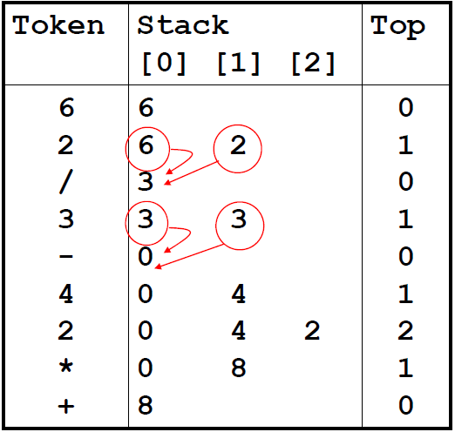
Phase 2: Postfix expression evaluation
6 2 / 3 – 4 2 * +

Slide 121
Postfix Evaluation
Rules
  Left to right scan
  Push operands onto a stack
  Evaluate operators using the required number of operands from the stack
  Push the evaluating results onto the stack again
  AB/C-DE*+AC*-# (# denotes the end of an expression)
/
-
*
+
*
-
#
E
C
B
C
D
T₃
A
T₅
A
T₁
T₁
T₂
T₂
T₂
T₄
T₄
T₄
T₆

Slide 122
Advantages of Postfix Notation
Evaluation is simpler than infix notation
  The need for parenthesis is gone
  The need for operator priority is gone
void Eval(Expression e)
{
Stack<Token> stack; // initialize a stack
for (Token x = NextToken(e); x!= end of expression; x=NextToken(e))
{
if (x is an operand) {
stak.Push(x)
} else {// x is an operator
pop from the stack the correct number of operands for the operator;
perform the operation x and store the result (if any) onto the stack;
}
}

Slide 123
Two Essential Algorithms
Combining two algorithms enables computers to handle human-written expressions
  Infix-to-Postfix conversion
  Postfix evaluation (just mentioned)
Infix
Postfix
  A/B-C+D*E-A*C
Conversion
algorithm
  AB/C-DE*+AC*-
Evaluation
Expressions

Slide 124


Infix to Postfix Conversion
Observations
  Number of operands and operators do not change
  Order of operands (A, B, C…) do not change
Infix
Postfix
  A/B-C+D*E-A*C
Conversion
algorithm
  AB/C-DE*+AC*-

Slide 125
Infix to Postfix Conversion
Method 1
  Fully parenthesize the expression (based on the operator priorities)
  Move all operators so that they replace their corresponding right parentheses
  Delete all parentheses
  A/B-C+D*E-A*C
  ( ( ( (A/B)-C)+(D*E) )-(A*C) )
  ( ( ( (AB/C-(DE* +(AC* -
  AB/C-DE*+AC* -

Slide 126
Infix to Postfix Conversion
Stack-based algorithm
  Create a stack
  Scan the input infix expression left to right
  Bypass each incoming operand to the output
  For each incoming operator
    First, continuously pop from the stack an operator (the top) if the top has equal or lower priority than the incoming operator
    Then, push the incoming operator onto the stack
  Pop all operators upon the end of an expression
Example: A + B * C
*
*
+
+
+
+
A
A
AB
AB
ABC
ABC*+

Slide 127
Parentheses Handling
We want the stack algorithm to handle parentheses similarly to handling operators
Specialized rules for left parenthesis
  Incoming left parenthesis has the highest priority (i.e., always gets pushed onto the stack)
    In-coming priority (ICP) = 0
  Only gets popped from the stack upon a matched right parenthesis
  Otherwise, behaves as one with the lowest priority
    In-stack priority (ISP) = 8
Priority | Operator
0 | In-coming (
1 | Unary minus (負號), !
2 | *, /, %
3 | +, -
4 | <, <=, >=, >
5 | = =, !=
6 | &&
7 | ||
8 | In-stack (

Slide 128
Example
A*(B+C)/D
Incoming token | Stack | Output | Note
Empty | Empty | Empty
A
*
(
B
+
C
)
/
D
Done

Slide 129
Example
A*(B+C)/D
Incoming token | Stack | Output | Note
Empty | Empty | Empty
A | Empty | A | Bypass operands
* | *
( | *( |  | ICP('(') higher than ISP('*')
B | *( | AB | Bypass operands
+ | *(+ |  | ICP('+') higher than ISP('(')
C | *(+ | ABC | Bypass operands
) | * | ABC+ | Pop until a left parenthesis
/ | / | ABC+* | ICP('/') == ISP('*')
D | / | ABC+*D | Bypass operands
Done | Empty | ABC+*D/ | Pop all operators

Slide 130
Recap Infix to Postfix Conversion
A B C
2
incoming operands always bypasses the stack
A + B * C
1
left to right scan
+ - * /
+ - * /
4
incoming operators always enters the stack
3
continuously pop top operator from the stack if it has equal or higher priority than the incoming ones

Slide 131
Recap Parenthesis Handling
Incoming left parenthesis has the highest priority
  It always enters the stack without popping any stacked operator
In-stack left parenthesis has the lowest priority
  It never gets popped from the stack until the right parenthesis appears
Different perspective ¹
  Left parenthesis creates an isolated, nested stack
  Right parenthesis cleans up a nested stack
A+B*(C+D)
+
*
+
1. Contributed by Mr. 陳德暉 (101061132) on April 2, 2015

Slide 132
Infix to Postfix Algorithm
void Postfix(Expression e)
{
Stack<Token>stack; // initialize the stack
stack.Push('#');
for (Token x = NextToken(e); x != '#'; x = NextToken(e))
if (x is an operand) cout << x;
else if (x == ')' ) { // pop until a left parenthesis
for (;stack.Top( ) != '('; stack.Pop( ))
cout << stack.Top( );
stack.Pop( ); // remove the left parenthesis
} else { // x is a operator
for (; isp(stack.Top( )) <= icp(x); stack.Pop( ))
cout << stack.Top( );
stack.Push(x);
}
// end of expression; empty the stack
for ( ; !stack.IsEmpty( ); cout << stack.Top( ), stack.Pop( ));
cout << endl;
}
// higher or equal priority

Slide 133
Limitations of the Current Algorithm
Characters to tokens conversion (parser)
  Energy = Mass * LightSpeed * LightSpeed
  Area = 3.14*radius1*radius2
Grammar
  X = A - B + -A
  computers need rules to differentiate the two minus symbols; Otherwise, the aforementioned postfix algorithm cannot work correctly.
More techniques are available in a compiler course

