Slide 1
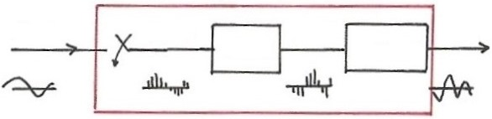
7.0 Sampling
      7.1 The Sampling Theorem
  A link between Continuous-time/Discrete-time Systems
x(t)
y(t)
Sampling
x[n]
y[n]
h(t)
h[n]
    x[n]=x(nT), T : sampling period
h(t)
x(t)
x[n]
y[n]
y(t)
h[n]
Recovery

Slide 2
  Motivation: handling continuous-time signals/systems
  digitally using computing environment
      accurate, programmable, flexible,
      reproducible, powerful
        compatible to digital networks and relevant
        technologies
        all signals look the same when digitized,
        except at different rates, thus can be supported by a single network
  Question: under what kind of conditions can a
  continuous-time signal be uniquely specified by its discrete-time samples?
  See Fig. 7.1, p.515 of text
      Sampling Theorem

Slide 3
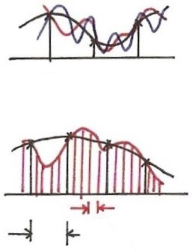




Recovery from Samples ?
$$n$$
0
1
2
$$t$$
$$T$$
$$T$$

Slide 4
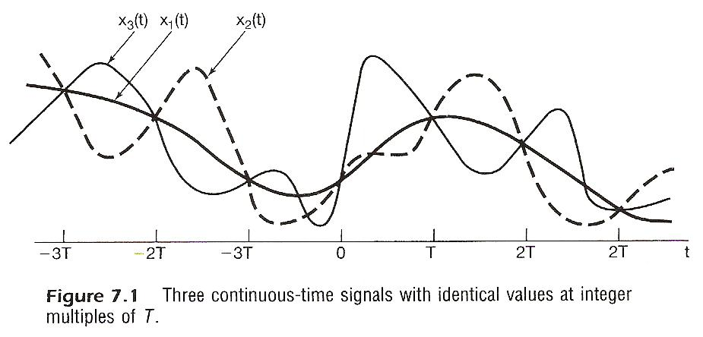

Slide 5
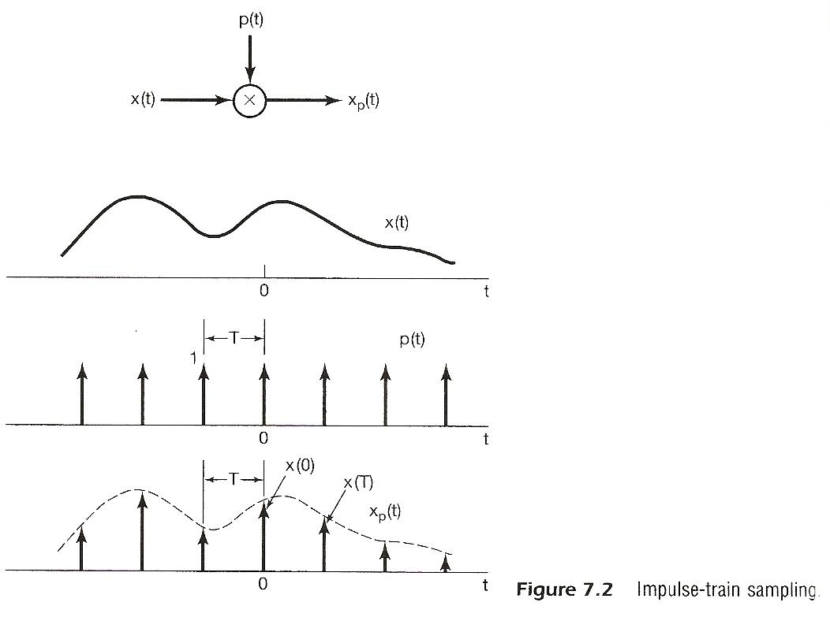

Slide 6
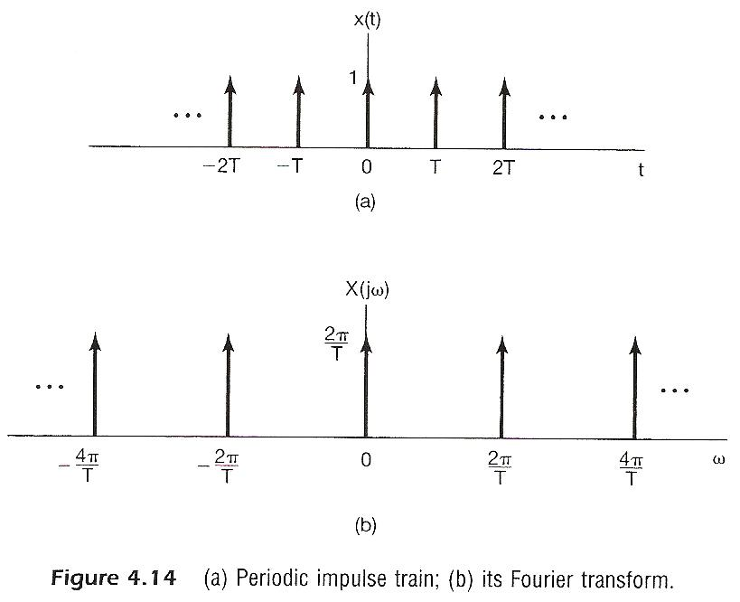

Slide 7
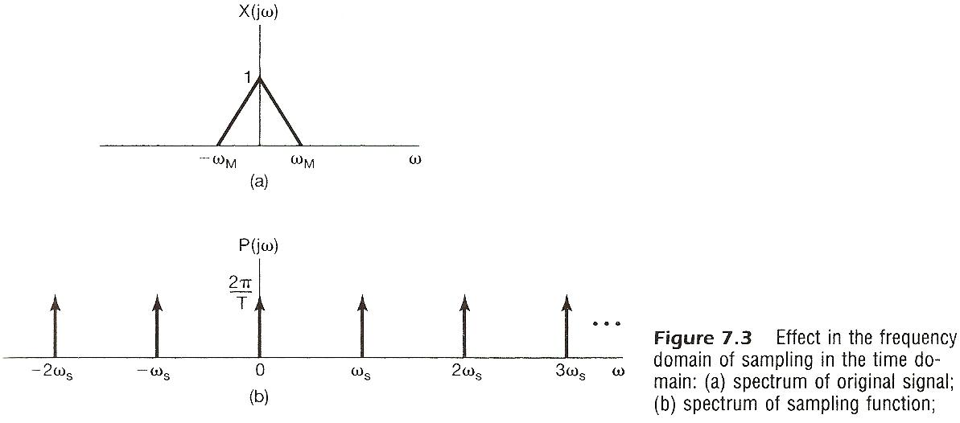

Slide 8
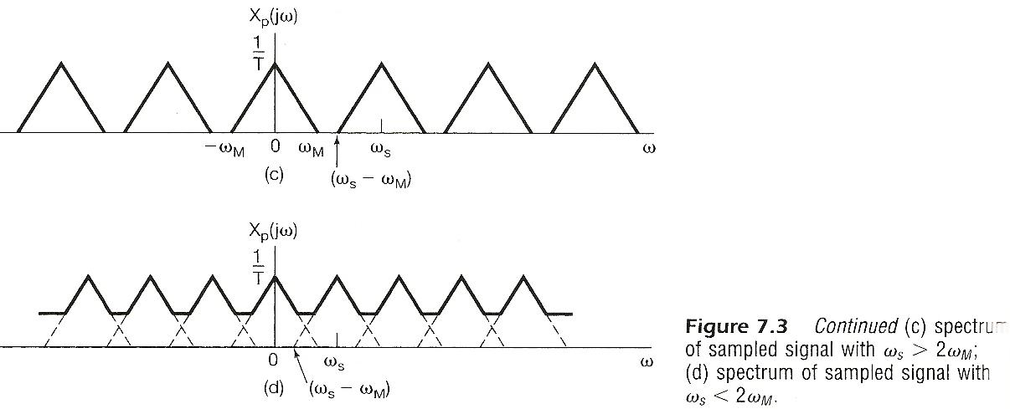

Slide 9
Impulse Train Sampling
    See Fig. 4.14, p.300 of text
    periodic spectrum, superposition of scaled, shifted replicas of X(jω)
    See Fig. 7.3, p.517 of text

Slide 10
Impulse Train Sampling
Sampling Theorem (1/2)
  x(t) uniquely specified by its samples x(nT), n=0, ±1, ±2……
  precisely reconstructed by an ideal lowpass filter with Gain T and cutoff frequency ω_{M} < ω_{c} < ω_{s}- ω_{M}
  applied on the impulse train of sample values
    See Fig. 7.4, p.519 of text

Slide 11
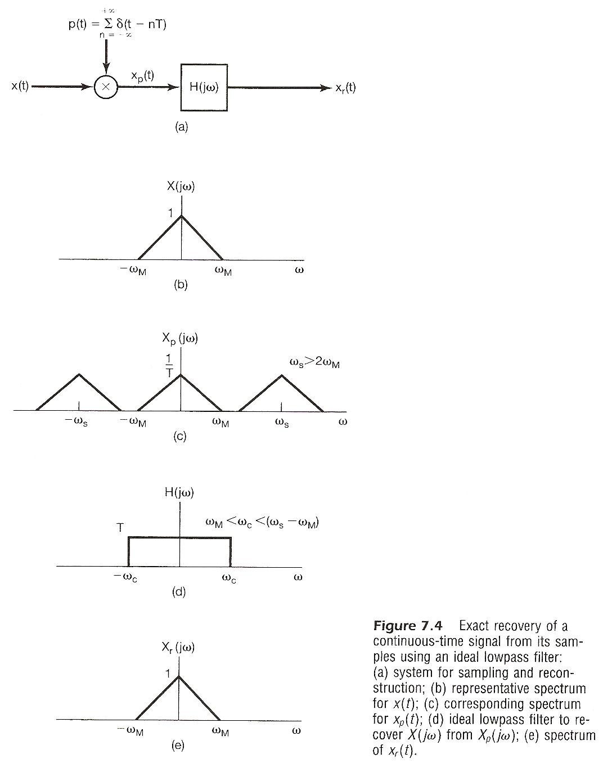

Slide 12
Impulse Train Sampling
Sampling Theorem (2/2)
  if ω_{s} ≤ 2 ω_{M}
  spectrum overlapped, frequency components confused --- aliasing effect
  can’t be reconstructed by lowpass filtering
    See Fig. 7.3, p.518 of text

Slide 13
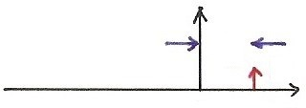
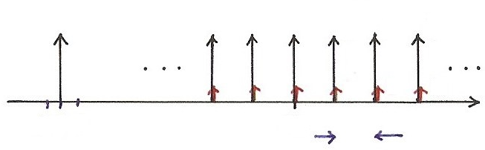
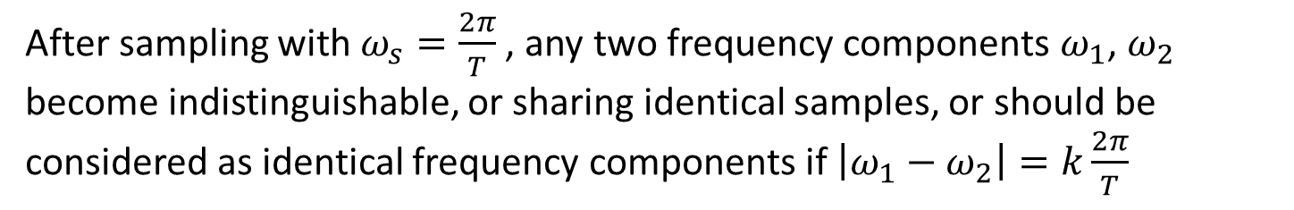


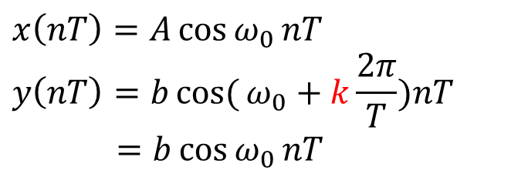



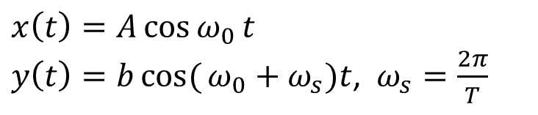

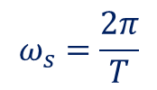




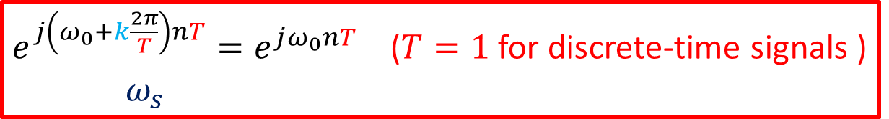




Aliasing Effect
$$x\left(t\right)=A\cos{ω_{0}}t$$
$y\left(t\right)=bcos({ω_{0}+ω_{s}})t$, $ω_{s}=\frac{2π}{T}$
$$x\left(nT\right)=A\cos{ω_{0}}nT$$
$$y\left(nT\right)=bcos({ω_{0}+k\frac{2π}{T}})nT$$
$=b\cos{ω_{0}}nT$
$$A$$
$$A$$
$$A$$
$$A$$
$$ω_{s}$$
$$b$$
$$b$$
$$b$$
$$b$$
$$ω_{0}$$
$$ω$$
$$ω$$
$$ω_{0}+ω_{s}$$
0 0 0
$$ω_{0}$$
$$ω_{s}=\frac{2π}{T}$$
After sampling with $ω_{s}=\frac{2π}{T}$ , any two frequency components $ω_{1}$, $ω_{2}$ become indistinguishable, or sharing identical samples, or should be considered as identical frequency components if $\left|ω_{1}−ω_{2}\right|=k\frac{2π}{T}$
$e^{j\left(ω_{0}+k\frac{2π}{T}\right)nT}=e^{jω_{0}nT}$ ($T=1$ for discrete-time signals )
$ω_{s}$

Slide 14
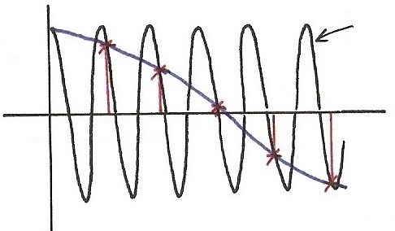
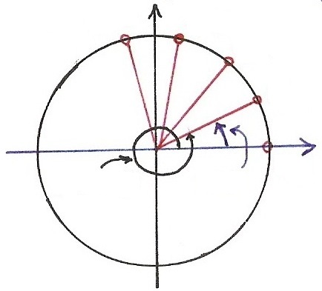
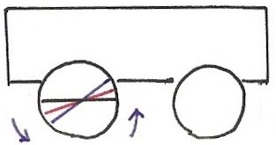




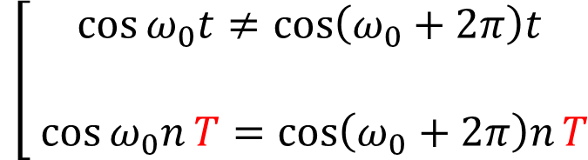




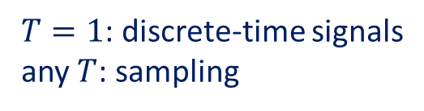











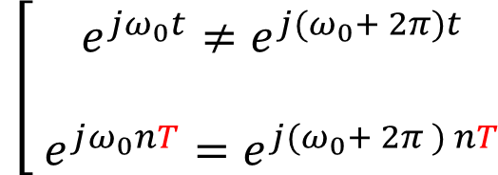




Continuous/Discrete Sinusoidals (p.36 of 1.0)
$$T$$
$$\cos{[\left(ω_{0}+2π \right) t }]$$
$$\cos{[⋅]}$$
$T=1$: discrete-time signals
any $T$: sampling
$$\overline{ T }$$
$∥$
$$nT$$
4
5
$$t,n$$
$$\left[\begin{aligned}\cos{ω_{0}t}≠\cos\left(ω_{0}+2π\right)t \\ \\ \cos{ω_{0}n}T=\cos\left(ω_{0}+2π\right)nT\end{aligned}\right.$$
0
1
2
3
$$\overline{ T }$$
$$nT$$
$$∥$$
$$\overline{ T }$$
$$\cos{[ω_{0} t ]}$$
$$\left[\begin{aligned} e^{jω_{0}t}≠e^{j{(ω}_{0}+ 2π)t} \\ \\ e^{jω_{0}nT}=e^{j{(ω}_{0}+ 2π ) nT}\end{aligned}\right.$$
$$Im$$
$$\overline{ T }$$
$$n=4$$
$$n=3$$
$$n=2$$
$$\overline{ T }$$
$$e^{j[⋅]}$$
$$n=1$$
$$Re$$
$$ω_{0}t$$
$$n=0$$
$${(ω}_{0}+2π)t$$
$$\overline{ T }$$

Slide 15
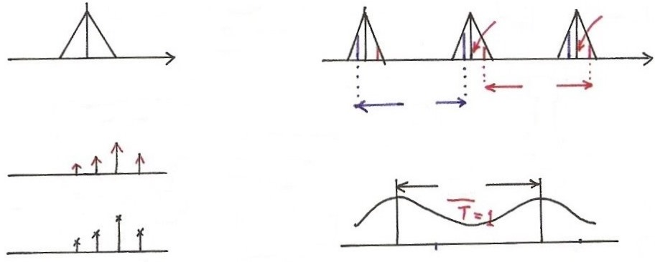



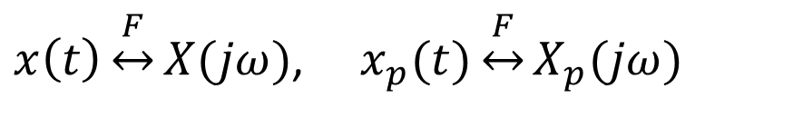



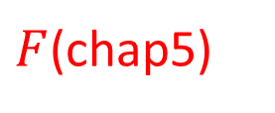

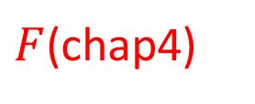











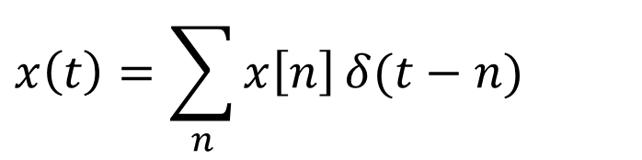

Sampling
sampling
$x\left(t\right)\underset{↔}{F}X(jω)$, $x_{p}(t)\underset{↔}{F}X_{p}(jω)$
$$X_{p}(jω)$$
$$X(jω)$$
$$2ω_{s}$$
$$ω_{s}$$
sampling
$$ω$$
$$ω$$
0
0
$$x\left(t\right)=\sum_{n}{x\left[n\right]}δ(t−n)$$
$$ω_{s}$$
$$ω_{s}$$
$$\frac{2π}{T}$$
$(=2π$, if $T=1)$
$F$(chap4)
$$t$$
0 1 2 3
$$2π$$
$$x[n]$$
$F$(chap5)
$$ω$$
$$n$$
$$ω_{0}$$
0 1 2 3
$$e^{jω_{0}n}$$
$$e^{j\left(ω_{0}+2π\right)n}$$
$$\overline{ T }=1$$

Slide 16
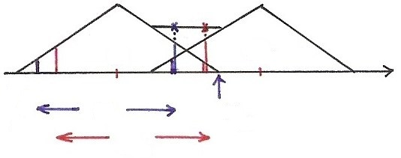



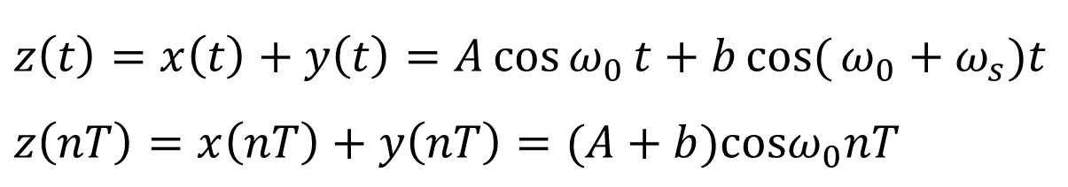




Aliasing Effect
$z\left(t\right)=x\left(t\right)+y\left(t\right)=A\cos{ω_{0}}t+$ $bcos({ω_{0}+ω_{s}})t$
$$z\left(nT\right)=x\left(nT\right)+y\left(nT\right)=(A+b)cosω_{0}nT$$
$$ω_{s}<2ω_{M}$$
Aliasing Effect
0
$$ω_{s}$$
$$ω$$
$${−ω}_{M}$$
$$ω_{s}$$
$$ω_{M}$$
$$ω_{s}$$

Slide 17
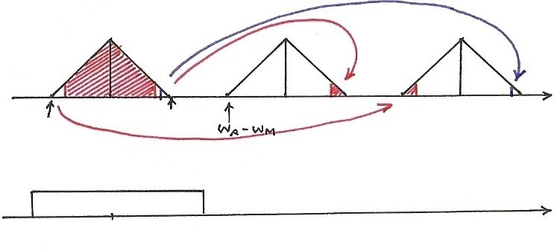








Sampling Thm
$$ω_{s}>2ω_{M}$$
$$ω$$
0
$$ω_{M}$$
$$ω_{s}$$
$${2ω}_{s}$$
$${−ω}_{M}$$
$$ω$$
$${−ω}_{c}$$
0
$$ω_{c}$$

Slide 18
Recovery from Samples ? (p.3 of 7.0)
$$n$$
0
1
2
$$t$$
$$T$$
$$T$$

Slide 19
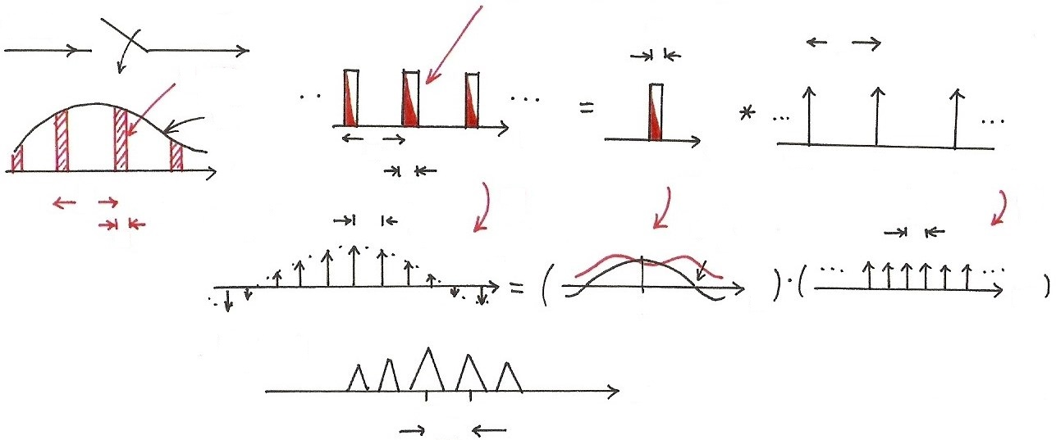












Practical Sampling
(any other pulse shape)
x(t)
$x_{p}$(t)
$$p(t)$$
$$τ$$
T
$x_{p}$(t)
1
x(t)
t
t
T
$$−T$$
0
t
t
$$T$$
$$τ$$
$$F$$
$$\frac{2π}{T}$$
T
$$F$$
$$F$$
$$\frac{2π}{T}$$
$$α\frac{1}{τ}$$
$$τ$$
$$P(jω)$$
$$ω$$
$$ω$$
$$ω$$
0
$$X_{p}(jω)$$
$$ω$$
0
$$\frac{2π}{T}$$

Slide 20
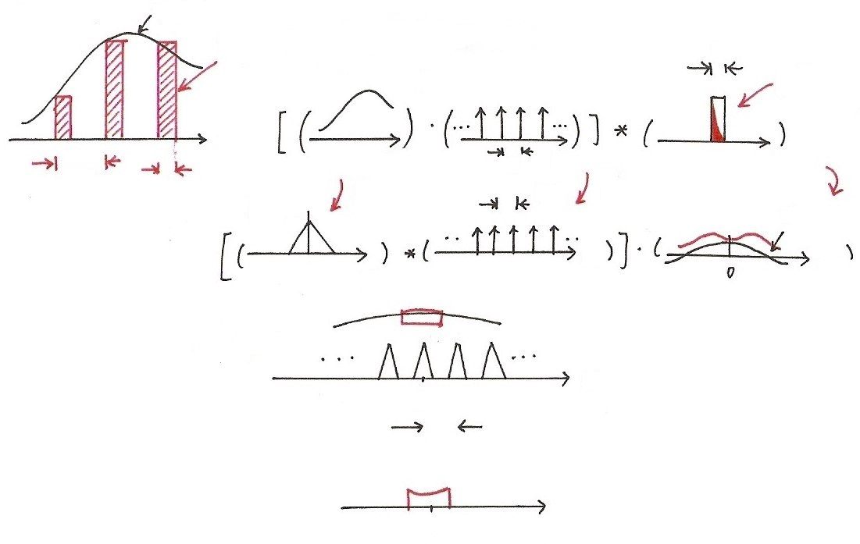




















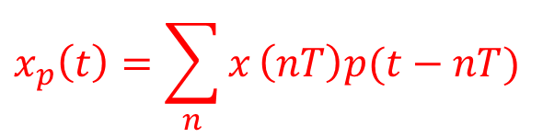




Practical Sampling
$$x(t)$$
$$x_{p}\left(t\right)=\sum_{n}{x}\left(nT\right)p(t−nT)$$
$$τ$$
(any other
pulse shape)
$$x(t)$$
$$t$$
$$T$$
$$t$$
$$T$$
$$t$$
$$t$$
$$F$$
$$τ$$
$$F$$
$$\frac{2π}{T}$$
$$F$$
$$X(jω)$$
$$α\frac{1}{τ}$$
$$ω$$
$$ω$$
$$ω$$
$$X_{p}(jω)$$
$$ω$$
0
$$\frac{2π}{T}$$
$$ω$$
0
$$ω_{c}$$

Slide 21
Impulse Train Sampling
Practical Issues
  nonideal lowpass filters accurate enough for practical purposes determined by acceptable level of distortion
  oversampling ω_{s} = 2 ω_{M} + ∆ ω 
  sampled by pulse train with other pulse shapes
  signals practically not bandlimited : pre-filtering

Slide 22
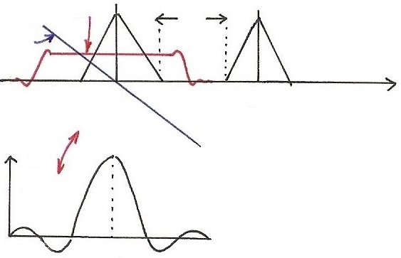










Oversampling with Non-ideal Lowpass Filters
$$\left|H(jω)\right|$$
$$∆ω$$
$$∡H(jω)$$
$$ω$$
$${−ω}_{M}$$
0
$$ω_{M}$$
$$ω_{s}$$
$$F$$
$$h(t)$$
$$t$$
0
$$t_{0}$$

Slide 23
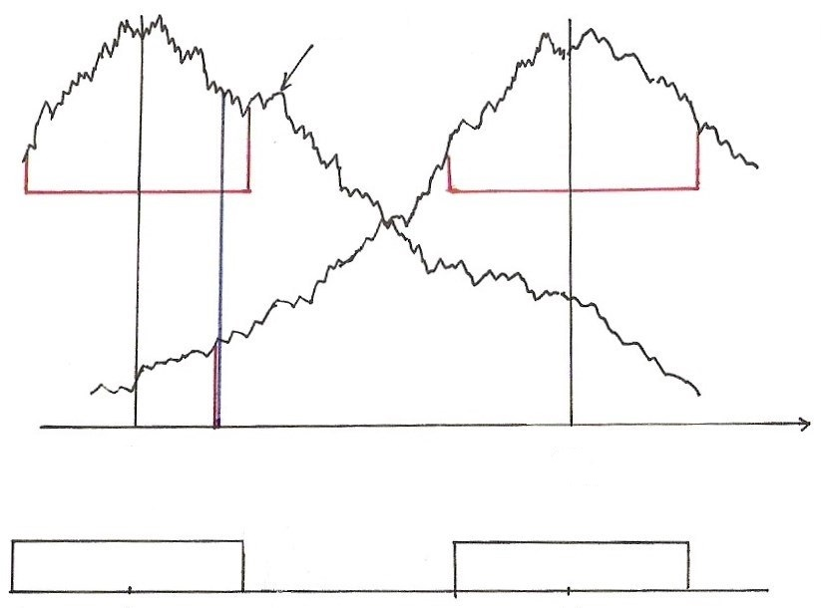





Signals not Bandlimited
$$X(jω)$$
$$ω$$
0
$$ω_{s}$$
0
$$ω_{c}$$
$$ω_{s}$$

Slide 24
Sampling with A Zero-order Hold
Zero-order Hold:
  holding the sampled value until the next sample taken
  modeled by an impulse train sampler followed by a system with rectangular impulse response
Reconstructed by a lowpass filter H_{r}(jω)
    See Fig. 7.6, 7.7, 7.8, p.521, 522 of text

Slide 25
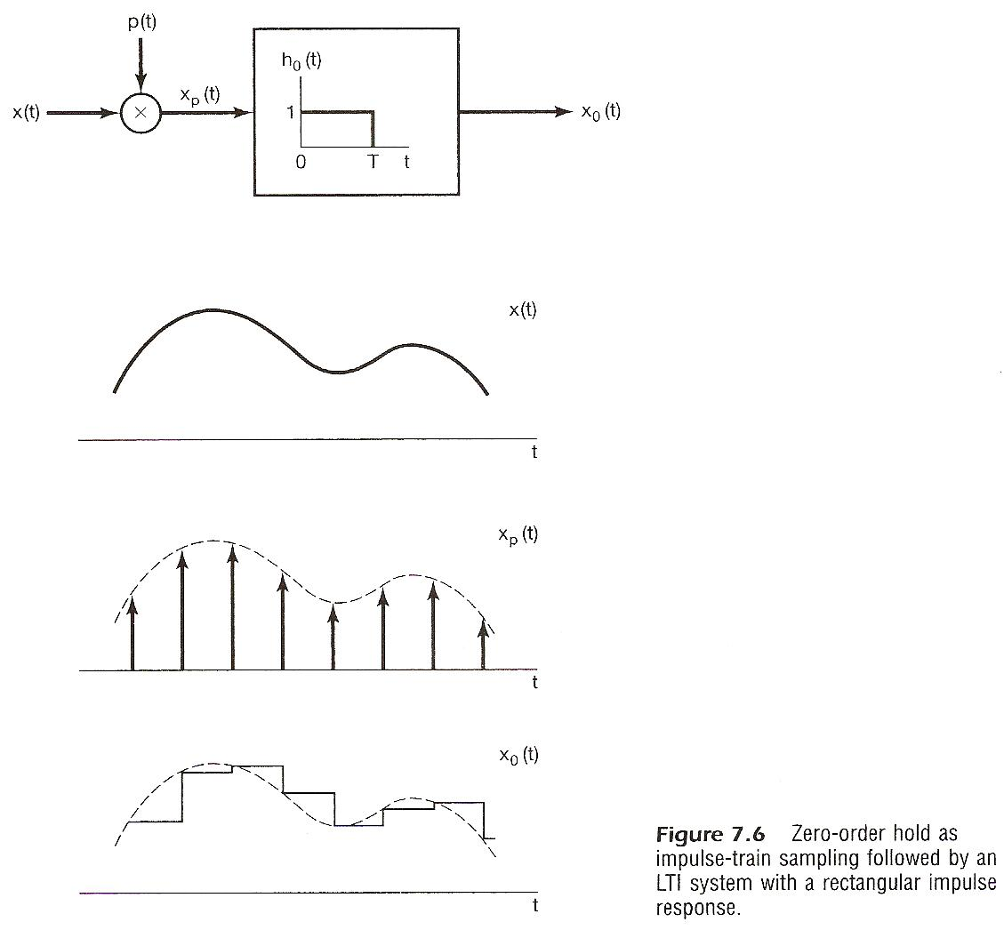

Slide 26
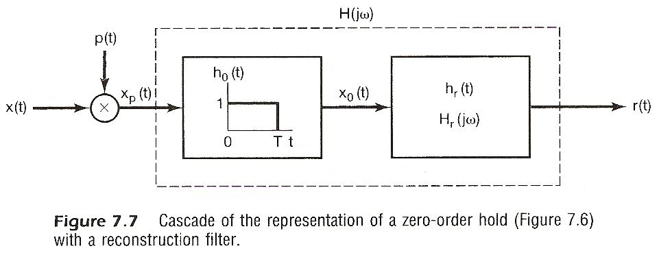
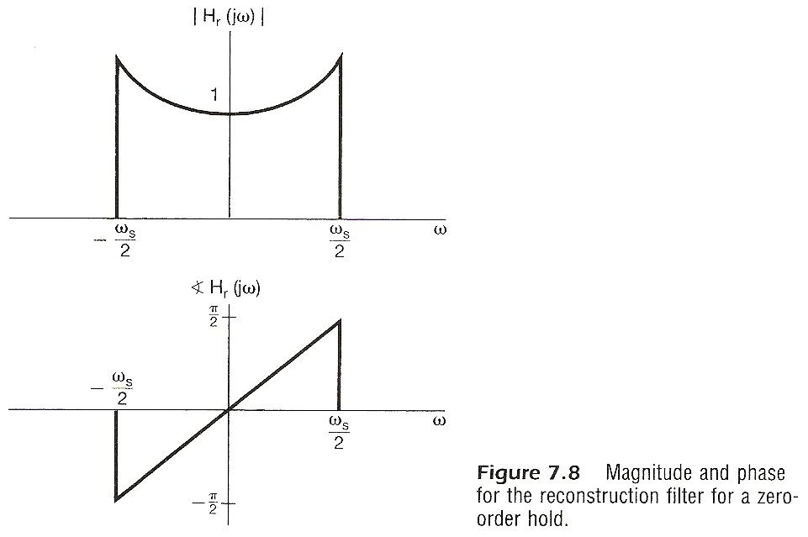

Slide 27
Interpolation
Impulse train sampling/ideal lowpass filtering
    See Fig. 7.10, p.524 of text

Slide 28
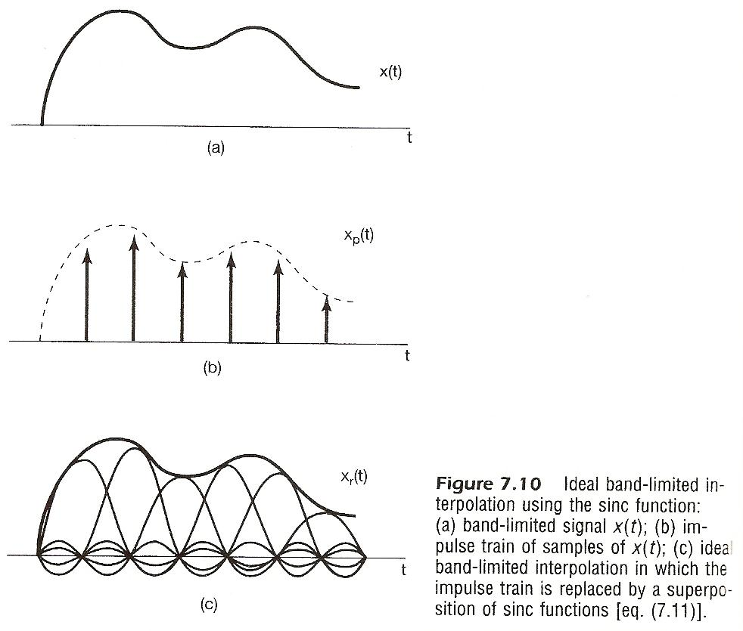

Slide 29
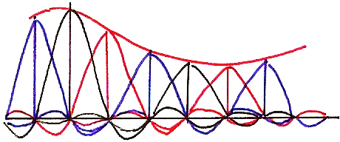
Ideal Interpolation

Slide 30
Interpolation
Zero-order hold can be viewed as a “coarse” interpolation
  See Fig. 7.11, p.524 of text
Sometimes additional lowpass filtering naturally applied
    e.g. viewed at a distance by human eyes, mosaic
    smoothed naturally
    See Fig. 7.12, p.525 of text

Slide 31
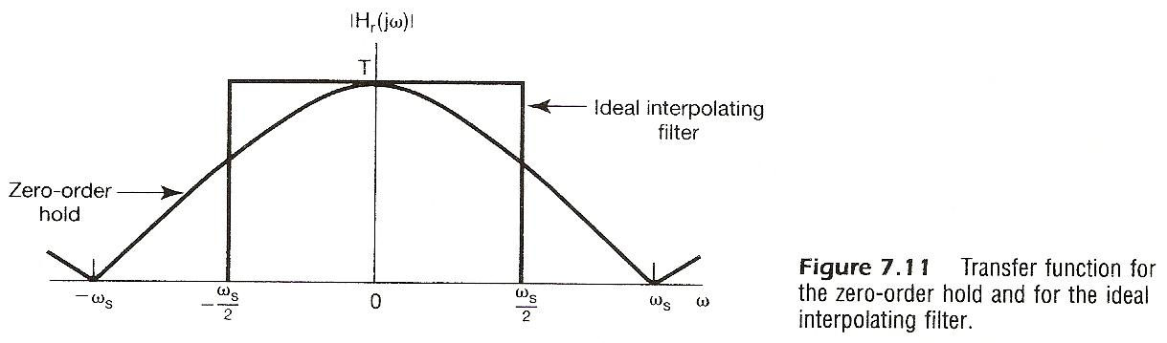

Slide 32
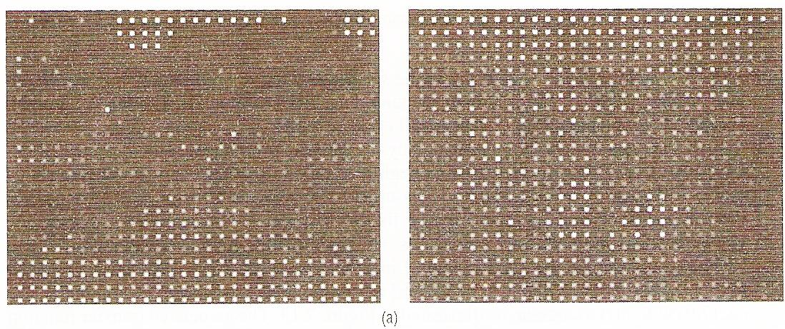

Slide 33
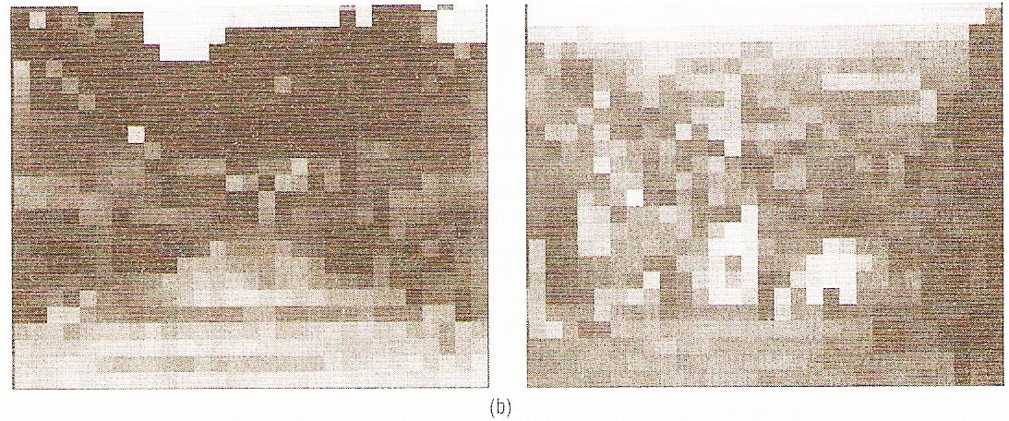

Slide 34
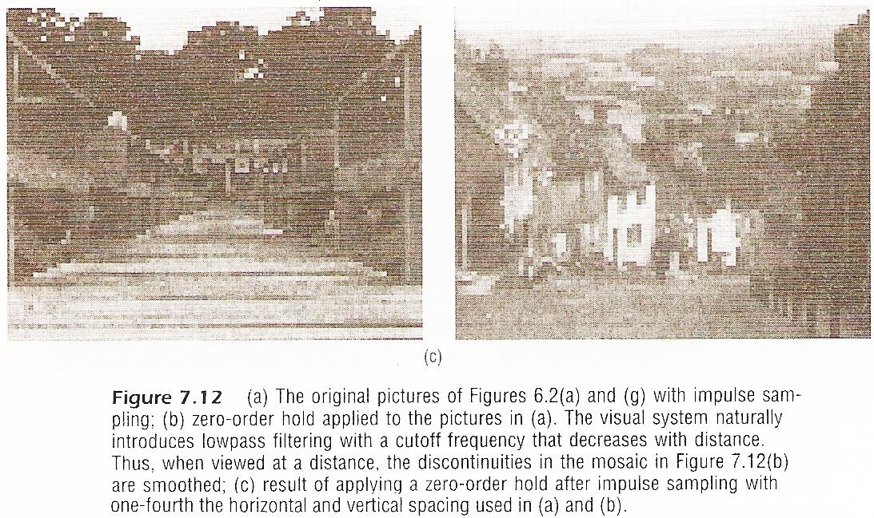

Slide 35
Interpolation
Higher order holds
  zero-order : output discontinuous
  first-order : output continuous, discontinuous
  derivatives
    See Fig. 7.13, p.526, 527 of text
  second-order : continuous up to first derivative
              discontinuous second derivative

Slide 36
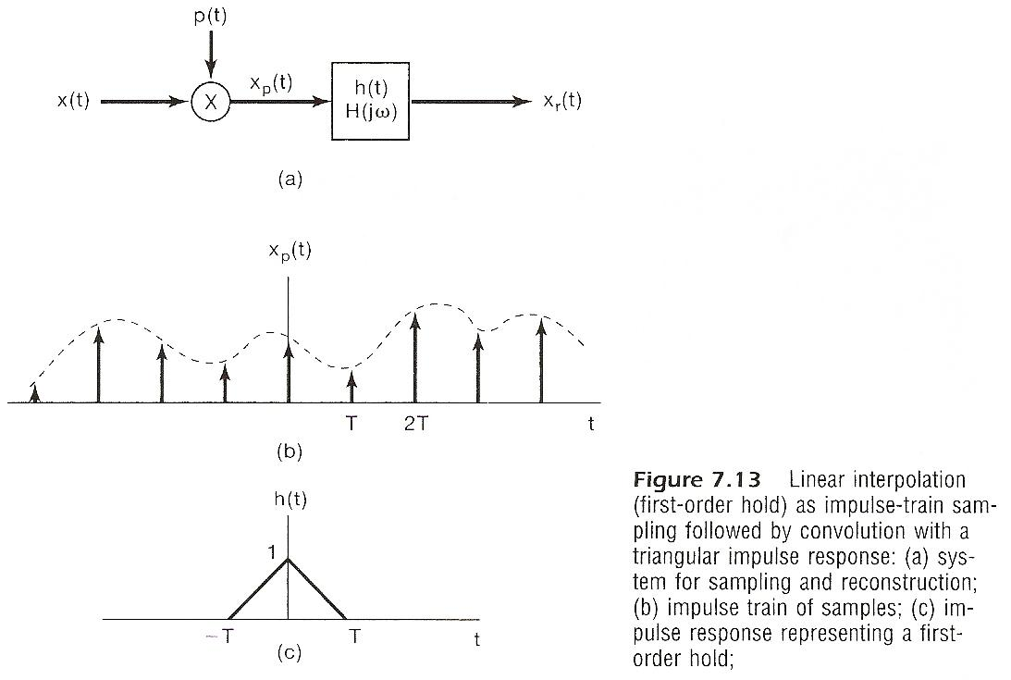

Slide 37
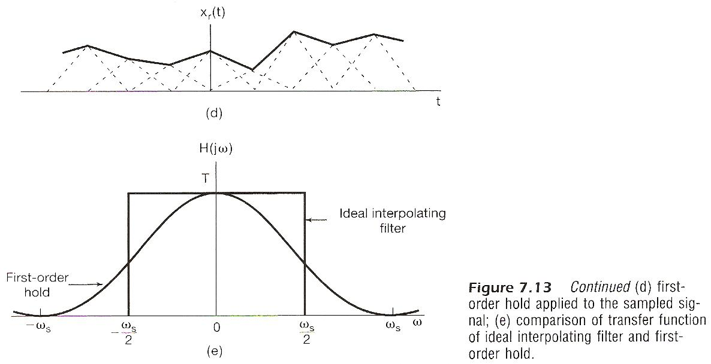

Slide 38
Aliasing
Consider a signal x(t)=cos ω₀t
  sampled at sampling frequency
  reconstructed by an ideal lowpass filter
  with
  x_{r}(t) : reconstructed signal
  fixed ω_{s}, varying ω₀

Slide 39
Aliasing
Consider a signal x(t)=cos ω₀t
  when aliasing occurs, the original frequency ω₀ takes on the identity of a lower frequency, ω_{s} – ω₀
  w₀ confused with not only ω_{s} + ω₀, but ω_{s} – ω₀
    See Fig. 7.15, 7.16, p.529-531 of text

Slide 40
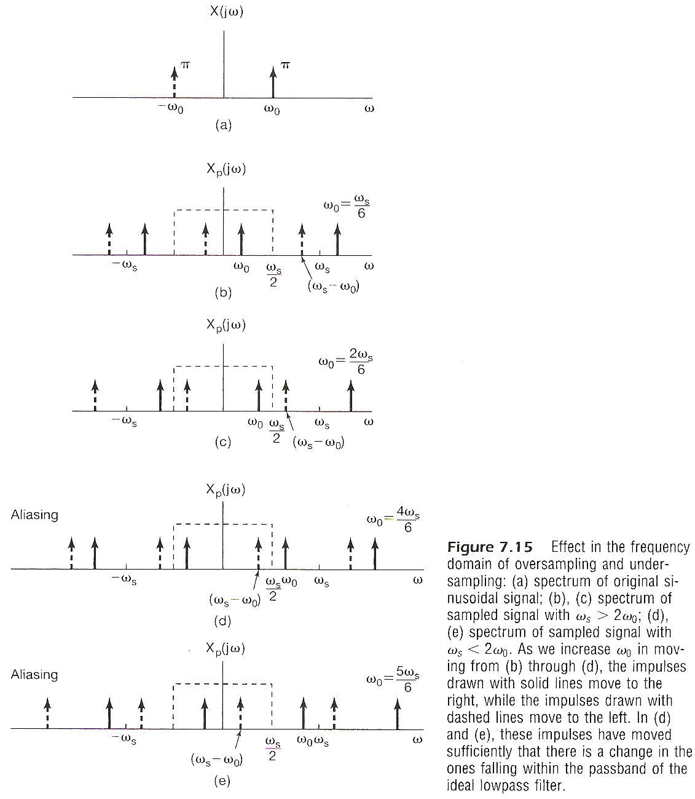

Slide 41
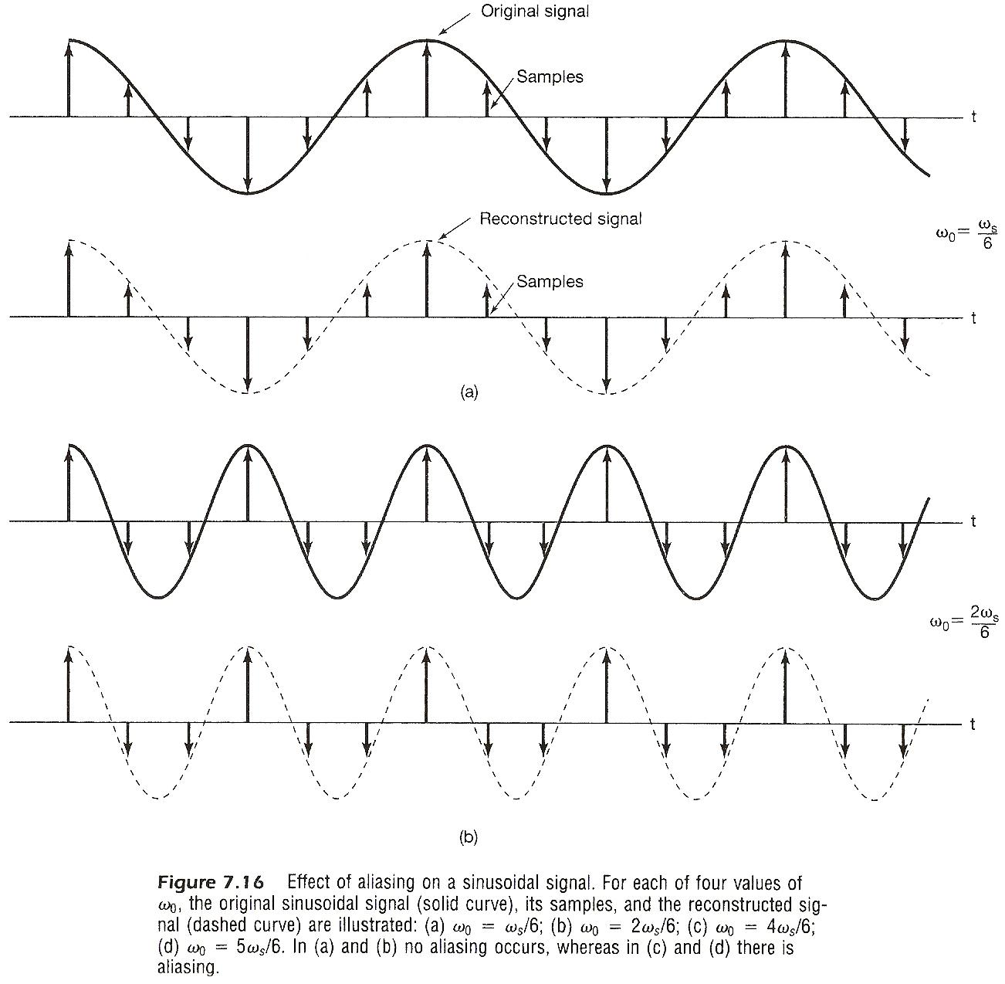

Slide 42
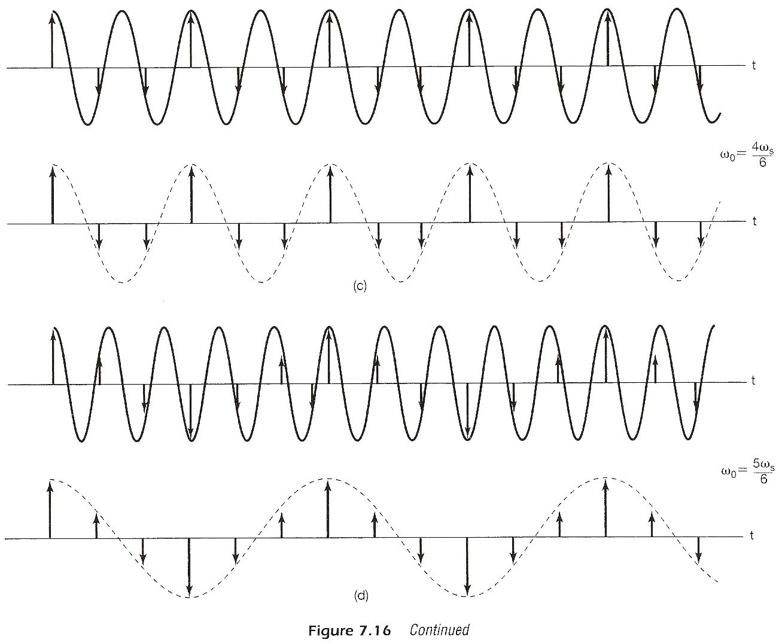

Slide 43
Aliasing
Consider a signal x(t)=cos ω₀t
  many x_{r}(t) exist such that
  the problem is it is not easy to find the right one
  if x(t) = cos(ω₀t + ϕ)
  the impulses have extra phases e^{jϕ}, e^{-jϕ}

Slide 44
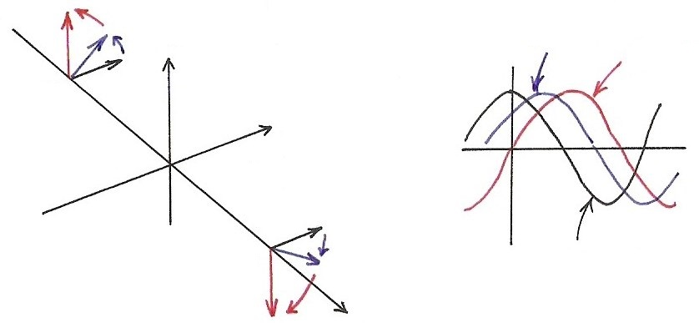


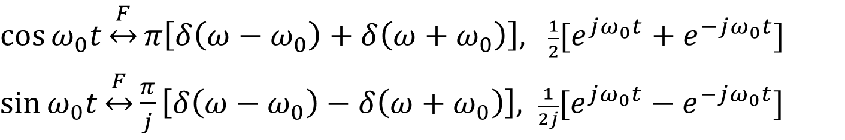







  Sinusoidals (p.25 of 4.0)
$\cos{ω_{0}t}\underset{↔}{F}π\left[δ\left(ω−ω_{0}\right)+δ\left(ω+ω_{0}\right)\right],$ $\frac{1}{2}[e^{jω_{0}t}+e^{−jω_{0}t}]$
$\sin{ω_{0}t}\underset{↔}{F}\frac{π}{j}\left[δ\left(ω−ω_{0}\right)−δ\left(ω+ω_{0}\right)\right],$ $\frac{1}{2j}[e^{jω_{0}t}−e^{−jω_{0}t}]$
$$Im$$
$$\cos{ω_{0}(t−t_{0})}$$
$$\sin{ω_{0}t}$$
$${−ω}_{0}$$
$$Re$$
$$ω_{0}$$
$$\cos{ω_{0}t}$$
$$ω$$
$$x\left(t−t_{0}\right)↔e^{−jω_{0}t}⋅X(jω)$$

Slide 45
Aliasing
Consider a signal x(t)=cos (ω₀t + Φ)
(a) (b)
(c) (d)
  phase also changed

Slide 46












  Example 7.1 of Text
$x\left(t\right)=\cos{(ω_{0}}t+φ)$, $ω_{s}=2ω_{0}$
$x_{r}\left(t\right)=(cos{φ)}cos(ω_{0}t)$, $t=nT$
$$ω_{s}$$
Sampling is “time-varying”
$$ω$$
$${−ω}_{0}$$
$$ω_{0}$$
$$t$$
(a) $φ=0$
0
$$t$$
(b) $φ≠0$
0
$$t$$
(c) $φ=\frac{π}{2}$
0

Slide 47




























  Example 7.1 of Text
(a) $φ=0$
(b) $φ≠0$
$$R_{e}$$
(c) $φ=\frac{π}{2}$
$$R_{e}$$
$$R_{e}$$
$$φ$$
$$I_{m}$$
$${−ω}_{0}$$
$${−ω}_{0}$$
$${−ω}_{0}$$
$$I_{m}$$
$$I_{m}$$
$$φ$$
0
$$R_{e}$$
0
0
$$R_{e}$$
$$R_{e}$$
$$φ$$
$$ω_{0}$$
$$I_{m}$$
$$ω_{0}$$
$$ω_{0}$$
$$I_{m}$$
$$I_{m}$$
$$ω$$
$$ω$$
$$ω$$

Slide 48















  Example 7.1 of Text
$$nT$$
$$nT$$
$$x\left(t\right)=\cos{(\frac{ω_{s}}{2}t+φ)}=\frac{1}{2}[e^{j\left(\frac{ω_{s}}{2} t+φ\right)}+e^{−j\left(\frac{ω_{s}}{2} t+φ\right)}]$$
$t=nT$, $\frac{ω_{s}}{2}⋅nT=\left(\frac{{ ω}_{s} }{2}\right)⋅n\left(\frac{ 2π }{ω_{s}}\right)=nπ$
$$x(nt)=\frac{1}{2}[e^{jnπ}⋅e^{jφ}+e^{−jnπ}⋅e^{−jφ}]$$
$e^{jnπ}$= $e^{−jnπ}=±1={(e^{jπ})}^{n}={(e^{−jπ})}^{n}={(−1)}^{n}$
$$x(nt)=\frac{1}{2}e^{jnπ}\left(e^{jφ}+e^{−jφ}\right)=(e^{jnπ})⋅(\cos{φ})$$
$${(−1)}^{n}$$
$$φ=0$$
$$φ≠0$$
$$n=$$
$$1,3,5,⋯$$
$$n=0,2,4,⋯$$
$$\cos{φ}$$
$$n=1,3,5,⋯$$
$$n=$$
$$0,2,4,⋯$$
$$n=0,2,4,⋯$$
$$n=$$
$$1,3,5,⋯$$

Slide 49
    Examples
Example 7.1, p.532 of text
(Problem 7.39, p.571 of text)
sampled and low-pass filtered

Slide 50
      7.2 Discrete-time Processing of
      Continuous-time Signals
Processing continuous-time signals digitally
x_{d}[n]=x_{c}(nT)
y_{d}[n]=y_{c}(nT)
x_{c}(t)
C/D
Conversion
Discrete-time
System
D/C
Conversion
y_{c}(t)
A/D Converter
D/A Converter
h(t)
x(t)
x[n]
h[n]
y[n]
y(t)
Recovery

Slide 51


Formal Formulation/Analysis
C/D Conversion
  impulse train sampling with sampling period T
  mapping the impulse train to a sequence with unity spacing
    normalization (or scaling) in time

Slide 52
Formal Formulation/Analysis
Frequency Domain Representation
  ω for continuous-time, Ω for discrete-time, only in this section

Slide 53
Formal Formulation/Analysis
Frequency Domain Relationships
  continuous-time
                (4.9)
  discrete-time
                (5.9)

Slide 54
Formal Formulation/Analysis
Frequency Domain Relationships
  relationship
                (7.6)
      See Fig. 7.22, p.537 of text

Slide 55























  C/D Conversion
$$x_{p}(t)$$
$$X_{c}(jω)$$
$$X_{p}(jω)$$
$$x_{c}(t)$$
$$F$$
$$t$$
$${−ω}_{s}$$
$$ω_{s}$$
$$ω$$
0
$$T$$
$$\left(T\right)⋅\left(\frac{2π}{T}\right)=2π$$
$$\frac{2π}{T}$$
$$=ω_{s}$$
$$x_{d}[n]$$
$$F$$
$$X_{d}(e^{jΩ})$$
$$(×T)$$
$$(×\frac{1}{T})$$
$$n$$
$$Ω$$
0 1 2 3 4
$$2π$$
1
$$(1)⋅(2π)$$
  X_{d}(e^{jΩ}) is a frequency-scaled (by T) version of X_{p}(jω)
  x_{d}[n] is a time-scaled (by 1/T) version of x_{p}(t)
  X_{d}(e^{jΩ}) periodic with period 2π
  X_{p}(jω) periodic with period 2π/T=ω_{s}

Slide 56


Slide 57

Formal Formulation/Analysis
D/C Conversion
  mapping a sequence to an impulse train
  lowpass filtering

Slide 58
Formal Formulation/Analysis
Complete System
  See Fig. 7.24, 7.25, 7.26, p.538, 539, 540 of text
                (7.24)
  equivalent to a continuous-time system
                (7.25)
  if the sampling theorem is satisfied

Slide 59

h(t)
x(t)
x[n]
y[n]
y(t)
h[n]
Recovery

Slide 60


Slide 61


Slide 62
Discrete-time Processing of Continuous-time Signals
Note
  the complete system is linear and time-invariant if the sampling theorem is satisfied
  sampling process itself is NOT time-invariant

Slide 63
Examples
Digital Differentiator
  band-limited differentiator
  discrete-time equivalent
      See Fig. 7.27, 7.28, p.541, 542 of text

Slide 64





Slide 65
Examples
Delay
  y_{c}(t)=x_{c}(t-∆)
  discrete-time equivalent
      See Fig. 7.29, p.543 of text

Slide 66


Slide 67
Examples
Delay
  ∆/T an integer
  ∆/T not an integer
    undefined in principle
    but makes sense in terms of sampling if the sampling theorem is satisfied
  e.g. ∆/T=1/2, half-sample delay
      See Fig. 7.30, p.544 of text

Slide 68


Slide 69


















      7.3 Change of Sampling Frequency
  Up/Down Sampling
$$\underset{↔}{F}$$
$$ω$$
$$t$$
0
$$ω_{M}^{′}$$
$$ω_{s}^{′}=\frac{2π}{T}$$
$$T$$
$$\underset{↔}{F}$$
Up
Sampling
Down
Sampling
$$ω$$
0
$$ω_{M}$$
$$ω_{s}^{′}=\frac{2π}{T}$$
$$\frac{2π}{T}$$
$$3T$$
$$ω$$
$$\underset{↔}{F}$$
0
$$ω_{s}=\frac{2π}{3T}$$
$$3T$$
$$\frac{2π}{3T}$$

Slide 70
Impulse Train Sampling of Discrete-time
Signals
Completely in parallel with impulse train sampling of continuous-time signals
      See Fig. 7.31, p.546 of text

Slide 71


      See Fig. 7.31, p.546 of text

Slide 72
(P.5 of 7.0)

Slide 73
(P.7 of 7.0)

Slide 74
(P.8 of 7.0)

Slide 75
Impulse Train Sampling of Discrete-time
Signals
Completely in parallel with impulse train sampling of continuous-time signals
      See Fig. 7.32, p.547 of text

Slide 76



Slide 77
Aliasing Effect
(P.13 of 7.0)
$$x\left(t\right)=A\cos{ω_{0}}t$$
$y\left(t\right)=bcos({ω_{0}+ω_{s}})t$, $ω_{s}=\frac{2π}{T}$
$$x\left(nT\right)=A\cos{ω_{0}}nT$$
$$y\left(nT\right)=bcos({ω_{0}+k\frac{2π}{T}})nT$$
$=b\cos{ω_{0}}nT$
$$A$$
$$A$$
$$A$$
$$A$$
$$ω_{s}$$
$$b$$
$$b$$
$$b$$
$$b$$
$$ω_{0}$$
$$ω$$
$$ω$$
$$ω_{0}+ω_{s}$$
0 0 0
$$ω_{0}$$
$$ω_{s}=\frac{2π}{T}$$
After sampling with $ω_{s}=\frac{2π}{T}$ , any two frequency components $ω_{1}$, $ω_{2}$ become indistinguishable, or sharing identical samples, or should be considered as identical frequency components if $\left|ω_{1}−ω_{2}\right|=k\frac{2π}{T}$
$e^{j\left(ω_{0}+k\frac{2π}{T}\right)nT}=e^{jω_{0}nT}$ ($T=1$ for discrete-time signals )
$ω_{s}$

Slide 78
Sampling
(P.15 of 7.0)
sampling
$x\left(t\right)\underset{↔}{F}X(jω)$, $x_{p}(t)\underset{↔}{F}X_{p}(jω)$
$$X_{p}(jω)$$
$$X(jω)$$
$$2ω_{s}$$
$$ω_{s}$$
sampling
$$ω$$
$$ω$$
0
0
$$x\left(t\right)=\sum_{n}{x\left[n\right]}δ(t−n)$$
$$ω_{s}$$
$$ω_{s}$$
$$\frac{2π}{T}$$
$(=2π$, if $T=1)$
$F$(chap4)
$$t$$
0 1 2 3
$$2π$$
$$x[n]$$
$F$(chap5)
$$ω$$
$$n$$
$$ω_{0}$$
0 1 2 3
$$e^{jω_{0}n}$$
$$e^{j\left(ω_{0}+2π\right)n}$$
$$\overline{ T }=1$$

Slide 79

Aliasing Effect
(P.16 of 7.0)
$z\left(t\right)=x\left(t\right)+y\left(t\right)=A\cos{ω_{0}}t+$ $bcos({ω_{0}+ω_{s}})t$
$$z\left(nT\right)=x\left(nT\right)+y\left(nT\right)=(A+b)bcosω_{0}nT$$
$$ω_{s}<2ω_{M}$$
Aliasing Effect
0
$$ω_{s}$$
$$ω$$
$${−ω}_{M}$$
$$ω_{s}$$
$$ω_{M}$$
$$ω_{s}$$

Slide 80







  Aliasing for Discrete-time Signals
$$kN$$
$$x\left[n\right]=Ae^{jω_{0}n}$$
$y\left[n\right]=$ $be^{j(ω_{0}+\frac{2π}{N})n}$
$z\left[n\right]=x\left[n\right]$+ $y\left[n\right]$
$$z\left[kN\right]=(A+b)e^{jω_{0}kN}$$
$$e^{j\left(ω_{0}+\frac{2π}{N}\right)kN}=e^{jω_{0}kN}$$
$$kN$$
$$T$$
$$T/N$$

Slide 81

Impulse Train Sampling of Discrete-time
Signals
Completely in parallel with impulse train sampling of continuous-time signals
  ω_{s} > 2ω_{M}, no aliasing, ω_{s} = $\frac{2π}{N}$
  x[n] can be exactly recovered from x_{p}[n] by a lowpass filter
  With Gain N and cutoff frequency ω_{M} < ω_{c} < ω_{s}- ω_{M}
    See Fig. 7.33, p.548 of text
  ω_{s} < 2ω_{M}, aliasing occurs
  filter output x_{r}[n] ≠ x[n]
  but x_{r}[kN] = x[kN], k=0, ±1, ±2, ……

Slide 82


Slide 83
Impulse Train Sampling of Discrete-time
Signals
Interpolation
  h[n] : impulse response of the lowpass filter
  in general a practical filter h_{r}[n] is used

Slide 85
Decimation/Interpolation
Decimation: reducing the sampling frequency by a factor of N, downsampling : two reversible steps
  taking every N-th sample, leaving zeros in between
  deleting all zero’s between non-zero samples to produce a new sequence (inverse of time expansion property of discrete-time Fourier transform)
  both steps reversible in both time/frequency domains
  See Fig. 7.34, p.550 of text

Slide 86


Slide 87

(p.38 of 5.0)

Slide 88

(p.39 of 5.0)

Slide 89
(p.37 of 5.0)
Time Expansion
If n/k is an integer, k: positive integer
        See Fig. 5.13, p.377 of text
        See Fig. 5.14, p.378 of text

Slide 90
Decimation/Interpolation
Decimation:
  See Figs. 7.34, 7.35, p. 550, 551 of text

Slide 92


Slide 93
Decimation/Interpolation
Decimation
  decimation without introducing aliasing requires oversampling situation
  See an example in Fig. 7.36, p. 552 of text

Slide 94


Slide 95
Decimation/Interpolation
Interpolation: increasing the sampling frequency by a factor of N, upsampling
  reverse the two-step process in decimation
  from x_{b}[n] construct x_{p}[n] by inserting N-1 zero’s
  from x_{p}[n] construct x[n] by lowpass filtering
See Fig. 7.37, p. 553 of text
Change of sampling frequency by a factor of N/M: first interpolating by N, then decimating by M

Slide 96


Slide 97














  Decimation/Interpolation
$$x_{d}\left[n\right]=x_{c}\left(nT\right)=x[n]$$
$$x_{p}[n]$$
$$T$$
$$x_{c}(t)$$
$$t$$
$$n$$
0
0 1 2
$$T$$
Interpolation
$$x_{d}^{′}\left[n\right]=x_{c}\left(nT^{′}\right)=x_{b}\left[n\right]$$
$=x_{c}(nNT)$
$$t$$
Decimation
$$T^{′}=NT$$
$$t$$
$$n$$
0 1 2
$$NT$$

Slide 98




















  Decimation/Interpolation
$X(jω)$, $X(e^{jΩ})$
$$ω$$
$$X(jω)$$
0
$$\frac{2π}{T}$$
$$T$$
$$Ω$$
0
$$2π$$
$$ω$$
$X_{p}(jω)$, $X_{p}(e^{jΩ^{′}})$
$$X_{b}(e^{jΩ})$$
0
$$ω$$
$$T^{′}=NT$$
0
$$\frac{2π}{T^{′}}=\frac{2π}{NT}$$
for $x_{p}[n]$
$$Ω^{′}$$
0
$$2π$$
for $x_{b}[n]$
$$Ω$$
0
$$2π$$

Slide 99

    Examples
Example 7.4/7.5, p.548, p.554 of text
sampling x[n] without aliasing

Slide 100
    Examples
Example 7.4/7.5, p.548, p.554 of text
maximum possible downsampling: using full band [-π, π]

Slide 101

    Examples
Example 7.4/7.5, p.548, p.554 of text

Slide 102

    Problem 7.6, p.557 of text

Slide 103

    Problem 7.20, p.560 of text
: inserting one zero after each sample
: decimation 2:1, extracting every second sample
Which of (a)(b) corresponds to low-pass filtering
with ?

Slide 104

    Problem 7.20, p.560 of text
(a) yes
: inserting one zero after each sample
: decimation 2:1, extracting every second sample

Slide 105

    Problem 7.20, p.560 of text
(b) no
: inserting one zero after each sample
: decimation 2:1, extracting every second sample

Slide 106

    Problem 7.23, p.562 of text

Slide 107
    Problem 7.23, p.562 of text

Slide 108

    Problem 7.23, p.562 of text

Slide 109


    Problem 7.24, p.562 of text
2

Slide 110

    Problem 7.41, p.572 of text

Slide 111
    Problem 7.41, p.572 of text

Slide 112

    Problem 7.52, p.580 of text
dual problem for frequency domain sampling

