Slide 1
6.0 Time/Frequency Characterization
of Signals/Systems
      6.1 Magnitude and Phase for Signals
      and Systems

Slide 2
Signals
  : magnitude of each frequency component
  : phase of each frequency component

Slide 3
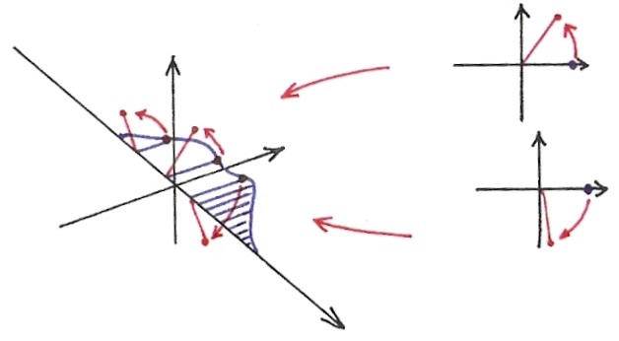







  Time Shift
(P.23 of 4.0)
$$Im$$
$$Im$$
$$Re$$
$$Im$$
$$Re$$
$$Re$$
$$ω$$

Slide 4
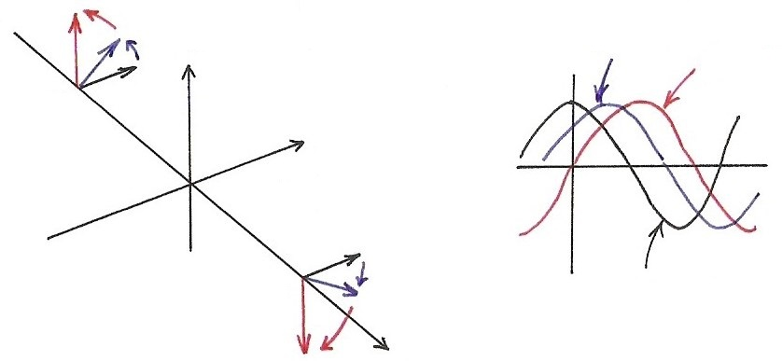


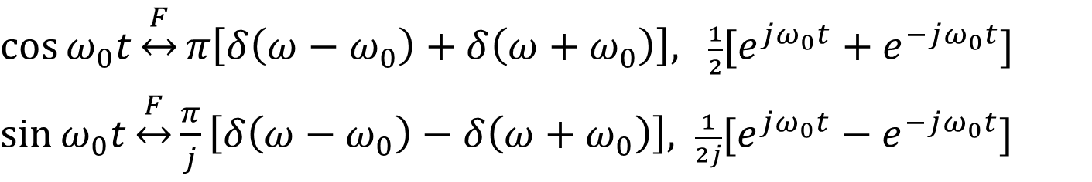







  Sinusoidals (p.25 of 4.0)
$\cos{ω_{0}t}\underset{↔}{F}π\left[δ\left(ω−ω_{0}\right)+δ\left(ω+ω_{0}\right)\right],$ $\frac{1}{2}[e^{jω_{0}t}+e^{−jω_{0}t}]$
$\sin{ω_{0}t}\underset{↔}{F}\frac{π}{j}\left[δ\left(ω−ω_{0}\right)−δ\left(ω+ω_{0}\right)\right],$ $\frac{1}{2j}[e^{jω_{0}t}−e^{−jω_{0}t}]$
$$Im$$
$$\cos{ω_{0}(t−t_{0})}$$
$$\sin{ω_{0}t}$$
$${−ω}_{0}$$
$$Re$$
$$ω_{0}$$
$$\cos{ω_{0}t}$$
$$ω$$
$$x\left(t−t_{0}\right)↔e^{−jω_{0}t}⋅X(jω)$$

Slide 5
Signals
Example
      See Fig. 3.4, p.188 and Fig. 6.1, p.425 of text
  change in phase leads to change in time-domain characteristics
  human auditory system is relatively insensitive to phase of sound signals

Slide 6
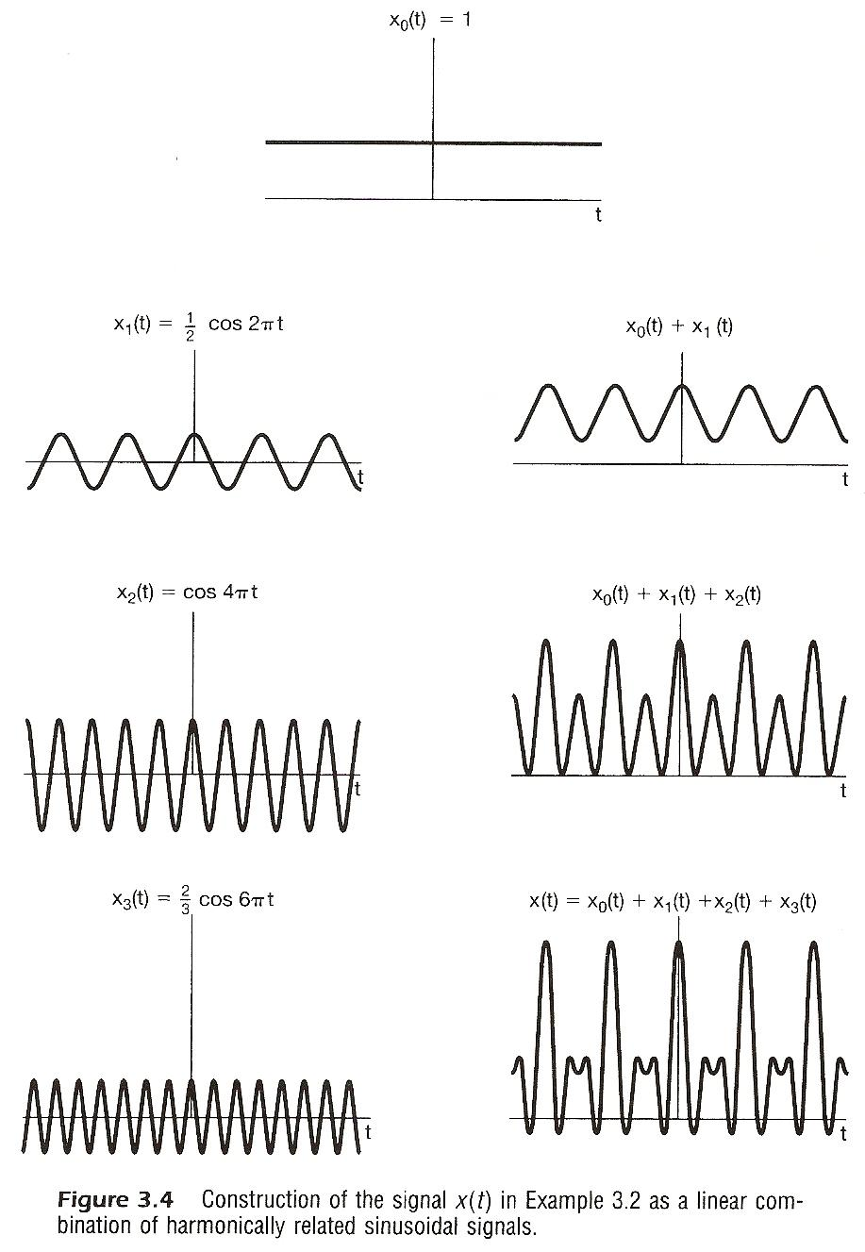

Slide 7
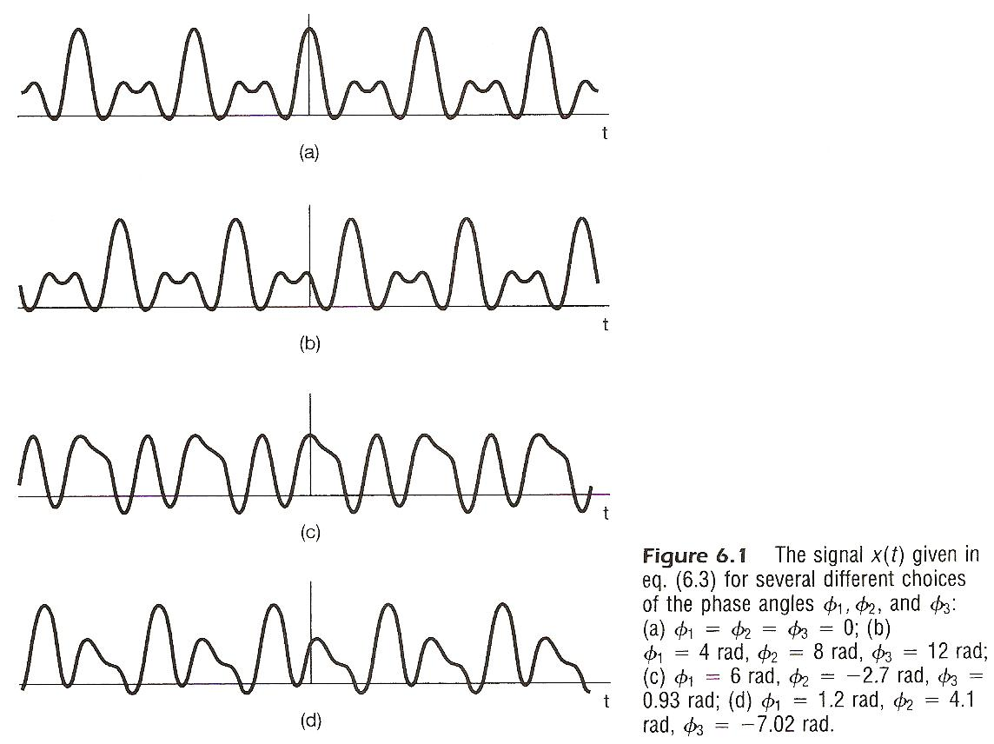

Slide 8
Signals
Example : pictures as 2-dim signals
  most important visual information in edges and regions of high contrast
  regions of max/min intensity are where different frequency components are in phase
      See Fig. 6.2, p.426~427 of text

Slide 9
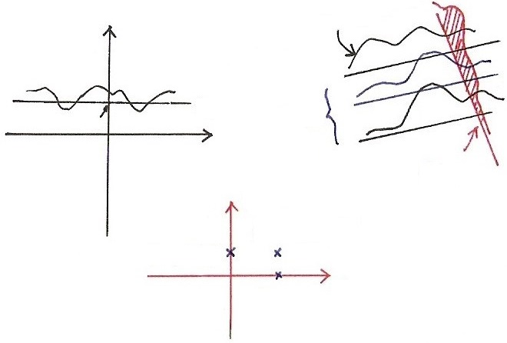








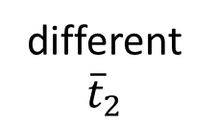









Two-dim Fourier Transform
$$t_{2}$$
$$X_{{\overline{t}}_{2}}(jω_{1})$$
$$ω_{1}$$
$$F_{{\overline{t}}_{2}}$$
$$ω_{1}$$
$$t_{1}$$
$${\overline{t}}_{2}$$
$$ω_{1}$$
$$t_{1}$$
different
${\overline{t}}_{2}$
fixed ${\overline{ω}}_{1}$
$$ω_{2}$$
$$F_{{\overline{ω}}_{1}}$$
$$(ω_{1},ω_{2})$$
$$(0,ω_{2})$$
$$ω_{1}$$
$$2−dim$$
$F$
$$(ω_{1},0)$$

Slide 10
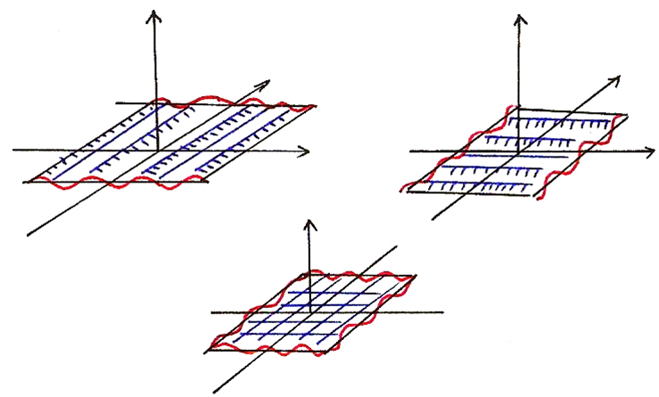









    Problem 3.70, p.281 of text
(P.65 of 3.0)
2-dimensional signals
$$e^{jω_{1}t_{1}}$$
$$e^{jω_{2}t_{2}}$$
$$t_{2}$$
$$t_{2}$$
$$t_{1}$$
$$t_{1}$$
$$t_{2}$$
$$e^{j(ω_{1}t_{1}+ω_{2}t_{2})}$$
$$t_{1}$$

Slide 11
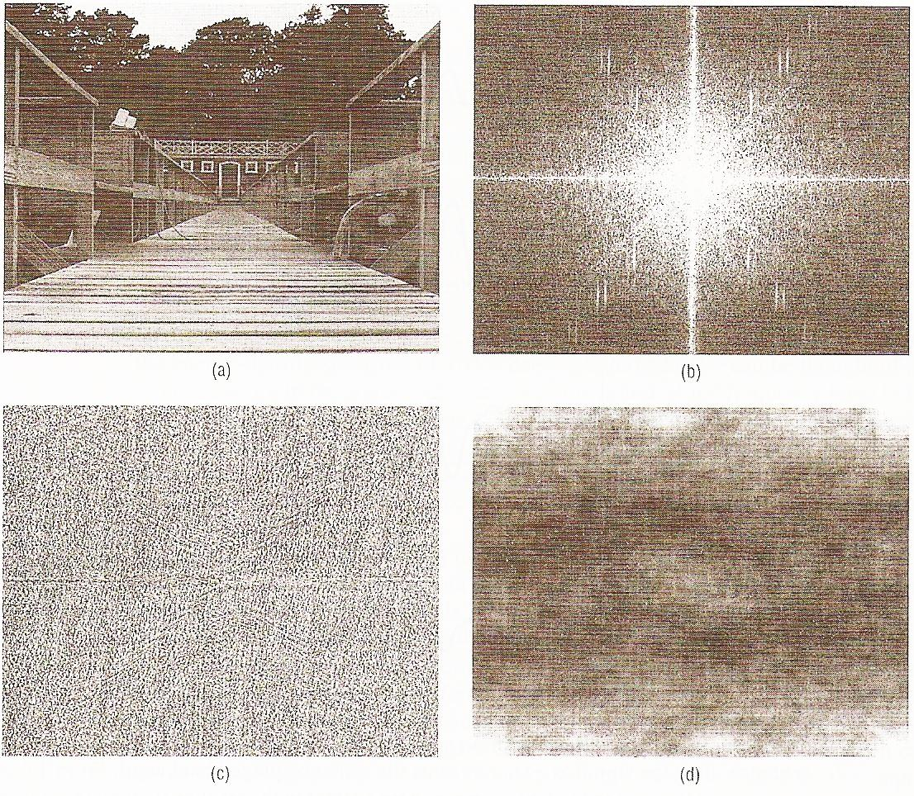

Slide 12
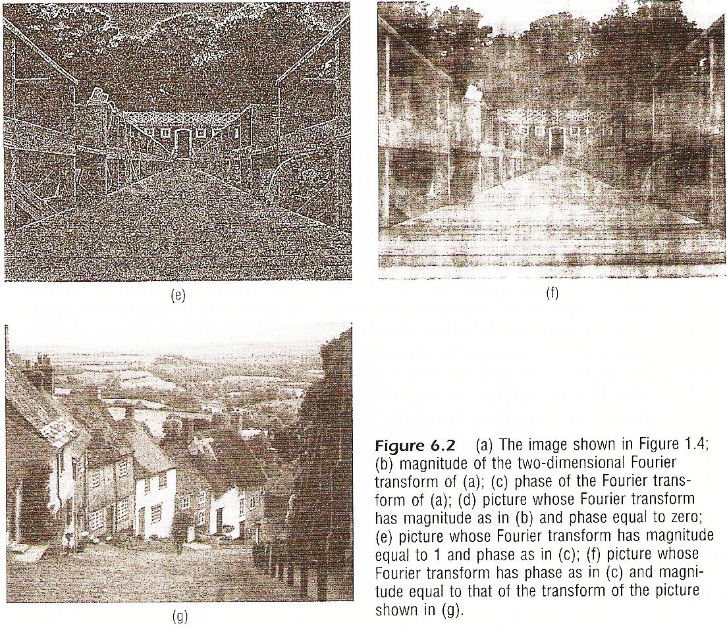

Slide 13
Systems
  : scaling of different frequency components
  : phase shift of different frequency
  components

Slide 14
Systems
Linear Phase (phase shift linear in frequency) means
constant delay for all frequency components
  slope of the phase function in frequency is the delay
  a nonlinear phase may be decomposed into a linear part plus a nonlinear part

Slide 15
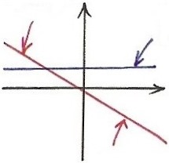




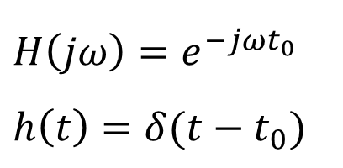












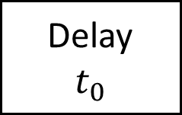
  Linear Phase for Time Delay
$$H\left(jω\right), h(t)$$
$$x(t)$$
Delay
$$t_{0}$$
$$y\left(t\right)=x(t−t_{0})$$
$$Y\left(jω\right)=e^{−jωt_{0}}⋅X(jω)$$
$$H\left(jω\right)=e^{−jωt_{0}}$$
$$h\left(t\right)=δ(t−t_{0})$$
$$−ωt_{0}$$
1
$$∡H(jω)$$
$$\left|H(jω)\right|$$
$$e^{−jωt_{0}}$$
$$ω$$
$$δ(t−t_{0})$$
$$\underset{↔}{ F }$$
$$t$$
$$ω$$
$$0$$
$$t_{0}$$
Scope=$−t_{0}$

Slide 16
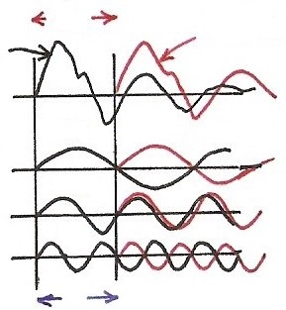










Time Shift
(P.28 of 3.0)
phase shift linear in frequency with amplitude unchanged
$$a_{k} e^{jkω_{0}(t−t_{0})}=e^{−jkω_{0}t_{0}} a_{k} e^{jkω_{0}t}$$
$$t_{0}$$
$${x(t−t}_{0})$$
$$x(t)$$
Time Shift
$$π$$
$$ω_{0}$$
$$2π$$
$${2ω}_{0}$$
  linear phase shift (linear in frequency) with amplitude unchanged
$$3π$$
$${3ω}_{0}$$
$${kω}_{0}t_{0}$$

Slide 17
  Time Shift
(P.23 of 4.0)
$$Im$$
$$Im$$
$$Re$$
$$Im$$
$$Re$$
$$Re$$
$$ω$$

Slide 18
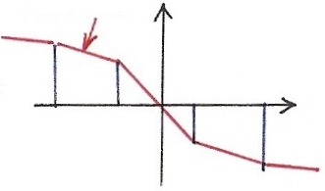
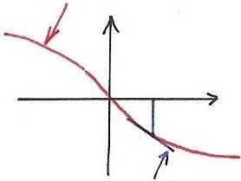


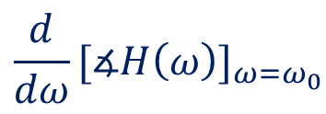



Systems
Group Delay at frequency ω
  common delay for frequencies near ω
$$∡H(ω)$$
$$∡H(ω)$$
$$ω_{0}$$
$$ω$$
$$ω$$
$${\frac{d}{dω}[∡H\left(ω\right)]}_{ω=ω_{0}}$$

Slide 19
Systems
Examples
  See Fig. 6.5, p.434 of text
  Dispersion : different frequency components delayed
  by different intervals
  later parts of the impulse response oscillates at near 50Hz
  Group delay/magnitude function for Bell System telephone lines
      See Fig. 6.6, p.435 of text

Slide 20
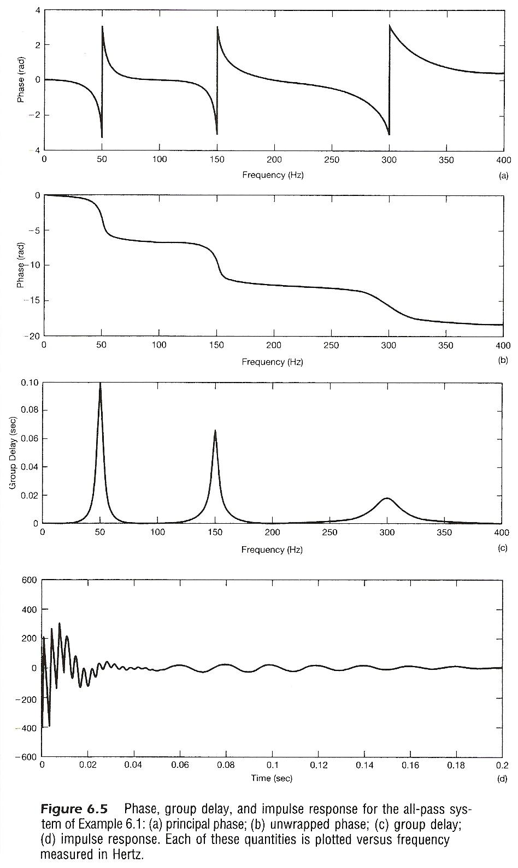

Slide 21
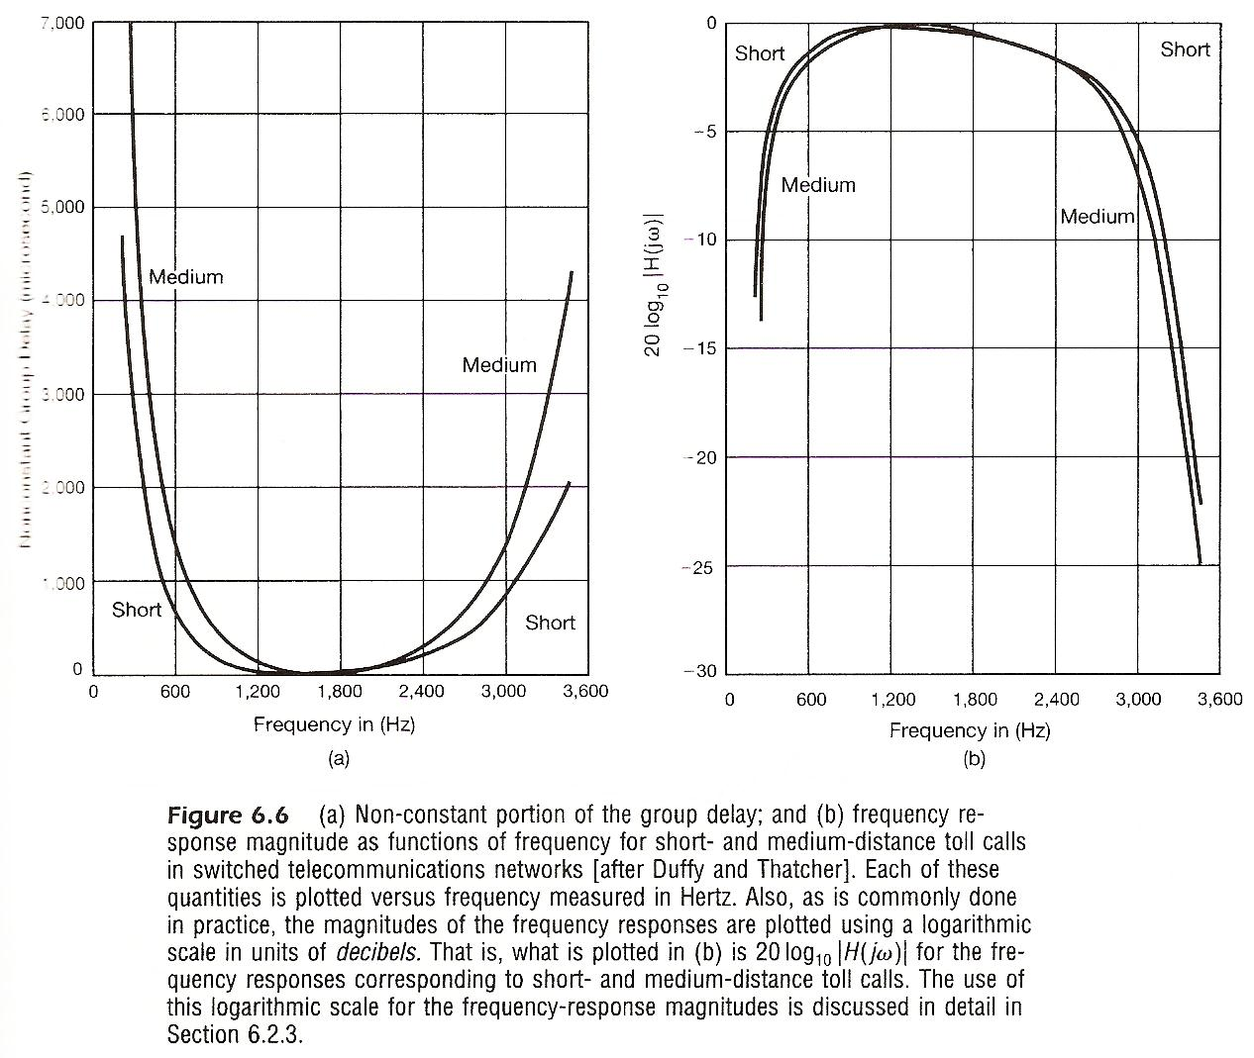

Slide 22
Systems
Bode Plots
Discrete-time Case
  ω not in log scale, finite within [ -π, π ]
Condition for Distortionless
  Constant magnitude plus linear phase in signal band

Slide 23
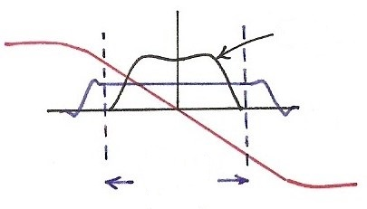

  Distortionless
$$x(t)$$
$$H(jω)$$
$$y(t)$$
$$Y\left(jω\right)=H\left(jω\right) X(jω)$$
$$X(jω)$$
$$ω$$
Signal
band

Slide 24
      6.2 Filtering
Ideal Filters
Low pass Filters as an example
  Continuous-time or Discrete-time
  See Figs. 6.10, 6.12, pp.440,442 of text
  mainlobe, sidelobe, mainlobe width

Slide 25
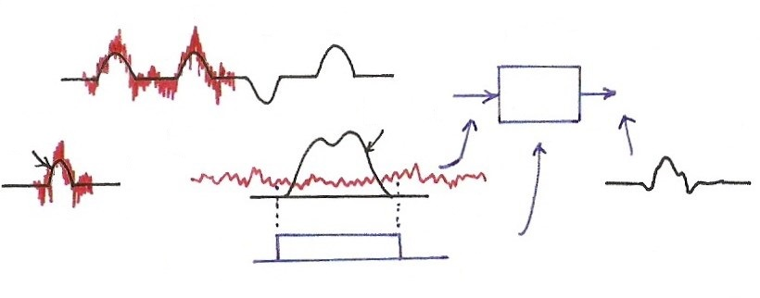








  Filtering of Signals
  (p.59 of 4.0)
1
1
0
1
$$H(jω)$$
$$P(jω)$$
$$p(t)$$
$$F$$
$$t$$
$$ω$$
0
$$H(jω)$$
$$ω$$
0

Slide 26
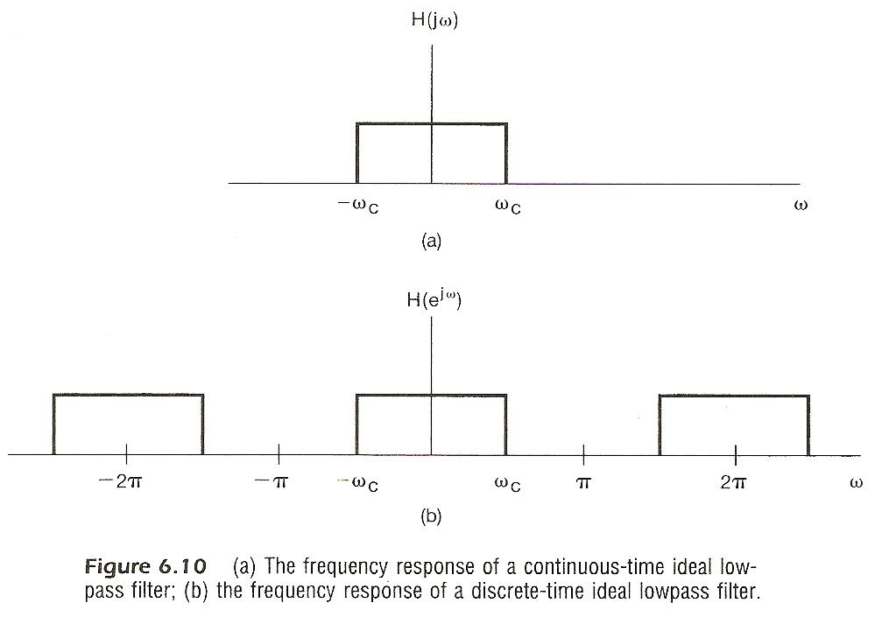

Slide 27
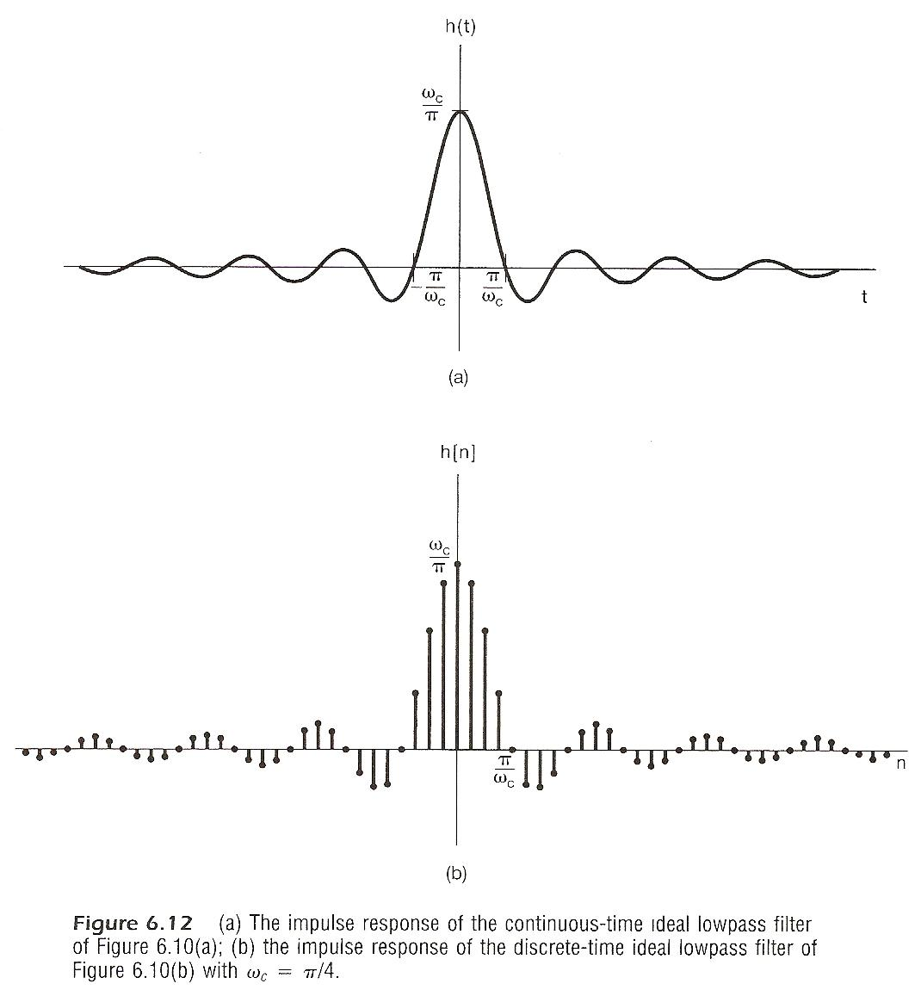

Slide 28
Ideal Filters
Low pass Filters as an example
  with a linear phase or constant delay
  See Figs. 6.11, 6.13, pp.441,442 of text
  causality issue
  implementation issues

Slide 29
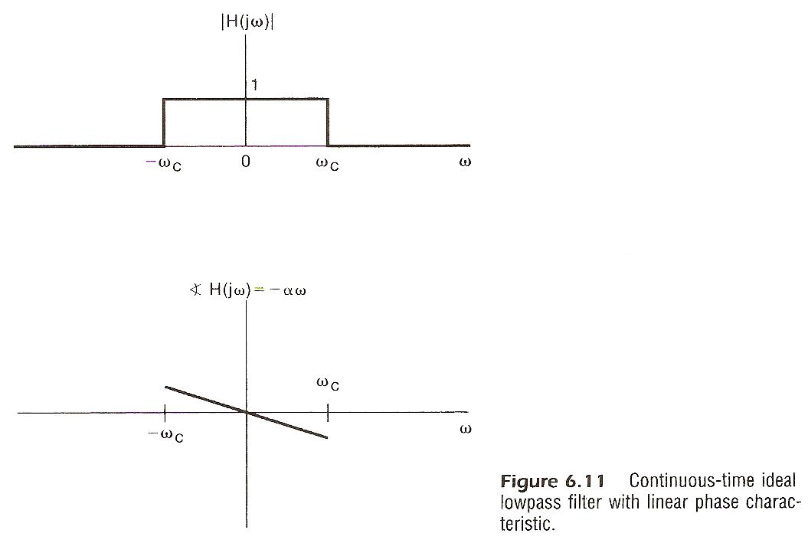

Slide 30
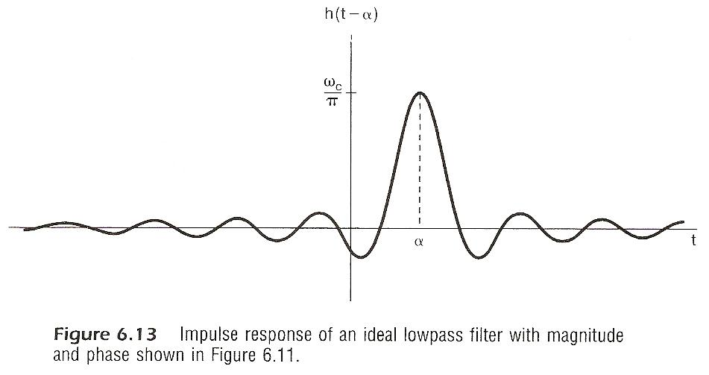

Slide 31
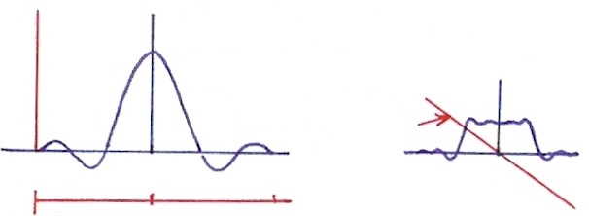





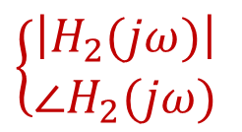




  Realizable Lowpass Filter
  (p.62 of 4.0)
$$F$$
$$h_{1}(t)$$
$$\left|H_{1}(jω)\right|$$
$$h_{2}(t)$$
$$F$$
$$\left\{\begin{aligned}\left|H_{2}(jω)\right| \\ ∠H_{2}(jω)\end{aligned}\right.$$
$$t$$
$$ω$$
$$−T$$
0
$$T$$
0
$$T$$
$$2T$$
0

Slide 32
Ideal Filters
Low pass Filters as an example
  step response
      See Fig. 6.14, p.443 of text
      overshoot, oscillatory behavior, rise time

Slide 33
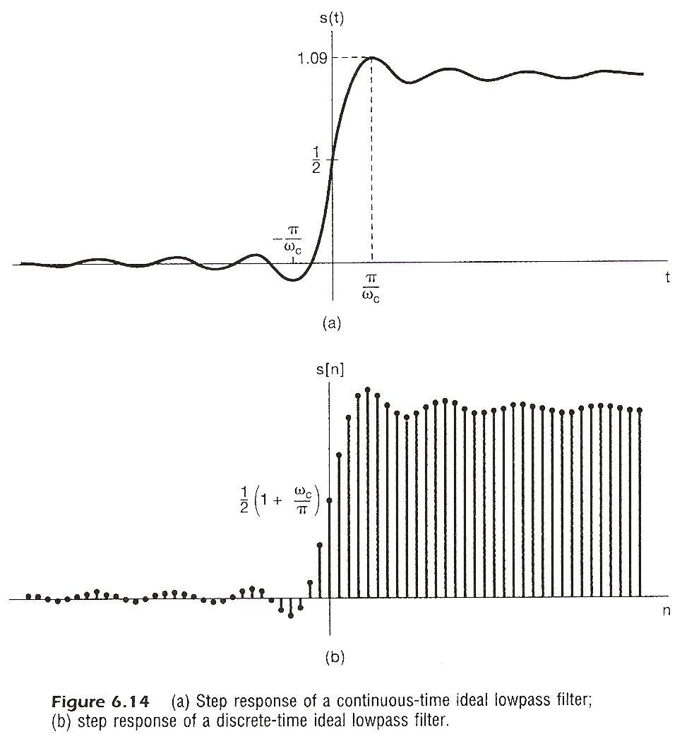

Slide 34
Nonideal Filters
Frequency Domain Specification
(Lowpass as an example)
  δ₁(passband ripple), δ₂(stopband ripple)
  ω_{p}(passband edge), ω_{s}(stopband edge)
  ω_{s} - ω_{p}(transition band)
  phase characteristics
magnitude
characteristics
      See Fig. 6.16, p.445 of text

Slide 35
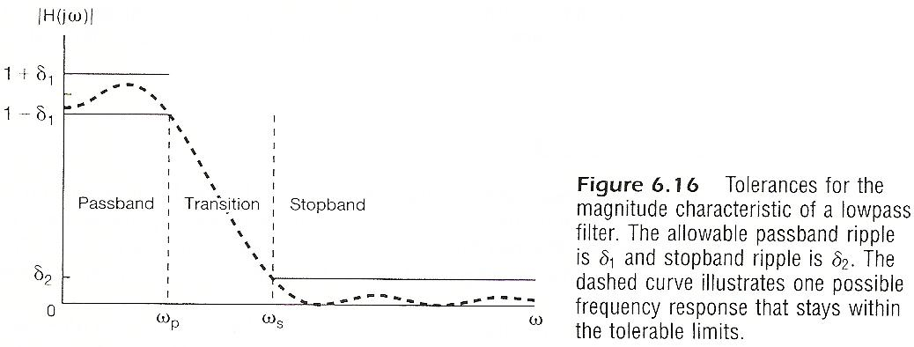
  δ₁(passband ripple), δ₂(stopband ripple)
  ω_{p}(passband edge), ω_{s}(stopband edge)
  ω_{s} - ω_{p}(transition band)
magnitude
characteristics

Slide 36
Nonideal Filters
Time Domain Behavior : step response
  t_{r}(rise time), δ(ripple), ∆(overshoot)
  ω_{r}(ringing frequency), t_{s}(settling time)
      See Fig. 6.17, p.446 of text

Slide 37
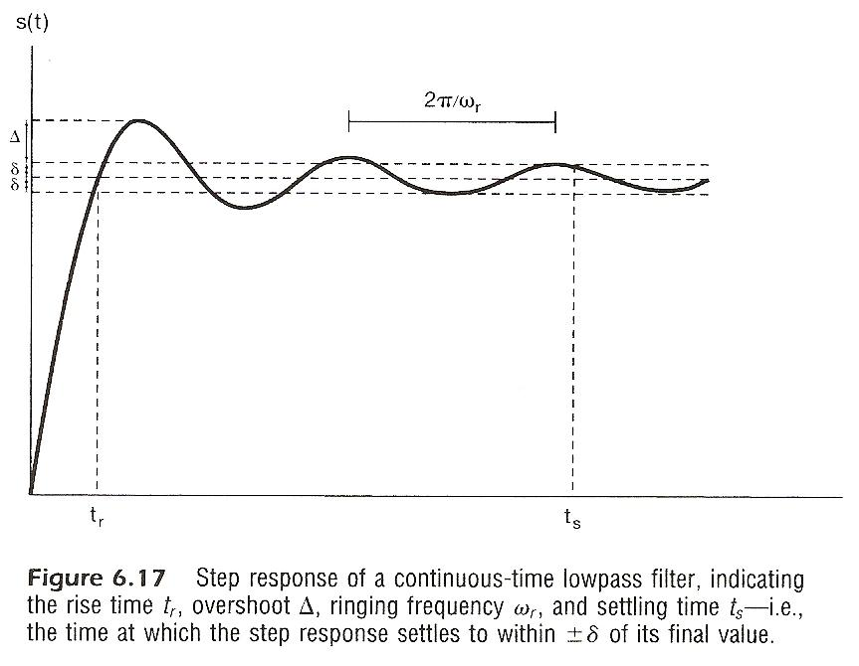
  t_{r}(rise time), δ(ripple), ∆(overshoot)
  ω_{r}(ringing frequency), t_{s}(settling time)

Slide 38
Nonideal Filters
Example: tradeoff between transition band width
(frequency domain) and settling time (time domain)
      See Fig. 6.18, p.447 of text

Slide 39
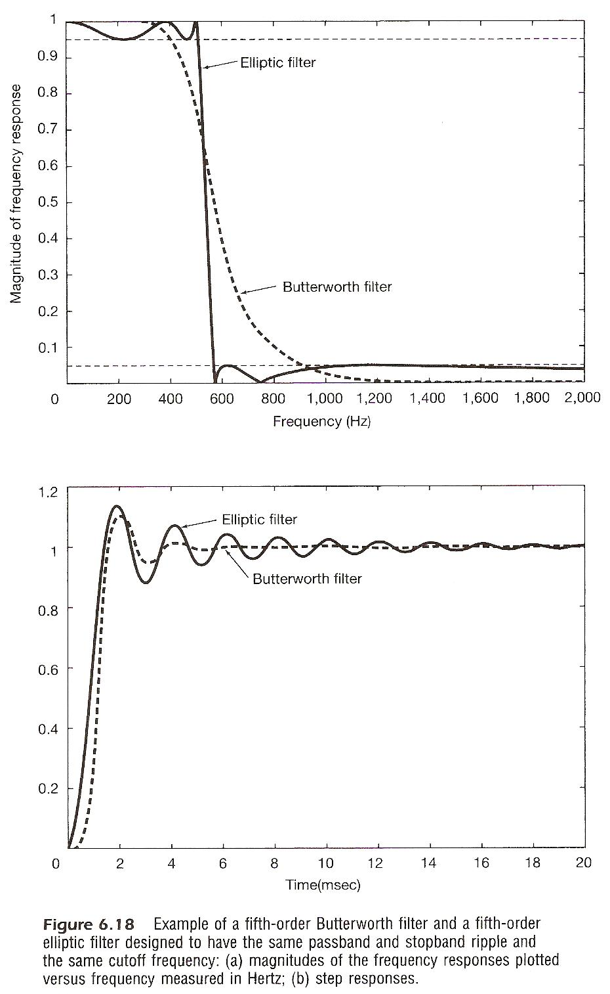

Slide 40
Nonideal Filters
Examples
  linear phase
  See Figs. 6.35, 6.36, pp.478,479 of text
  A narrower passband requires longer impulse response

Slide 41
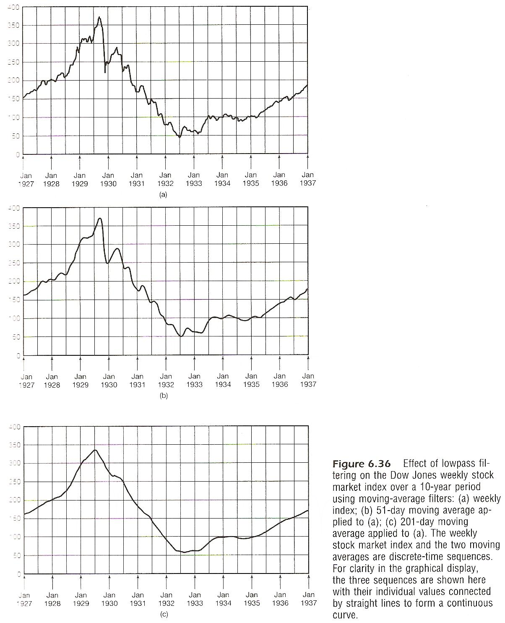

Slide 42
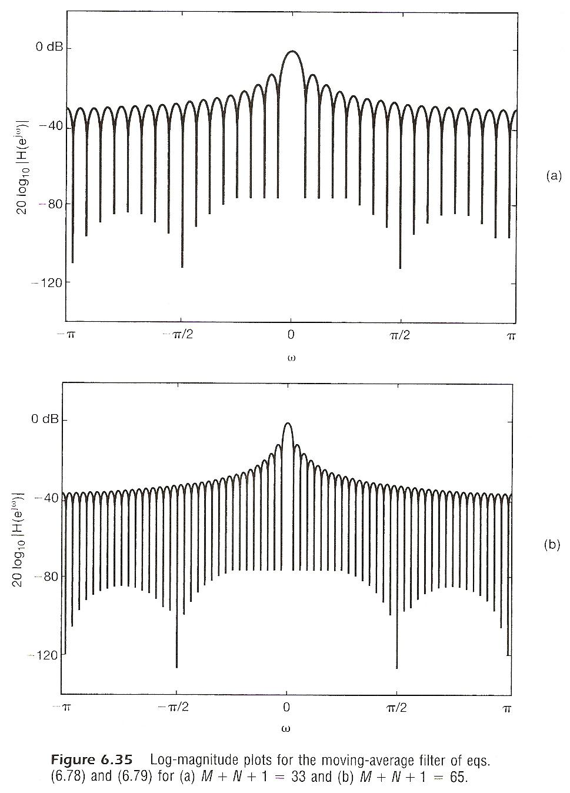

Slide 43
Nonideal Filters
Examples
  A more general form
  See Figs. 6.37, 6.38, p.480,481 of text
  A truncated impulse response for ideal lowpass filter gives much sharper transition
  See Figs. 6.39, p.482 of text
  very sharp transition is possible

Slide 44
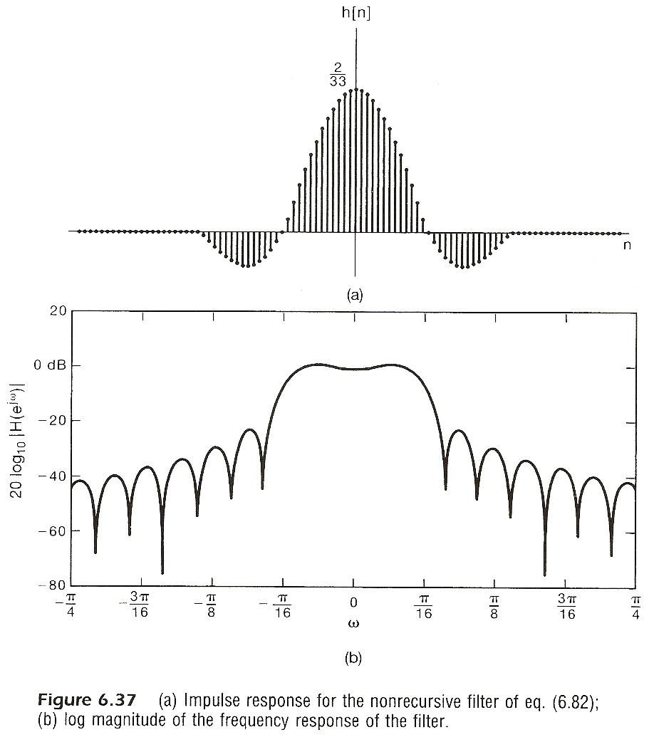

Slide 45
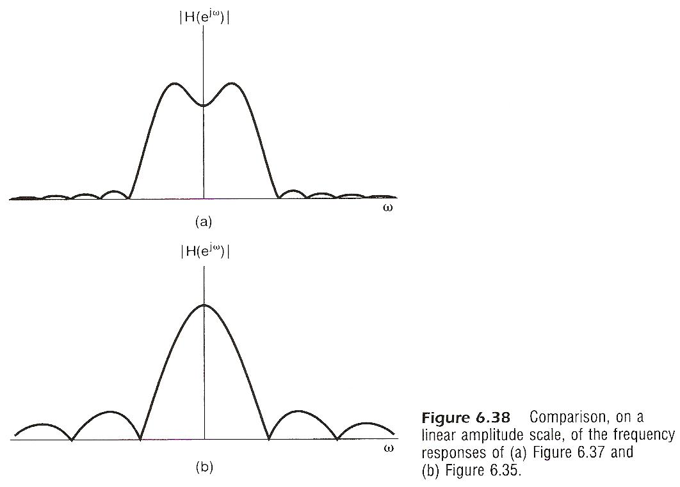

Slide 46
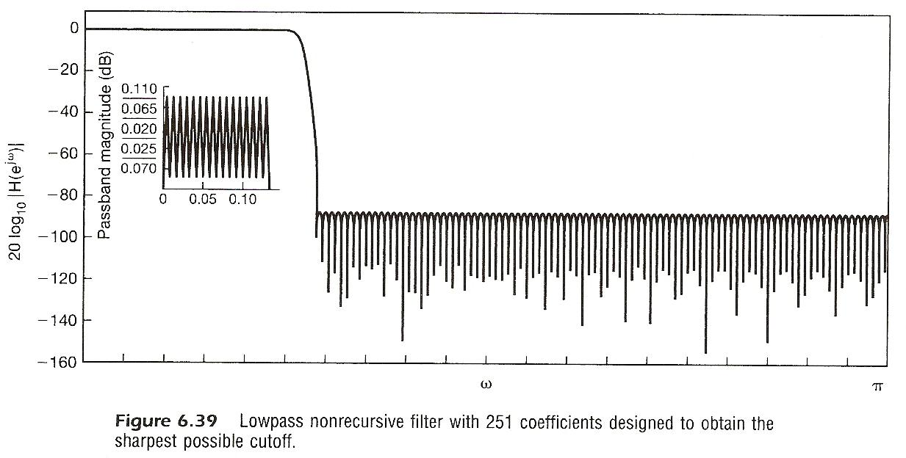

Slide 47
Nonideal Filters
To make a FIR filter causal

Slide 48
      6.3 First/Second-Order Systems
      Described by Differential/Difference
      Equations
  Higher-order systems can usually be represented as combinations of 1st/2nd-order systems
Continuous-time Systems by Differential Equations
  first-order
  second-order
        See Fig. 6.21, p.451 of text

Slide 49
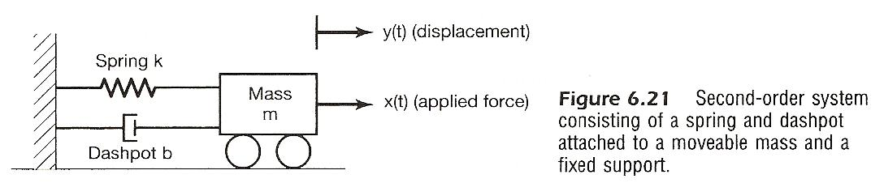

Slide 50
Discrete-time Systems by Differential Equations
  first-order
        See Fig. 6.26, 27, 28, p.462, 463, 464, 465 of text
  second-order

Slide 51
First-order Discrete-time system (P.461 of text)
y[n]
x[n]
D
a
y[n-1]

Slide 52
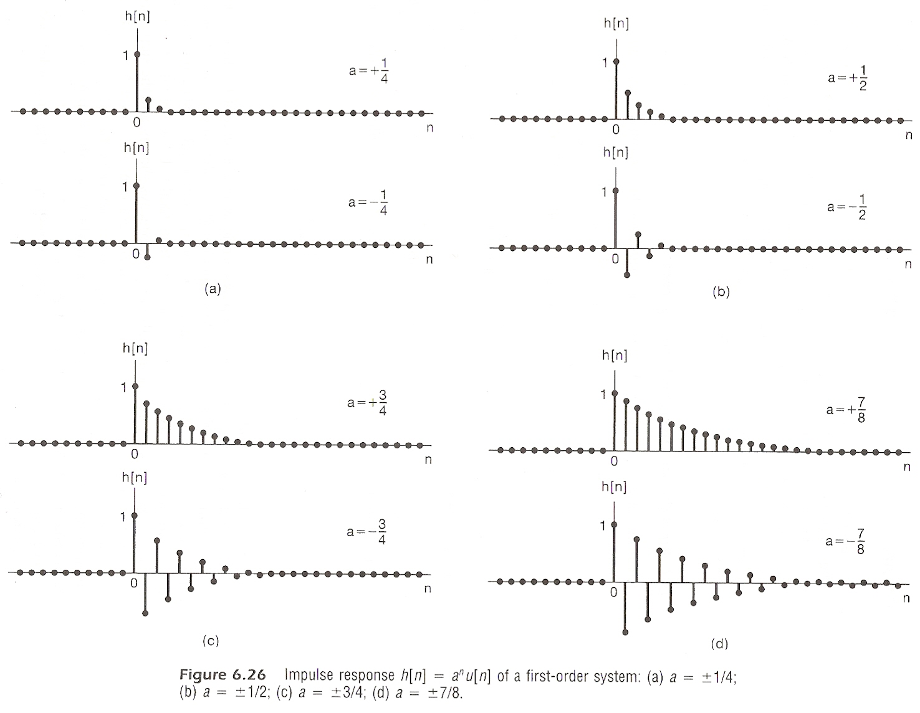

Slide 53
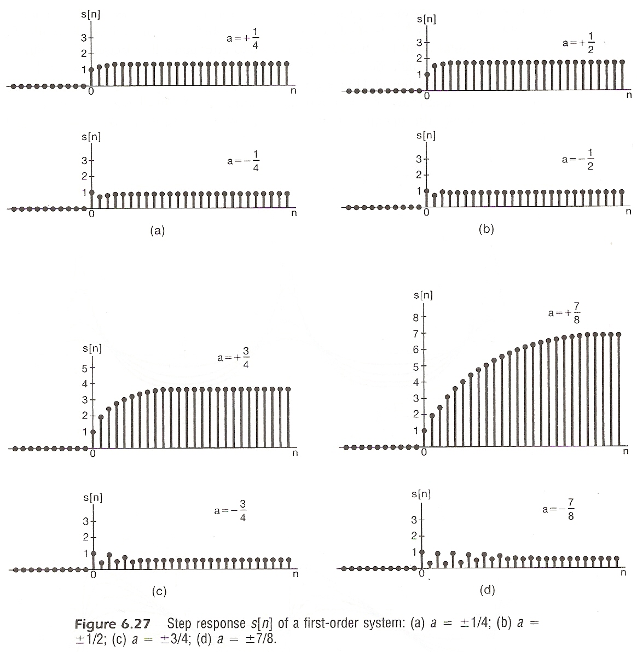

Slide 54
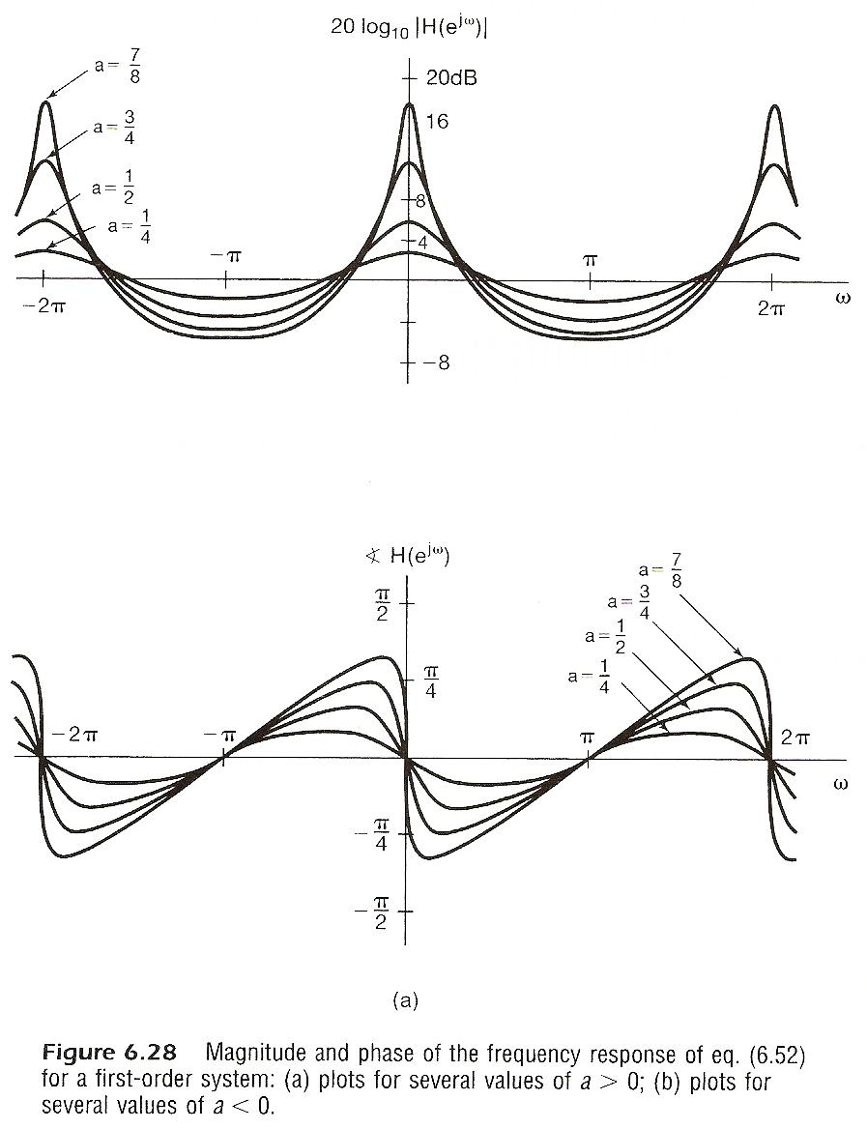

Slide 55
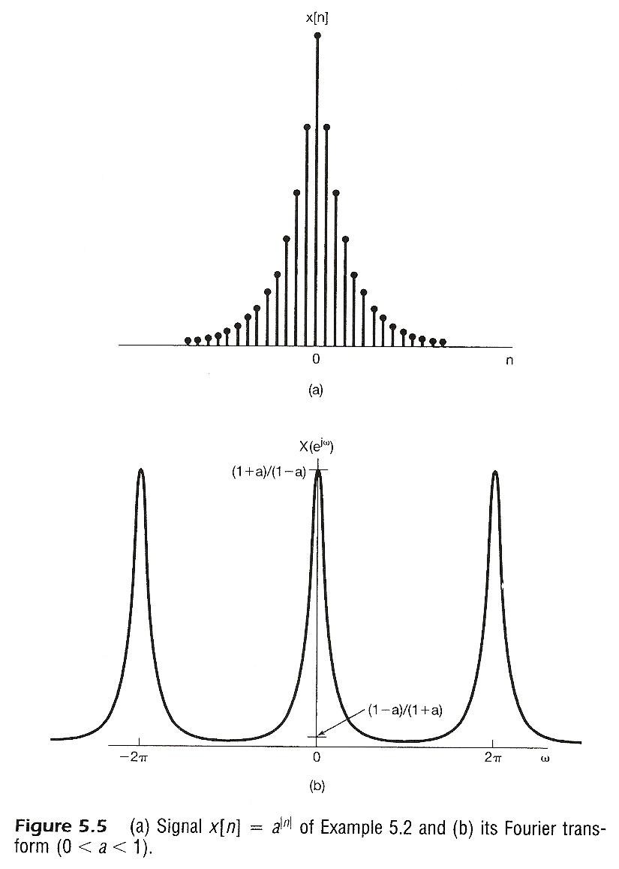

Slide 56
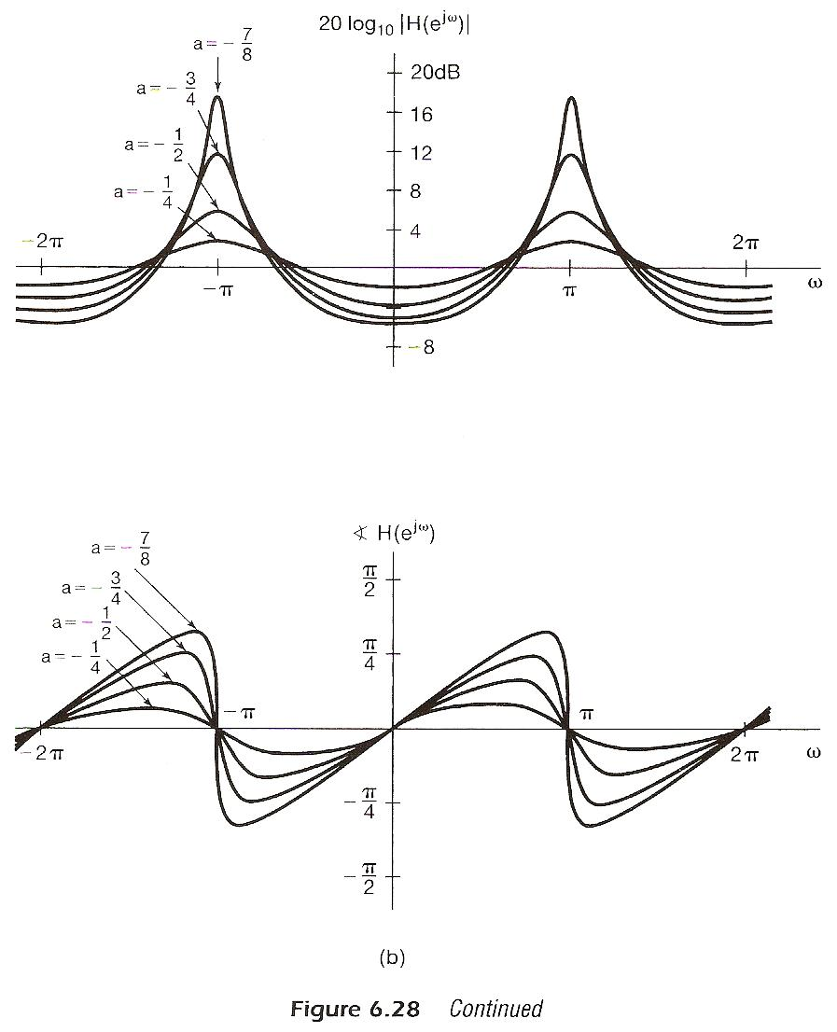

Slide 57
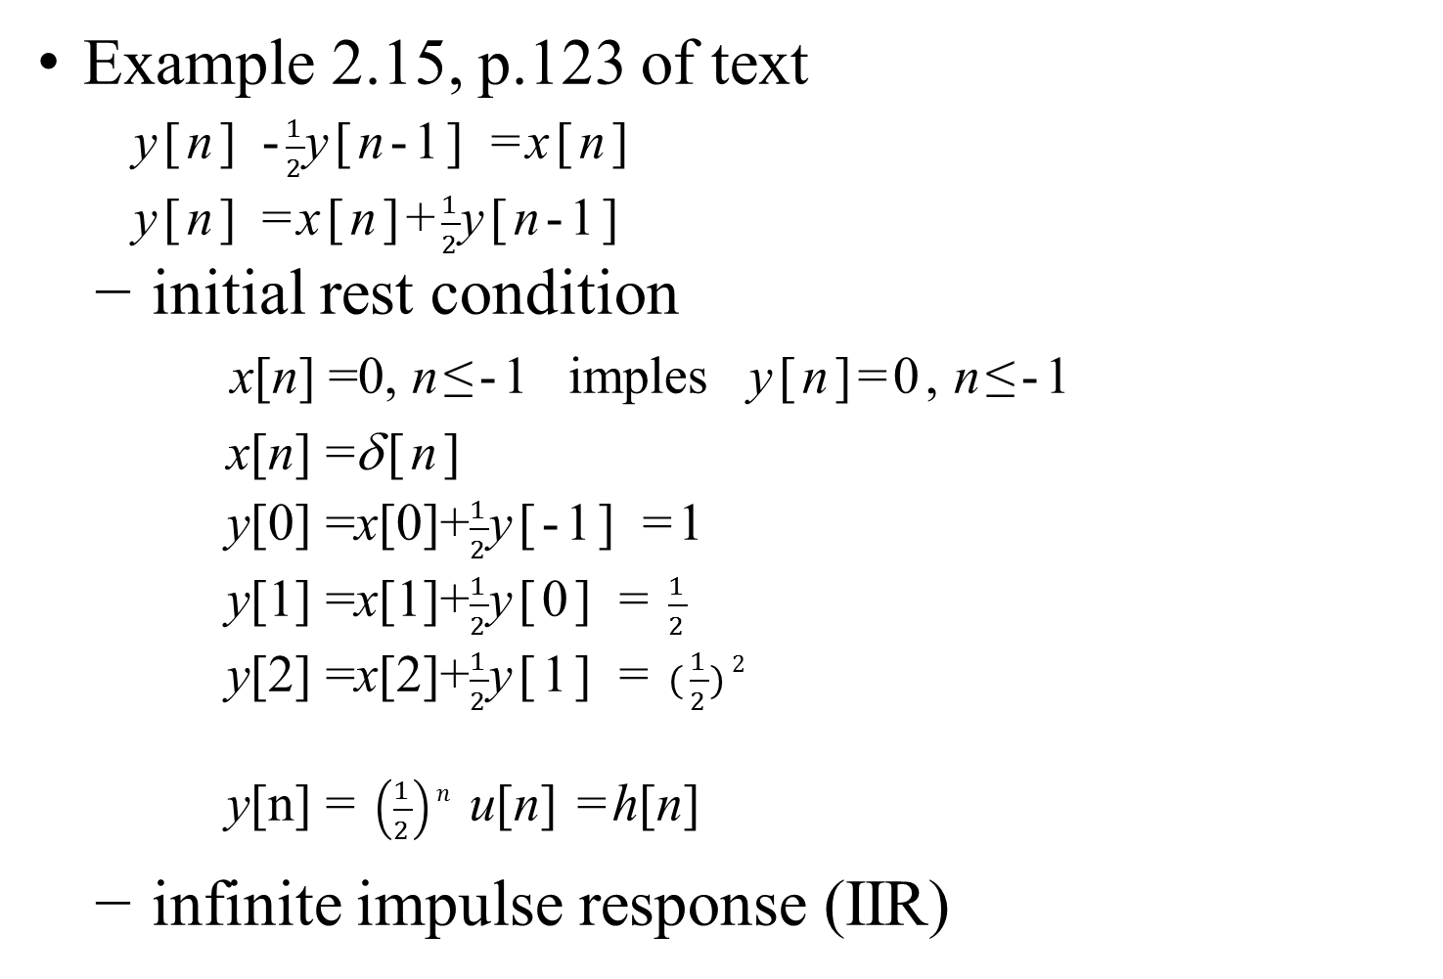
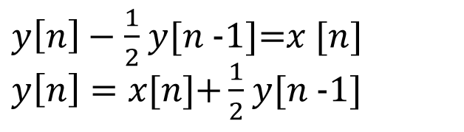
    Examples
  (p.114 of 2.0)
…

Slide 58
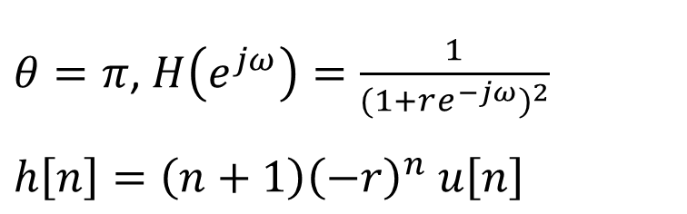
Second-order Discrete-time system (P.465 of text)
$θ=π$, $H\left(e^{jω}\right)=\frac{1}{{(1+re^{−jω})}^{2}}$
$$h\left[n\right]=\left(n+1\right){\left(−r\right)}^{n} u\left[n\right]$$

Slide 59
  (p.85 of 5.0)
    Problem 5.46, p.415 of text
F
F
F
F

Slide 60
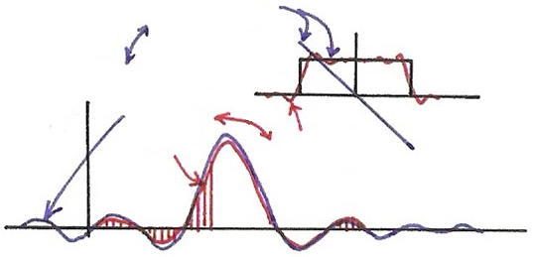









    Problem 6.59, p.508 of text
$$H_{d}(e^{jω})$$
$$F$$
$$h_{d}[n]$$
$$F$$
$$ω$$
$$h[n]$$
$$H(e^{jω})$$
$$n$$
0
$$N−1$$

Slide 61
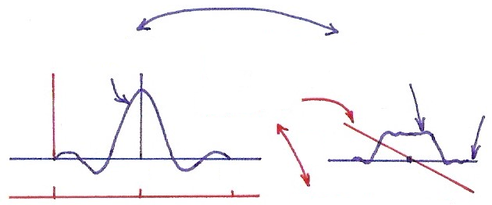















    Problem 6.64, p.511 of text
(a)
(b)
(4.3.3 of Table 4.1)
(c)
$$F$$
$$h[n]$$
$$h_{r}[n]$$
$$\left|H\left(e^{jω}\right)\right|=\left|H_{r}\left(e^{jω}\right)\right|$$
$$∡H_{r}\left(e^{jω}\right)=0$$
$$∡H\left(e^{jω}\right)$$
$$F$$
$$n$$
$$ω$$
$$−M$$
0
$$M$$
0
$$n$$
$$h\left[n\right]=h_{r}[n−M]$$
0
$$M$$
$$2M$$

Slide 62
