Slide 1
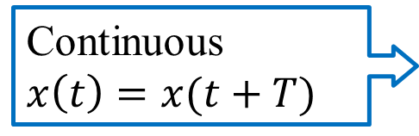
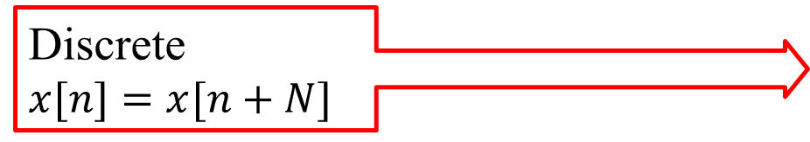


5.0 Discrete-time Fourier Transform
      5.1 Discrete-time Fourier Transform
        Representation for discrete-time signals
  Chapters 3, 4, 5
Chap 3 Periodic Fourier Series | Chap 4 Aperiodic Fourier Transform | Chap 5 Aperiodic Fourier Transform
$$x\left(t\right)↔X\left(jω\right)$$
$$x[n]↔X(e^{jω})$$
Continuous
$$x\left(t\right)=x(t+T)$$
Discrete
$$x[n]=x[n+N]$$

Slide 2
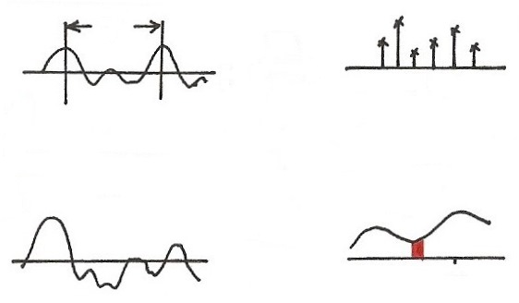







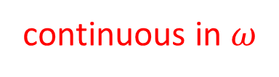






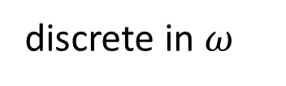
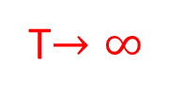




  Fourier Transform (p.3 of 4.0)
T
FS
$$t$$
$$ω$$
0
$$ω_{0}$$
$${3ω}_{0}$$
$$ω_{0}=\frac{2π}{T}$$
$${2ω}_{0}$$
$$e^{j3ω_{0}t}$$
T$→∞$
$$ω_{0}→0$$
periodic in $t$
discrete in $ω$
$$x(t)$$
$$X(jω)$$
$$F$$
$$t$$
$$jω$$
$$ω_{k}$$
$$e^{jω_{k}t}$$
aperiodic in $t$
continuous in $ω$

Slide 3
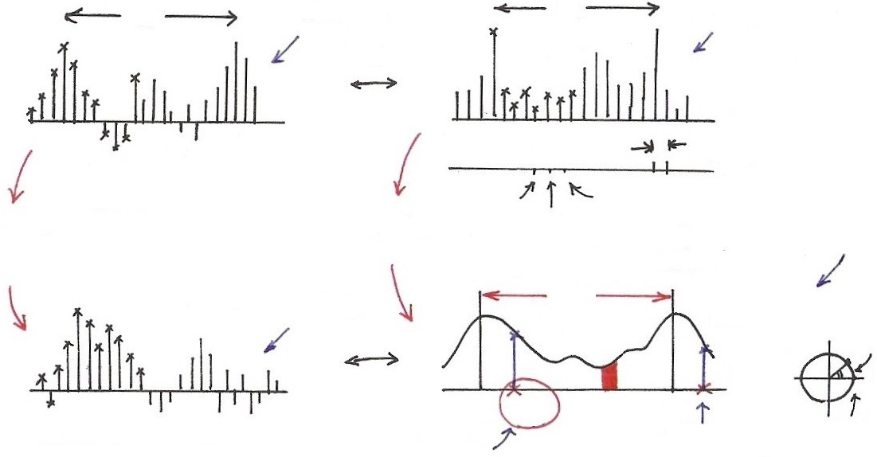
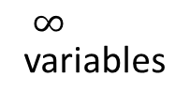











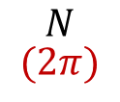













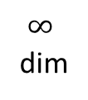




  Discrete-time Fourier Transform
$$N$$
$$N$$
$$(2π)$$
N dim
N variables
$$FS$$
$$n$$
$$k$$
012
$$ω_{0}$$
periodic in $n$
$$ω$$
0
$${2ω}_{0}$$
$$ω_{0}$$
$$ω_{0}=\frac{2π}{N}$$
$∞$
dim
$$ω_{0}→0$$
$$N→∞$$
discrete and periodic in $ω$
$$x[n]$$
$∞$
variables
$$2π$$
$$X(e^{jω})$$
$$Im$$
$$F$$
$$ω$$
$$n$$
$$Re$$
$$ω_{k}$$
$$e^{jω}$$
$$ω_{k}+2π$$
(1,0)
aperiodic in $n$
$$e^{jω_{k}n}$$
$${=e}^{j(ω_{k}+2π)n}$$
continuous and periodic in $ω$

Slide 4
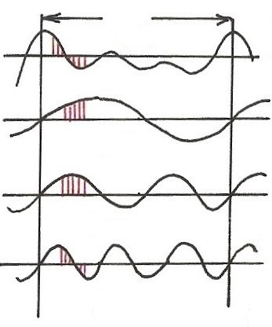
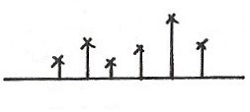


















  Harmonically Related Exponentials for Periodic Signals
  (p.11 of 3.0)
$$[n]$$
T
$V=\{x(t)\left|x(t)\right.$ periodic, fundamental period
$$(N)$$
$$[n]$$
$$=T(N)\}$$
$$t, n$$
$$a_{4}$$
$$t, n$$
$$a_{1}$$
$$a_{3}$$
$$a_{5}$$
$$k=1$$
$$a_{0}$$
$$ω_{0}=\frac{2π}{T}$$
$$k$$
$$(N)$$
$$0 1 2 3 4 5$$
$$t, n$$
$$k=2$$
$$ω$$
$$0$$
$$ω_{0}$$
$${3ω}_{0}$$
$${5ω}_{0}$$
$$t, n$$
$${2ω}_{0}$$
$${4ω}_{0}$$
$$k=3$$
All with period T: integer multiples of ω₀
Discrete in frequency domain
$$(N)$$

Slide 5
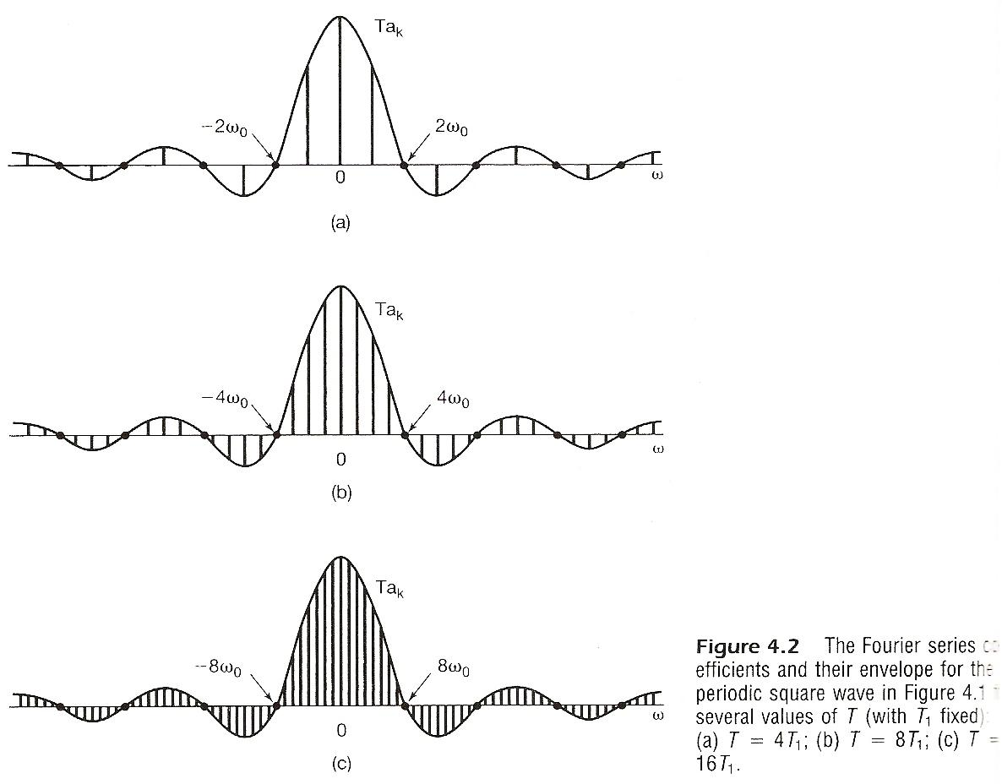

Slide 6
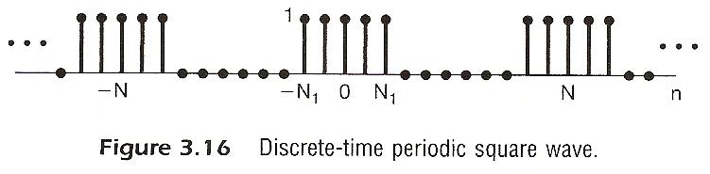

Slide 7
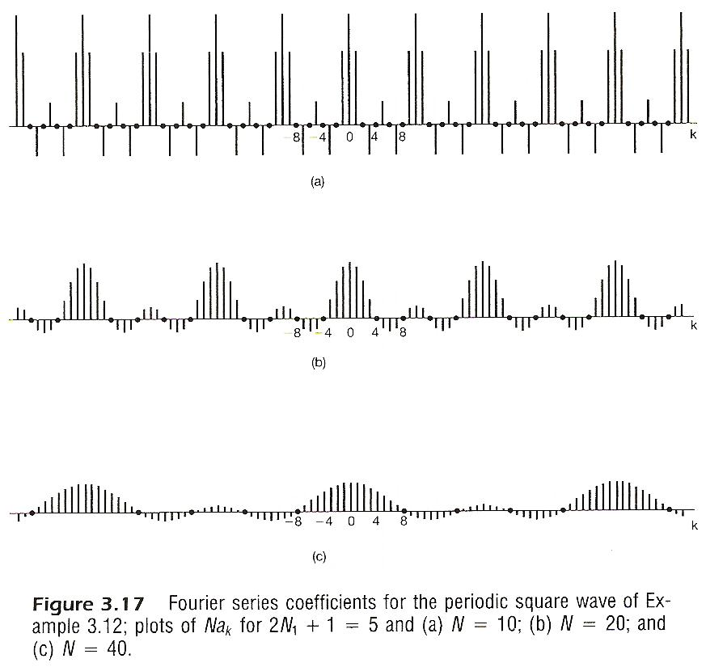

Slide 8
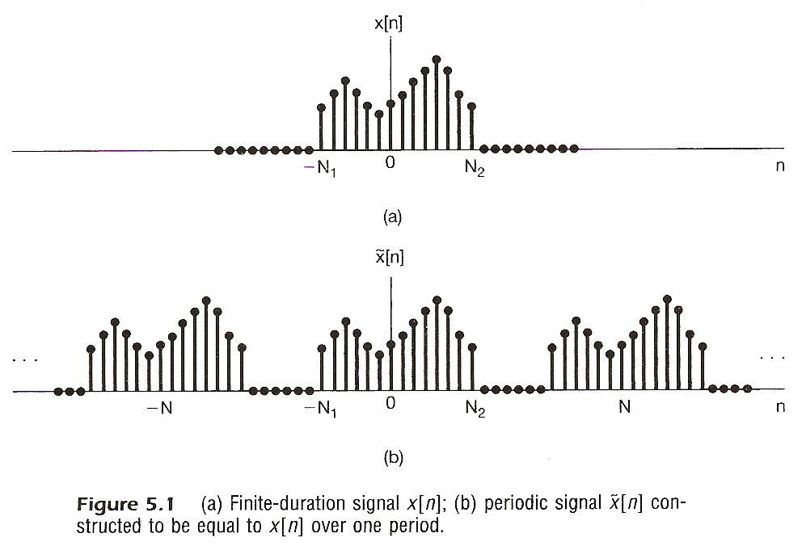
From Periodic to Aperiodic
Considering x[n], x[n]=0 for n > N₂ or n < -N₁
  Construct

Slide 9
From Periodic to Aperiodic
Considering x[n], x[n]=0 for n > N₂ or n < -N₁
  Fourier series for
  Defining envelope of

Slide 10
  As
signal, time domain, Inverse Discrete-time Fourier Transform
spectrum, frequency domain Discrete-time Fourier Transform
  Similar format to all Fourier analysis representations previously discussed

Slide 11
(p.10 of 4.0)
spectrum, frequency domain
Fourier Transform
signal, time domain Inverse Fourier Transform
        Fourier Transform pair, different expressions
        very similar format to Fourier Series for periodic signals

Slide 12
Note: X(e^{jω}) is continuous and periodic with period
  2π
  Integration over 2π only
  Frequency domain spectrum is continuous and periodic, while time domain signal is discrete-time and aperiodic
  Frequencies around ω=0 or 2π are low-frequencies, while those around ω= ±π are high-frequencies, etc.
        See Fig. 5.3, p.362 of text
        For Examples see Fig. 5.5, 5.6, p.364, 365 of text

Slide 13
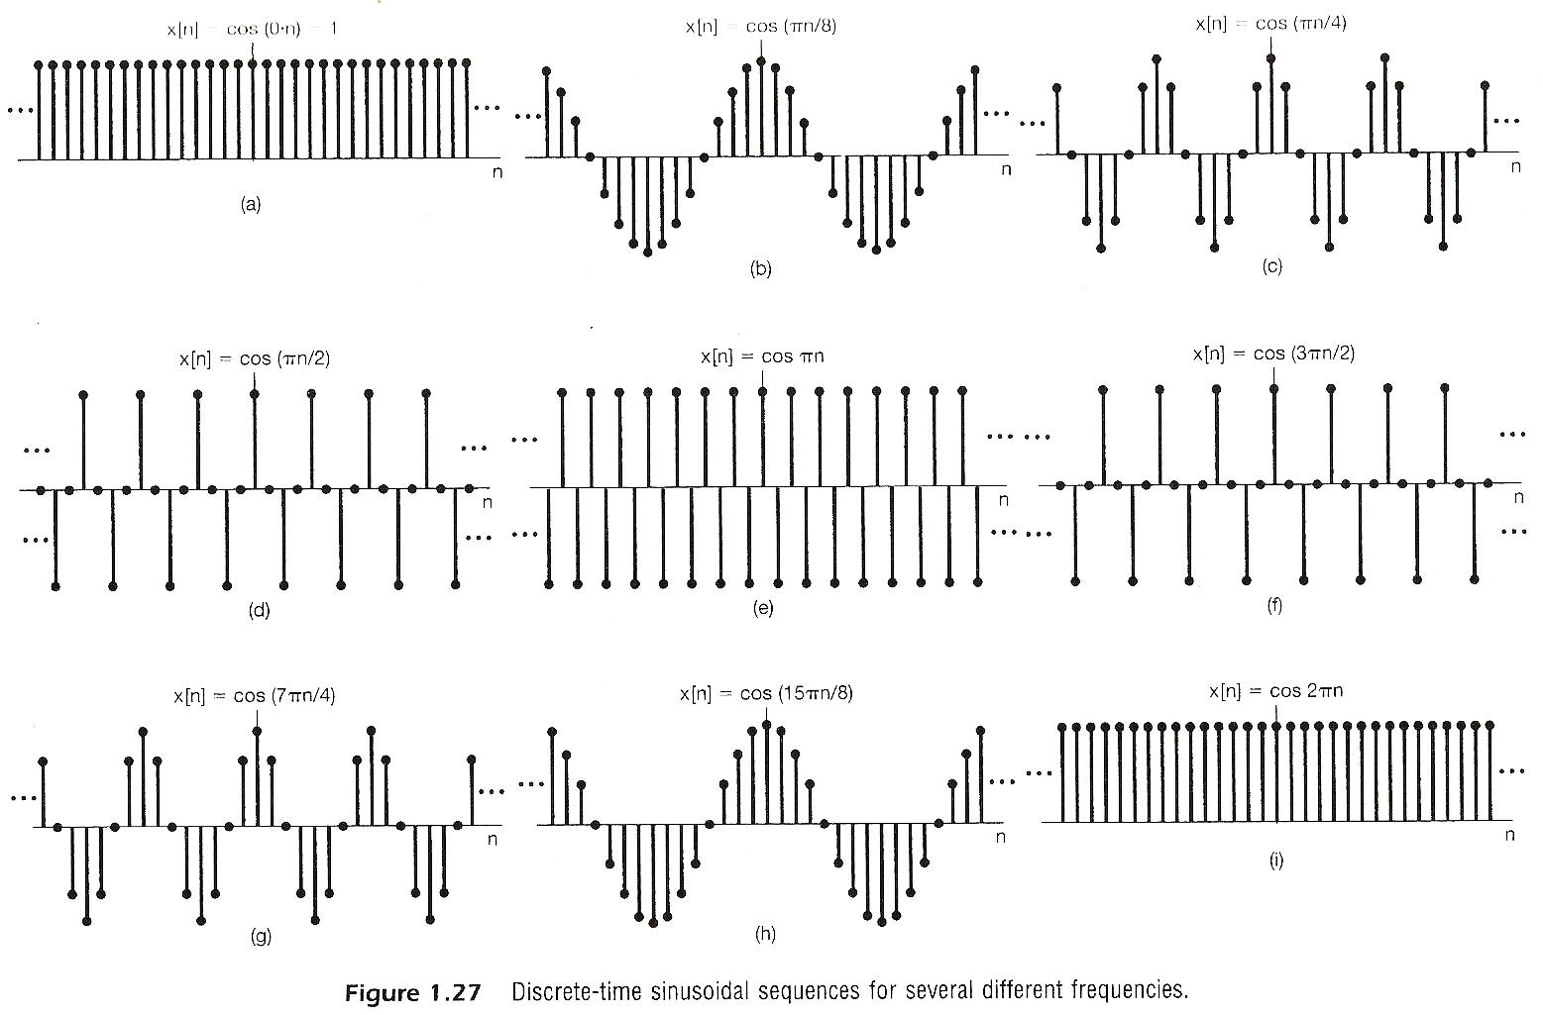

Slide 14
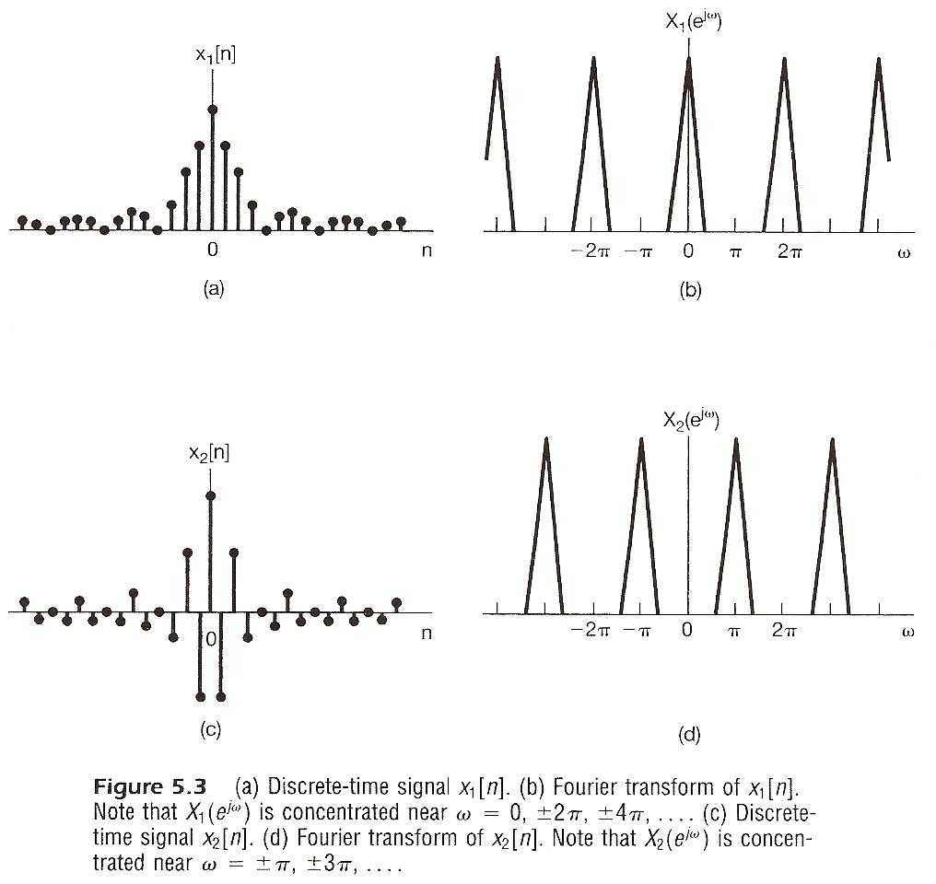

Slide 15
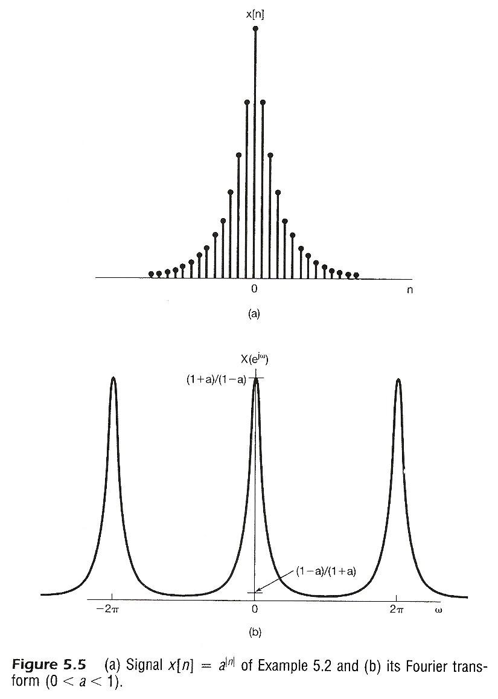

Slide 16
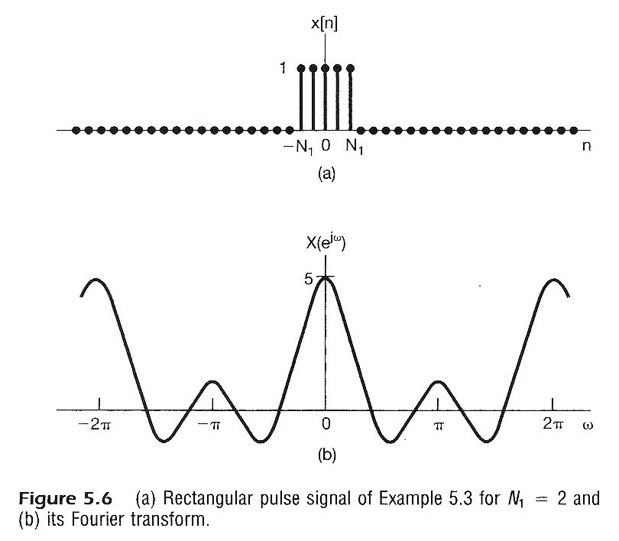

Slide 17
From Periodic to Aperiodic
Convergence Issue
given x[n]
  No convergence issue since the integration is over an finite interval
  No Gibbs phenomenon
        See Fig. 5.7, p.368 of text

Slide 18
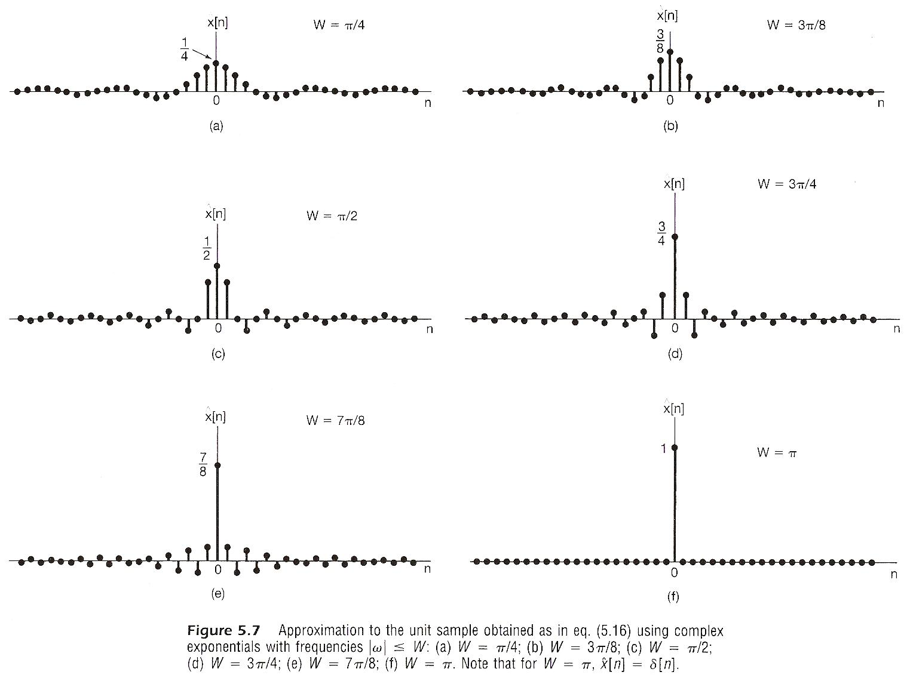

Slide 19
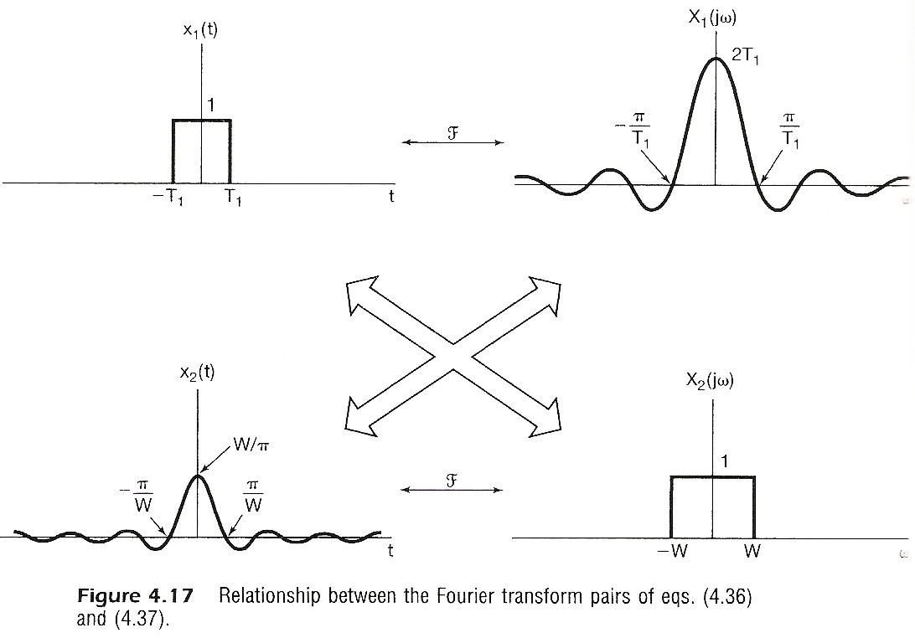

Slide 20
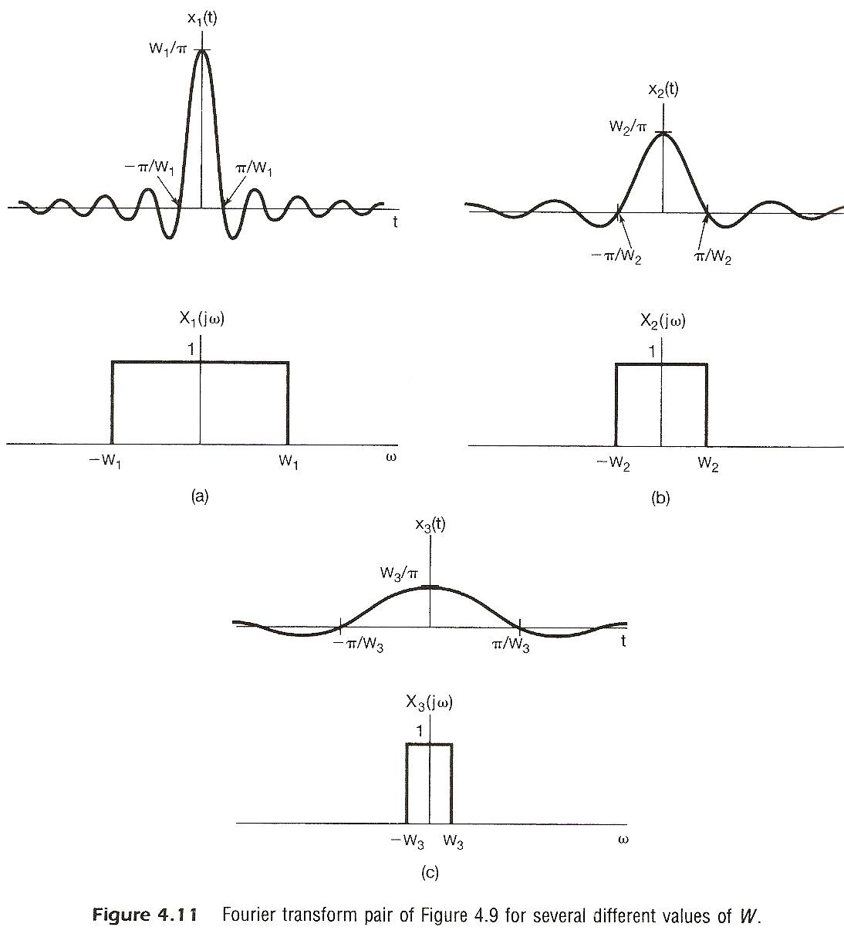

Slide 21
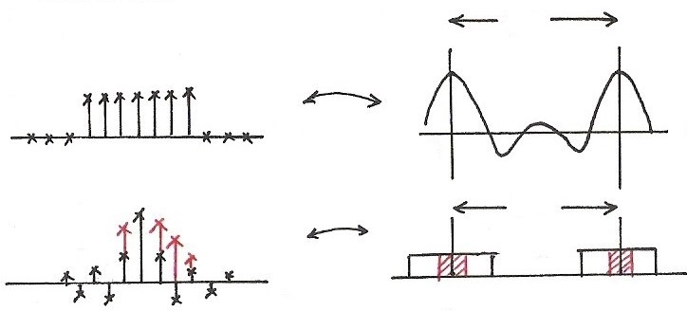










  Rectangular/Sinc
$$2π$$
$$F$$
$$n$$
$$ω$$
0
$$2π$$
$$F$$
$$2π$$
$$ω$$
$$n$$
0
$$2π$$

Slide 22
Fourier Transform for Periodic Signals –
Unified Framework (p.16 of 4.0)
  Given x(t)
  (easy in one way)

Slide 23
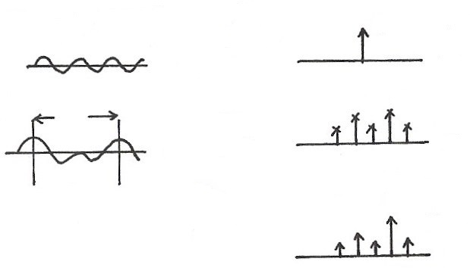











  Unified Framework: Fourier Transform for Periodic Signals (p.17 of 4.0)
$$2πδ(ω−ω_{0})$$
$$e^{jω_{0}t}$$
$$F$$
$$t$$
$$ω$$
$$ω_{0}$$
T
$$a_{k}$$
$$x(t)$$
FS
$$ω$$
$$t$$
$${kω}_{0}$$
$$F$$
$$X(jω)$$
$$2πa_{k}δ(ω−{kω}_{0})$$
  If
$$ω$$
$${kω}_{0}$$
F

Slide 24
From Periodic to Aperiodic
For Periodic Signals – Unified Framework
  Given x[n]
        See Fig. 5.8, p.369 of text

Slide 25
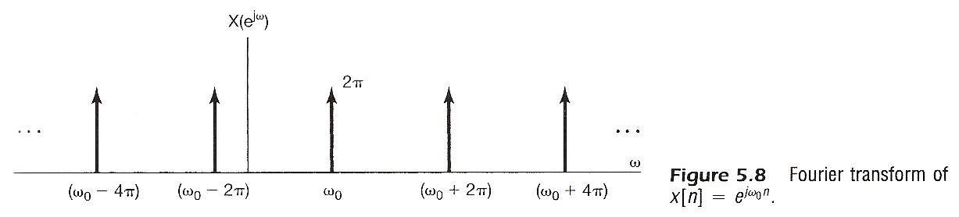

Slide 26
From Periodic to Aperiodic
For Periodic Signals – Unified Framework
  If
        See Fig. 5.9, p.370 of text

Slide 27
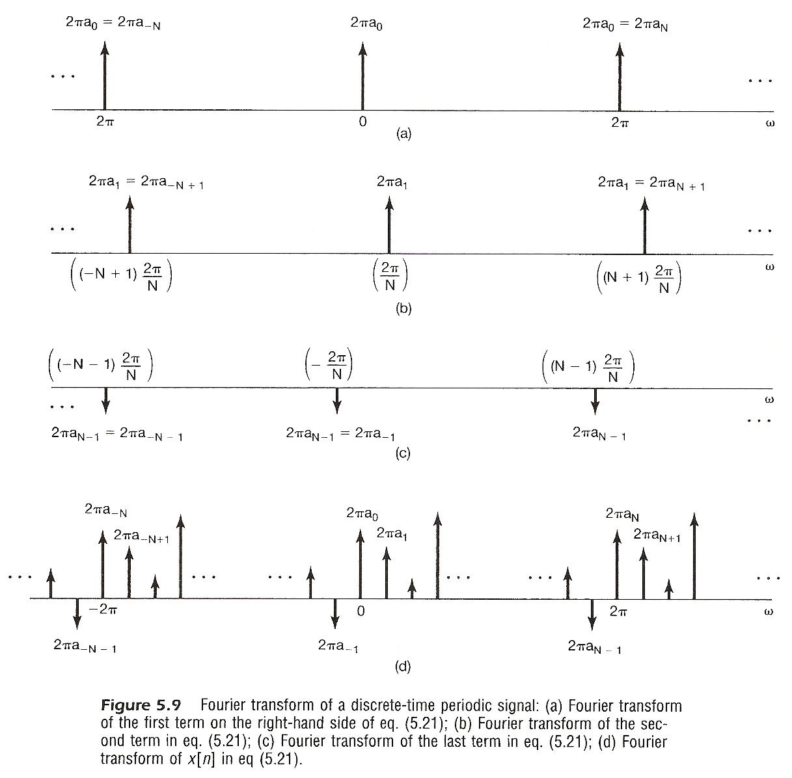

Slide 28
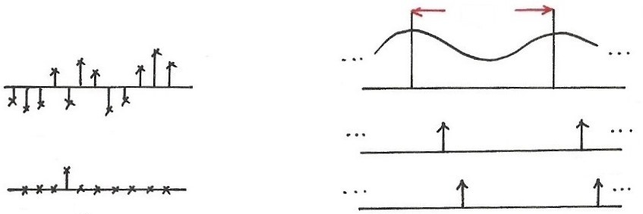


















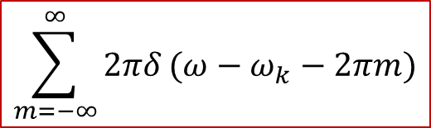




  Signal Representation in Two Domains
Time Domain Frequency Domain
$$2π$$
$$X(e^{jω})$$
$$x[n]$$
$$ω$$
$$δ[n−k_{1}]$$
$$ω$$
$$ω_{1}$$
$$ω_{1}+2π$$
$$k_{1}$$
$$ω$$
$$ω_{2}$$
$$ω_{2}+2π$$
$$δ[n−k_{2}]$$
$$\sum_{m=−∞}^{∞}{2πδ}(ω−ω_{k}−2πm)$$
$$\{$$
$$, −∞<ω<∞\}$$
$$k_{2}$$
$\{δ\left[n−k\right]$ , k: integer, $−∞<k<∞\}$
$$F$$
$$n$$
$$e^{jω_{k}n}$$

Slide 29
      5.2 Properties of Discrete-time Fourier
      Transform
Periodicity
Linearity

Slide 30
Time/Frequency Shift
Conjugation

Slide 32
Differencing/Accumulation
Time Reversal

Slide 33
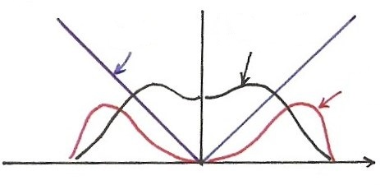





  Differentiation (p.35 of 4.0)
$$\left|jω⋅X(jω)\right|=\left|ω\right|⋅\left|X(jω)\right|$$
$$\left|ω\right|$$
$$\left|X(jω)\right|$$
$$\left|ω\right|\left|X(jω)\right|$$
$$ω$$
Enhancing higher frequencies
De-emphasizing lower frequencies
Deleting DC term ( =0 for ω=0)

Slide 34
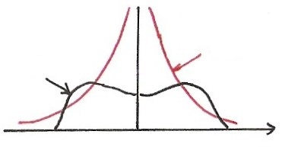
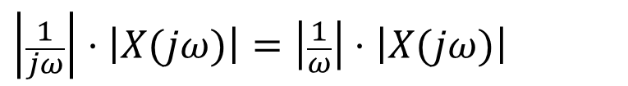




  Integration (p.36 of 4.0)
  dc term
$$\frac{1}{j}=e^{−j90°}$$
$$\left|\frac{1}{jω}\right|⋅\left|X(jω)\right|=\left|\frac{1}{ω}\right|⋅\left|X(jω)\right|$$
$$\left|\frac{1}{ω}\right|$$
$$X(jω)$$
$$ω$$
Enhancing lower frequencies (accumulation effect)
De-emphasizing higher frequencies
(smoothing effect)
Undefined for ω=0
Accumulation

Slide 35
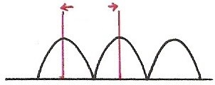
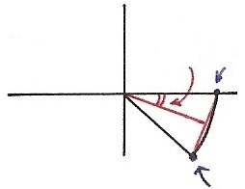
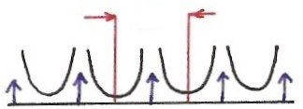












  Differencing/Accumulation
Differencing
$$2π$$
$$\frac{1}{2}ω$$
1
$$ω$$
$$−2π$$
$$0$$
$$2π$$
Enhancing higher frequencies
De-emphasizing lower freq
Deleting DC term
$$e^{−jω}$$
$$\left|1−e^{−jω}\right|=2\left|\sin{(\frac{ω}{2})}\right|$$
Differencing/Accumulation
Accumulation
$$2π$$
$$−2π$$
$$0$$
$$2π$$

Slide 36

Time Reversal
(p.29 of 3.0)
the effect of sign change for x(t) and a_{k} are identical
$$⋯a_{−1} e^{−jω_{0}t}+a_{0}+a_{1} e^{jω_{0}t}+⋯=x(t)$$
$$⋯a_{−1} e^{jω_{0}t}⋯=x(−t)$$
unique representation for orthogonal basis

Slide 37
Time Expansion
If n/k is an integer, k: positive integer
        See Fig. 5.13, p.377 of text
        See Fig. 5.14, p.378 of text

Slide 38
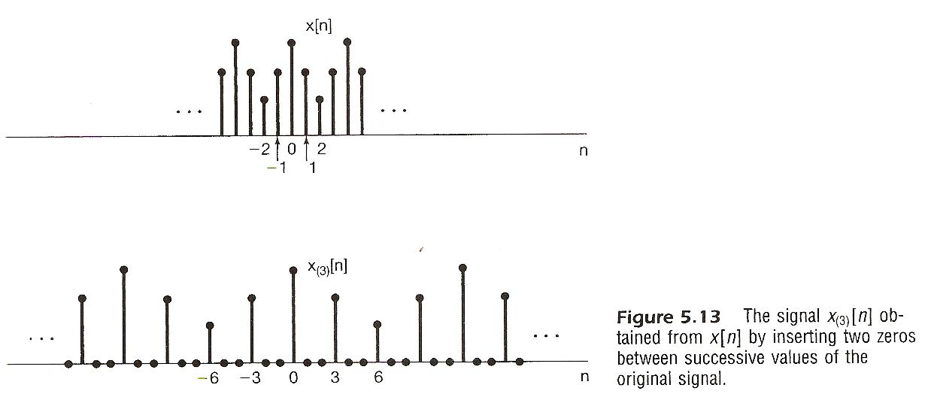

Slide 39
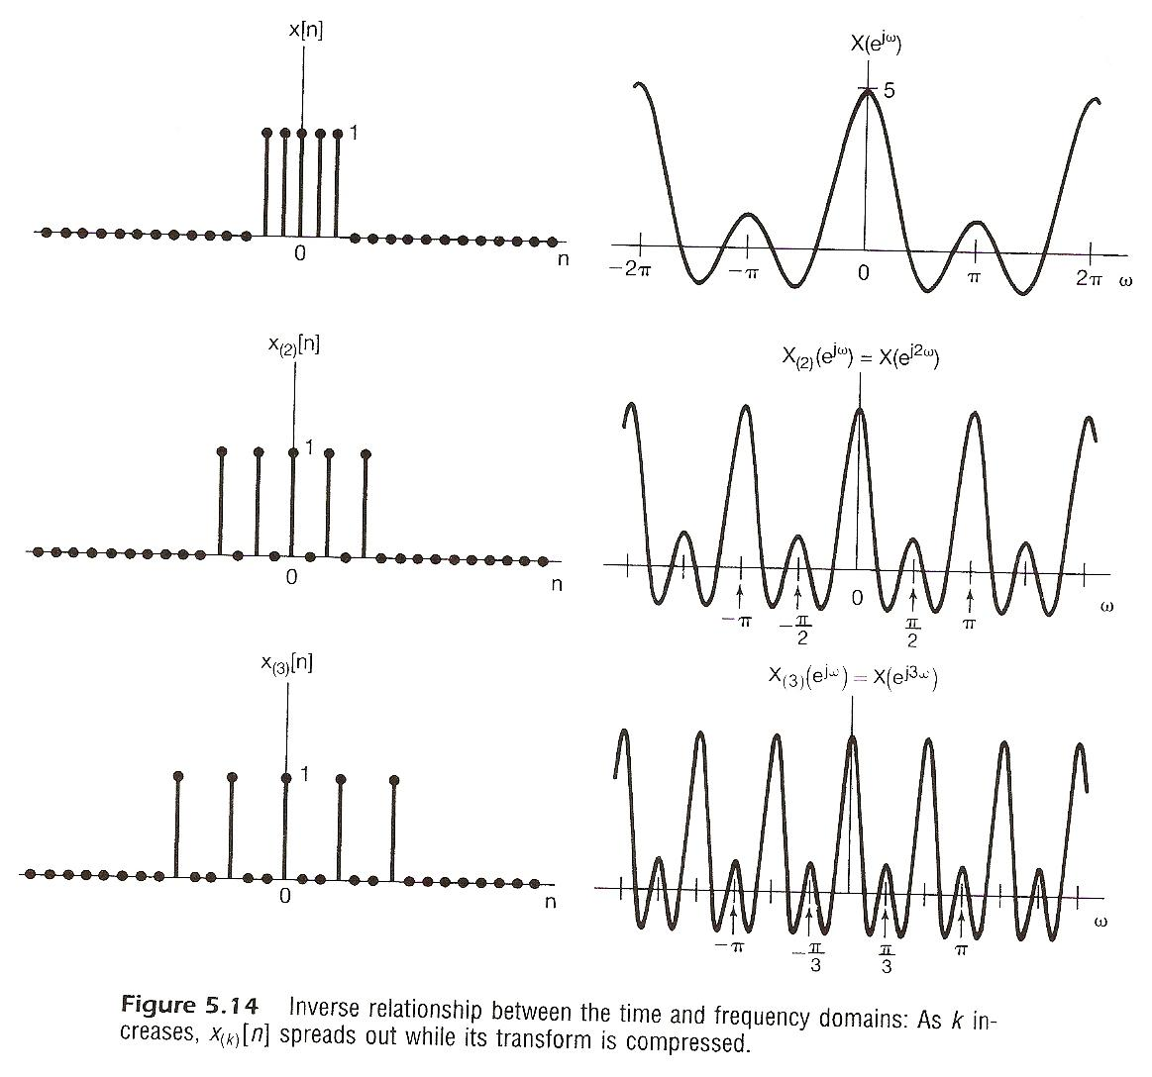

Slide 40
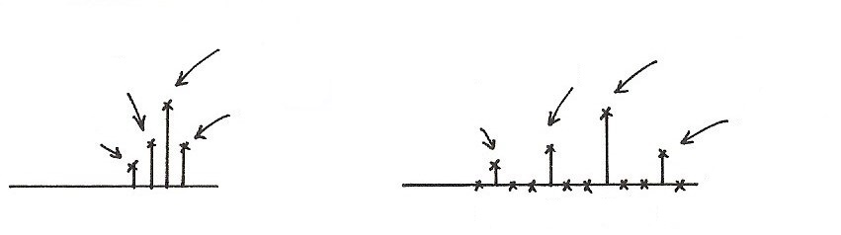







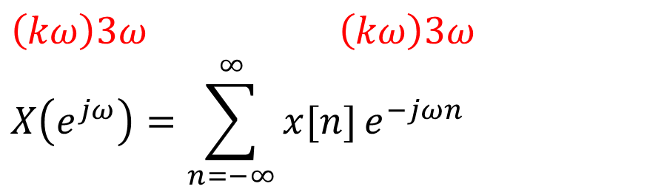

  Time Expansion
$$e^{−jω}$$
$$e^{−j3ω}$$
1
1
$$e^{−j2ω}$$
$$e^{j3ω}$$
$$e^{−j6ω}$$
$$e^{jω}$$
$$n$$
$$n$$
-1 01 2
-3 0 3 6
$\left(kω\right)3ω$ $\left(kω\right)3ω$
$$X\left(e^{jω}\right)=\sum_{n=−∞}^{∞}{x[n]}e^{−jωn}$$

Slide 41



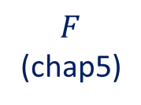

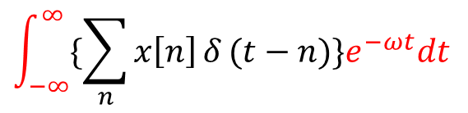





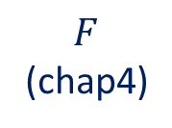

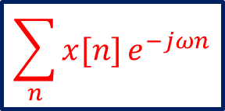
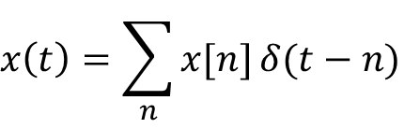
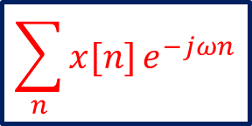
  Time Expansion
$$n$$
$$n$$
-1 0 1 2
-3 0 3 6
Discrete-time
Continuous-time
$$x[n]$$
$$x\left(t\right)=\sum_{n}{x[n]}δ(t−n)$$
$$F$$
(chap5)
$$\sum_{n}{x[n]}e^{−jωn}$$
$$F$$
(chap4)
$$\int_{−∞}^{∞}{\{\sum_{n}{x\left[n\right]}δ}(t−n)\}e^{−ωt}dt$$
$$\sum_{n}{x[n]}e^{−jωn}$$
$$=$$
$$t$$
$$t$$
-1 0 1 2
-3 0 3 6
?
$$x\left(a t\right)\underset{↔}{ F } \frac{1}{\left|a\right|} X (\frac{jω}{a})$$
$a=\frac{1}{k}$ , k=integer

Slide 42
Differentiation in Frequency
Parseval’s Relation

Slide 43
Convolution Property
frequency response or transfer function
Multiplication Property
      periodic convolution

Slide 44



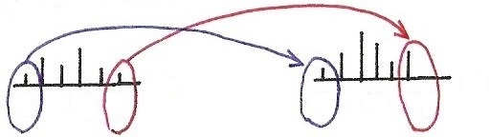








  Input/Output Relationship
(P.55 of 4.0)
$$x(t)$$
$$y(t)$$
Time Domain
$$δ(t)$$
$$h(t)$$
$$t$$
$$t$$
0
0
Frequency Domain
$$ω$$
$$ω$$
$$ω_{1}$$
$$ω_{3}$$
$$ω_{5}$$
$$ω_{1}$$
$$ω_{3}$$
$$ω_{5}$$

Slide 45
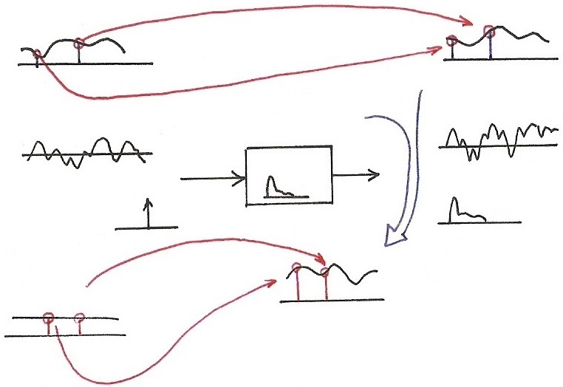




































  Convolution Property
  (p.57 of 4.0)
$$X\left(jω_{2}\right)H\left(jω_{2}\right)=Y(jω_{2})$$
$$Y\left(jω\right)=X(jω)H\left(jω\right)$$
$$X(jω)$$
$$H\left(jω_{2}\right)=\int_{−∞}^{∞}{h(τ)}e^{−jω_{2}τ}dτ$$
$$F$$
$$ω$$
$$ω_{1}$$
$$ω_{2}$$
$$ω$$
$$ω_{1}$$
$$ω_{2}$$
$$F$$
$$H\left(jω_{1}\right)=\int_{−∞}^{∞}{h(τ)}e^{−jω_{1}τ}dτ$$
$$x\left(t\right)∗h(t)=y(t)$$
$$F$$
$$x(t)$$
$$t$$
$$t$$
$$h(t)$$
$$δ(t)$$
$$h(t)$$
$$t$$
$$F$$
$$t$$
$$F$$
$$H\left(jω_{2}\right)$$
$$H(jω)$$
$$F$$
$$1.0$$
$$1.0$$
$$ω$$
$$1$$
$$ω_{1}$$
$$ω_{2}$$
$$ω$$
$$H\left(jω\right)=\int_{−∞}^{∞}{h(τ)}e^{−jωτ}dτ$$
$$ω_{1}$$
$$ω_{2}$$
Transfer Function
Frequency Response
$$H\left(jω_{1}\right)$$
$$H\left(s\right)=\int_{−∞}^{∞}{h(τ)}e^{−sτ}dτ$$

Slide 46
System Characterization
Tables of Properties and Pairs
        See Table 5.1, 5.2, p.391, 392 of text

Slide 47


Slide 48


Slide 49
Vector Space Interpretation
      {x[n], aperiodic defined on -∞ < n < ∞}=V
      is a vector space
  basis signal sets
repeats itself for very 2π

Slide 50
Vector Space Interpretation
  Generalized Parseval’s Relation
      {X(e^{jω}), with period 2π defined on -∞ < ω < ∞}=V : a vector space
inner-product can be evaluated in either domain

Slide 51
Vector Space Interpretation
  Orthogonal Bases

Slide 52
Vector Space Interpretation
  Orthogonal Bases
  Similar to the case of continuous-time Fourier transform. Orthogonal bases but not normalized, while makes sense with operational definition.

Slide 53




  Summary and Duality (p.1 of 5.0)
Chap 3 Periodic Fourier Series | Chap 4 Aperiodic Fourier Transform | Chap 5 Aperiodic Fourier Transform
$$x\left(t\right)↔X\left(jω\right)$$
<A>
<D>
$$x[n]↔X(e^{jω})$$
Continuous <C>
$$x\left(t\right)=x(t+T)$$
Discrete <B>
$$x[n]=x[n+N]$$

Slide 54
      5.3 Summary and Duality
<A> Fourier Transform for Continuous-time Aperiodic Signals
(Synthesis) (4.8)
(Analysis) (4.9)
-x(t) : continuous-time aperiodic in time
(∆t→0) (T→∞)
-X(jω) : continuous in aperiodic in
frequency(ω₀→0) frequency(W→∞)
Duality<A> :

Slide 55
















  Case <A> (p.44 of 4.0)
$$x\left(t\right):y(t)$$
$$X\left(jω\right):z(ω)$$
$$F$$
$$T→∞$$
$$W→∞$$
$$t$$
$$ω$$
0
$$F^{−1}$$
$$ω_{0}→0$$
$∆t→$0
$$z(t)$$
$$2πy(−ω)$$
$$F$$
$$t$$
$$ω$$
0

Slide 56
<B> Fourier Series for Discrete-time Periodic Signals
(Synthesis) (3.94)
(Analysis) (3.95)
-x[n] : discrete-time periodic in time
(∆t = 1) (T = N)
-a_{k} : discrete in periodic in
frequency(ω₀ = 2π / N) frequency(W = 2π)
Duality<B> :

Slide 57




















  Case <B> Duality
$$x[n]:g[n]$$
$$a_{k}:f[k]$$
$$N$$
$$FS$$
$$N$$
$$T$$
$$W=2π$$
$$n$$
$$k$$
$$0$$
$$∆t=1$$
$$ω_{0}=\frac{2π}{N}$$
$$f[n]$$
$$N$$
$$\frac{1}{N}g[−k]$$
$$FS$$
$$N$$
$$n$$
$$k$$

Slide 58
<C> Fourier Series for Continuous-time Periodic Signals
(Synthesis) (3.38)
(Analysis) (3.39)
-x(t) : continuous-time periodic in time
(∆t → 0) (T = T)
-a_{k} : discrete in aperiodic in
frequency(ω₀ = 2π / T) frequency(W → ∞)

Slide 59
























  Case <C> <D> Duality
<C>
$$T$$
$$a_{k}:g[k]$$
$$W→∞$$
$$x(t):v(t)$$
$$FS$$
$$T$$
$$y[−k]$$
$$z(t)$$
$$t$$
$$k$$
0 1 2 3
$∆t→$0
$$ω_{0}=\frac{2π}{T}$$
$$X\left(e^{jω}\right):z(ω)$$
<D>
$$T→∞$$
$$2π$$
$$v[−ω]$$
$$x[n]:y[n]$$
$$F$$
$$g[n]$$
$$n$$
$$ω$$
$$∆t=1$$
$ω_{0}→$0
For <C>
For <D>
Duality

Slide 60
<D> Discrete-time Fourier Transform for Discrete-time
Aperiodic Signals
(Synthesis) (5.8)
(Analysis) (5.9)
-x[n] : discrete-time aperiodic in time
(∆t = 1) (T→∞)
-X(e^{jω}) : continuous in periodic in
frequency(ω₀→0) frequency(W = 2π)

Slide 61
Duality<C> / <D>
For <C>
For <D>
Duality
  taking z(t) as a periodic signal in time with period 2π, substituting into (3.38), ω₀ = 1
  which is of exactly the same form of (5.9) except for a sign change, (3.39) indicates how the coefficients a_{k} are obtained, which is of exactly the same form of (5.8) except for a sign change, etc.
        See Table 5.3, p.396 of text

Slide 62

$$n$$

Slide 63


More Duality
  Discrete in one domain with ∆ between two values
  → periodic in the other domain with period
  Continuous in one domain (∆ → 0)
  → aperiodic in the other domain

Slide 64
  Harmonically Related Exponentials for Periodic Signals
(P.11 of 3.0)
$$[n]$$
T
$V=\{x(t)\left|x(t)\right.$ periodic, fundamental period
$$(N)$$
$$[n]$$
$$=T(N)\}$$
$$t, n$$
$$a_{4}$$
$$t, n$$
$$a_{1}$$
$$a_{3}$$
$$a_{5}$$
$$k=1$$
$$a_{0}$$
$$ω_{0}=\frac{2π}{T}$$
$$k$$
$$(N)$$
$$0 1 2 3 4 5$$
$$t, n$$
$$k=2$$
$$ω$$
$$0$$
$$ω_{0}$$
$${3ω}_{0}$$
$${5ω}_{0}$$
$$t, n$$
$${2ω}_{0}$$
$${4ω}_{0}$$
$$k=3$$
All with period T: integer multiples of ω₀
Discrete in frequency domain
$$(N)$$

Slide 65
Extra Properties Derived from Duality
  examples for Duality <B>
duality
duality

Slide 66
Unified Framework
Fourier Transform : case <A>
(4.8)
(4.9)

Slide 67
Unified Framework
Discrete frequency components for signals periodic
in time domain: case <C>
you get (3.38)
(applied on (4.8))
Case <C> is a special case of Case <A>

Slide 68

  Unified Framework: Fourier Transform for Periodic Signals (p.17 of 4.0)
$$2πδ(ω−ω_{0})$$
$$e^{jω_{0}t}$$
$$F$$
$$t$$
$$ω$$
$$ω_{0}$$
T
$$a_{k}$$
$$x(t)$$
FS
$$ω$$
$$t$$
$${kω}_{0}$$
$$F$$
$$X(jω)$$
$$2πa_{k}δ(ω−{kω}_{0})$$
  If
$$ω$$
$${kω}_{0}$$
F

Slide 69
Unified Framework
Discrete time values with spectra periodic in
frequency domain: case <D>
(4.9) becomes
(5.9)
Case <D> is a special case of Case <A>
Note : ω in rad/sec for continuous-time but in rad for
discrete-time

Slide 70

  Time Expansion (p.41 of 5.0)
$$n$$
$$n$$
-1 0 1 2
-3 0 3 6
Discrete-time
Continuous-time
$$x[n]$$
$$x\left(t\right)=\sum_{n}{x[n]}δ(t−n)$$
$$F$$
(chap5)
$$\sum_{n}{x[n]}e^{−jωn}$$
$$F$$
(chap4)
$$\int_{−∞}^{∞}{\{\sum_{n}{x\left[n\right]}δ}(t−n)\}e^{−ωt}dt$$
$$\sum_{n}{x[n]}e^{−jωn}$$
$$=$$
$$t$$
$$t$$
-1 0 1 2
-3 0 3 6
?
$$x\left(a t\right)\underset{↔}{ F } \frac{1}{\left|a\right|} X (\frac{jω}{a})$$
$a=\frac{1}{k}$ , k=integer

Slide 71
Unified Framework
Both discrete/periodic in time/frequency domain:
case <B> -- case <C> plus case <D>
periodic and discrete, summation over a period of N
(4.8) becomes (4.9) becomes
(3.94) (3.95)

Slide 72
Unified Framework
Cases <B> <C> <D> are special cases of case <A>
Dualities <B>, <C>/<D> are special case of Duality <A>
Vector Space Interpretation
----similarly unified

Slide 73
  Summary and Duality (p.1 of 5.0)
Chap 3 Periodic Fourier Series | Chap 4 Aperiodic Fourier Transform | Chap 5 Aperiodic Fourier Transform
$$x\left(t\right)↔X\left(jω\right)$$
<A>
<D>
$$x[n]↔X(e^{jω})$$
Continuous <C>
$$x\left(t\right)=x(t+T)$$
Discrete <B>
$$x[n]=x[n+N]$$

Slide 74

    Examples
Example 5.6, p.371 of text

Slide 75




    Examples
Example 4.8, p.299 of text
(P.76 of 4.0)
Discrete $(∆t=T)$ $→$ Periodic
Periodic $( T=T)$ $→$ Discrete
$(W=\frac{2π}{T})$
$(ω_{0}=\frac{2π}{T})$

Slide 76

    Examples
Example 5.11, p.383 of text
time shift property

Slide 77


    Examples
Example 5.14, p.387 of text

Slide 78


Slide 79


Slide 80
    Examples
Example 5.17, p.395 of text

Slide 81

    Examples
Example 3.5, p.193 of text
(P. 58 of 3.0)
(a)
(b)
(c)

Slide 82

  Rectangular/Sinc (p.21 of 5.0)

Slide 83
    Problem 5.36(c), p.411 of text

Slide 84
    Problem 5.43, p.413 of text

Slide 85
    Problem 5.46, p.415 of text

Slide 86
    Problem 5.56, p.422 of text

Slide 87









    Problem 3.70, p.281 of text
(P. 65 of 3.0)
2-dimensional signals
$$e^{jω_{1}t_{1}}$$
$$e^{jω_{2}t_{2}}$$
$$t_{2}$$
$$t_{2}$$
$$t_{1}$$
$$t_{1}$$
$$t_{2}$$
$$e^{j(ω_{1}t_{1}+ω_{2}t_{2})}$$
$$t_{1}$$

Slide 88









    Problem 3.70, p.281 of text
2-dimensional signals
(P. 64 of 3.0)
$$t_{2}$$
$$ω_{10}$$
$$ω_{1}$$
$${FS}_{({\overline{t}}_{2})}$$
$$T_{1}$$
$$ω_{1}$$
$$t_{1}$$
$$T_{2}$$
$${\overline{t}}_{2}$$
$$t_{1}$$
different
$${\overline{ω}}_{1}$$
$${\overline{t}}_{2}$$
$$ω_{2}$$
$$t_{2}$$
$$(0,ω_{2})$$
$$(ω_{1},ω_{2})$$
$${FS}_{({\overline{ω}}_{1})}$$
$$ω_{1}$$
$$ω_{20}$$
$$(ω_{1},0)$$
$$ω_{10}$$

Slide 89
  An Example across Cases <A><B><C><D>
<A> $x\left(at\right)\underset{↔}{F}\frac{1}{\left|a\right|} X(\frac{jω}{a})$ (4.34)
<D> $x_{\left(k\right)}\left[n\right]\underset{↔}{F}\left(\right)X(e^{jkω})$ (5.45)
<C> $x\left(αt\right)\underset{↔}{FS}\left(\right)a_{k}$ (Sec. 3.5.4)
$(T^{′}=T/α$, $ω_{0}^{′}=αω_{0})$ (Table 3.1)
<B> $x_{(m)}[n]$ $\underset{↔}{FS}\frac{1}{m}a_{k}$ (Table 3.2)

Slide 90















Time/Frequency Scaling (p.38 of 4.0)
(time reversal)
$$x(t)$$
$$X(jω)$$
$$F$$
$$t$$
$$ω$$
$$\frac{1}{\left|a\right|} X\left(j\frac{ω}{a}\right), a>1$$
$$x\left(at\right), a>1$$
$$t$$
$$F$$
$$ω$$
$$x\left(at\right), a<1$$
$$\frac{1}{\left|a\right|} X\left(j \frac{ω}{a}\right), a<1$$
$$F$$
$$t$$
$$ω$$
      See Fig. 4.11, p.296 of text

Slide 91

















  Single Frequency (p.40 of 4.0)
$$\cos{ω_{0}t}=\frac{1}{2} \left(e^{jω_{0}t}+e^{−jω_{0}t}\right)$$
$$F$$
$$ω$$
$$t$$
$${−ω}_{0}$$
$$ω_{0}$$
$$ω$$
$$F$$
$$t$$
$${−2ω}_{0}$$
$${2ω}_{0}$$
$$ω$$
$$F$$
$$t$$
$$−{\frac{1}{2} ω}_{0}$$
$${\frac{1}{2} ω}_{0}$$

Slide 92


Parseval’s Relation (p.37 of 4.0)
          total energy: energy per unit time integrated over the
          time
          total energy: energy per unit frequency integrated
          over the frequency
$$\vec{A}=\sum_{i}{a_{i}}{\hat{v}}_{i}=\sum_{k}{b_{k}}{\hat{u}}_{k}$$
$${\left\| \vec{A} \right\|}^{2}=\sum_{i}{{\left|a_{i}\right|}^{2}}=\sum_{k}{{\left|b_{k}\right|}^{2}}$$

Slide 93





  Single Frequency
<A> $x\left(at\right) \underset{↔}{ F } \frac{1}{\left|a\right|}X(\frac{jω}{a})$ (4.34)
$x\left(t\right)=\cos{ω_{0}t} \underset{↔}{ F } X\left(jω\right)=πδ\left(ω−ω_{0}\right)+⋯$
$$x\left(at\right)=\cos\left(aω_{0}t\right)\underset{↔}{ F } \frac{1}{a} π δ\left(\frac{ω}{a}−ω_{0}\right)+⋯$$
$$a⋅\int_{−∞}^{∞}{δ\left(\frac{ω}{a}\right)} d\left(\frac{ω}{a}\right)=a$$
$δ\left(\frac{ω}{a}\right)=aδ\left(ω\right)$
$$δ\left(\frac{ω}{a}−ω_{0}\right)=a δ\left(ω−aω_{0}\right)$$
$$=1$$
$$x\left(at\right)=\cos\left(aω_{0}t\right)\underset{↔}{ F } \frac{1}{a} X (\frac{jω}{a})=πδ\left(ω−aω_{0}\right)+⋯$$

Slide 94















  Another Example
$$x\left(t\right)$$
1
$$X\left(jω\right)$$
$$\frac{2π}{T}$$
$$⋯$$
$$⋯$$
$$F$$
$$⋯$$
$$⋯$$
$$t$$
$$ω$$
$$T$$
$$\frac{2π}{T}$$
$$⋯$$
See Figure 4.14 (example 4.8), p.300 of text
$$F$$
1
$$\frac{2π}{2T}$$
$$⋯$$
$$⋯$$
$$⋯$$
$$⋯$$
$$t$$
$$ω$$
$$2T$$
$$\frac{2π}{2T}$$

Slide 95























  Cases <C><D>
<C>
$$T$$
$α$: any real number
$$FS$$
$$t$$
$$ω$$
$$ω_{0}=\frac{2π}{T}$$
$$α>1$$
$$t$$
$$ω$$
$$T/α$$
$$ω_{0}=\frac{2π}{T/α}$$
$x\left(αt\right) \underset{↔}{ FS } \left(\right)a_{k} (T^{′}=T/α$ , $ω_{0}^{′}=αω_{0})$
Duality
$$2π$$
<D>
$k$: positive integer only
$$n$$
$$ω$$
$$\underset{↔}{ F }$$
$$2π$$
$$n$$
$$ω$$
$$x_{(k)}[n] \underset{↔}{ F } \left(\right) X(e^{jkω})$$

Slide 96

























  Cases <B>
$$x_{(m)}\left[n\right] \underset{↔}{ FS } \frac{1}{m}a_{k}$$
$$\left(2π\right)$$
$$N$$
$$N$$
$$x\left[n\right]$$
$$FS$$
$$a_{k}$$
$$n$$
$$ω$$
$$x_{(2)}\left[n\right]$$
$$\frac{2π}{N}$$
$$\left(2π\right)$$
$$mN$$
$$ω$$
$$mN$$
$$m$$
$$\frac{2π}{mN}$$
$$\frac{2π}{m}$$
$$∥$$
$$2$$
$$∥$$
$$2$$
$$x_{(m)}\left[n\right] \underset{↔}{ FS } a_{k}^{′}=\frac{1}{mN}\sum_{n=<mN>}{x_{(m)}\left[n\right]}e^{−jk\left(\frac{2π}{mN}\right)n}$$
$$lm$$
$$lm$$
$$l=<N>$$
$$=\frac{1}{m} ⋅[ \frac{1}{N}\sum_{l=<N>}{x\left[l\right]}e^{−jk\left(\frac{2π}{N}\right)l} ]$$
$$=\frac{1}{m} ⋅a_{k}$$

