Slide 1
4.0 Continuous-time Fourier Transform
4.1 From Fourier Series to Fourier Transform
Fourier Series : for periodic signal
See Fig. 3.6, 3.7, p.193, 195, Fig, 4.2, p.286 of text
aperiodic : T→∞ , ω₀ → 0

Slide 2
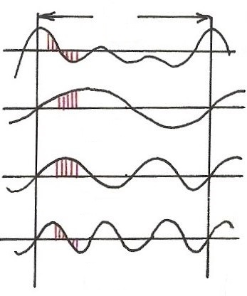
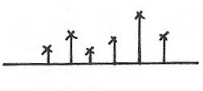
Harmonically Related Exponentials for Periodic Signals
(P.11 of 3.0)
$$[n]$$
T
$V=\{x(t)\left|x(t)\right.$ periodic, fundamental period
$$(N)$$
$$[n]$$
$$=T(N)\}$$
$$t, n$$
$$a_{4}$$
$$t, n$$
$$a_{1}$$
$$a_{3}$$
$$a_{5}$$
$$k=1$$
$$a_{0}$$
$$ω_{0}=\frac{2π}{T}$$
$$k$$
$$(N)$$
$$0 1 2 3 4 5$$
$$t, n$$
$$k=2$$
$$ω$$
$$0$$
$$ω_{0}$$
$${3ω}_{0}$$
$${5ω}_{0}$$
$$t, n$$
$${2ω}_{0}$$
$${4ω}_{0}$$
$$k=3$$
All with period T: integer multiples of ω₀
Discrete in frequency domain
$$(N)$$

Slide 3
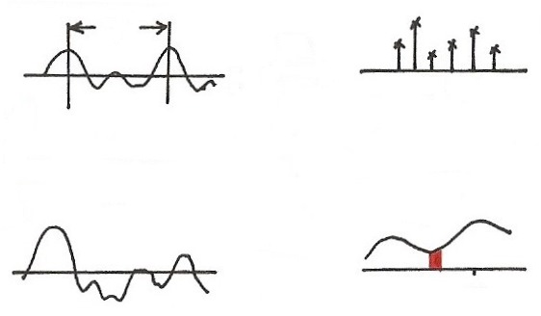
Fourier Transform
T
FS
$$t$$
$$ω$$
0
$$ω_{0}$$
$${3ω}_{0}$$
$$ω_{0}=\frac{2π}{T}$$
$${2ω}_{0}$$
$$e^{j3ω_{0}t}$$
T$→∞$
$$ω_{0}→0$$
periodic in $t$
discrete in $ω$
$$x(t)$$
$$X(jω)$$
$$F$$
$$t$$
$$jω$$
$$ω_{k}$$
$$e^{jω_{k}t}$$
aperiodic in $t$
continuous in $ω$

Slide 5
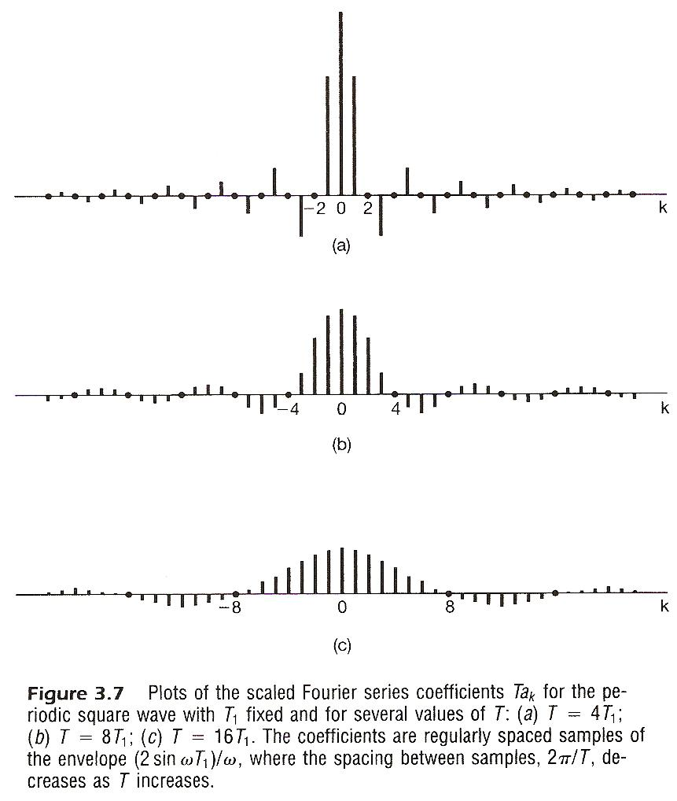

Slide 6
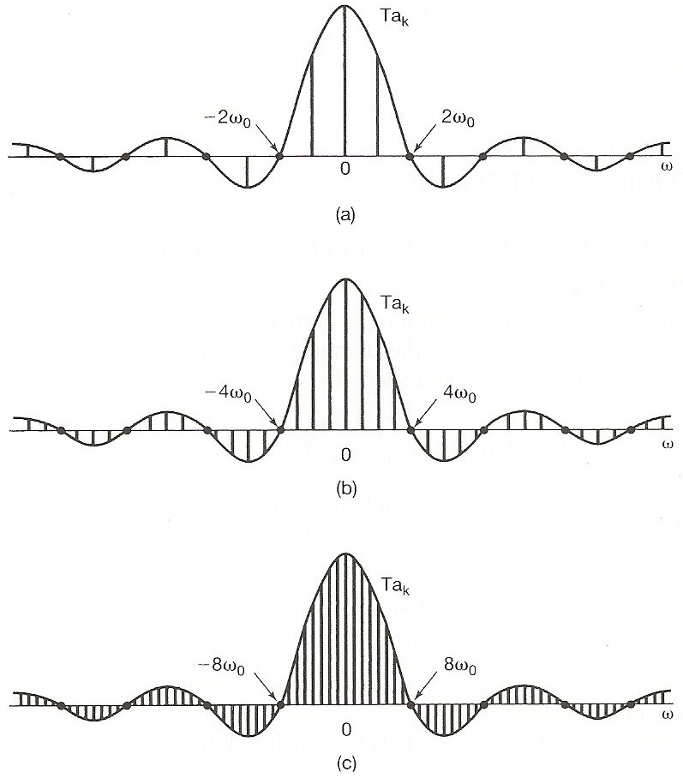
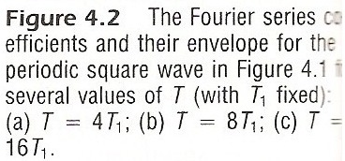
See Fig. 3.6, 3.7, p.193, 195, Fig, 4.2, p.286 of text

Slide 7
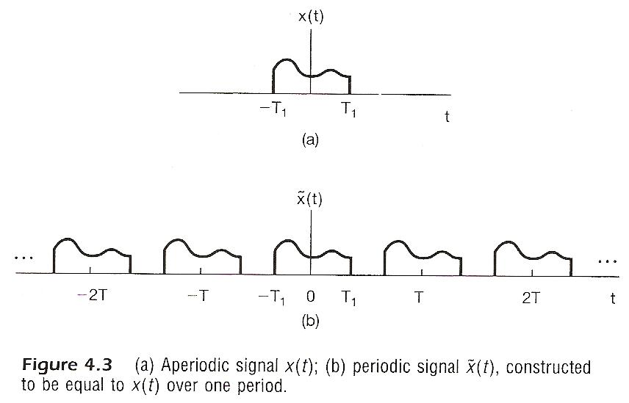
Considering x(t), x(t)=0 for | t | > T₁
construct

Slide 8
Considering x(t), x(t)=0 for | t | > T₁
Fourier series for
Defining envelope of Ta_{k} as X(jω)

Slide 9
Considering x(t), x(t)=0 for | t | > T₁
as

Slide 10
spectrum, frequency domain
Fourier Transform
signal, time domain Inverse Fourier Transform
Fourier Transform pair, different expressions
very similar format to Fourier Series for periodic signals

Slide 11
Convergence Issues
Given x(t)

Slide 12
Convergence Issues
It can be shown
is obtainable (finite) for every ω
zero energy for the difference signal
differences at isolated points are possible
converges to x(t) at continuous points, but to averages at discontinuities

Slide 13
Convergence Issues
Dirichlet’s conditions
absolutely integrable
finite number of maxima and minima within any
finite interval
finite number of discontinuities with finite values
within any finite interval

Slide 14
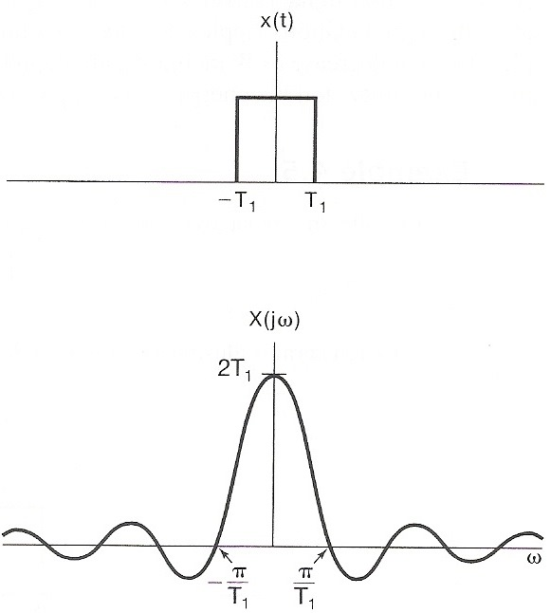
Examples
Example 4.4, p.293 of text
$x\left(t\right)=\left\{\begin{aligned}1, \left|t\right|<T_{1} \\ 0, \left|t\right|>T_{1}\end{aligned}\right.$
then $X\left(jω\right)=\int_{{−T}_{1}}^{T_{1}}{e^{−jωt}}dt$
$$=\frac{2\sin{ωT_{1}}}{ω}$$
$$=2T_{1}\operatorname{sinc}{(\frac{ωT_{1}}{π})}$$
where $\operatorname{sinc}{(θ)=(\frac{\sin{πθ}}{πθ})}$

Slide 15
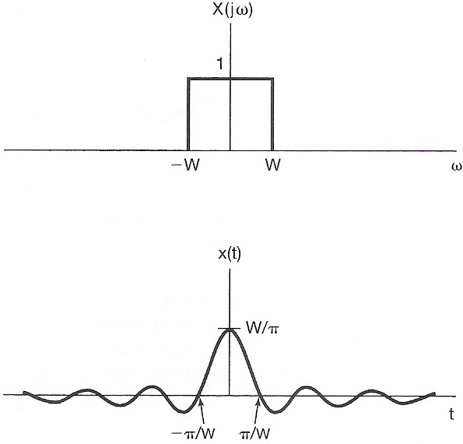
Examples
Example 4.5, p.294 of text
$X\left(jω\right)=\left\{\begin{aligned}1, \left|ω\right|<W \\ 0, \left|ω\right|>W\end{aligned}\right.$
then $x\left(t\right)=\frac{1}{2π} \int_{−W}^{W}{e^{jωt}}dω$
$$=\frac{\sin{Wt}}{πt}$$
$$=\frac{W}{π}\operatorname{sinc}{(\frac{Wt}{π})}$$

Slide 16
Fourier Transform for Periodic Signals –
Unified Framework
Given x(t)
(easy in one way)

Slide 17
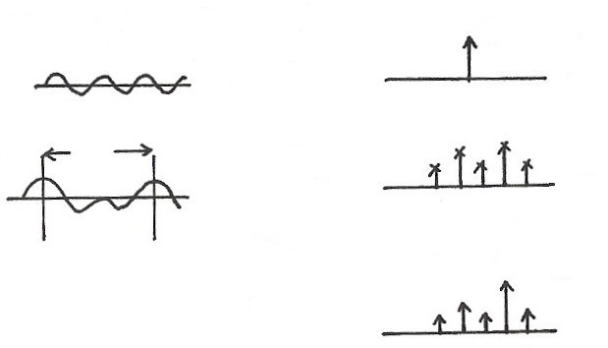
Unified Framework: Fourier Transform for Periodic Signals
$$2πδ(ω−ω_{0})$$
$$e^{jω_{0}t}$$
$$F$$
$$t$$
$$ω$$
$$ω_{0}$$
T
$$a_{k}$$
$$x(t)$$
FS
$$ω$$
$$t$$
$${kω}_{0}$$
$$F$$
$$X(jω)$$
$$2πa_{k}δ(ω−{kω}_{0})$$
If
$$ω$$
$${kω}_{0}$$
F

Slide 18
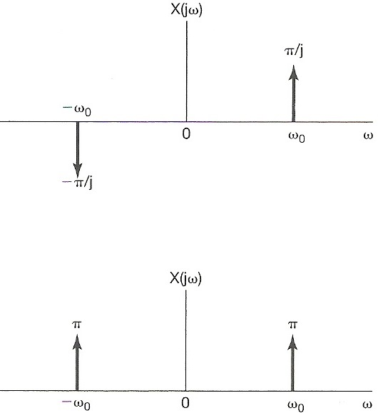
Examples
Example 4.7, p.298 of text
$$Y\left(jω\right)$$
$x\left(t\right)=\cos{ω_{0}t}=\frac{1}{2}(e^{jω_{0}t}+e^{−jω_{0}t})$
$X\left(jω\right)=πδ\left(ω−ω_{0}\right)+πδ\left(ω+ω_{0}\right)$
$FS$: $a_{1}=a_{−1}=\frac{1}{2}$ , $a_{k}=0$ else
$y\left(t\right)=\sin{ω_{0}t}=\frac{1}{2j}(e^{jω_{0}t}−e^{−jω_{0}t})$
$Y\left(jω\right)=\frac{π}{j}δ\left(ω−ω_{0}\right)−\frac{π}{j}δ\left(ω+ω_{0}\right)$
$FS$: $a_{1}=−a_{−1}=\frac{1}{2j}$ , $a_{k}=0$ else

Slide 19
4.2 Properties of Continuous-time Fourier
Transform
Linearity

Slide 20
Linearity
(P.27 of 3.0)
Linearity
$$\vec{x}=(a_{1},a_{2},a_{3},⋯)$$
$$\vec{y}=(b_{1},b_{2},b_{3},⋯)$$
$$A\vec{x}+B\vec{y}=(Aa_{1}+Bb_{1},Aa_{2}+Bb_{2},⋯)$$

Slide 21
Time Shift
linear phase shift (linear in frequency) with amplitude unchanged

Slide 22
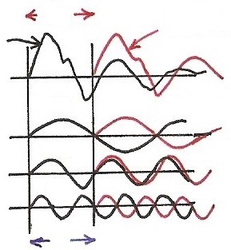
Time Shift
(P.28 of 3.0)
phase shift linear in frequency with amplitude unchanged
$$a_{k} e^{jkω_{0}(t−t_{0})}=e^{−jkω_{0}t_{0}} a_{k} e^{jkω_{0}t}$$
$$t_{0}$$
$${x(t−t}_{0})$$
$$x(t)$$
$$π$$
$$ω_{0}$$
$$2π$$
$${2ω}_{0}$$
$$3π$$
$${3ω}_{0}$$
$${kω}_{0}t_{0}$$

Slide 23
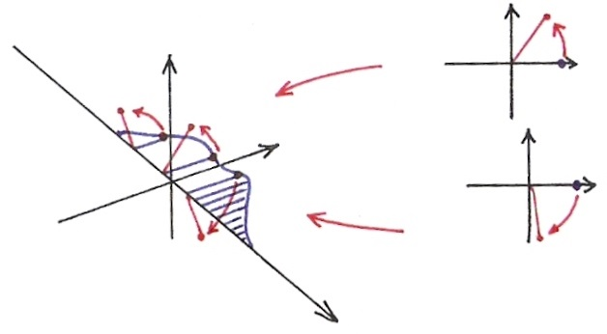
Time Shift
$$Im$$
$$Im$$
$$Re$$
$$Im$$
$$Re$$
$$Re$$
$$ω$$

Slide 24
Examples
(P.18 of 4.0)
Example 4.7, p.298 of text
$$Y\left(jω\right)$$
$x\left(t\right)=\cos{ω_{0}t}=\frac{1}{2}(e^{jω_{0}t}+e^{−jω_{0}t})$
$X\left(jω\right)=πδ\left(ω−ω_{0}\right)+πδ\left(ω+ω_{0}\right)$
$FS$: $a_{1}=a_{−1}=\frac{1}{2}$ , $a_{k}=0$ else
$y\left(t\right)=\sin{ω_{0}t}=\frac{1}{2j}(e^{jω_{0}t}−e^{−jω_{0}t})$
$Y\left(jω\right)=\frac{π}{j}δ\left(ω−ω_{0}\right)−\frac{π}{j}δ\left(ω+ω_{0}\right)$
$FS$: $a_{1}=−a_{−1}=\frac{1}{2j}$ , $a_{k}=0$ else

Slide 25
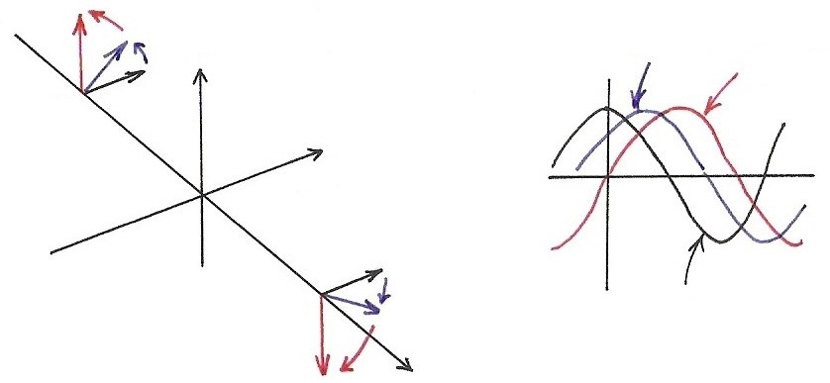
Sinusoidals
$\cos{ω_{0}t}\underset{↔}{F}π\left[δ\left(ω−ω_{0}\right)+δ\left(ω+ω_{0}\right)\right],$ $\frac{1}{2}[e^{jω_{0}t}+e^{−jω_{0}t}]$
$\sin{ω_{0}t}\underset{↔}{F}\frac{π}{j}\left[δ\left(ω−ω_{0}\right)−δ\left(ω+ω_{0}\right)\right],$ $\frac{1}{2j}[e^{jω_{0}t}−e^{−jω_{0}t}]$
$$Im$$
$$\cos{ω_{0}(t−t_{0})}$$
$$\sin{ω_{0}t}$$
$${−ω}_{0}$$
$$Re$$
$$ω_{0}$$
$$\cos{ω_{0}t}$$
$$ω$$
$$x\left(t−t_{0}\right)↔e^{−jω_{0}t}⋅X(jω)$$

Slide 26
Conjugation

Slide 27
Conjugation
(P.32 of 3.0)
$${\left[⋯a_{−1} e^{−jω_{0}t}+a_{0}+a_{1} e^{jω_{0}t}+⋯\right]}^{∗}$$
$$a_{−1}^{∗}$$
$$e^{jω_{0}t}$$
unique representation

Slide 28
Conjugation
$${\left[\int_{−∞}^{∞}{⋯} X\left(−jω_{k}\right) e^{−jω_{k}t}+⋯+X\left(jω_{k}\right)e^{jω_{k}t}+⋯dω\right]}^{∗}$$
$$X^{∗}\left(−jω_{k}\right) e^{jω_{k}t}$$
Unique representation for orthogonal bases
Conjugation

Slide 29
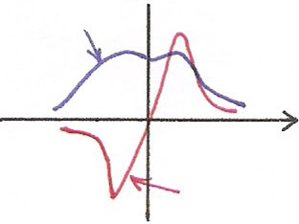
Even/Odd Properties
Conjugation Property
$Re\left\{⋅\right\}$ or $\left|⋅\right|$
$$ω$$
$$0$$
$$Im\left\{⋅\right\} or ∡⋅$$
o

Slide 30
Time Reversal
$$\int_{−∞}^{∞}{⋯}X\left(−jω_{k}\right)e^{−jω_{k}t}+⋯+X\left(jω_{k}\right)e^{jω_{k}t}+⋯dω=x(t)$$
$$X\left(−jω_{k}\right) e^{jω_{k}t}$$
$$=x(−t)$$
Unique representation for orthogonal bases

Slide 31
Time Reversal
(P.29 of 3.0)
the effect of sign change for x(t) and a_{k} are identical
$$⋯a_{−1} e^{−jω_{0}t}+a_{0}+a_{1} e^{jω_{0}t}+⋯=x(t)$$
$$⋯a_{−1} e^{jω_{0}t}⋯=x(−t)$$
unique representation for orthogonal basis

Slide 32
Even/Odd Properties
x(t) both real and even
Time Reversal
x(t) real and odd

Slide 33
Differentiation/Integration
dc term

Slide 34
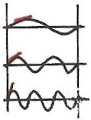
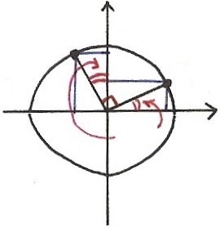
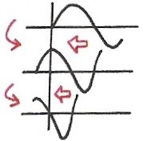
Differentiation
(P.33 of 3.0)
$$k=1$$
$$\frac{d}{dt}\left(a_{k}e^{jkω_{0}t}\right)= j {kω}_{0} a_{k} e^{jkω_{0}t}$$
$$k=2$$
$$= =$$
$$k=3$$
$$j⋅[\cos{ω_{0}t}+j\sin{ω_{0}t}]$$
$$Im$$
$$\frac{d}{dt}$$
$$\frac{d}{dt}$$
$$=−\sin{ω_{0}t}+j\cos{ω_{0}t}$$
$$ω_{0}t$$
$$Re$$
$$\frac{d}{dt}$$
$$\sin{ωt}$$
$$j=e^{j{90}^{∘}}$$
$$\cos{ωt}$$
$$\frac{d}{dt}$$
$$−sin{ωt}$$

Slide 35
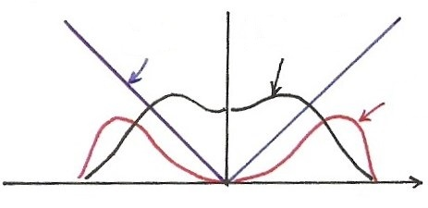
Differentiation
$$\left|jω⋅X(jω)\right|=\left|ω\right|⋅\left|X(jω)\right|$$
$$\left|ω\right|$$
$$\left|X(jω)\right|$$
$$\left|ω\right|\left|X(jω)\right|$$
$$ω$$
Enhancing higher frequencies
De-emphasizing lower frequencies
Deleting DC term ( =0 for ω=0)

Slide 36
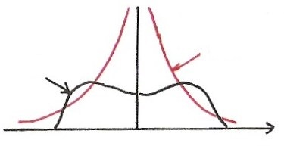
Integration
dc term
$$\frac{1}{j}=e^{−j90°}$$
$$\left|\frac{1}{jω}\right|⋅\left|X(jω)\right|=\left|\frac{1}{ω}\right|⋅\left|X(jω)\right|$$
$$\left|\frac{1}{ω}\right|$$
$$X(jω)$$
$$ω$$
Enhancing lower frequencies (accumulation effect)
De-emphasizing higher frequencies
(smoothing effect)
Undefined for ω=0
Accumulation

Slide 37
Parseval’s Relation
total energy: energy per unit time integrated over the
time
total energy: energy per unit frequency integrated
over the frequency
$$\vec{A}=\sum_{i}{a_{i}}{\hat{v}}_{i}=\sum_{k}{b_{k}}{\hat{u}}_{k}$$
$${\left\| \vec{A} \right\|}^{2}=\sum_{i}{{\left|a_{i}\right|}^{2}}=\sum_{k}{{\left|b_{k}\right|}^{2}}$$

Slide 38
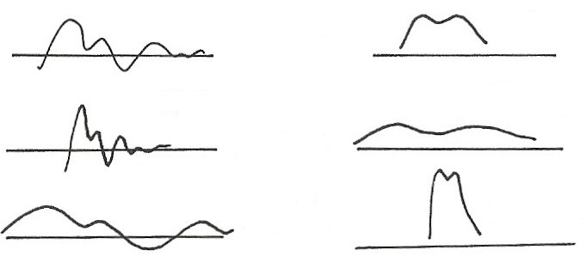
Time/Frequency Scaling
(time reversal)
$$x(t)$$
$$X(jω)$$
$$F$$
$$t$$
$$ω$$
$$\frac{1}{\left|a\right|} X\left(j\frac{ω}{a}\right), a>1$$
$$x\left(at\right), a>1$$
$$t$$
$$F$$
$$ω$$
$$x\left(at\right), a<1$$
$$\frac{1}{\left|a\right|} X\left(j \frac{ω}{a}\right), a<1$$
$$F$$
$$t$$
$$ω$$
See Fig. 4.11, p.296 of text

Slide 39
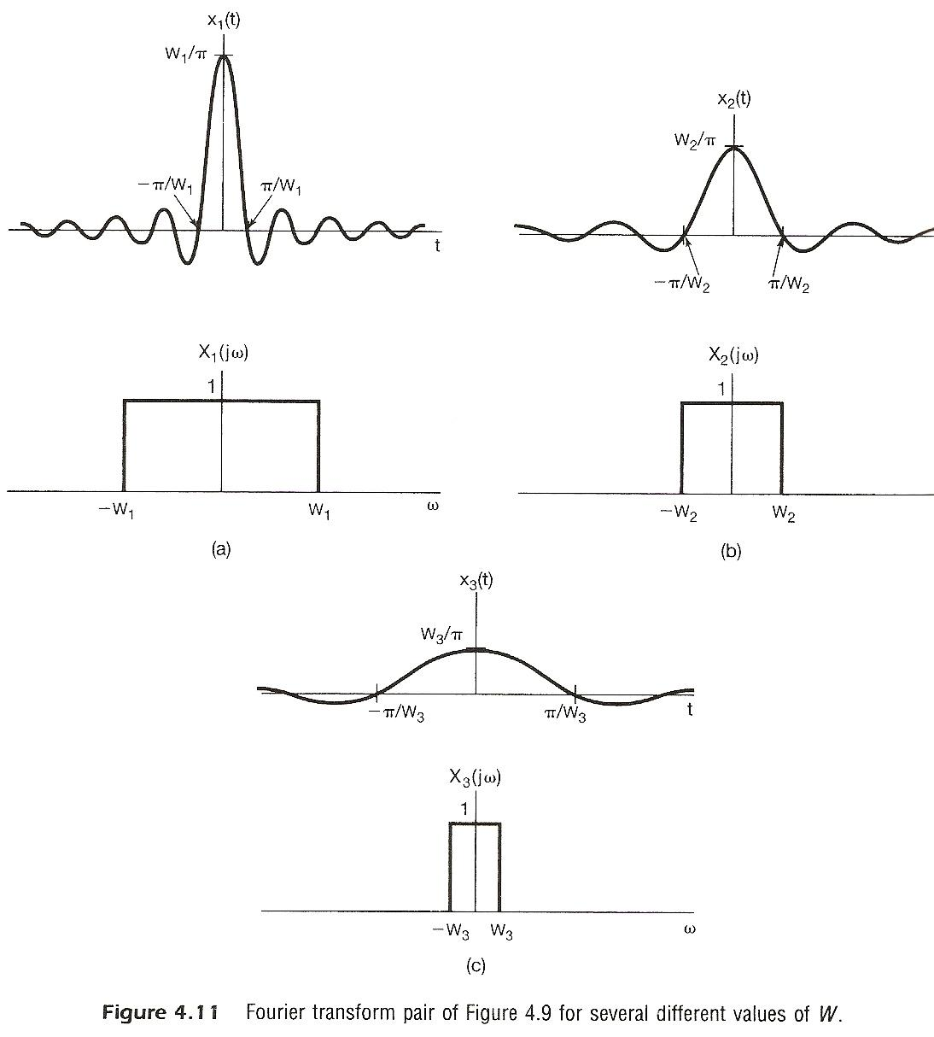
inverse relationship between signal “width” in time/frequency domains

Slide 40
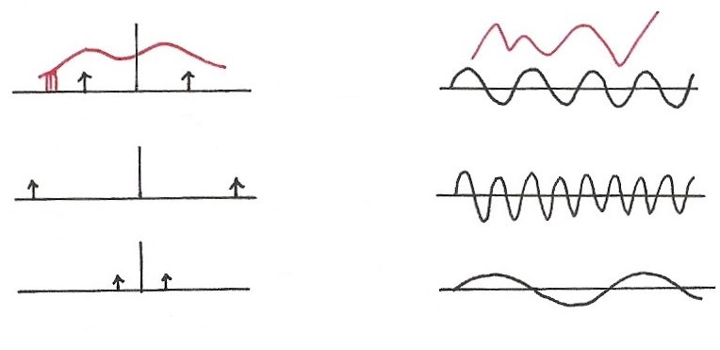
Single Frequency
$$\cos{ω_{0}t}=\frac{1}{2} \left(e^{jω_{0}t}+e^{−jω_{0}t}\right)$$
$$F$$
$$ω$$
$$t$$
$${−ω}_{0}$$
$$ω_{0}$$
$$ω$$
$$F$$
$$t$$
$${−2ω}_{0}$$
$${2ω}_{0}$$
$$ω$$
$$F$$
$$t$$
$$−{\frac{1}{2} ω}_{0}$$
$${\frac{1}{2} ω}_{0}$$

Slide 41
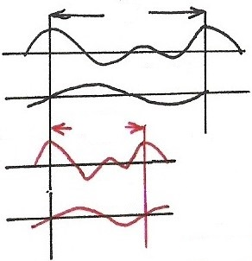
Time Scaling
(P.30 of 3.0)
positive real number
periodic with period T/α and fundamental frequency αω₀
a_{k} unchanged, but x(αt) and each harmonic component are different
$$T$$
$$x(t)$$
$$ω_{0}=\frac{2π}{T}$$
$$k=1$$
$$T/α$$
$$α>1$$
$$x(αt)$$
$$k=1$$
$$ω_{0}=\frac{2π}{T/α}=α(\frac{2π}{T})$$

Slide 42
Data Transmission
1
1
0
1
$$F$$
$$ω$$
$$τ$$
W:
$τ$:
T: bit duration
bandwidth
pulse width
$$W∝\frac{1}{τ}≥\frac{1}{T}=r$$
: bit rate
(required bandwidth) $∝$ (bit rate)

Slide 43
Duality
time/frequency domains are kind of “symmetric” except for a sign change (and a factor of 2π) --- “two domains”
See Fig. 4.17, p.310 of text

Slide 44
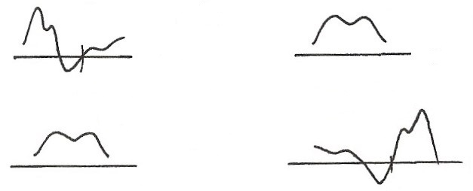
Duality
$$x(t)$$
$$y(t)$$
$$F$$
$$z\left(ω\right) X(jω)$$
$$t$$
$$ω (jω)$$
0
$$F^{−1}$$
$$z(t)$$
$$2πy(−ω)$$
$$F$$
$$t$$
$$ω$$
0

Slide 45
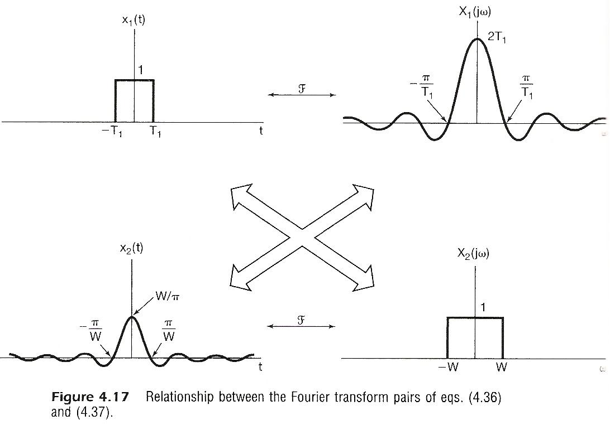

Slide 46
(P.10 of 4.0)
spectrum, frequency domain
Fourier Transform
signal, time domain Inverse Fourier Transform
Fourier Transform pair, different expressions
very similar format to Fourier Series for periodic signals

Slide 47
Signal Representation in Two Domains
Time Domain Basis Frequency Domain Basis
$$X(jω)$$
$$x(t)$$
$$F$$
$$t$$
$$ω$$
$$t_{1} t_{2}$$
$$ω_{1} ω_{2}$$
$$t$$
$$2πδ(ω−ω_{1})$$
$$ω$$
$$δ(t−t_{1})$$
$$t_{1}$$
$$ω_{1}$$
$$t$$
$$2πδ(ω−ω_{2})$$
$$ω$$
$$δ(t−t_{2})$$
$$t_{2}$$
$$ω_{2}$$
$$⋮$$
$$⋮$$

Slide 48
Signal Representation in Two Domains
Time Domain Basis Frequency Domain Basis
{$δ\left(t−t_{k}\right), −∞<t_{k}<∞$}
{$2πδ\left(ω−ω_{k}\right), −∞<ω_{k}<∞$}
$$F$$
$$e^{−jt_{k}ω}$$
$$δ\left(t−t_{k}\right)$$
$$ω$$
$$t$$
$$t_{k}$$
$$e^{+jω_{k}t}$$
$$F$$
$$2πδ\left(ω−ω_{k}\right)$$
$$ω$$
$$t$$
$$ω_{k}$$

Slide 49
Signal Representation in Two Domains
Time Domain Basis Frequency Domain Basis
$$A$$
$$δ\left(t−t_{3}\right)$$
$$2πδ\left(ω−ω_{3}\right)$$
$$ω_{2}$$
$$t_{2}$$
$$ω_{1}$$
$$t_{1}$$
$$\vec{A}=\sum_{i}{a_{i} }{\vec{v}}_{i} =\sum_{k}{b_{k}{\vec{u}}_{k}} \text{(}合成\text{)}$$
$a_{i}=\vec{A}⋅{\vec{v}}_{i} b_{k}=\vec{A}⋅{\vec{u}}_{k}$ (分析)

Slide 50
Signal Representation in Two Domains
Time Domain Basis Frequency Domain Basis
$$\vec{A}=\sum_{i}{a_{i} }{\vec{v}}_{i}$$
$$(\sum_{k}{c_{k} }{\vec{u}}_{k})$$
$$=\sum_{k}{( ⋯ ) }{\vec{u}}_{k}$$
$$\vec{A}=\sum_{k}{b_{k} }{\vec{u}}_{k}$$
$$(\sum_{i}{d_{i} }{\vec{v}}_{i})$$
$$=\sum_{i}{( ⋯ ) }{\vec{v}}_{i}$$
$$b_{k}$$
$$a_{i}$$

Slide 51
Signal Representation in Two Domains
Time Domain Basis Frequency Domain Basis
$$\sum_{k}{c_{k}{\vec{u}}_{k}}$$
$$\sum{d_{i}}{\vec{v}}_{i}$$
$$b_{k}$$
$$a_{i}$$
$$b_{k}$$
$$\left\{\begin{aligned}X\left(jω\right)=\int_{−∞}^{∞}{x\left(t\right) e^{−jtω} dt } \\ \\ \\ x\left(t\right)=\frac{1}{2π}\int_{−∞}^{∞}{X\left(jω\right)e^{jtω}dω}\end{aligned}\right.$$
$$\left\{\begin{aligned}x\left(t\right)=\frac{1}{2π}\int_{−∞}^{∞}{X\left(jω\right) e^{jωt} dω} \\ \\ \\ X\left(jω\right)=\int_{−∞}^{∞}{x\left(t\right) e^{−jωt}dt } \end{aligned}\right.$$
(合成)
(合成)
(分析)
(分析)
$$\vec{A}$$
$$a_{i}$$
$${\vec{v}}_{i}$$
$$b_{k}$$
$${\vec{u}}_{k}$$
$$x\left(t\right)=\int_{−∞}^{∞}{x\left(τ\right) δ\left(t−τ\right) dτ }$$
$$\vec{A}$$
$$X\left(jω\right)=\int_{−∞}^{∞}{X\left(jη\right) δ\left(ω−η\right) dη }$$
(合成/分析)
(合成/分析)

Slide 52
Duality
If any characteristics of signals in one domain implies some characteristics of signals in the other domain, the inverse is true except for a sign change (dual properties)
modulation property

Slide 53
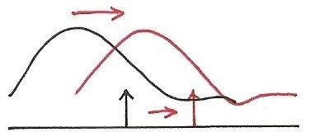
Modulation Property
$$ω_{0}$$
$$e^{jω_{0}t}\left(e^{jω_{k}t}\right)=e^{j{(ω}_{k}+ω_{0})t}$$
modulation:
frequency translation
shift in frequency
$$ω$$
$$ω_{k}$$
$$ω_{k}+ω_{0}$$
Multiplication Property
$$e^{jω_{0}t}⋅x(t)⟷\frac{1}{2π} [2πδ({ω−ω}_{0})∗X(jω)]$$
$=X(j(ω−ω_{0}))$

Slide 54
Convolution Property
System Input/Output Relationship
superposition property
closed-form solution
frequency response

Slide 55
Input/Output Relationship
(P.5 of 3.0)
$$x(t)$$
$$y(t)$$
Time Domain
$$δ(t)$$
$$h(t)$$
$$t$$
$$t$$
0
0
Frequency Domain
$$ω$$
$$ω$$
$$ω_{1}$$
$$ω_{3}$$
$$ω_{5}$$
$$ω_{1}$$
$$ω_{3}$$
$$ω_{5}$$

Slide 56
System Characterization
Superposition Property
continuous-time
(P.9 of 3.0)
discrete-time
each frequency component never split to other frequency components, no convolution involved
desirable to decompose signals in terms of such eigenfunctions

Slide 57
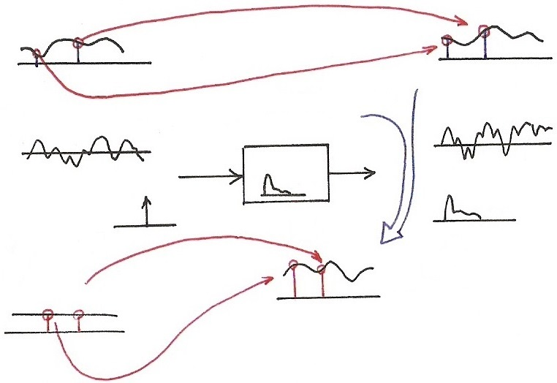
Convolution Property
$$X\left(jω_{2}\right)H\left(jω_{2}\right)=Y(jω_{2})$$
$$Y\left(jω\right)=X(jω)H\left(jω\right)$$
$$X(jω)$$
$$H\left(jω_{2}\right)=\int_{−∞}^{∞}{h(τ)}e^{−jω_{2}τ}dτ$$
$$F$$
$$ω$$
$$ω_{1}$$
$$ω_{2}$$
$$ω$$
$$ω_{1}$$
$$ω_{2}$$
$$F$$
$$H\left(jω_{1}\right)=\int_{−∞}^{∞}{h(τ)}e^{−jω_{1}τ}dτ$$
$$x\left(t\right)∗h(t)=y(t)$$
$$F$$
$$x(t)$$
$$t$$
$$t$$
$$h(t)$$
$$δ(t)$$
$$h(t)$$
$$t$$
$$F$$
$$t$$
$$F$$
$$H\left(jω_{2}\right)$$
$$H(jω)$$
$$F$$
$$1.0$$
$$1.0$$
$$ω$$
$$1$$
$$ω_{1}$$
$$ω_{2}$$
$$ω$$
$$H\left(jω\right)=\int_{−∞}^{∞}{h(τ)}e^{−jωτ}dτ$$
$$ω_{1}$$
$$ω_{2}$$
Transfer Function
Frequency Response
$$H\left(jω_{1}\right)$$
$$H\left(s\right)=\int_{−∞}^{∞}{h(τ)}e^{−sτ}dτ$$

Slide 58
Convolution Property
unit impulse response h(t)
frequency response or transfer function H(jω)
convolution in time domain reduced to multiplication in frequency domain
cascade of two systems implies product of the two frequency responses, independent of the order of the cascade
example: filtering of signals
See Fig. 4.20, 4.21, p.318, 319 of text

Slide 59
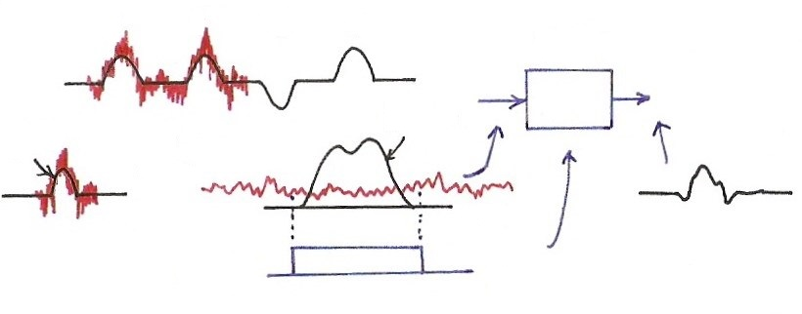
Filtering of Signals
1
1
0
1
$$H(jω)$$
$$P(jω)$$
$$p(t)$$
$$F$$
$$t$$
$$ω$$
0
$$H(jω)$$
$$ω$$
0

Slide 60
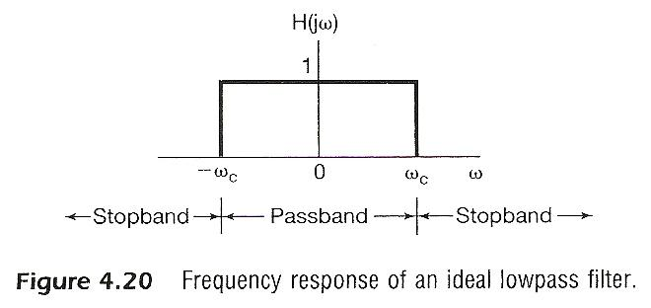

Slide 61
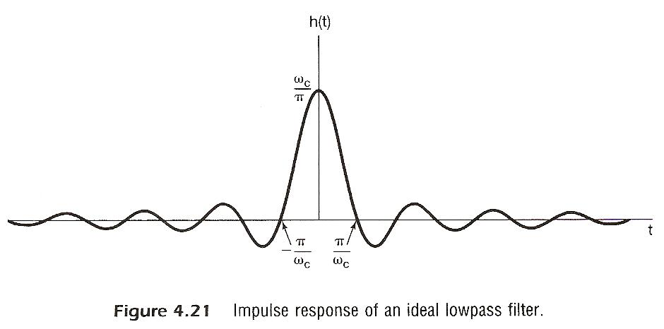

Slide 62
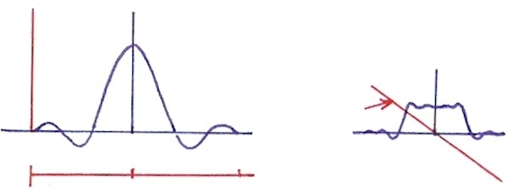
Realizable Lowpass Filter
$$F$$
$$h_{1}(t)$$
$$\left|H_{1}(jω)\right|$$
$$h_{2}(t)$$
$$F$$
$$\left\{\begin{aligned}\left|H_{2}(jω)\right| \\ ∠H_{2}(jω)\end{aligned}\right.$$
$$t$$
$$ω$$
$$−T$$
0
$$T$$
0
$$T$$
$$2T$$
0

Slide 63
Differentiation/Integration
(P.33 of 4.0)
dc term

Slide 64
Integration
$$2πδ(ω)$$
$$δ(t)$$
1
1
$$t$$
$$ω$$
$$t$$
$$ω$$
0
$$F$$
0
Duality
$$F$$
$$u\left(t\right)=\int_{−∞}^{t}{δ}\left(τ\right)dτ$$
$$\frac{1}{2}⋅2πδ\left(ω\right)=πδ\left(ω\right)$$
$U\left(jω\right)=\frac{1}{jω}+$(dc term)
$=\frac{1}{jω}+πδ\left(ω\right)$
$$\frac{1}{2}$$
$$1$$
$$t$$
$$\int_{−∞}^{t}{x}\left(τ\right)dτ=x\left(t\right)∗u\left(t\right)=X\left(jω\right)⋅[\frac{1}{jω}+πδ\left(ω\right)]$$
$=\frac{1}{jω}X\left(jω\right)+πX(jο)δ(ω)$

Slide 65
Multiplication Property
dual property of the convolution property
example: frequency-selective filtering with variable center frequency
See Fig. 4.26, 4.27, p.326 of text
Tables of Properties and Pairs
See Tables. 4.1, 4.2, p.328, 329 of text

Slide 66
Modulation Property
(P.53 of 4.0)
$$ω_{0}$$
$$e^{jω_{0}t}\left(e^{jω_{k}t}\right)=e^{j{(ω}_{k}+ω_{0})t}$$
modulation:
frequency translation
shift in frequency
$$ω$$
$$ω_{k}$$
$$ω_{k}+ω_{0}$$
Multiplication Property
$$e^{jω_{0}t}⋅x(t)⟷\frac{1}{2π} [2πδ({ω−ω}_{0})∗X(jω)]$$
$=X(j(ω−ω_{0}))$

Slide 67
Frequency Division Multiplexing
$$x_{1}(t)$$
$$X_{1}(jω)$$
$$X_{2}(jω)$$
$$x_{2}(t)$$
$$ω$$

Slide 68
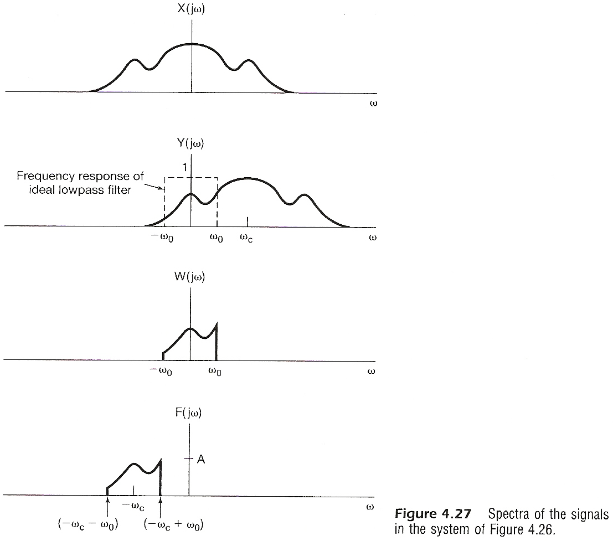

Slide 69
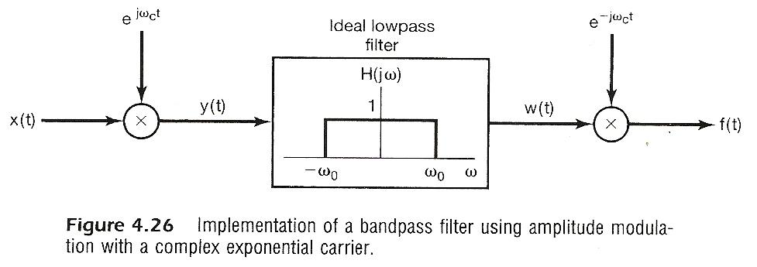

Slide 70
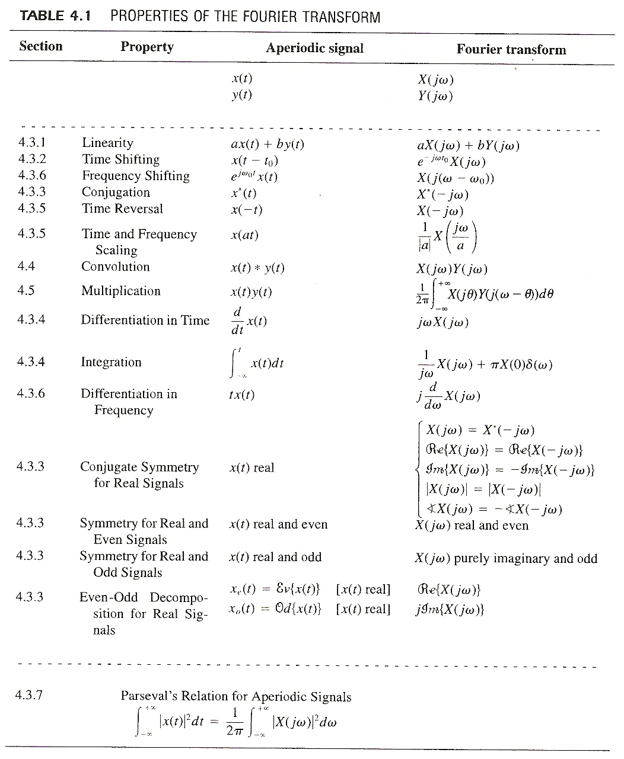

Slide 71
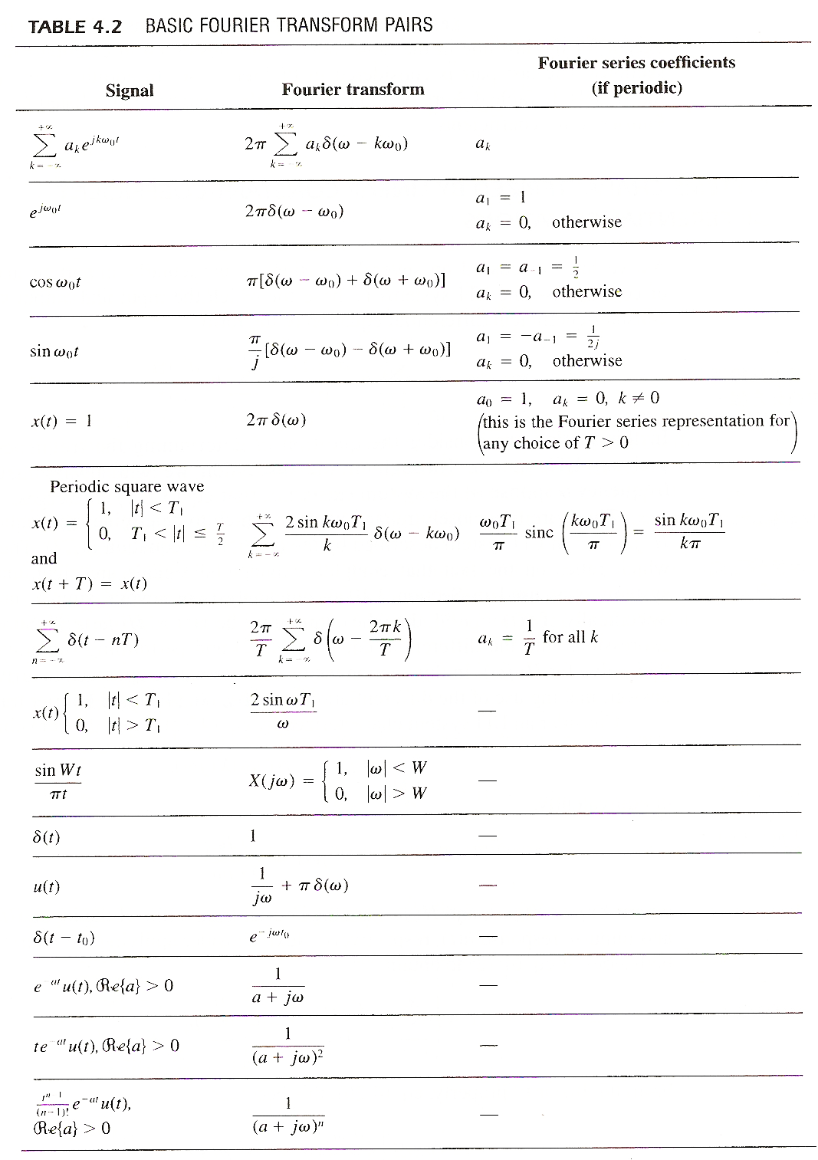

Slide 72
Another Application Example
systems described by differential equations:
closed-form solution

Slide 73
Vector Space Interpretation of Fourier Transform
generalized Parseval’s Relation
{X(jω) defined on -∞ < ω < ∞}=V: a vector space
inner-product of two vectors(signals) can be evaluated in either the time domain or the frequency domain
Parseval’s relation is a special case here: the magnitude (norm) of a vector can be evaluated in either the time domain or the frequency domain

Slide 74
Vector Space Interpretation of Fourier Transform
considering the basis signal set

Slide 75
Vector Space Interpretation of Fourier Transform
considering the basis signal set
similar to the vector space of continuous-time signals
orthogonal bases but not normalized, while makes sense considering operational definition

Slide 76
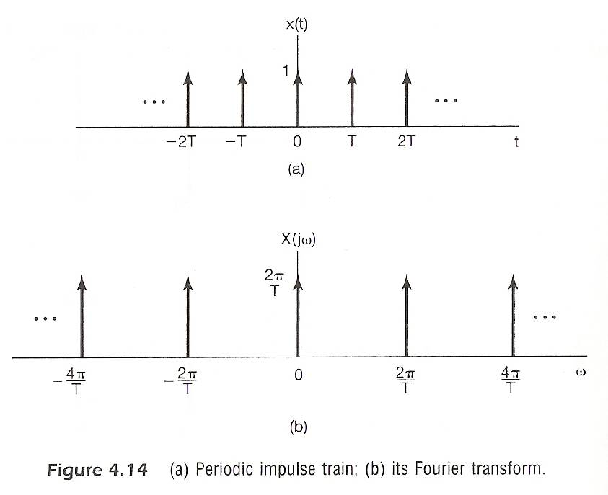
Examples
Example 4.8, p.299 of text

Slide 77
Examples
Example 4.13, p.310 of text
From Example 4.2
$$x\left(t\right)=e^{−2\left|t\right|} \underset{↔}{F} X\left(jω\right)=\frac{2}{1+ω^{2}}$$
by duality
$$x\left(t\right)=\frac{2}{1+t^{2}} \underset{↔}{F} {2πe}^{−2\left|ω\right|}$$

Slide 78
Examples
Example 4.19, p.320 of text
$h\left(t\right)=e^{−at}u\left(t\right),$ $a>0$
$x\left(t\right)=e^{−bt}u\left(t\right),$ $b>0$
$X\left(jω\right)=\frac{1}{b+jω}$ , $H\left(jω\right)=\frac{1}{a+jω}$
$$Y\left(jω\right)=\frac{1}{(a+jω)(b+jω)}=\frac{1}{b−a} [ \frac{1}{a+jω}−\frac{1}{b+jω} ]$$
$$y\left(t\right)=\frac{1}{b−a}\left[e^{−at} u\left(t\right)−e^{−bt}u\left(t\right)\right], b≠a$$
$b=a : Y\left(jω\right)=\frac{1}{{(a+jω)}^{2}}=j \frac{d}{dω} [\frac{1}{a+jω}]$
Since$−jtx\left(t\right)↔\frac{d}{dω} X\left(jω\right)$
$y\left(t\right)=te^{−at} u\left(t\right), b=a$

Slide 79
Problem 4.12, p.336 of text
(a) Given $e^{−\left|t\right|} \underset{↔}{ F } \frac{2}{1+ω^{2}}$
$$te^{−\left|t\right|} \underset{↔}{ F }j\frac{d}{dω}\left[\frac{2}{1+ω^{2}}\right]=−\frac{4jω}{{(1+ω^{2})}^{2}}$$
by differentiation in frequency domain
(b) By duality $−\frac{4jt}{{\left(1+t^{2}\right)}^{2}} \underset{↔}{ F } −2πωe^{−\left|ω\right|}$
$∴\frac{4t}{{\left(1+t^{2}\right)}^{2}} \underset{↔}{ F } −j2πωe^{−\left|ω\right|}$

Slide 80
Problem 4.13, p.336 of text
(a) $X\left(jω\right)=δ\left(ω\right)+δ\left(ω−π\right)+δ\left(ω−5\right)$
Is $x\left(t\right)$ periodic ?
$$x\left(t\right)=\frac{1}{2π}+\frac{1}{2π}e^{jπt}+\frac{1}{2π}e^{j5t}$$
$π$ and 5 are not integer multiples of any common fundamental frequency
$∴x(t)$ Not periodic
(b) $h\left(t\right)=u\left(t\right)−u\left(t−2\right)$
Is $x\left(t\right)∗h(t)$ periodic ?
$$H\left(jω\right)=e^{−jω}\left[\frac{2\sin{ω}}{ω}\right], H\left(jπ\right)=0$$
$$X\left(jω\right)H\left(jω\right)=H\left(j0\right)δ\left(ω\right)+H(j5)δ\left(ω−5\right)$$
$$∴x\left(t\right)∗h(t) \text{is} \text{periodic}$$

Slide 81
Problem 4.33, p.345 of text
$$\frac{d^{2}}{dt^{2}} y\left(t\right)+6\frac{d}{dt} y\left(t\right)+8y\left(t\right)=2x(t)$$
(a) find impulse response
$$H\left(jω\right)=\frac{Y(jω)}{X(jω)}=\frac{2}{−ω^{2}+6jω+8}=\frac{1}{jω+2}−\frac{1}{jω+4}$$
$$∴h\left(t\right)=e^{−2t}u\left(t\right)−e^{−4t}u(t)$$
(b) For $x\left(t\right)=te^{−2t}u(t)$
$$X\left(jω\right)=\frac{1}{{(2+jω)}^{2}}$$
$$Y\left(jω\right)=X\left(jω\right)H\left(jω\right)=\frac{1/4}{jω+2}−\frac{1/2}{{(jω+2)}^{2}}+\frac{1}{{(jω+2)}^{3}}−\frac{1/4}{jω+4}$$
$$∴y\left(t\right)=\frac{1}{4}e^{−2t}u\left(t\right)−\frac{1}{2}te^{−2t}u\left(t\right)+t^{2}e^{−2t}u\left(t\right)−\frac{1}{4}e^{−4t}u(t)$$

Slide 82
Problem 4.35, p.346 of text
(a) $H\left(jω\right)=\frac{a−jω}{a+jω}$
$\left|H(jω)\right|=\sqrt{a^{2}+ω^{2}}/\sqrt{a^{2}+ω^{2}}$ $=1$
$$∡H\left(jω\right)=−\tan^{−1}{\frac{ω}{a}}−\tan^{−1}{\frac{ω}{a}}=−2\tan^{−1}{\frac{ω}{a}}$$
$H\left(jω\right)=−1+\frac{2a}{a+jω}$ , $h\left(t\right)=−δ\left(t\right)+2ae^{−at}u(t)$
(b) $x\left(t\right)=\cos{t}+\cos{\sqrt{3}}t, a=1$
$$X\left(jω\right)=π[δ\left(ω−1\right)+δ\left(ω+1\right)+δ\left(ω−\sqrt{3}\right)+δ(ω+\sqrt{3})]$$
$H\left(jω\right)=1⋅e^{−j\frac{π}{2}}$ at $ω=1$, $H\left(jω\right)=1⋅e^{−j\frac{2}{3}π}$ at $ω=\sqrt{3}$, etc
$$y\left(t\right)=\frac{1}{2}\left[e^{j\left(t−\frac{π}{2}\right)}+e^{−j\left(t−\frac{π}{2}\right)}+e^{j\left(\sqrt{3}t−\frac{2}{3}π\right)}+e^{−j\left(\sqrt{3}t−\frac{2}{3}π\right)}\right]$$
$$∴y\left(t\right)=\cos{(t−\frac{π}{2})}+\cos{(\sqrt{3}t−\frac{2}{3}π)}$$

Slide 83
Problem 4.51, p.354 of text, part (c)
An echo system
x(t)
y(t)
……
x(t)
y(t)
α
T
T
(-α)
h(t)
g(t)

