Slide 1
2.0 Linear Time-invariant Systems
  2.1 Discrete-time Systems: the Convolution Sum
Representing an arbitrary signal as a sequence of unit impulses
        an unit impulse located at n = k on the index n
    See Fig. 2.1, p.76 of text
                a special case

Slide 2
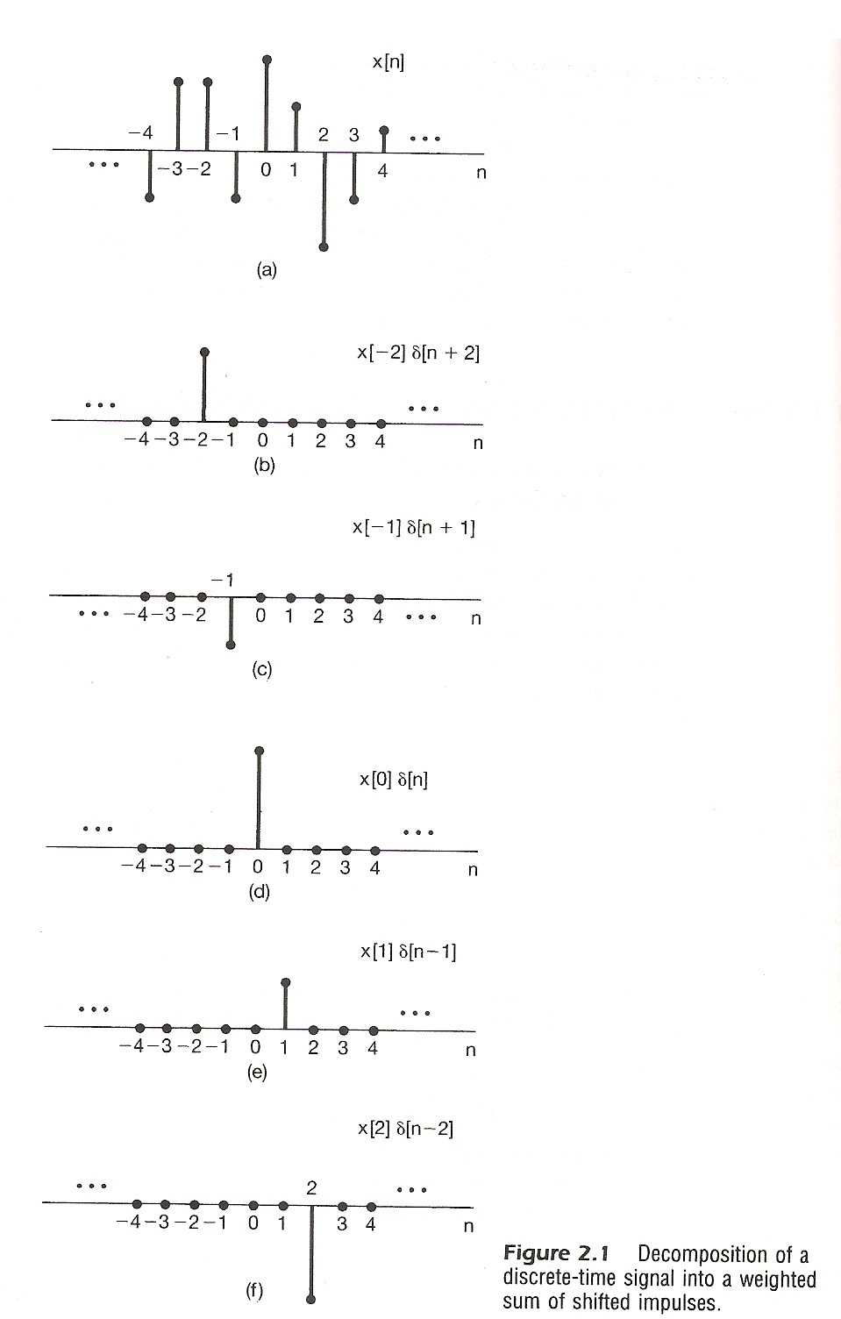

Slide 3
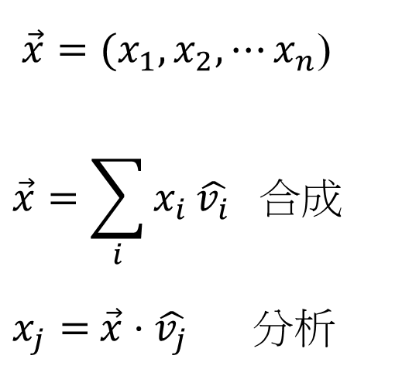
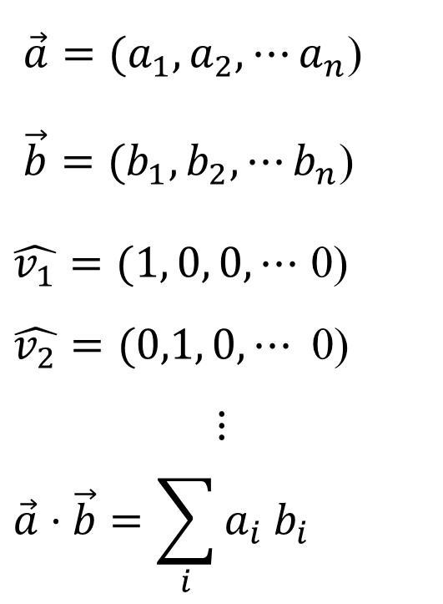
Vector Space Representation of Discrete-
time Signals (P.47 of 1.0)
  n-dim
$\vec{a}=(a_{1},a_{2}, ⋯a_{n}$)
$\vec{b}=(b_{1},b_{2}, ⋯b_{n}$)
$\hat{v_{1}}=(1, 0, 0,⋯$ 0)
$$\hat{v_{2}}=(0,1, 0,⋯\text{ 0)}$$
$$⋮$$
$$\vec{a}⋅\vec{b}=\sum_{i}{a_{i}{ b}_{i}}$$
$\vec{x}=(x_{1},x_{2}, ⋯x_{n}$)
$$\vec{x}=\sum_{i}{x_{i}}\hat{v_{i}} 合成$$
$x_{j}=$ $\vec{x}⋅\hat{v_{j}}$ 分析

Slide 4

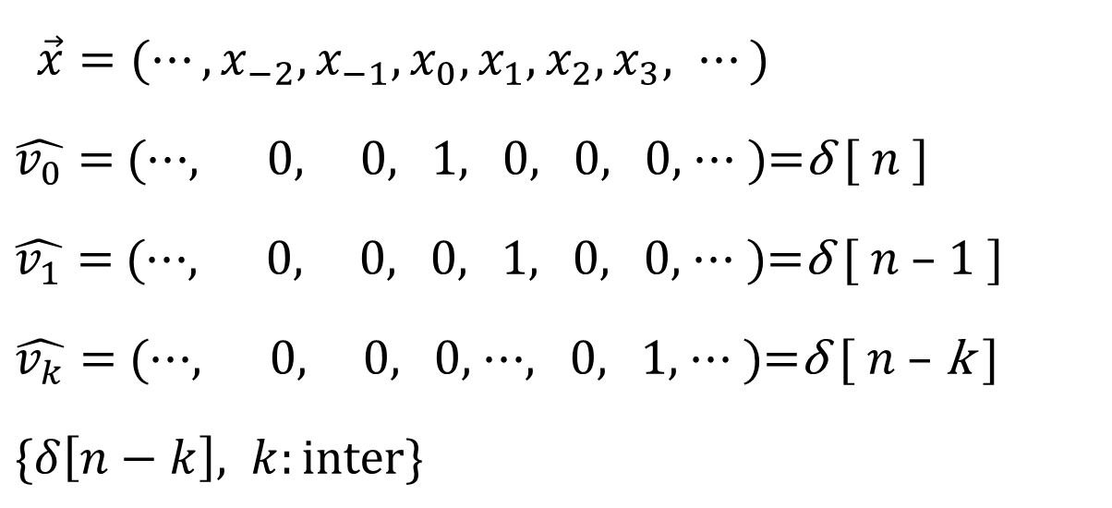
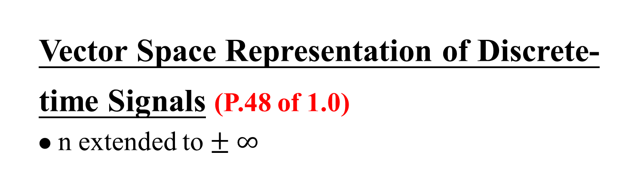
Vector Space Representation of Discrete-
time Signals (P.48 of 1.0)
  n extended to $± ∞$
$\vec{x}=(⋯,x_{−2},x_{−1},x_{0},x_{1},x_{2},x_{3}, ⋯)$
$\hat{v_{0}}=$ (⋯, 0, 0, 1, 0, 0, 0, ⋯ )=δ [ $n$ ]
$\hat{v_{1}}=$ (⋯, 0, 0, 0, 1, 0, 0, ⋯ )=δ [ $n$ – 1 ]
$\hat{v_{k}}=$ (⋯, 0, 0, 0, ⋯, 0, 1, ⋯ )=δ [ $n$ – k ]
$\{δ\left[n−k\right], k:\text{inter}\text{\}}$
$$\vec{x}=\sum_{i}{x_{i}\hat{v_{i}}} 合成$$
$x_{j}= \vec{x}⋅\hat{v_{j}}$ 分析

Slide 5
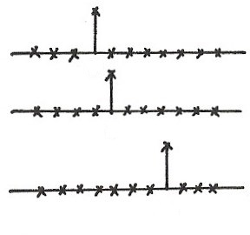

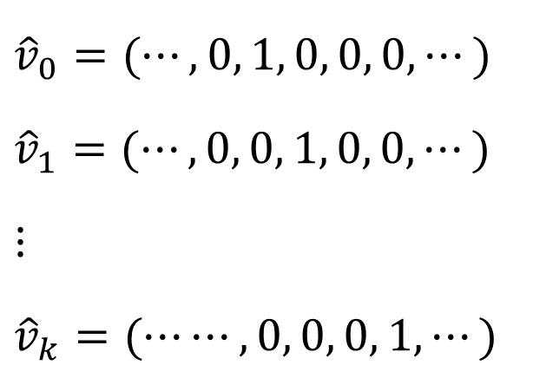
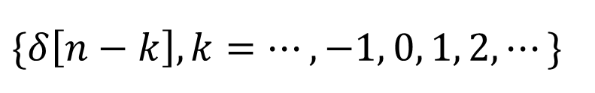
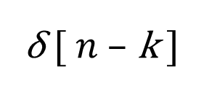

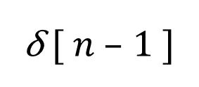

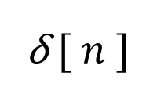

Vector Space Interpretation
$${\hat{v}}_{0}=(⋯,0, 1, 0, 0, 0,⋯)$$
$${\hat{v}}_{1}=(⋯,0, 0, 1, 0, 0,⋯)$$
$$⋮$$
$${\hat{v}}_{k}=(⋯⋯,0, 0, 0, 1,⋯)$$
δ [ $n$ ]
$$0$$
δ [ $n$ – 1 ]
$$1$$
δ [ $n$ – k ]
$$k$$
$$\{δ\left[n−k\right], k=⋯,−1, 0, 1, 2, ⋯\}$$
$$k$$

Slide 6
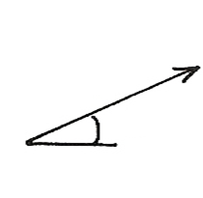
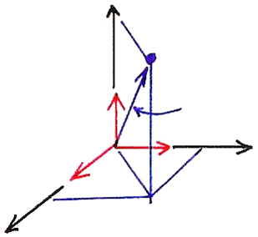

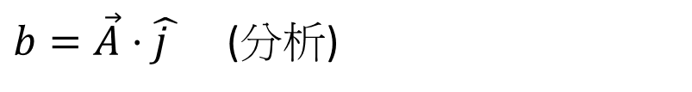
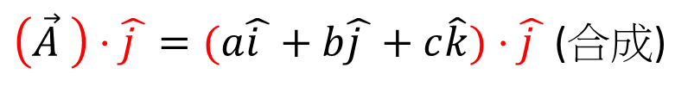




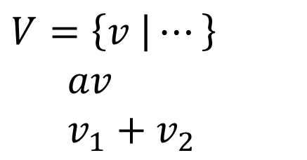

Vector Space (P.30 of 1.0)
$$V=\left\{v | ⋯\right\}$$
$av$
$v_{1}+$ $v_{2}$
$$b$$
$$θ$$
3-dim Vector Space
$\left(\vec{A} \right)⋅\hat{j }=(a\hat{i }+b\hat{j }+c\hat{k})⋅\hat{j }$ (合成)
$$\hat{k}$$
$$\vec{A}$$
$b=\vec{A}⋅\hat{j }$ (分析)
$$\hat{i }$$
$$\hat{j }$$

Slide 7

N-dim Vector Space (P.31 of 1.0)
$$\overset{⃑}{A}=\sum_{k=1}^{N}{}$$
$a_{j}=\overset{⃑}{A}∙\hat{v_{j}}$
$$\hat{v_{i}}∙\hat{v_{j}}=δ_{ij}$$
(合成)
$$a_{k}$$
$${\hat{v}}_{k}$$
(分析)

Slide 8
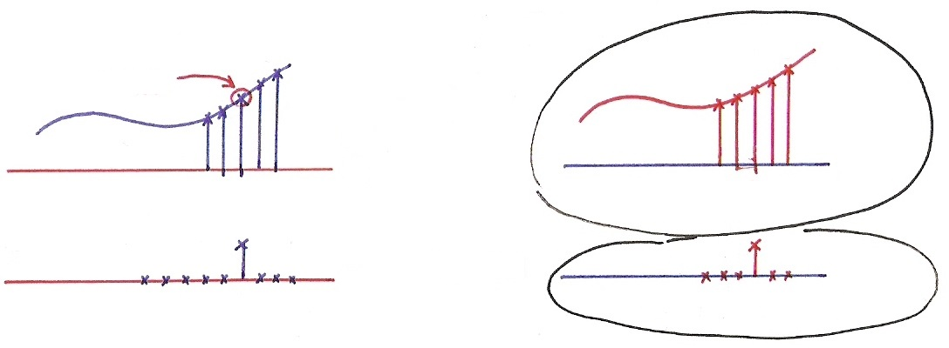




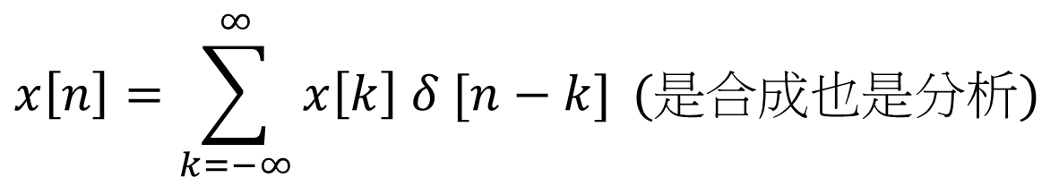
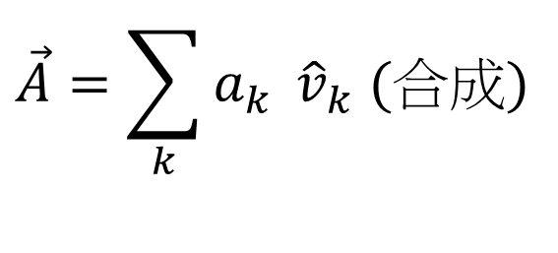









Vector Space Interpretation
$$x\left[n\right]=\sum_{k=−∞}^{∞}{x\left[k\right] δ [n−k]} (是合成也是分析)$$
$$x[k]$$
$$x[k]$$
$$x[n]$$
$$n$$
$$k$$
$$k$$
$$n$$
$$δ[n−k]$$
$$δ[k−n]$$
$$n$$
$$k$$
$$k$$
$$n$$
$$\vec{A}=\sum_{k}{a_{k} }{\hat{v}}_{k} (合成)$$
$$a_{j}=\vec{A}⋅{\hat{v}}_{j}\left(分析\right)$$
$$a_{n}=\vec{A}⋅{\hat{v}}_{n} (\vec{A}⋅\vec{B}=\sum_{k}{a_{k} b_{k}})$$

Slide 9
Representing an arbitrary signal as a sequence of
unit impulses
(合成)
        an unit impulse located at n = k on the index n
Sifting property of the unit impulse:looked at on the index k, δ[n-k] is nonzero only at k = n, which “sifts” the value x[n] out of the function x[k]. (分析)

Slide 10
Defining the output for an unit impulse input as the
Unit Impulse Response
x[n]=δ[n]
y[n]=h[n]:unit impulse response
S
0
n
0
n

Slide 11
By Linearity (Superposition Property)
    The output for an arbitrary input signal is the superposition of a series of “shifted, scaled unit impulse response”
x[k]
δ[n-k]
x[k]
h[n-k]
            Convolution Sum
      See Fig2.3,p.80 of text

Slide 12
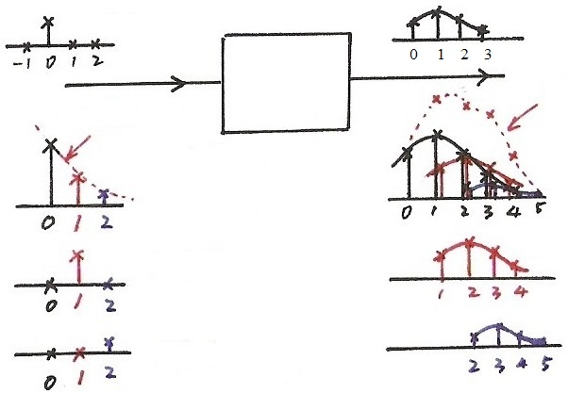






Input/Output Relation in Every Dimension
$$δ[n]$$
$$h[n]$$
$$y[n]$$
$$x[n]$$
$x\left[0\right] h[n]$
$$x[0]$$
$$x[1]$$
$x\left[1\right] h[n−1]$
$x\left[2\right] h[n−2]$
$$x[2]$$

Slide 13
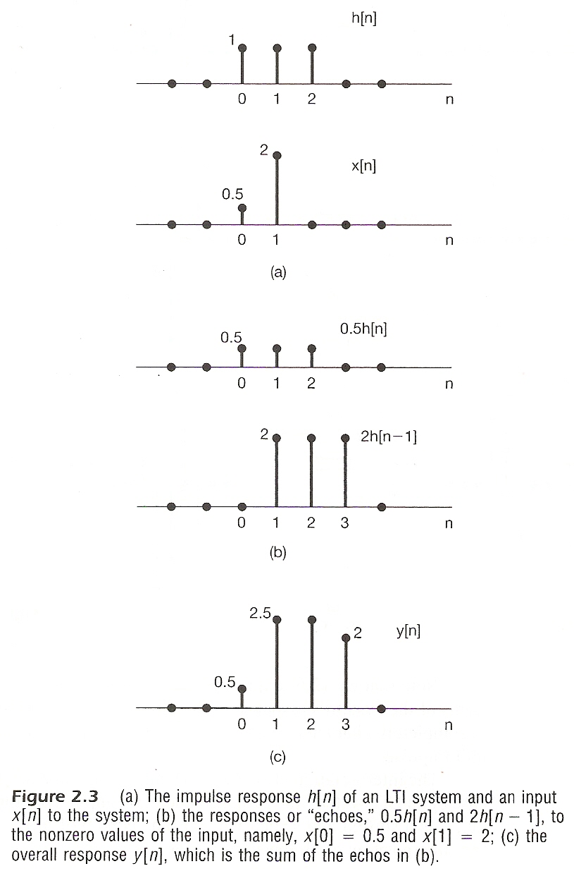

Slide 14
A Different Way to visualize the convolution sum
    looked at on the index k
    on the dummy index k, h[k] is reflected over and shifted to k=n, weighted by x[k] and summed to produce an output sample y[n] at time n
See Figs 2.5, 2.6, 2.7, pp. 83-85 of text
input signal
Contribution to the output signal at time n
reflected-over version of h[k] located at k = n

Slide 15
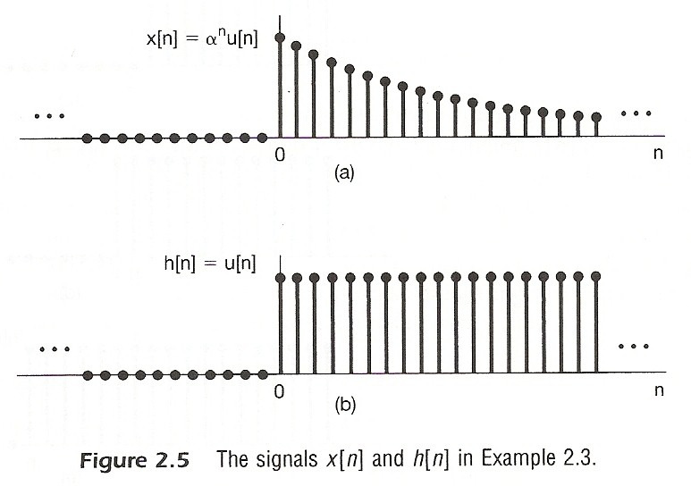

Slide 16
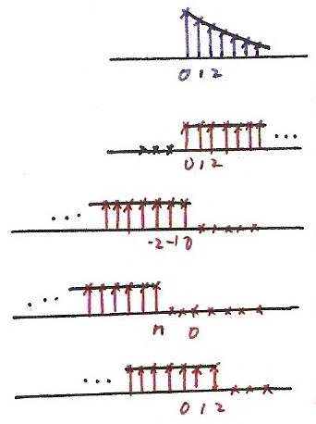








Fig. 2.6
$$x[k]$$
$$k$$
$$h[k]$$
$$k$$
$$h\left[−k\right], n=0$$
$$k$$
$$h\left[n−k\right], n<0$$
$$k$$
$$h\left[n−k\right], n=2>0$$
$$k$$

Slide 17
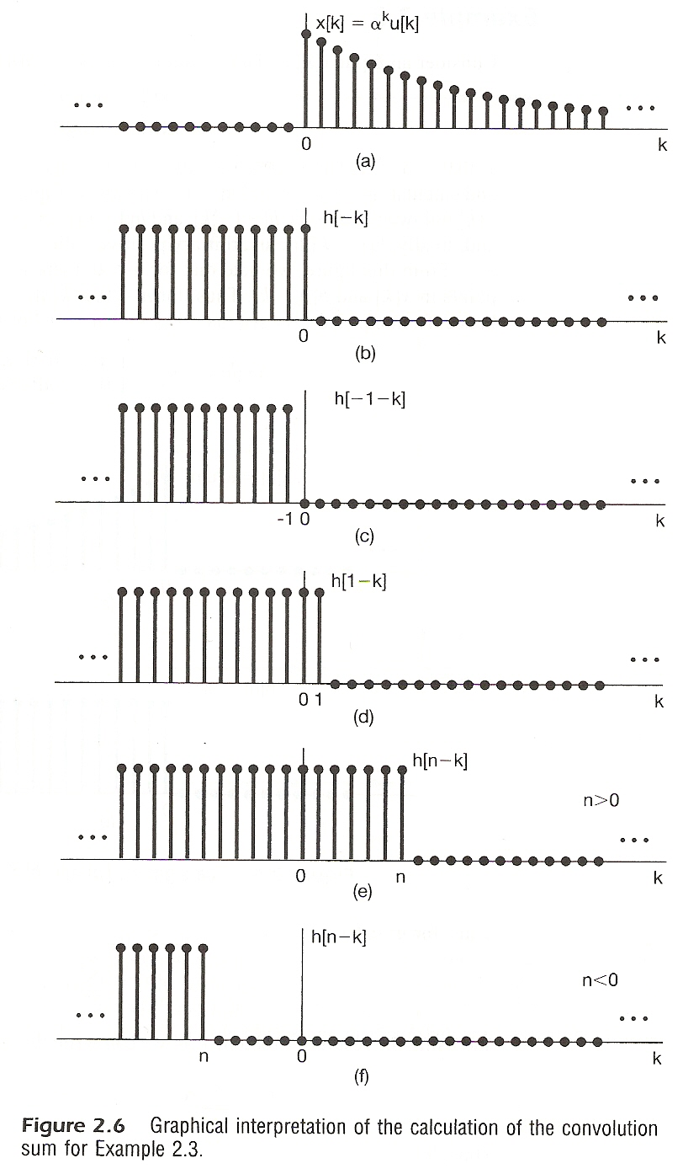

Slide 18
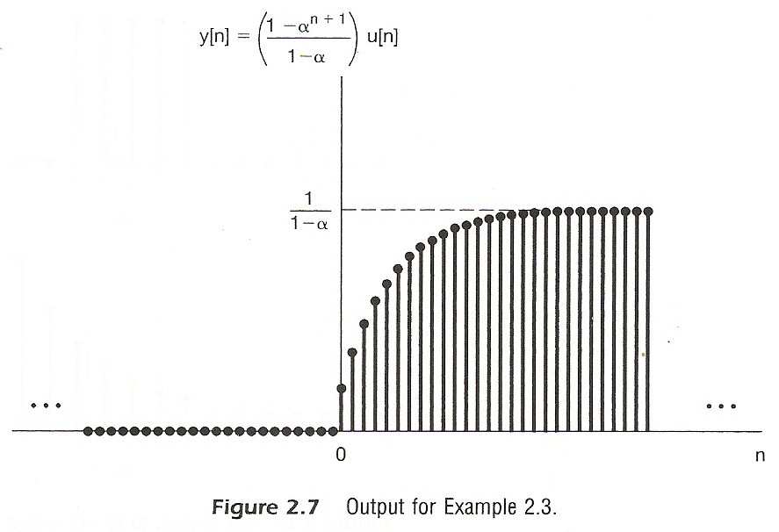

Slide 19
A linear time-invariant system is completely characterized by its unit impulse response

Slide 20
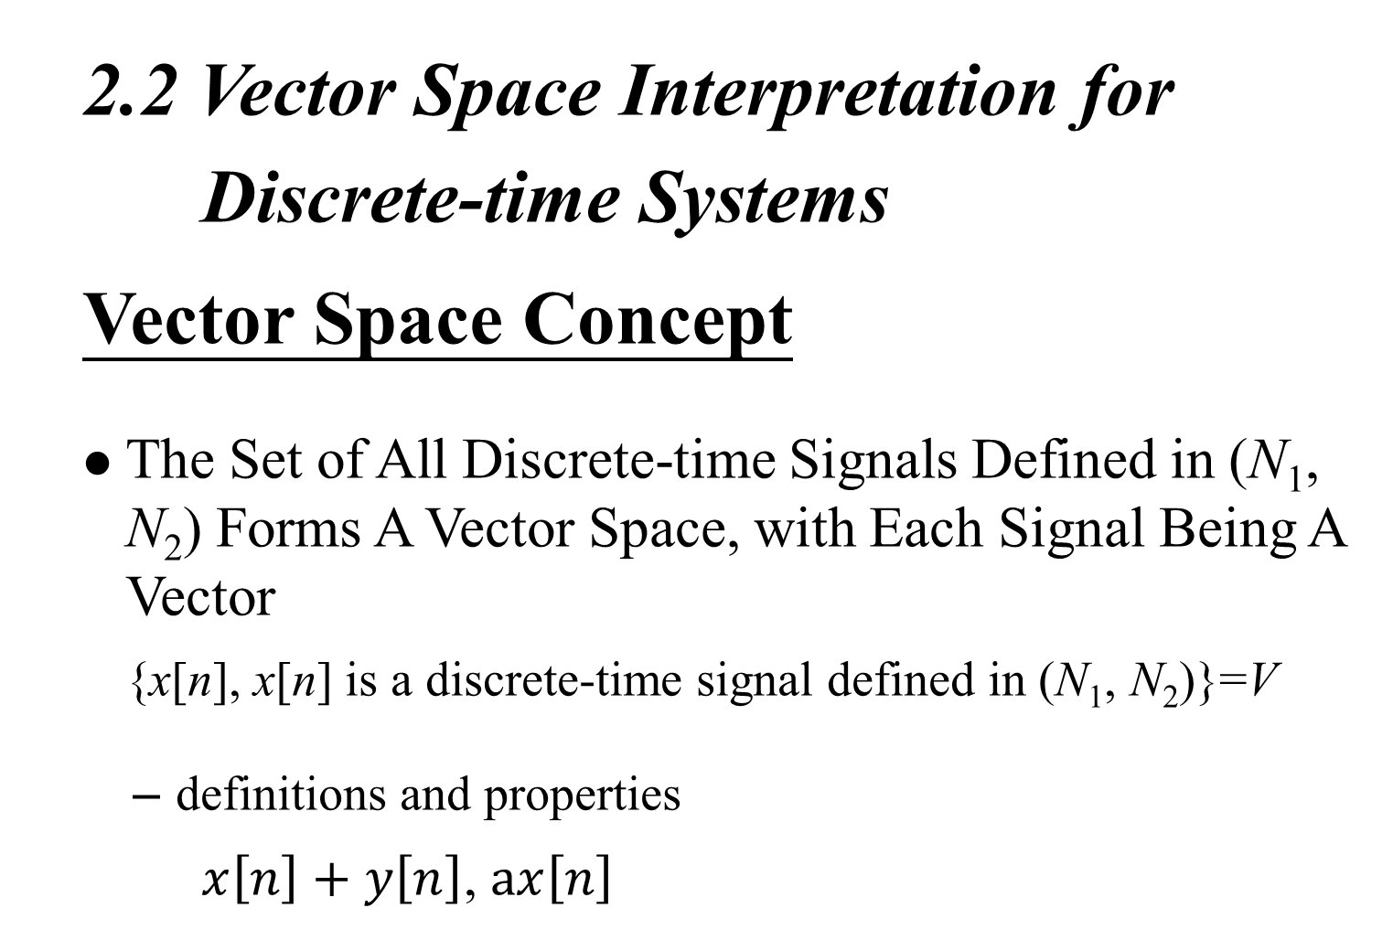

Slide 21
  Vector Space Concept
Definition of Inner-product
    Example
    Simple Definition

Slide 22
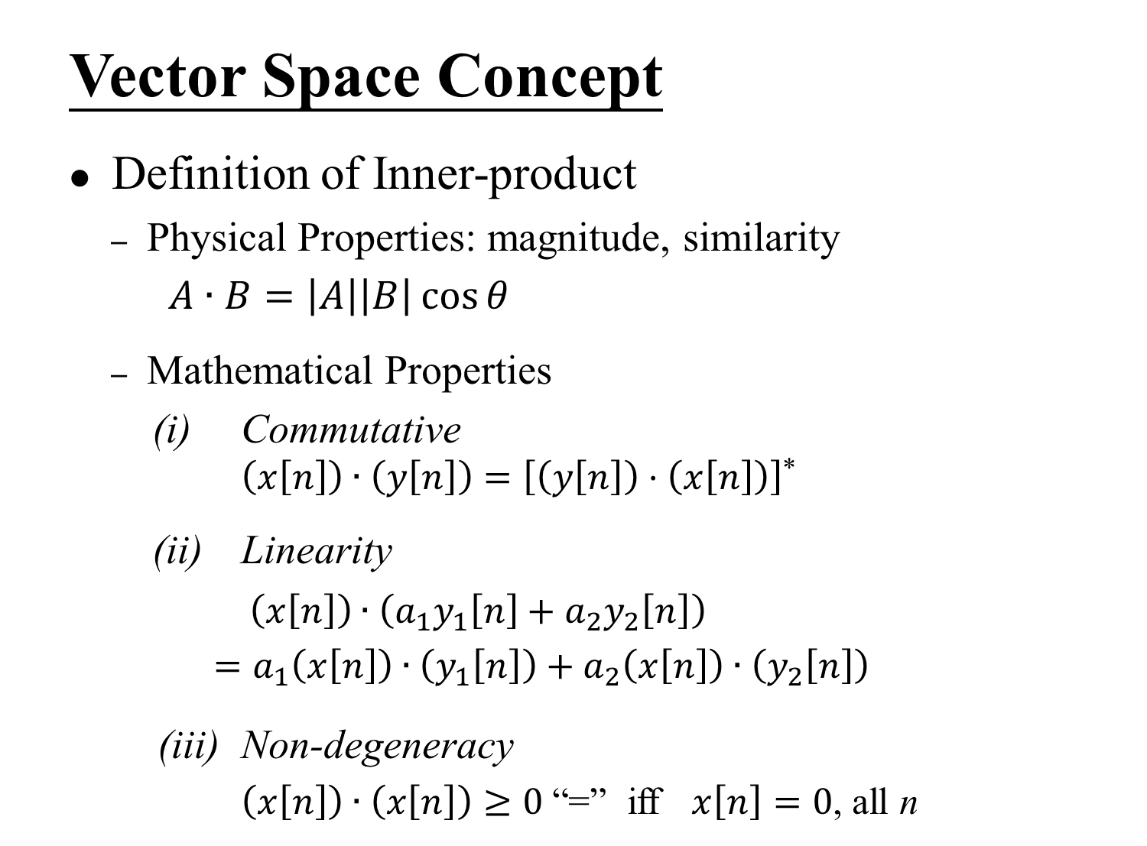

Slide 23
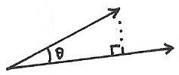
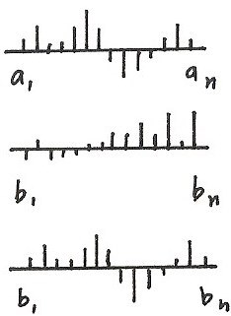


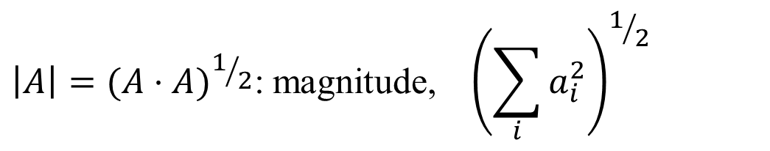

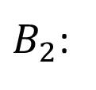

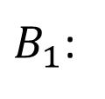


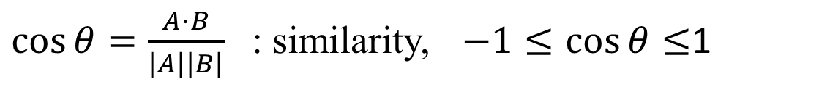
Inner Product
$$A⋅B=\underbrace{\left|A\right|\left|B\right|} \underbrace{\cos{θ}}$$
$$A$$
magnitude
similarity
$$\left|A\right|={(A⋅A)}^{1/2}\text{:} \text{magnitude}\text{, }{\left(\sum_{i}{a_{i}^{2}}\right)}^{1/2}$$
$$B$$
$\cos{θ}=\frac{A⋅B}{\left|A\right|\left|B\right|}$ : similarity, $−1≤\cos{θ}≤$1
$A⋅B = 0$ : orthogonal
$A$:
$B_{1}$:
$$A⋅B_{2}>A⋅B_{1}$$
$B_{2}$:

Slide 24

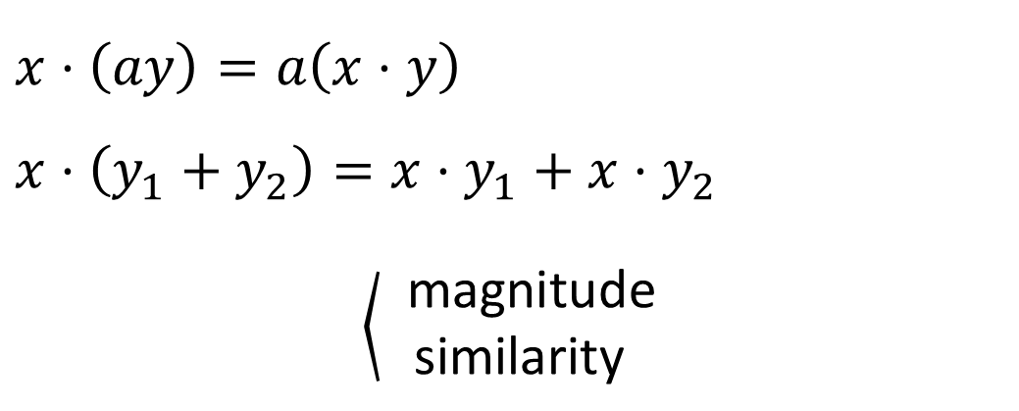
Linearity in Inner Product
$$x⋅\left(ay\right)=a\left(x⋅y\right)$$
$$x⋅\left(y_{1}+y_{2}\right)=x⋅y_{1}+x⋅y_{2}$$
$\left\langle \begin{aligned} \text{magnitude} \\ \text{similarity} \end{aligned}\right.$
Commutative, Non-degeneracy
$\left\langle \begin{aligned} \text{magnitude} \\ \text{similarity} \end{aligned}\right.$

Slide 25
  Vector Space Concept
Definition of Inner-product
    Physical Properties: magnitude, similarity
    For the vector space of signals defined in (N₁, N₂)
    Inner-product Space
    (N₁, N₂) extended to (-∞, ∞)

Slide 26
  Vector Space Concept
    Magnitude/Similarity

Slide 27
  Vector Space Concept
    Orthonormal bases
    orthogonal
    orthonormal
    orthonormal basis
    any vector (signal) in the vector space can be expanded by
    the set of orthonormal signals
(合成)

Slide 28
  System Characterization
    Vector Space
    Orthonormal bases
  time-shifted unit impulses, dim = ∞
    A signal expanded by this set of orthonormal basis
(合成)

Slide 29
  System Characterization
    A Different View of the Sifting Property
    3-dim vector space
    Sifting property
(分析)

Slide 30
  System Characterization
  Transformation of Vectors
    A System is a Transformation which maps one vector x[n]
    to another vector y[n] (linear, time-invariant)
H [ ]

Slide 31
Defining the output for an unit impulse input as the
Unit Impulse Response (P.10 of 2.0)
x[n]=δ[n]
y[n]=h[n]:unit impulse response
S
0
n
0
n

Slide 32
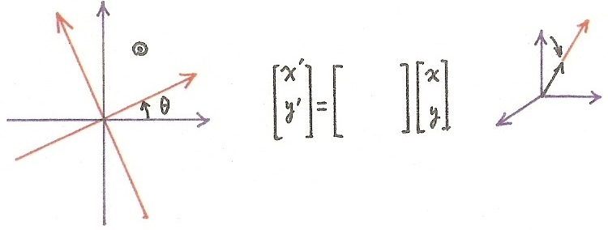



  Rotation as a vector transformation
y
$$y^{′}$$
(1,0,0)
$(αa,αb,αc)$
$$x^{′}$$
(a, b, c)
x
Rotation plus
vector scaling
Rotation as a
vector transformation
(1, 0, 0) → (0.9, 0.3, 0.3)
(0, 1, 0) → (0.3, 0.9, 0.3)
(0, 0, 1) → (0.3, 0.3, 0.9)
(1, 0, 0, 0,⋯) → (0.9, 0.3, 0.2,⋯)
(0, 1, 0, 0,⋯) → ( 0, 0.9, 0.3, 0.2,⋯)
(0, 0, 1, 0,⋯) → ( 0, 0, 0.9, 0.3,02,⋯)

Slide 33
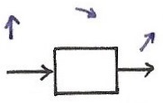
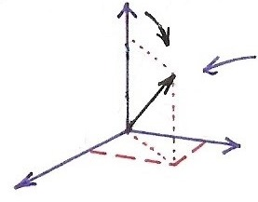



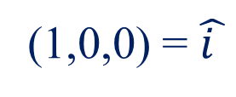
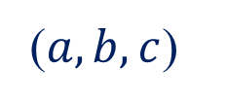
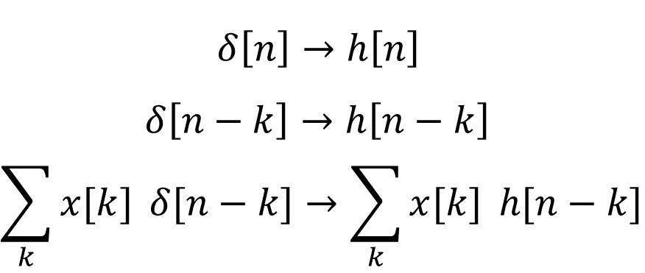
Splitting a single basis vector into a few more basis vectors
$\hat{i }$
a
(a,b,c)
(1,0,0)
($a,b,c$)
(1,0,0) = $\hat{i }$
$δ\left[n\right]→h\left[n\right]$
$δ\left[n−k\right]→h\left[n−k\right]$
$$\sum_{k}{x[k]} δ[n−k]→\sum_{k}{x[k]} h[n−k]$$
c
b
$\hat{k}$
$\hat{j }$
transforming a single basis vector enough to describe the transformation of any vectors

Slide 34
  System Characterization
  Transformation of Vectors
    unit impulse response is the transformation of δ[n]. A basis vector is transformed to a set of other bases
    superposition property for convolution sum

Slide 35
  System Characterization
  Linear, Time-invariant Transformation of vectors can be expressed by a matrix
x
y
Convolution Sum

Slide 36
  System Characterization
  Matrix Representation of Convolution Sum
    example: x[n]=…0,0,x₀,x₁,x₂,0,0,…
    h[n]=…0,0,h₀,h₁,h₂,0,0,…
    y[n]=…0,0,y₀,y₁,y₂,y₃,y₄,0,0,…

Slide 37

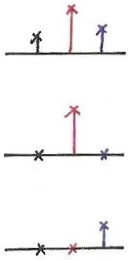
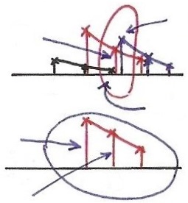



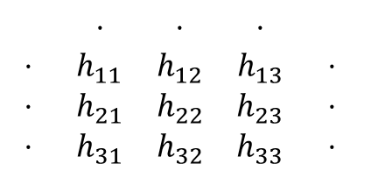

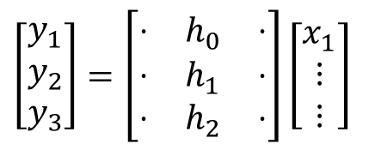
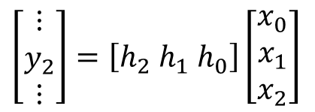



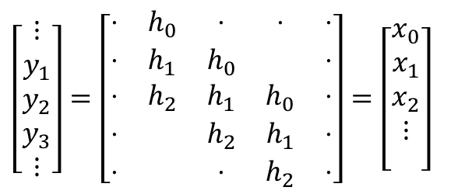


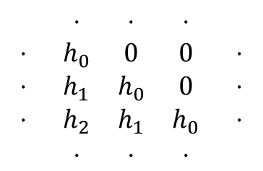


Matrix Representation
$$δ[n]$$
$$h_{0}$$
$$h_{1}$$
$$h_{2}$$
$$\left[\begin{matrix}⋮ \\ y_{2} \\ ⋮\end{matrix}\right]=\left[h_{2} h_{1} h_{0}\right]\left[\begin{matrix}x_{0} \\ x_{1} \\ x_{2}\end{matrix}\right]$$
$$h[n]$$
01 2
$$h_{1}x_{1}$$
$$h_{0}x_{2}$$
0 1 2
0 1 2
$$h_{2}x_{0}$$
$$h_{0}x_{1}$$
$$\left[\begin{matrix}y_{1} \\ y_{2} \\ y_{3}\end{matrix}\right]=\left[\begin{matrix}⋅ & h_{0} & ⋅ \\ ⋅ & h_{1} & ⋅ \\ ⋅ & h_{2} & ⋅\end{matrix}\right]\left[\begin{matrix}x_{1} \\ ⋮ \\ ⋮\end{matrix}\right]$$
0 1 2
$$h_{1}x_{1}$$
1 2 3
0 1 2
2 3 4
$$\left[\begin{matrix}⋮ \\ y_{1} \\ y_{2} \\ y_{3} \\ ⋮\end{matrix}\right]=\left[\begin{matrix}⋅ & h_{0} & ⋅ & ⋅ & ⋅ \\ ⋅ & h_{1} & h_{0} & & ⋅ \\ ⋅ & h_{2} & h_{1} & h_{0} & ⋅ \\ ⋅ & & h_{2} & h_{1} & ⋅ \\ ⋅ & & ⋅ & h_{2} & ⋅\end{matrix}\right]=\left[\begin{matrix}x_{0} \\ x_{1} \\ x_{2} \\ ⋮ \\ \end{matrix}\right]$$
$$\begin{matrix} & ⋅ & ⋅ & ⋅ & \\ ⋅ & h_{0} & 0 & 0 & ⋅ \\ ⋅ & h_{1} & h_{0} & 0 & ⋅ \\ ⋅ & h_{2} & h_{1} & h_{0} & ⋅ \\ & ⋅ & ⋅ & ⋅ & \end{matrix}$$
$$\begin{matrix} & ⋅ & ⋅ & ⋅ & \\ ⋅ & h_{11} & h_{12} & h_{13} & ⋅ \\ ⋅ & h_{21} & h_{22} & h_{23} & ⋅ \\ ⋅ & h_{31} & h_{32} & h_{33} & ⋅\end{matrix}$$

Slide 38
  System Characterization
  Matrix Representation of Convolution Sum
    each component of the input vector is transformed to a set of other components of the output vector, and all these are superpositioned (superposition property)
    each component of the output vector is contributed respectively by the transformed component of each input vector component (reflected, shifted, weighted sum)

Slide 39
  2.3 Continuous-time System :
  the Convolution Integral
  Representing an arbitrary signal as an integral of impulses
See Fig 2.12 , p.91 of text
an impulse located at t = τ whose value is x(τ)
(合成)
a special case

Slide 40
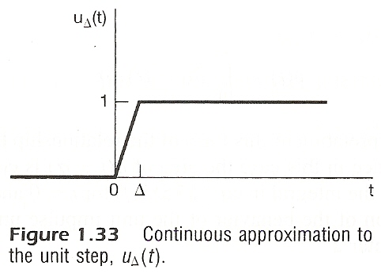
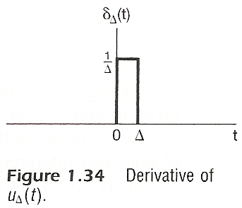

Slide 41


Slide 42
Vector Space Representation of Discrete-
time Signals (P.48 of 1.0)
  n extended to $± ∞$
$\vec{x}=(⋯,x_{−2},x_{−1},x_{0},x_{1},x_{2},x_{3}, ⋯)$
$\hat{v_{0}}=$ (⋯, 0, 0, 1, 0, 0, 0, ⋯ )=δ [ $n$ ]
$\hat{v_{1}}=$ (⋯, 0, 0, 0, 1, 0, 0, ⋯ )=δ [ $n$ – 1 ]
$\hat{v_{k}}=$ (⋯, 0, 0, 0, ⋯, 0, 1, ⋯ )=δ [ $n$ – k ]
$\{δ\left[n−k\right], k:\text{inter}\text{\}}$
$$\vec{x}=\sum_{i}{x_{i}\hat{v_{i}}} 合成$$
$x_{j}= \vec{x}⋅\hat{v_{j}}$ 分析

Slide 43







Vector Space Interpretation (P.8 of 2.0)
$$x\left[n\right]=\sum_{k=−∞}^{∞}{x\left[k\right] δ [n−k]} (是合成也是分析)$$
$$x[k]$$
$$x[k]$$
$$x[n]$$
$$n$$
$$k$$
$$k$$
$$n$$
$$δ[k−n]$$
$$δ[k−n]$$
$$n$$
$$k$$
$$k$$
$$n$$
$$\vec{A}=\sum_{k}{a_{k} \hat{v_{k}}} (合成)$$
$$a_{j}=\vec{A}⋅\hat{v_{j}} \left(分析\right)$$
$$a_{n}=\vec{A}⋅\hat{v_{n}} (\vec{A}⋅\vec{B}=\sum_{k}{a_{k} b_{k}})$$

Slide 44


















Vector Space Representation
$$x\left(t\right)=\int_{−∞}^{∞}{x}\left(τ\right) δ\left(t−τ\right)dτ\text{(}是合成也是分析\text{)}$$
$$x\left(τ\right)$$
$$x\left(τ\right)$$
$$x\left(t\right)$$
$$t$$
$$τ$$
$$τ$$
$$t$$
$$δ\left(t−τ\right)$$
$$δ\left(τ−t\right)$$
$$t$$
$$τ$$
$$τ$$
$$t$$
$$\vec{A}=\sum_{k}{a_{k}}\hat{v_{k}} \text{(}合成\text{)}$$
$$a_{j}=\vec{A}⋅\hat{v_{j}}\text{ (}分析\text{)}$$
discrete-time:
continuous-time:
$\overset{⃑}{A}⋅\overset{⃑}{B}=\sum_{n}{a}\left[n\right] b^{∗}\left[n\right]$
$\overset{⃑}{A}⋅\overset{⃑}{B}=\int_{−∞}^{∞}{a\left(t\right)}b^{∗}\left(t\right) dt$

Slide 45









Continuous-time Vector Space
$\left\{ x(t) | τ_{2}≤t≤τ_{1} \right\}$ or $\left\{ x(t) | −∞<t<∞ \right\}$
$ax(t)$, $x_{1}\left(t\right)+x_{2}\left(t\right)$
{ $δ(t−τ)$, $−∞<τ<∞$ } is a set of basis
$$t$$
$$δ(t−τ_{1})$$
$$t$$
$$δ(t−τ_{2})$$
$$t$$
$$δ(t−τ_{3})$$
$$\left[x\left(t\right)\right]⋅\left[y\left(t\right)\right]=\int_{−∞}^{∞}{x\left(t\right)}y^{∗}\left(t\right) dt$$
$$\left|x(t)\right|={\left|\int_{−∞}^{∞}{{\left|x(t)\right|}^{2} dt}\right|}^{1/2}$$

Slide 46










Unit Step
1
$$u\left(t\right)=\int_{0}^{∞}{δ\left(t−τ\right)}dτ$$
t
0
$$δ\left(τ−t\right)$$
$$τ$$
$$t>0$$
0
t
$$δ\left(τ−t\right)$$
$$τ$$
$$t<0$$
t
0
    running integral
$$u\left(t\right)=\int_{−∞}^{t}{δ\left(τ\right)}dτ, τ=t−τ^{′}$$

Slide 47
  Representing an arbitrary signal as an integral of
  impulses
    Sifting Property : (分析)
    Looked at on the index τ, δ(t-τ) located at τ = t shifts the value x(t) out of the function x(τ)
See Fig 2.14 ,p.94 of text

Slide 48


Slide 49
  Defining the output for an unit impulse input as the unit impulse response
S
Unit Impulse Response
t
t
0
0

Slide 50
  By Linearity (Superposition Property)
    The output for an arbitrary input signal is the superposition of a series of “shifted, scaled unit impulse response”
Convolution Integral

Slide 51
Defining the output for an unit impulse input as the
Unit Impulse Response (P.10 of 2.0)
x[n]=δ[n]
y[n]=h[n]:unit impulse response
S
0
n
0
n

Slide 52
By Linearity (Superposition Property) (P.11 of 2.0)
    The output for an arbitrary input signal is the superposition of a series of “shifted, scaled unit impulse response”
x[k]
δ[n-k]
x[k]
h[n-k]
            Convolution Sum
      See Fig2.3,p.80 of text

Slide 53






Input/Output Relation in Every Dimension
(P.12 of 2.0)
$$δ[n]$$
$$h[n]$$
$$y[n]$$
$$x[n]$$
$x\left[0\right] h[n]$
$$x[0]$$
$$x[1]$$
$x\left[1\right] h[n−1]$
$x\left[2\right] h[n−2]$
$$x[2]$$

Slide 54




















Input/Output Relation in Every Dimension
$$δ(t)$$
$$h(t)$$
$$t$$
$$t$$
0
0
$$x(t)$$
$$y(t)$$
$$t$$
$$t$$
0
$${τ_{1} τ}_{2}$$
$$t$$
$$t$$
0
0
$$t$$
$$t$$
$$τ_{1}$$
$$τ_{1}$$
$$t$$
$$t$$
$$τ_{2}$$
$$τ_{2}$$

Slide 55
  A Different Way to visualize the convolution integral
    Look on the index τ
input signal
output signal at time t
reflected-over version of h(t)located at τ =t
    On the dummy index τ, h(t) is reflected over and shifted to τ = t, weighted by x(t) and integrated to produce the output value at time t, y(t)
see Figs.2.19,2.20,2.21,pp.100-101 of text
  A linear time-invariant system is completely
  characterized by its unit impulse response

Slide 56




$$−2T$$
0
$$h(−t)$$

Slide 57


Slide 58


Slide 59
  2.4 Properties of Linear
  Time-invariant Systems
  Commutative Property
    the role of input signal and unit impulse response is interchangeable, giving the same output signal
    In evaluating the convolution sum or integral, the input signal can be reflected over and weighted by the unit impulse response

Slide 60
  Distributive Property
            additive (linear) property

Slide 61
  Associative Property
    Cascade of two systems gives an unit impulse response which is the convolution of the unit impulse responses of the two individual systems
    The behavior of a cascade of two systems is independent of the order in which the two systems are cascaded

Slide 62
  Causality
  causal if y[n] dose not depend on x[k] for k > n
  Causal iff h[n]=0, n < 0

Slide 63
  Causality
    continuous-time
    Causal iff h(t)=0,t<0

Slide 64





    Causality (P.56 of 1.0)
$$x[n]$$
$$y[n]$$
$$n$$
$$n$$
$$y\left[n\right]=\sum_{k=−∞}^{n+m}{x[k]}$$

Slide 65










Causality & Memory
$$y\left[n\right]=\sum_{k=−∞}^{∞}{x}\left[k\right] h[n−k]$$
(for future)
non-causal
memory
(for past)
$$h[n]$$
$$n$$
memory
non-causal
$$h[n−k]$$
$$k$$
$$n$$
$$x[k]$$
$$k$$
$$n$$
$$( h\left[n\right]=0\text{, }n<0 )⇔( h\left[n−k\right]=0\text{, }k>n )\text{: }\text{Causality}$$

Slide 66
  Memoryless / with Memory
    A linear, time-invariant, causal system is memoryless only if
    if k=1 further, they are identity systems
    sifting property, i.e., convolution sum (or integral) with an unit impulse function gives the original signal

Slide 67
  Invertibility / Inverse system

Slide 68
  Stability
    stable if bounded input gives bounded output
    |x[n]| < B, all n
    Stable iff the impulse response is absolutely summable,
    or absolutely integrable,
    the necessary condition can be proved

Slide 69
  Unit step response
    output for an unit step function input
    similarly
Running sum
First difference
Running integral
First derivative

Slide 70
  2.5 Systems Described by
  Differential/Difference Equations
  Continuous-time
  Differential Equation Specification for Input/Output Relationships
    derived by physical phenomena and relationships
    very often auxiliary conditions are needed to completely specify the system

Slide 71
  Continuous-time
  Differential Equation Specification for Input/Output Relationships
    the response y(t) to an input x(t) in general consists of two parts:
    (1) homogeneous solution (natural response): a solution for
    (2) particular solution: to the complete differential equation

Slide 72
  Continuous-time
  Initial Rest Condition for Causal Systems
    initial conditions

Slide 73
  Discrete-time
  Difference Equation Specification
    derived by sequential behavior of different processes
    auxiliary conditions needed
    response y(t) consists of two parts
      (1) homogeneous solution (natural response) for
      (2) particular solution

Slide 74
  Discrete-time
  Initial Rest Condition for Causal Systems
  Recursive Equation
    output at time n expressed in terms of previous values of input/output

Slide 75


Slide 76
  Block Diagram Representation
  Elementary Operations
x₂[n]
x₂(t)
x₁[n]
x₁(t)
x₁[n]+ x₂[n]
x₁(t)+ x₂(t)
x[n]
x(t)
a
ax[n]
ax(t)

Slide 77
  Block Diagram Representation
  Elementary Operations
x[n]
D
x[n-1]
x(t)
x(t)

Slide 78
  Block Diagram Representation
  An Example
b
x[n]
y[n]
D
-a
y[n-1]
Feedback, with memory, initial value of the memory element as the initial condition
Initial rest condition: initial value in the memory element is zero

Slide 79
  Block Diagram Representation
  Continuous-time Example
x(t)
y(t)

Slide 80
  Block Diagram Representation
  Continuous-time Example
Expressed by integrator, assuming initially at rest
b
x(t)
y(t)
-a
The integrator represents the memory element

Slide 81
  2.6 The Unit Impulse for
  Continuous-time Cases
  Many Different Functions
  Approaching δ(t) in the Limit
  Sifting Property

Slide 82

















Unit Impulse
$$δ(t)$$
$$h(t)$$
$$h(t)$$
$$x(t)$$
$$y\left(t\right)=x\left(t\right)∗h\left(t\right)$$
$$x\left(t\right)=\int_{−∞}^{∞}{x\left(τ\right)}δ\left(t−τ\right)dτ=x\left(t\right)∗δ(t)$$
(是分析, 是合成, 是單位元素)
$$x(t)$$
$$x(t)$$
$$δ(t)$$
$$y\left(t\right)=x\left(t\right)∗δ\left(t\right)=x(t)$$
$$δ(t)$$
$$x(t)$$
$$x(t)$$
$$δ(t)$$
$$δ(t)$$
$$δ(t)$$
$$δ\left(t\right)=δ\left(t\right)∗δ\left(t\right)∗δ(t)$$

Slide 83
  Many Different Functions
  Approaching δ(t) in the Limit
  Let
See Fig. 2.33, p. 128 of text
then
.
.
.
.

Slide 84


Slide 85

  Many Different Functions
  Approaching δ(t) in the Limit
  Let

Slide 86


Slide 87


Slide 88
  Operational Definition of Unit Impulse
  A Function can be defined by
what it is at each value of the independent variable
what it does under some mathematical operation such as an integral or a convolution, or how it behaves with a system, or some mathematical constraints: Singularity Function

Slide 89



$$x\left(t\right)=\int_{−∞}^{∞}{x}\left(τ\right) δ\left(t−τ\right) dτ$$

Slide 90










Operational Definition of δ(t)
  {$δ\left(t−τ\right), −∞<τ<∞$} is a set of basis
  All are operational definitions
$$x\left(t\right)=\int_{−∞}^{∞}{x}\left(τ\right) δ\left(t−τ\right)dτ=x\left(t\right)∗δ(t)$$
$$t$$
  是合成也是分析
  是單位元素
$$τ_{1}$$
$$t$$
$$τ_{2}$$
$$t$$
$$τ_{3}$$

Slide 91

  Differentiator, Integrator and
  Singularity Functions
  Differentiator
x(t)
unit impulse response

Slide 92

See Fig. 2.36, p. 134 of text

Slide 93


Slide 94
  Differentiator, Integrator and
  Singularity Functions
  Cascade of Differentiators
k times

Slide 95
  Differentiator, Integrator and
  Singularity Functions
  Integrator
unit impulse response

Slide 96
  Differentiator, Integrator and
  Singularity Functions
  Cascade of Integrators
unit ramp function

Slide 97
  Differentiator, Integrator and
  Singularity Functions
  Cascade of Integrators
k times

Slide 98
  Differentiator, Integrator and
  Singularity Functions
  Unified Definition
||
δ(t)
integrators differentiators

Slide 99
  Differentiator, Integrator and
  Singularity Functions
  Unified Definition
    operational definitions with singularity functions
    manipulate operations efficiently and easily
||
δ(t)
integrators differentiators

Slide 100
  2.7 Vector Space Interpretation for
  Continuous-time Systems
  Vector Space Concept
  The Set of All Continuous-time Signals Defined in
  (t₁, t₂) Forms A Vector Space
  {x(t), x(t) is a continuous-time signal defined in
  (t₁,t₂)}=V
definitions and properties

Slide 101
  Vector Space Concept
  Definition of Inner-product
similar to

Slide 102
  Vector Space Concept
  Magnitude/Similarity

Slide 103






Inner Product for Continuous-time Signals
$$\left[x\left(t\right)\right]⋅\left[y\left(t\right)\right]=\int_{−∞}^{∞}{x\left(t\right)}y^{∗}\left(t\right) dt$$
$$x\left(t\right)$$
$$y_{1}\left(t\right)$$
$$y_{2}\left(t\right)$$
$$\left[x\left(t\right)\right]⋅\left[y_{1}\left(t\right)\right]>\left[x\left(t\right)\right]⋅\left[y_{2}\left(t\right)\right]$$

Slide 104
  Vector Space Concept
  Orthonormal Bases
orthogonal
orthonormal

Slide 105
  Vector Space Concept
a typical example of orthonormal signal set
      b: scaling factor
orthonormal basis
any vector in the vector space can be expanded by the set of orthonormal signals

Slide 107
  Vector Space for Continuous-time
  Signals
  Vector Space
  Orthonormal Bases(?)
    time-shifted unit impulses, dim=∞
Inner-product

Slide 108
  Vector Space for Continuous-time
  Signals
  Orthonormal Bases(?)
Inner-product
Not really orthonormal (but are orthogonal), but makes sense under the operational definition

Slide 109


  System Characterization
  A Signal expanded by unit impulse bases
(合成)
$$τ=t$$
(分析)

Slide 110

  System Characterization
  A System is a Transformation
x(t)
H
y(t)
δ(t)
h(t)
  Can’t be represented by a matrix due to the discrete property of the matrices, but the concept is the same

Slide 111








Data Transmission
“1”
“0”
Transmitter
…1101 …
1 1 0 1
$$h_{c}\left(t\right)$$
channel distortion
$$n\left(t\right)$$
noise
…1101 …
$$h_{2}\left(t\right)$$
$$h_{1}\left(t\right)$$
$$h_{1,2}[n]$$
Decision
equalizer
front-end
filter
$$h_{2}[t]≈h_{c}^{−1}[t]$$
$$h_{1,2}[t]$$

Slide 112
    Examples
Example 2.11, p.110 of text
time shift of signals
convolution of a signal with a shifted impulse is the signal itself but shifted
x(t)
y(t)=x(t-t₀)
h(t)
δ(t)
h(t)= δ(t-t₀)

Slide 113
    Examples
Example 2.12, p.111 of text
running sum or accumulation
first difference is the inverse
y[n]=x[n]-x[n-1]
h₁[n]=δ[n]-δ[n-1]
u[n]*{δ[n]-δ[n-1]}=u[n]-u[n-1]=δ[n]
x[n]
h[n]
δ[n]
h[n]=u[n]

Slide 114


    Examples
…

Slide 115

    Problem 2.51(a), p.154 of text
System A is linear, time-invariant with
  $h\left[n\right]={(\frac{1}{2})}^{n} u[n]$
System B is linear but time-varying with
  $y\left[n\right]=nx[n]$
  Show that the commutativity property does not hold for
  $\left[A−B\right]$ and $\left[B−A\right]$ cascade structure
For $\left[A−B\right]$
  $x_{1}\left[n\right]=δ\left[n\right]$, $y_{1}\left[n\right]={(\frac{1}{2})}^{n} u\left[n\right]$, $z_{1}\left[n\right]=n{(\frac{1}{2})}^{n} u\left[n\right]$
For $\left[B−A\right]$
$x_{1}\left[n\right]=δ\left[n\right]$, $y_{1}\left[n\right]=0$, $z_{1}\left[n\right]=0$

Slide 116
    Problem 2.64, p.166 of text
A simplified echo system and its inverse
x(t)
y(t)
……
x(t)
y(t)
T
½
T
(-½)
h(t)
g(t)

Slide 117
    Problem 2.64, p.166 of text
A more realistic model
stability analysis
0<α<1, , stable
α>1, not integrable, “NOT” stable
x(t)
y(t)
……
x(t)
y(t)
α
T
T
(-α)
h(t)
g(t)

