Slide 1
信號與系統
Signals & Systems
李琳山

Slide 2
A Signal
A signal is a function of one or more variables, which conveys information on the nature of some physical phenomena.
Examples
    f ( t ) : a voice signal, a music signal
    f ( x , y ) : an image signal, a picture
    f ( x , y , t ) : a video signal
    x_{n} : a sequence of data ( n: integer )
    b_{n} : a bit stream ( b:1 or 0 )
    continuous-time, discrete-time
    analog, digital
  Human Perceptible/Machine Processed

Slide 3
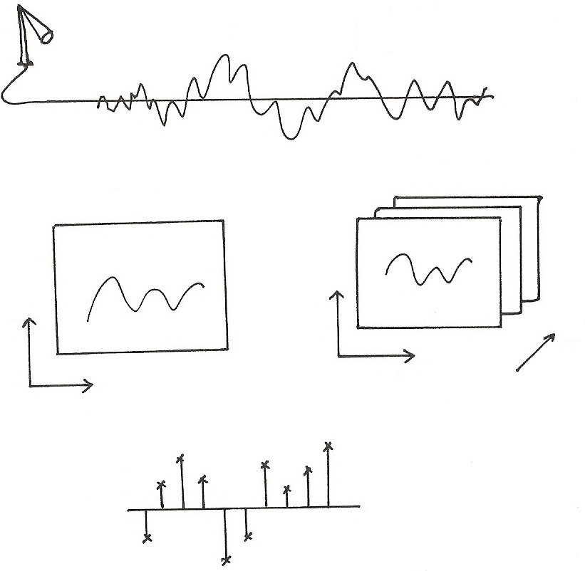











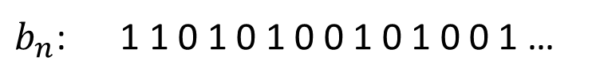
A Signal
$$f(t)$$
$$t$$
$$f(x,y, t)$$
$$f(x,y)$$
$$y$$
$$y$$
$$t$$
$$x$$
$$x$$
$$x_{n}$$
$$x[n]$$
$$n$$
$b_{n}$: 1 1 0 1 0 1 0 0 1 0 1 0 0 1 …

Slide 4
A System
An entity that manipulates one or more signals to accomplish some function, including yielding some new signals.
Examples
    an electric circuit
    a telephone handset
    a PC software receiving pictures from Internet
    a TV set
    a computer with some software handling some data
System
input
signal
output
signal

Slide 5
Typical Examples of Signals/Systems
Concerned
Communication Systems
s(t)
r(t)
Transmitter
Channel
Receiver
Message signal (information) data, text, audio, video
Transmitted signal
Received signal
Estimate of message signal (information)
noise, loss
distortion,
interference

Slide 6
Typical Examples of Signals/Systems
Concerned
Computers
Signal Processing Systems
    software systems processing the signal by computation/ memory
    examples : audio enhancement systems, picture processing systems, video compression systems, voice recognition/ synthesis systems, array signal processors, equalizers, etc.

Slide 7
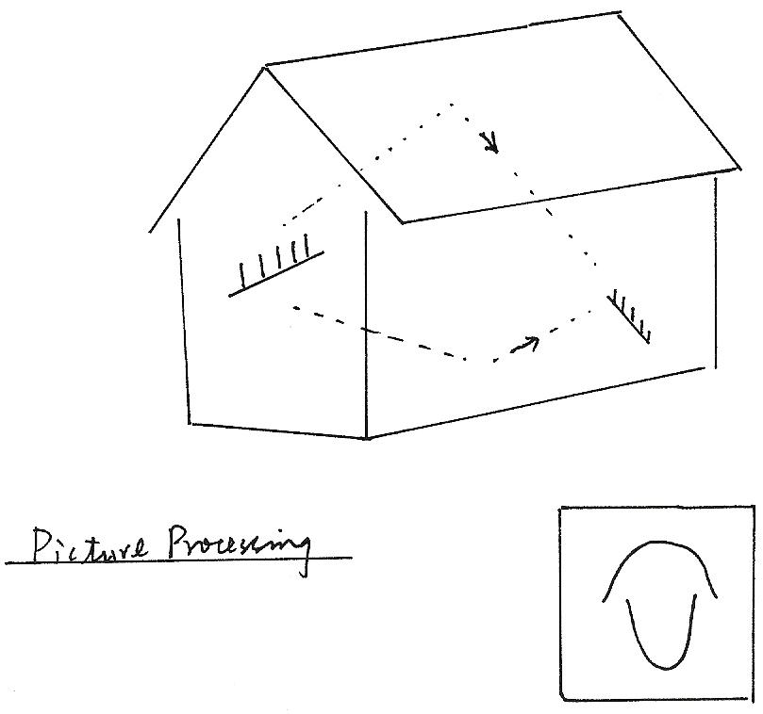
Audio Enhancement
Picture Processing

Slide 8
Typical Examples of Signals/Systems
Concerned
Networks
user B
user A

Slide 9
Typical Examples of Signals/Systems
Concerned
Information Retrieval Systems
Internet
Other Information Systems
    examples : remote sensing systems, biomedical signal
    processing systems, etc.
Internet
Search Engine
User

Slide 10
  Internet
Internet
Digital
Libraries,
Virtual
Museums,
Electronic
Home,
Network
Entertainment
Google,
Facebook,
YouTube,
Amazon
Intelligent
Offices,
Distant
Learning,
Electronic
Commerce,
Network
Banking,
Electronic
Government
Services,
.
.
.
.
.
.
.
.
.
.
.
.
.
.
.
.
.
.

Slide 11
  Internet
Network Technology Connects Everywhere Globally
Huge Volume of Information Disseminated across the Globe in Microseconds
Multi-media, Multi-lingual, Multi-functionality
Cross-cultures, Cross-domains, Cross-regions
Integrating All Knowledge Systems and Information related Activities Globally

Slide 12
  Typical Examples of Signals/Systems
  Concerned
Control Systems
    close-loop/feedback control systems
disturbance z(t)
error signal e(t)
control signal v(t)
input signal x(t)
controller
plant
output signal y(t)
feedback signal
sensor
    example: aircraft landing systems, satellite stabilization systems, robot arm control systems, etc.

Slide 13
  Typical Examples of Signals/Systems
  Concerned
Other Systems
    manufacturing systems, computer-aided-design systems, mechanical systems, chemical process systems, etc.

Slide 14
Scope of The Course
Those Signals/Systems Operated by Electricity, in Particular by Software and Computers, with Extensive Computation and Memory, for Information and Control Primarily
Analytical Framework to Handle Such Signals/Systems
Mathematical Description/Representation of Such Signals/Systems

Slide 15
Scope of The Course
Language and Tools to Solve Problems with Such Signals/Systems
Closely Related to: Communications, Signal Processing, Computers, Networks, Control, Biomedical Engineering, Circuits, Chips, EM Waves, etc.
A Fundamental Course for E.E.

Slide 16
Text/Reference Books and Lecture Notes
Textbook:
    Oppenheim & Willsky, “Signals & Systems”, 2nd Ed. 1997
    Prentice-Hall, 新月
Reference:
    S. Haykin & B.Van Veen, “Signals & Systems”, 1999
    John Willey & Sons, 歐亞
Lecture Notes:
    Available on web before the day of class

Slide 17
Course Outline
    Fundamentals
    Linear Time-invariant Systems
    Fourier Series & Fourier Transform
    Discrete Fourier Transform (DFT)
    Time/Frequency Characterization of Signals/Systems
    Sampling & Sampling Theorem
    Communication Systems
    Laplace Transform
    Z-Transform
    Linear Feedback Systems
    Some Application Examples

Slide 18
History of the Area
Independently Developed by People Working on Different Problems in Different Areas
Fast Development after Computers Become Available and Powerful
Re-organized into an Integrated Framework

Slide 19
Background Required
2nd semester of 2nd year of EE
Mathematics
Pre-requisite : No
Grading
Midterm 35%
Final 35%
MATLAB Problems 20%
Homeworks 10%

Slide 20
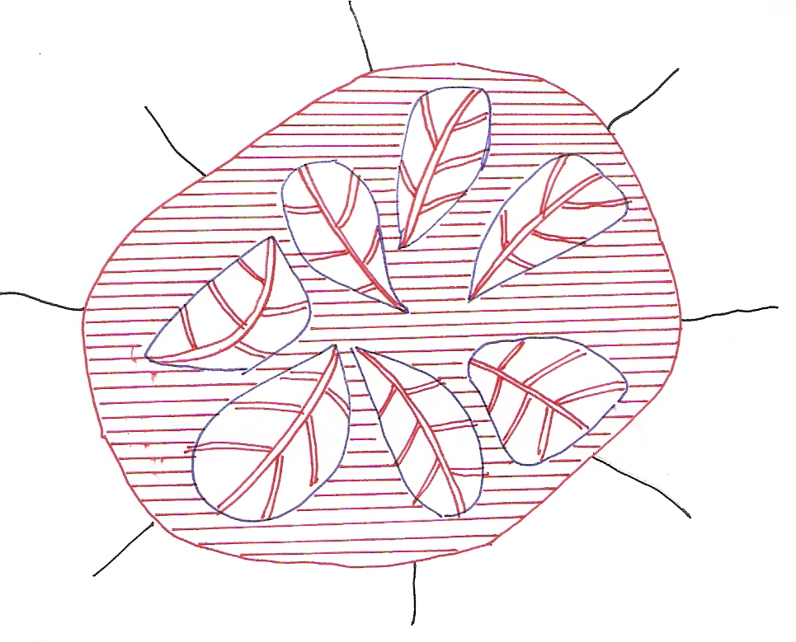
學習要領
網路導論
訊號處理
通訊原理
控制系統
線性代數
電子學
電路學
微分方程
每週準時上課認真聽講，不遲到缺席
每週自行閱讀課本，跟上上課進度
課本中上課未能提到之處，自行仔細研讀(含例題、習題)

Slide 21
1.0 Fundamentals
  1.1 Signals
    Continuous/Discrete-time Signals
      x(t), x[n]
    Signal Energy/Power

Slide 22
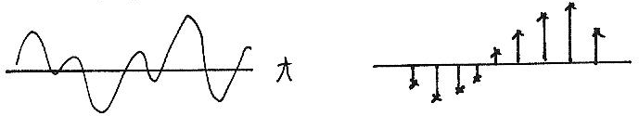
Continuous/Discrete-time
x(t)
x[n]
t
n

Slide 23
    Transformation of A Signal
      Time Shift
      Time Reversal
      Time Scaling
      Combination

Slide 24
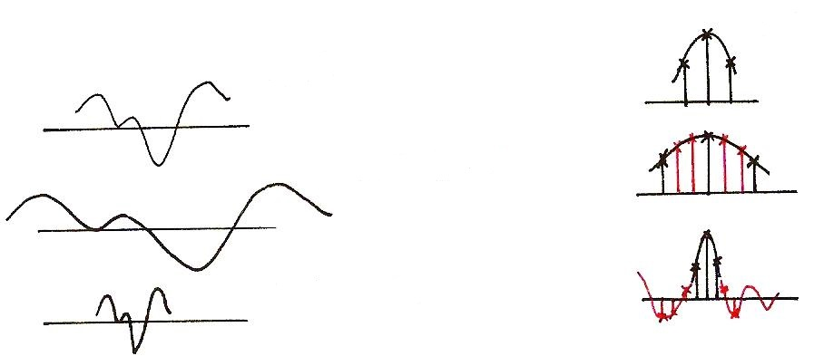
Time Scaling
x[n]
x(t)
?
x(at), a<1
?
x(at), a>1

Slide 25
  Periodic Signal
    T₀ : Fundamental period : the smallest positive value of T
    aperiodic : NOT periodic

Slide 26
    Even/Odd Signals
      Even
      Odd
      Any signal can be discomposed into a sum of an
      even and an odd

Slide 27
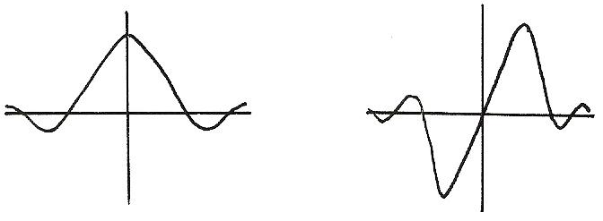
Even/Odd
Even
Odd
x(-t)=x(t)
x(-t)=-x(t)

Slide 28
    Exponential/Sinusoidal Signals
  Basic Building Blocks from which one can construct many different signals and define frameworks for analyzing many different signals efficiently
fundamental period
fundamental frequency

Slide 29
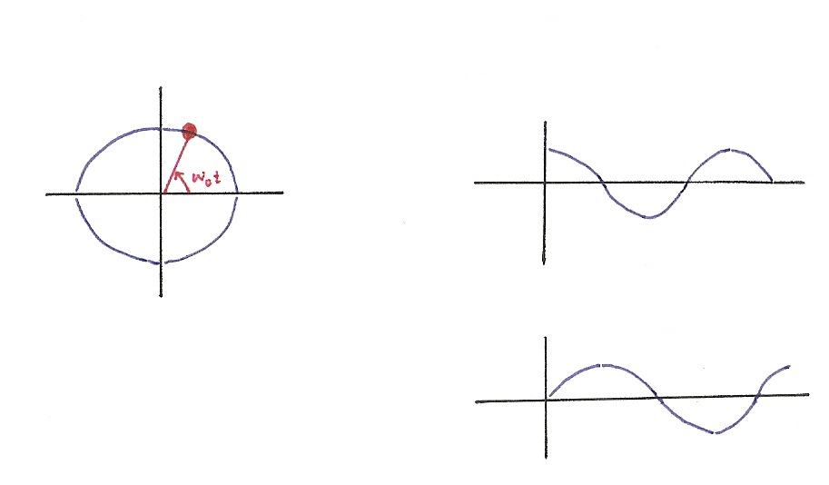






    Exponential/Sinusoidal Signals
$$x\left(t\right)=e^{jω_{0}t}$$
$$Re\left\{e^{jω_{0}t}\right\}=\cos{ω_{0}t}$$
$$Im$$
$$Re$$
$$Im\left\{e^{jω_{0}t}\right\}=\sin{ω_{0}t}$$
$$e^{jx}=\cos{x}+j sin{x}$$

Slide 30
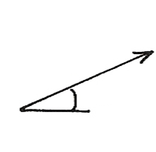
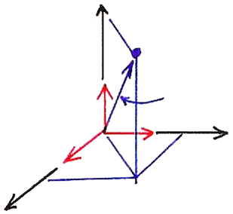

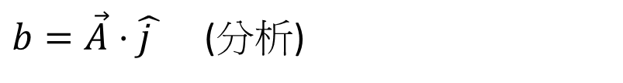
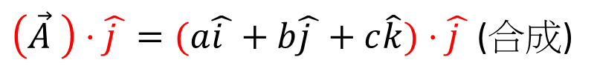




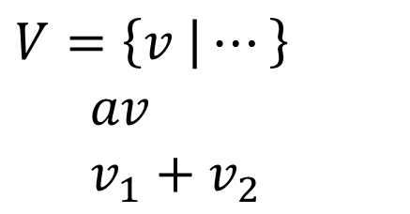

Vector Space
$$V=\left\{v | ⋯\right\}$$
$av$
$v_{1}+$ $v_{2}$
$$b$$
$$θ$$
3-dim Vector Space
$\left(\vec{A} \right)⋅\hat{j }=(a\hat{i }+b\hat{j }+c\hat{k})⋅\hat{j }$ (合成)
$$\hat{k}$$
$$\vec{A}$$
$b=\vec{A}⋅\hat{j }$ (分析)
$$\hat{i }$$
$$\hat{j }$$

Slide 31

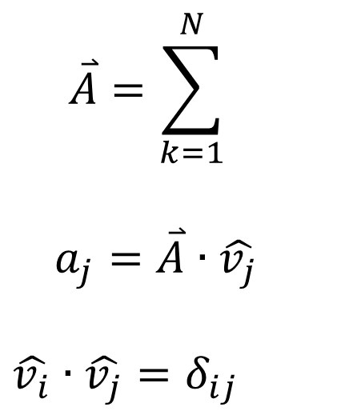

N-dim Vector Space
$$\overset{⃑}{A}=\sum_{k=1}^{N}{}$$
$a_{j}=\overset{⃑}{A}∙\hat{v_{j}}$
$$\hat{v_{i}}∙\hat{v_{j}}=δ_{ij}$$
(合成)
$$a_{k}$$
$${\hat{v}}_{k}$$
(分析)

Slide 32
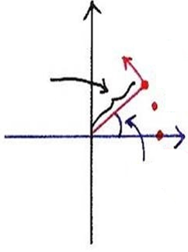
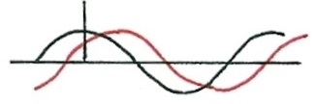
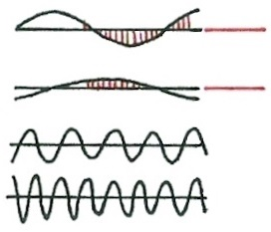












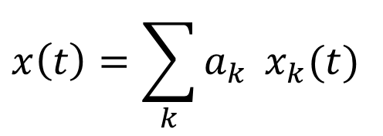










Signal Analysis
$$x\left(t\right)=\sum_{k}{a_{k}} x_{k}(t)$$
$$t=n$$
$$t=n$$
$$x_{k}\left(t\right)=Re\left\{ e^{jω_{k}t} \right\}={ \cos{ω}}_{k}t$$
$$a_{k}=A_{k}e^{jφ_{k}}$$
$$t=n$$
$$Re\left\{\left(A_{k}e^{jφ_{k}}\right) \left(e^{jω_{k}t}\right)\right\}=A_{k}\cos{(ω_{k}t+φ_{k})}$$
$$Im$$
$$n$$
$$ω_{k}$$
$$t$$
$$n$$
$$A_{k}$$
$$n=2$$
$$0$$
$$t$$
$$t$$
$$n=1$$
$$t$$
$$Re$$
$$ω_{k}=kω_{0}$$
$$t$$
$$n=0$$
$$φ_{k}$$

Slide 33
  Exponential/Sinusoidal Signals
  Harmonically related signal sets
fundamental period
fundamental frequency
all with common period

Slide 34
  Exponential/Sinusoidal Signals
  Sinusoidal signal
  General format
  Discrete-Time

Slide 35
  Exponential/Sinusoidal Signals
  Important Differences Between Continuous-time and Discrete-time Exponential/Sinusoidal Signals
      For discrete-time, signals with frequencies ω₀ and
      ω₀ +m．2π are identical. This is Not true for
      continuous-time.
      see : Fig.1.27, p.27 of text

Slide 36
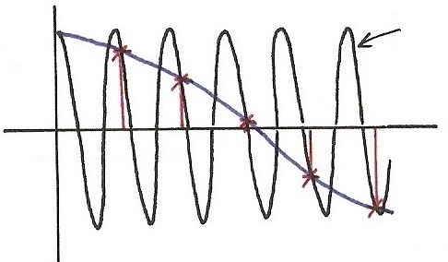
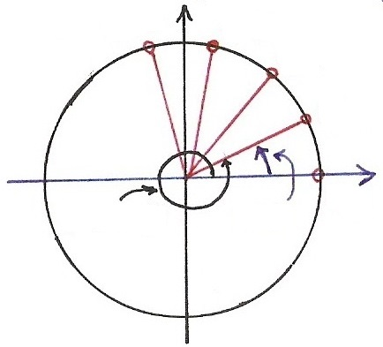
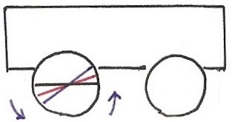



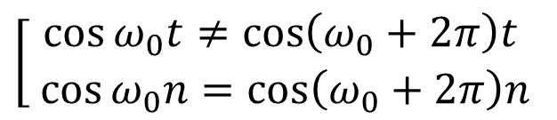











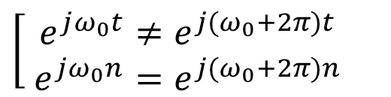


Continuous/Discrete Sinusoidals
$$\cos{[\left(ω_{0}+2π\right)t]}$$
$$(t=n)$$
$$\cos{[⋅]}$$
$$\left[\begin{aligned}\cos{ω_{0}t}≠\cos\left(ω_{0}+2π\right)t \\ \cos{ω_{0}n}=\cos\left(ω_{0}+2π\right)n\end{aligned}\right.$$
4
5
$$t,n$$
0
1
2
3
$$\left[\begin{aligned} e^{jω_{0}t}≠e^{j{(ω}_{0}+2π)t} \\ e^{jω_{0}n}=e^{j{(ω}_{0}+2π)n}\end{aligned}\right.$$
$$\cos{[ω_{0}t]}$$
$$(t=n)$$
$$Im$$
$$n=4$$
$$n=3$$
$$n=2$$
$$e^{j[⋅]}$$
$$n=1$$
$$Re$$
$$ω_{0}t$$
$$n=0$$
$${(ω}_{0}+2π)t$$

Slide 37
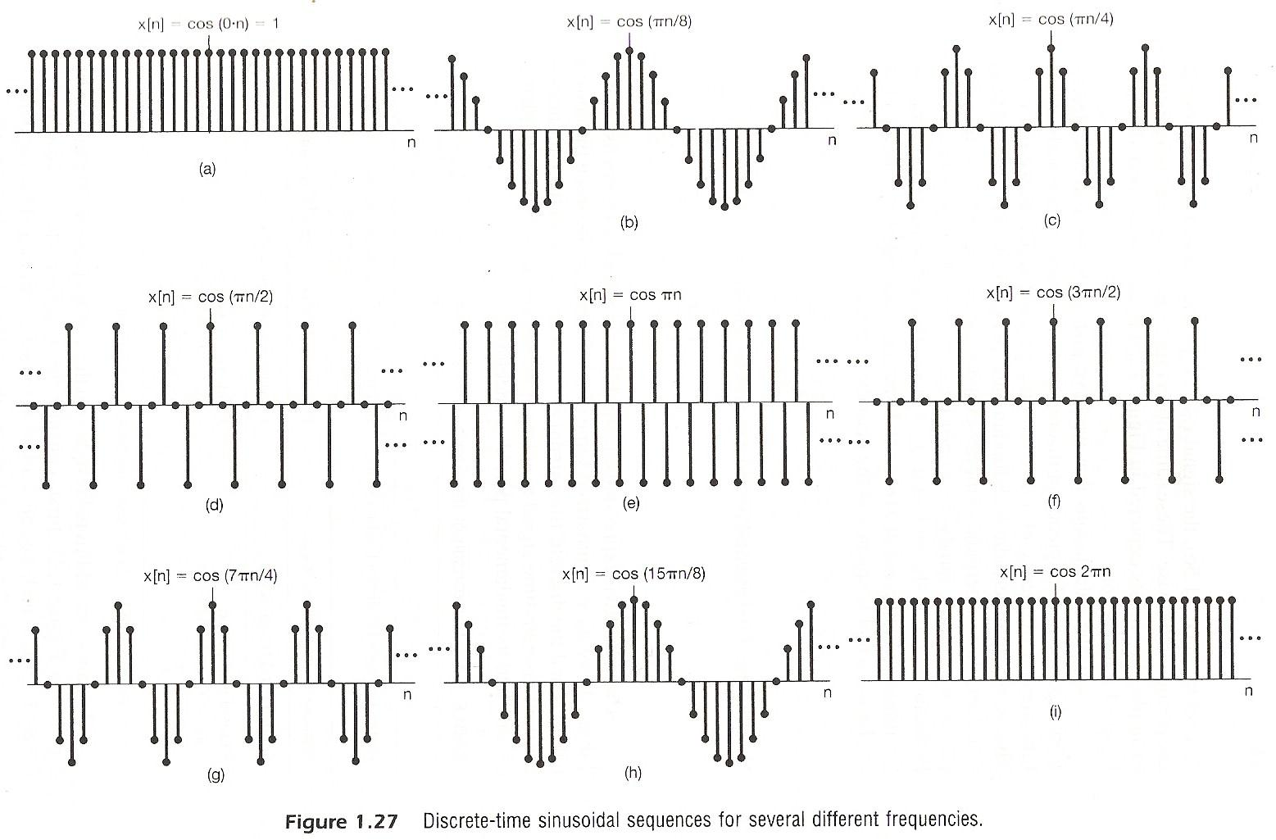

Slide 38
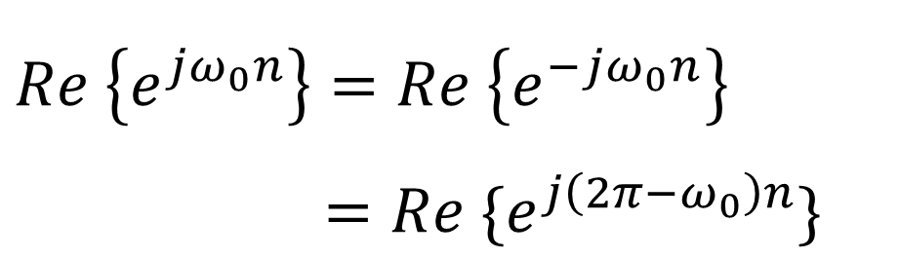
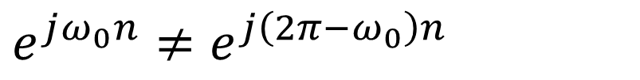
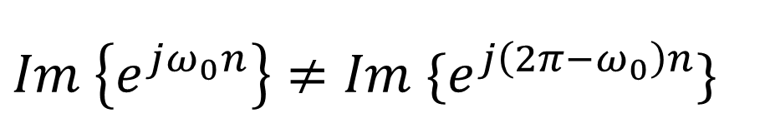
Fig. 1.27
$$e^{jω_{0}n}≠e^{j\left({2π−ω}_{0}\right)n}$$
but
$$Re \left\{e^{jω_{0}n}\right\}=Re \left\{e^{−jω_{0}n}\right\}$$
$=Re \{e^{j\left({2π−ω}_{0}\right)n}\}$
Note:
$$Im \left\{e^{jω_{0}n}\right\}≠Im \{e^{j\left({2π−ω}_{0}\right)n}\}$$

Slide 39
  Exponential/Sinusoidal Signals
  Important Differences Between Continuous-time and Discrete-time Exponential/Sinusoidal Signals
      For discrete-time, ω₀ is usually defined only for [-π, π] or [0, 2π]. For continuous-time, ω₀ is defined for (-∞, ∞)
      For discrete-time, the signal is periodic only when
      ω₀N=2πm,
      see : Fig.1.25, p.24 of text

Slide 40
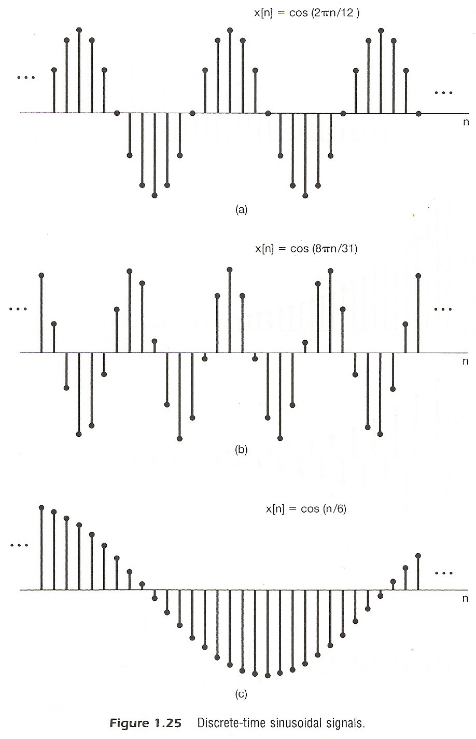

Slide 41
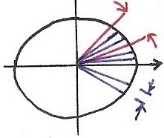
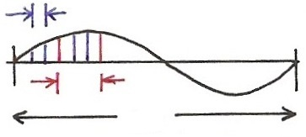
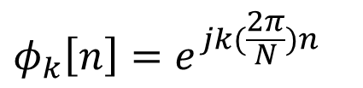










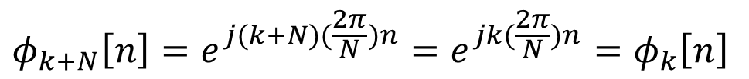

Harmonically Related Signal Sets
For being periodic
real period in cycles
$$=$$
$$ω_{k}⋅N=2π⋅k$$
$$ω_{k}=k(\frac{2π}{N})$$
$$=$$
real period in n
$$Im$$
$$\frac{2π}{N}$$
$$k\left(\frac{2π}{N}\right), k=3$$
$$Re$$
$$k\left(\frac{2π}{N}\right), k=3$$
$$2π$$
divided in N
$$\frac{2π}{N}$$
$$φ_{k}\left[n\right]=e^{jk(\frac{2π}{N})n}$$
$$φ_{k+N}\left[n\right]=e^{j(k+N)(\frac{2π}{N})n}=e^{jk(\frac{2π}{N})n}=φ_{k}\left[n\right]$$

Slide 42
  Exponential/Sinusoidal Signals
  Harmonically related discrete-time signal sets
  all with common period N
  This is different from continuous case. Only N distinct signals in this set.

Slide 43
  Unit Impulse and Unit Step Functions
  Continuous-time
      First Derivative
      see: Fig1.33, Fig1.34, P,33 of text
      Running Integral
      Sampling property

Slide 44
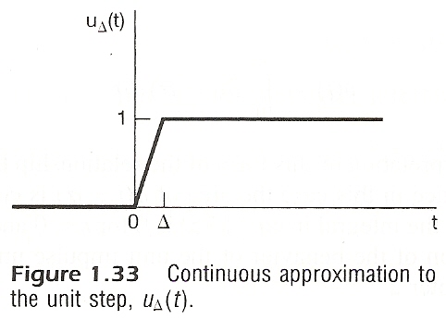
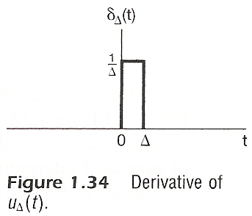

Slide 45
  Unit Impulse and Unit Step Functions
  Discrete-time
      First difference
      Running Sum
      Sampling property

Slide 46
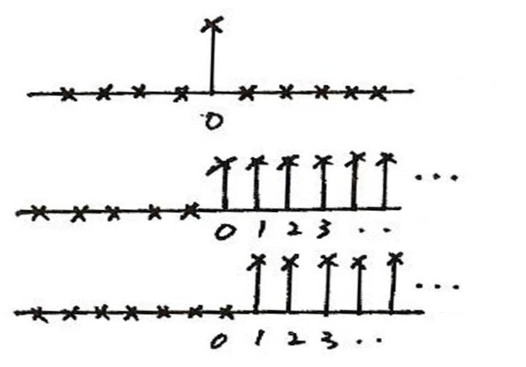
Unit Impulse & Unit Step
  Discrete-time
δ [n]
n
u [n]
n
u [n – 1]
n
δ [n] = u[n] – u[n – 1]

Slide 47
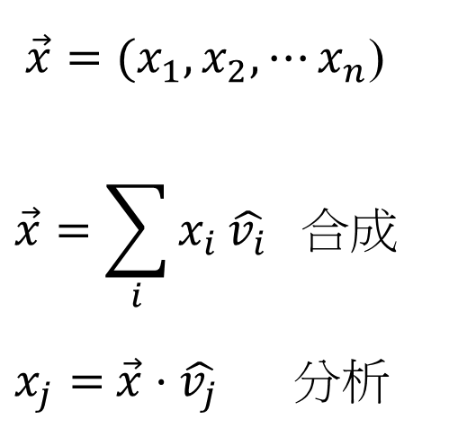
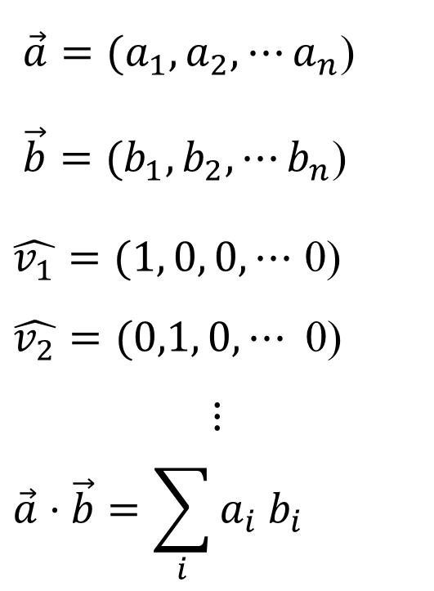
Vector Space Representation of Discrete-
time Signals
  n-dim
$\vec{a}=(a_{1},a_{2}, ⋯a_{n}$)
$\vec{b}=(b_{1},b_{2}, ⋯b_{n}$)
$\hat{v_{1}}=(1, 0, 0,⋯$ 0)
$$\hat{v_{2}}=(0,1, 0,⋯\text{ 0)}$$
$$⋮$$
$$\vec{a}⋅\vec{b}=\sum_{i}{a_{i}{ b}_{i}}$$
$\vec{x}=(x_{1},x_{2}, ⋯x_{n}$)
$$\vec{x}=\sum_{i}{x_{i}}\hat{v_{i}} 合成$$
$x_{j}=$ $\vec{x}⋅\hat{v_{j}}$ 分析

Slide 48

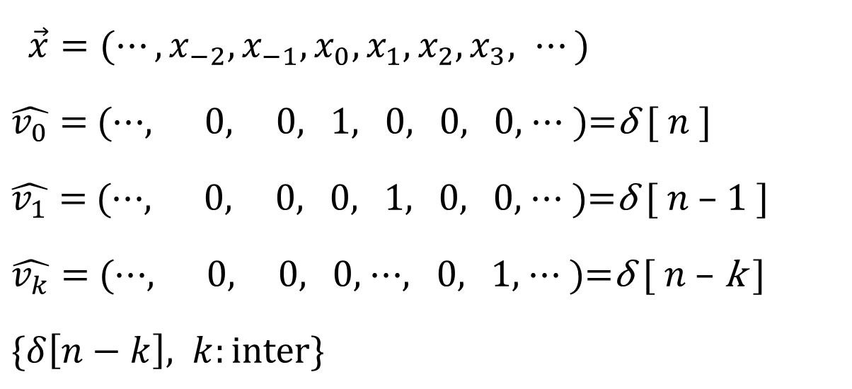
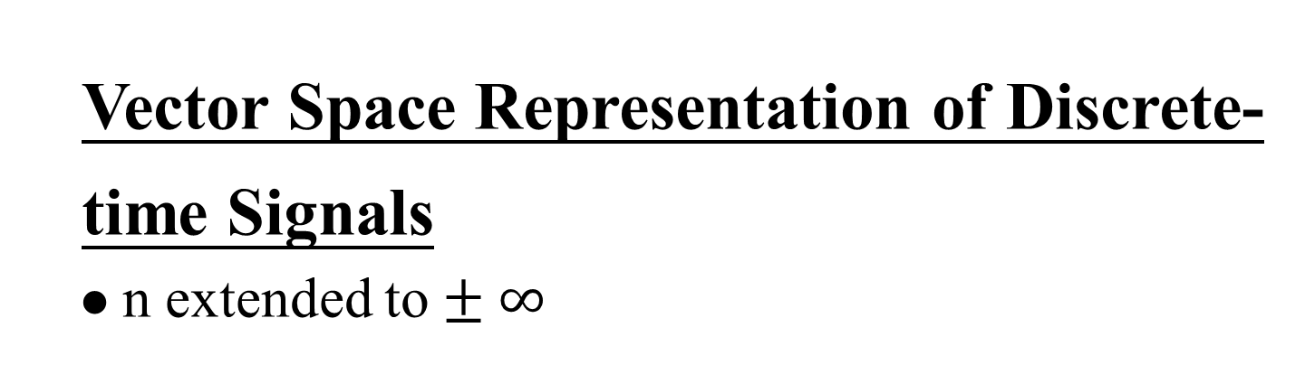
Vector Space Representation of Discrete-
time Signals
  n extended to $± ∞$
$\vec{x}=(⋯,x_{−2},x_{−1},x_{0},x_{1},x_{2},x_{3}, ⋯)$
$\hat{v_{0}}=$ (⋯, 0, 0, 1, 0, 0, 0, ⋯ )=δ [ $n$ ]
$\hat{v_{1}}=$ (⋯, 0, 0, 0, 1, 0, 0, ⋯ )=δ [ $n$ – 1 ]
$\hat{v_{k}}=$ (⋯, 0, 0, 0, ⋯, 0, 1, ⋯ )=δ [ $n$ – k ]
$\{δ\left[n−k\right], k:\text{inter}\text{\}}$
$$\vec{x}=\sum_{i}{x_{i}\hat{v_{i}}} 合成$$
$x_{j}= \vec{x}⋅\hat{v_{j}}$ 分析

Slide 49
  1.2 Systems
    Continuous/Discrete-time Systems
    Interconnections of Systems
        Series
        Parallel
x(t)
y(t)
x[n]
y[n]
+

Slide 50
    Interconnections of Systems
        Feedback
        Combinations
+

Slide 51
    Stability
        stable : bounded inputs lead to bounded outputs
    Time Invariance
        time invariant : behavior and characteristic of the system are fixed over time

Slide 52
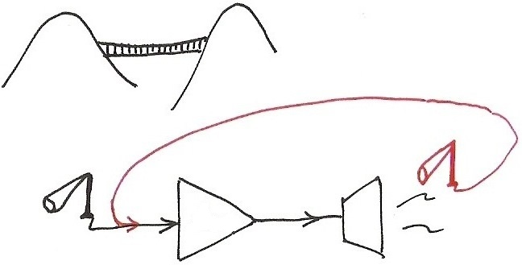
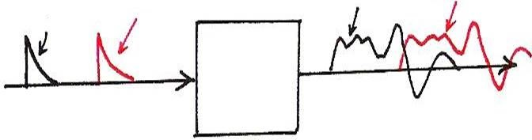
    Stability
Examples of unstable systems
Amp
    Time Invariance
x(t-T₀)
y(t)
y(t-T₀)
x(t)

Slide 53
    Linearity
        linear : superposition property
        scaling or homogeneity property
        additive property

Slide 54
    Memoryless/With Memory
        Memoryless : output at a given time depends only on the input at the same time
        eg.
        With Memory
        eg.

Slide 55
    Invertibility
        invertible : distinct inputs lead to distinct outputs, i.e. an inverse system exits
        eg.
    Causality
        causal : output at any time depends on input at the same time and in the past
        eg.

Slide 56
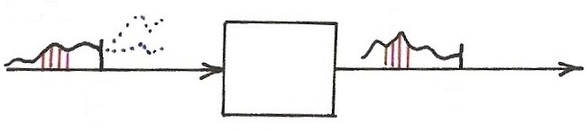

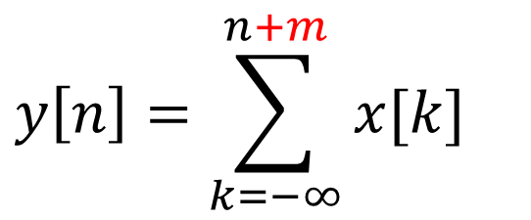



    Causality
$$x[n]$$
$$y[n]$$
$$n$$
$$n$$
$$y\left[n\right]=\sum_{k=−∞}^{n+m}{x[k]}$$

Slide 57
    Examples
Example 1.12, p.47 of text
Example 1.13, p.49 of text
“NOT” causal
causal
unstable
stable

Slide 58
    Examples
Example 1.20, p.55 of text
zero input leads to zero output for linear systems
incrementally linear: difference between the responses to any two inputs is a linear function of the difference between the two inputs
“NOT” linear

Slide 59
    Problem 1.35, p.64 of text
.
a has to divide N for N₀ being an integer and N₀ ≤ N
a has to divide k for m being an integer
a=gcd(k, N), N₀ =N/gcd(k, N)
example: N=12, k=3, N₀ =4, m=1
N=12, k=9, N₀ =4, m=3
Selected problems for chap1: 4, 9, 14, 16, 18, 19, 27, 30, 35, 37, 47
fundamental period=?
,

