Slide 1
4.0 Continuous-time Fourier Transform
    4.1 From Fourier Series to Fourier Transform
Fourier Series : for periodic signal
      See Fig. 3.6, 3.7, p.193, 195, Fig, 4.2, p.286 of text
  aperiodic : T→∞ , ω₀ → 0

Slide 2
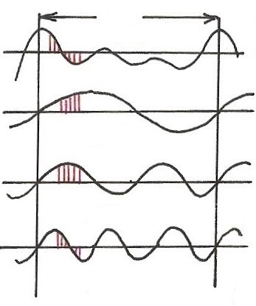
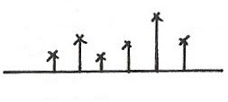














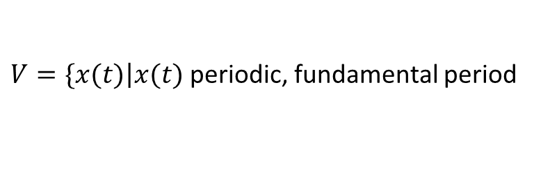














  Harmonically Related Exponentials for Periodic Signals
(P.11 of 3.0)
$$[n]$$
T
$V=\{x(t)\left|x(t)\right.$ periodic, fundamental period
$$(N)$$
$$[n]$$
$$=T(N)\}$$
$$t, n$$
$$a_{4}$$
$$t, n$$
$$a_{1}$$
$$a_{3}$$
$$a_{5}$$
$$k=1$$
$$a_{0}$$
$$ω_{0}=\frac{2π}{T}$$
$$k$$
$$(N)$$
$$0 1 2 3 4 5$$
$$t, n$$
$$k=2$$
$$ω$$
$$0$$
$$ω_{0}$$
$${3ω}_{0}$$
$${5ω}_{0}$$
$$t, n$$
$${2ω}_{0}$$
$${4ω}_{0}$$
$$k=3$$
All with period T: integer multiples of ω₀
Discrete in frequency domain
$$(N)$$

Slide 3
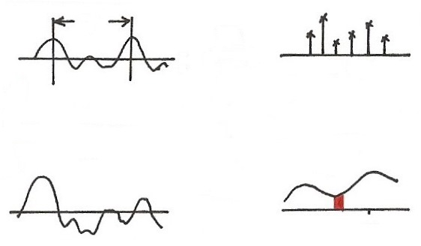







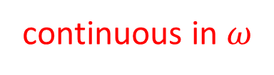






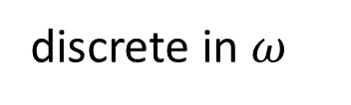
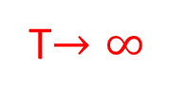




  Fourier Transform
T
FS
$$t$$
$$ω$$
0
$$ω_{0}$$
$${3ω}_{0}$$
$$ω_{0}=\frac{2π}{T}$$
$${2ω}_{0}$$
$$e^{j3ω_{0}t}$$
T$→∞$
$$ω_{0}→0$$
periodic in $t$
discrete in $ω$
$$x(t)$$
$$X(jω)$$
$$F$$
$$t$$
$$jω$$
$$ω_{k}$$
$$e^{jω_{k}t}$$
aperiodic in $t$
continuous in $ω$

Slide 4
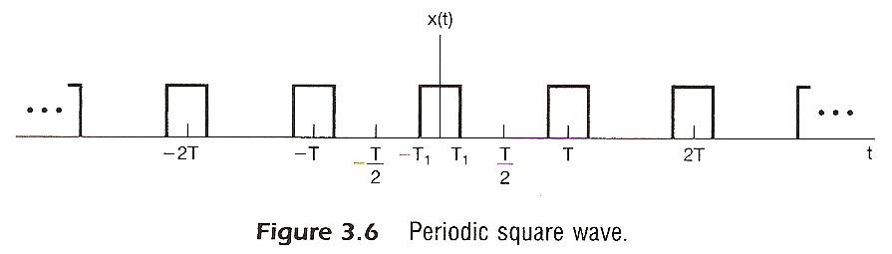

Slide 5
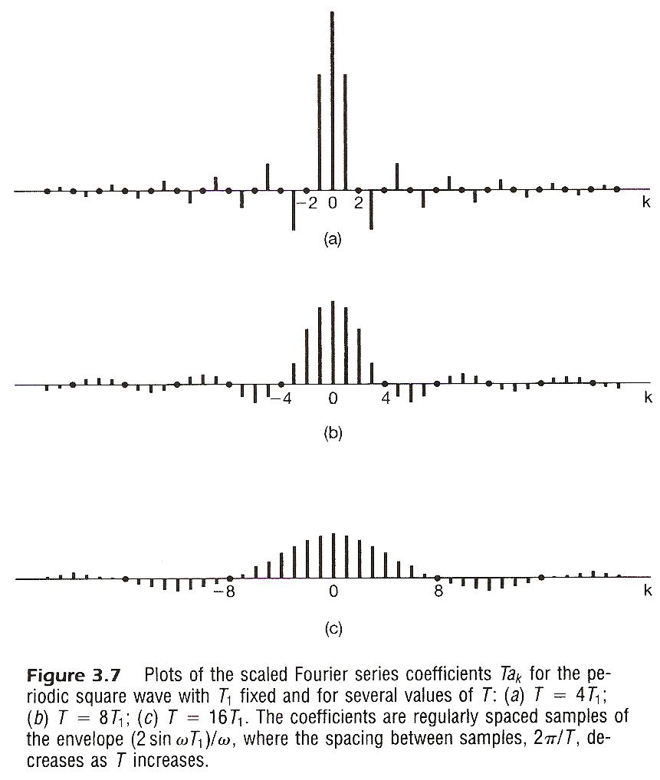

Slide 6
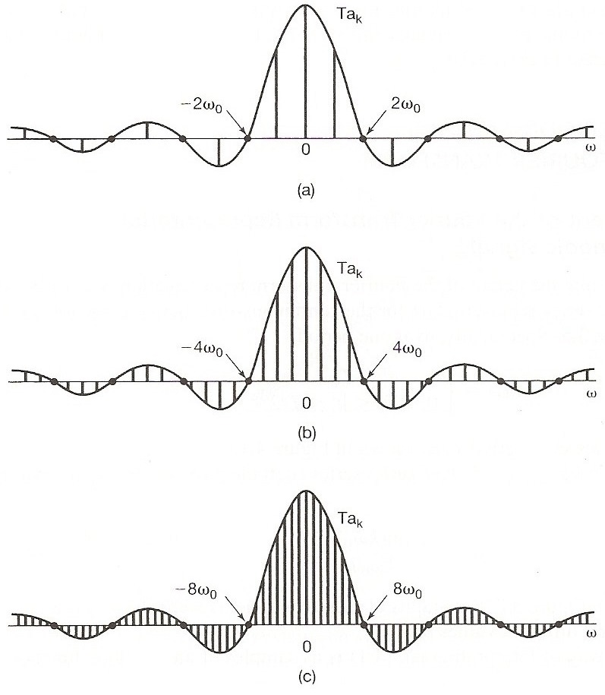
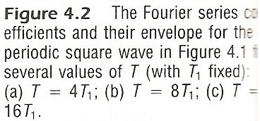
      See Fig. 3.6, 3.7, p.193, 195, Fig, 4.2, p.286 of text

Slide 7
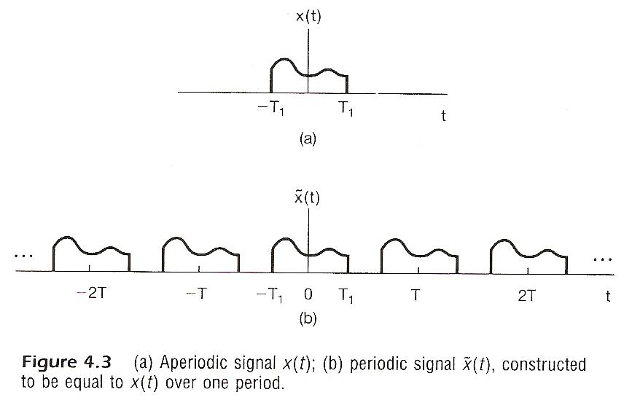
Considering x(t), x(t)=0 for | t | > T₁
  construct

Slide 8
Considering x(t), x(t)=0 for | t | > T₁
  Fourier series for
  Defining envelope of Ta_{k} as X(jω)

Slide 9
Considering x(t), x(t)=0 for | t | > T₁
  as

Slide 10
spectrum, frequency domain
Fourier Transform
signal, time domain Inverse Fourier Transform
        Fourier Transform pair, different expressions
        very similar format to Fourier Series for periodic signals

Slide 11
Convergence Issues
  Given x(t)

Slide 12
Convergence Issues
  It can be shown
is obtainable (finite) for every ω
zero energy for the difference signal
differences at isolated points are possible
converges to x(t) at continuous points, but to averages at discontinuities

Slide 13
Convergence Issues
  Dirichlet’s conditions
      absolutely integrable
      finite number of maxima and minima within any
      finite interval
      finite number of discontinuities with finite values
      within any finite interval

Slide 14
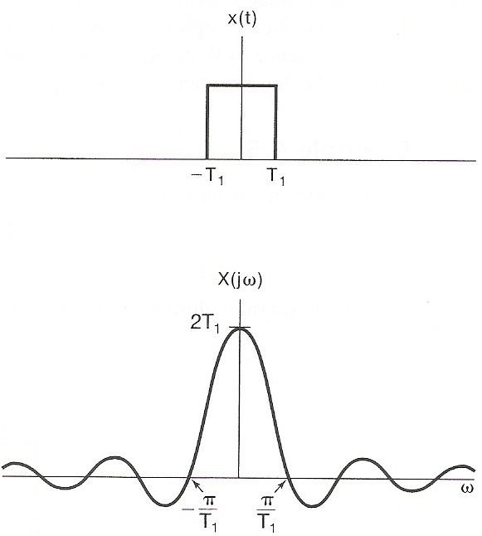
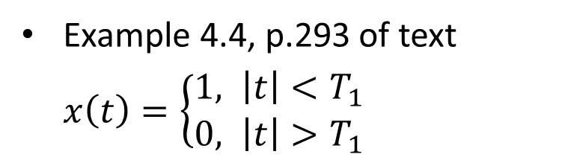
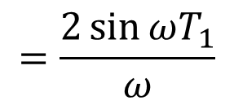
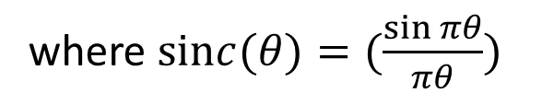
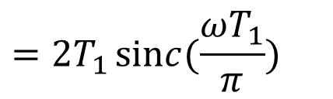
Examples
Example 4.4, p.293 of text
$x\left(t\right)=\left\{\begin{aligned}1, \left|t\right|<T_{1} \\ 0, \left|t\right|>T_{1}\end{aligned}\right.$
then $X\left(jω\right)=\int_{{−T}_{1}}^{T_{1}}{e^{−jωt}}dt$
$$=\frac{2\sin{ωT_{1}}}{ω}$$
$$=2T_{1}\operatorname{sinc}{(\frac{ωT_{1}}{π})}$$
where $\operatorname{sinc}{(θ)=(\frac{\sin{πθ}}{πθ})}$

Slide 15
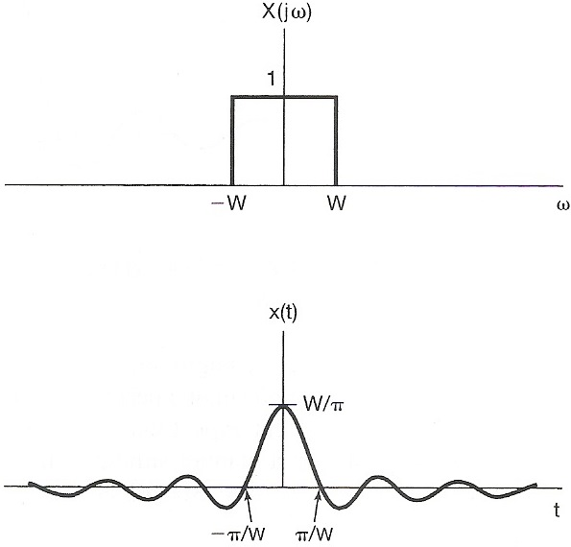
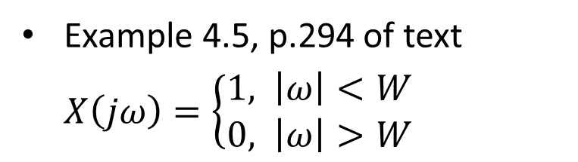
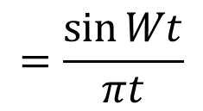
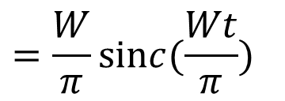

Examples
Example 4.5, p.294 of text
$X\left(jω\right)=\left\{\begin{aligned}1, \left|ω\right|<W \\ 0, \left|ω\right|>W\end{aligned}\right.$
then $x\left(t\right)=\frac{1}{2π} \int_{−W}^{W}{e^{jωt}}dω$
$$=\frac{\sin{Wt}}{πt}$$
$$=\frac{W}{π}\operatorname{sinc}{(\frac{Wt}{π})}$$

Slide 16
Fourier Transform for Periodic Signals –
Unified Framework
  Given x(t)
  (easy in one way)

Slide 17
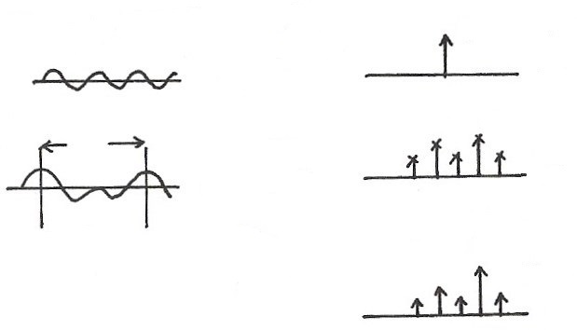









  Unified Framework: Fourier Transform for Periodic Signals
$$2πδ(ω−ω_{0})$$
$$e^{jω_{0}t}$$
$$F$$
$$t$$
$$ω$$
$$ω_{0}$$
T
$$a_{k}$$
$$x(t)$$
FS
$$ω$$
$$t$$
$${kω}_{0}$$
$$F$$
$$X(jω)$$
$$2πa_{k}δ(ω−{kω}_{0})$$
  If
$$ω$$
$${kω}_{0}$$
F

Slide 18
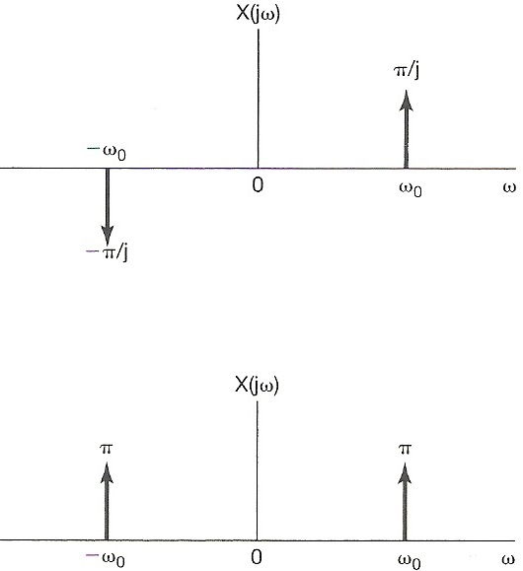
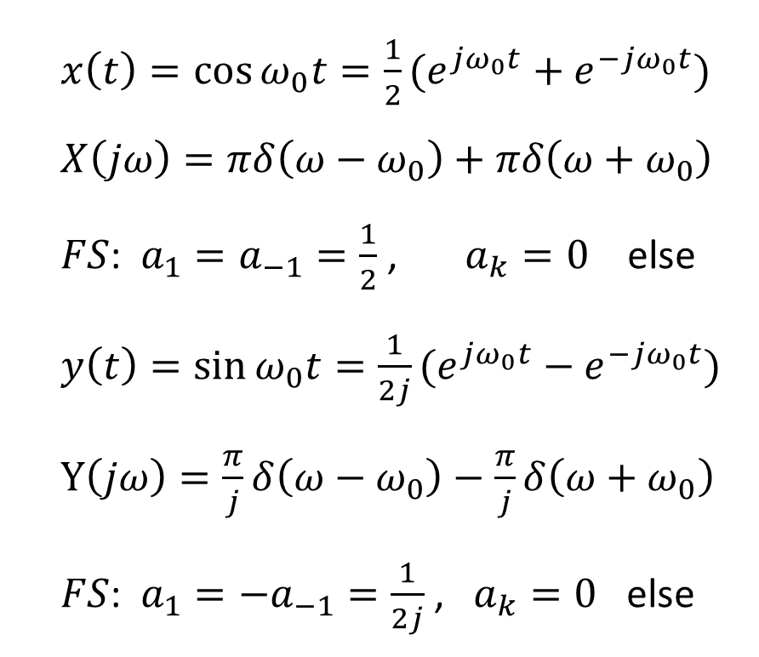

Examples
Example 4.7, p.298 of text
$$Y\left(jω\right)$$
$x\left(t\right)=\cos{ω_{0}t}=\frac{1}{2}(e^{jω_{0}t}+e^{−jω_{0}t})$
$X\left(jω\right)=πδ\left(ω−ω_{0}\right)+πδ\left(ω+ω_{0}\right)$
$FS$: $a_{1}=a_{−1}=\frac{1}{2}$ , $a_{k}=0$ else
$y\left(t\right)=\sin{ω_{0}t}=\frac{1}{2j}(e^{jω_{0}t}−e^{−jω_{0}t})$
$Y\left(jω\right)=\frac{π}{j}δ\left(ω−ω_{0}\right)−\frac{π}{j}δ\left(ω+ω_{0}\right)$
$FS$: $a_{1}=−a_{−1}=\frac{1}{2j}$ , $a_{k}=0$ else

Slide 19
      4.2 Properties of Continuous-time Fourier
      Transform
Linearity

Slide 20
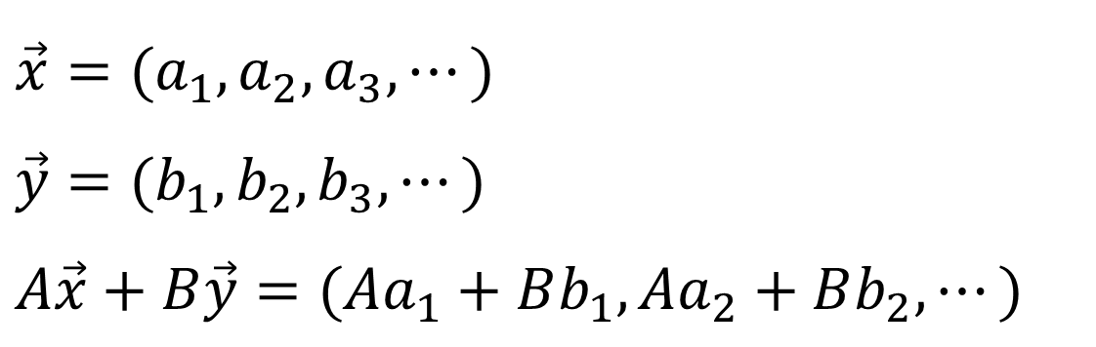
  Linearity
(P.27 of 3.0)
Linearity
$$\vec{x}=(a_{1},a_{2},a_{3},⋯)$$
$$\vec{y}=(b_{1},b_{2},b_{3},⋯)$$
$$A\vec{x}+B\vec{y}=(Aa_{1}+Bb_{1},Aa_{2}+Bb_{2},⋯)$$

Slide 21
Time Shift
  linear phase shift (linear in frequency) with amplitude unchanged

Slide 22
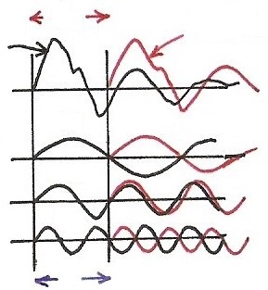










  Time Shift
(P.28 of 3.0)
phase shift linear in frequency with amplitude unchanged
$$a_{k} e^{jkω_{0}(t−t_{0})}=e^{−jkω_{0}t_{0}} a_{k} e^{jkω_{0}t}$$
$$t_{0}$$
$${x(t−t}_{0})$$
$$x(t)$$
$$π$$
$$ω_{0}$$
$$2π$$
$${2ω}_{0}$$
$$3π$$
$${3ω}_{0}$$
$${kω}_{0}t_{0}$$

Slide 23
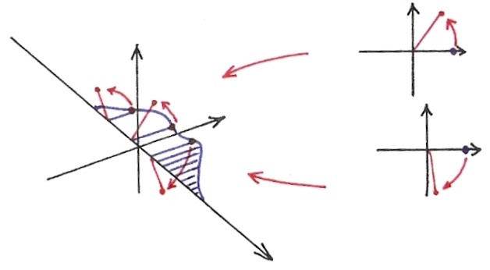





  Time Shift
$$Im$$
$$Im$$
$$Re$$
$$Im$$
$$Re$$
$$Re$$
$$ω$$

Slide 24
Examples
(P.18 of 4.0)
Example 4.7, p.298 of text
$$Y\left(jω\right)$$
$x\left(t\right)=\cos{ω_{0}t}=\frac{1}{2}(e^{jω_{0}t}+e^{−jω_{0}t})$
$X\left(jω\right)=πδ\left(ω−ω_{0}\right)+πδ\left(ω+ω_{0}\right)$
$FS$: $a_{1}=a_{−1}=\frac{1}{2}$ , $a_{k}=0$ else
$y\left(t\right)=\sin{ω_{0}t}=\frac{1}{2j}(e^{jω_{0}t}−e^{−jω_{0}t})$
$Y\left(jω\right)=\frac{π}{j}δ\left(ω−ω_{0}\right)−\frac{π}{j}δ\left(ω+ω_{0}\right)$
$FS$: $a_{1}=−a_{−1}=\frac{1}{2j}$ , $a_{k}=0$ else

Slide 25
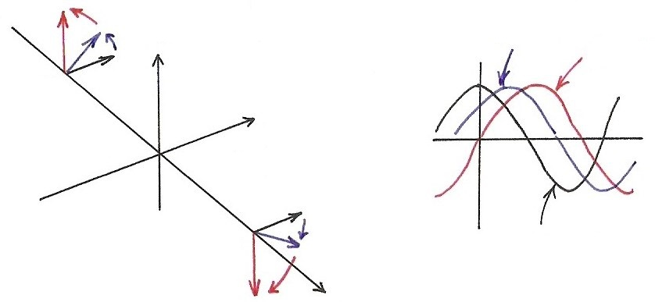


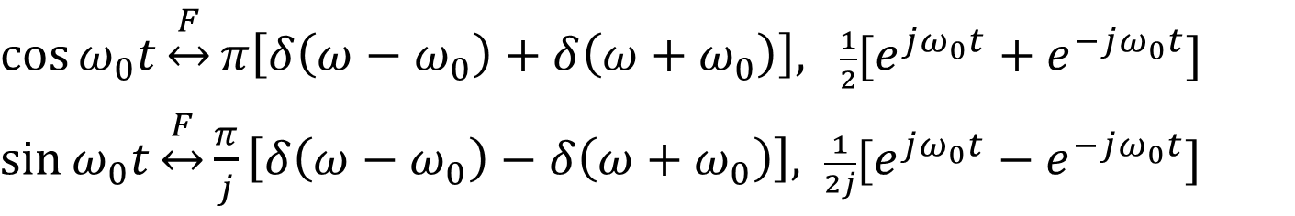







  Sinusoidals
$\cos{ω_{0}t}\underset{↔}{F}π\left[δ\left(ω−ω_{0}\right)+δ\left(ω+ω_{0}\right)\right],$ $\frac{1}{2}[e^{jω_{0}t}+e^{−jω_{0}t}]$
$\sin{ω_{0}t}\underset{↔}{F}\frac{π}{j}\left[δ\left(ω−ω_{0}\right)−δ\left(ω+ω_{0}\right)\right],$ $\frac{1}{2j}[e^{jω_{0}t}−e^{−jω_{0}t}]$
$$Im$$
$$\cos{ω_{0}(t−t_{0})}$$
$$\sin{ω_{0}t}$$
$${−ω}_{0}$$
$$Re$$
$$ω_{0}$$
$$\cos{ω_{0}t}$$
$$ω$$
$$x\left(t−t_{0}\right)↔e^{−jω_{0}t}⋅X(jω)$$

Slide 26
Conjugation

Slide 27



Conjugation
(P.32 of 3.0)
$${\left[⋯a_{−1} e^{−jω_{0}t}+a_{0}+a_{1} e^{jω_{0}t}+⋯\right]}^{∗}$$
$$a_{−1}^{∗}$$
$$e^{jω_{0}t}$$
unique representation

Slide 28

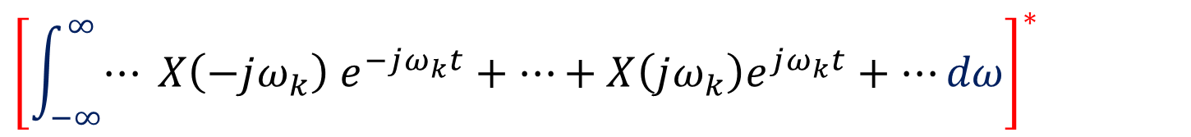
  Conjugation
$${\left[\int_{−∞}^{∞}{⋯} X\left(−jω_{k}\right) e^{−jω_{k}t}+⋯+X\left(jω_{k}\right)e^{jω_{k}t}+⋯dω\right]}^{∗}$$
$$X^{∗}\left(−jω_{k}\right) e^{jω_{k}t}$$
Unique representation for orthogonal bases
Conjugation

Slide 29
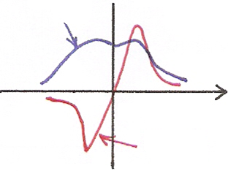




    Even/Odd Properties
Conjugation Property
$Re\left\{⋅\right\}$ or $\left|⋅\right|$
$$ω$$
$$0$$
$$Im\left\{⋅\right\} or ∡⋅$$
o

Slide 30


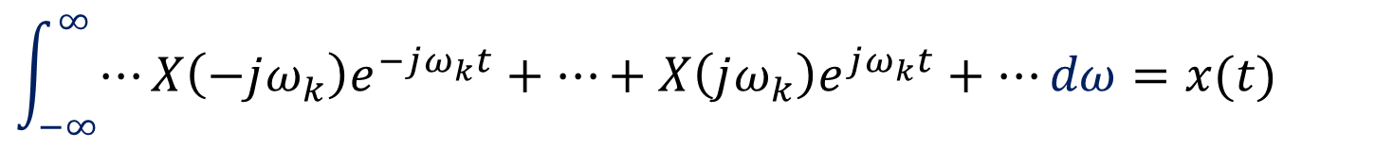
  Time Reversal
$$\int_{−∞}^{∞}{⋯}X\left(−jω_{k}\right)e^{−jω_{k}t}+⋯+X\left(jω_{k}\right)e^{jω_{k}t}+⋯dω=x(t)$$
$$X\left(−jω_{k}\right) e^{jω_{k}t}$$
$$=x(−t)$$
Unique representation for orthogonal bases

Slide 31

Time Reversal
(P.29 of 3.0)
the effect of sign change for x(t) and a_{k} are identical
$$⋯a_{−1} e^{−jω_{0}t}+a_{0}+a_{1} e^{jω_{0}t}+⋯=x(t)$$
$$⋯a_{−1} e^{jω_{0}t}⋯=x(−t)$$
unique representation for orthogonal basis

Slide 32
    Even/Odd Properties
x(t) both real and even
Time Reversal
x(t) real and odd

Slide 33
Differentiation/Integration
  dc term

Slide 34
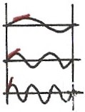
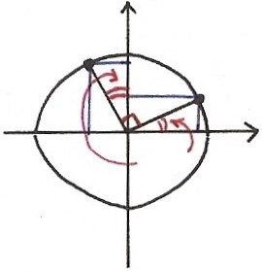
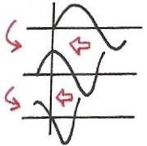
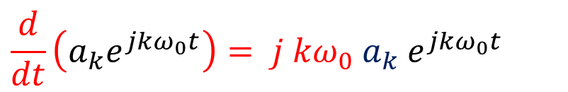

















Differentiation
(P.33 of 3.0)
$$k=1$$
$$\frac{d}{dt}\left(a_{k}e^{jkω_{0}t}\right)= j {kω}_{0} a_{k} e^{jkω_{0}t}$$
$$k=2$$
$$= =$$
$$k=3$$
$$j⋅[\cos{ω_{0}t}+j\sin{ω_{0}t}]$$
$$Im$$
$$\frac{d}{dt}$$
$$\frac{d}{dt}$$
$$=−\sin{ω_{0}t}+j\cos{ω_{0}t}$$
$$ω_{0}t$$
$$Re$$
$$\frac{d}{dt}$$
$$\sin{ωt}$$
$$j=e^{j{90}^{∘}}$$
$$\cos{ωt}$$
$$\frac{d}{dt}$$
$$−sin{ωt}$$

Slide 35
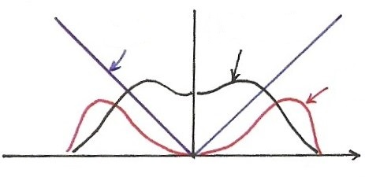
  Differentiation
$$\left|jω⋅X(jω)\right|=\left|ω\right|⋅\left|X(jω)\right|$$
$$\left|ω\right|$$
$$\left|X(jω)\right|$$
$$\left|ω\right|\left|X(jω)\right|$$
$$ω$$
Enhancing higher frequencies
De-emphasizing lower frequencies
Deleting DC term ( =0 for ω=0)

Slide 36
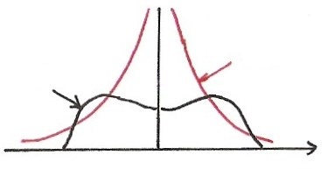
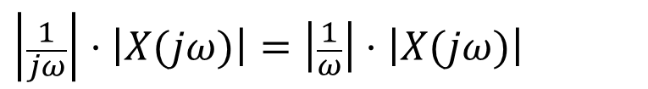



  Integration
  dc term
$$\frac{1}{j}=e^{−j90°}$$
$$\left|\frac{1}{jω}\right|⋅\left|X(jω)\right|=\left|\frac{1}{ω}\right|⋅\left|X(jω)\right|$$
$$\left|\frac{1}{ω}\right|$$
$$X(jω)$$
$$ω$$
Enhancing lower frequencies (accumulation effect)
De-emphasizing higher frequencies
(smoothing effect)
Undefined for ω=0
Accumulation

Slide 37
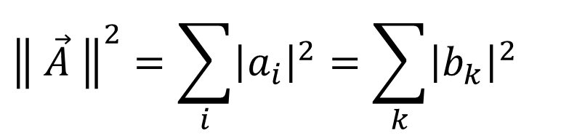
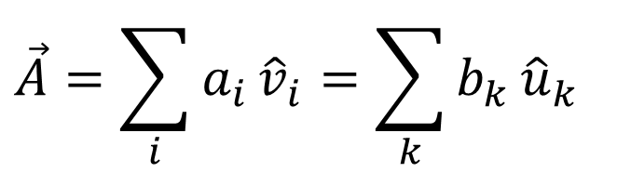
Parseval’s Relation
          total energy: energy per unit time integrated over the
          time
          total energy: energy per unit frequency integrated
          over the frequency
$$\vec{A}=\sum_{i}{a_{i}}{\hat{v}}_{i}=\sum_{k}{b_{k}}{\hat{u}}_{k}$$
$${\left\| \vec{A} \right\|}^{2}=\sum_{i}{{\left|a_{i}\right|}^{2}}=\sum_{k}{{\left|b_{k}\right|}^{2}}$$

Slide 38
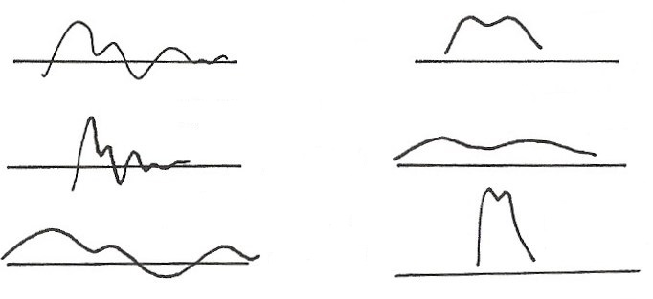















Time/Frequency Scaling
(time reversal)
$$x(t)$$
$$X(jω)$$
$$F$$
$$t$$
$$ω$$
$$\frac{1}{\left|a\right|} X\left(j\frac{ω}{a}\right), a>1$$
$$x\left(at\right), a>1$$
$$t$$
$$F$$
$$ω$$
$$x\left(at\right), a<1$$
$$\frac{1}{\left|a\right|} X\left(j \frac{ω}{a}\right), a<1$$
$$F$$
$$t$$
$$ω$$
      See Fig. 4.11, p.296 of text

Slide 39
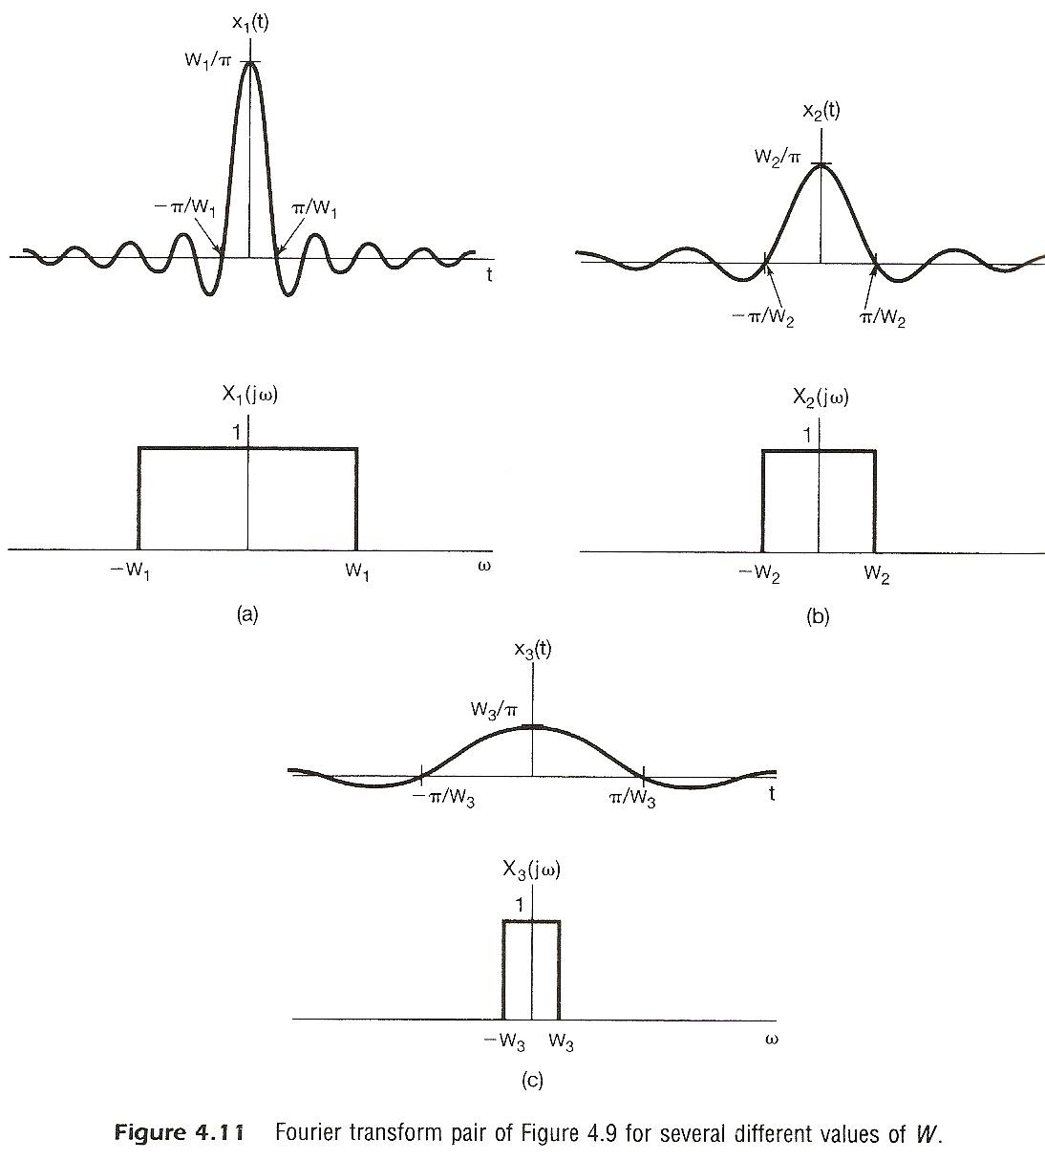
  inverse relationship between signal “width” in time/frequency domains

Slide 40
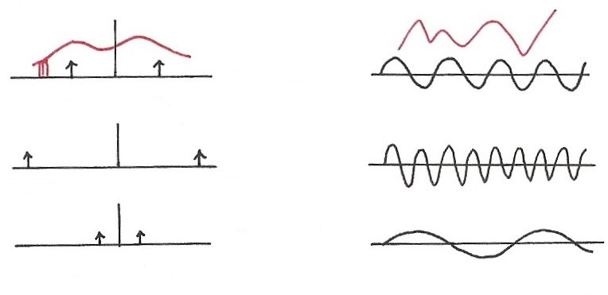




  Single Frequency
$$\cos{ω_{0}t}=\frac{1}{2} \left(e^{jω_{0}t}+e^{−jω_{0}t}\right)$$
$$F$$
$$ω$$
$$t$$
$${−ω}_{0}$$
$$ω_{0}$$
$$ω$$
$$F$$
$$t$$
$${−2ω}_{0}$$
$${2ω}_{0}$$
$$ω$$
$$F$$
$$t$$
$$−{\frac{1}{2} ω}_{0}$$
$${\frac{1}{2} ω}_{0}$$

Slide 41
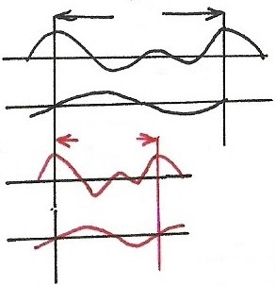


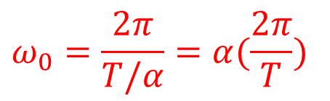


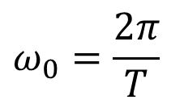
Time Scaling
(P.30 of 3.0)
positive real number
periodic with period T/α and fundamental frequency αω₀
a_{k} unchanged, but x(αt) and each harmonic component are different
$$T$$
$$x(t)$$
$$ω_{0}=\frac{2π}{T}$$
$$k=1$$
$$T/α$$
$$α>1$$
$$x(αt)$$
$$k=1$$
$$ω_{0}=\frac{2π}{T/α}=α(\frac{2π}{T})$$

Slide 42
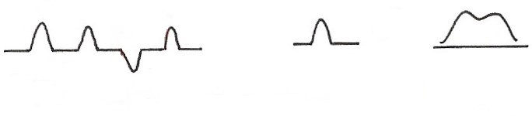
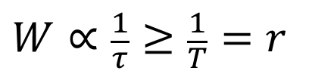




  Data Transmission
1
1
0
1
$$F$$
$$ω$$
$$τ$$
W:
$τ$:
T: bit duration
bandwidth
pulse width
$$W∝\frac{1}{τ}≥\frac{1}{T}=r$$
: bit rate
  (required bandwidth) $∝$ (bit rate)

Slide 43
Duality
  time/frequency domains are kind of “symmetric” except for a sign change (and a factor of 2π) --- “two domains”
      See Fig. 4.17, p.310 of text

Slide 44













  Duality
$$x(t)$$
$$y(t)$$
$$F$$
$$z\left(ω\right) X(jω)$$
$$t$$
$$ω (jω)$$
0
$$F^{−1}$$
$$z(t)$$
$$2πy(−ω)$$
$$F$$
$$t$$
$$ω$$
0

Slide 45


Slide 46
(P.10 of 4.0)
spectrum, frequency domain
Fourier Transform
signal, time domain Inverse Fourier Transform
        Fourier Transform pair, different expressions
        very similar format to Fourier Series for periodic signals

Slide 47






















  Signal Representation in Two Domains
  Time Domain Basis Frequency Domain Basis
$$X(jω)$$
$$x(t)$$
$$F$$
$$t$$
$$ω$$
$$t_{1} t_{2}$$
$$ω_{1} ω_{2}$$
$$t$$
$$2πδ(ω−ω_{1})$$
$$ω$$
$$δ(t−t_{1})$$
$$t_{1}$$
$$ω_{1}$$
$$t$$
$$2πδ(ω−ω_{2})$$
$$ω$$
$$δ(t−t_{2})$$
$$t_{2}$$
$$ω_{2}$$
$$⋮$$
$$⋮$$

Slide 48















  Signal Representation in Two Domains
  Time Domain Basis Frequency Domain Basis
{$δ\left(t−t_{k}\right), −∞<t_{k}<∞$}
{$2πδ\left(ω−ω_{k}\right), −∞<ω_{k}<∞$}
$$F$$
$$e^{−jt_{k}ω}$$
$$δ\left(t−t_{k}\right)$$
$$ω$$
$$t$$
$$t_{k}$$
$$e^{+jω_{k}t}$$
$$F$$
$$2πδ\left(ω−ω_{k}\right)$$
$$ω$$
$$t$$
$$ω_{k}$$

Slide 49









  Signal Representation in Two Domains
  Time Domain Basis Frequency Domain Basis
$$A$$
$$δ\left(t−t_{3}\right)$$
$$2πδ\left(ω−ω_{3}\right)$$
$$ω_{2}$$
$$t_{2}$$
$$ω_{1}$$
$$t_{1}$$
$$\vec{A}=\sum_{i}{a_{i} }{\vec{v}}_{i} =\sum_{k}{b_{k}{\vec{u}}_{k}} \text{(}合成\text{)}$$
$a_{i}=\vec{A}⋅{\vec{v}}_{i} b_{k}=\vec{A}⋅{\vec{u}}_{k}$ (分析)

Slide 50




  Signal Representation in Two Domains
  Time Domain Basis Frequency Domain Basis
$$\vec{A}=\sum_{i}{a_{i} }{\vec{v}}_{i}$$
$$(\sum_{k}{c_{k} }{\vec{u}}_{k})$$
$$=\sum_{k}{( ⋯ ) }{\vec{u}}_{k}$$
$$\vec{A}=\sum_{k}{b_{k} }{\vec{u}}_{k}$$
$$(\sum_{i}{d_{i} }{\vec{v}}_{i})$$
$$=\sum_{i}{( ⋯ ) }{\vec{v}}_{i}$$
$$b_{k}$$
$$a_{i}$$

Slide 51















  Signal Representation in Two Domains
  Time Domain Basis Frequency Domain Basis
$$\sum_{k}{c_{k}{\vec{u}}_{k}}$$
$$\sum{d_{i}}{\vec{v}}_{i}$$
$$b_{k}$$
$$a_{i}$$
$$b_{k}$$
$$\left\{\begin{aligned}X\left(jω\right)=\int_{−∞}^{∞}{x\left(t\right) e^{−jtω} dt } \\ \\ \\ x\left(t\right)=\frac{1}{2π}\int_{−∞}^{∞}{X\left(jω\right)e^{jtω}dω}\end{aligned}\right.$$
$$\left\{\begin{aligned}x\left(t\right)=\frac{1}{2π}\int_{−∞}^{∞}{X\left(jω\right) e^{jωt} dω} \\ \\ \\ X\left(jω\right)=\int_{−∞}^{∞}{x\left(t\right) e^{−jωt}dt } \end{aligned}\right.$$
(合成)
(合成)
(分析)
(分析)
$$\vec{A}$$
$$a_{i}$$
$${\vec{v}}_{i}$$
$$b_{k}$$
$${\vec{u}}_{k}$$
$$x\left(t\right)=\int_{−∞}^{∞}{x\left(τ\right) δ\left(t−τ\right) dτ }$$
$$\vec{A}$$
$$X\left(jω\right)=\int_{−∞}^{∞}{X\left(jη\right) δ\left(ω−η\right) dη }$$
(合成/分析)
(合成/分析)

Slide 52
Duality
  If any characteristics of signals in one domain implies some characteristics of signals in the other domain, the inverse is true except for a sign change (dual properties)
          modulation property

Slide 53







  Modulation Property
$$ω_{0}$$
$$e^{jω_{0}t}\left(e^{jω_{k}t}\right)=e^{j{(ω}_{k}+ω_{0})t}$$
modulation:
frequency translation
shift in frequency
$$ω$$
$$ω_{k}$$
$$ω_{k}+ω_{0}$$
  Multiplication Property
$$e^{jω_{0}t}⋅x(t)⟷\frac{1}{2π} [2πδ({ω−ω}_{0})∗X(jω)]$$
$=X(j(ω−ω_{0}))$

Slide 54
Convolution Property
  System Input/Output Relationship
                superposition property
                closed-form solution
                frequency response

Slide 55












  Input/Output Relationship
(P.5 of 3.0)
$$x(t)$$
$$y(t)$$
Time Domain
$$δ(t)$$
$$h(t)$$
$$t$$
$$t$$
0
0
Frequency Domain
$$ω$$
$$ω$$
$$ω_{1}$$
$$ω_{3}$$
$$ω_{5}$$
$$ω_{1}$$
$$ω_{3}$$
$$ω_{5}$$

Slide 56
  System Characterization
Superposition Property
  continuous-time
(P.9 of 3.0)
  discrete-time
  each frequency component never split to other frequency components, no convolution involved
  desirable to decompose signals in terms of such eigenfunctions

Slide 57









































  Convolution Property
$$X\left(jω_{2}\right)H\left(jω_{2}\right)=Y(jω_{2})$$
$$Y\left(jω\right)=X(jω)H\left(jω\right)$$
$$X(jω)$$
$$H\left(jω_{2}\right)=\int_{−∞}^{∞}{h(τ)}e^{−jω_{2}τ}dτ$$
$$F$$
$$ω$$
$$ω_{1}$$
$$ω_{2}$$
$$ω$$
$$ω_{1}$$
$$ω_{2}$$
$$F$$
$$H\left(jω_{1}\right)=\int_{−∞}^{∞}{h(τ)}e^{−jω_{1}τ}dτ$$
$$x\left(t\right)∗h(t)=y(t)$$
$$F$$
$$x(t)$$
$$t$$
$$t$$
$$h(t)$$
$$δ(t)$$
$$h(t)$$
$$t$$
$$F$$
$$t$$
$$F$$
$$H\left(jω_{2}\right)$$
$$H(jω)$$
$$F$$
$$1.0$$
$$1.0$$
$$ω$$
$$1$$
$$ω_{1}$$
$$ω_{2}$$
$$ω$$
$$H\left(jω\right)=\int_{−∞}^{∞}{h(τ)}e^{−jωτ}dτ$$
$$ω_{1}$$
$$ω_{2}$$
Transfer Function
Frequency Response
$$H\left(jω_{1}\right)$$
$$H\left(s\right)=\int_{−∞}^{∞}{h(τ)}e^{−sτ}dτ$$

Slide 58
Convolution Property
  unit impulse response h(t)
  frequency response or transfer function H(jω)
  convolution in time domain reduced to multiplication in frequency domain
  cascade of two systems implies product of the two frequency responses, independent of the order of the cascade
  example: filtering of signals
      See Fig. 4.20, 4.21, p.318, 319 of text

Slide 59









  Filtering of Signals
1
1
0
1
$$H(jω)$$
$$P(jω)$$
$$p(t)$$
$$F$$
$$t$$
$$ω$$
0
$$H(jω)$$
$$ω$$
0

Slide 60


Slide 61


Slide 62











  Realizable Lowpass Filter
$$F$$
$$h_{1}(t)$$
$$\left|H_{1}(jω)\right|$$
$$h_{2}(t)$$
$$F$$
$$\left\{\begin{aligned}\left|H_{2}(jω)\right| \\ ∠H_{2}(jω)\end{aligned}\right.$$
$$t$$
$$ω$$
$$−T$$
0
$$T$$
0
$$T$$
$$2T$$
0

Slide 63
Differentiation/Integration
(P.33 of 4.0)
  dc term

Slide 64

















  Integration
$$2πδ(ω)$$
$$δ(t)$$
1
1
$$t$$
$$ω$$
$$t$$
$$ω$$
0
$$F$$
0
Duality
$$F$$
$$u\left(t\right)=\int_{−∞}^{t}{δ}\left(τ\right)dτ$$
$$\frac{1}{2}⋅2πδ\left(ω\right)=πδ\left(ω\right)$$
$U\left(jω\right)=\frac{1}{jω}+$(dc term)
$=\frac{1}{jω}+πδ\left(ω\right)$
$$\frac{1}{2}$$
$$1$$
$$t$$
$$\int_{−∞}^{t}{x}\left(τ\right)dτ=x\left(t\right)∗u\left(t\right)=X\left(jω\right)⋅[\frac{1}{jω}+πδ\left(ω\right)]$$
$=\frac{1}{jω}X\left(jω\right)+πX(jο)δ(ω)$

Slide 65
Multiplication Property
    dual property of the convolution property
  example: frequency-selective filtering with variable center frequency
      See Fig. 4.26, 4.27, p.326 of text
Tables of Properties and Pairs
      See Tables. 4.1, 4.2, p.328, 329 of text

Slide 66
  Modulation Property
(P.53 of 4.0)
$$ω_{0}$$
$$e^{jω_{0}t}\left(e^{jω_{k}t}\right)=e^{j{(ω}_{k}+ω_{0})t}$$
modulation:
frequency translation
shift in frequency
$$ω$$
$$ω_{k}$$
$$ω_{k}+ω_{0}$$
  Multiplication Property
$$e^{jω_{0}t}⋅x(t)⟷\frac{1}{2π} [2πδ({ω−ω}_{0})∗X(jω)]$$
$=X(j(ω−ω_{0}))$

Slide 67






  Frequency Division Multiplexing
$$x_{1}(t)$$
$$X_{1}(jω)$$
$$X_{2}(jω)$$
$$x_{2}(t)$$
$$ω$$

Slide 68


Slide 69


Slide 70


Slide 71


Slide 72
Another Application Example
  systems described by differential equations:
            closed-form solution

Slide 73
Vector Space Interpretation of Fourier Transform
  generalized Parseval’s Relation
      {X(jω) defined on -∞ < ω < ∞}=V: a vector space
      inner-product of two vectors(signals) can be evaluated in either the time domain or the frequency domain
      Parseval’s relation is a special case here: the magnitude (norm) of a vector can be evaluated in either the time domain or the frequency domain

Slide 74
Vector Space Interpretation of Fourier Transform
  considering the basis signal set

Slide 75
Vector Space Interpretation of Fourier Transform
  considering the basis signal set
  similar to the vector space of continuous-time signals
  orthogonal bases but not normalized, while makes sense considering operational definition

Slide 76

    Examples
Example 4.8, p.299 of text

Slide 77


    Examples
Example 4.13, p.310 of text
  From Example 4.2
$$x\left(t\right)=e^{−2\left|t\right|} \underset{↔}{F} X\left(jω\right)=\frac{2}{1+ω^{2}}$$
  by duality
$$x\left(t\right)=\frac{2}{1+t^{2}} \underset{↔}{F} {2πe}^{−2\left|ω\right|}$$

Slide 78



    Examples
Example 4.19, p.320 of text
$h\left(t\right)=e^{−at}u\left(t\right),$ $a>0$
$x\left(t\right)=e^{−bt}u\left(t\right),$ $b>0$
$X\left(jω\right)=\frac{1}{b+jω}$ , $H\left(jω\right)=\frac{1}{a+jω}$
$$Y\left(jω\right)=\frac{1}{(a+jω)(b+jω)}=\frac{1}{b−a} [ \frac{1}{a+jω}−\frac{1}{b+jω} ]$$
$$y\left(t\right)=\frac{1}{b−a}\left[e^{−at} u\left(t\right)−e^{−bt}u\left(t\right)\right], b≠a$$
$b=a : Y\left(jω\right)=\frac{1}{{(a+jω)}^{2}}=j \frac{d}{dω} [\frac{1}{a+jω}]$
Since$−jtx\left(t\right)↔\frac{d}{dω} X\left(jω\right)$
$y\left(t\right)=te^{−at} u\left(t\right), b=a$

Slide 79


    Problem 4.12, p.336 of text
(a) Given $e^{−\left|t\right|} \underset{↔}{ F } \frac{2}{1+ω^{2}}$
  $$te^{−\left|t\right|} \underset{↔}{ F }j\frac{d}{dω}\left[\frac{2}{1+ω^{2}}\right]=−\frac{4jω}{{(1+ω^{2})}^{2}}$$
  by differentiation in frequency domain
(b) By duality $−\frac{4jt}{{\left(1+t^{2}\right)}^{2}} \underset{↔}{ F } −2πωe^{−\left|ω\right|}$
$∴\frac{4t}{{\left(1+t^{2}\right)}^{2}} \underset{↔}{ F } −j2πωe^{−\left|ω\right|}$

Slide 80


    Problem 4.13, p.336 of text
(a) $X\left(jω\right)=δ\left(ω\right)+δ\left(ω−π\right)+δ\left(ω−5\right)$
Is $x\left(t\right)$ periodic ?
  $$x\left(t\right)=\frac{1}{2π}+\frac{1}{2π}e^{jπt}+\frac{1}{2π}e^{j5t}$$
  $π$ and 5 are not integer multiples of any common fundamental frequency
  $∴x(t)$ Not periodic
(b) $h\left(t\right)=u\left(t\right)−u\left(t−2\right)$
Is $x\left(t\right)∗h(t)$ periodic ?
  $$H\left(jω\right)=e^{−jω}\left[\frac{2\sin{ω}}{ω}\right], H\left(jπ\right)=0$$
  $$X\left(jω\right)H\left(jω\right)=H\left(j0\right)δ\left(ω\right)+H(j5)δ\left(ω−5\right)$$
  $$∴x\left(t\right)∗h(t) \text{is} \text{periodic}$$

Slide 81


    Problem 4.33, p.345 of text
$$\frac{d^{2}}{dt^{2}} y\left(t\right)+6\frac{d}{dt} y\left(t\right)+8y\left(t\right)=2x(t)$$
(a) find impulse response
$$H\left(jω\right)=\frac{Y(jω)}{X(jω)}=\frac{2}{−ω^{2}+6jω+8}=\frac{1}{jω+2}−\frac{1}{jω+4}$$
$$∴h\left(t\right)=e^{−2t}u\left(t\right)−e^{−4t}u(t)$$
(b) For $x\left(t\right)=te^{−2t}u(t)$
$$X\left(jω\right)=\frac{1}{{(2+jω)}^{2}}$$
$$Y\left(jω\right)=X\left(jω\right)H\left(jω\right)=\frac{1/4}{jω+2}−\frac{1/2}{{(jω+2)}^{2}}+\frac{1}{{(jω+2)}^{3}}−\frac{1/4}{jω+4}$$
$$∴y\left(t\right)=\frac{1}{4}e^{−2t}u\left(t\right)−\frac{1}{2}te^{−2t}u\left(t\right)+t^{2}e^{−2t}u\left(t\right)−\frac{1}{4}e^{−4t}u(t)$$

Slide 82


    Problem 4.35, p.346 of text
(a) $H\left(jω\right)=\frac{a−jω}{a+jω}$
$\left|H(jω)\right|=\sqrt{a^{2}+ω^{2}}/\sqrt{a^{2}+ω^{2}}$ $=1$
$$∡H\left(jω\right)=−\tan^{−1}{\frac{ω}{a}}−\tan^{−1}{\frac{ω}{a}}=−2\tan^{−1}{\frac{ω}{a}}$$
$H\left(jω\right)=−1+\frac{2a}{a+jω}$ , $h\left(t\right)=−δ\left(t\right)+2ae^{−at}u(t)$
(b) $x\left(t\right)=\cos{t}+\cos{\sqrt{3}}t, a=1$
$$X\left(jω\right)=π[δ\left(ω−1\right)+δ\left(ω+1\right)+δ\left(ω−\sqrt{3}\right)+δ(ω+\sqrt{3})]$$
$H\left(jω\right)=1⋅e^{−j\frac{π}{2}}$ at $ω=1$, $H\left(jω\right)=1⋅e^{−j\frac{2}{3}π}$ at $ω=\sqrt{3}$, etc
$$y\left(t\right)=\frac{1}{2}\left[e^{j\left(t−\frac{π}{2}\right)}+e^{−j\left(t−\frac{π}{2}\right)}+e^{j\left(\sqrt{3}t−\frac{2}{3}π\right)}+e^{−j\left(\sqrt{3}t−\frac{2}{3}π\right)}\right]$$
$$∴y\left(t\right)=\cos{(t−\frac{π}{2})}+\cos{(\sqrt{3}t−\frac{2}{3}π)}$$

Slide 83
    Problem 4.51, p.354 of text, part (c)
An echo system
x(t)
y(t)
……
x(t)
y(t)
α
T
T
(-α)
h(t)
g(t)

