Slide 1
CS4100: Computer Architecture
Computer Abstractions and Technology (II)
Prof. Chung-Ta King
Department of Computer Science
National Tsing Hua University, Taiwan
(Adapted from textbook slides https://www.elsevier.com/books-and-journals/book-companion/9780128122754/lecture-slides)

Slide 2
Technology and Computer Summary
Technology progresses:
Mechanic → electro-mechanic → electronic
(vacuum tube → transistor → integrated circuit)
  Size ↓
  Switching speed ↑
  Reliability ↑
  Power ↓
  Cost ↓
Also requires innovative architectural ideas to ride the technology scaling for computer advances
0-1 switch
Moore’s Law
2-fold effects of IC technology scaling on computer performance:
Faster without change of design
More transistors to implement new architecture features

Slide 3
Outline
Computer: a historical perspective
Great ideas in computer architecture (Sec. 1.2)
Below your program (Sec. 1.3)
Under the covers (Sec. 1.4)
Technologies for building processors and memory (Sec. 1.5)
Performance (Sec. 1.6)
The power wall (Sec. 1.7)
From uniprocessors to multiprocessors (Sec. 1.8)
Benchmarking for performance and power (Sec. 1.9)
Fallacies and Pitfalls (Sec. 1.10)

Slide 4
Why Study Performance?
As a computer scientist/engineer, you task is not just to solve a problem, but to solve a problem better
  Solving a problem is related to correctness
  Solving a problem better is related to optimization
As computer architects, we strive to design better computers
What do we mean by “better”? Better for “what”?
  Optimization goals
How do we know “how good” our design is?
  Performance metrics and evaluation
  Performance-guided design
C/P ratio

Slide 5


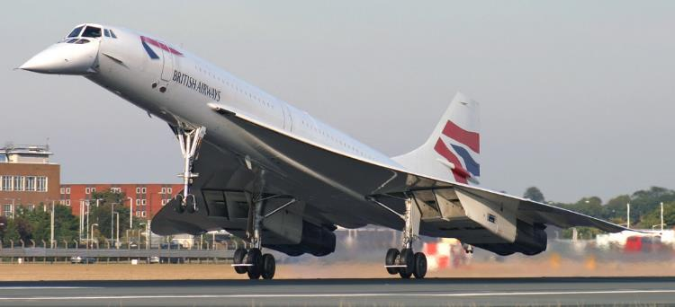
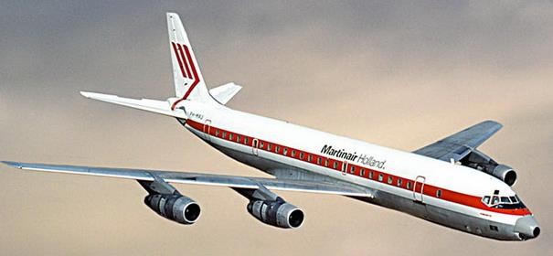
Defining Performance
Which airplane has the best performance?
Boeing 777
Boeing 747
BAC/Sud Concorde
Douglas DC-8-50

Slide 6
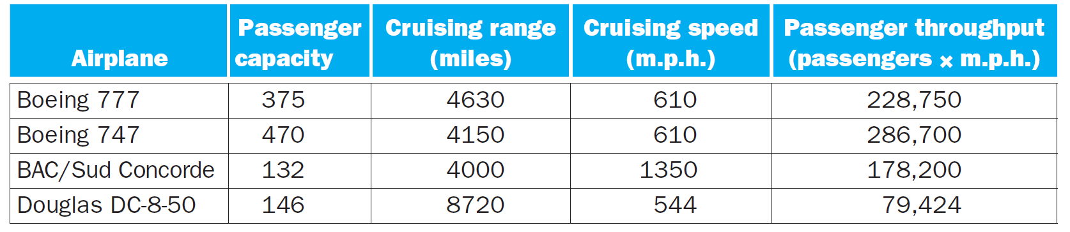
Which Airplane Has the Best Performance?
Fig. 1.14

Slide 7
What Do You Mean by Performance?
Notes:
Fuel efficiency, comfort, reliability, degree of automation, …

Slide 8
For Us, Time Is the Ultimate Measure
For comparing performance of individual computers, time (how fast can we compute) is most important
  v.s., comparing performance of servers in data centers
Yet, still two performance metrics related to time:
  Execution time (response time, latency): how long it takes to do a task (focusing more on non-interactive apps)
  Throughput: total work done per unit time
    e.g., tasks/transactions/… per hour
  Ex.: how are execution time and throughput affected by
    Replacing the processor with a faster version?
    Adding more processors?
Which one is easier to improve?
Notes:
Execution time: traveling time from Taipei to Kaohsiung → concerned by drivers
Throughput: amount of cars to travel from Taipei to Kaohsiung → concerned by Ministry of Transportation

Slide 9
Latency vs. Throughput
Latency (flying time) of Boeing 747 vs. Concorde
  6.5 hours vs 3 hours (2.17:1)
  Concord is 2.17 times faster in terms of latency
Throughput of Boeing 747 vs. Concorde
  72.3 pph vs 44 pph (1.63 : 1)
  Boeing is 1.63 times faster (better) in terms of throughput
Plane | DC to Paris | Speed | Passengers | Throughput (phh)
 | 6.5 hours | 610 mph | 470 | 72.3
 | 3 hours | 1350 mph | 132 | 44
Will focus on latency
(Prof. Jing-Jia Liou)

Slide 10
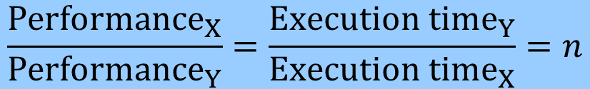
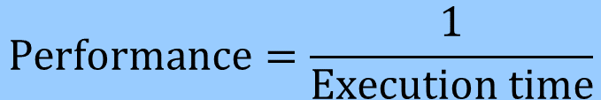
Performance in Terms of Execution Time
Time is the measure of computer performance
  The computer that performs the same amount of work in the least time has a higher performance
So, we can define
“X is n time faster than Y” means
$$Performance=\frac{1}{Execution time}$$
$$\frac{{Performance}_{X}}{{Performance}_{Y}}=\frac{{Execution time}_{Y}}{{Execution time}_{X}}=n$$

Slide 11
What to Measure in Terms of Time?
But, execution time can be defined differently:
  Elapsed time: total response time, wall clock time
    Total time to complete a task/program, including everything: memory accesses, I/O activities, OS overhead, idle time
    Determines system performance
  CPU time: time the CPU spent processing a task/program (discounts I/O time, other jobs’ shares)
CPU time of a task/program further consists of
  User CPU time: CPU time spent in the task/program
  System CPU time: CPU time spent in OS performing tasks on behalf of the task/program

Slide 12
How to Express Time?
Computer time can be seconds or system clocks
  Clocks related to how fast HW can perform basic functions
  CPU clocking: operation of digital hardware governed by a constant-rate clock
  Clock period: duration of a clock cycle, e.g., 1 ns=1×10^{–9} s
  Clock frequency (rate): cycles per second,
  e.g., 4 GHz = 4000 MHz = 4.0×10⁹ Hz
Clock period
Clock (cycles)
Data transfer
and computation
Update state

Slide 13
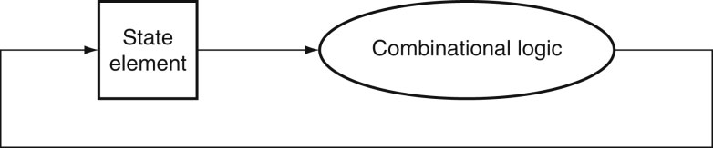
Clocking and Circuits
Clock period
Clock (cycles)
Data transfer
and computation
Update state
Clock
Register
15
27
15
27
12
12
ALU
Fig. B.7.3. Clocked sequential circuit
Clock period = longest paths between registers (complexity of computation)
Notes:
Analog: water ways and flows of water in the channels

Slide 14
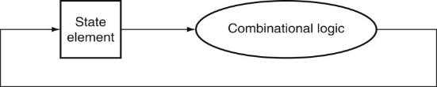
CPU Performance
The most fundamental CPU performance measure is CPU execution time of a program (user CPU time):
CPU performance can be improved by
  Reducing number of clock cycles
  Increasing clock rate
Hardware designers must often trade off clock rate against cycle count (Why?)
Clock
Notes:
Computer A: half the combinational logic part of the datapath → half clock cycle, but increase cycle counts

Slide 15
CPU Performance Example
Computer A: 2GHz clock, 10s CPU time for our prog.
Want to design Computer B
  Aim for 6s CPU time for our program
  Can do faster clock, but causes 1.2 × clock cycles
How fast must Computer B clock be?
Observations?

Slide 16
CPU Performance & Program Instructions
CPU performance is determined by the total number of CPU clock cycles to execute our program
Total CPU clock cycle is affected in turn by the number of instructions and their types
  e.g., a multiply takes more CPU cycles than an addition
Need a way to relate CPU time with instructions in our program

Slide 17
CPU Performance & Program Instructions
Instruction Count (IC) of execution of a program
  Determined by program, ISA and compiler
Average Cycles per Instruction (CPI)
  Determined by CPU hardware
  If different instructions have different CPI
    Average CPI affected by instruction mix
Not static IC
Which is better?
CPI ↑ or CPI ↓
Can CPI < 1?

Slide 18
CPI Example
Computer A: clock cycle time = 250 ps, CPI = 2.0
Computer B: clock cycle time = 500 ps, CPI = 1.2
Same ISA
Which is faster, and by how much?
A is faster…
… by this much
Observations?
Notes:
Computer A: half the combinational logic part of the datapath → half clock cycle, but increase cycle counts

Slide 19
CPI in More Detail
If different instruction classes take different numbers of cycles
Weighted average CPI
Relative frequency of i^{th} class of instructions in the program

Slide 20
CPI Example
Alternative compiled code sequences using instructions in classes A, B, C
Sequence 1: IC = 5
  Clock Cycles
  = 2×1 + 1×2 + 2×3
  = 10
  Avg. CPI = 10/5 = 2.0
Class | A | B | C
CPI for class | 1 | 2 | 3
IC in sequence 1 | 2 | 1 | 2
IC in sequence 2 | 4 | 1 | 1
Sequence 2: IC = 6
  Clock Cycles
  = 4×1 + 1×2 + 1×3
  = 9
  Avg. CPI = 9/6 = 1.5
Observations?
Notes:
Sequence 2: more instructions but run faster, because use more faster instructions

Slide 21
Performance Summary
The only complete and reliable measure of computer performance is time
  Response time, execution time, latency
  Throughput
Execution time of a program on a computer can be
  Elapsed time (total response time, wall clock time)
  CPU time
CPU time of a program consists of
  User CPU time
  System CPU time
  Can be measured by number of CPU cycles and cycle time
Number of CPU cycles is related to instruction count

Slide 22
Performance Summary
Computer performance of a program is thus
  Must look at all three when comparing two computers
Performance depends on
CPU Time $=\frac{Instructions}{Program}×\frac{Clock Cycles}{Instruction}×\frac{Seconds}{Clock Cycle}$
 | Inst. Count | CPI | Clock Rate
Algorithm | √ | √
Program Language | √ | √
Compiler | √ | √
ISA | √ | √ | √
Notes:
Algorithm: (Instruction count, possibly CPI)
The algorithm determines the number of source program instructions executed and hence the number of processor instructions executed. The algorithm may also affect the CPI, by favoring slower or faster instructions. For example, if the algorithm uses more divides, it will tend to have a higher CPI.
Programming language: (Instruction count, CPI)
The programming language certainly affects the instruction count, since statements in the language are translated to processor instructions, which determine instruction count. The language may also affect the CPI because of its features; for example, a language with heavy support for data abstraction (e.g., Java) will require indirect calls, which will use higher CPI instructions.
Compiler: (Instruction count, CPI)
The efficiency of the compiler affects both the instruction count and average cycles per instruction, since the compiler determines the translation of the source language instructions into computer instructions. The compiler’s role can be very complex and affect the CPI in complex ways.
Instruction set architecture: (Instruction count, clock rate, CPI)
The instruction set architecture affects all three aspects of CPU performance, since it affects the instructions needed for a function, the cost in cycles of each instruction, and the overall clock rate of the processor.

Slide 23
Outline
Computer: a historical perspective
Great ideas in computer architecture (Sec. 1.2)
Below your program (Sec. 1.3)
Under the covers (Sec. 1.4)
Technologies for building processors and memory (Sec. 1.5)
Performance (Sec. 1.6)
The power wall (Sec. 1.7)
From uniprocessors to multiprocessors (Sec. 1.8)
Benchmarking for performance and power (Sec. 1.9)
Fallacies and Pitfalls (Sec. 1.10)

Slide 24
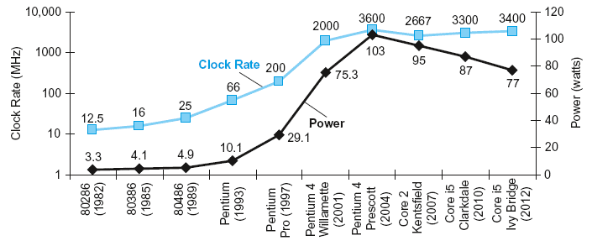
Power Trends
Eight generations of x86 processors:
→ power increases as clock rate
  Slowing down after 2004, because of “power wall” (power limit for cooling commodity microprocessors)
Fig. 1.16

Slide 25
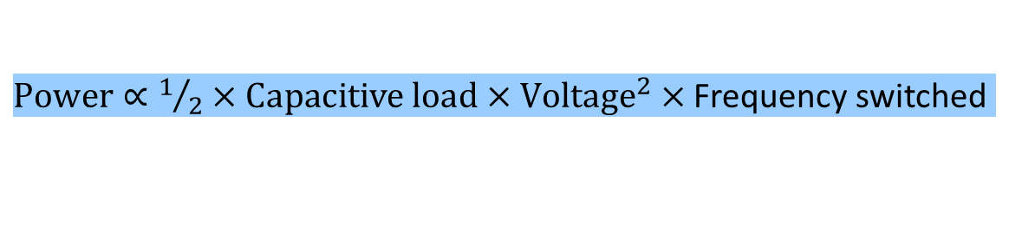
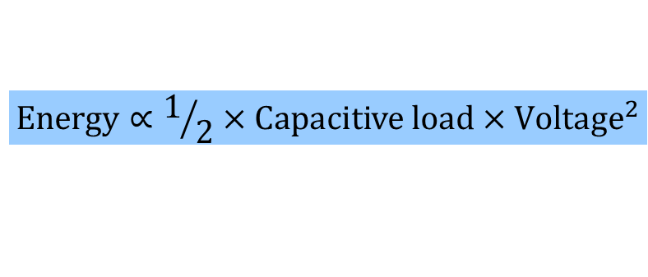
Power Trends
In the PostPC Era the really critical resource is energy
  For personal mobile device → battery life
  For data centers → powering and cooling servers
For IC technology based on CMOS, primary energy consumption is dynamic energy
  Depends on capacitive loading of each transistor and the voltage applied, for a single 0 → 1 or 1 → 0 transition
  Power required per transistor
    Can be lowered by reducing voltage (15% per IC generation) or clock rate
$$\text{Energy}∝1/2×\text{Capacitive} \text{load}\text{ × }{\text{Voltage}}^{2}$$
$\text{Power}∝1/2×\text{Capacitive} \text{load}\text{ × }{\text{Voltage}}^{2}×$ Frequency switched
Notes:
Frequency switched is a function of the clock rate. The capacitive load per transistor is a function of both the number of transistors connected to an output (called the fanout) and the technology, which determines the capacitance of both wires and transistors.
Equation without ½: gives the energy of a pulse during the logic transition of 0 → 1 → 0 or 1 → 0 → 1. The energy of a single transition is then half of it.

Slide 26
Power Reduction Example
Suppose a new CPU has
  85% of capacitive load of old CPU
  15% voltage reduction and thus 15% frequency reduction
Problem with lowering voltage
  Static energy consumption (due to leakage current, even when a transistor is off) becomes dominant
The power wall
  We cannot reduce voltage further
  We cannot remove more heat
How else can we do to get performance?

Slide 27
Outline
Computer: a historical perspective
Great ideas in computer architecture (Sec. 1.2)
Below your program (Sec. 1.3)
Under the covers (Sec. 1.4)
Technologies for building processors and memory (Sec. 1.5)
Performance (Sec. 1.6)
The power wall (Sec. 1.7)
From uniprocessors to multiprocessors (Sec. 1.8)
Benchmarking for performance and power (Sec. 1.9)
Fallacies and Pitfalls (Sec. 1.10)

Slide 28
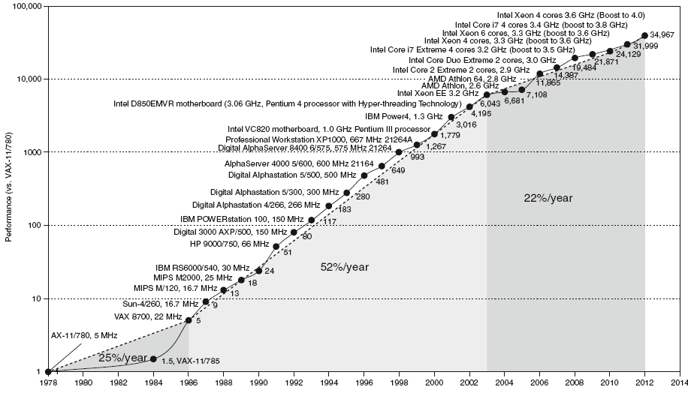
Uniprocessor Performance
Fig. 1.17
Go for multicore
Constrained by power, instruction-level parallelism, memory latency

Slide 29

Move into Multiprocessors
Multicore microprocessors
  More than one processor (core) per chip
  A 2-core chip normally consumes less power than a 1-large-core chip of same size and performance
No free lunch for software anymore
  In single-core era, IC technology scaling (e.g., clock rate) automatically improves program performance
  Architecture innovation on instruction level parallelism lets hardware exploit parallelism among instructions and execute multiple parallel instructions at once
    Programmer and compiler can view hardware as executing instructions sequentially and no need to change programs

Slide 30
Problems with Multiprocessors
Require programmers and compilers to be aware of the parallel hardware and to explicitly rewrite their programs to be parallel
Hard to do:
  Need to program for performance, not just correctness
  Load balancing parallel tasks
  Optimizing communication and synchronization among parallel tasks
To be elaborated in later chapters

Slide 31
Outline
Computer: a historical perspective
Great ideas in computer architecture (Sec. 1.2)
Below your program (Sec. 1.3)
Under the covers (Sec. 1.4)
Technologies for building processors and memory (Sec. 1.5)
Performance (Sec. 1.6)
The power wall (Sec. 1.7)
From uniprocessors to multiprocessors (Sec. 1.8)
Benchmarking for performance and power (Sec. 1.9)
Fallacies and Pitfalls (Sec. 1.10)

Slide 32
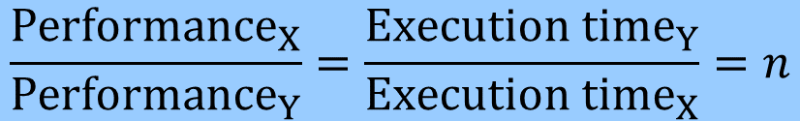
Comparing Performance
Recall that “X is n time faster than Y” means
  It is easy to compare two computers using one program, but what about multiple programs?
Why compare performance using multiple programs?
→ benchmarking
  A standard set of programs specifically chosen to measure and compare computer performance
    Represent a workload that will predict the performance of the actual workload
$$\frac{{Performance}_{X}}{{Performance}_{Y}}=\frac{{Execution time}_{Y}}{{Execution time}_{X}}=n$$

Slide 33
How to Summarize Performance Data?
Two machines with two programs
Average execution time ratio relative to machine A
  (program 1 + program 2)/2 = (4/2 + 8/12)/2 = 4/3
  B is 1.33 times slower than A
Average execution time ratio relative to machine B
  (program 1 + program 2)/2 = (2/4 + 12/8)/2= 1
  A is same as B
Different conclusions if different references are used
 | Machine A | Machine B
Program 1 | 2 s | 4 s
Program 2 | 12 s | 8 s

Slide 34
Better Metric to Summarize Performance
Geometric Mean
  Consistent performance ratios regardless of reference
 | Machine A (Normalized to B) | Machine B (Normalized to A)
Program 1 | 0.5 | 2.0
Program 2 | 1.5 | 0.666
Geometric Mean | 0.866 | 1.155
Note: 1.155=1/0.866

Slide 35
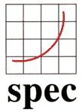
Example Benchmark Suite: SPEC
Standard Performance Evaluation Corp (SPEC)
  Began in 1989 on benchmarking workstation and servers
  Developed benchmarks for cloud, CPU, Web, …
SPEC CPU2017 (43 benchmarks)
  SPECspeed 2017 Integer and Floating Point suites
    Elapse time to execute each benchmark from the suite
  SPECrate 2017 Integer and Floating Point suites
    Elapse time to execute n copies of each benchmark
  Normalize relative to a reference machine
  Summarize as geometric mean of performance ratios
  For desktop computers or servers using non-interactive applications
Notes:
SPEC CPU2006 consists of a set of 12 integer benchmarks (CINT2006) and 17 floating-point benchmarks (CFP2006).

Slide 36
SPEC CPU2017 Integer Benchmarks
SPECrate 2017 | SPECspeed 2017 | Lang. | KLOC | Application Area
500.perlbench_r | 600.perlbench_s | C | 362 | Perl interpreter
502.gcc_r | 602.gcc_s | C | 1,304 | GNU C compiler
505.mcf_r | 605.mcf_s | C | 3 | Route planning
520.omnetpp_r | 620.omnetpp_s | C++ | 134 | Discrete Event simulation - computer network
523.xalancbmk_r | 623.xalancbmk_s | C++ | 520 | XML to HTML conversion via XSLT
525.x264_r | 625.x264_s | C | 96 | Video compression
531.deepsjeng_r | 631.deepsjeng_s | C++ | 10 | Artificial Intelligence: alpha-beta tree search (Chess)
541.leela_r | 641.leela_s | C++ | 21 | Artificial Intelligence: Monte Carlo tree search (Go)
548.exchange2_r | 648.exchange2_s | Fortran | 1 | Artificial Intelligence: recursive solution generator (Sudoku)
557.xz_r | 657.xz_s | C | 33 | General data compression
KLOC = line count (including comments/whitespace) for source files used in a build / 1000

Slide 37
SPEC CPU2017 Floating-Point Benchmarks
SPECrate 2017 | SPECspeed 2017 | Lang. | KLOC | Application Area
503.bwaves_r | 603.bwaves_s | Fortran | 1 | Explosion modeling
507.cactuBSSN_r | 607.cactuBSSN_s | C++, C, Fortran | 257 | Physics: relativity
508.namd_r |  | C++ | 8 | Molecular dynamics
510.parest_r |  | C++ | 427 | Biomedical imaging
511.povray_r |  | C++, C | 170 | Ray tracing
519.lbm_r | 619.lbm_s | C | 1 | Fluid dynamics
521.wrf_r | 621.wrf_s | Fortran, C | 991 | Weather forecasting
526.blender_r |  | C++, C | 1,577 | 3D rendering & animation
527.cam4_r | 627.cam4_s | Fortran, C | 407 | Atmosphere modeling
 | 628.pop2_s | Fortran, C | 338 | Wide-scale ocean modeling
538.imagick_r | 638.imagick_s | C | 259 | Image manipulation
544.nab_r | 644.nab_s | C | 24 | Molecular dynamics
549.fotonik3d_r | 649.fotonik3d_s | Fortran | 14 | Computational Electromagnetics
554.roms_r | 654.roms_s | Fortran | 210 | Regional ocean modeling

Slide 38
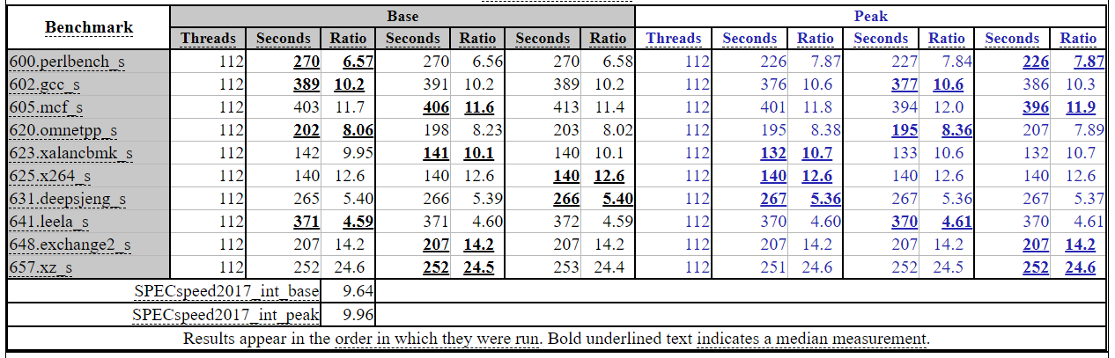
Performance Report
ASUS WS C621E SAGE Server System
Intel Xeon Platinum 8180, 2.50 GHz
  Note how the performance is reported! → repeatable
https://www.spec.org/cpu2017/results/res2018q1/cpu2017-20180121-02622.html

Slide 39
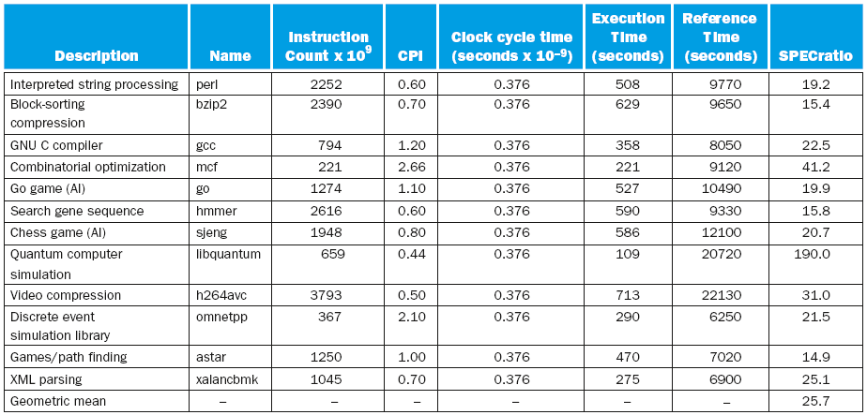
CINT2006 for 2.66GHz Intel Core i7 920
Fig. 1.18

Slide 40
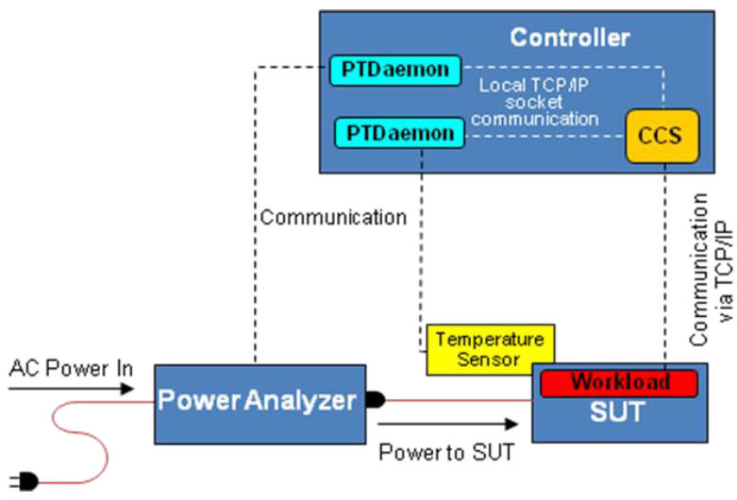
SPEC Power Benchmark
SPECpower_ssj2008: power consumption to generate performance of servers (at 10 workload levels)
  Performance: ssj_ops/sec
    Workload: Java business application to generate transactions, performance measured in throughput (transactions per sec)
  Power: Watts (Joules/sec)
  Metric:
Overall ssj_ops per Watt =
Power Analyzer
Notes:
SPECpower started with another SPEC benchmark for Java business applications (SPECJBB2005), which exercises the processors, caches, and main memory as well as the Java virtual machine, compiler, garbage collector, and pieces of the operating system. Performance is measured in throughput, and the units are business operations per second.
The workload is a Java application. It generates and completes a mix of transactions, and the throughput is the number of transactions completed per second over a fixed period. The application begins by running a calibration phase designed to determine the maximum throughput of the system. The application then calculates the throughput values that correspond to each target load (100%, 90%, … 20%, 10%, 0% of maximum as calibrated). After this is determined, the benchmark then enters the measurement interval during which the workload iterates through ten target loads, at each load generating transactions for completion at the target rate, using a randomized distribution to determine the times at which transactions are issued. As the workload described above runs, power measurements are recorded for later correlation with the performance at each target load, and for calculation of the benchmark metric. Temperature is also recorded to ensure that the ambient temperature during the run is no less than 20 degrees Centigrade. Power is measured using one or more power analyzers, which sit between the wall A/C power and the SUT. Temperature is measured using one or more temperature sensors. The benchmark in fact consists of the workload application on the SUT plus additional modules that are used to gather data and analyze the results. The first is the SPEC Power Temperature Daemon (SPEC PTDaemon) that communicates with a power analyzer or a temperature sensor by a standard hardware interface, e.g., serial, USB, or GPIB. PTDaemon itself is controlled via a simple socket interface, responding to requests for power (and temperature) readings. A second module is the Control and Collection System (CCS), which collects information from the workload on the SUT, and power and temperature information from the power and temperature daemons. It communicates with both through TCP/IP connections. The CCS is required to run on a system separate from the SUT, called the controller.

Slide 41
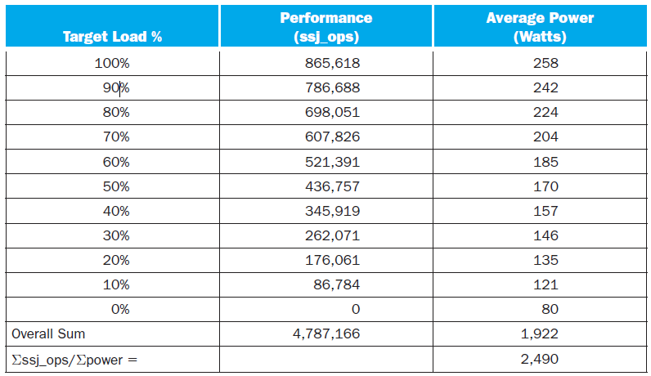
SPECpower_ssj2008 for Xeon X5650
Fig. 1.19.
Notes:
SPECpower_ssj2008 running on a dual socket 2.66 GHz Intel Xeon X5650 with 16 GB of DRAM and one 100 GB SSD disk

Slide 42
Outline
Computer: a historical perspective
Great ideas in computer architecture (Sec. 1.2)
Below your program (Sec. 1.3)
Under the covers (Sec. 1.4)
Technologies for building processors and memory (Sec. 1.5)
Performance (Sec. 1.6)
The power wall (Sec. 1.7)
From uniprocessors to multiprocessors (Sec. 1.8)
Benchmarking for performance and power (Sec. 1.9)
Fallacies and Pitfalls (Sec. 1.10)

Slide 43
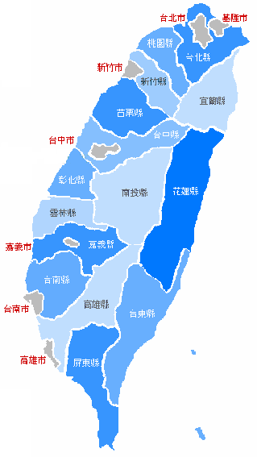
Pitfall: Amdahl’s Law
Improving one aspect of a computer and expecting a proportional improvement in overall performance
Example:
  Traveling from Taipei to Kaohsiung by train
  would take 4 hr
  High speed rail shortens the time to 1.5 hr
  Improvement factor = 4/1.5 = 2.67
  Can we expect the overall performance
  (door-to-door) to be improved also by
  the same factor (2.67)?
Actually, we cannot
  There is a limitation, as stated by the Amdahl’s Law

Slide 44
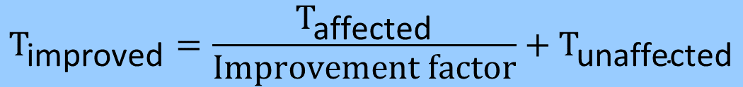
Pitfall: Amdahl’s Law
Example: door-to-door improvement by
high speed rail
  T_{affected} = 4 hr
  T_{unaffected} = 0.5 hr + 0.5 hr = 1 hr
  T_{improved} = 4 hr / 2.67 + 1 hr = 2.5 hr
  Overall improvement factor (speedup)
  = (4 + 1) hr / 2.5 hr = 2.0
  which is less than 2.67
  Time that cannot be enhanced
  (local traveling) is more dominant
$${\text{T}}_{\text{improved}}=\frac{{\text{T}}_{\text{affected}}}{\text{Improvement} \text{factor}}+{\text{T}}_{\text{unaffected}}$$
0.5 hr
(local)
0.5 hr
(local)

Slide 45

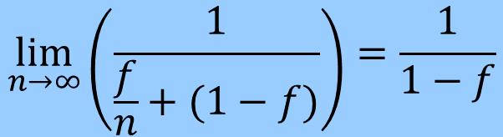
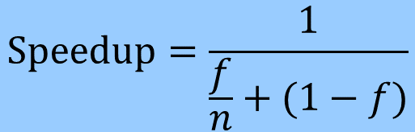
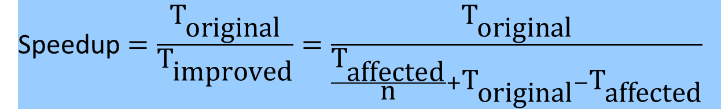
Pitfall: Amdahl’s Law
Amdahl’s Law is often expressed as speedup:
$${\text{T}}_{\text{improved}}=\frac{{\text{T}}_{\text{affected}}}{\text{Improvement} \text{factor}}+{\text{T}}_{\text{unaffected}}$$
Speedup $=\frac{{\text{T}}_{\text{original}}}{{\text{T}}_{\text{improved}}}=\frac{{\text{T}}_{\text{original}}}{\frac{{\text{T}}_{\text{affected}}}{\text{n}}+{{\text{T}}_{\text{original}}−\text{T}}_{\text{affected}}}$
$$\text{Speedup}=\frac{1}{\frac{f}{n}+(1−f)}$$
f: % that can be improved (T_{aff}/T_{orig})
n: improvement factor
$$\lim_{n→∞}\left(\frac{1}{\frac{f}{n}+(1−f)}\right)=\frac{1}{1−f}$$
Performance improvement from using enhancement E is limited by the fraction that E cannot be applied

Slide 46
Fallacy: Low Power at Idle
Computers at low utilization use little power
Look back at i7 power benchmark
  At 100% load: 258W
  At 50% load: 170W (66%)
  At 10% load: 121W (47%)
Google datacenter
  Mostly operates at 10% ~ 50% load
  At 100% load less than 1% of the time
Should consider designing processors to make power proportional to load (energy-proportional computing)
Ideally, should be 10%!

Slide 47
Pitfall: MIPS as a Performance Metric
Using a subset of the performance equation as a performance metric
Ex.: MIPS (Millions of Instructions Per Second)
  Doesn’t account for capacities of instructions → cannot compare computers with different ISAs
  MIPS varies between programs on the same computer
  MIPS can vary independently from performance (e.g., more instructions but each is faster)
Notes:
if a new program executes more instructions but each instruction is faster, MIPS can vary independently from performance!

Slide 48
Concluding Remarks
Cost/performance is improving
  Due to underlying technology development
  Also need architecture innovations to scale performance
Eight great architecture ideas and hierarchical layers of abstraction
  In both hardware and software
Instruction set architecture
  The hardware/software interface
Execution time: the best performance measure
Power is a limiting factor
  Use parallelism to improve performance

