Slide 1
CS4100: Computer Architecture
Computer Abstractions and Technology (I)
Prof. Chung-Ta King
Department of Computer Science
National Tsing Hua University, Taiwan
(Adapted from textbook slides https://www.elsevier.com/books-and-journals/book-companion/9780128122754/lecture-slides)

Slide 2
Outline
Computer: a historical perspective (Sec. 1.1, 1.5, 1.12)
  Technology affects computer development
  Great ideas in computer architecture require technology
Great ideas in computer architecture (Sec. 1.2)
Below your program (Sec. 1.3)
Under the covers (Sec. 1.4)
Technologies for building processors and memory (Sec. 1.5)
Performance (Sec. 1.6)
The power wall (Sec. 1.7)
From uniprocessors to multiprocessors (Sec. 1.8)

Slide 3
When was “computer” developed?

Slide 4
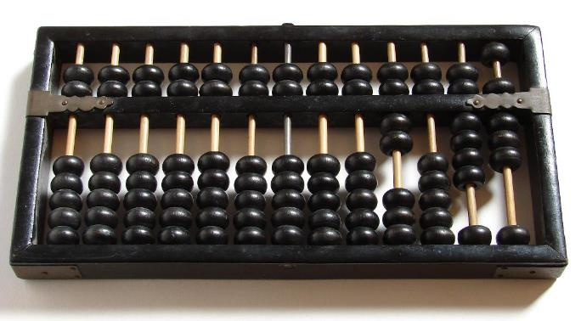

About 1300 years ago …
Why don’t we call it “computer”?
Notes:
No power, more like a calculator, not programmable/general purpose

Slide 5
Have to Be Precise about What We Mean
A device that computes, especially a programmable electronic machine that performs high-speed mathematical or logical operations or that assembles, stores, correlates, or otherwise processes information
-- The American Heritage Dictionary of the English Language, 4th Edition, 2000

Slide 6
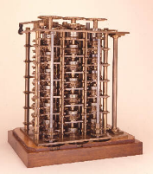
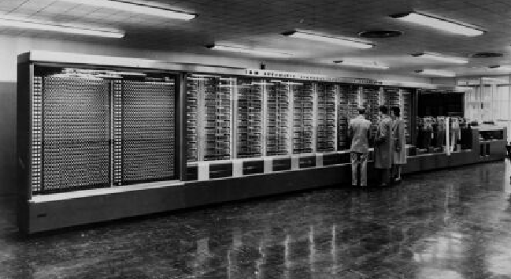
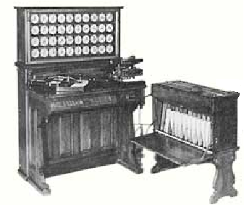
There Were Many Computing Devices
Special-purpose versus general-purpose
Non-programmable versus programmable
Decimal versus binary (Boolean algebra)
Scientific versus data processing
Mechanical, electromechanical, electronic, …
Difference Engine
(C. Babbage, 1822)
Tabulating machine
(H. Hollerith, 1889)
Harvard Mark I
(IBM, H. Aiken, 1944)
Notes:
General purpose: e.g. food processor

Slide 7
When was the first all-electronic, programmable, general-purpose computer developed?

Slide 8
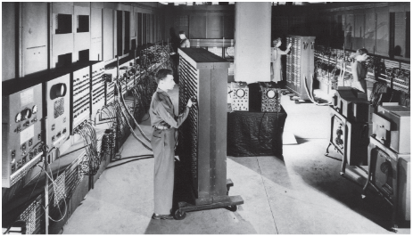
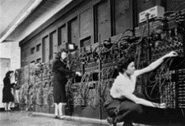
First Modern “Computer”
ENIAC: Electronic Numerical Integrator and Calculator
  Widely accepted to be the world’s first operational electronic, general-purpose computer
  Built by J. Presper Eckert and John Mauchly at the Moore School of the University of Pennsylvania
  Work started in 1943,
  operational during World
  War II, publicly disclosed
  after 1946
Fig. 1.12.1
Notes:
The first computer was designed for war (World War II, 1939-1945) for artillery calculation.

Slide 9

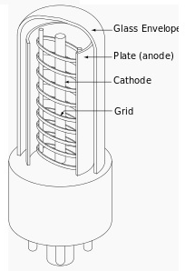
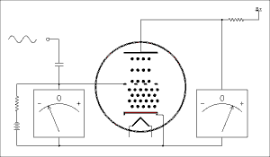
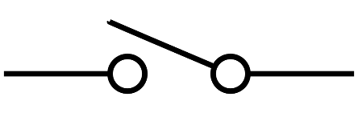
ENIAC
Size:
  80 feet long by 8.5 feet high, several feet wide
  20 10-digit registers, each 2 feet long
Programming:
  Manually by plugging cables and setting switches
Performance:
  1900 additions/sec
Technology:
  Vacuum tube (used 18,000
  vacuum tubes, which are
  electronic switches developed
  around 1906)
Anode
Control grid
Cathode
https://electronics.stackexchange.com/questions/156301/how-does-a-vacuum-tube-amplifier-work
Notes:
In 1907, De Forest invented the triode, which consists of three elements: a heater (or filament) surrounding a cathode, a plate (anode), and a control grid in the form of a spiral of wires or an open mesh (so the electrons can pass through) in between the cathode and plate. The cathode is heated by the filament and gives off electrons, which are attracted by the plate. If the voltage applied to the control grid is lowered below that of the cathode, the amount of current from the cathode to the plate is reduced.

Slide 10
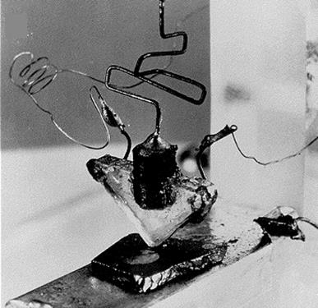
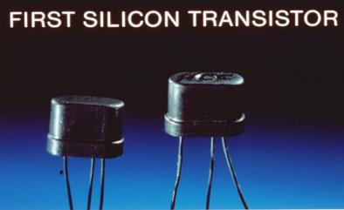
Transistors Were Invented at Same Time
W. Shockley, J. Bardeen, W. Brattain of Bell Lab. (1947)
  More reliable, smaller, faster than vacuum tubes
  Electronic switches in “solids”

Slide 11
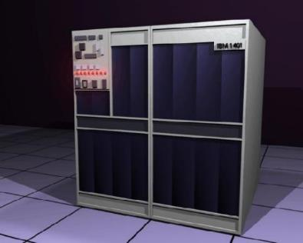
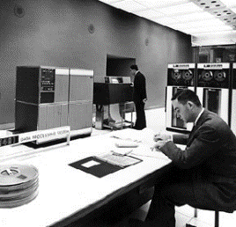
Computers Start Leveraging Transistors
Transistor computers: 2nd generation computers
  First operational transistor computer: Transistor Computer by Univ. of Manchester, operational in Nov. 1953
  Commercial transistor computers also appear soon after, e.g. IBM 1401 (1959)
Notes:
IBM is first in punched card and office automation business.
The 1401 is considered to be the Model-T Ford of the computer industry, because it was mass-produced and because of its sales volume. Over 12,000 units were produced and many were leased or resold after they were replaced with newer technology. The 1401 was withdrawn on February 8, 1971.

Slide 12
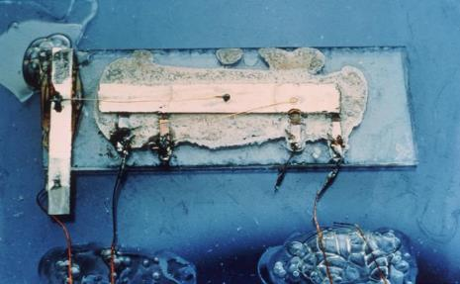
Another Technology Breakthrough: IC
Jack Kilby of Texas Instrument (1958):
  Integrated a transistor with resistors and capacitors on a single semiconductor chip, which is a monolithic IC
  Fast on-chip signal communication, smaller size, more reliable, easier to implement, cheaper
Moore’s law comes
into play
(2X transistors/chip
every 1.5~2 years)
  Shrinking transistors

Slide 13
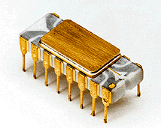
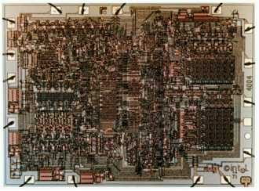
As IC Chips Scale …
We can put an entire processor onto a chip
  First microprocessor (μP): Intel 4004 (1971)
    108 KHz, 0.06 MIPS, 2300 transistors (10 microns)
  8-bit and 16-bit μP soon appeared, enabling
  low-cost, high-volume home/personal computers
  It is not until 32-bit μP developed in early 1980’s did we see μP-based computers entered main stream of computing
    Many architectural ideas were adopted
    to put a 32-bit μP on a chip of that time,
    e.g. RISC ISA, pipelining, cache, … (with
    techniques most developed in the 60’s)
    Other enablers: OS, compiler, IC design
    rules and automation, …
Why 32 bits?
Notes:
32-bit addressing space vs. 16-bit (64K locatons)

Slide 14
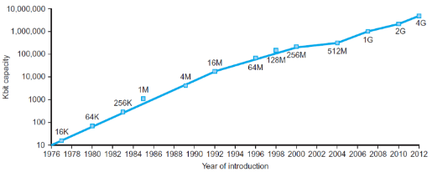
Importance of Technology Push
Electronics technology
continues to evolve
  Increased capacity and
  performance
  Reduced cost
DRAM capacity
Fig. 1.11
Fig. 1.10
Year | Technology in computer | Relative performance/cost
1951 | Vacuum tube | 1
1965 | Transistor | 35
1975 | Integrated circuit (IC) | 900
1995 | Very large scale IC (VLSI) | 2,400,000
2013 | Ultra large scale IC | 250,000,000,000
Notes:
This rate of increasing integration has been remarkably stable. Figure 1.11 shows the growth in DRAM capacity since 1977. For decades, the industry has consistently quadrupled capacity every 3 years, resulting in an increase in excess of 16,000 times

Slide 15
Technology and Architecture Evolution
1950s Vacuum tubes
1958 Transistors
1960s Integrated circuits
Disk storage
1970s Microprocessors
Semiconductor mem.
1980s-90s CMOS convergence
(smaller, faster, low
power, …)
1951 Index registers
1960 Memory protection (B5000)
1960 Demand paging
(Atlas)
1960s Deep pipelines
(IBM Stretch, CDC6600)
1960s Superscalar issue
Dynamic scheduling
Branch prediction
(CDC6600, IBM 360/95)
1968 Cache memory (360/85)

Slide 16
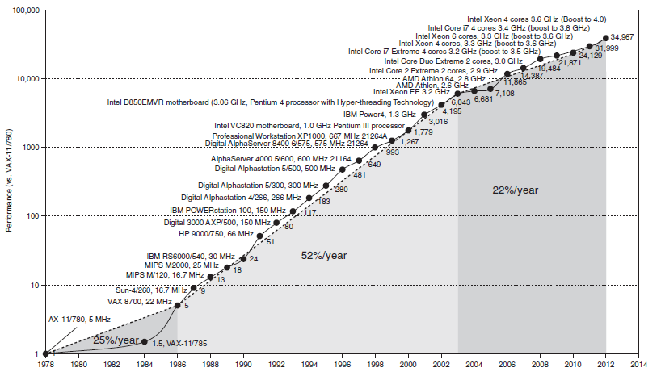
Arch. Innovations Ride Technology Scaling
Moore’s Law:
2X transistors/chip
every 1.5~2 years
Fig. 1.17

Slide 17
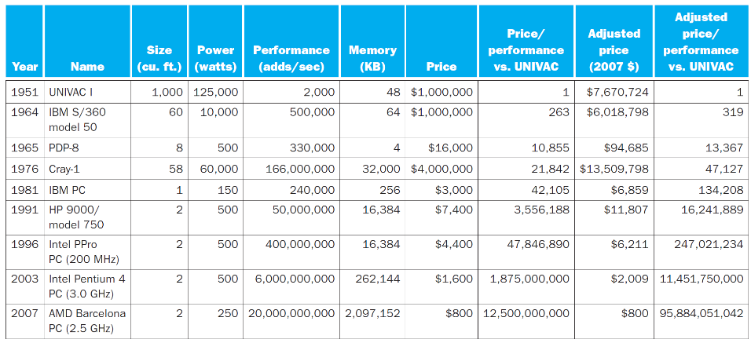
Comparison of Computers Since 1950
Fig. 1.12.7

Slide 18
Computers Are Now Pervasive
Classes of Computers:
  Personal computers
    General purpose, variety of software
    Subject to cost/performance tradeoff
  Server computers
    Network based, high capacity, performance, reliability
    Range from small servers to building sized
  Supercomputers
    High-end scientific and engineering calculations
    Highest capability but represent a small fraction of the overall computer market
  Embedded computers
    Hidden as components of systems
    Stringent power/performance/cost constraints

Slide 19
The PostPC Era
Personal Mobile Device (PMD)
  Battery operated
  Connects to the Internet
  Hundreds of dollars
  Smart phones, tablets, electronic glasses
Cloud computing
  Warehouse Scale Computers (WSC)
  Software as a Service (SaaS)
  Portion of software run on a PMD and a portion run in the Cloud
  Amazon and Google

Slide 20
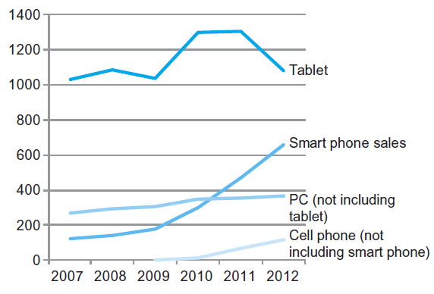
The PostPC Era
Fig. 1.2
Notes:
The number manufactured per year of tablets and smart phones, which reflect the post-PC era, versus personal computers and traditional cell phones. Smart phones represent the recent growth in the cell phone industry, and they passed PCs in 2011. Tablets
are the fastest growing category, nearly doubling between 2011 and 2012. Recent PCs and traditional cell phone categories are relatively flat or declining.

Slide 21
Technology and Computer Summary
Technology progresses:
Mechanic → electro-mechanic → electronic
(vacuum tube → transistor → integrated circuit)
  Size ↓
  Switching speed ↑
  Reliability ↑
  Power ↓
  Cost ↓
Also requires innovative architectural ideas to ride the technology scaling for computer advances
0-1 switch
Moore’s Law
2-fold effects of IC technology scaling on computer performance:
Faster without change of design
More transistors to implement new architecture features

Slide 22
Outline
Computer: a historical perspective (Sec. 1.1, 1.5)
  Technology affects computer development
  Great ideas in computer architecture require technology
Great ideas in computer architecture (Sec. 1.2)
Below your program (Sec. 1.3)
Under the covers (Sec. 1.4)
Technologies for building processors and memory (Sec. 1.5)
Performance (Sec. 1.6)
The power wall (Sec. 1.7)
From uniprocessors to multiprocessors (Sec. 1.8)

Slide 23




Eight Great Ideas in Computer Architecture
Design for Moore’s Law
  Very long computer design time → must anticipate the technology when the design finishes rather than starts
Use abstraction to simplify design (next page)
  To improve productivity → represent design with different levels and hide lower-level details with simpler models
Make the common case fast
  To make the most of limited resources, but need to
  know what the common case is
Performance via parallelism
  To improve throughput by doing things in parallel, but
  need to throw in multiple resources

Slide 24
An Example of Abstraction
Abstraction helps us deal with complexity
  Hide lower-level detail
Recall instruction set architecture (ISA)
  ISA: the hardware/software interface
  Application binary interface: ISA + system SW interface
  Implementation: details
  underlying an interface
Application
Operating
System
Compiler
Software
Assembler
Hardware
Processor
Memory
I/O System
Datapath & Control
Digital Design
Instruction Set Architecture (ISA)
Circuit Design
Transistors
Notes:
instruction set architecture
Also called architecture. An abstract interface between the hardware and the lowest-level software that encompasses all the information necessary to write a machine language program that will run correctly, including instructions, registers, memory access, I/O, and so on.

Slide 25




Eight Great Ideas in Computer Architecture
Performance via pipelining
  To improve throughput by subdividing a task and doing subtasks in cascade; requiring minimal resources
Performance via prediction
  To get head start, if can predict correctly most of time
  and cheap to recover from misprediction
Hierarchy of memories
  To provide an illusion of large, cheap, fast memory by leveraging program/data locality
Dependability via redundancy
  Include lower-cost, redundant components that can
  take over when a failure occurs and to help detect failures

Slide 26
Outline
Computer: a historical perspective
  Technology affects computer development
  Great ideas in computer architecture require technology
Great ideas in computer architecture (Sec. 1.2)
Below your program (Sec. 1.3)
Under the covers (Sec. 1.4)
Technologies for building processors and memory (Sec. 1.5)
Performance (Sec. 1.6)
The power wall (Sec. 1.7)
From uniprocessors to multiprocessors (Sec. 1.8)

Slide 27
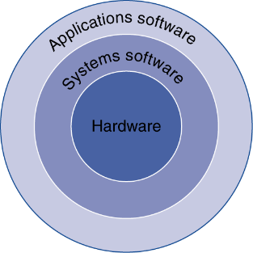
Below Your Program
Application software
  Written in high-level language
System software
  Compiler: translates HLL code to machine code
  Operating System: service code
    Handling input/output
    Managing memory and storage
    Scheduling tasks & sharing resources
Hardware
  Processor, memory, I/O controllers
Fig. 1.3
Notes:
application binary interface (ABI)
The user portion of the instruction set plus the operating system interfaces used by application programmers. It defines a standard for binary portability across computers.

Slide 28
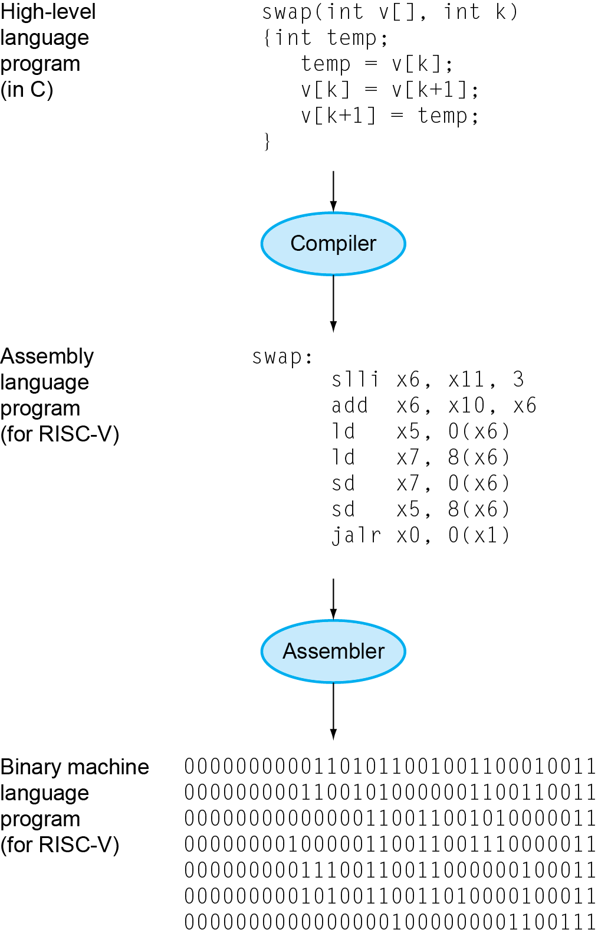
Levels of Program Code
High-level language
  Level of abstraction closer to
  problem domain
  Provides for productivity and
  portability
Assembly language
  Textual representation of
  instructions
Hardware representation
  Binary digits (bits)
  Encoded instructions and data
Fig. 1.4

Slide 29
Understanding Performance
Algorithm
  Determines number of operations executed
Programming language, compiler, architecture
  Determine number of machine instructions executed per operation
Processor and memory system
  Determine how fast instructions are executed
I/O system (including OS)
  Determines how fast I/O operations are executed

Slide 30
Outline
Computer: a historical perspective
  Technology affects computer development
  Great ideas in computer architecture require technology
Great ideas in computer architecture (Sec. 1.2)
Below your program (Sec. 1.3)
Under the covers (Sec. 1.4)
Technologies for building processors and memory (Sec. 1.5)
Performance (Sec. 1.6)
The power wall (Sec. 1.7)
From uniprocessors to multiprocessors (Sec. 1.8)

Slide 31
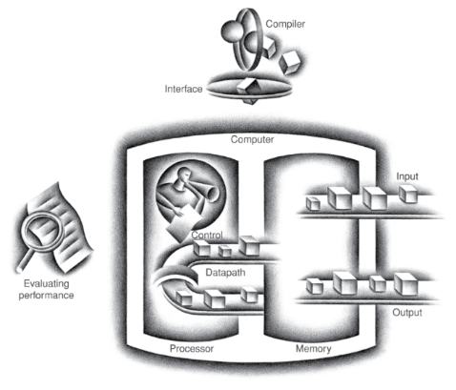
Components of a Computer
Same components for
all kinds of computer
  Desktop, server,
  embedded
Input/output includes
  User-interface devices
    Display, keyboard, mouse
  Storage devices
    Hard disk, CD/DVD, flash
  Network adapters
    For communicating with other computers
Fig. 1.5

Slide 32
Inside a Computer
CPU
Memory
Arithmetic Logic
Unit
Registers
Program
Instructions
Program Data
Registers
Control Unit
Registers
Registers
System BUS
Keyboard
Screen
Hard disk
(Prof. Jing-Jia Liou)

Slide 33
Central Processing Unit (CPU)
Control Unit
  A finite state machine (FSM)
  Retrieves and decodes program instructions
  Generate signals to coordinate computer operations: load/store registers, perform ALU functions, take branches, etc…
Arithmetic & Logic Unit (ALU)
  Performs mathematical operations
(Prof. Jing-Jia Liou)

Slide 34
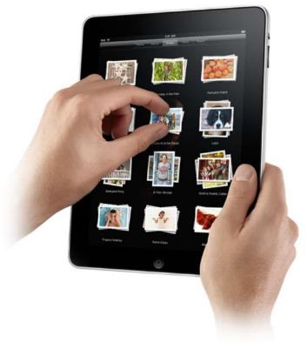
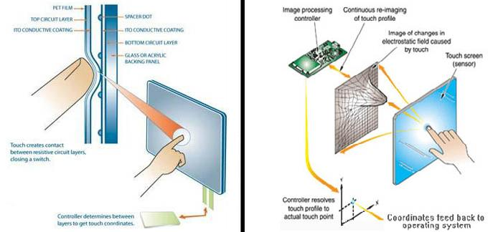
Touchscreen
PostPC device
Supersedes keyboard and mouse
Resistive and Capacitive types
  Tablets, smartphones use capacitive
  Capacitive allows multi-touch controls
(http://4.bp.blogspot.com/-DFIwFWSWuCc/UO0mRtFp3BI/AAAAAAAAC8Q/nRsDW1I0nBQ/s1600/resistive-touch-screen.jpg)
Notes:
Resistive touch screens consists of several very thin layers. When someone presses the touch panel, the top layer bends to make contact with the bottom layer, closing a circuit and causing a current loop. Resistive touch screens can generally only be used as a single-touch device, but they cost less to make and incorporate into your application and respond to any type of touch.
Capacitive touch screens are commonly made of two layers (a surface insulator and a transparent conductive layer beneath it). Since the human body itself is an electrical conductor, when the touch panel is touched with a finger (or a conductive pen), the electrostatic field of the panel is distorted. The touchscreen’s controller is able to tell where this distortion is on the touch screen and sends instructions to the rest of the system accordingly. Capacitive touch screens accept “Multi-touch” controls and require less physical force to register a touch.

Slide 35
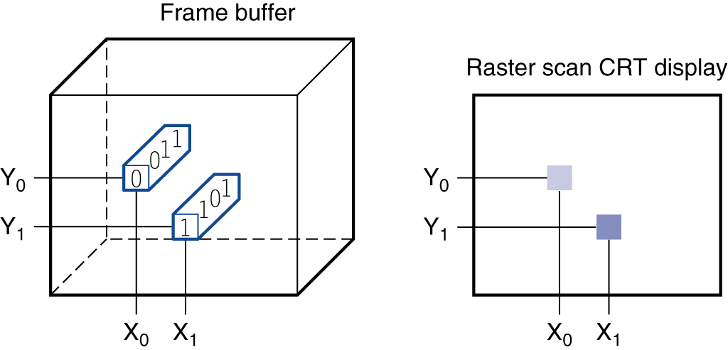
Through the Looking Glass
LCD screen: picture elements (pixels)
  Mirrors content of frame buffer memory
Fig. 1.6
(LCD working principle: http://www.npeducations.com/2012/07/liquid-crystal-display-and-its-internal.html)
Notes:
liquid crystal display (LCD): A display technology using a thin layer of liquid polymers that can be used to transmit or block light according to whether a charge is applied. (http://www.npeducations.com/2012/07/liquid-crystal-display-and-its-internal.html)
active matrix display: A liquid crystal display using a transistor to control the transmission of light at each individual pixel. (TFT (thin-film transistor) technology)
https://www.tomshardware.co.uk/lcd-led-led-oled-panel-difference,review-34522.html

Slide 36
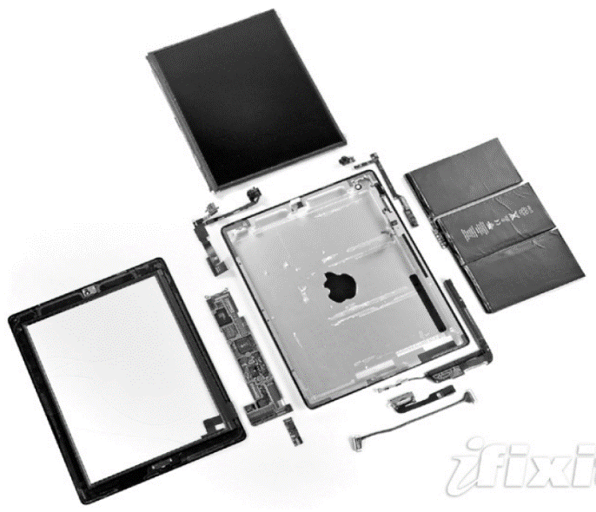
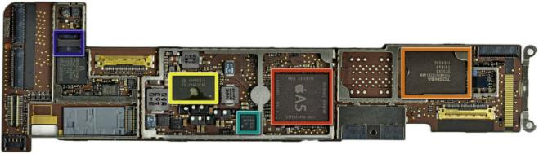
Opening the Box (Apple iPad 2)
Capacitive multitouch LCD screen
3.8 V, 25 Watt-hour battery
Computer board
Fig. 1.8
Fig. 1.7
Notes:
The tiny rectangle below the logic board contains a chip that provides wireless communication: Wi-Fi, Bluetooth, and FM tuner. It fits into a small slot in the lower left corner of the logic board.
Near the upper left corner of the case is another L-shaped component, which is a front-facing camera assembly that includes the camera, headphone jack,
and microphone.
Near the right upper corner of the case is the board containing the volume control and silent/screen rotation lock button along with a gyroscope and accelerometer. These last two chips combine to allow the iPad to recognize six-axis motion.
The tiny rectangle next to it is the rear-facing camera.
Near the bottom right of the case is the L-shaped speaker assembly.
The cable at the bottom is the connector between the logic board and the camera/volume control board.
The board between the cable and the speaker assembly is the controller for the capacitive touchscreen.
Apple A5 chip (red box), which contains dual ARM processor cores that run at 1 GHz as well as 512 MB of main memory.
32 GB flash memory chip (orange box) for non-volatile storage
Power controller and I/O controller chips (yellow box)

Slide 37
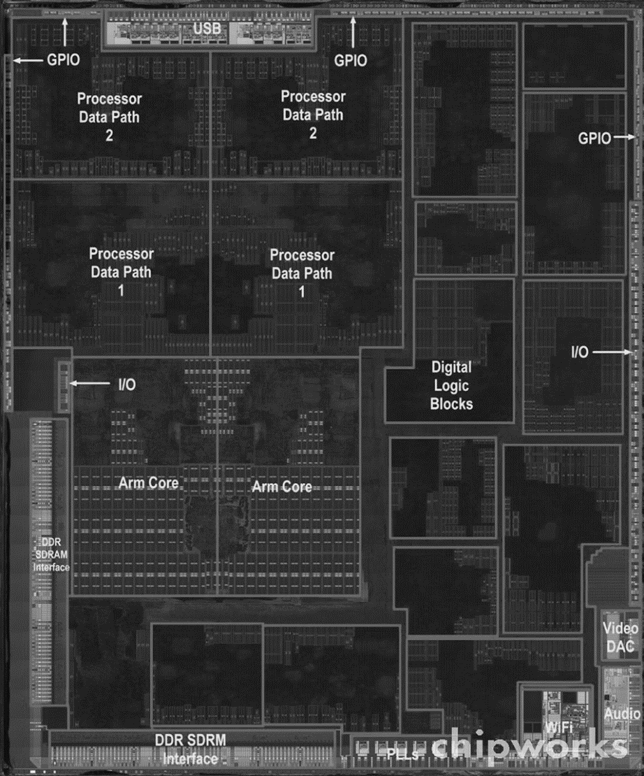
Inside the Processor (CPU)
Dual ARM cores + GPU
  Datapath: performs operations
  on data
  Control: sequences datapath,
  memory, ...
Cache memory
  Small fast SRAM memory for
  immediate access to data
DRAM
  Dynamic random access
  memory
Fig. 1.9
Apple A5
Notes:
Two identical ARM processors or cores in the middle left of the chip and a PowerVR graphics processing unit (GPU) with four datapaths in
the upper left quadrant. To the left and bottom side of the ARM cores are interfaces to main memory (DRAM).

Slide 38
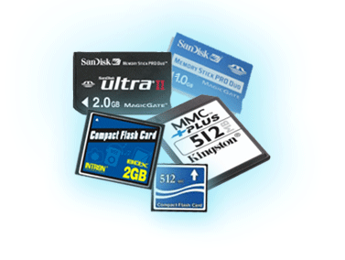
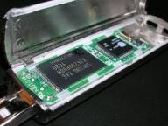
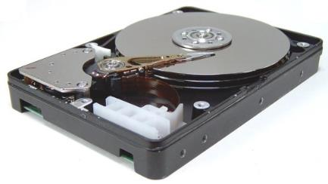
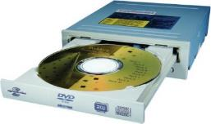
A Safe Place for Data
Volatile main memory (DRAM)
  Loses instructions and data when power off
Non-volatile secondary memory
  Magnetic disk
  Flash memory
  Optical disk (CDROM, DVD)

Slide 39
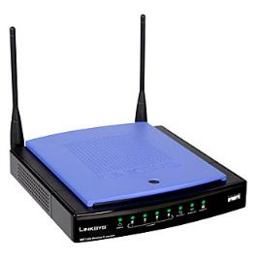
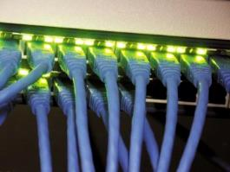
Networks
Communication, resource sharing, nonlocal access
Local area network (LAN): Ethernet
Wide area network (WAN): the Internet
Wireless network: WiFi, Bluetooth, wireless broadbad

Slide 40
Outline
Computer: a historical perspective
  Technology affects computer development
  Great ideas in computer architecture require technology
Great ideas in computer architecture (Sec. 1.2)
Below your program (Sec. 1.3)
Under the covers (Sec. 1.4)
Technologies for building processors and memory (Sec. 1.5)
Performance (Sec. 1.6)
The power wall (Sec. 1.7)
From uniprocessors to multiprocessors (Sec. 1.8)

Slide 41
Semiconductor Technology
IC technology affects computer designs
  Shapes what computers will be able to do and how quickly they will evolve
How computer design affects IC implementation?
Need to understand chip manufacturing
  Silicon: basic element, does not conduct electricity well
  → semiconductor
  Can add materials to allow tiny areas to transform into one of three devices: conductors, insulators, switches
  IC manufacturing process is critical to the cost of the chips and hence important to computer designers

Slide 42
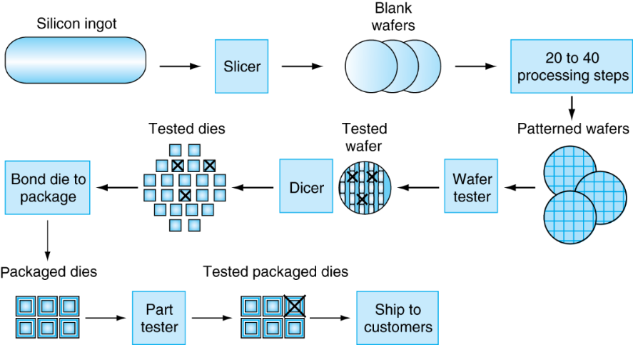
Manufacturing ICs
Fig. 1.12
Yield: proportion of working dies per wafer
Notes:
Today, ingots are 8–12 inches in diameter and about 12–24 inches long. An ingot is finely sliced into wafers no more than 0.1 inches thick. Th ese wafers then go through a series of processing steps, during which patterns of chemicals are placed on each wafer, creating the transistors, conductors, and insulators discussed earlier. Today’s integrated circuits contain only one layer of transistors but may have from two to eight levels of metal conductor, separated by layers of insulators.

Slide 43
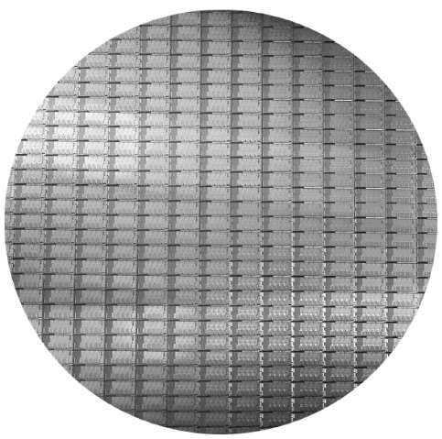
Intel Core i7 Wafer
12-inch (300mm) wafer, 280 chips, 32nm technology
Each chip is 20.7 x 10.5 mm
Fig. 1.13

Slide 44
Integrated Circuit Cost
Nonlinear relation to area and defect rate
  Wafer cost and area are fixed
  Defect rate determined by manufacturing process
  Die area is determined by architecture and circuit design

Slide 45
Big Picture
Abstraction Layers
Application
Algorithm
Software
ISA
Microarchitecture
Circuit
Transistor
(Prof. Jing-Jia Liou)

Slide 46
Abstractions
Abstraction helps us deal with complexity
  Hide lower-level detail
Instruction set architecture (ISA)
  The hardware/software interface
Application binary interface (ABI)
  The ISA plus system software interface
Implementation (microarchitecture)
  The details underlying and interface
(Prof. Jing-Jia Liou)

