Slide 1
EE2310 Introduction to Programming – Lecture 6
Scott CH Huang

Slide 2
Arrays
An array is a group of contiguous memory locations that all have the same type.
To refer to a particular location or element in the array, we specify the array’s name and the position number of the particular element in the array.
Figure 6.1 shows an integer array called c, containing 12 elements.
Any one of these elements may be referred to by giving the array’s name followed by the position number of the particular element in square brackets ([]).

Slide 3
A 12-element Array

Slide 4
Arrays
The first element in every array is the zeroth element.
An array, like other variable names, can contain only letters, digits and underscores and cannot begin with a digit.
The position number within square brackets is called a subscript.
A subscript must be an integer or an integer expression.

Slide 5
Arrays
For example, if a = 5 and b = 6, then the statement
c[ a + b ] += 2;
adds 2 to array element c[11].
A subscripted array name is an lvalue—it can be used on the left side of an assignment.

Slide 6
Arrays
The array’s name is c.
Its 12 elements are referred to as c[0], c[1], c[2], …, c[10] and c[11].
The value stored in c[0] is –45, the value of c[1] is 6, c[2] is 0, c[7] is 62 and c[11] is 78.
To print the sum of the values contained in the first three elements of array c, we’d write
printf( "%d", c[ 0 ] + c[ 1 ] + c[ 2 ] );
To divide the value of element 7 of array c by 2 and assign the result to the variable x, write

Slide 7
Arrays
The brackets used to enclose the subscript of an array are actually considered to be an operator in C.
They have the same level of precedence as the function call operator (i.e., the parentheses that are placed after a function name to call that function).
Figure 6.2 shows the precedence and associativity of the operators introduced to this point in the text.

Slide 8
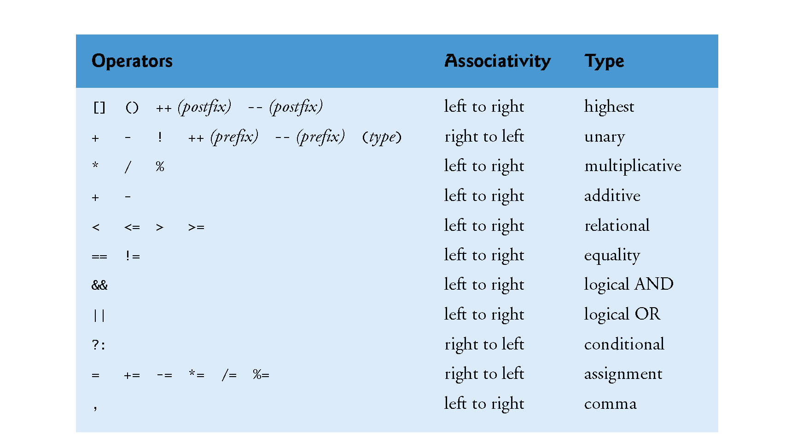
Operator Precedence and Associativity

Slide 9
Defining Arrays
Arrays occupy space in memory.
You specify the type of each element and the number of elements each array requires so that the computer may reserve the appropriate amount of memory.
The following definition reserves 12 elements for integer array c, which has subscripts in the range 0-11.
int c[ 12 ];

Slide 10
Defining Arrays
The definition
int b[ 100 ], x[ 27 ];
reserves 100 elements for integer array b and 27 elements for integer array x.
These arrays have subscripts in the ranges 0–99 and 0–26, respectively.
Arrays may contain other data types.
Character strings and their similarity to arrays are discussed in Chapter 8. The relationship between pointers and arrays is discussed in Chapter 7.

Slide 11
Array Examples
Defining an Array and Using a Loop to Initialize the Array’s Elements
Like any other variables, uninitialized array elements contain garbage values.
Figure 6.3 uses for statements to initialize the elements of a 10-element integer array n to zeros and print the array in tabular format.
The first printf statement (line 16) displays the column heads for the two columns printed in the subsequent for statement.

Slide 12
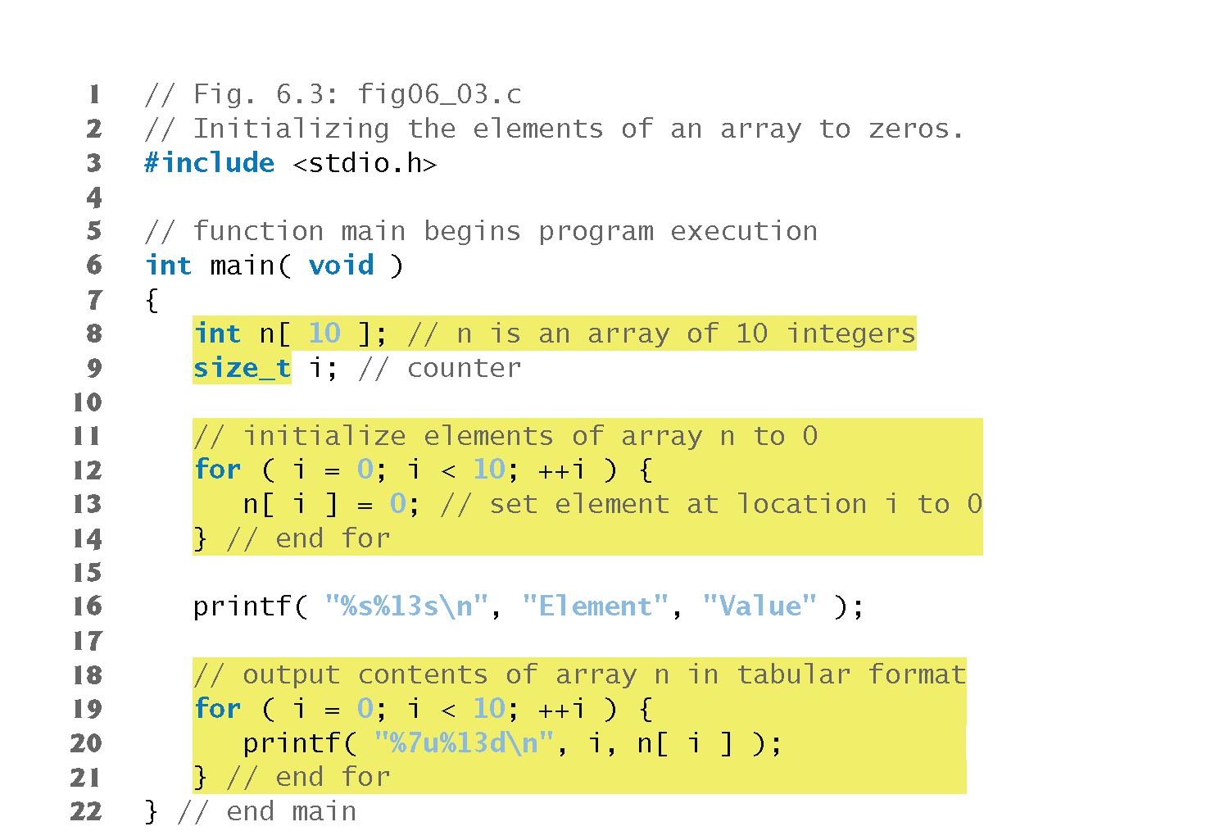
Initializing an Array

Slide 13
Initializing an Array

Slide 14
Array Examples
Notice that the variable i is declared to be of type size_t (line 9), which according to the C standard represents an unsigned integral type.
This type is recommended for any variable that represents an array’s size or an array’s subscripts.
Type size_t is defined in header <stddef.h>, which is often included by other headers (such as <stdio.h>).
[Note: If you attempt to compile Fig. 6.3 and receive errors, simply include <stddef.h> in your program.]

Slide 15
Initializing an Array w/ an Initializer List
The elements of an array can also be initialized when the array is defined by following the definition with an equals sign and braces, {}, containing a comma-separated list of array initializers.
Figure 6.4 initializes an integer array with 10 values (line 9) and prints the array in tabular format.

Slide 16
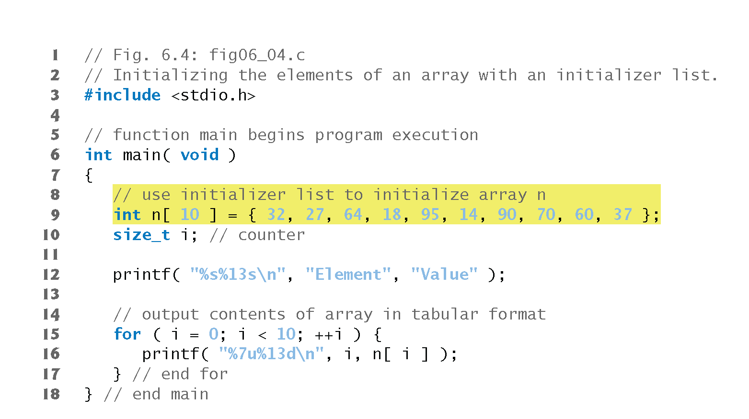
Initializing an Array w/ an Initializer List

Slide 17
Initializing an Array w/ an Initializer List

Slide 18
Array Examples
If there are fewer initializers than elements in the array, the remaining elements are initialized to zero.
For example, the elements of the array n in Fig. 6.3 could have been initialized to zero as follows:
// initializes entire array to zeros
int n[ 10 ] = { 0 };
This explicitly initializes the first element to zero and initializes the remaining nine elements to zero because there are fewer initializers than there are elements in the array.

Slide 19
Array Examples
It’s important to remember that arrays are not automatically initialized to zero.
You must at least initialize the first element to zero for the remaining elements to be automatically zeroed.
Array elements are initialized before program startup for static arrays and at runtime for automatic arrays.

Slide 20
Array Examples
The array definition
int n[ 5 ] = { 32, 27, 64, 18, 95, 14 };
causes a syntax error because there are six initializers and only five array elements.

Slide 21
Array Examples
If the array size is omitted from a definition with an initializer list, the number of elements in the array will be the number of elements in the initializer list.
For example,
int n[] = { 1, 2, 3, 4, 5 };
would create a five-element array initialized with the indicated values.

Slide 22
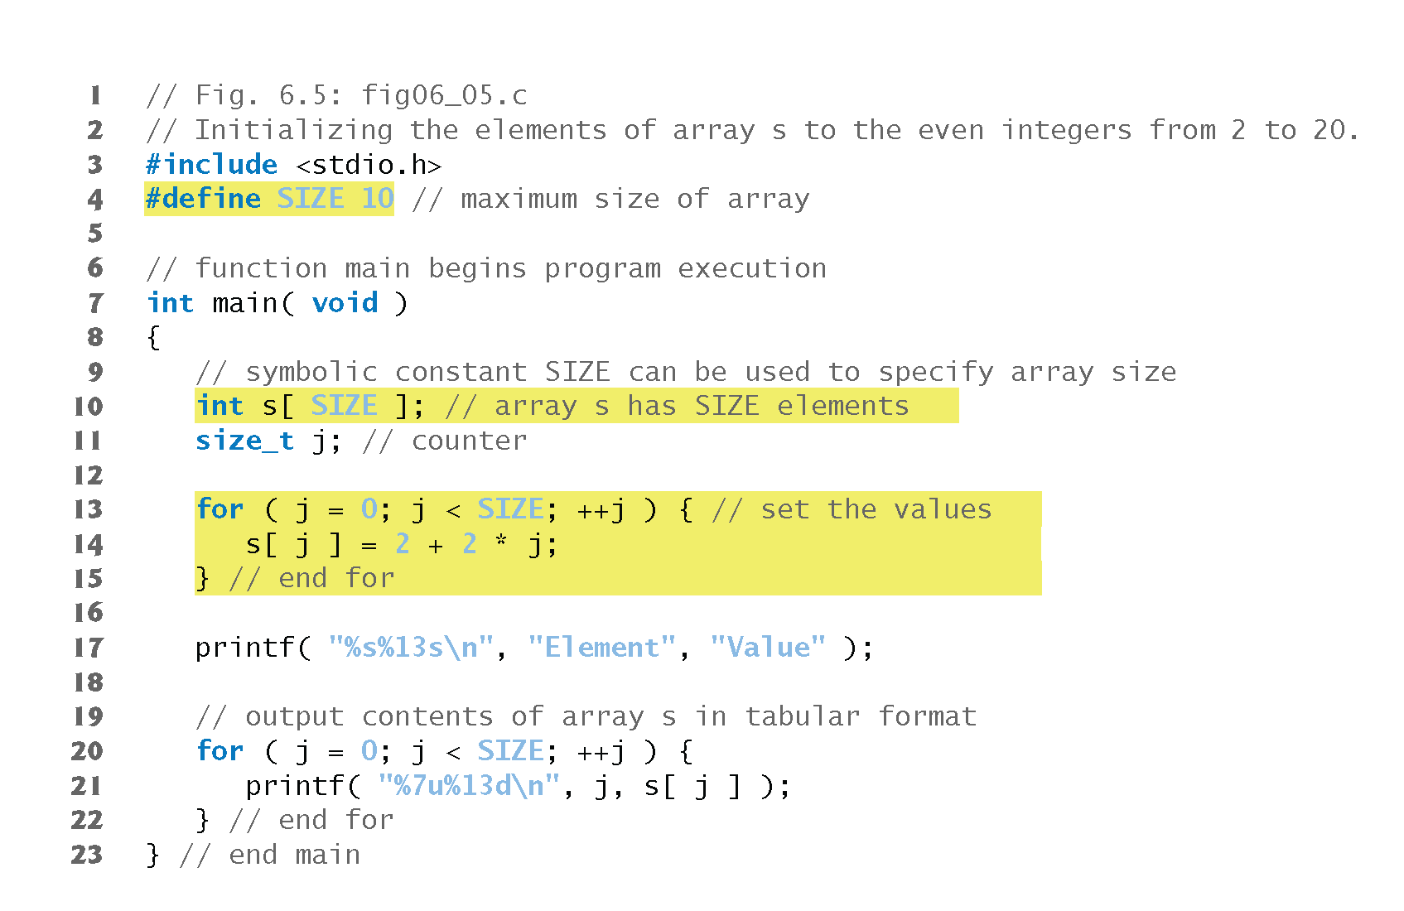
Initializing an Array

Slide 23
Initializing an Array

Slide 24
Array Examples
The #define preprocessor directive is introduced in this program.
Line 4
#define SIZE 10
defines a symbolic constant SIZE whose value is 10.
A symbolic constant is an identifier that’s replaced with replacement text by the C preprocessor before the program is compiled.

Slide 25
Array Examples
When the program is preprocessed, all occurrences of the symbolic constant SIZE are replaced with the replacement text 10.
Using symbolic constants to specify array sizes makes programs more scalable.
We could have the first for loop (line 13) fill a 1000-element array by simply changing the value of SIZE in the #define directive from 10 to 1000.
If the symbolic constant SIZE had not been used, we’d have to change the program in three separate places.

Slide 26
Array Examples
If the #define preprocessor directive in line 4 is terminated with a semicolon, the preprocessor replaces all occurrences of the symbolic constant SIZE in the program with the text 10;.

Slide 27
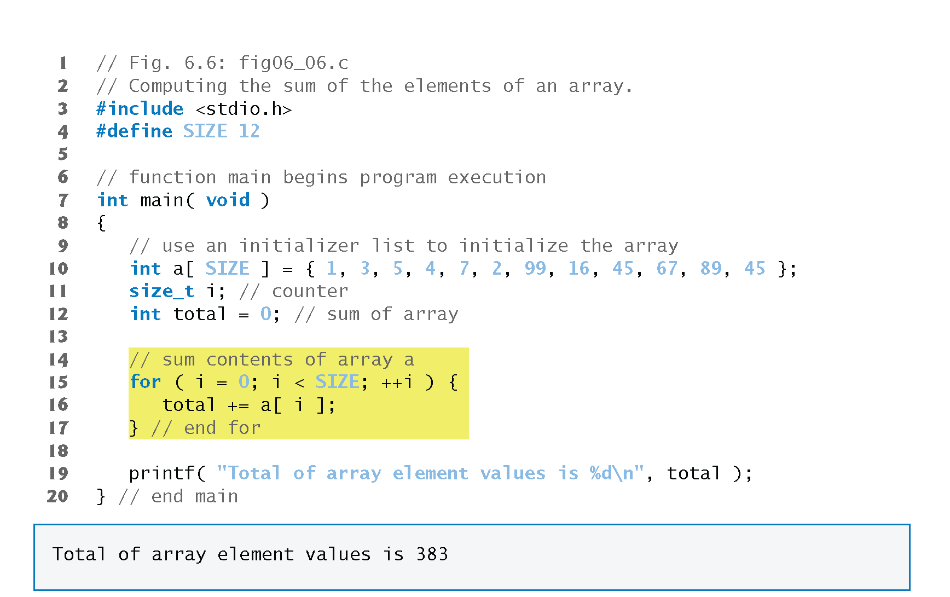
Summing the Elements of an Array

Slide 28
Using Arrays to Summarize Survey Results
Our next example uses arrays to summarize the results of data collected in a survey.
Consider the problem statement.
Forty students were asked to rate the quality of the food in the student cafeteria on a scale of 1 to 10 (1 means awful and 10 means excellent). Place the 40 responses in an integer array and summarize the results of the poll.
We wish to summarize the number of responses of each type (i.e., 1 through 10).

Slide 29
Array Examples
The array responses (line 17) is a 40-element array of the students’ responses.
We use an 11-element array frequency (line 14) to count the number of occurrences of each response.
We ignore frequency[0] because it’s logical to have response 1 increment frequency[1] rather than frequency[0].
This allows us to use each response directly as the subscript in the frequency array.

Slide 30
Analyzing a Student Poll

Slide 31
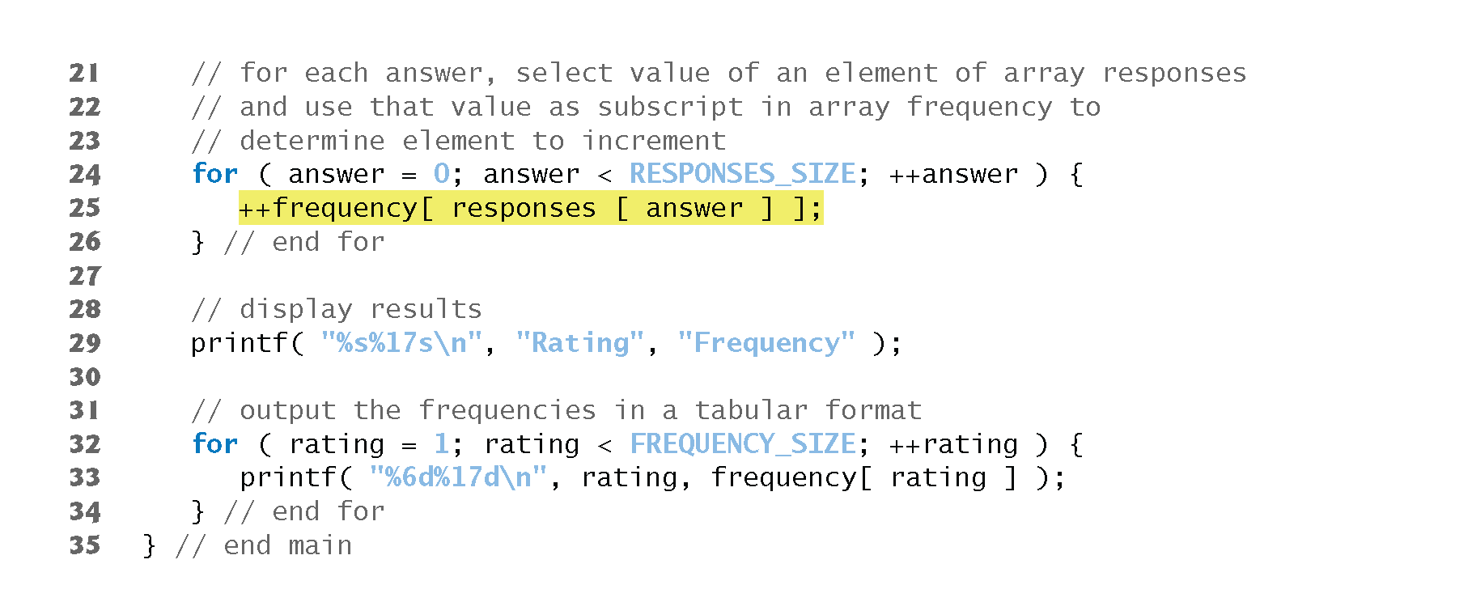
Analyzing a Student Poll

Slide 32
Analyzing a Student Poll

Slide 33
Analyzing a Student Poll
The for loop (line 24) takes the responses one at a time from the array responses and increments one of the 10 counters (frequency[1] to frequency[10]) in the frequency array.
The key statement in the loop is line 25
++frequency[ responses[ answer ] ];
which increments the appropriate frequency counter depending on the value of responses[answer].

Slide 34
Analyzing a Student Poll
When the counter variable answer is 0, responses[answer] is 1, so ++frequency[ responses[answer]]; is interpreted as
++frequency[ 1 ];
which increments array element one.
When answer is 1, responses[answer] is 2, so ++frequency[responses[answer]]; is interpreted as
++frequency[ 2 ];
which increments array element two.

Slide 35
Analyzing a Student Poll
When answer is 2, responses[answer] is 6, so ++frequency[responses[answer]]; is interpreted as
++frequency[ 6 ];
which increments array element six, and so on.
Regardless of the number of responses processed in the survey, only an 11-element array is required (ignoring element zero) to summarize the results.
If the data contained invalid values such as 13, the program would attempt to add 1 to frequency[13].
This would be outside the bounds of the array.

Slide 36
Analyzing a Student Poll
C has no array bounds checking to prevent the program from referring to an element that does not exist.
Thus, an executing program can “walk off” either end of an array without warning—a security problem that we will discuss later.
You should ensure that all array references remain within the bounds of the array.

Slide 37
Graphing Array Element Values with Histograms
Our next example reads numbers from an array and graphs the information in the form of a bar chart or histogram—each number is printed, then a bar consisting of that many asterisks is printed beside the number.
The nested for statement (line 20) draws the bars.
Note the use of puts( "" ) to end each histogram bar (line 24).

Slide 38
Displaying a Histogram

Slide 39
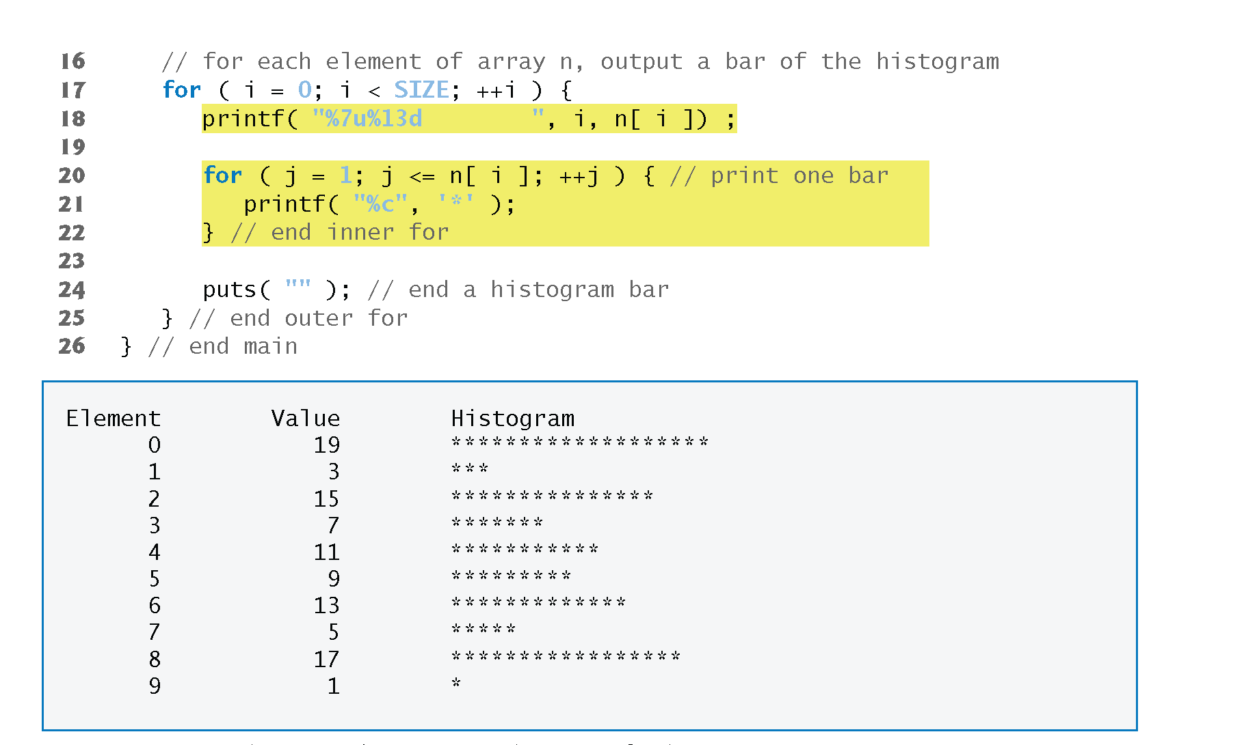
Displaying a Histogram

Slide 40
Rolling a Die 6,000,000 Times and Summarizing the Results in an Array
Roll a single six-sided die 6,000,000 times to test whether the random number generator actually produces random numbers.
An array version of this program is shown on the next few pages.

Slide 41
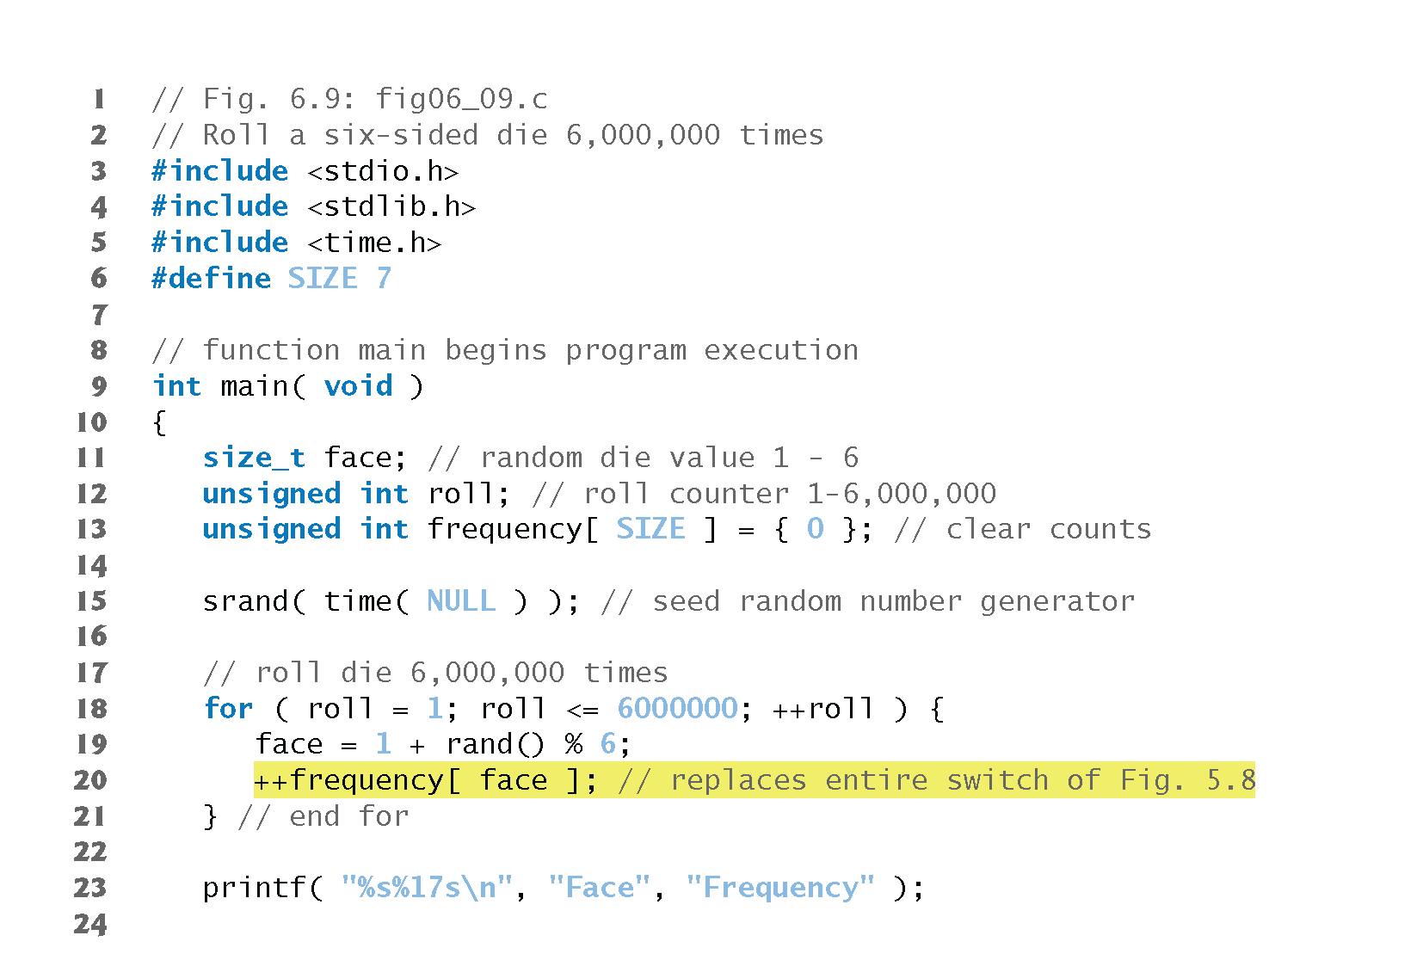
Roll a Die 6,000,000 times

Slide 42
Roll a Die 6,000,000 times

Slide 43
Using Character Arrays to Store and Manipulate Strings
So far, the only string-processing capability we have is outputting a string with printf.
A string such as "hello" is really an array of individual characters in C.
A character array can be initialized using a string literal.
For example, char string1[] = "first";
initializes the elements of array string1 to the individual characters in the string literal "first".

Slide 44
Using Character Arrays to Store and Manipulate Strings
In this case, the size of array string1 is determined by the compiler based on the length of the string.
The string "first" contains five characters plus a special string-termination character called the null character.
Thus, array string1 actually contains six elements.
The character constant representing the null character is '\0'. All strings in C end with this character.
A character array representing a string should always be defined large enough to hold the number of characters in the string and the terminating null character.
Character arrays also can be initialized with individual character constants in an initializer list, but this can be tedious.

Slide 45
Array Examples
The preceding definition is equivalent to
char string1[] = { 'f', 'i', 'r', 's', 't', '\0' };
Because a string is really an array of characters, we can access individual characters in a string directly using array subscript notation.
For example, string1[0] is the character 'f' and string1[3] is the character 's'.
We also can input a string directly into a character array from the keyboard using scanf and the conversion specifier %s.

Slide 46
Array Examples
For example, char string2[ 20 ];
creates a character array capable of storing a string of at most 19 characters and a terminating null character.
The statement scanf( "%19s", string2 ); reads a string from the keyboard into string2.
The name of the array is passed to scanf without the preceding & used with nonstring variables.
The & is normally used to provide scanf with a variable’s location in memory so that a value can be stored there.

Slide 47
Array Examples
When we discuss passing arrays to functions, we’ll see that the value of an array name is the address of the start of the array; therefore, the & is not necessary.
Function scanf will read characters until a space, tab, newline or end-of-file indicator is encountered.
The string2 should be no longer than 19 characters to leave room for the terminating null character.
If the user types 20 or more characters, your program may crash or create a security vulerability.
For this reason, we used the conversion specifier %19s so that scanf reads a maximum of 19 characters and does not write characters into memory beyond the end of the array string2.

Slide 48
Array Examples
It’s your responsibility to ensure that the array into which the string is read is capable of holding any string that the user types at the keyboard.
Function scanf does not check how large the array is.
Thus, scanf can write beyond the end of the array.

Slide 49
Array Examples
A character array representing a string can be output with printf and the %s conversion specifier.
The array string2 is printed with the statement
printf( "%s\n", string2 );
Function printf, like scanf, does not check how large the character array is.
The characters of the string are printed until a terminating null character is encountered.

Slide 50
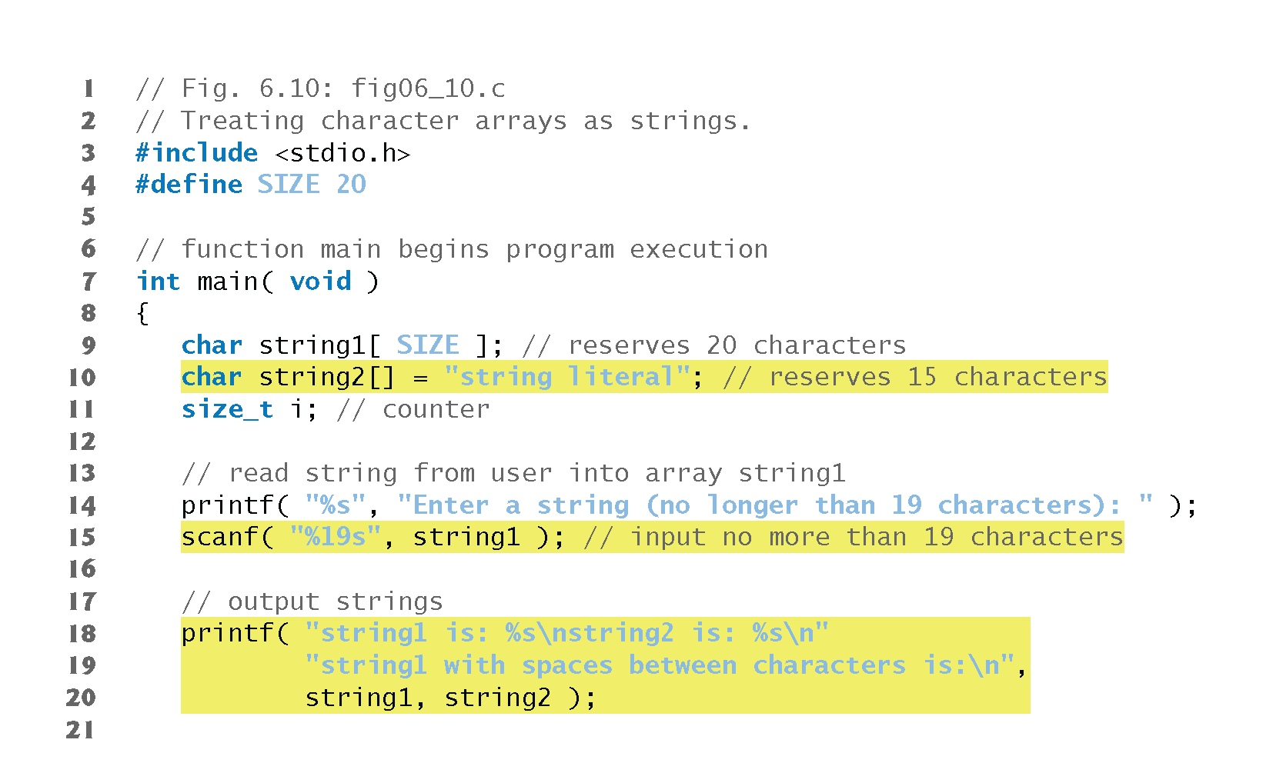
Treating Character Arrays as Strings

Slide 51
Treating Character Arrays as Strings

Slide 52
Static Local Arrays and Automatic Local Arrays
A static local variable exists for the duration of the program but is visible only in the function body.
We can apply static to a local array definition so the array is not created and initialized each time the function is called and the array is not destroyed each time the function is exited in the program.
This reduces program execution time, particularly for programs with frequently called functions that contain large arrays.

Slide 53
Static Local Arrays and Automatic Local Arrays
Arrays that are static are initialized once at program startup.
If you do not explicitly initialize a static array, that array’s elements are initialized to zero by default.
In the next example, there are a function staticArrayInit (lines 21-40) with a local static array (line 24) and another function automaticArrayInit (lines 43-62) with a local automatic array (line 46).
Function staticArrayInit is called twice (lines 12 and 16).
The local static array in the function is initialized to zero before program startup (line 24).
The function prints the array, adds 5 to each element and prints the array again.

Slide 54
Static Local Arrays and Automatic Local Arrays
The second time the function is called, the static array contains the values stored during the first function call.
Function automaticArrayInit is also called twice (lines 13 and 17).
The elements of the automatic local array in the function are initialized with the values 1, 2 and 3 (line 46).
The function prints the array, adds 5 to each element and prints the array again.
The second time the function is called, the array elements are initialized to 1, 2 and 3 again because the array has automatic storage duration.

Slide 55
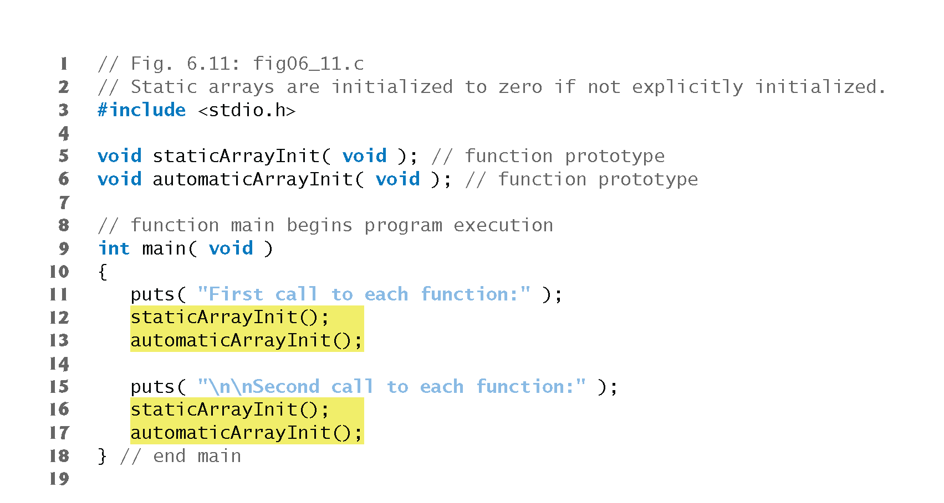
Static Arrays not Explicitly Initialized

Slide 56
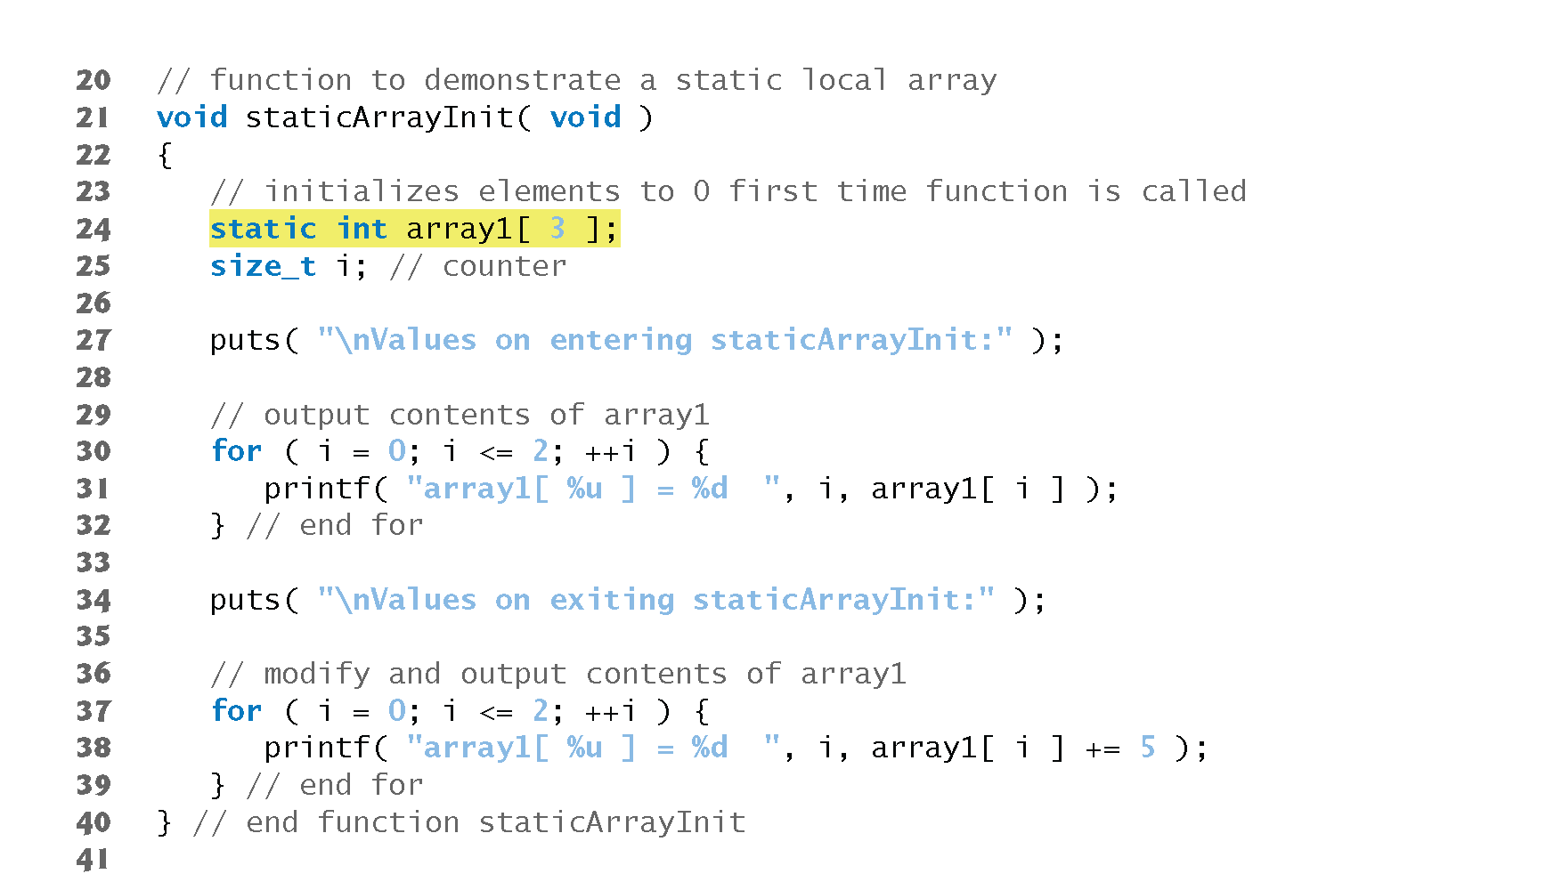
Static Arrays not Explicitly Initialized

Slide 57
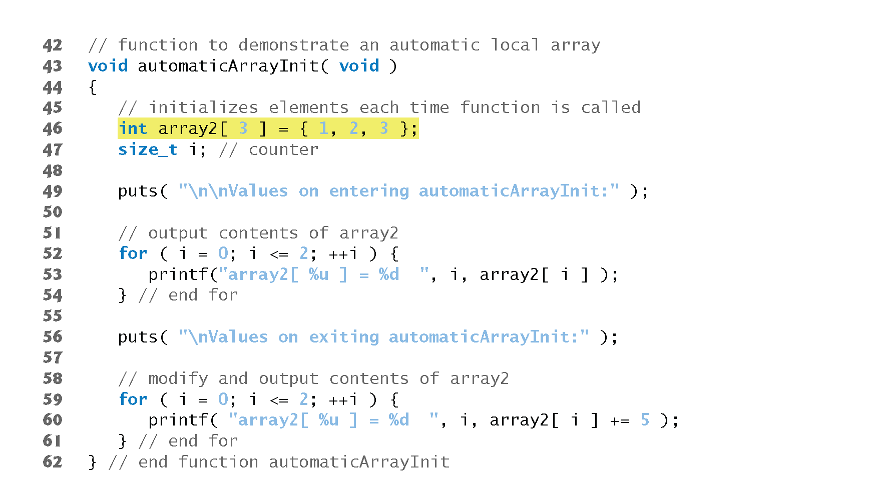
Static Arrays not Explicitly Initialized

Slide 58
Static Arrays not Explicitly Initialized

Slide 59
Static Arrays not Explicitly Initialized

Slide 60
Passing Arrays to Functions
To pass an array argument to a function, specify the array’s name without any brackets.
For example, if array hourlyTemperatures has been defined as int hourlyTemperatures[ HOURS_IN_A_DAY ];
the function call modifyArray( hourlyTemperatures, HOURS_IN_A_DAY )
passes array hourlyTemperatures and its size to function modifyArray.

Slide 61
Passing Arrays to Functions
C automatically passes arrays to functions by reference (to be explained later)—the called functions can modify the element values in the callers’ original arrays.
The name of the array evaluates to the address of the first element of the array.
Because the starting address of the array is passed, the called function knows precisely where the array is stored.

Slide 62
Passing Arrays to Functions
Therefore, when the called function modifies array elements in its function body, it’s modifying the actual elements of the array in their original memory locations.
An array name is really the address of the first element of the array. We print array, &array[0] and &array using the %p conversion specifier—a special conversion specifier for printing addresses.
The %p conversion specifier normally outputs addresses as hexadecimal numbers, but this is compiler dependent.

Slide 63
Passing Arrays to Functions
Hexadecimal (base 16) numbers consist of the digits 0 through 9 and the letters A through F (these letters are the hexadecimal equivalents of the numbers 10–15).
The output shows that array, &array and &array[0] have the same value, namely 0012FF78.

Slide 64
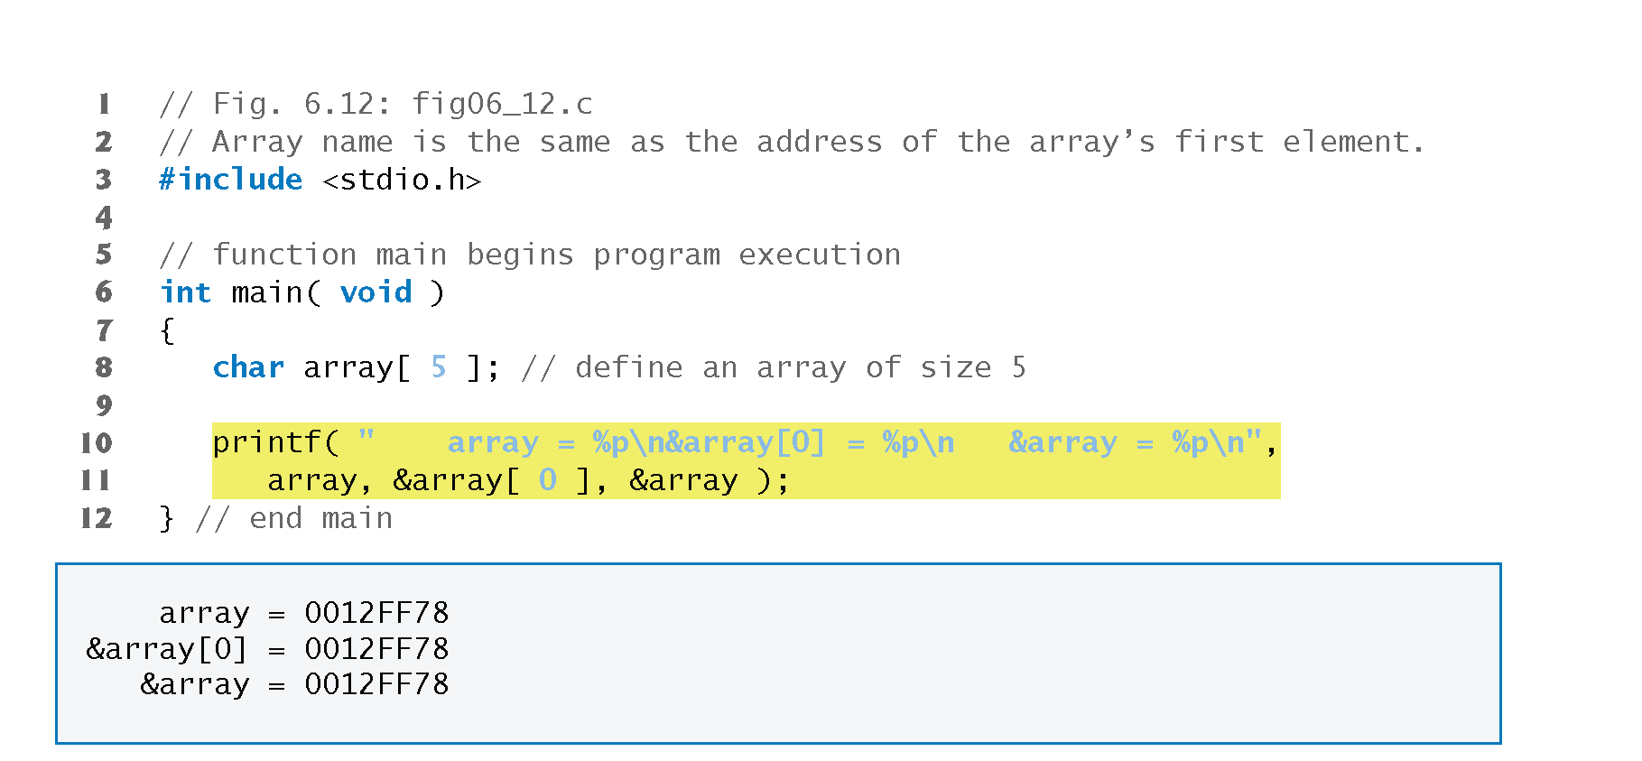
Array Names are Pointers

Slide 65
Passing Arrays to Functions
Although entire arrays are passed by reference, individual array elements are passed by value exactly as simple variables are.
Such simple single pieces of data (such as individual ints, floats and chars) are called scalars.
To pass an element of an array to a function, use the subscripted name of the array element as an argument in the function call.
We will also show how to pass scalars (i.e., individual variables and array elements) to functions by reference later.

Slide 66
Passing Arrays to Functions
For a function to receive an array through a function call, the function’s parameter list must specify that an array will be received.
For example, the function header for function modifyArray (that we called earlier in this section) might be written as void modifyArray( int b[], int size )
indicating that modifyArray expects to receive an array of integers in parameter b and the number of array elements in parameter size.
The size of the array is not required between the array brackets.

Slide 67
Passing Arrays to Functions
If it’s included, the compiler checks that it’s greater than zero, then ignores it.
Specifying a negative size is a compilation error.
Because arrays are automatically passed by reference, when the called function uses the array name b, it will be referring to the array in the caller (array hourlyTemperatures in the preceding call).

Slide 68
Difference Between Passing an Entire Array and Passing an Array Element
The program first prints the five elements of integer array a (lines 20–22).
Next, a and its size are passed to function modifyArray (line 27), where each of a’s elements is multiplied by 2 (lines 53–55).
Then a is reprinted in main (lines 32–34).

Slide 69
Difference Between Passing an Entire Array and Passing an Array Element
As the output shows, the elements of a are indeed modified by modifyArray.
Now the program prints the value of a[3] (line 38) and passes it to function modifyElement (line 40).
Function modifyElement multiplies its argument by 2 (line 63) and prints the new value.
When a[3] is reprinted in main (line 43), it has not been modified, because individual array elements are passed by value.

Slide 70
Passing Arrays to Functions
There may be situations in your programs in which a function should not be allowed to modify array elements.
C provides the type qualifier const (for “constant”) that can be used to prevent modification of array values in a function.
When an array parameter is preceded by the const qualifier, the array elements become constant in the function body, and any attempt to modify an element of the array in the function body results in a compile-time error.
This enables you to correct a program so it does not attempt to modify array elements.

Slide 71
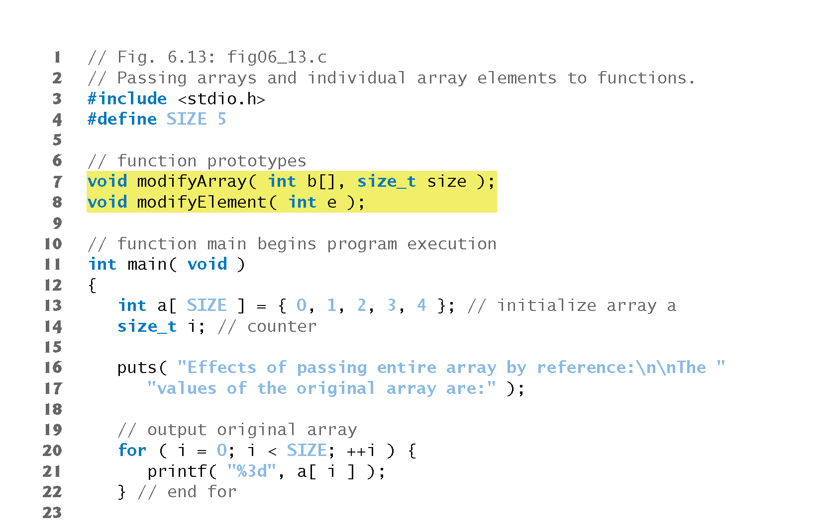
Passing Arrays and Individual Array Elements to Functions

Slide 72
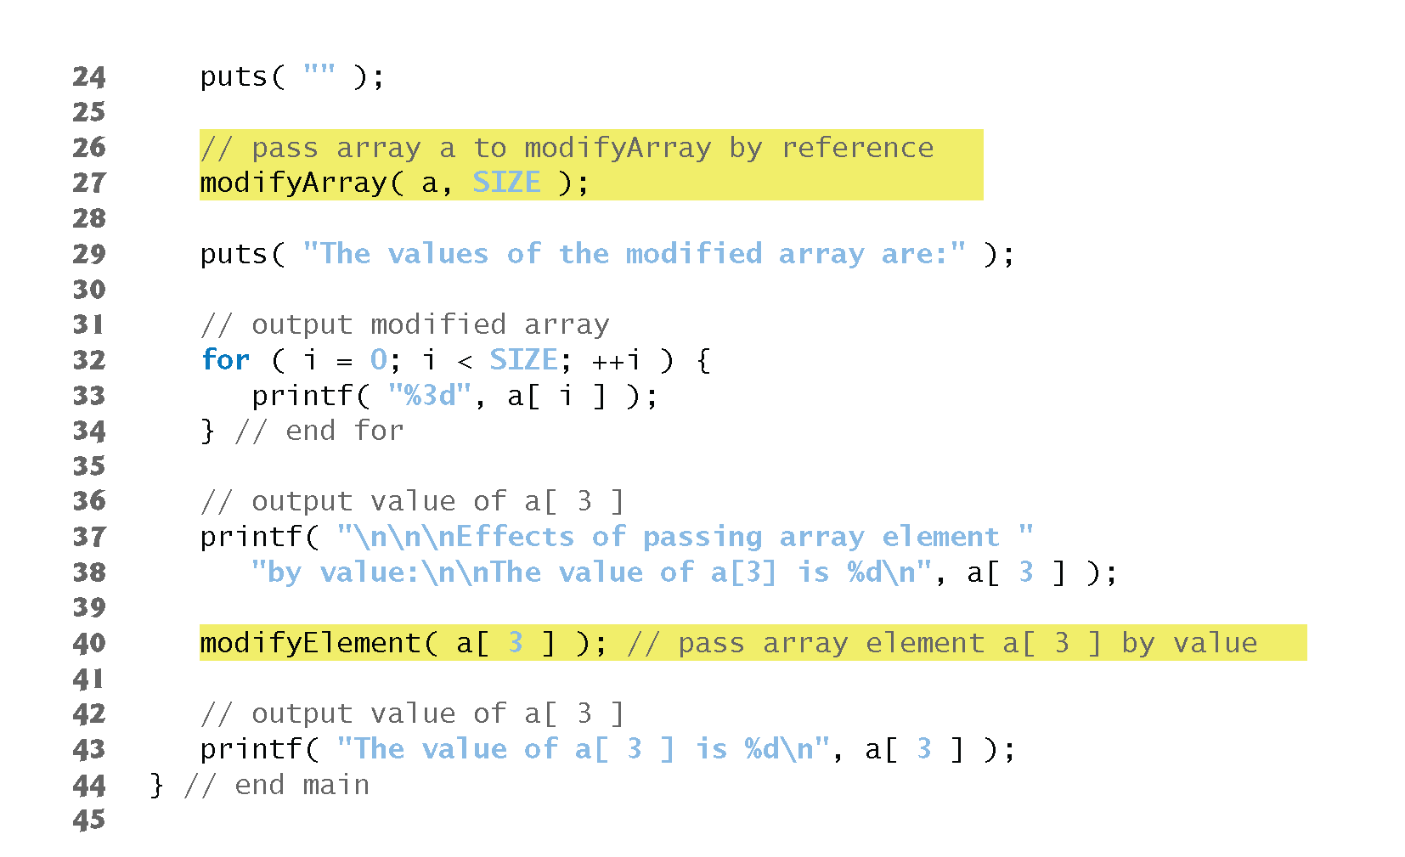
Passing Arrays and Individual Array Elements to Functions

Slide 73
Passing Arrays and Individual Array Elements to Functions

Slide 74
Passing Arrays and Individual Array Elements to Functions

Slide 75
Using the const Qualifier with Array Parameters
Function tryToModifyArray (line 19) is defined with parameter const int b[], which specifies that array b is constant and cannot be modified.
The output shows the error messages produced by the compiler—the errors may be different for your compiler.
Each of the function’s three attempts to modify array elements results in the compiler error “l-value specifies a const object.” .

Slide 76
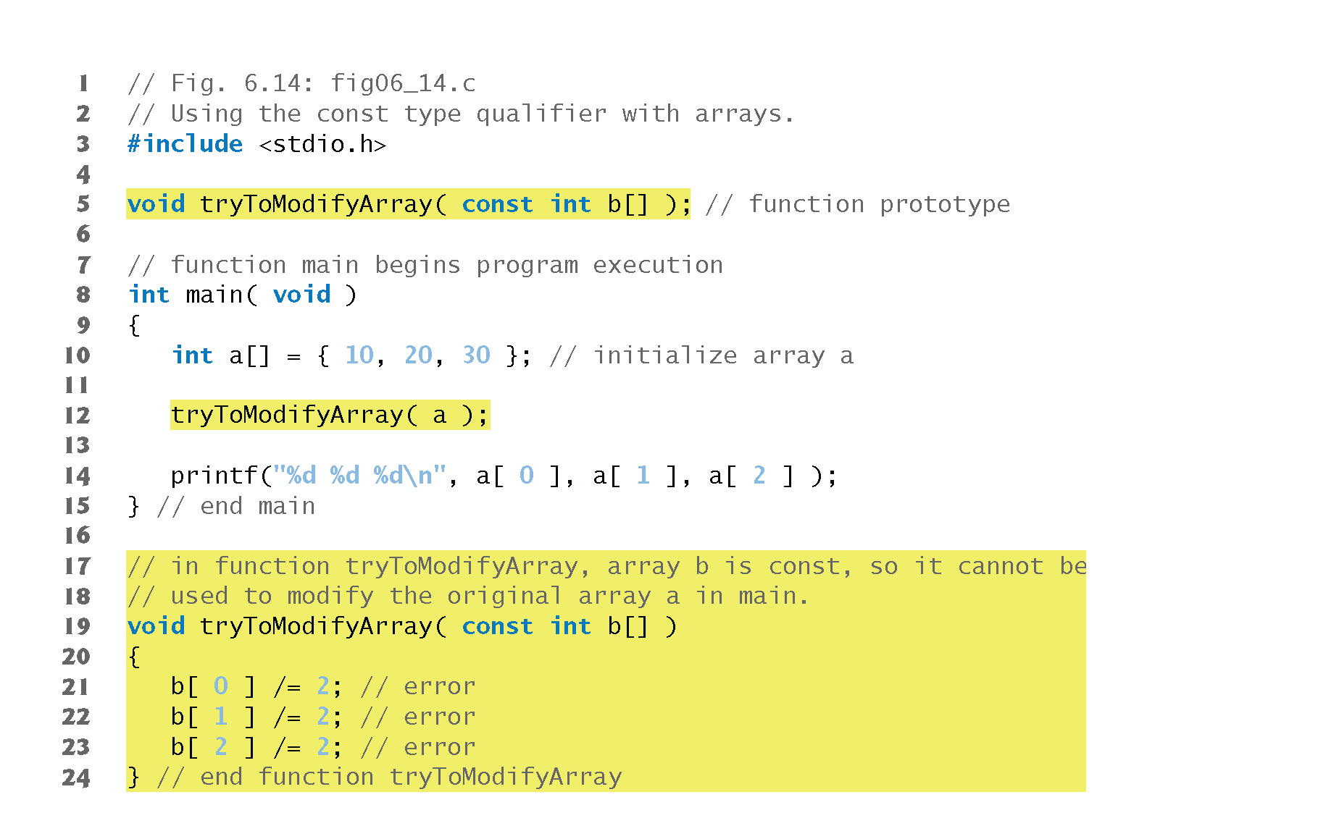
Using const to Pass Arrays

Slide 77
Using const to Pass Arrays

Slide 78
Programming Tips
The const qualifier can be applied to array parameters (in a function definition) to prevent the original array from being modified in the function body.
You should use it whenever you don’t want your array parameters to be accidentally modified.

