Slide 1
Notes:
‹#›

Slide 2
The Process That Feeds the Biosphere
Plants and other photosynthetic organisms contain organelles called chloroplasts
Photosynthesis is the process that converts solar energy into chemical energy within chloroplasts
Directly or indirectly, photosynthesis nourishes almost the entire living world

Slide 3
Autotrophs (自營生物) are “self-feeders” that sustain themselves without eating anything derived from other organisms
Autotrophs are the producers of the biosphere, producing organic molecules from CO₂ and other inorganic molecules
Almost all plants are photoautotrophs, using the energy of sunlight to make organic molecules

Slide 4
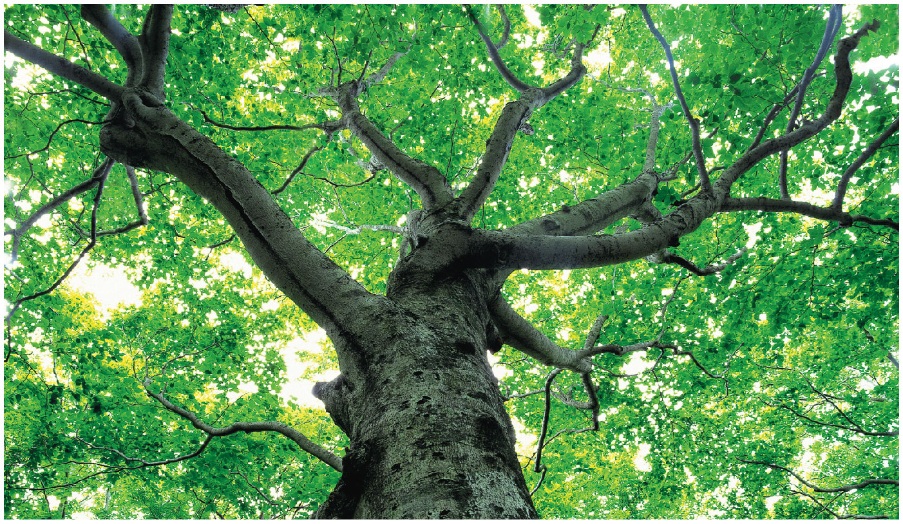
Figure 11.1
How does sunlight help build the trunk, branches, and leaves of this broadleaf tree?
© 2018 Pearson Education Ltd.
Notes:
Figure 11.1 How does sunlight help build the trunk, branches, and leaves of this broadleaf tree?

Slide 5
Photosynthesis occurs in plants, algae, certain other unicellular eukaryotes, and some prokaryotes

Slide 6
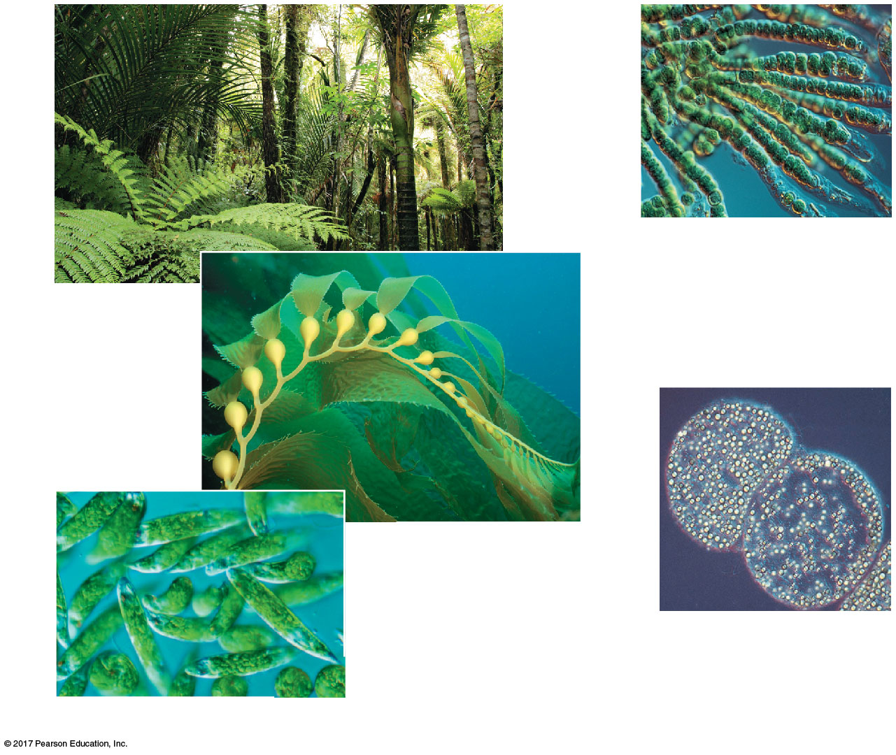
Figure 11.2
(d) Cyanobacteria
40
µm
(a) Plants
(b) Multicellular alga
1 µm
(e) Purple sulfur bacteria
10 µm
Photoautotrophs
(c) Unicellular eukaryotes
© 2018 Pearson Education Ltd.
Notes:
Figure 11.2 Photoautotrophs

Slide 7
Heterotrophs (異營生物) obtain organic material from other organisms
Heterotrophs are the consumers of the biosphere
Some eat other living organisms; others, called decomposers, consume dead organic material or feces
Almost all heterotrophs, including humans, depend on photoautotrophs for food and O₂

Slide 8
Earth’s supply of fossil fuels was formed from the remains of organisms that died hundreds of millions of years ago
Fossil fuels are being consumed faster then they are being replenished
Researchers are exploring methods of using the photosynthetic process to produce alternative fuels

Slide 9
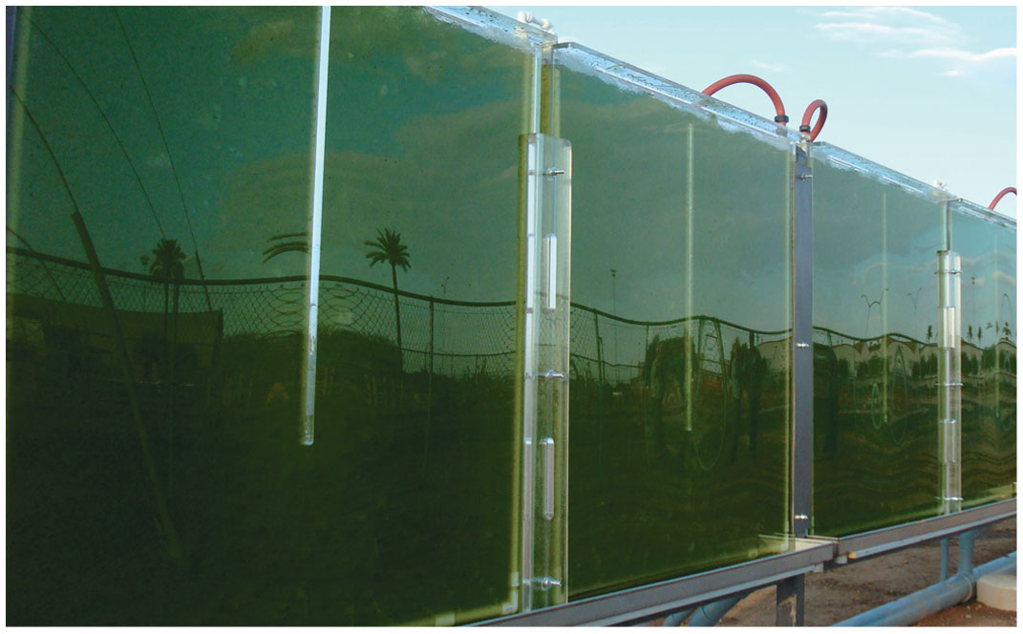
Figure 11.3
Alternative fuels from algae
© 2018 Pearson Education Ltd.
Notes:
Figure 11.3 Alternative fuels from algae

Slide 10
Concept 11.1: Photosynthesis converts light energy to the chemical energy of food
Chloroplasts are structurally similar to and likely evolved from photosynthetic bacteria
The structural organization of these organelles allows for the chemical reactions of photosynthesis

Slide 11
Chloroplasts: The Sites of Photosynthesis in Plants
Leaves are the major locations of photosynthesis in plants
Chloroplasts are found mainly in cells of the mesophyll (葉肉), the interior tissue of the leaf
Each mesophyll cell contains 30–40 chloroplasts
CO₂ enters and O₂ exits the leaf through microscopic pores called stomata (氣孔)

Slide 12
A chloroplast has an envelope of two membranes surrounding a dense fluid called the stroma (葉綠體內基質)
Thylakoids (類囊體)are connected sacs in the chloroplast that compose a third membrane system
Thylakoids may be stacked in columns called grana (葉綠餅)
Chlorophyll (葉綠素), the pigment that gives leaves their green color, resides in the thylakoid membranes

Slide 13
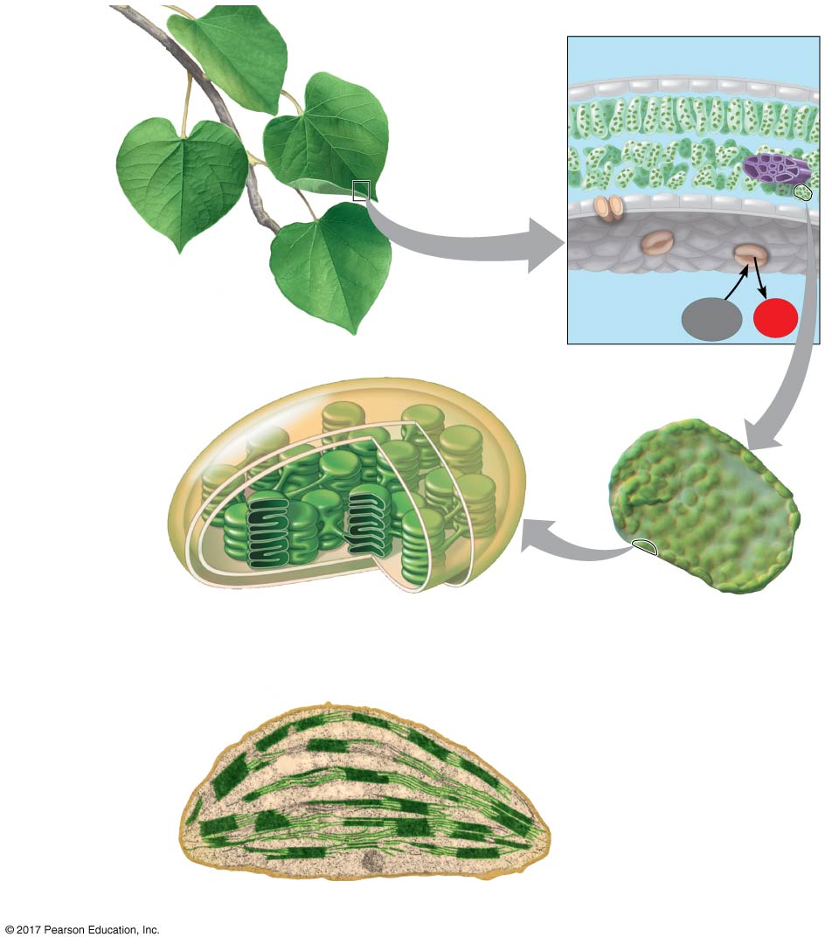
Figure 11.4
Leaf cross section
Chloroplasts
Vein
Mesophyll
Stomata
CO₂
O₂
Chloroplast
Mesophyll
cell
Outer
membrane
Thylakoid
Thylakoid
space
Intermembrane
space
20 µm
Stroma
Granum
Inner
membrane
Chloroplast
1 µm
© 2018 Pearson Education Ltd.
Notes:
Figure 11.4 Zooming in on the location of photosynthesis in a plant

Slide 14
Tracking Atoms Through Photosynthesis: Scientific Inquiry
Photosynthesis is a complex series of reactions that can be summarized as the following equation:
6 CO₂ + 12 H₂O + Light energy → C₆H₁₂O₆ + 6 O₂ + 6 H₂O
The overall chemical change during photosynthesis is the reverse of the one that occurs during cellular respiration

Slide 15
The Splitting of Water
Chloroplasts split H₂O into hydrogen and oxygen, incorporating the electrons of hydrogen into sugar molecules and releasing oxygen as a by-product

Slide 16
Figure 11.5
Tracking atoms through photosynthesis
Reactants:
6 CO₂
12 H₂O
Products:
C₆H₁₂O₆
6 H₂O
6 O₂
© 2018 Pearson Education Ltd.
Notes:
Figure 11.5 Tracking atoms through photosynthesis

Slide 17
Photosynthesis as a Redox Process
Photosynthesis reverses the direction of electron flow compared to respiration
Photosynthesis is a redox process in which H₂O is oxidized and CO₂ is reduced
Photosynthesis is an endergonic (吸能) process; the energy boost is provided by light

Slide 18
Figure 11.UN01
Photosynthesis equation
becomes reduced
becomes oxidized
© 2018 Pearson Education Ltd.
Notes:
Figure 11.UN01 In-text figure, photosynthesis equation, p. 263

Slide 19
The Two Stages of Photosynthesis: A Preview
Photosynthesis consists of the light reactions (the photo part) and Calvin cycle (the synthesis part)
The light reactions (in the thylakoids)
Split H₂O
Release O₂
Reduce the electron acceptor NADP⁺ to NADPH
Generate ATP from ADP by photophosphorylation (光合磷酸化)

Slide 20
The Calvin cycle (in the stroma) forms sugar from CO₂, using ATP and NADPH
The Calvin cycle begins with carbon fixation (碳固定), incorporating CO₂ into organic molecules

Slide 21
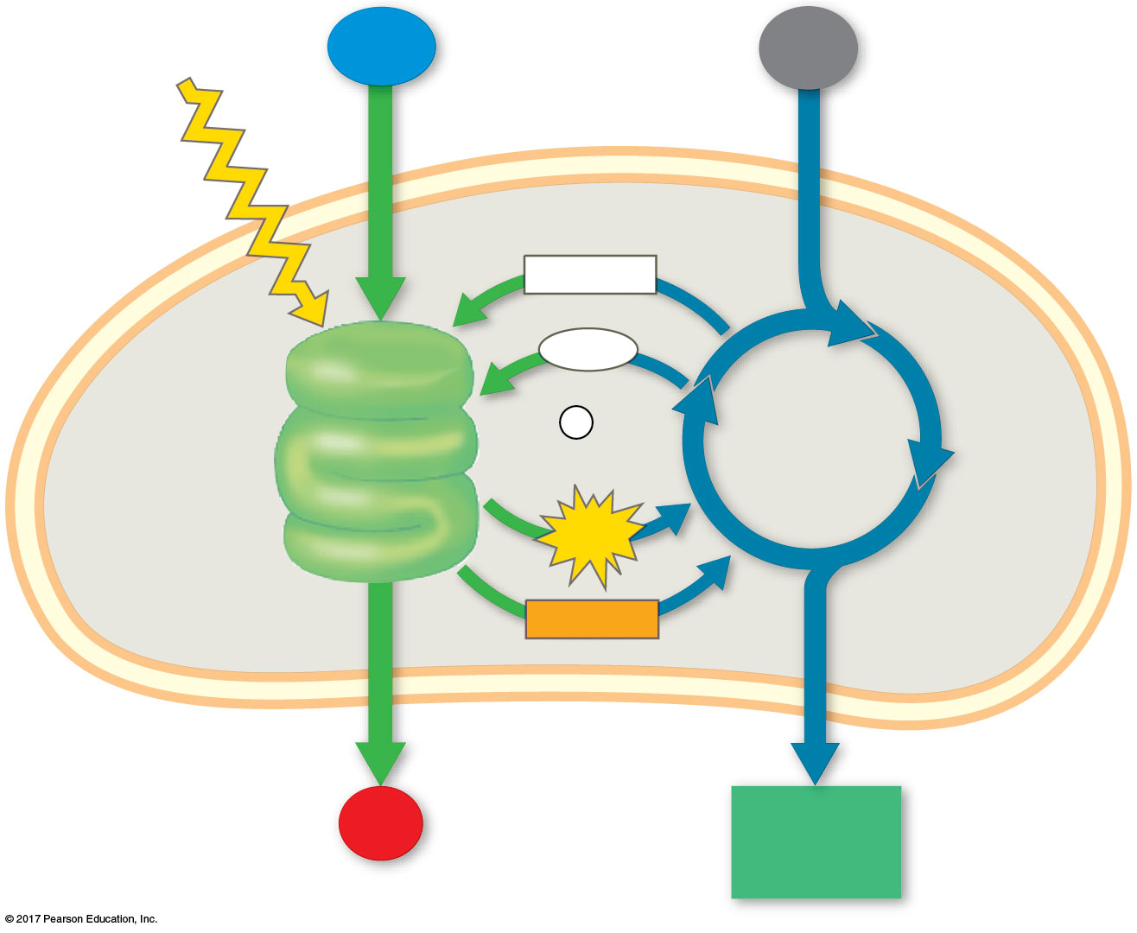
Figure 11.6_4
Light
H₂O
CO₂
NADP⁺
ADP
+
LIGHT
REACTIONS
P
i
CALVIN
CYCLE
ATP
Thylakoid
Stroma
NADPH
Chloroplast
O₂
[CH₂O]
(sugar)
© 2018 Pearson Education Ltd.
Notes:
Figure 11.6_4 An overview of photosynthesis: cooperation of the light reactions and the Calvin cycle (step 4)

Slide 22
Concept 11.2: The light reactions convert solar energy to the chemical energy of ATP and NADPH
Chloroplasts are solar-powered chemical factories
Their thylakoids transform light energy into the chemical energy of ATP and NADPH

Slide 23
The Nature of Sunlight
Light is electromagnetic energy, also called electromagnetic radiation
Electromagnetic energy travels in rhythmic waves
Wavelength is the distance between crests of electromagnetic waves
Wavelength determines the type of electromagnetic energy

Slide 24
The electromagnetic spectrum is the entire range of electromagnetic energy, or radiation
Visible light consists of wavelengths (380 nm to 750 nm) that produce colors we can see
Visible light also includes the wavelengths that drive photosynthesis
Light also behaves as though it consists of discrete particles, called photons

Slide 25
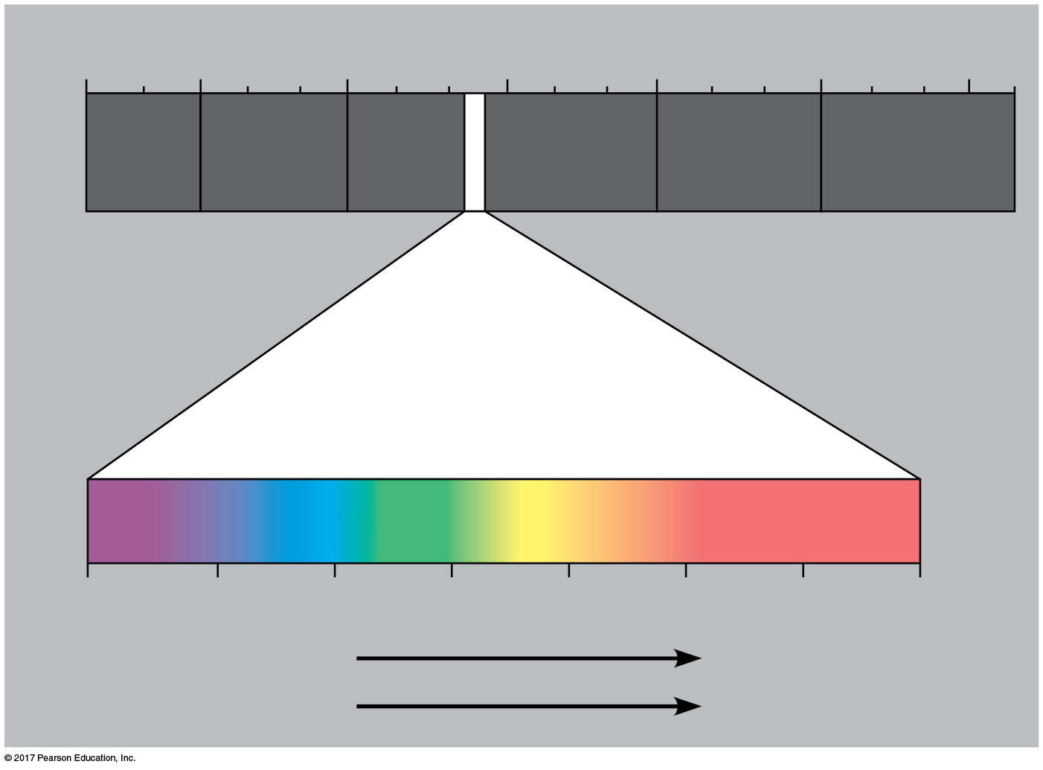
Figure 11.7
The electromagnetic spectrum
1 m
10^{–5} nm
10^{–3} nm
1 nm
10³ nm
10⁶ nm
(10⁹ nm)
10³ m
Gamma
rays
Micro-
waves
Radio
waves
X-rays
UV
Infrared
Visible light
380
450
500
550
600
650
700
750 nm
Shorter wavelength
Longer wavelength
Higher energy
Lower energy
© 2018 Pearson Education Ltd.
Notes:
Figure 11.7 The electromagnetic spectrum

Slide 26
Photosynthetic Pigments: The Light Receptors
Pigments are substances that absorb visible light
Different pigments absorb different wavelengths
Wavelengths that are not absorbed are reflected or transmitted
Leaves appear green because chlorophyll reflects and transmits green light

Slide 27
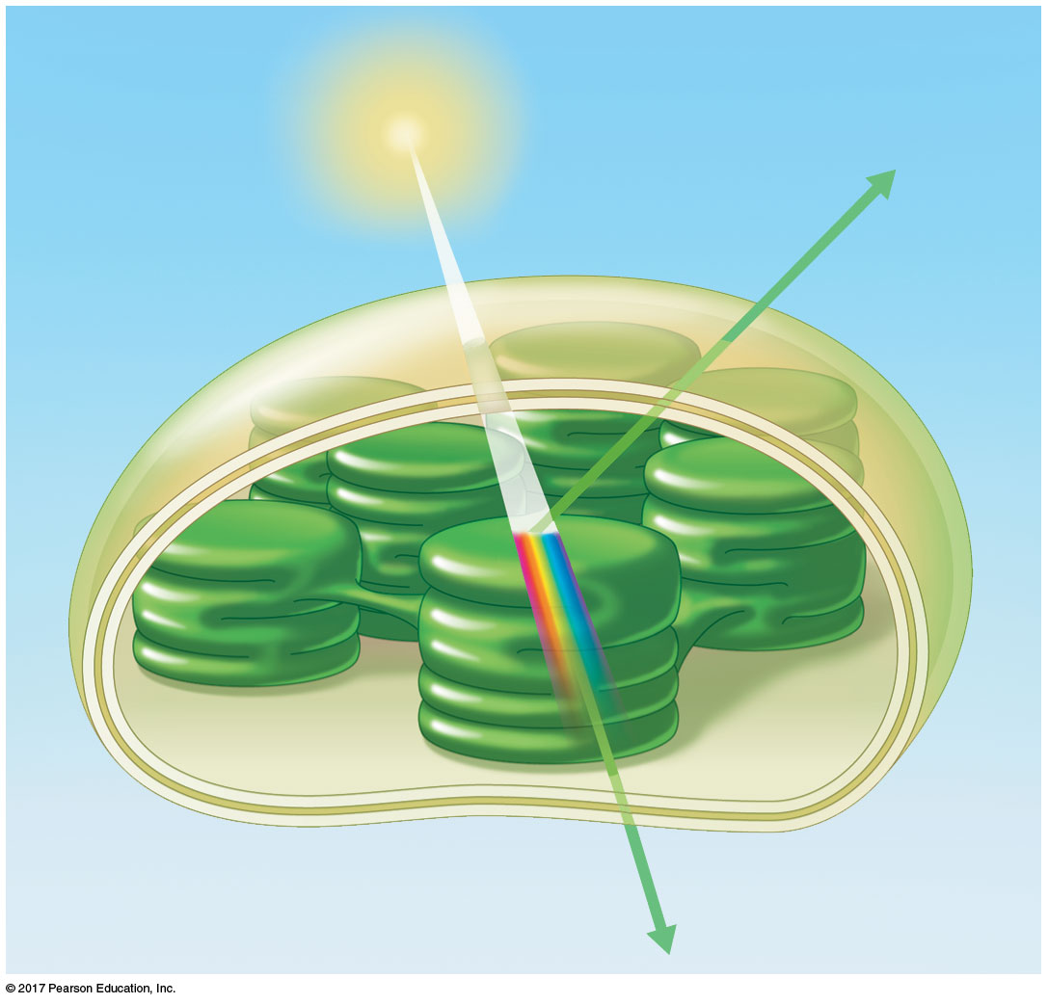
Figure 11.8
Why leaves are green: interaction of light with chloroplasts
Light
Reflected
light
Chloroplast
Absorbed
light
Granum
Transmitted
light
© 2018 Pearson Education Ltd.
Notes:
Figure 11.8 Why leaves are green: interaction of light with chloroplasts

Slide 28
A spectrophotometer (分光光度計)measures a pigment’s ability to absorb various wavelengths
This machine sends light through pigments and measures the fraction of light transmitted at each wavelength

Slide 29
An absorption spectrum (吸收光譜)is a graph plotting a pigment’s light absorption versus wavelength

Slide 30
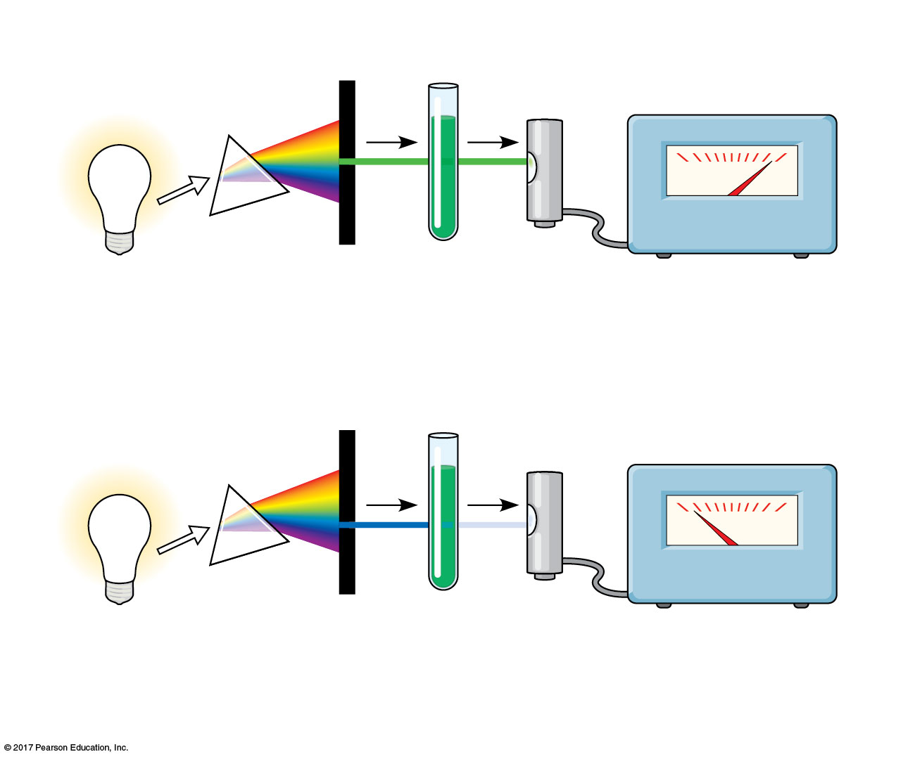
Figure 11.9
White
light
Refracting
prism
Chlorophyll
solution
Photoelectric
tube
Galvanometer
2
3
1
4
0
100
The high transmittance (low
absorption) reading indicates
that chlorophyll absorbs
very little green light.
Slit moves to pass light
of selected wavelength.
Green
light
0
100
The low transmittance (high
absorption) reading indicates
that chlorophyll absorbs
most blue light.
Blue
light
© 2018 Pearson Education Ltd.
Notes:
Figure 11.9 Research method: determining an absorption spectrum

Slide 31
There are three types of pigments in chloroplasts:
Chlorophyll a, the key light-capturing pigment
Chlorophyll b, an accessory pigment
Carotenoids (類胡蘿蔔素), a separate group of accessory pigments

Slide 32
The absorption spectrum of chlorophyll a suggests that violet-blue and red light work best for photosynthesis
An action spectrum (作用光譜) profiles the relative effectiveness of different wavelengths of radiation in driving a process

Slide 33
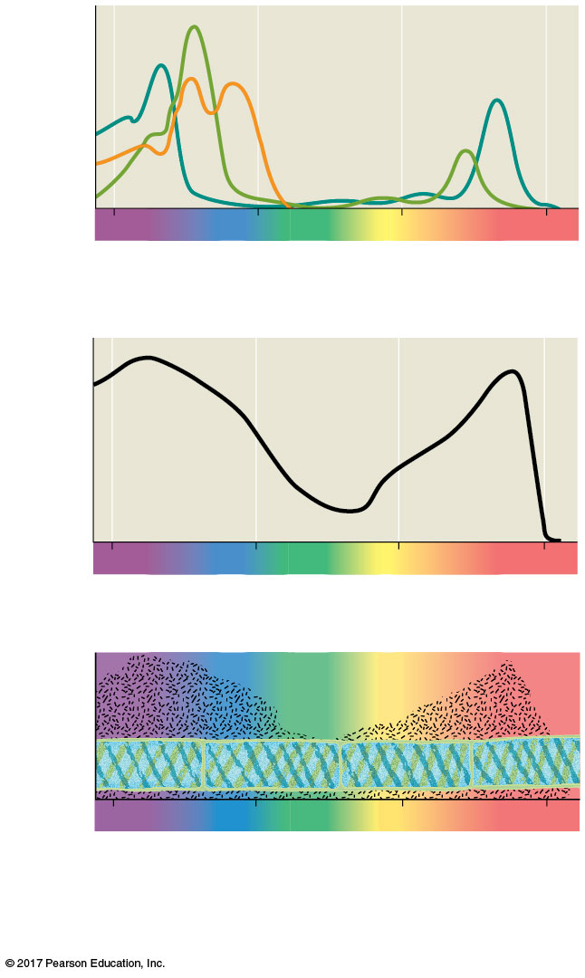
Figure 11.10
Which wavelengths of light are most effective in driving photosynthesis?
Chloro-
phyll a
Chlorophyll b
Absorption
of light by chloroplast
pigments
Carotenoids
400
500
600
700
Wavelength of light (nm)
(a) Absorption spectra
Rate of photosynthesis
(measured by O₂
release)
400
500
600
700
(b) Action spectrum
Aerobic bacteria
Filament of alga
400
500
600
700
(c) Engelmann’s experiment
Data from T. W. Engelmann, Bacterium photometricum. Ein
Beitrag zur vergleichenden Physiologie des Licht-und
Farbensinnes, Archiv. für Physiologie 30:95–124 (1883).
© 2018 Pearson Education Ltd.
Notes:
Figure 11.10 Inquiry: Which wavelengths of light are most effective in driving photosynthesis?

Slide 34
The action spectrum of photosynthesis was first demonstrated in 1883 by Theodor W. Engelmann
In his experiment, he exposed different segments of a filamentous alga to different wavelengths
Areas receiving wavelengths favorable to photosynthesis produced excess O₂
He used the growth of aerobic bacteria clustered along the alga as a measure of O₂ production

Slide 35
The action spectrum for photosynthesis is broader than the absorption spectrum of chlorophyll
Accessory pigments, such as chlorophyll b, broaden the spectrum used for photosynthesis
The difference in the absorption spectrum between chlorophyll a and b is due to a slight structural difference between the pigment molecules

Slide 36
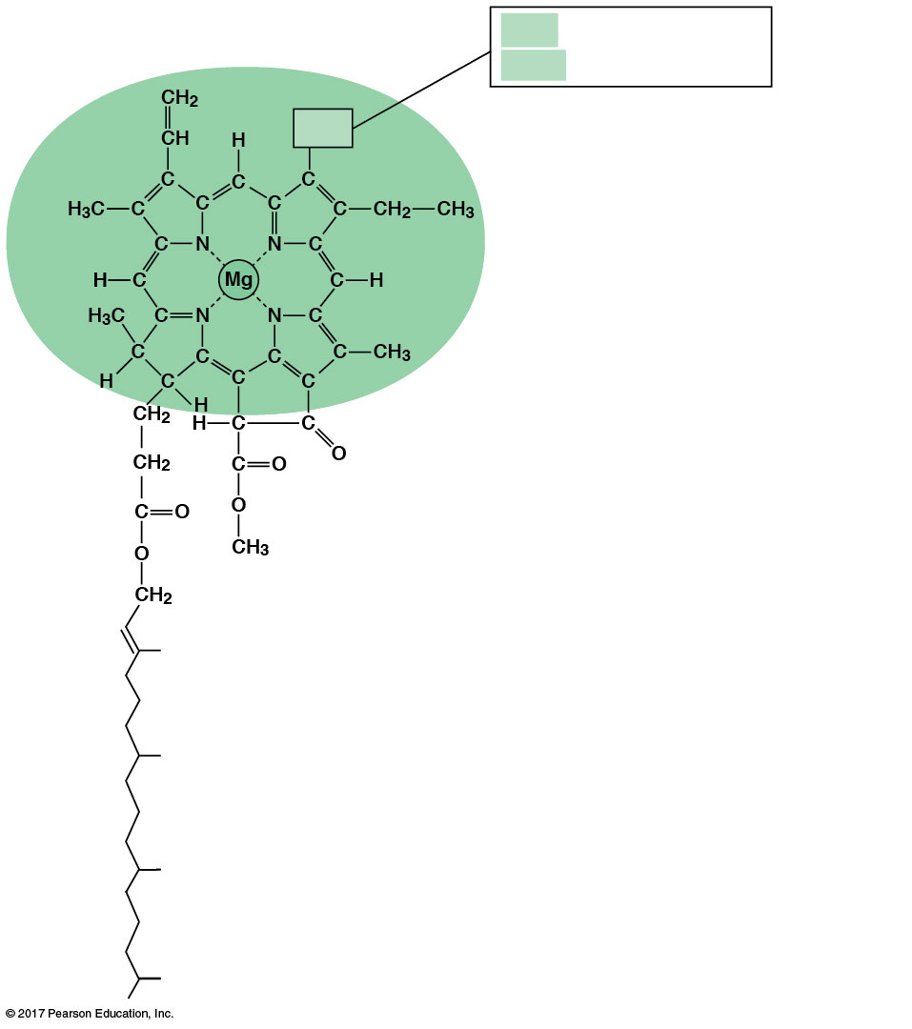
Figure 11.11
CH₃ in chlorophyll a
CHO in chlorophyll b
CH₃
Porphyrin ring:
light-absorbing
“head” of molecule;
note magnesium
atom at center
Structure of chlorophyll molecules in chloroplasts of plants
Hydrocarbon tail:
interacts with hydrophobic
regions of proteins inside
thylakoid membranes of
chloroplasts; H atoms not
shown
© 2018 Pearson Education Ltd.
Notes:
Figure 11.11 Structure of chlorophyll molecules in chloroplasts of plants

Slide 37
Accessory pigments called carotenoids may broaden the spectrum of colors that drive photosynthesis
Some carotenoids function in photoprotection; they absorb excessive light that would damage chlorophyll or react with oxygen

Slide 38
Excitation of Chlorophyll by Light
When a pigment absorbs light, it goes from a ground state to an excited state, which is unstable
When excited electrons fall back to the ground state, excess energy is released as heat
In isolation, some pigments also emit light, an afterglow called fluorescence

Slide 39
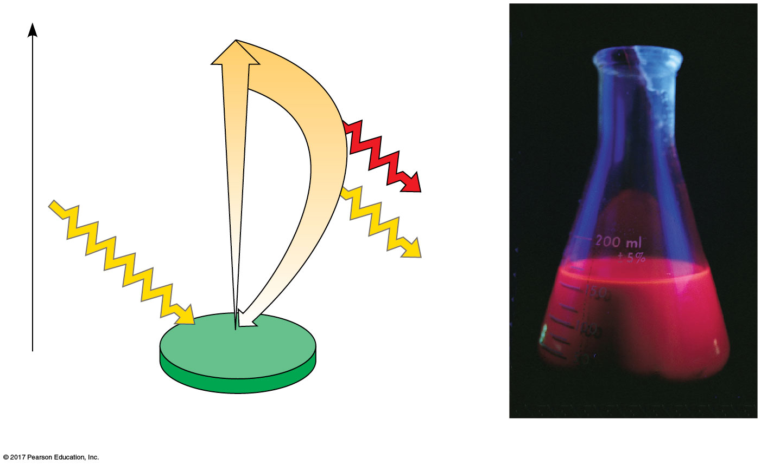
Figure 11.12
Excitation of isolated chlorophyll by light
Excited
state
e–
Heat
Energy of electron
Photon
(fluorescence)
Photon
Ground
state
Chlorophyll
molecule
(a) Excitation of isolated chlorophyll molecule
(b) Fluorescence
© 2018 Pearson Education Ltd.
Notes:
Figure 11.12 Excitation of isolated chlorophyll by light

Slide 40
A Photosystem: A Reaction-Center Complex Associated with Light-Harvesting Complexes
A photosystem (光系統) consists of a reaction-center complex surrounded by light-harvesting complexes
The reaction-center complex is an association of proteins holding a special pair of chlorophyll a molecules and a primary electron acceptor

Slide 41
The light-harvesting complex consists of pigment molecules bound to proteins
Light-harvesting complexes transfer the energy of photons to the chlorophyll a molecules in the reaction-center complex
These chlorophyll a molecules are special because they can transfer an excited electron to a different molecule

Slide 42
A primary electron acceptor in the reaction center accepts excited electrons and is reduced as a result
Solar-powered transfer of an electron from a chlorophyll a molecule to the primary electron acceptor is the first step of the light reactions

Slide 43
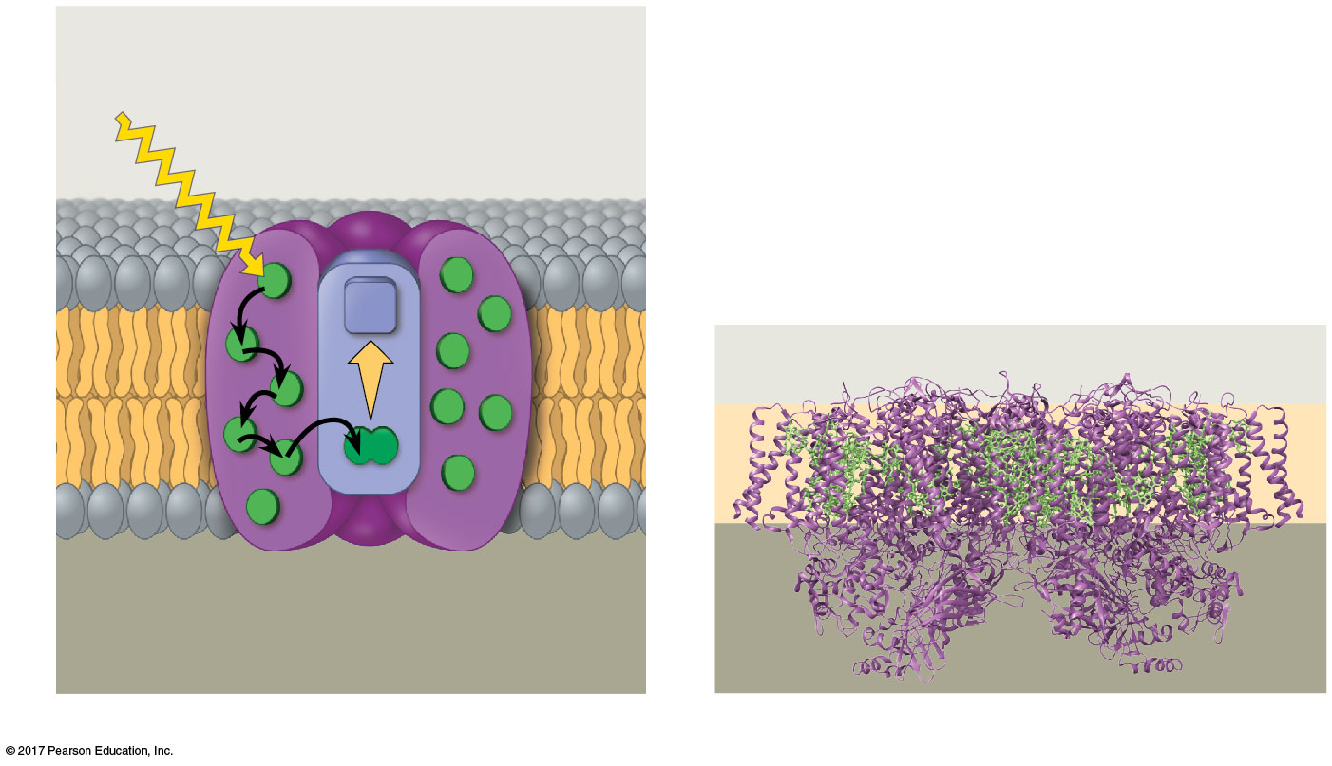
Figure 11.13
The structure and function of a photosystem
Photosystem
STROMA
Photon
Light-
harvesting
complexes
Reaction-
center
complex
Primary
electron
acceptor
Chlorophyll (green)
STROMA
e–
Thylakoid membrane
Thylakoid membrane
Transfer
of energy
Special pair of chloro-
phyll a molecules
Pigment
molecules
Protein
subunits
(purple)
THYLAKOID SPACE
(INTERIOR OF THYLAKOID)
THYLAKOID
SPACE
(a) How a photosystem harvests light
(b) Structure of a photosystem
© 2018 Pearson Education Ltd.
Notes:
Figure 11.13 The structure and function of a photosystem

Slide 44
There are two types of photosystems in the thylakoid membrane
Photosystem II (PS II) functions first (the numbers reflect order of discovery)
The reaction-center chlorophyll a of PS II is called P680 because it is best at absorbing a wavelength of 680 nm

Slide 45
Photosystem I (PS I) is best at absorbing a wavelength of 700 nm
The reaction-center chlorophyll a of PS I is called P700

Slide 46
Linear Electron Flow
During the light reactions, there are two possible routes for electron flow: cyclic and linear
Linear electron flow, the primary pathway, involves both photosystems and produces ATP and NADPH using light energy

Slide 47
There are eight steps in linear electron flow:
A photon hits a pigment in a light-harvesting complex of PS II, and its energy is passed among pigment molecules until it excites P680
An excited electron from P680 is transferred to the primary electron acceptor (we now call it P680⁺)

Slide 48
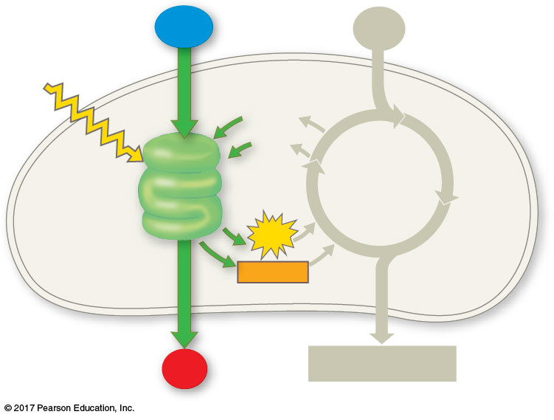
Figure 11.UN02
H₂O
CO₂
Light
NADP⁺
ADP
LIGHT
REACTIONS
CALVIN
CYCLE
ATP
NADPH
O₂
[CH₂O] (sugar)
© 2018 Pearson Education Ltd.
Notes:
Figure 11.UN02 In-text figure, light reaction schematic, p. 269

Slide 49
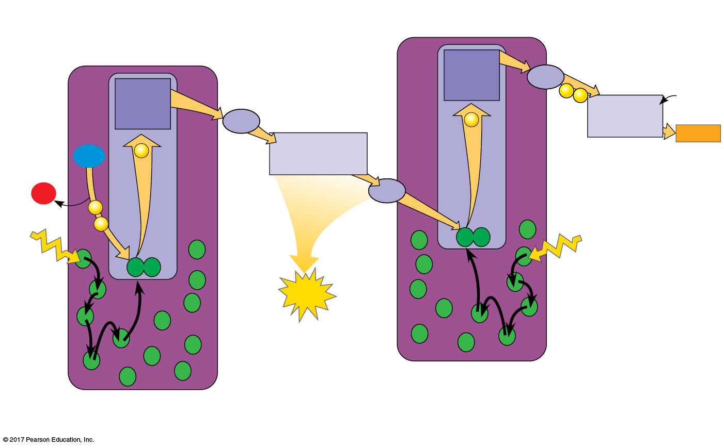
Figure 11.14_5
How linear electron flow during the light reactions generates ATP and NADPH
7
Electron
transport chain
4
Electron
transport chain
Primary
electron
acceptor
Fd
8
NADP⁺
+ H⁺
Primary
electron
acceptor
e–
e–
Pq
NADP⁺
reductase
e–
2
NADPH
2 H⁺
H₂O
e–
Cytochrome
complex
+
1
/2
O₂
3
Pc
e–
P700
1
e–
P680
5
Light
Light
6
ATP
Pigment
molecules
Photosystem I
(PS I)
Photosystem II
(PS II)
© 2018 Pearson Education Ltd.
Notes:
Figure 11.14_5 How linear electron flow during the light reactions generates ATP and NADPH (step 5)

Slide 50
H₂O is split by enzymes, and the electrons are transferred from the hydrogen atoms to P680⁺, thus reducing it to P680
P680⁺ is the strongest known biological oxidizing agent
The H⁺ are released into the thylakoid space
O₂ is released as a by-product of this reaction

Slide 51
Each electron “falls” down an electron transport chain from the primary electron acceptor of PS II to PS I. Energy released by the fall drives the creation of a proton gradient across the thylakoid membrane
Potential energy stored in the proton gradient drives production of ATP by chemiosmosis

Slide 52
In PS I (like PS II), transferred light energy excites P700, which loses an electron to the primary electron acceptor
P700⁺ (P700 that is missing an electron) accepts an electron passed down from PS II via the electron transport chain

Slide 53
Each electron “falls” down an electron transport chain from the primary electron acceptor of PS I to the protein ferredoxin (鐵氧還蛋白) (Fd)
NADP⁺ reductase catalyzes the transfer of electrons to NADP⁺, reducing it to NADPH
The electrons of NADPH are available for the reactions of the Calvin cycle
This process also removes an H⁺ from the stroma

Slide 54
The energy changes of electrons during linear flow through the light reactions can be shown in a mechanical analogy

Slide 55
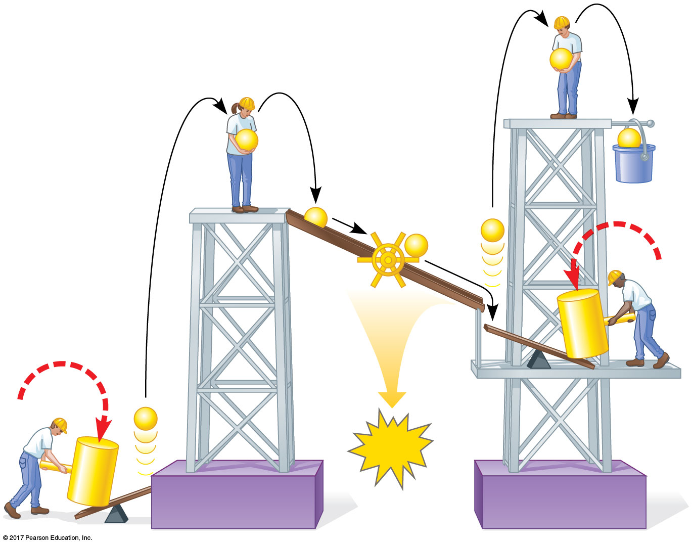
Figure 11.15
A mechanical analogy for linear electron flow during the light reactions
e–
e–
e–
Mill
makes
NADPH
e–
ATP
e–
e–
Photon
e–
ATP
Photon
Photosystem II
Photosystem I
© 2018 Pearson Education Ltd.
Notes:
Figure 11.15 A mechanical analogy for linear electron flow during the light reactions

Slide 56
Cyclic Electron Flow
In cyclic electron flow, electrons cycle back from Fd to the PS I reaction center via a plastocyanin molecule (Pc)
Cyclic electron flow uses only photosystem I and produces ATP, but not NADPH
No oxygen is released

Slide 57
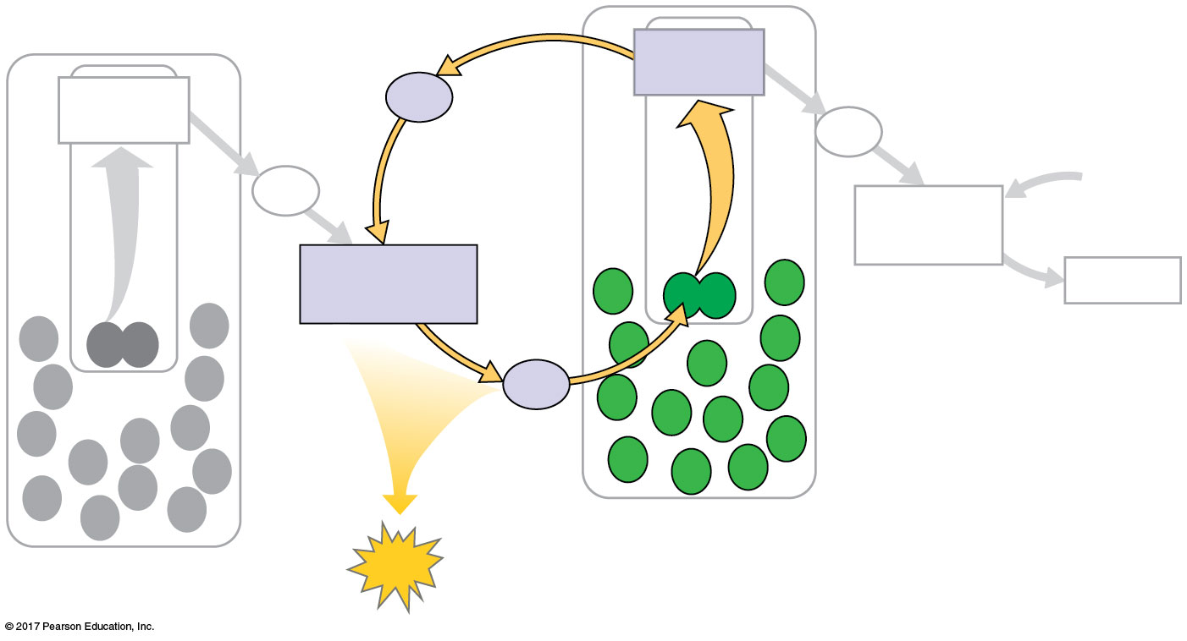
Figure 11.16
Cyclic electron flow
Primary
acceptor
Primary
acceptor
Fd
Fd
Pq
NADP⁺
NADP⁺
reductase
+ H⁺
Cytochrome
complex
NADPH
Pc
Photosystem I
Photosystem II
ATP
© 2018 Pearson Education Ltd.
Notes:
Figure 11.16 Cyclic electron flow

Slide 58
Some organisms such as purple sulfur bacteria have PS I but not PS II
Cyclic electron flow is thought to have evolved before linear electron flow
Cyclic electron flow may protect cells from light-induced damage

Slide 59
A Comparison of Chemiosmosis in Chloroplasts and Mitochondria
Chloroplasts and mitochondria generate ATP by chemiosmosis, but use different sources of energy
Mitochondria transfer chemical energy from food to ATP; chloroplasts transform light energy into the chemical energy of ATP
Spatial (空間的) organization of chemiosmosis differs between chloroplasts and mitochondria but also shows similarities

Slide 60
In mitochondria, protons are pumped to the intermembrane space and drive ATP synthesis as they diffuse back into the mitochondrial matrix
In chloroplasts, protons are pumped into the thylakoid (類囊體) space and drive ATP synthesis as they diffuse back into the stroma

Slide 61
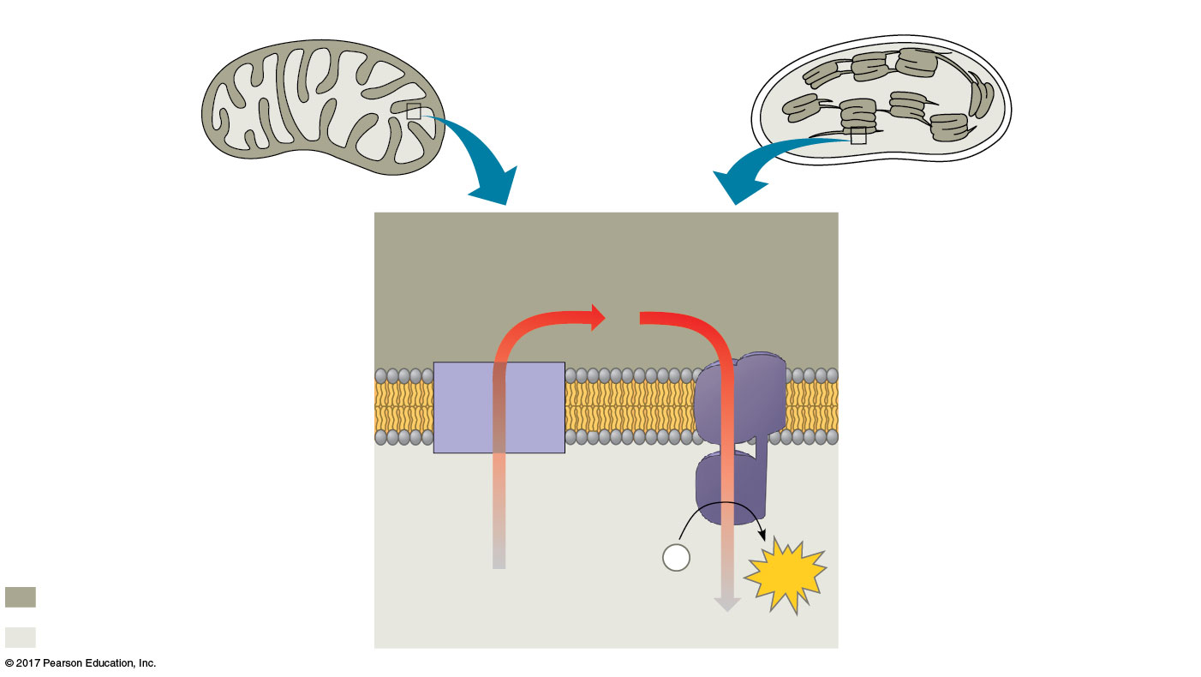
Figure 11.17
Comparison of chemiosmosis in mitochondria and chloroplasts
Mitochondrion
Chloroplast
Diffusion of
H⁺ through
ATP synthase
Inter-
membrane
space
Thylakoid
space
H⁺
Inner
membrane
Electron
transport
chain
Thylakoid
membrane
MITOCHONDRION
STRUCTURE
CHLOROPLAST
STRUCTURE
ATP
synthase
Pumping
of H⁺
by ETC
Matrix
ADP
P
Stroma
+
i
ATP
Higher [H⁺]
H⁺
Lower [H⁺]
H⁺
© 2018 Pearson Education Ltd.
Notes:
Figure 11.17 Comparison of chemiosmosis in mitochondria and chloroplasts

Slide 62
ATP and NADPH are produced on the side facing the stroma, where the Calvin cycle takes place
In summary, light reactions generate ATP and increase the potential energy of electrons by moving them from H₂O to NADPH

Slide 63
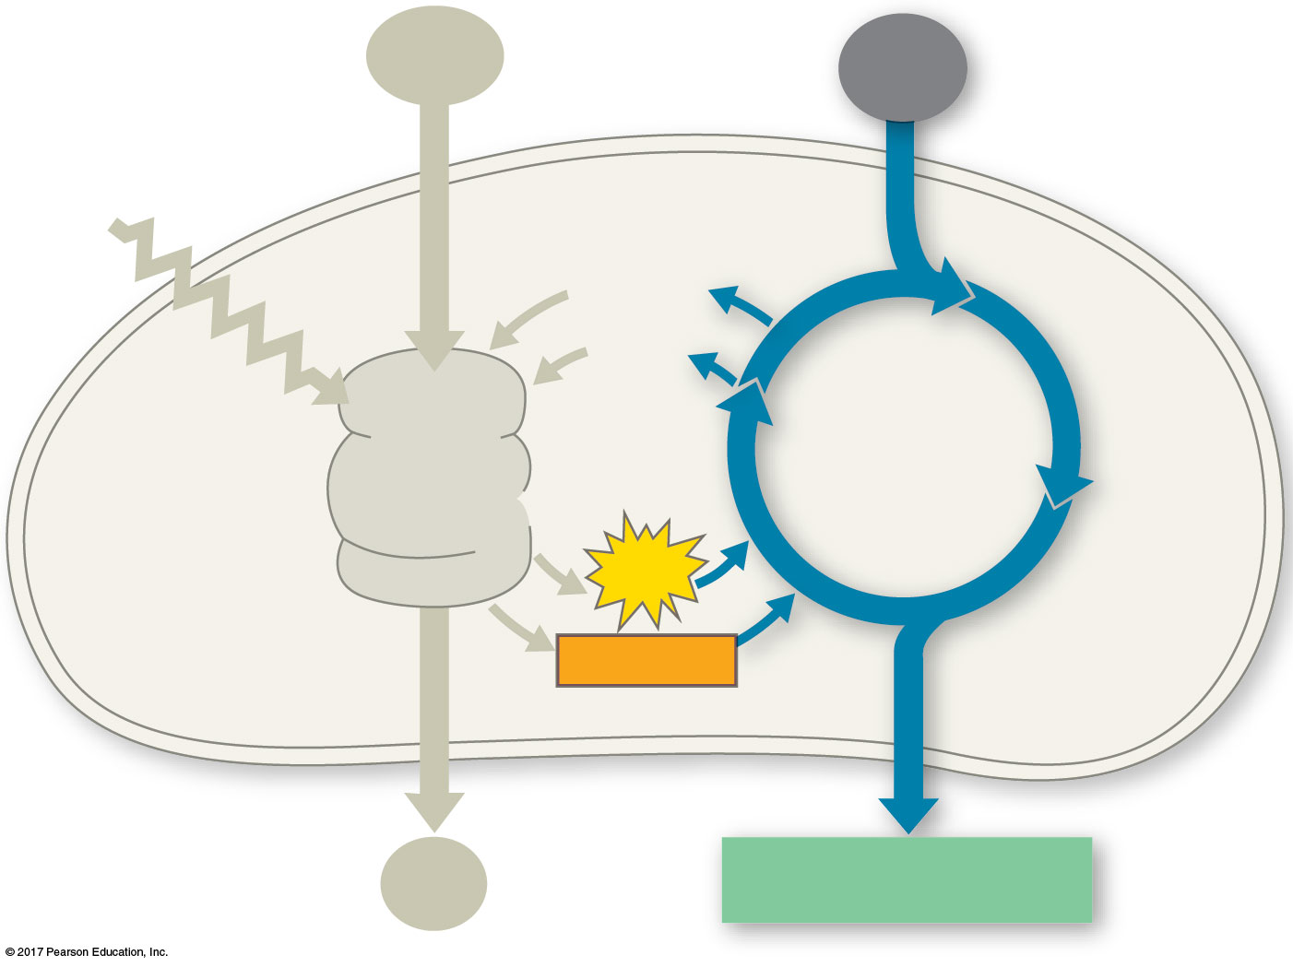
Figure 11.UN03
H₂O
CO₂
Light
NADP⁺
ADP
CALVIN
CYCLE
LIGHT
REACTIONS
ATP
NADPH
O₂
[CH₂O] (sugar)
© 2018 Pearson Education Ltd.
Notes:
Figure 11.UN03 In-text figure, Calvin cycle schematic, p. 274

Slide 64
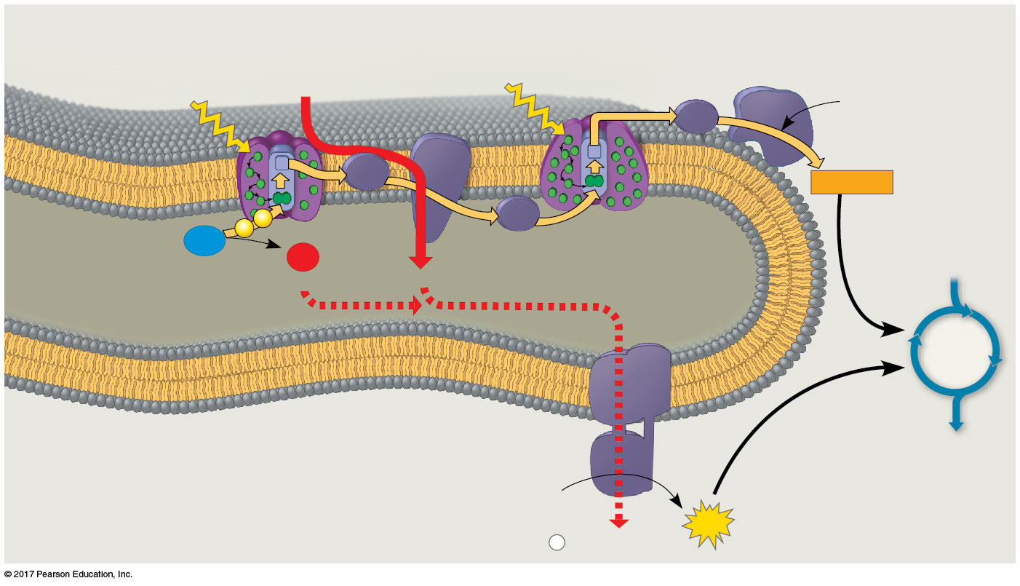
Figure 11.18
The light reactions and chemiosmosis: Current model of the organization of the thylakoid membrane
Cytochrome
complex
NADP⁺
reductase
Photosystem II
Photosystem I
Light
4 H⁺
Light
3
NADP⁺ + H⁺
Fd
Pq
NADPH
e–
2
Pc
H₂O
e–
1
1
/
2
O₂
THYLAKOID SPACE
(high H⁺ concentration)
+2 H⁺
4 H⁺
CALVIN
CYCLE
Thylakoid
membrane
ATP
synthase
STROMA
(low H⁺ concentration)
ADP
+
ATP
P
i
H⁺
© 2018 Pearson Education Ltd.
Notes:
Figure 11.18 The light reactions and chemiosmosis: Current model of the organization of the thylakoid membrane

Slide 65
Concept 11.3: The Calvin cycle uses the chemical energy of ATP and NADPH to reduce CO₂ to sugar
The Calvin cycle, like the citric acid cycle, regenerates its starting material after molecules enter and leave the cycle
The Calvin cycle is anabolic (合成代謝); it builds sugar from smaller molecules by using ATP and the reducing power of electrons carried by NADPH

Slide 66
Carbon enters the cycle as CO₂ and leaves as a sugar named glyceraldehyde 3-phospate (G3P)甘油醛3-磷酸
For net synthesis of one G3P, the cycle must take place three times, fixing three molecules of CO₂
The Calvin cycle has three phases:
Carbon fixation (catalyzed by rubisco)
Reduction
Regeneration of the CO₂ acceptor (RuBP)

Slide 67
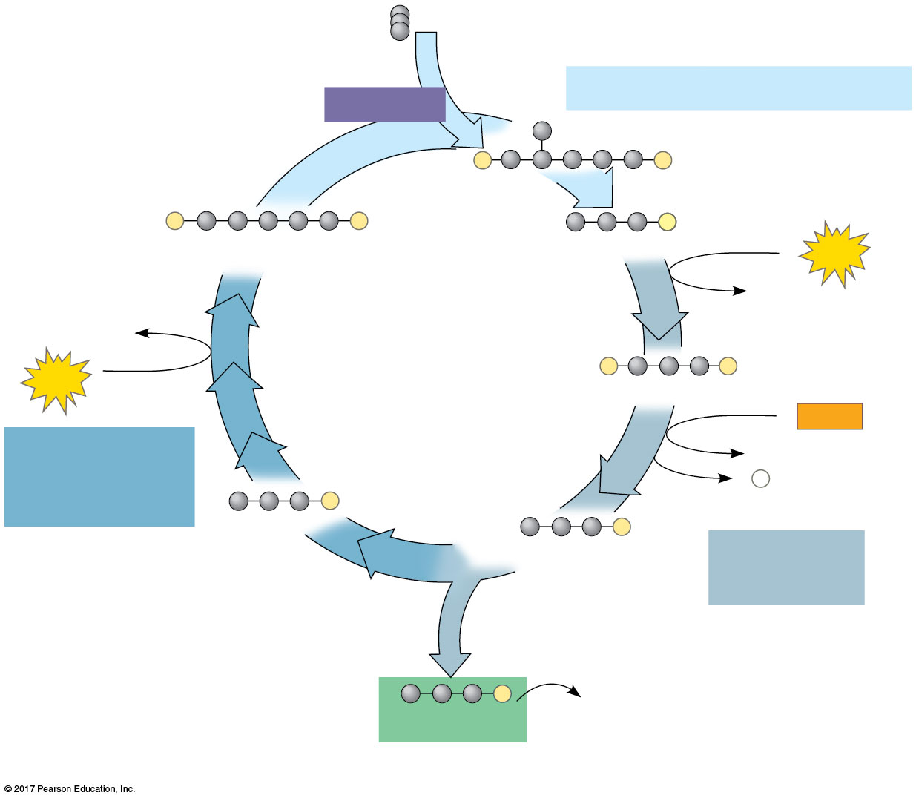
Figure 11.19_3
Input 3 CO₂, entering one per cycle
The Calvin cycle
Phase 1: Carbon fixation
Rubisco
3
P
P
3
P
P
6
P
RuBP
3-Phosphoglycerate
6
ATP
6 ADP
3 ADP
Calvin
Cycle
3
ATP
6
P
P
1,3-Bisphosphoglycerate
6
NADPH
Phase 3:
Regeneration
of RuBP
6 NADP⁺
6
P
i
5
P
G3P
6
P
G3P
Phase 2:
Reduction
1
P
Glucose and
other organic
compounds
G3P
Output
© 2018 Pearson Education Ltd.
Notes:
Figure 11.19_3 The Calvin cycle (step 3)

Slide 68
Concept 11.4: Alternative mechanisms of carbon fixation have evolved in hot, arid climates
Dehydration is a problem for plants, sometimes requiring trade-offs with other metabolic processes, especially photosynthesis
On hot, dry days, plants close stomata, which conserves H₂O but also limits photosynthesis
The closing of stomata reduces access to CO₂ and causes O₂ to build up
These conditions favor an apparently wasteful process called photorespiration(光呼吸)

Slide 69
Photorespiration: An Evolutionary Relic?
In most plants (C₃ plants), initial fixation of CO₂, via rubisco, forms a three-carbon compound (3-phosphoglycerate)
In photorespiration, rubisco adds O₂ instead of CO₂ in the Calvin cycle, producing a two-carbon compound
Photorespiration consumes O₂ and organic fuel and releases CO₂ without producing ATP or sugar

Slide 70
Photorespiration may be an evolutionary relic because rubisco first evolved at a time when the atmosphere had far less O₂ and more CO₂
Photorespiration limits damaging products of light reactions that build up in the absence of the Calvin cycle
In many plants, photorespiration is a problem because on a hot, dry day it can drain as much as 50% of the carbon fixed by the Calvin cycle

Slide 71
C₄ Plants
C₄ plants minimize the cost of photorespiration by incorporating CO₂ into four-carbon compounds
There are two distinct types of cells in the leaves of C₄ plants:
Bundle-sheath (维管束鞘)cells are arranged in tightly packed sheaths around the veins of the leaf
Mesophyll cells (葉肉細胞)are loosely packed between the bundle sheath and the leaf surface

Slide 72
Sugar production in C₄ plants occurs in a three-step process:
The production of the four-carbon precursors is catalyzed by the enzyme PEP carboxylase in the mesophyll cells
PEP carboxylase has a higher affinity for CO₂ than rubisco does; it can fix CO₂ even when CO₂ concentrations are low

Slide 73
These four-carbon compounds are exported to bundle-sheath cells
Within the bundle-sheath cells, they release CO₂ that is then used in the Calvin cycle

Slide 74
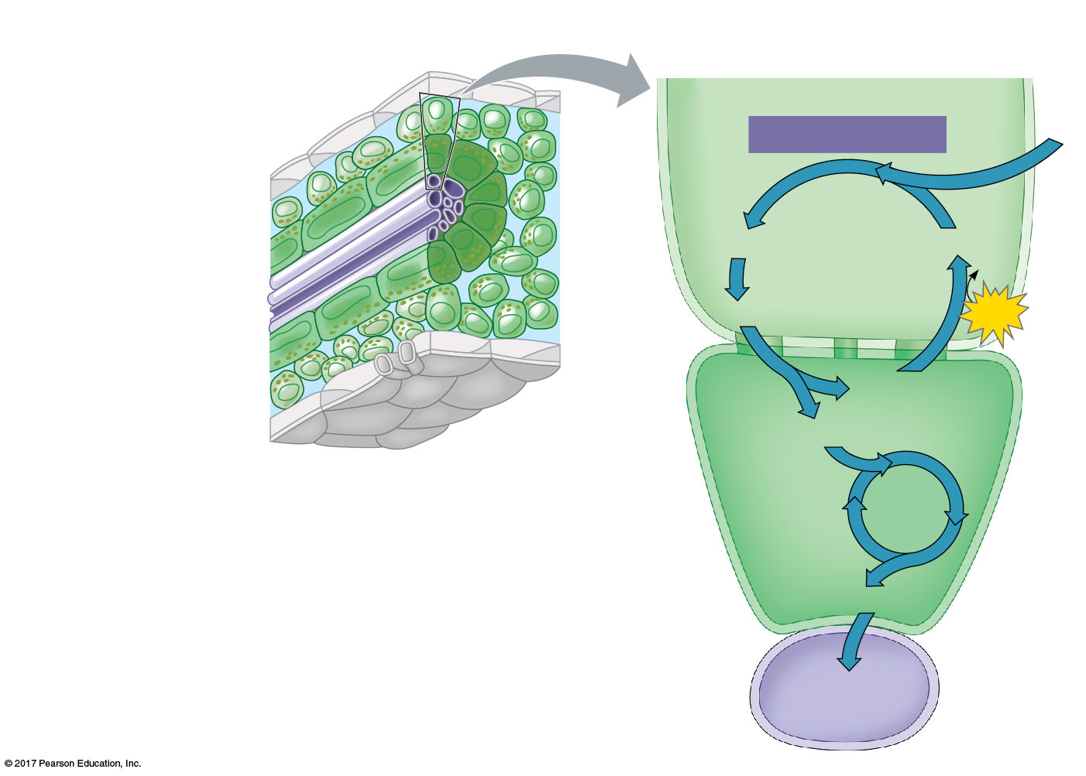
Figure 11.20
C₄ leaf anatomy
The C₄ pathway
Photo-
synthetic
cells of
C₄ plant
leaf
Mesophyll
cell
Mesophyll
cell
PEP carboxylase
CO₂
Bundle-
sheath
cell
Oxaloacetate (4C)
PEP (3C)
Vein
(vascular
tissue)
ADP
Malate (4C)
ATP
Pyruvate
Plasmodesma
CO₂
(3C)
Stoma
Bundle-
sheath
cell
Calvin
Cycle
C₄ leaf anatomy and the C₄ pathway
Sugar
Vascular
tissue
© 2018 Pearson Education Ltd.
Notes:
Figure 11.20 C₄ leaf anatomy and the C₄ pathway

Slide 75
Since the Industrial Revolution in the 1800s, CO₂ levels have risen greatly
Increasing levels of CO₂ may affect C₃ and C₄ plants differently, perhaps changing the relative abundance of these species
The effects of such changes are unpredictable and a cause for concern

Slide 76
Suitable agricultural land is decreasing due to the effects of climate change, while the world demand for food continues to increase
C₄ photosynthesis uses less water and resources than C₃ photosynthesis
Scientists have genetically modified rice, a C₃ plant, to carry out C₄ photosynthesis
They estimate 30–50% increase in yield compared to C₃ rice

Slide 77
CAM Plants
Some plants, including succulents, use crassulacean acid metabolism (CAM景天酸代謝) to fix carbon
CAM plants open their stomata at night, incorporating CO₂ into organic acids that are stored in the vacuoles
Stomata close during the day, and CO₂ is released from organic acids and used in the Calvin cycle

Slide 78
The CAM pathway is similar to the C₄ pathway in that they both incorporate CO₂ into organic intermediates before it enters the Calvin cycle
The C₄ pathway structurally separates the initial steps of carbon fixation from the Calvin cycle
In the CAM pathway, these steps occur in the same cell, but are separated in time

Slide 79
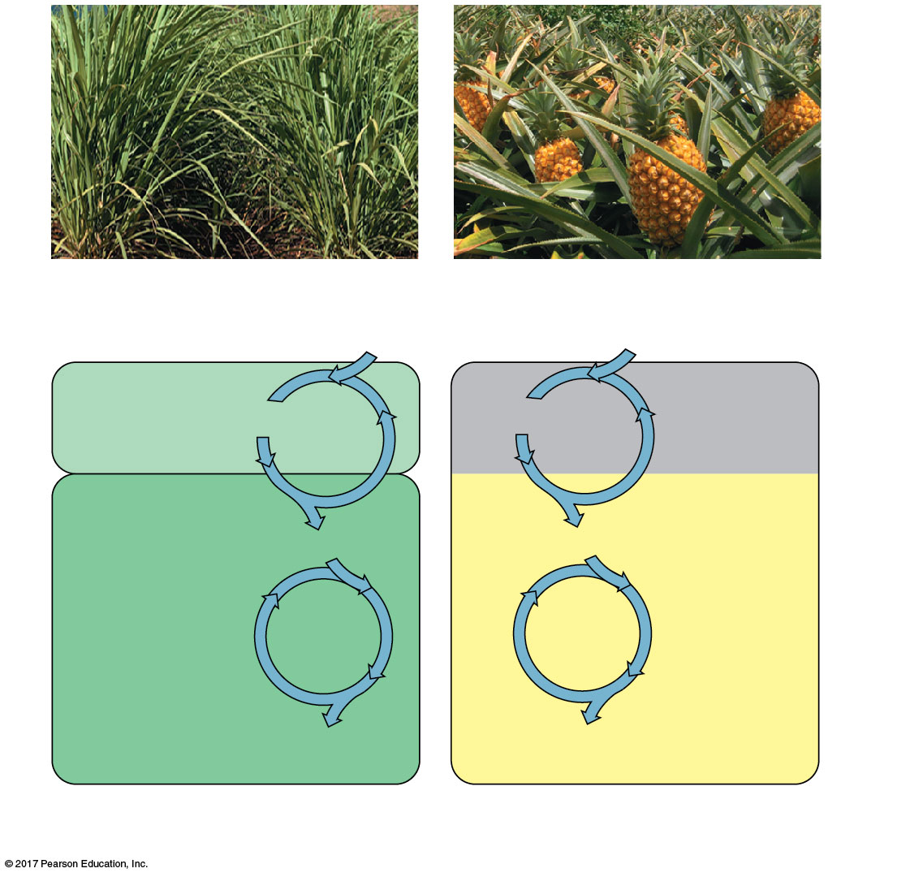
Figure 11.21
C₄ and CAM photosynthesis compared
Sugarcane
Pineapple
1
1
CO₂
CO₂
C₄
CAM
Mesophyll
cell
Organic
acid
Organic
acid
Night
CO₂
2
CO₂
2
Bundle-
sheath
cell
Day
Calvin
Cycle
Calvin
Cycle
Sugar
Sugar
(a) Spatial separation of steps
(b) Temporal separation of steps
© 2018 Pearson Education Ltd.
Notes:
Figure 11.21 C₄ and CAM photosynthesis compared

Slide 80
Concept 11.5: Life depends on photosynthesis The Importance of Photosynthesis: A Review
The energy entering chloroplasts as sunlight gets stored as chemical energy in organic compounds
Sugar made in the chloroplasts supplies chemical energy and carbon skeletons to synthesize the organic molecules of cells
Plants store excess sugar as starch in chloroplasts and other structures such as roots, tubers, seeds, and fruits

Slide 81
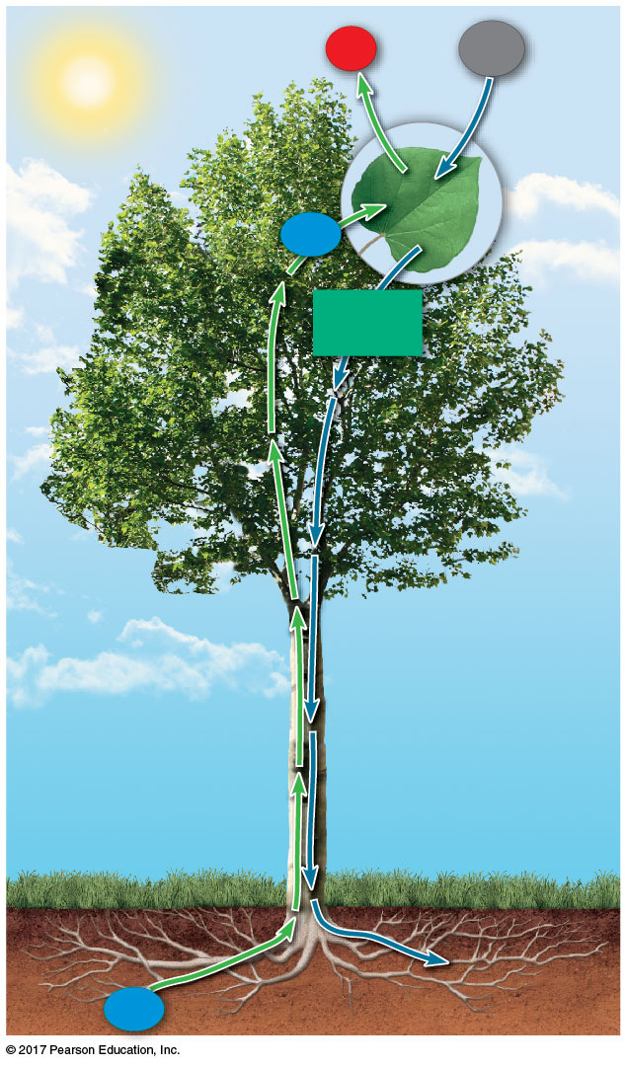
Figure 11.22a
O₂
CO₂
H₂O
Sucrose
(export)
H₂O
© 2018 Pearson Education Ltd.
Notes:
Figure 11.22a A review of photosynthesis (part 1)

Slide 82
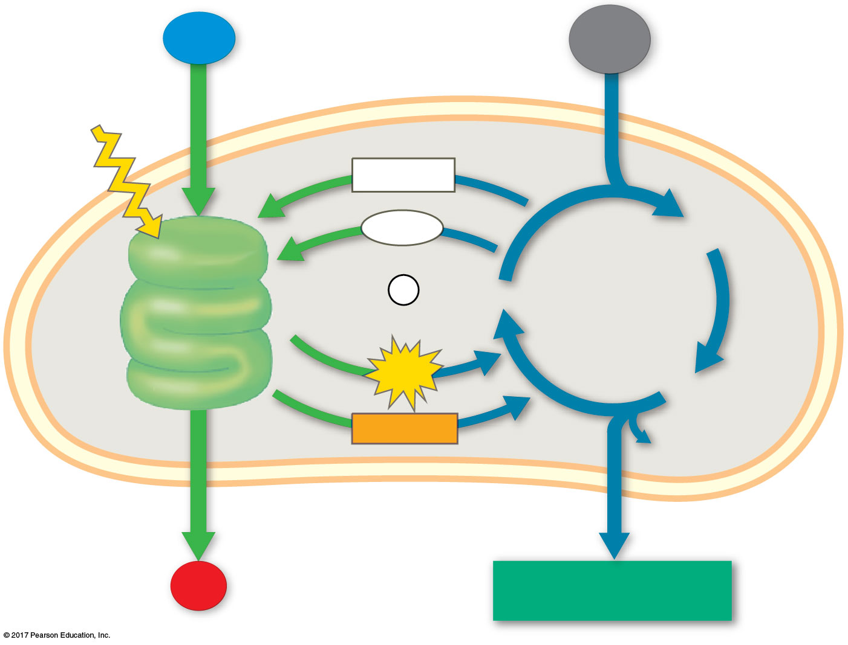
Figure 11.22b
Chloroplast
H₂O
CO₂
Light
NADP⁺
ADP
3-Phosphoglycerate
LIGHT
+
REACTIONS:
Photosystem II
P
RuBP
CALVIN
CYCLE
i
Electron transport chain
Photosystem I
Electron transport chain
ATP
G3P
NADPH
Starch
(storage)
O₂
Sucrose (export)
© 2018 Pearson Education Ltd.
Notes:
Figure 11.22b A review of photosynthesis (part 2)

Slide 83
Figure 11.22c
LIGHT REACTIONS
CALVIN CYCLE REACTIONS
Are carried out by molecules in the thylakoid membranes
Take place in the stroma
Use ATP and NADPH to convert CO₂ to the sugar G3P
Convert light energy to the chemical energy of ATP and NADPH
Return ADP, inorganic phosphate, and NADP⁺ to the light reactions
Split H₂O and release O₂ to the atmosphere
© 2018 Pearson Education Ltd.
Notes:
Figure 11.22c A review of photosynthesis (part 3)

Slide 84
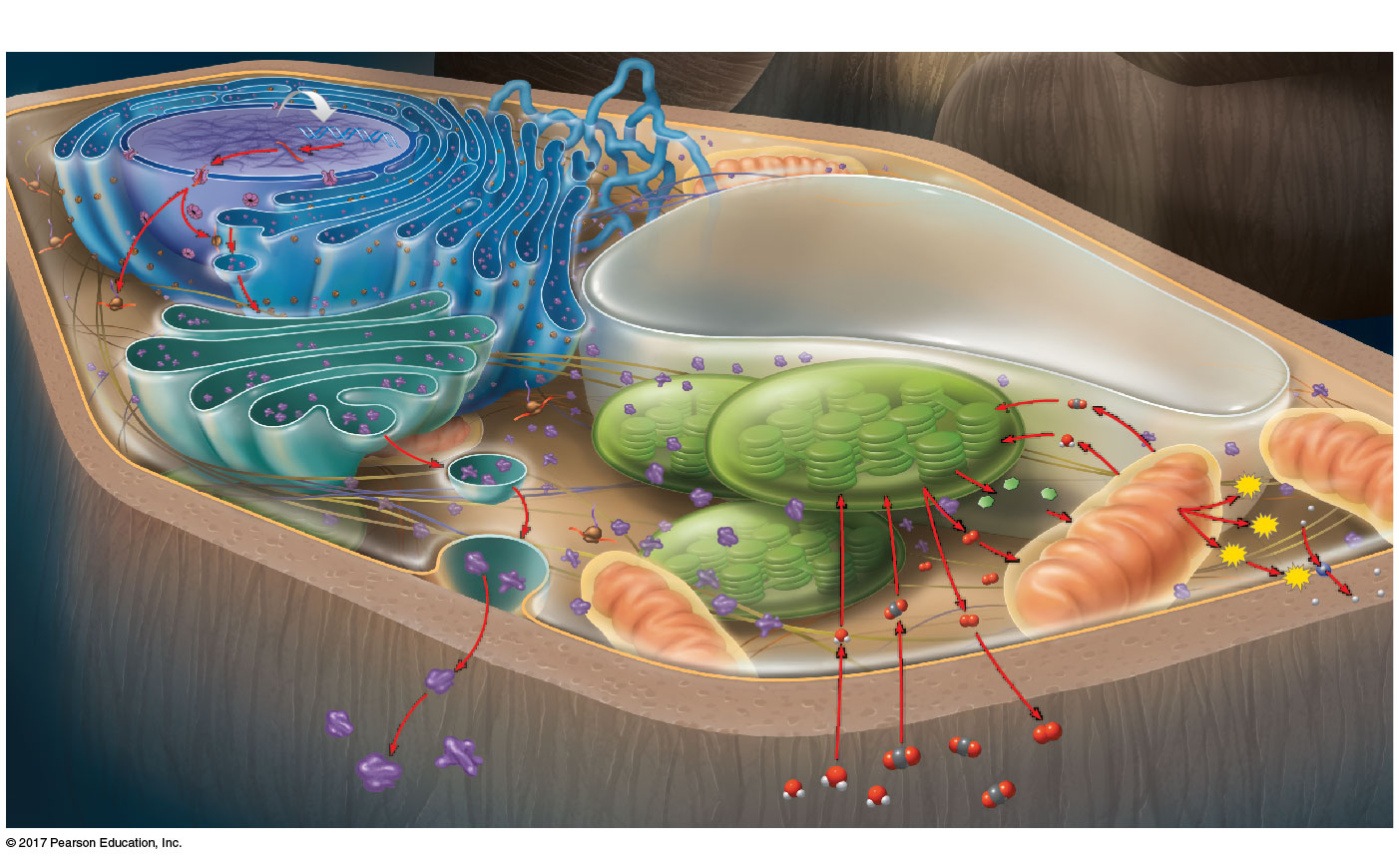
Figure 11.23
MAKE CONNECTIONS: The Working Cell
Movement Across Cell Membranes
(Chapter 8)
DNA
1
DNA
Nucleus
Nucleus
Energy Transformations in the Cell:
Photosynthesis and Cellular
Respiration (Chapters 6, 10, and 11)
mRNA
Nuclear
pore
mRNA
Nuclear
pore
2
Rough endoplasmic
reticulum (ER)
Rough endoplasmic
reticulum (ER)
Protein
in vesicle
Protein
Protein
in vesicle
Protein
3
Ribosome
mRNA
Vacuole
Ribosome
mRNA
4
7
Photosynthesis
in chloroplast
Vesicle
forming
Photosynthesis
in chloroplast
CO₂
Golgi
apparatus
Vesicle
forming
Golgi
apparatus
H₂O
Protein
Protein
ATP
Organic
molecules
Organic
molecules
Transport
pump
Plasma
membrane
6
Transport
pump
Plasma
membrane
5
8
ATP
O₂
Cellular respiration
in mitochondrion
Flow of Genetic
O₂
ATP
11
Information in the Cell:
ATP
DNA → RNA → Protein
(Chapters 5, 7, and 8)
9
10
Cell wall
Cell wall
O₂
O₂
O₂
CO₂
H₂O
CO₂
H₂O
© 2018 Pearson Education Ltd.
Notes:
Figure 11.23 Make connections: the working cell

