Slide 1
Notes:
‹#›

Slide 2
Life Is Work
Living cells require energy from outside sources to do work
The work of the cell includes assembling polymers, membrane transport, moving, and reproducing
Animals can obtain energy to do this work by feeding on other animals or photosynthetic organisms

Slide 3
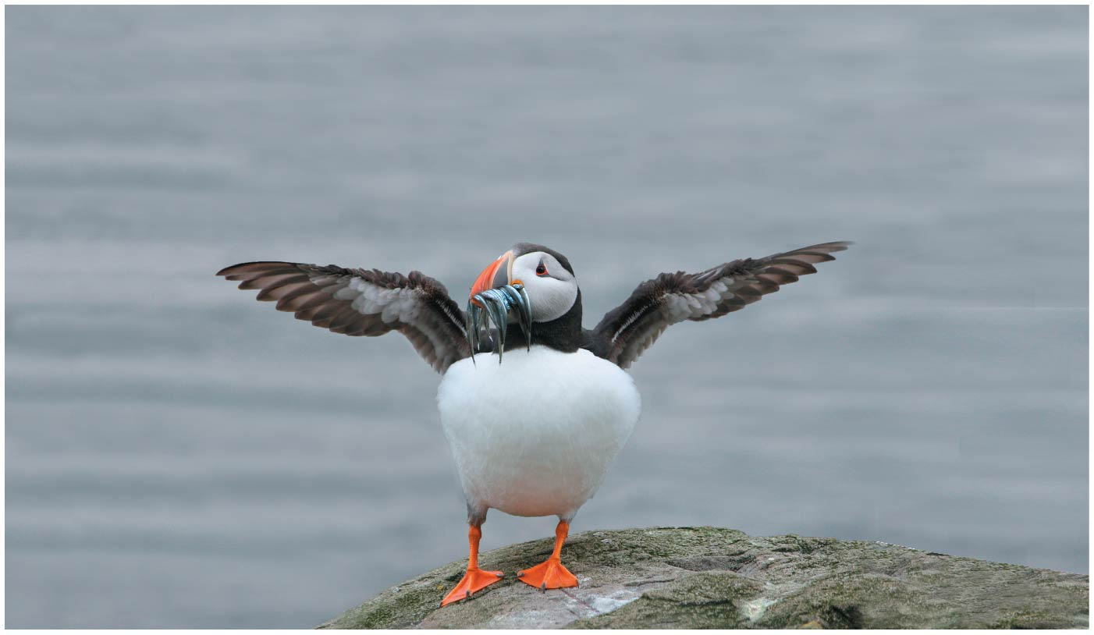
Figure 10.1
How does food, like the sand eels captured by this puffin, power the work of life?
© 2018 Pearson Education Ltd.
Notes:
Figure 10.1 How does food, like the sand eels captured by this puffin, power the work of life?

Slide 4
Energy flows into an ecosystem as sunlight and leaves as heat
The chemical elements essential to life are recycled
Photosynthesis generates O₂ and organic molecules, which are used in cellular respiration(呼吸作用)
Cells use chemical energy stored in organic molecules to generate ATP, which powers work

Slide 5
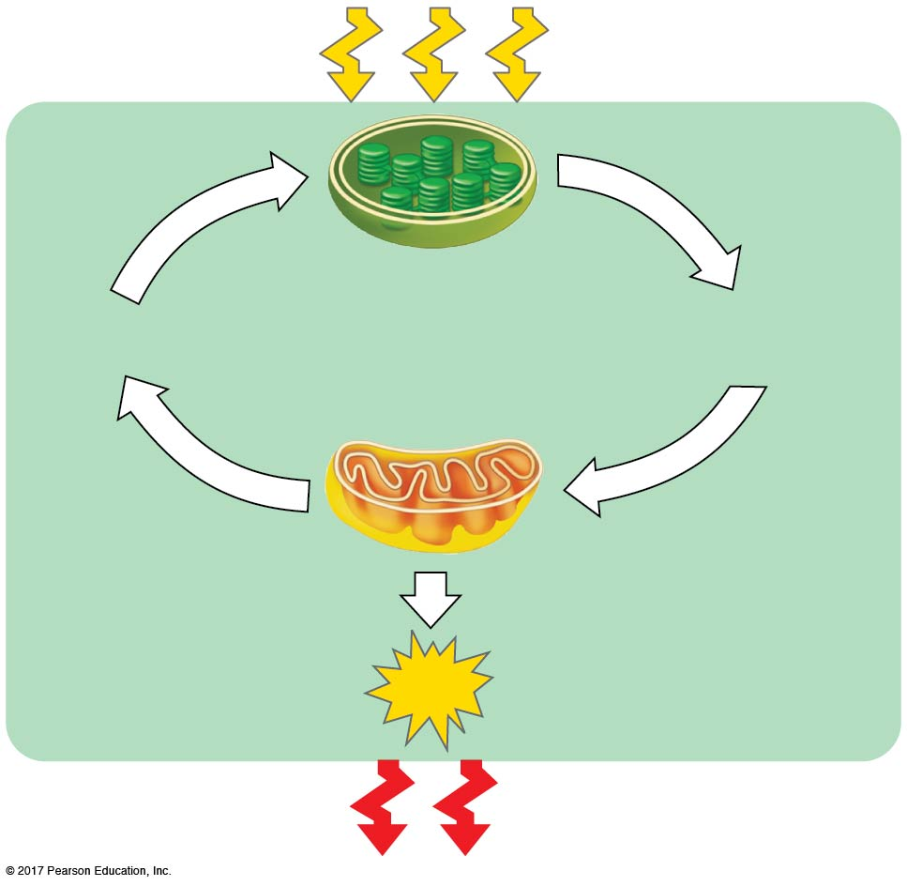
Figure 10.2
Energy flow and chemical recycling in ecosystems
Light
energy
ECOSYSTEM
Photosynthesis
in chloroplasts (葉綠體)
CO₂ + H₂O
Organic
molecules
+
O₂
Cellular respiration
in mitochondria
ATP
ATP powers
most cellular work
Heat
energy
© 2018 Pearson Education Ltd.
Notes:
Figure 10.2 Energy flow and chemical recycling in ecosystems

Slide 6
BioFlix: The Carbon Cycle

Slide 7
Concept 10.1: Catabolic (分解代謝) pathways yield energy by oxidizing organic fuels
Catabolic pathways release stored energy by breaking down complex molecules
分解 → 放能
Electron transfer plays a major role in these pathways
These processes are central to cellular respiration

Slide 8
Catabolic Pathways and Production of ATP
The breakdown of organic molecules is exergonic (放能的)
Fermentation (發酵作用) is a partial degradation of sugars that occurs without O₂
Aerobic respiration (有氧呼吸) consumes organic molecules and O₂ and yields ATP
Anaerobic respiration (無氧呼吸) is similar to aerobic respiration but consumes compounds other than O₂

Slide 9
Cellular respiration includes both aerobic and anaerobic respiration but is often used to refer to aerobic respiration
Although carbohydrates, fats, and proteins are all consumed as fuel, it is helpful to trace cellular respiration with the sugar glucose (葡萄糖)
C₆H₁₂O₆ + 6 O₂ → 6 CO₂ + 6 H₂O + Energy (ATP + heat)

Slide 10
Redox Reactions (氧化還原反應): Oxidation and Reduction
The transfer of electrons during chemical reactions releases energy stored in organic molecules
This released energy is ultimately used to synthesize ATP

Slide 11
The Principle of Redox
Chemical reactions that transfer electrons between reactants are called oxidation-reduction reactions, or redox reactions
In oxidation, a substance loses electrons, or is oxidized
In reduction, a substance gains electrons, or is reduced (the amount of positive charge is reduced)

Slide 12
Figure 10.UN01
NaCl redox reaction
becomes oxidized
(loses electron)
becomes reduced
(gains electron)
© 2018 Pearson Education Ltd.
Notes:
Figure 10.UN01 In-text figure, NaCl redox reaction, p. 238

Slide 13
Figure 10.UN02
Generalized redox reaction
becomes oxidized
becomes reduced
© 2018 Pearson Education Ltd.
Notes:
Figure 10.UN02 In-text figure, generalized redox reaction, p. 238

Slide 14
The electron donor (予體) is called the reducing agent (還原劑)
The electron receptor (受體) is called the oxidizing agent (氧化劑)
Some redox reactions do not transfer electrons but change the electron sharing in covalent bonds (共價鍵)
An example is the reaction between methane and O₂

Slide 15
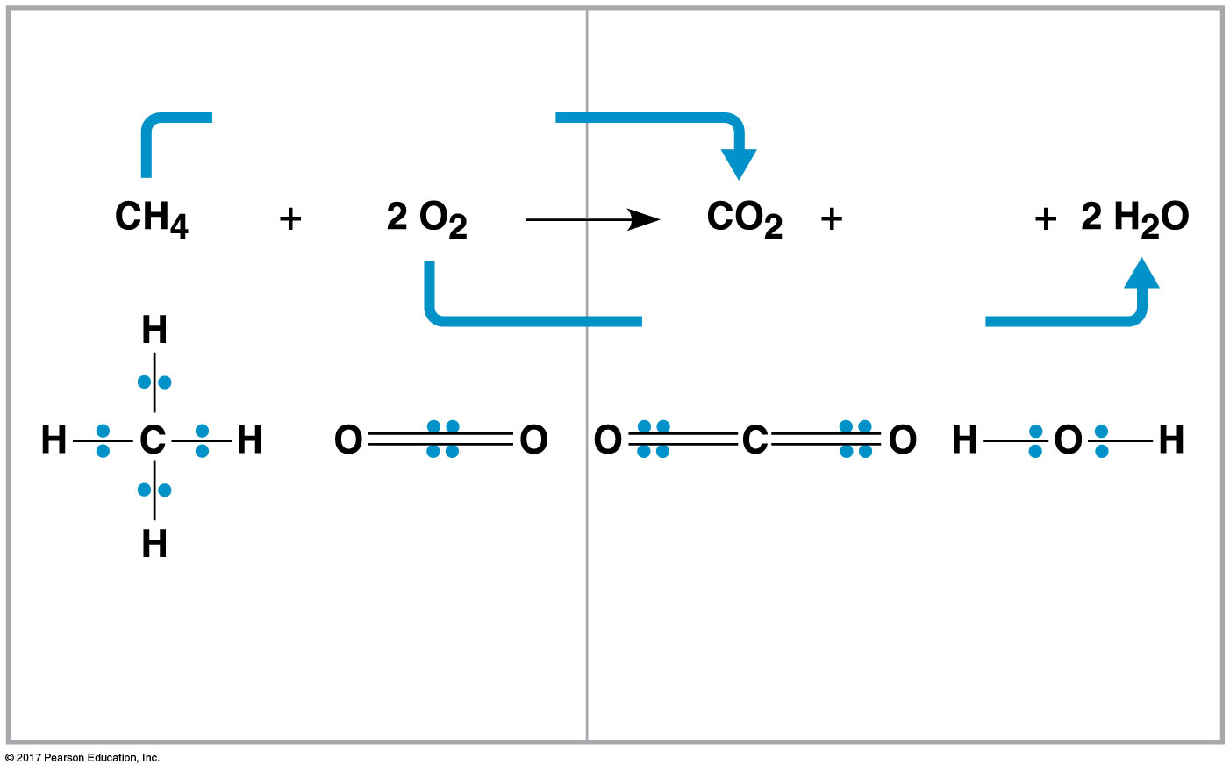
Figure 10.3
Methane combustion as an energy-yielding redox reaction
Reactants
Products
becomes oxidized
Energy
becomes reduced
Methane
(reducing
agent)
Oxygen
(oxidizing
agent)
Carbon dioxide
Water
© 2018 Pearson Education Ltd.
Notes:
Figure 10.3 Methane combustion as an energy-yielding redox reaction

Slide 16
Oxidation of Organic Fuel Molecules During Cellular Respiration
During cellular respiration, the fuel (such as glucose) is oxidized, and O₂ is reduced
Organic molecules with an abundance of hydrogen are excellent sources of high-energy electrons
Energy is released as the electrons associated with hydrogen ions are transferred to oxygen, a lower energy state

Slide 17
Figure 10.UN03
Cellular respiration redox reaction
becomes oxidized
becomes reduced
© 2018 Pearson Education Ltd.
Notes:
Figure 10.UN03 In-text figure, cellular respiration redox reaction, p. 238

Slide 18
Stepwise (逐步) Energy Harvest via NAD⁺ and the Electron Transport Chain (P.239)
In cellular respiration, glucose and other organic molecules are broken down in a series of steps
Electrons from organic compounds are usually first transferred to NAD⁺, a coenzyme (輔酶)
As an electron acceptor, NAD⁺ functions as an oxidizing agent during cellular respiration
Each NADH 還原態 (the reduced form of NAD⁺氧化態) represents stored energy that is tapped to synthesize(合成) ATP

Slide 19
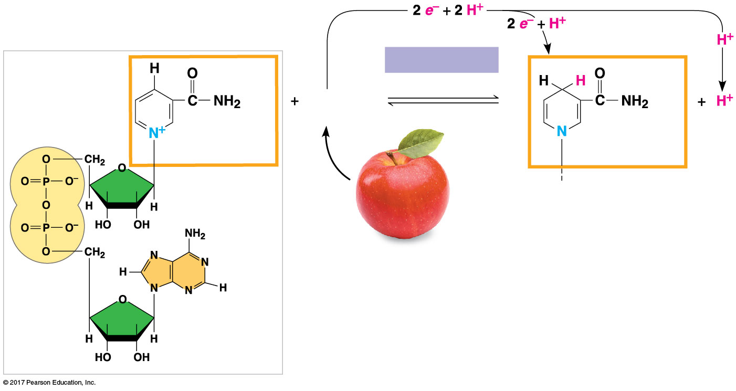
Figure 10.4
NAD⁺ as an electron shuttle
NAD⁺
NADH
Dehydrogenase
(脫氫酶)
Reduction of NAD⁺
2[H]
(from food)
Oxidation of NADH
Nicotinamide
(oxidized form)
Nicotinamide
(reduced form)
© 2018 Pearson Education Ltd.
Notes:
Figure 10.4 NAD⁺ as an electron shuttle

Slide 20
Figure 10.UN04
Dehydrogenase reaction
Dehydrogenase
© 2018 Pearson Education Ltd.
Notes:
Figure 10.UN04 In-text figure, dehydrogenase reaction, p. 239

Slide 21
NADH passes the electrons to the electron transport chain
Unlike an uncontrolled reaction, the electron transport chain passes electrons in a series of steps instead of one explosive reaction
O₂ pulls electrons down the chain in an energy-yielding tumble
The energy yielded is used to regenerate ATP

Slide 22
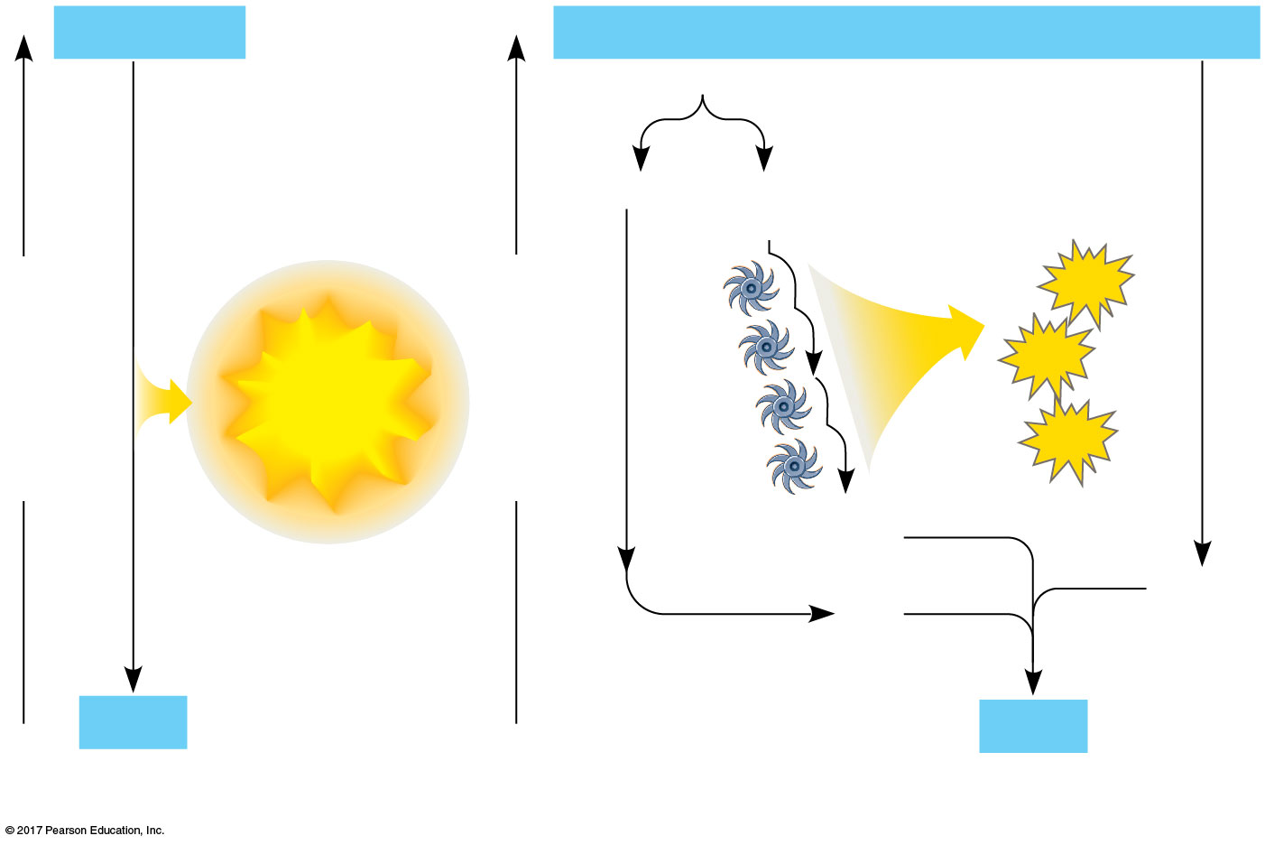
Figure 10.5
An introduction to electron transport chains
H₂
+
½ O₂
2 H
+
½ O₂
Controlled
release of
energy
2 H⁺ + 2 e–
ATP
Free energy, G
Explosive
release of
energy
Free energy, G
ATP
chain
Electron transport
ATP
2 e–
½ O₂
2 H⁺
H₂O
H₂O
(a) Uncontrolled reaction
(b) Cellular respiration
© 2018 Pearson Education Ltd.
Notes:
Figure 10.5 An introduction to electron transport chains

Slide 23
The Stages of Cellular Respiration: A Preview
Harvesting of energy from glucose has three stages
​Glycolysis (糖解) (breaks down glucose into two molecules of pyruvate (丙酮酸))
The citric acid cycle (檸檬酸循環) (completes the breakdown of glucose)
​Oxidative phosphorylation (氧化磷酸化) (accounts for most of the ATP synthesis)

Slide 24
Figure 10.UN05
Color code for stages of cellular respiration
1.
GLYCOLYSIS (color-coded blue throughout the chapter)
2.
PYRUVATE OXIDATION and the CITRIC ACID CYCLE
(color-coded light orange and dark orange)
3.
OXIDATIVE PHOSPHORYLATION: Electron transport and
chemiosmosis (color-coded purple)
© 2018 Pearson Education Ltd.
Notes:
Figure 10.UN05 In-text figure, color code for stages of cellular respiration, p. 240

Slide 25
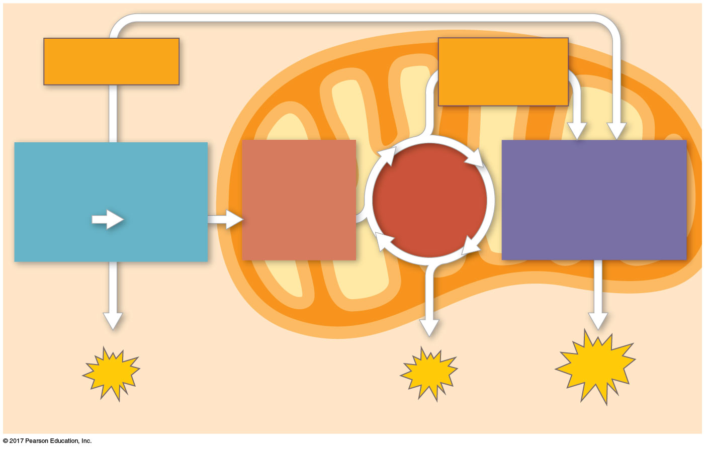
Figure 10.6_3
An overview of cellular respiration
Electrons
via NADH
Electrons
via NADH
and FADH₂
GLYCOLYSIS
PYRUVATE
OXIDATION
OXIDATIVE
PHOSPHORYLATION
CITRIC
ACID
CYCLE
Glucose
Pyruvate
Acetyl CoA
(Electron transport
and chemiosmosis)
CYTOSOL
MITOCHONDRION
ATP
ATP
ATP
Substrate-level
Substrate-level
Oxidative
© 2018 Pearson Education Ltd.
Notes:
Figure 10.6_3 An overview of cellular respiration (step 3)

Slide 26
BioFlix: Cellular Respiration

Slide 27
The process that generates almost 90% of the ATP is called oxidative phosphorylation because it is powered by redox reactions
A smaller amount of ATP is formed in glycolysis and the citric acid cycle by substrate-level phosphorylation

Slide 28
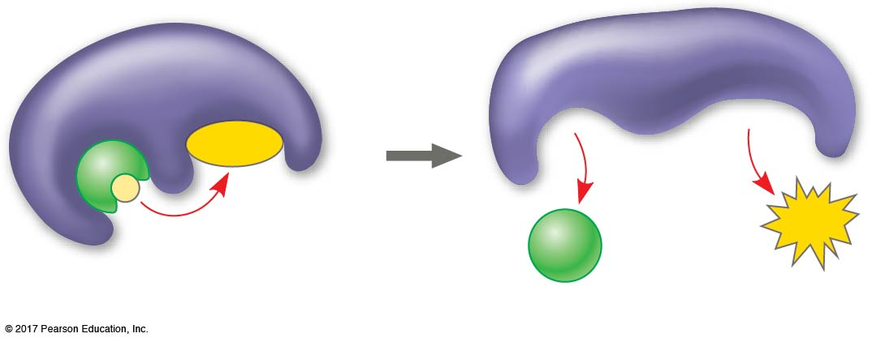
Figure 10.7
Substrate-level phosphorylation
Enzyme
Enzyme
ADP
P
ATP
Substrate
Product
© 2018 Pearson Education Ltd.
Notes:
Figure 10.7 Substrate-level phosphorylation

Slide 29
For each molecule of glucose degraded to CO₂ and water by respiration, the cell makes up to 32 molecules of ATP

Slide 30
We can use money as an analogy for cellular respiration:
Glucose is like a larger-denomination bill—it is worth a lot, but it is hard to spend
ATP is like a number of smaller-denomination bills of equivalent value—they can be spent more easily
Cellular respiration cashes in a large denomination of energy (glucose) for the small change of many molecules of ATP

Slide 31
Concept 10.2: Glycolysis harvests chemical energy by oxidizing glucose to pyruvate
Glycolysis (“sugar splitting”) breaks down glucose into two molecules of pyruvate
Glycolysis occurs in the cytoplasm (細胞質) and has two major phases
Energy investment phase
Energy payoff phase
Glycolysis occurs whether or not O₂ is present

Slide 32
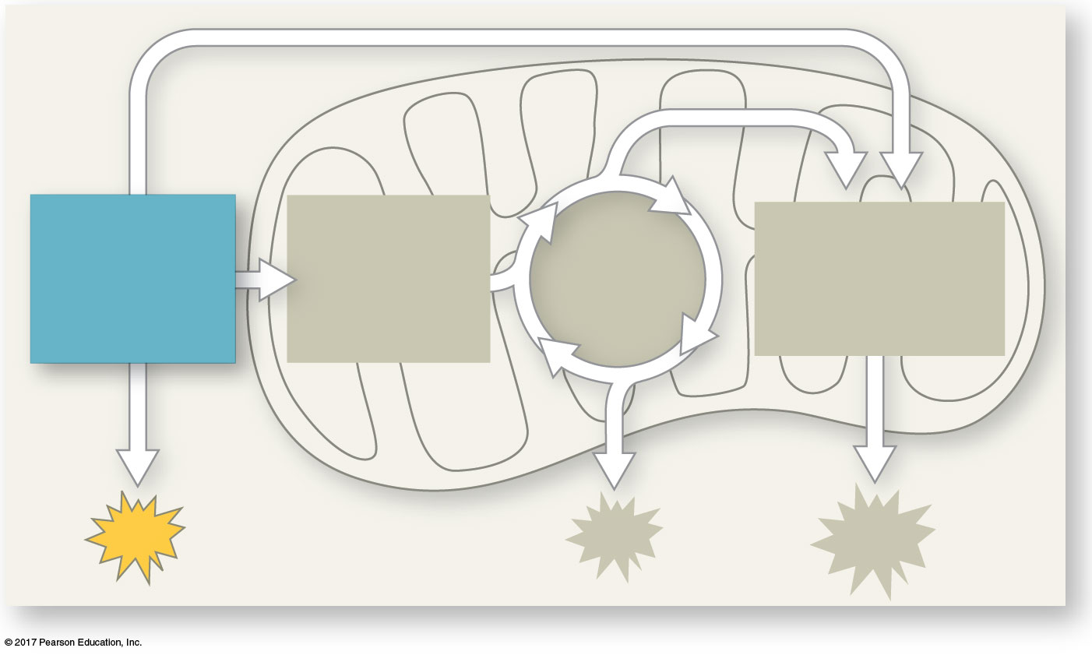
Figure 10.UN06
CITRIC
ACID
CYCLE
OXIDATIVE
PHOSPHORYL-
ATION
GLYCOLYSIS
PYRUVATE
OXIDATION
ATP
© 2018 Pearson Education Ltd.
Notes:
Figure 10.UN06 In-text figure, mini-map, glycolysis, p. 242

Slide 33
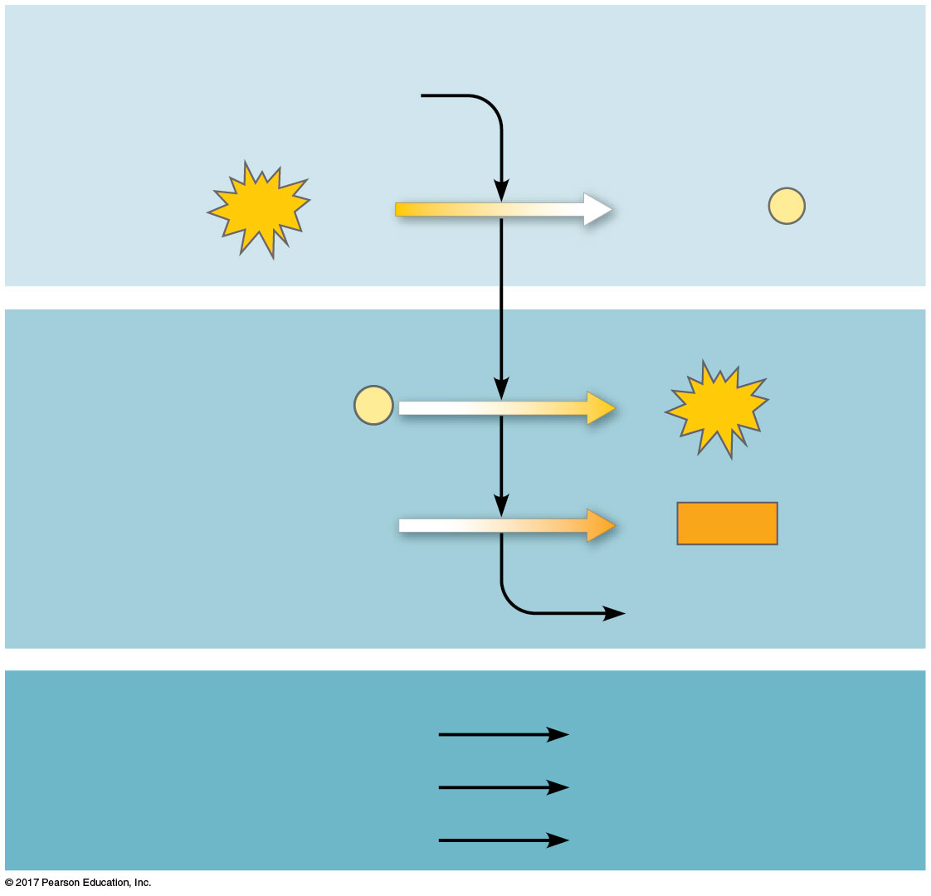
Figure 10.8
Energy Investment Phase
Glucose
2
ATP used
2 ADP + 2
P
Energy Payoff Phase
4 ADP + 4
P
4
ATP formed
2 NAD⁺ + 4 e– + 4 H⁺
2
NADH
+ 2 H⁺
2 Pyruvate + 2 H₂O
Net
Glucose
2 Pyruvate + 2 H₂O
4 ATP formed – 2 ATP used
2 ATP
2 NAD⁺ + 4 e– + 4 H⁺
2 NADH + 2 H⁺
© 2018 Pearson Education Ltd.
Notes:
Figure 10.8 The energy input and output of glycolysis

Slide 34
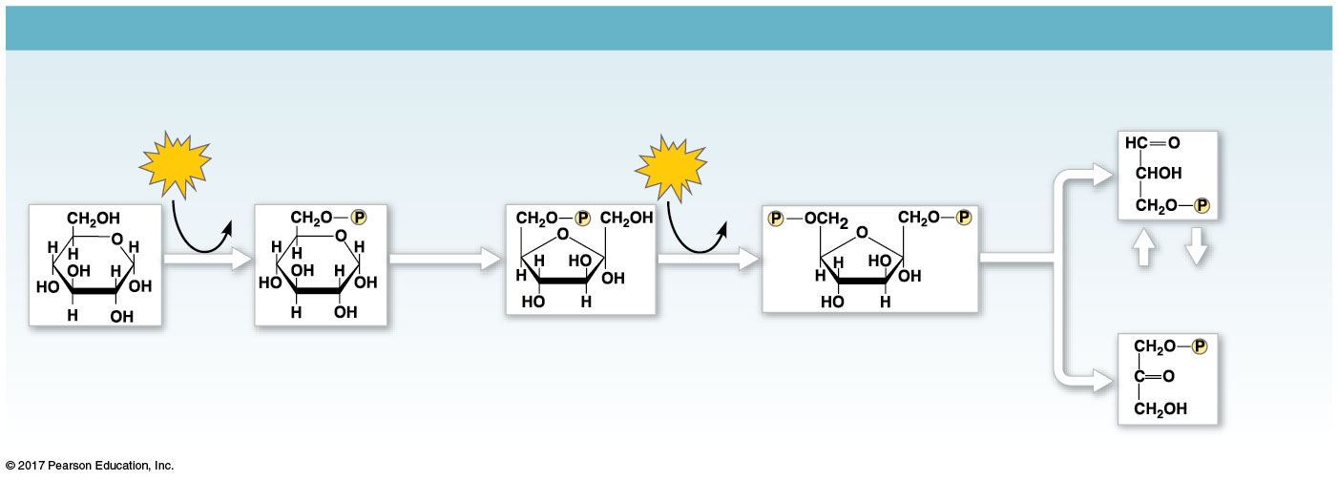
Figure 10.9a
GLYCOLYSIS: Energy Investment Phase
Glyceraldehyde
3-phosphate (G3P)
ATP
Glucose
6-phosphate
Fructose
6-phosphate
ATP
Fructose
1,6-bisphosphate
Glucose
ADP
ADP
Isomerase
5
Hexokinase
Phosphogluco-
isomerase
Phospho-
Aldolase
Dihydroxyacetone
phosphate (DHAP)
1
fructokinase
4
2
3
GLYCOLYSIS: Energy Payoff Phase
2 NADH
2 ATP
2 H₂O
2
ATP
2 NAD⁺
+ 2 H⁺
2 ADP
2
2
2
2 ADP
2
2
Triose
phosphate
dehydrogenase
Phospho-
glycerokinase
Phospho-
glyceromutase
Enolase
Pyruvate
kinase
Glycer-
aldehyde
3-phosphate
(G3P)
2
P
i
9
6
1,3-Bisphospho-
glycerate
7
3-Phospho-
glycerate
8
2-Phospho-
glycerate
Phosphoenol-
pyruvate (PEP)
10
Pyruvate
© 2018 Pearson Education Ltd.
Notes:
Figure 10.9a A closer look at glycolysis (part 1: investment phase)

Slide 35
Concept 10.3: After pyruvate is oxidized, the citric acid cycle completes the energy-yielding oxidation of organic molecules
In the presence of O₂, pyruvate enters a mitochondrion (in eukaryotic cells), where the oxidation of glucose is completed

Slide 36
Oxidation of Pyruvate to Acetyl CoA
Before the citric acid cycle can begin, pyruvate must be converted to acetyl coenzyme A (acetyl CoA), which links glycolysis to the citric acid cycle
This step is carried out by a multienzyme complex that catalyzes three reactions
Oxidation of pyruvate and release of CO₂
Reduction of NAD⁺ to NADH
Combination of the remaining two-carbon fragment and coenzyme A to form acetyl CoA

Slide 37
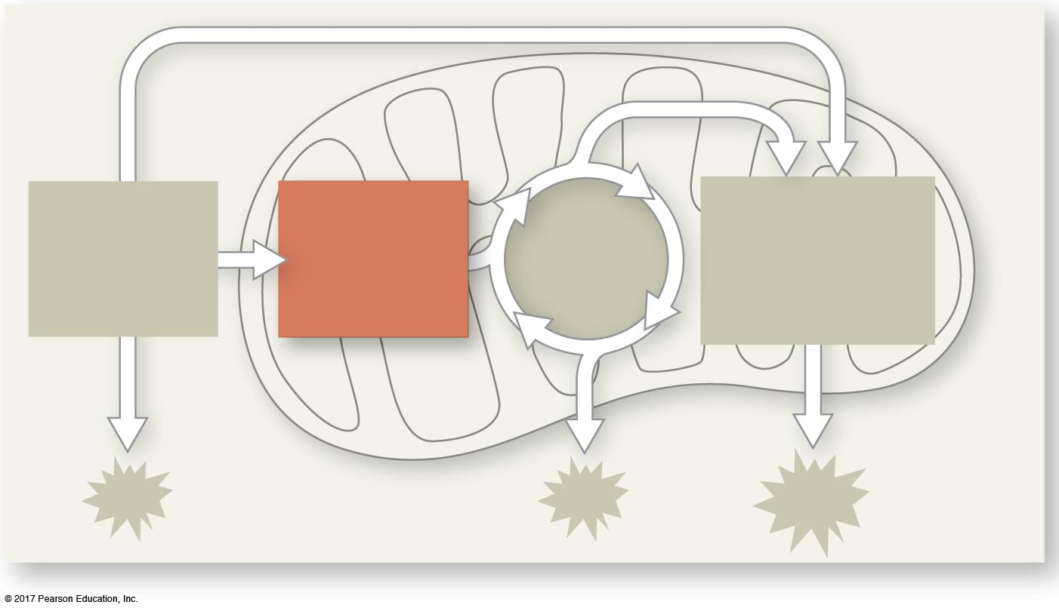
Figure 10.UN07
PYRUVATE
OXIDATION
CITRIC
ACID
CYCLE
OXIDATIVE
PHOSPHORYL-
ATION
GLYCOLYSIS
© 2018 Pearson Education Ltd.
Notes:
Figure 10.UN07 In-text figure, mini-map, pyruvate oxidation, p. 243

Slide 38
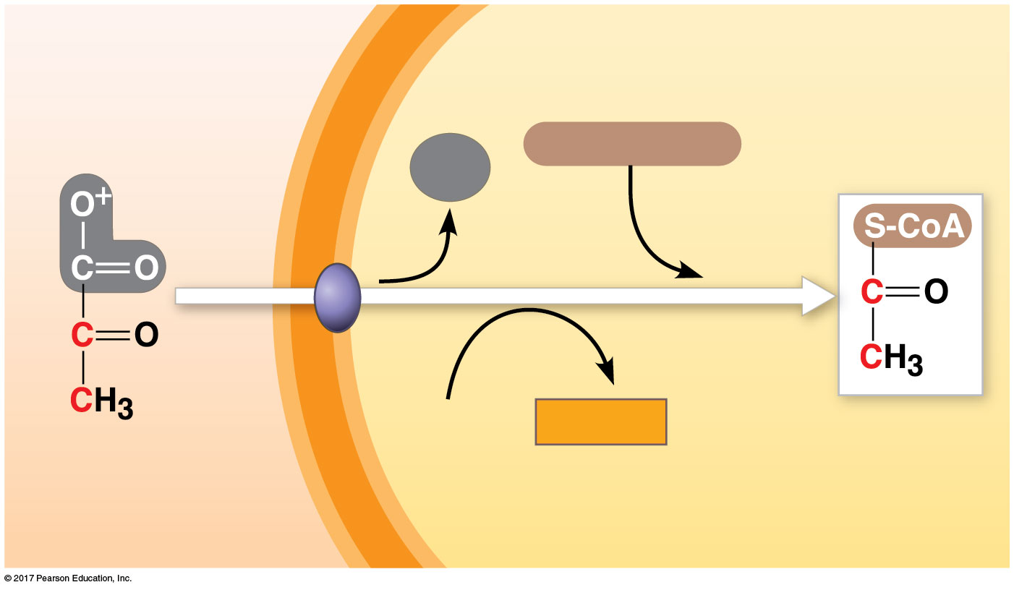
Figure 10.10
Oxidation of pyruvate to acetyl CoA, the step before the citric acid cycle
MITOCHONDRION
CYTOSOL
Coenzyme A
CO₂
1
3
2
NAD⁺
NADH
+ H⁺
Acetyl CoA
Pyruvate
Transport protein
© 2018 Pearson Education Ltd.
Notes:
Figure 10.10 Oxidation of pyruvate to acetyl CoA, the step before the citric acid cycle

Slide 39
The Citric Acid Cycle
The citric acid cycle, also called the Krebs cycle, completes the breakdown of pyruvate to CO₂
The cycle oxidizes organic fuel derived from pyruvate, generating 1 ATP, 3 NADH, and 1 FADH₂ per turn

Slide 40
The citric acid cycle has eight steps, each catalyzed by a specific enzyme
The acetyl group of acetyl CoA joins the cycle by combining with oxaloacetate (草醯乙酸), forming citrate
The next seven steps decompose the citrate back to oxaloacetate, making the process a cycle
The NADH and FADH₂ produced by the cycle relay electrons extracted from food to the electron transport chain

Slide 41
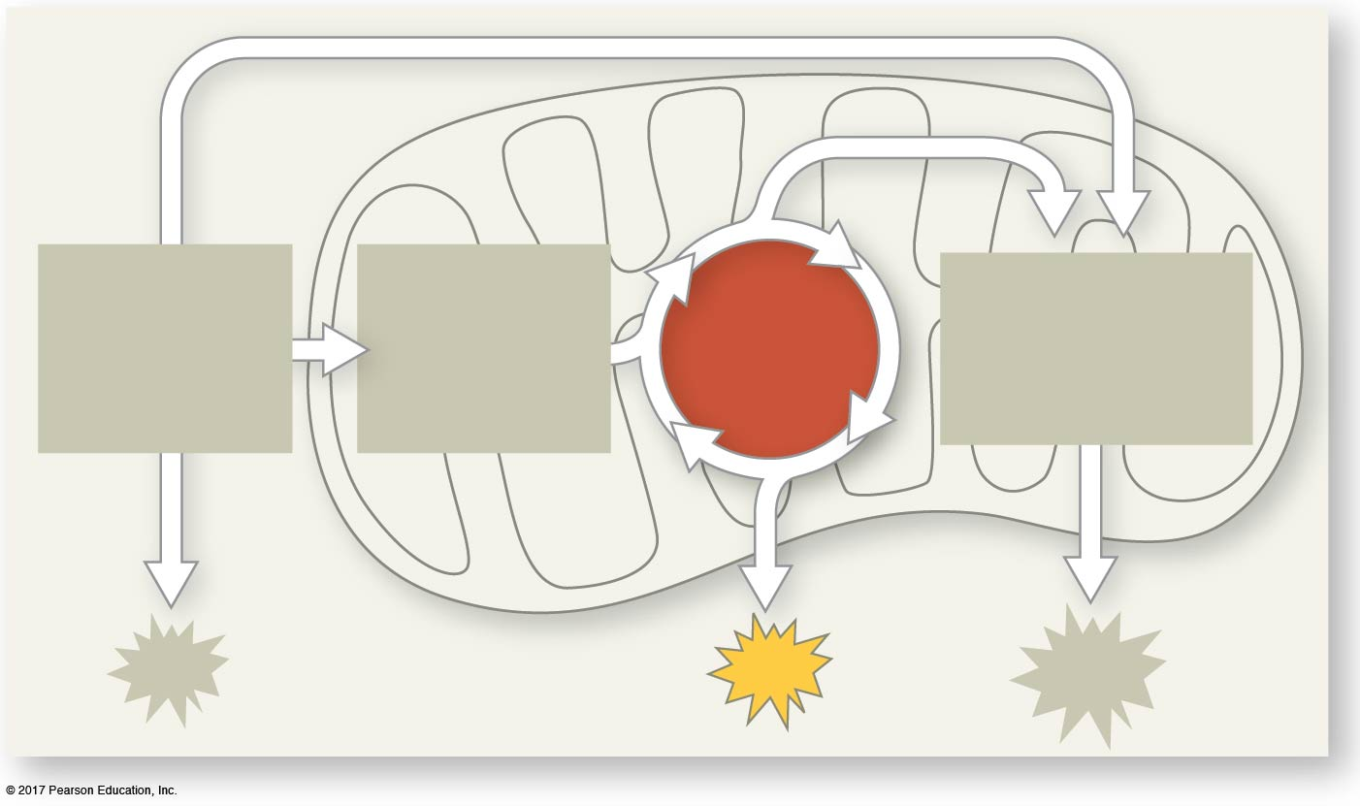
Figure 10.UN08
PYRUVATE
OXIDATION
CITRIC
ACID
CYCLE
OXIDATIVE
PHOSPHORYL-
ATION
GLYCOLYSIS
ATP
© 2018 Pearson Education Ltd.
Notes:
Figure 10.UN08 In-text figure, mini-map, citric acid cycle, p. 245

Slide 42
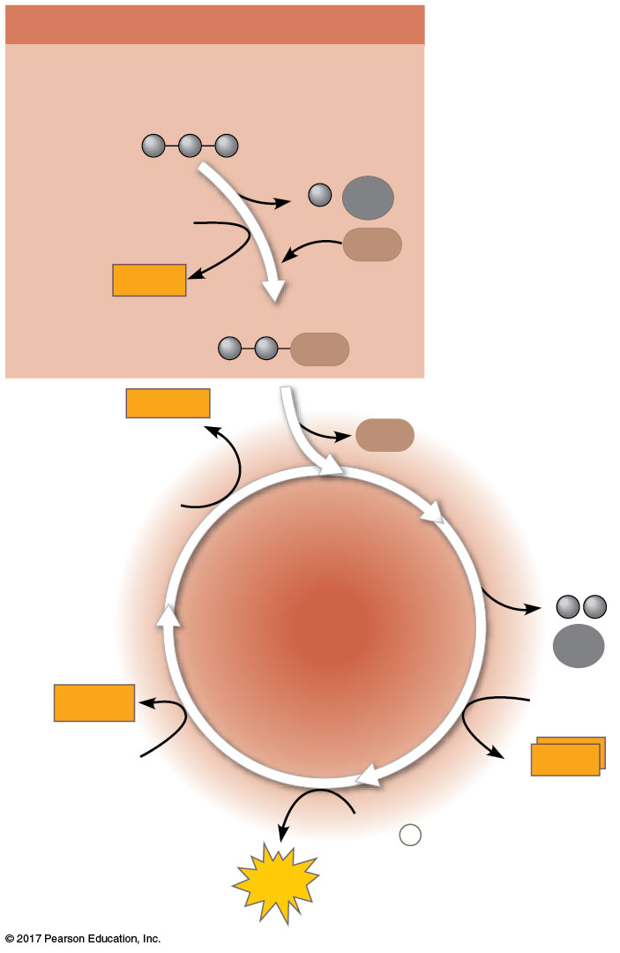
Figure 10.11
PYRUVATE OXIDATION
Pyruvate
(from glycolysis,
2 molecules per glucose)
CO₂
NAD⁺
CoA
NADH
+ H⁺
Acetyl CoA
CoA
NADH
+ H⁺
CoA
NAD⁺
CITRIC
ACID
CYCLE
2
CO₂
FADH₂
2 NAD⁺
FAD
2
NADH
+ 2 H⁺
ADP + P _{i}
ATP
© 2018 Pearson Education Ltd.
Notes:
Figure 10.11 An overview of pyruvate oxidation and the citric acid cycle

Slide 43
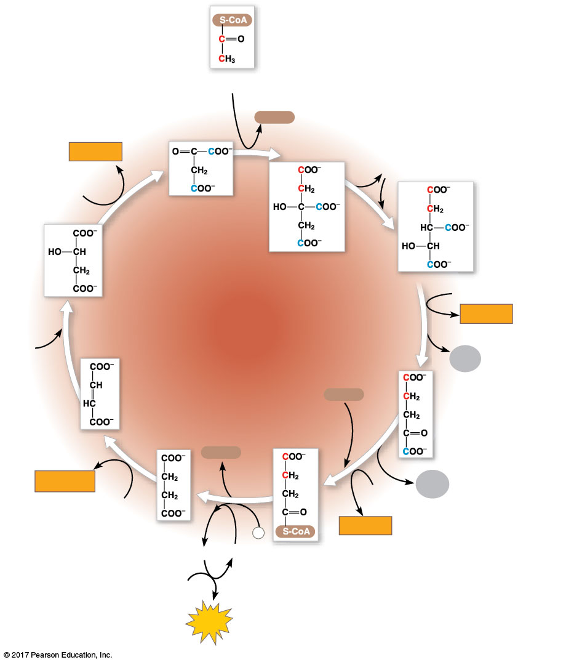
Figure 10.12_8
Acetyl CoA
CoA-SH
NADH
H₂O
+ H⁺
1
NAD⁺
8
Oxaloacetate
2
Malate
Citrate
Isocitrate
NAD⁺
CITRIC
ACID
CYCLE
3
NADH
7
+ H⁺
H₂O
CO₂
Fumarate
CoA-SH
4
α-Ketoglutarate
6
CoA-SH
FADH₂
5
NAD⁺
CO₂
FAD
Succinate
P
NADH
GDP
i
+ H⁺
GTP
Succinyl
CoA
ADP
ATP
© 2018 Pearson Education Ltd.
Notes:
Figure 10.12_8 A closer look at the citric acid cycle (step 8)

Slide 44
Concept 10.4: During oxidative phosphorylation, chemiosmosis (化學滲透) couples electron transport to ATP synthesis
Following glycolysis and the citric acid cycle, NADH and FADH₂ account for most of the energy extracted from food
These two electron carriers donate electrons to the electron transport chain, which powers ATP synthesis via oxidative phosphorylation

Slide 45
The Pathway of Electron Transport
The electron transport chain is in the inner membrane (cristae) of the mitochondrion
Most of the chain’s components are proteins, which exist in multiprotein complexes
Electrons drop in free energy as they go down the chain and are finally passed to O₂, forming H₂O
Electron carriers alternate between reduced and oxidized states as they accept and donate electrons

Slide 46
Electrons are transferred from NADH or FADH₂ to the electron transport chain
Electrons are passed through a number of proteins including cytochromes ( 細胞色素) (each with an iron atom) to O₂
The electron transport chain generates no ATP directly
It breaks the large free-energy drop from food to O₂ into smaller steps that release energy in manageable amounts

Slide 47
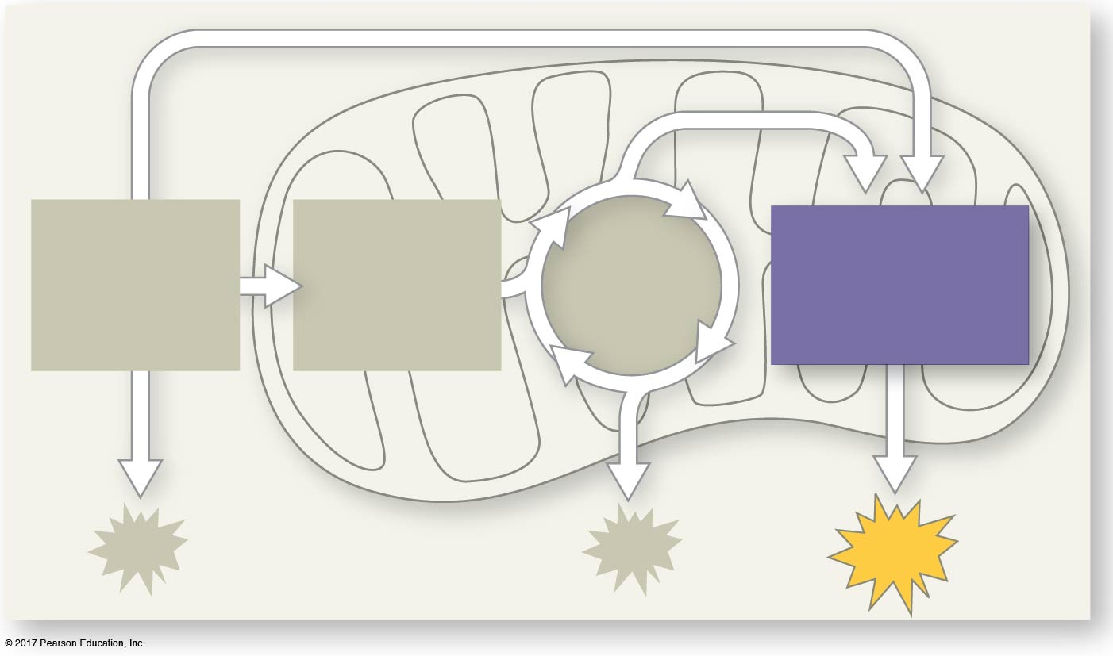
Figure 10.UN09
PYRUVATE
OXIDATION
CITRIC
ACID
CYCLE
OXIDATIVE
PHOSPHORYL-
ATION
GLYCOLYSIS
ATP
© 2018 Pearson Education Ltd.
Notes:
Figure 10.UN09 In-text figure, mini-map, oxidative phosphorylation, p. 246

Slide 48
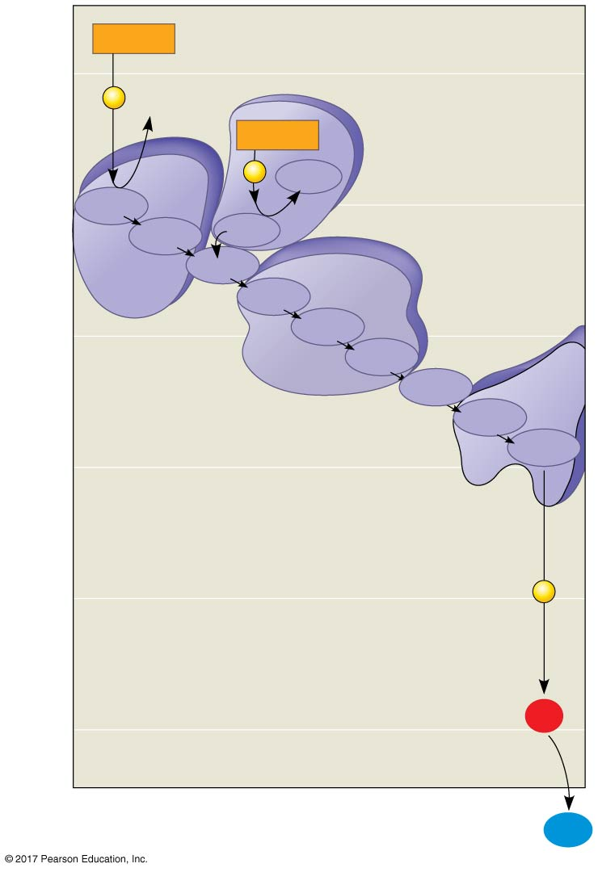
Figure 10.13
NADH
(least electronegative)
50
2
e–
NAD⁺
FADH₂
Complexes I-IV each consist of multiple proteins with electron
carriers.
2
e–
FAD
40
FMN
I
Fe•S
Fe•S
II
Q
III
Cyt b
30
Fe•S
Cyt c₁
IV
Free energy (G) relative to O₂ (kcal/mol)
Cyt c
Cyt a
Electron transport
chain
Cyt a₃
20
10
2
e–
0
2 H⁺ + ½
O₂
(most electronegative)
H₂O
© 2018 Pearson Education Ltd.
Notes:
Figure 10.13 Free-energy change during electron transport

Slide 49
Chemiosmosis: The Energy-Coupling Mechanism
The energy released as electrons are passed down the electron transport chain is used to pump H⁺ from the mitochondrial matrix (粒線體基質) to the intermembrane space (更外面)
H⁺ then moves down its concentration gradient back across the membrane, passing through the protein complex ATP synthase (ATP合成酶)

Slide 50
H⁺ moves into binding sites on the rotor of ATP synthase, causing it to spin in a way that catalyzes phosphorylation of ADP to ATP
This is an example of chemiosmosis, the use of energy in a H⁺ gradient to drive cellular work

Slide 51
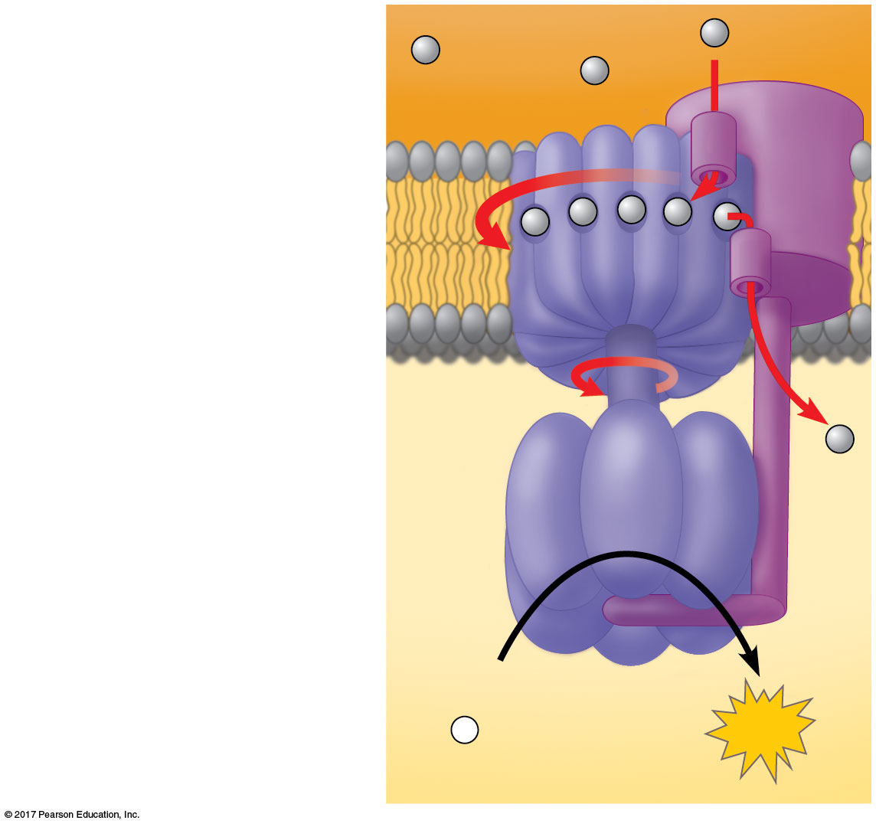
Figure 10.14
ATP synthase, a molecular mill
H⁺
Stator
INTERMEMBRANE SPACE
Rotor
Internal rod
Catalytic knob
ADP
+
P _{i}
ATP
MITOCHONDRIAL MATRIX
© 2018 Pearson Education Ltd.
Notes:
Figure 10.14 ATP synthase, a molecular mill

Slide 52
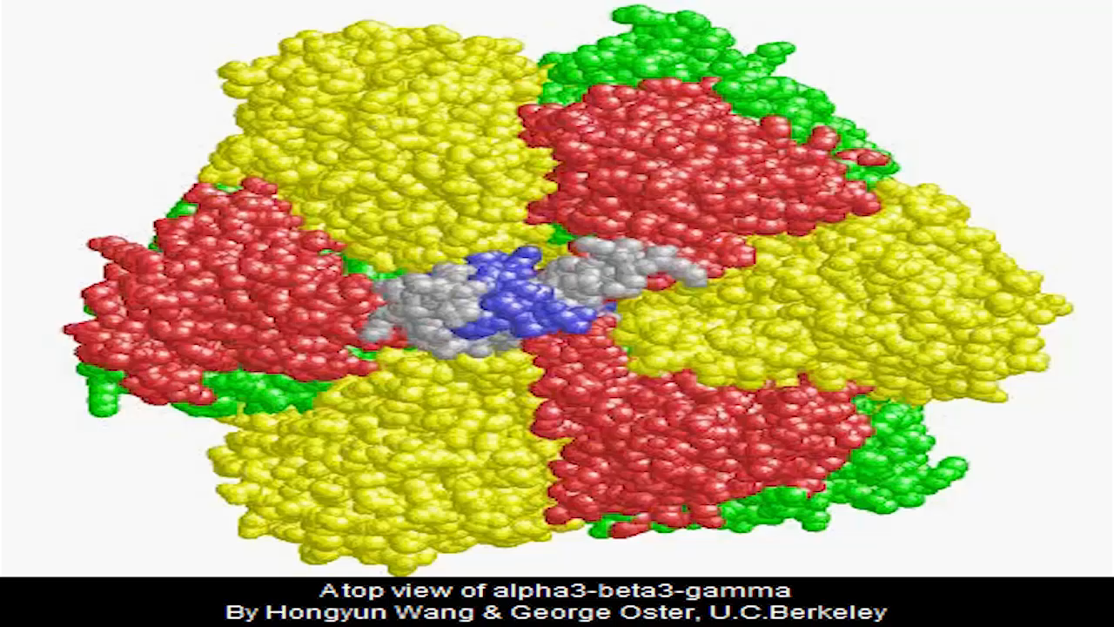
Video: ATP Synthase 3-D Structure, Top View

Slide 53
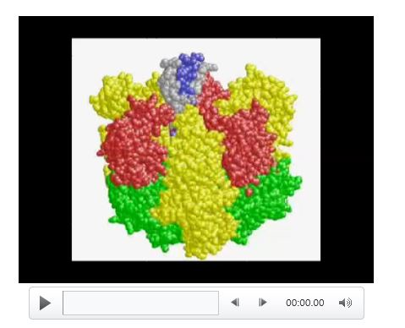
Video: ATP Synthase 3-D Structure, Side View

Slide 54
Certain electron carriers in the electron transport chain accept and release H⁺ along with the electrons
In this way, the energy stored in a H⁺ gradient across a membrane couples the redox reactions of the electron transport chain to ATP synthesis
The H⁺ gradient is referred to as a proton-motive force, emphasizing its capacity to do work

Slide 55
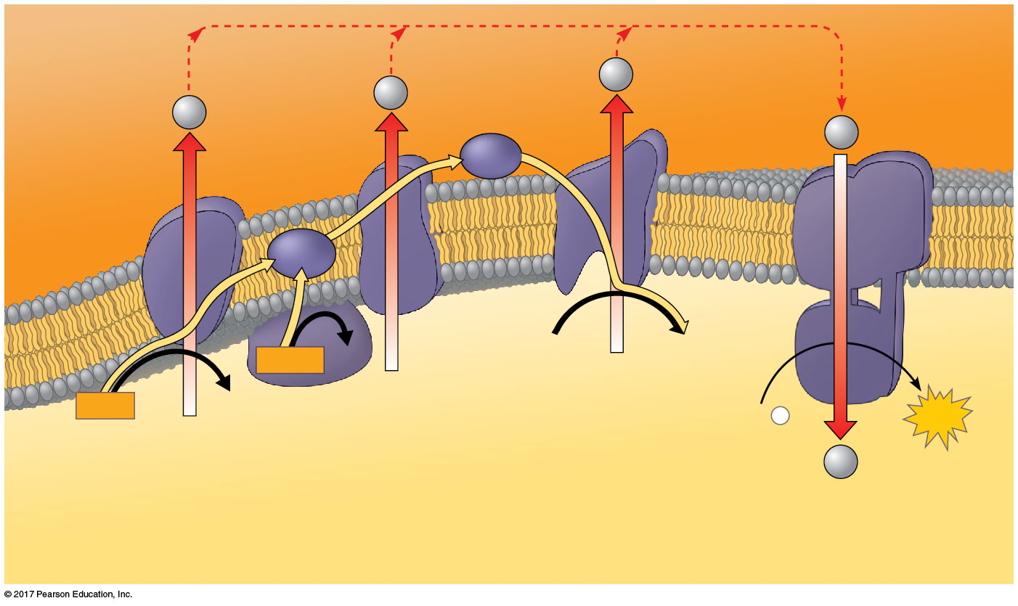
Figure 10.15
Chemiosmosis couples the electron transport chain to ATP synthesis
Protein
complex
of electron
carriers
H⁺
ATP
synthase
H⁺
H⁺
H⁺
Cyt c
Q
IV
I
III
II
2 H⁺ + ½ O₂
H₂O
FADH₂
FAD
NADH
NAD⁺
ADP + P _{i}
ATP
(carrying electrons
from food)
H⁺
1
Electron transport chain
2
Chemiosmosis
Oxidative phosphorylation
© 2018 Pearson Education Ltd.
Notes:
Figure 10.15 Chemiosmosis couples the electron transport chain to ATP synthesis

Slide 56
An Accounting of ATP Production by Cellular Respiration
During cellular respiration, most energy flows in this sequence:
glucose → NADH → electron transport chain → proton-motive force → ATP
About 34% of the energy in a glucose molecule is transferred to ATP during cellular respiration, making about 32 ATP
The rest of the energy is lost as heat

Slide 57
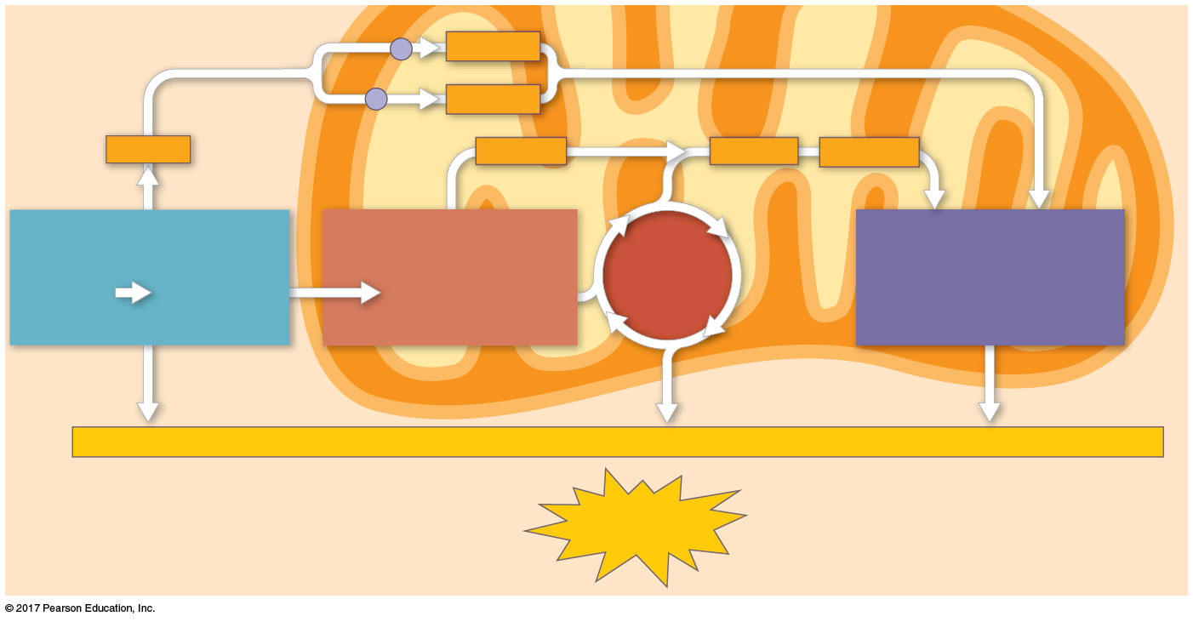
Figure 10.16
ATP yield per molecule of glucose at each stage of cellular respiration
Electron shuttles
span membrane
MITOCHONDRION
2 NADH
CYTOSOL
or
2 FADH₂
2 NADH
2 NADH
6 NADH
2 FADH₂
GLYCOLYSIS
PYRUVATE
OXIDATION
OXIDATIVE
PHOSPHORYLATION
CITRIC
ACID
CYCLE
Glucose
2 Pyruvate
2 Acetyl CoA
(Electron transport
and chemiosmosis)
+ 2 ATP
+ 2 ATP
+ about 26 or 28 ATP
Maximum per glucose:
About
30 or 32 ATP
© 2018 Pearson Education Ltd.
Notes:
Figure 10.16 ATP yield per molecule of glucose at each stage of cellular respiration

Slide 58
There are three reasons why the number of ATP is not known exactly
Photophosphorylation and the redox reactions are not directly coupled; the ratio of NADH to ATP molecules is not a whole number
ATP yield varies depending on whether electrons are passed to NAD⁺ or FAD in the mitochondrial matrix
The proton-motive force is also used to drive other kinds of work

Slide 59
Concept 10.5: Fermentation and anaerobic respiration enable cells to produce ATP without the use of oxygen
Most cellular respiration depends on electronegative oxygen to pull electrons down the transport chain
Without oxygen, the electron transport chain will cease to operate
In that case, glycolysis couples with anaerobic respiration or fermentation to produce ATP

Slide 60
Anaerobic respiration uses an electron transport chain with a final electron acceptor other than oxygen, for example, sulfate (硫酸)
Fermentation uses substrate-level phosphorylation instead of an electron transport chain to generate ATP

Slide 61
Types of Fermentation
Fermentation consists of glycolysis plus reactions that regenerate NAD⁺, which can be reused by glycolysis
Two common types are alcohol fermentation and lactic acid fermentation (乳酸發酵)

Slide 62
In alcohol fermentation, pyruvate is converted to ethanol (乙醇) in two steps
The first step releases CO₂ from pyruvate
The second step produces NAD⁺ and ethanol
Alcohol fermentation by yeast is used in brewing, winemaking, and baking

Slide 63
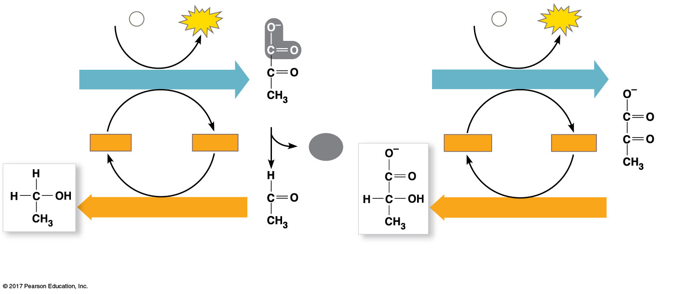
Figure 10.17
Fermentation
2 ADP + 2 P _{i}
2
ATP
2 ADP + 2 P _{i}
2
ATP
Glucose
GLYCOLYSIS
Glucose
GLYCOLYSIS
2 Pyruvate
2 NAD⁺
2 NADH
2
CO₂
2 NAD⁺
2 NADH
+ 2 H⁺
+ 2 H⁺
2 Pyruvate
NAD⁺ REGENERATION
NAD⁺ REGENERATION
2 Ethanol
2 Acetaldehyde
2 Lactate
(a) Alcohol fermentation
(b) Lactic acid fermentation
© 2018 Pearson Education Ltd.
Notes:
Figure 10.17 Fermentation

Slide 64
In lactic acid fermentation, pyruvate is reduced by NADH, forming NAD⁺ and lactate as end products, with no release of CO₂
Lactic acid fermentation by some fungi and bacteria is used to make cheese and yogurt
Human muscle cells use lactic acid fermentation to generate ATP during strenuous exercise when O₂ is scarce

Slide 65
Comparing Fermentation with Anaerobic and Aerobic Respiration
All use glycolysis (net ATP = 2) to oxidize glucose and harvest the chemical energy of food
In all three, NAD⁺ is the oxidizing agent that accepts electrons during glycolysis

Slide 66
The processes have different mechanisms for oxidizing NADH to NAD⁺:
In fermentation, an organic molecule (such as pyruvate or acetaldehyde) acts as a final electron acceptor
In cellular respiration, electrons are transferred to the electron transport chain
Cellular respiration produces 32 ATP per glucose molecule; fermentation produces 2 ATP per glucose molecule

Slide 67
Obligate anaerobes (厭氧菌) carry out fermentation or anaerobic respiration and cannot survive in the presence of O₂
Yeast and many bacteria are facultative anaerobes (兼性厭氧), meaning that they can survive using either fermentation or cellular respiration
In a facultative anaerobe, pyruvate is a fork in the metabolic road that leads to two alternative catabolic routes

Slide 68
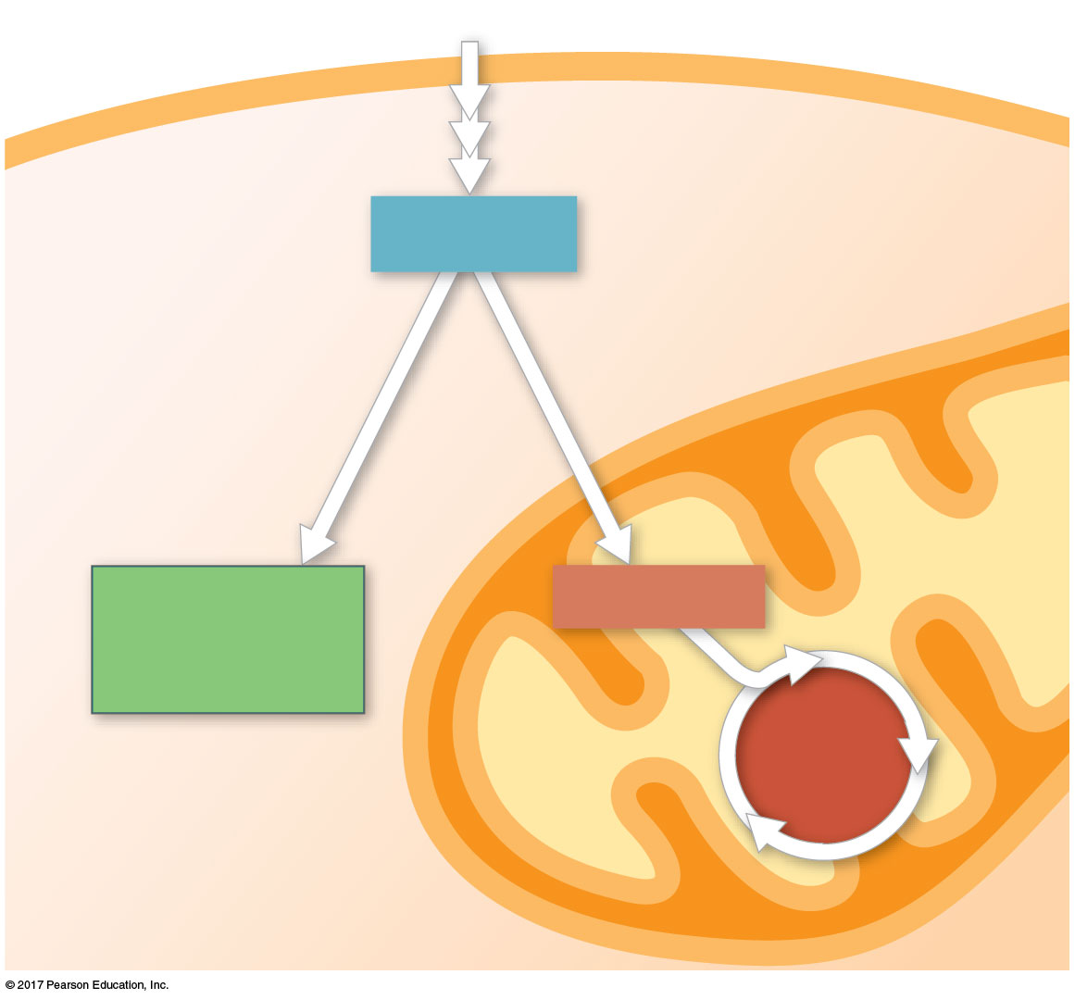
Figure 10.18
Pyruvate as a key juncture in catabolism
Glucose
Glycolysis
CYTOSOL
Pyruvate
No O₂ present:
O₂ present:
Fermentation
Aerobic cellular
respiration
MITOCHONDRION
Ethanol,
lactate, or
other products
Acetyl CoA
CITRIC
ACID
CYCLE
© 2018 Pearson Education Ltd.
Notes:
Figure 10.18 Pyruvate as a key juncture in catabolism

Slide 69
The Evolutionary Significance of Glycolysis
Glycolysis is an ancient process
Early prokaryotes likely used glycolysis to produce ATP before O₂ accumulated in the atmosphere
Used in both cellular respiration and fermentation, it is the most widespread metabolic pathway on Earth
This pathway occurs in the cytosol so does not require the membrane-bound organelles of eukaryotic cells

Slide 70
Concept 10.6: Glycolysis and the citric acid cycle connect to many other metabolic pathways
Gycolysis and the citric acid cycle are major intersections to various catabolic and anabolic pathways

Slide 71
The Versatility of Catabolism
Catabolic pathways funnel electrons from many kinds of organic molecules into cellular respiration
Glycolysis accepts a wide range of carbohydrates including starch, glycogen, and several disaccharides (雙糖)
Proteins that are used for fuel must be digested to amino acids and their amino groups must be removed

Slide 72
Fats are digested to glycerol (used to produce compounds needed for glycolysis) and fatty acids
Fatty acids are broken down by beta oxidation and yield acetyl CoA, NADH, and FADH₂
An oxidized gram of fat produces more than twice as much ATP as an oxidized gram of carbohydrate

Slide 73
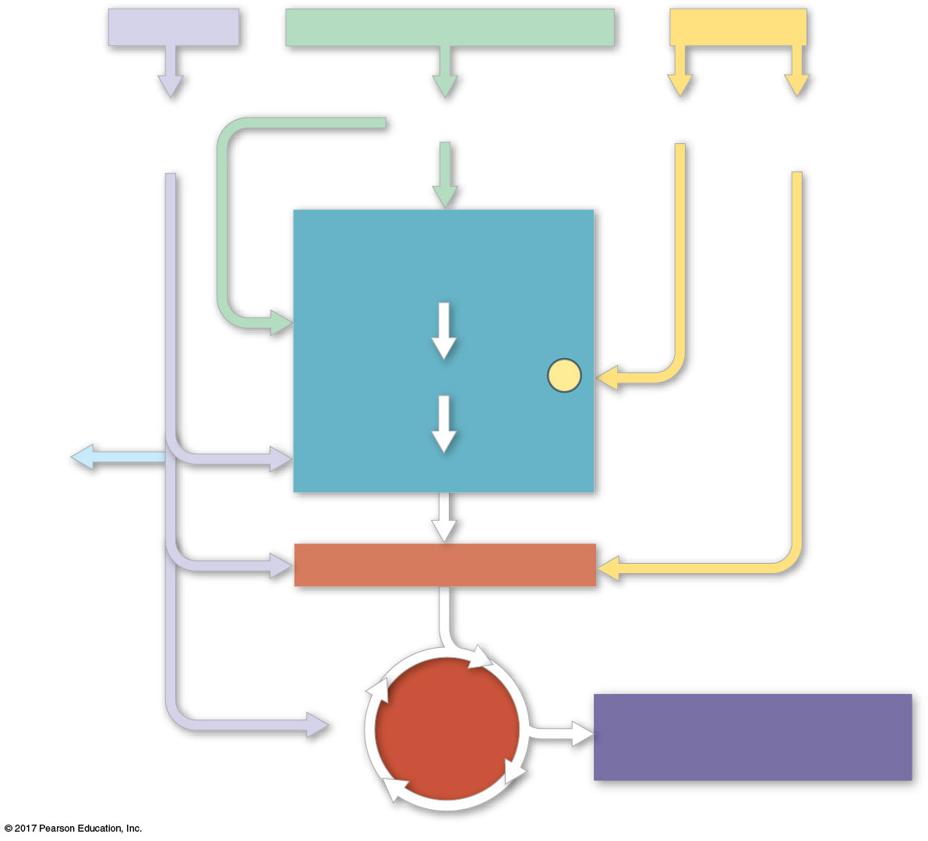
Figure 10.19_5
Proteins
Carbohydrates
Fats
Amino
acids
Sugars
Glycerol
Fatty
acids
GLYCOLYSIS
Glucose
Glyceraldehyde 3-
P
NH₃
Pyruvate
Acetyl CoA
CITRIC
ACID
CYCLE
OXIDATIVE
PHOSPHORYLATION
© 2018 Pearson Education Ltd.
Notes:
Figure 10.19_5 The catabolism of various molecules from food (step 5)

Slide 74
Biosynthesis (生物合成) (Anabolic Pathways)
The body uses small molecules from food to build other their own molecules such as proteins
These small molecules may come directly from food, from glycolysis, or from the citric acid cycle

Slide 75
Regulation of Cellular Respiration via Feedback Mechanisms
Feedback inhibition (回饋抑制作用) is the most common mechanism for metabolic control
If ATP concentration begins to drop, respiration speeds up; when there is plenty of ATP, respiration slows down
Control of catabolism is based mainly on regulating the activity of enzymes at strategic points in the catabolic pathway

Slide 76
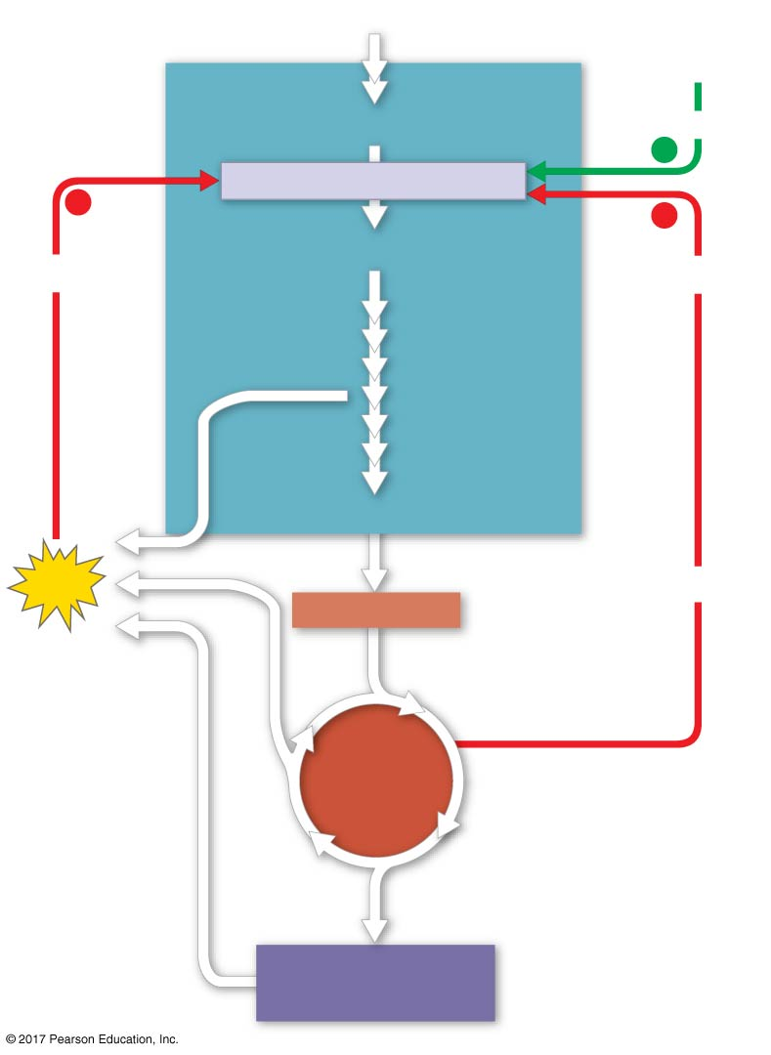
Figure 10.20
The control of cellular respiration
Glucose
AMP
GLYCOLYSIS
Fructose 6-phosphate
Stimulates
+
–
Phosphofructokinase
–
Fructose 1,6-bisphosphate
Inhibits
Inhibits
Pyruvate
ATP
Citrate
Acetyl CoA
CITRIC
ACID
CYCLE
Oxidative
phosphorylation
© 2018 Pearson Education Ltd.
Notes:
Figure 10.20 The control of cellular respiration

