Slide 1
Notes:
‹#›

Slide 2
Life at the Edge
The plasma membrane is the boundary that separates the living cell from its surroundings
The plasma membrane exhibits selective permeability選擇性通透, allowing some substances to cross it more easily than others
Transport proteins are often responsible for controlling passage across cellular membranes

Slide 3
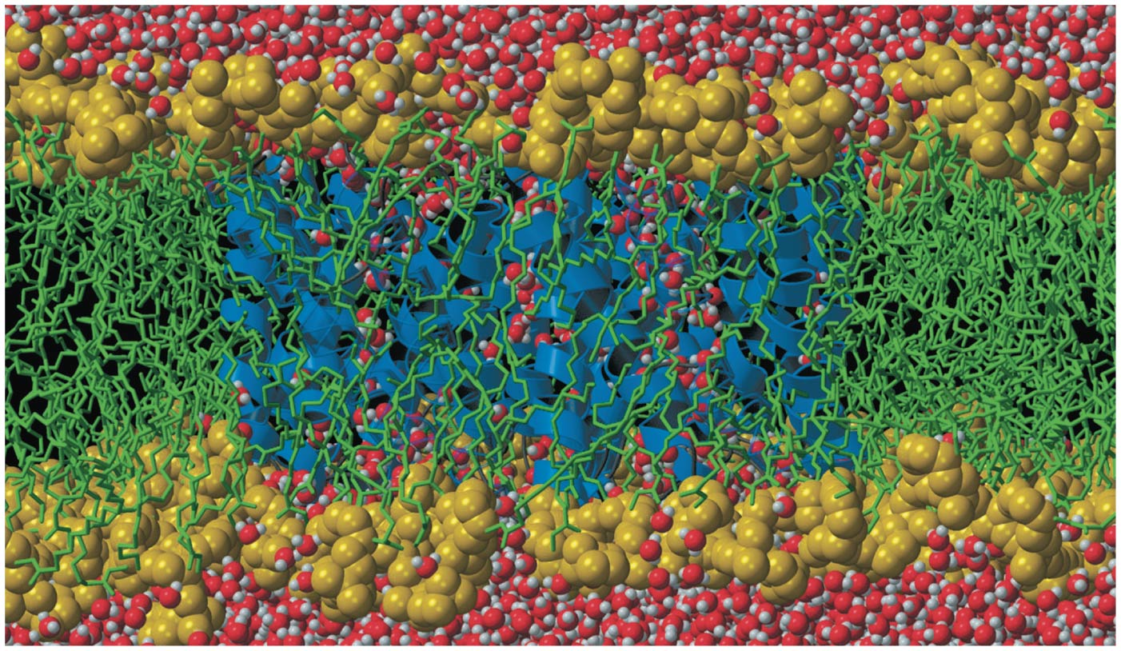
Figure 8.1
How do cell membrane proteins like this aquaporin (blue ribbons) help regulate chemical traffic?
© 2018 Pearson Education Ltd.
Notes:
Figure 8.1 How do cell membrane proteins like this aquaporin (blue ribbons) help regulate chemical traffic?

Slide 4
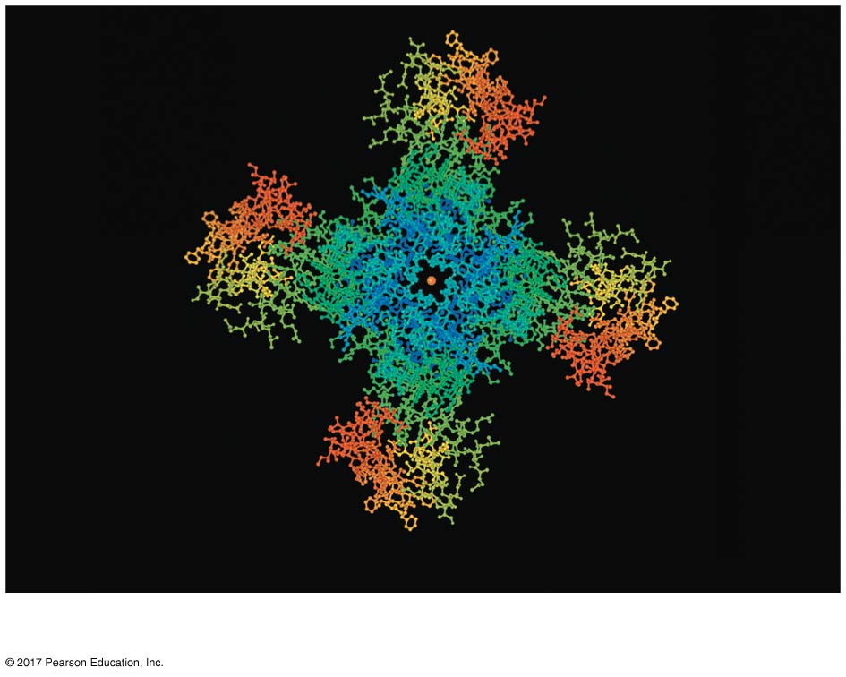
Figure 8.1a
Potassium ion
Potassium ion channel protein
© 2018 Pearson Education Ltd.
Notes:
Figure 8.1a How do cell membrane proteins help regulate chemical traffic? (part 1: ion channel protein)

Slide 5
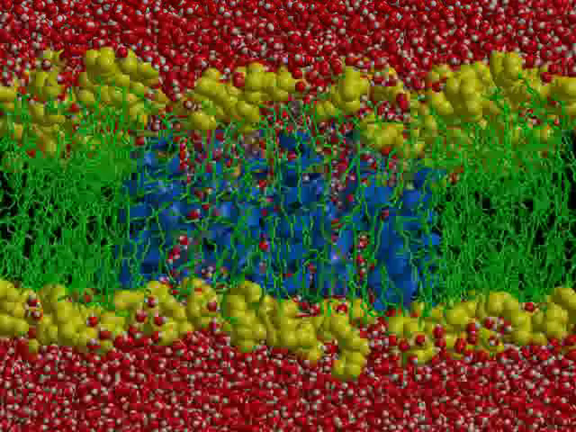
Video: Structure of the Cell Membrane

Slide 6
Concept 8.1: Cellular membranes are fluid mosaics of lipids and proteins
Phospholipids磷脂are the most abundant lipid in the plasma membrane
Phospholipids are amphipathic雙極性molecules, containing hydrophobic (“water-fearing”) and hydrophilic (“water-loving”) regions
The hydrophobic tails of the phospholipids are sheltered inside the membrane, while the hydrophilic heads are exposed to water on either side

Slide 7
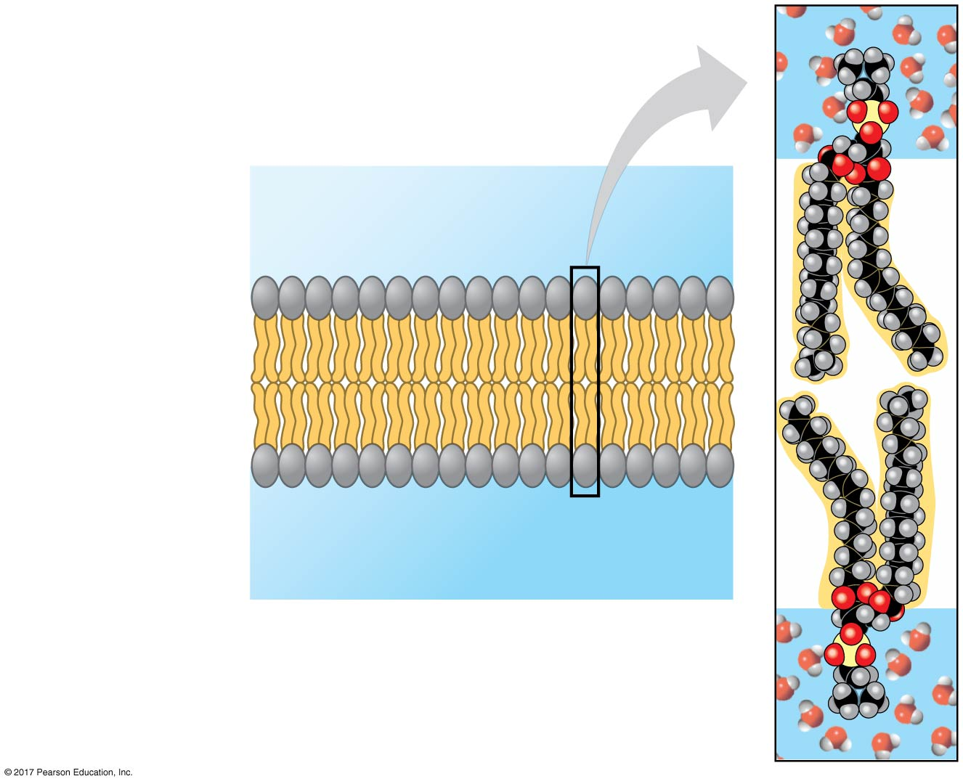
Figure 8.2
Phospholipid bilayer (cross section)
Two phospholipids
WATER
Hydrophilic
head
Hydrophobic
tail
WATER
© 2018 Pearson Education Ltd.
Notes:
Figure 8.2 Phospholipid bilayer (cross section)

Slide 8
In the fluid mosaic model流體鑲嵌模型, the membrane is a mosaic of protein molecules bobbing in a fluid bilayer of phospholipids
Proteins are not randomly distributed in the membrane

Slide 9
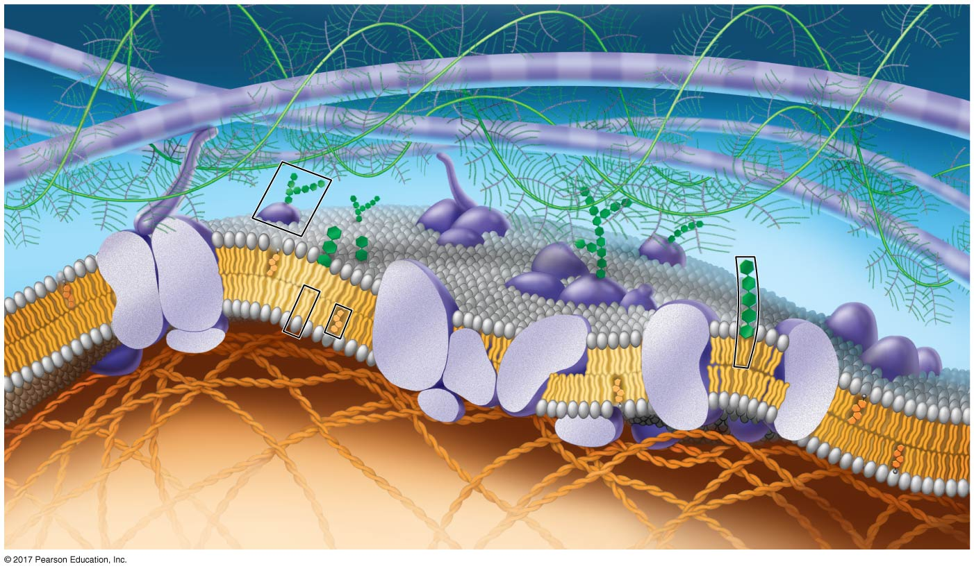
Figure 8.3
Updated model of an animal cell’s plasma membrane
Fibers of extra-
cellular matrix (ECM)
Carbo-
hydrates
Glyco-
protein
Glycolipid
EXTRACELLULAR
SIDE OF
MEMBRANE
Phospholipid Cholesterol
Microfilaments
of cytoskeleton
Peripheral
proteins
Integral
protein
CYTOPLASMIC
SIDE OF
MEMBRANE
© 2018 Pearson Education Ltd.
Notes:
Figure 8.3 Updated model of an animal cell’s plasma membrane (cutaway view)

Slide 10
The Fluidity of Membranes
Membranes are held together mainly by weak hydrophobic interactions
Most of the lipids and some proteins can move sideways within the membrane
Rarely, a lipid may flip-flop across the membrane, from one phospholipid layer to the other

Slide 11
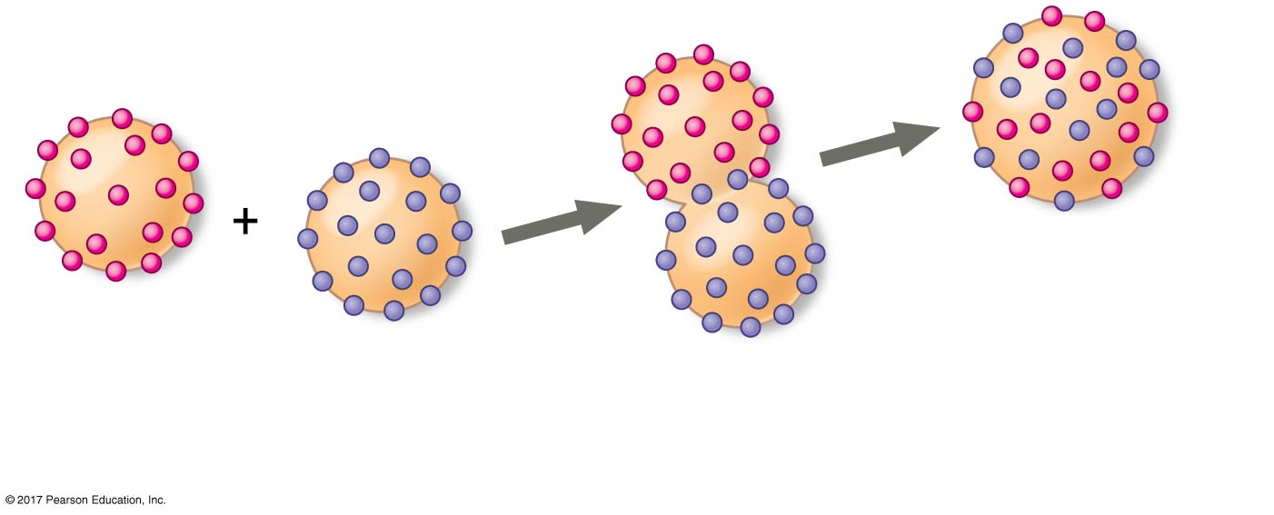
Figure 8.4_3
Do membrane proteins move?
Results
Membrane proteins
Mixed proteins
after 1 hour
Mouse cell
Human cell
Hybrid cell
Data from L. D. Frye and M. Edidin, The rapid intermixing of cell surface antigens after formation of
mouse-human heterokaryons, Journal of Cell Science 7:319 (1970).
© 2018 Pearson Education Ltd.
Notes:
Figure 8.4_3 Inquiry: Do membrane proteins move? (step 3)

Slide 12
As temperatures cool, membranes switch from a fluid state to a solid state
The temperature at which a membrane solidifies depends on the types of lipids
Membranes rich in unsaturated fatty acids are more fluid than those rich in saturated fatty acids
Membranes must be fluid to work properly; membranes are usually about as fluid as salad oil

Slide 13
The steroid cholesterol has different effects on the membrane fluidity of animal cells at different temperatures
At warm temperatures (such as 37ºC), cholesterol restrains movement of phospholipids
At cool temperatures, it maintains fluidity by preventing tight packing
Though cholesterol is present in plants, they use related steroid lipids to buffer membrane fluidity

Slide 14
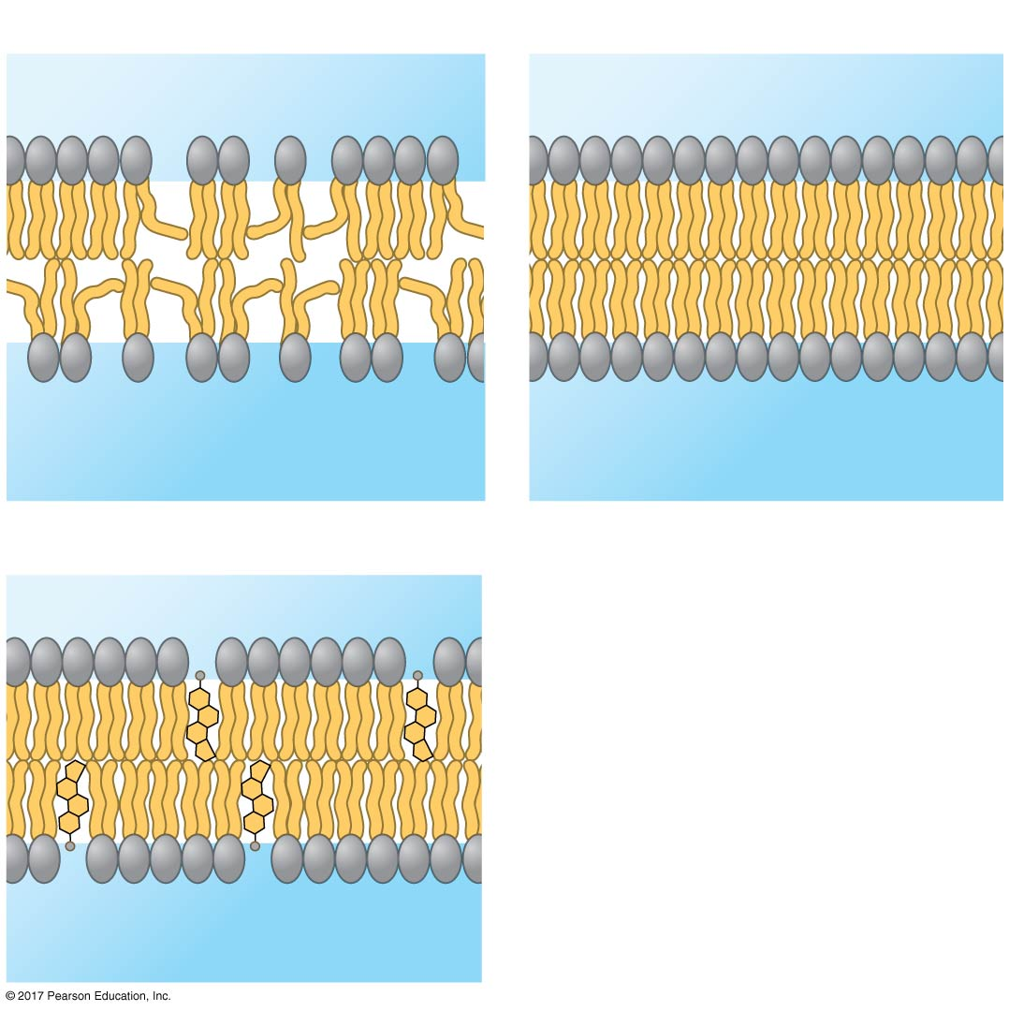
Figure 8.5
(a) Unsaturated versus saturated hydrocarbon tails
Fluid
Viscous
Unsaturated tails
prevent packing.
Saturated tails pack
together.
(b) Cholesterol within the animal cell membrane
Cholesterol reduces
membrane fluidity at
moderate temperatures, but at low temperatures
hinders solidification.
Fluidity buffer
Cholesterol
© 2018 Pearson Education Ltd.
Notes:
Figure 8.5 Factors that affect membrane fluidity

Slide 15
Evolution of Differences in Membrane Lipid Composition
Variations in lipid composition of cell membranes of many species appear to be adaptations to specific environmental conditions
Ability to change the lipid compositions in response to temperature changes has evolved in organisms that live where temperatures vary

Slide 16
Membrane Proteins and Their Functions
Somewhat like a tile mosaic, a membrane is a collage of different proteins, often clustered in groups, embedded in the fluid matrix of the lipid bilayer
Phospholipids form the main fabric of the membrane
Proteins determine most of the membrane’s functions

Slide 17
Peripheral proteins周邊蛋白are bound to the surface of the membrane
Integral proteins鑲嵌蛋白penetrate the hydrophobic core
Integral proteins that span the membrane are called transmembrane proteins
The hydrophobic regions of an integral protein consist of one or more stretches of nonpolar amino acids, often coiled into α helices

Slide 18
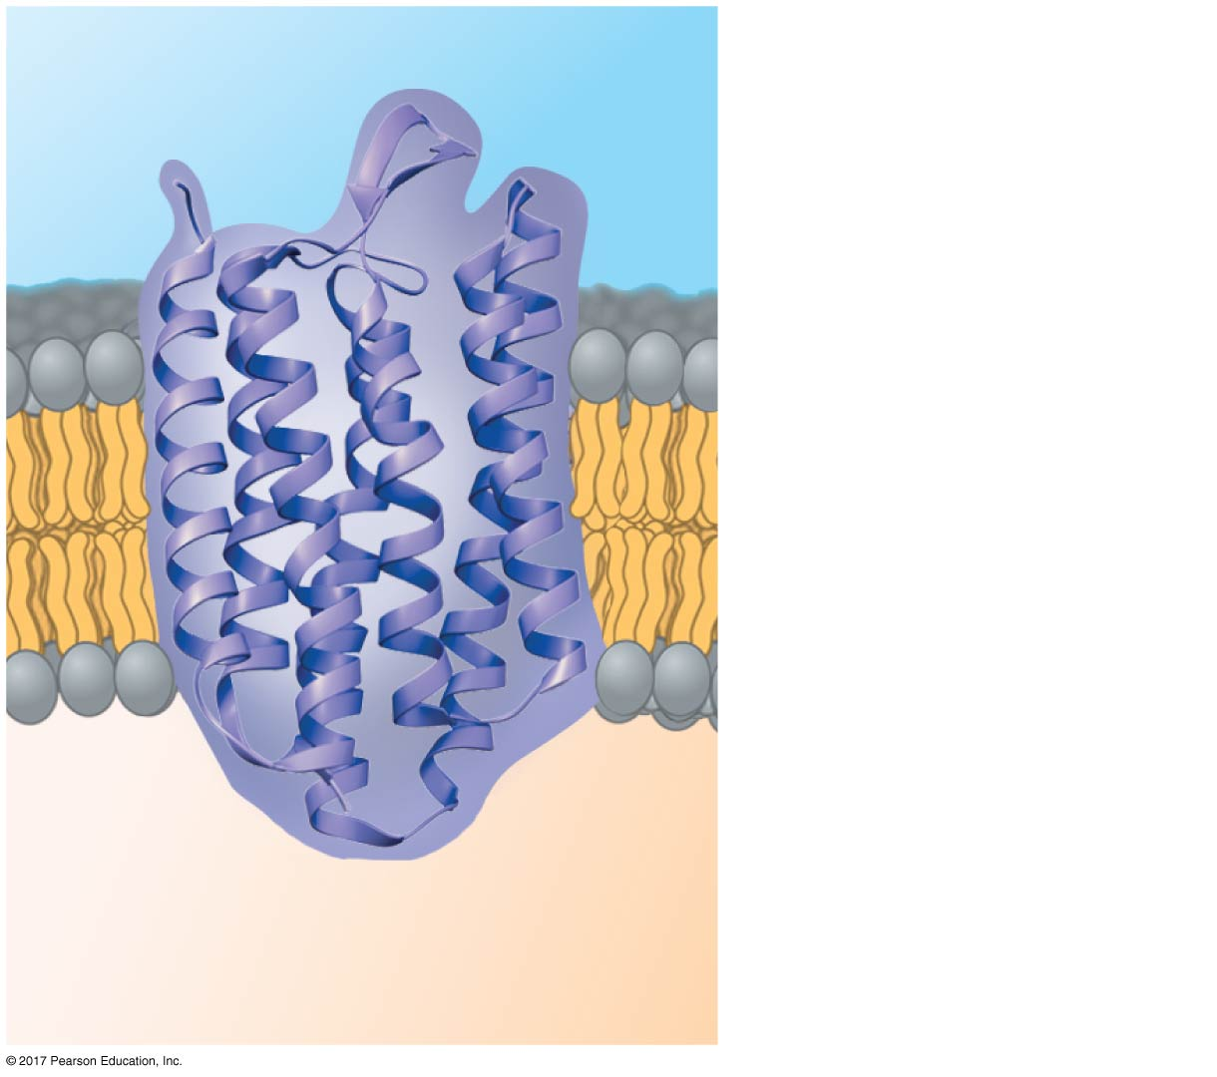
Figure 8.6
N-terminus
EXTRACELLULAR
SIDE
The structure of a transmembrane protein
α helix
C-terminus
CYTOPLASMIC
SIDE
© 2018 Pearson Education Ltd.
Notes:
Figure 8.6 The structure of a transmembrane protein

Slide 19
Cell-surface membranes can carry out several functions:
Transport
Enzymatic activity
Signal transduction
Cell-cell recognition
Intercellular joining
Attachment to the cytoskeleton and extracellular matrix (ECM)

Slide 20
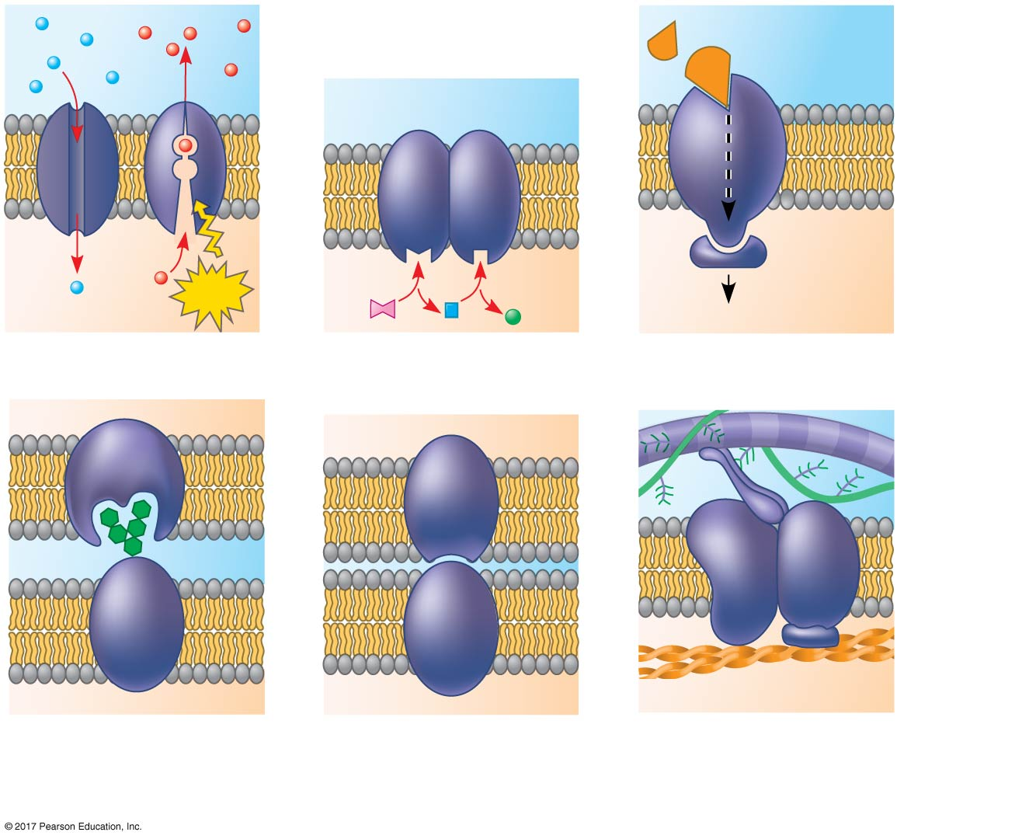
Figure 8.7
Signaling
molecule
Receptor
Enzymes
ATP
Signal transduction
(a) Transport
(b) Enzymatic activity
(c) Signal transduction
Glyco-
protein
(d) Cell-cell recognition
(e) Intercellular joining
(f) Attachment to the cytoskeleton and extracellular matrix (ECM)
© 2018 Pearson Education Ltd.
Notes:
Figure 8.7 Some functions of membrane proteins

Slide 21
Cell-surface proteins are important in the medical field
For example, HIV must bind to the immune cell-surface protein CD4 and a “co-receptor” CCR5 in order to infect a cell
HIV cannot enter the cells of resistant individuals who lack CCR5
Drugs are now being developed to mask the CCR5 protein

Slide 22
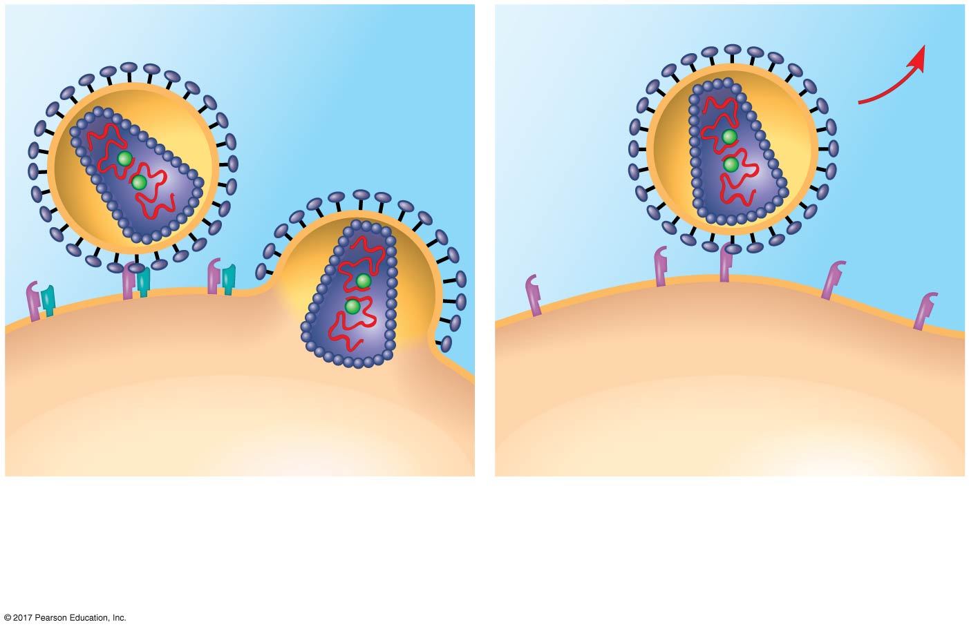
Figure 8.8
The genetic basis for HIV resistance
HIV
Receptor
(CD4)
Receptor (CD4)
but no CCR5
Co-receptor
(CCR5)
Plasma
membrane
(a) HIV can infect a cell with CCR5 on its surface, as in most people.
(b) HIV cannot infect a cell lacking CCR5 on its surface, as in resistant individuals.
© 2018 Pearson Education Ltd.
Notes:
Figure 8.8 The genetic basis for HIV resistance

Slide 23
The Role of Membrane Carbohydrates in Cell-Cell Recognition
Cells recognize each other by binding to molecules, often containing carbohydrates, on the extracellular surface of the plasma membrane
Membrane carbohydrates may be covalently bonded to lipids (forming glycolipids :糖脂) or, more commonly, to proteins (forming glycoproteins糖蛋白)
Carbohydrates on the extracellular side of the plasma membrane vary among species, individuals, and even cell types in an individual

Slide 24
Synthesis and Sidedness of Membranes
Membranes have distinct inside and outside faces
The asymmetrical distribution of proteins, lipids, and associated carbohydrates in the plasma membrane is determined when the membrane is built by the ER and Golgi apparatus

Slide 25
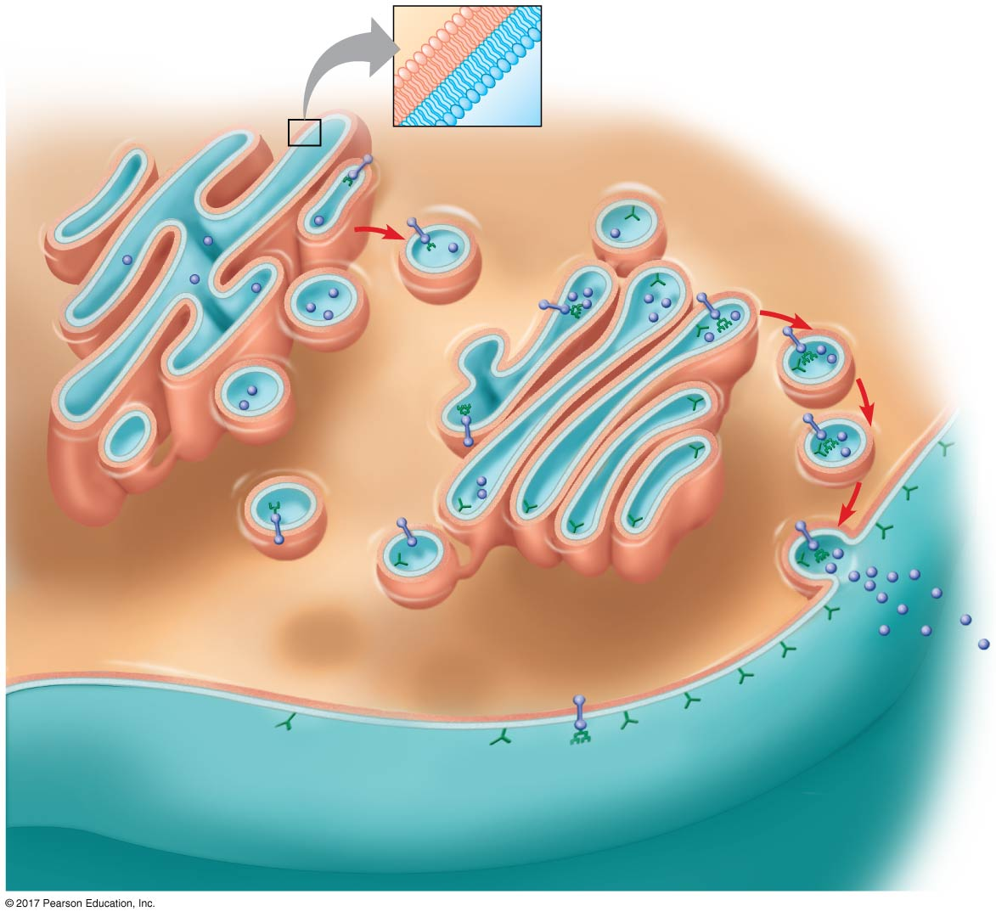
Figure 8.9
Synthesis of membrane components and their orientation in the membrane
Lipid
bilayer
Transmembrane
glycoproteins
Secretory
protein
Golgi
apparatus
Vesicle
Attached
carbohydrate
Glycolipid
ER
lumen
Plasma membrane:
Cytoplasmic face
Transmembrane
glycoprotein
Extracellular face
Secreted
protein
Membrane
glycolipid
© 2018 Pearson Education Ltd.
Notes:
Figure 8.9 Synthesis of membrane components and their orientation in the membrane

Slide 26
Concept 8.2: Membrane structure results in selective permeability
A cell must exchange materials with its surroundings, a process controlled by the plasma membrane
Plasma membranes are selectively permeable, regulating the cell’s molecular traffic

Slide 27
The Permeability of the Lipid Bilayer
Hydrophobic (nonpolar) molecules, such as hydrocarbons, can dissolve in the lipid bilayer and pass through the membrane rapidly
Hydrophilic molecules including ions and polar molecules do not cross the membrane easily
Proteins built into the membrane play key roles in regulating transport

Slide 28
Transport Proteins
Transport proteins allow passage of hydrophilic substances across the membrane
Some transport proteins, called channel proteins, have a hydrophilic channel that certain molecules or ions can use as a tunnel
Channel proteins called aquaporins水通道蛋白greatly facilitate the passage of water molecules

Slide 29
Other transport proteins, called carrier proteins, bind to molecules and change shape to shuttle them across the membrane
A transport protein is specific for the substance it moves

Slide 30
Concept 8.3: Passive transport is diffusion of a substance across a membrane with no energy investment
Diffusion擴散is the tendency for molecules to spread out evenly into the available space
Although each molecule moves randomly, diffusion of a population of molecules may be directional
At dynamic equilibrium, as many molecules cross the membrane in one direction as in the other

Slide 31
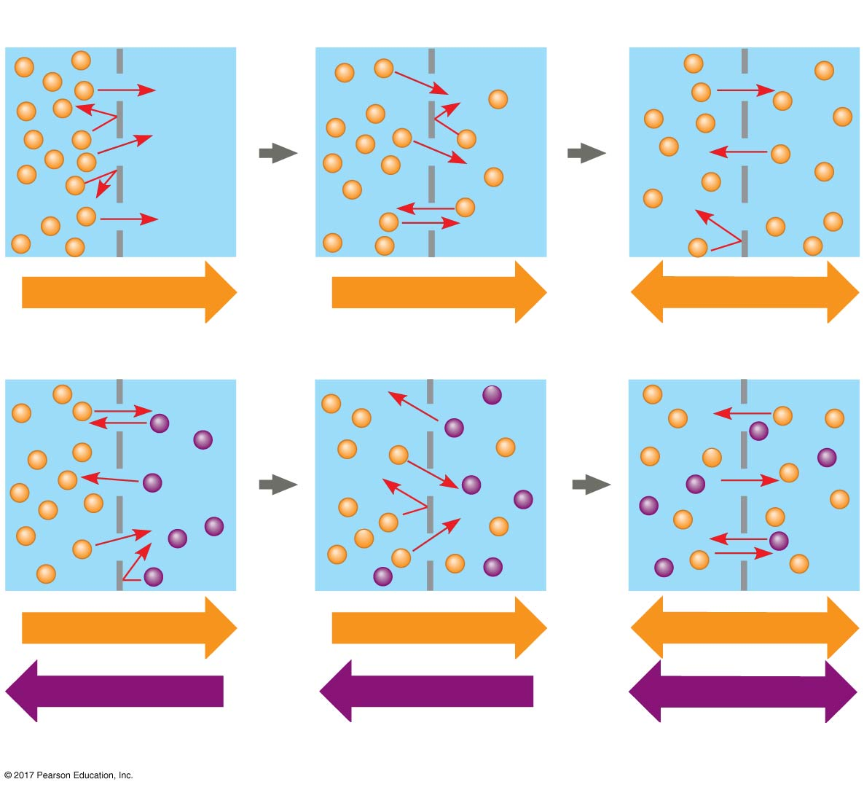
Figure 8.10
Molecules of dye
Membrane (cross section)
WATER
Net diffusion
Net diffusion
Equilibrium
(a) Diffusion of one solute
Net diffusion
Net diffusion
Equilibrium
Net diffusion
Net diffusion
Equilibrium
(b) Diffusion of two solutes
© 2018 Pearson Education Ltd.
Notes:
Figure 8.10 The diffusion of solutes across a synthetic membrane

Slide 32
Substances diffuse down their concentration gradient濃度梯度, the region along which the density of a chemical substance increases or decreases
No work must be done to move substances down the concentration gradient
The diffusion of a substance across a biological membrane is passive transport because no energy is expended by the cell to make it happen

Slide 33
Effects of Osmosis on Water Balance
Osmosis is the diffusion of water across a selectively permeable membrane
Water diffuses across a membrane from the region of lower solute concentration to the region of higher solute concentration until the solute concentration is equal on both sides

Slide 34
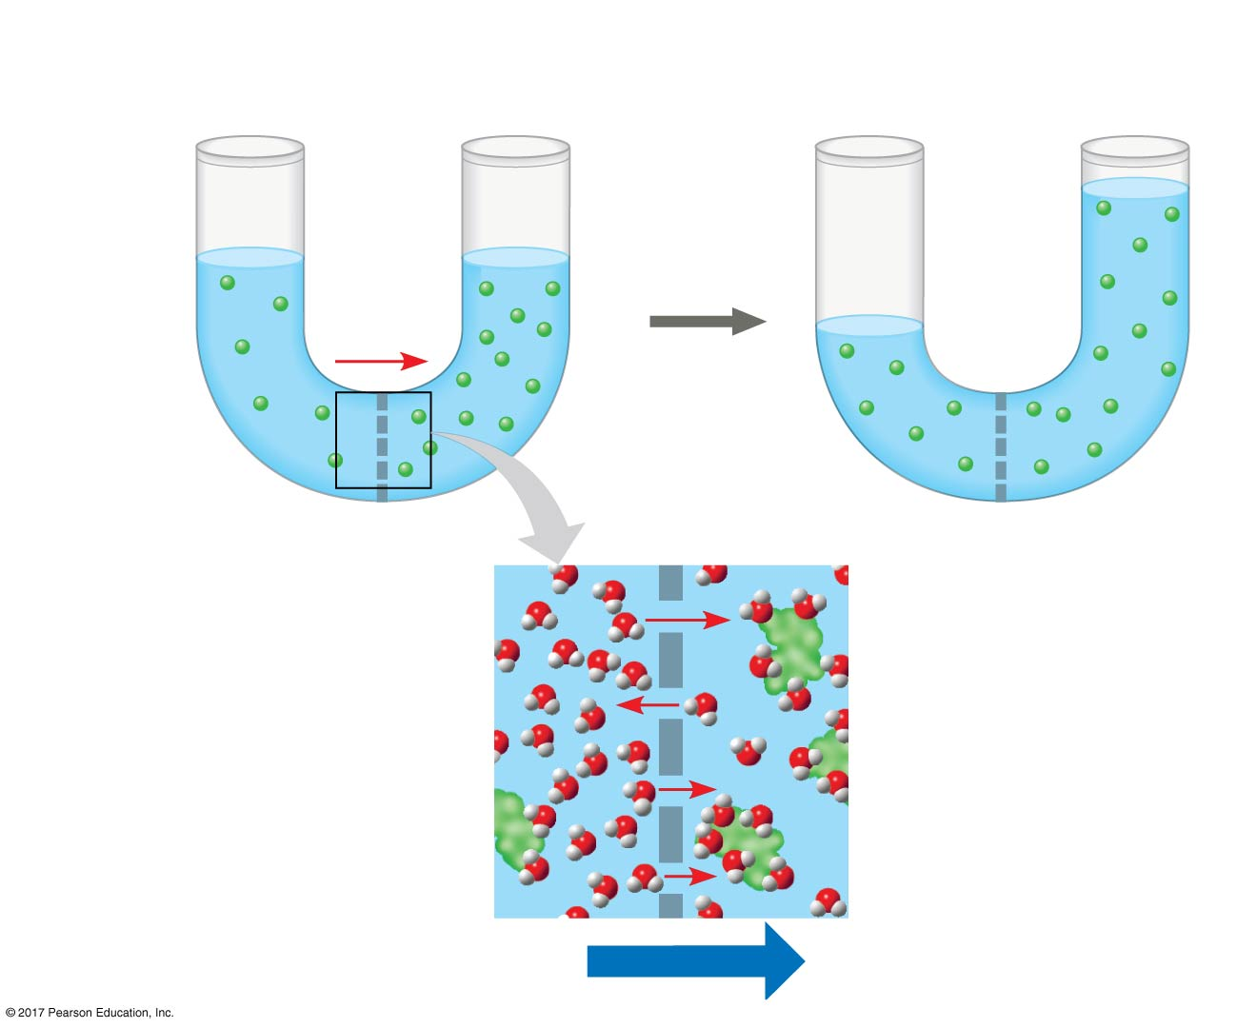
Figure 8.11
Lower concentration
of solute (sugar)
Higher concentration
of solute
More similar
concentrations of solute
Sugar
molecule
H₂O
Selectively
permeable
membrane
Osmosis
© 2018 Pearson Education Ltd.
Notes:
Figure 8.11 Osmosis

Slide 35
Water Balance of Cells Without Cell Walls
Tonicity張力 is the ability of a surrounding solution to cause a cell to gain or lose water
The tonicity of a solution depends on its concentration of solutes that cannot cross the membrane relative to that inside the cell

Slide 36
Isotonic等張的solution: Solute concentration is the same as that inside the cell; no net water movement across the plasma membrane
Hypertonic高張性的solution: Solute concentration is greater than that inside the cell; cell loses water
Hypotonic低張性的solution: Solute concentration is less than that inside the cell; cell gains water
Cells without cell walls will shrivel in hypertonic solution and lyse (burst) in a hypotonic solution

Slide 37
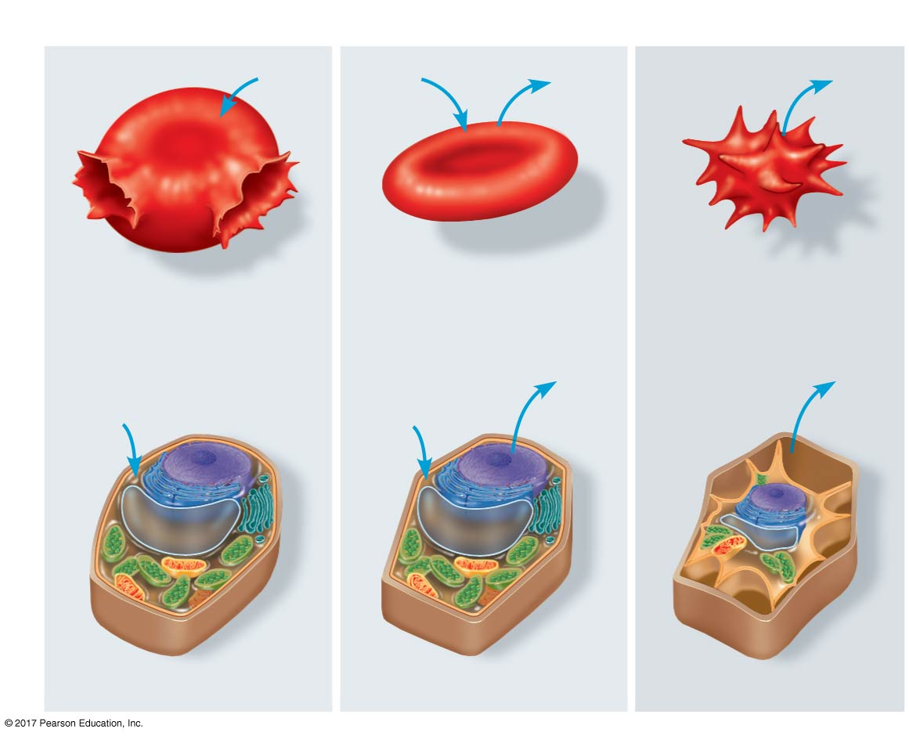
Figure 8.12
The water balance of living cells
Hypotonic
Isotonic
Hypertonic
H₂O
H₂O
H₂O
H₂O
(a) Animal cell
Lysed
Normal
Shriveled
Cell
Plasma
membrane
wall
H₂O
Plasma
membrane
H₂O
H₂O
H₂O
(b) Plant cell
Turgid (normal)
Flaccid
Plasmolyzed
© 2018 Pearson Education Ltd.
Notes:
Figure 8.12 The water balance of living cells

Slide 38
Hypertonic or hypotonic environments create osmotic problems for organisms that have cells without rigid walls
Osmoregulation, the control of solute concentrations and water balance, is a necessary adaptation for life in such environments
For example, the unicellular eukaryote Paramecium, which is hypertonic to its pond water environment, has a contractile vacuole that acts as a pump

Slide 39
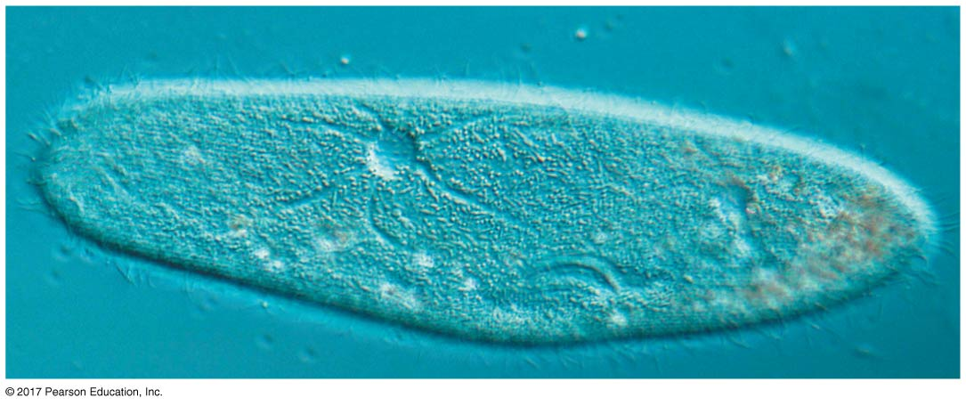
Figure 8.13
The contractile vacuole of Paramecium
Contractile vacuole
50 µm
© 2018 Pearson Education Ltd.
Notes:
Figure 8.13 The contractile vacuole of Paramecium

Slide 40
Bacteria and archaea that live in hypersaline (excessively salty) environments have cellular mechanisms to balance internal and external solute concentrations

Slide 41
Water Balance of Cells with Cell Walls
Cell walls help maintain water balance
A plant cell in a hypotonic solution swells until the wall opposes uptake; the cell is now turgid (firm)
If a plant cell and its surroundings are isotonic, there is no net movement of water into the cell; the cell becomes flaccid (limp)

Slide 42
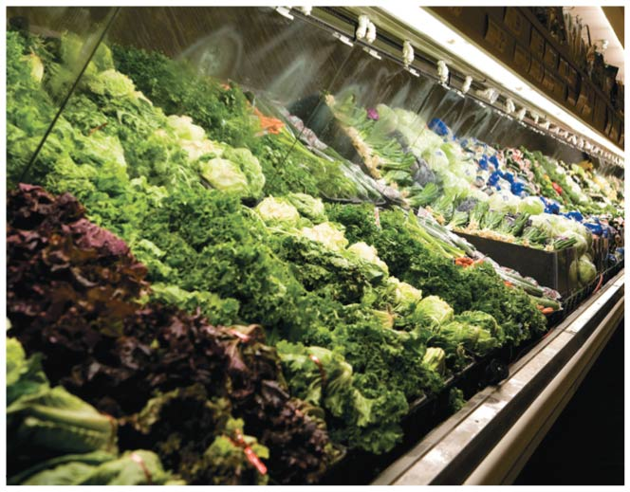
Figure 8.UN07
Crisp vegetables
© 2018 Pearson Education Ltd.
Notes:
Figure 8.UN07 Test your understanding, question 11 (crisp vegetables)

Slide 43
In a hypertonic environment, plant cells lose water
The membrane pulls away from the cell wall, causing the plant to wilt, a potentially lethal effect called plasmolysis原形質分離

Slide 44
Facilitated Diffusion: Passive Transport Aided by Proteins
In facilitated diffusion促進擴散, transport proteins speed the passive movement of molecules across the plasma membrane
Transport proteins include channel proteins and carrier proteins

Slide 45
Channel proteins provide corridors that allow a specific molecule or ion to cross the membrane
Aquaporins facilitate the diffusion of water
Ion channels facilitate the transport of ions
Some ion channels, called gated channels, open or close in response to a stimulus
For example, in nerve cells, ion channels open in response to electrical stimulus

Slide 46
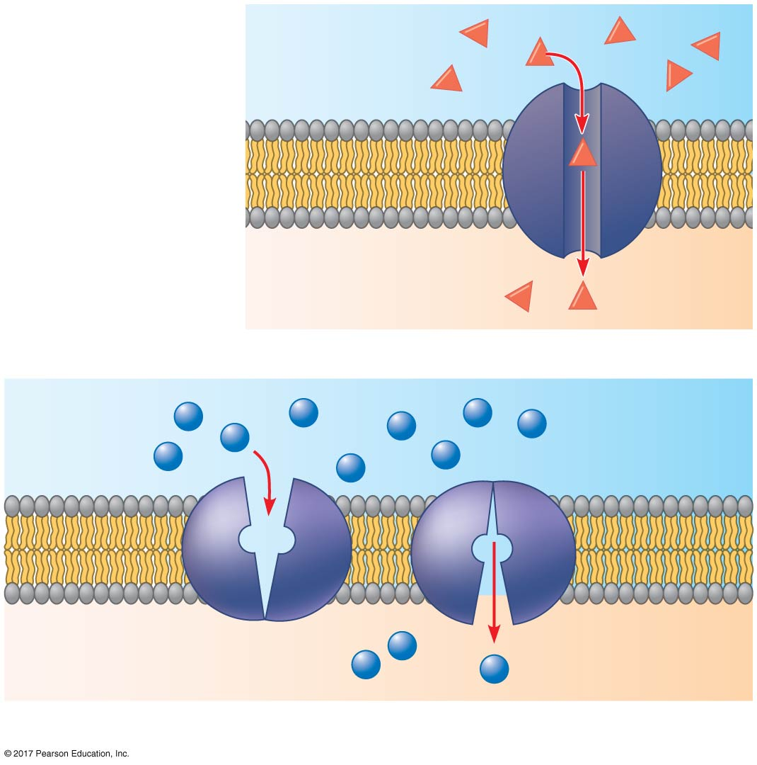
Figure 8.14
(a) A channel protein
EXTRACELLULAR
FLUID
Two types of transport proteins that carry out facilitated diffusion
Channel protein
Solute
CYTOPLASM
Carrier protein
Solute
(b) A carrier protein
© 2018 Pearson Education Ltd.
Notes:
Figure 8.14 Two types of transport proteins that carry out facilitated diffusion

Slide 47
Carrier proteins undergo a subtle change in shape that translocates the solute-binding site across the membrane
This change in shape can be triggered by the binding and release of the transported molecule

Slide 48
Concept 8.4: Active transport uses energy to move solutes against their gradients
Facilitated diffusion is still passive because the solute moves down its concentration gradient, and the transport requires no energy
Some transport proteins, however, can move solutes against their concentration gradients

Slide 49
The Need for Energy in Active Transport
Active transport requires energy, usually in the form of ATP hydrolysis, to move substances against their concentration gradients
All proteins involved in active transport are carrier proteins

Slide 50
Active transport allows cells to maintain concentration gradients that differ from their surroundings
For example, an animal cell has a much higher potassium (K⁺) and a much lower sodium (Na⁺) concentration compared to its surroundings
This is controlled by the sodium-potassium pump, a transport protein that is energized by transfer of a phosphate group from the hydrolysis of ATP

Slide 51
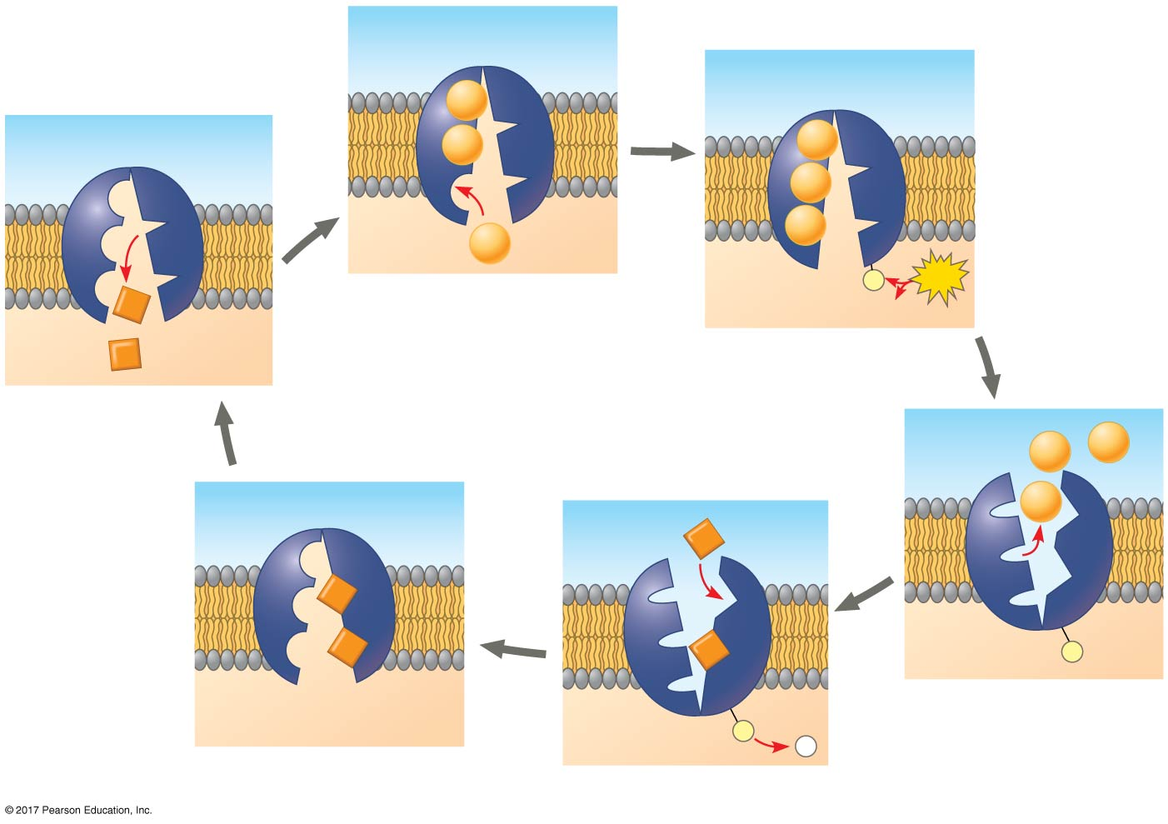
Figure 8.15
The sodium-potassium pump
EXTRACELLULAR
FLUID
[Na⁺] high
[K⁺] low
Na⁺
Na⁺
Na⁺
Na⁺
Na⁺
[Na⁺] low
Na⁺
CYTOPLASM
[K⁺] high
P
ATP
K⁺
1
ADP
K⁺
2
6
Na⁺
Na⁺
Na⁺
K⁺
K⁺
K⁺
K⁺
P
3
P
P
5
i
4
© 2018 Pearson Education Ltd.
Notes:
Figure 8.15 The sodium-potassium pump: a specific case of active transport

Slide 52
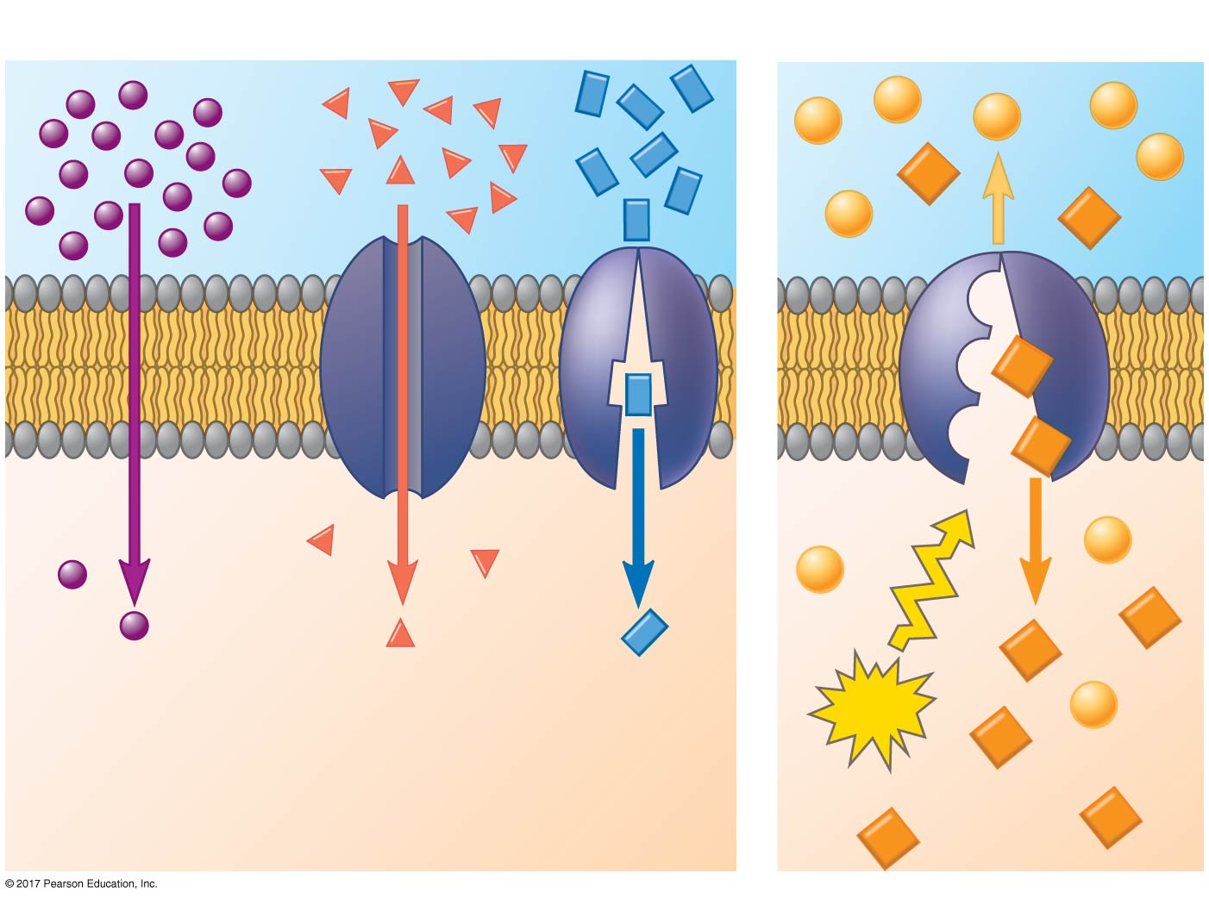
Figure 8.16
Passive transport
Active transport
Diffusion
Facilitated diffusion
ATP
© 2018 Pearson Education Ltd.
Notes:
Figure 8.16 Review: passive and active transport

Slide 53
BioFlix: Membrane Transport

Slide 54
How Ion Pumps Maintain Membrane Potential
Membrane potential(膜電位)is the voltage across a membrane
Voltage is created by differences in the distribution of positive and negative ions across a membrane
The cytoplasmic side of the membrane is negative in charge relative to the extracellular side

Slide 55
Two combined forces, collectively called the electrochemical gradient離子濃度梯度, drive the diffusion of ions across a membrane
A chemical force (the ion’s concentration gradient)
An electrical force (the effect of the membrane potential on the ion’s movement)

Slide 56
An electrogenic pump is a transport protein that generates voltage across a membrane
The sodium-potassium pump is the major electrogenic pump of animal cells
The main electrogenic pump of plants, fungi, and bacteria is a proton pump, which actively transports hydrogen ions (H⁺) out of the cell
Electrogenic pumps help store energy that can be used for cellular work

Slide 57
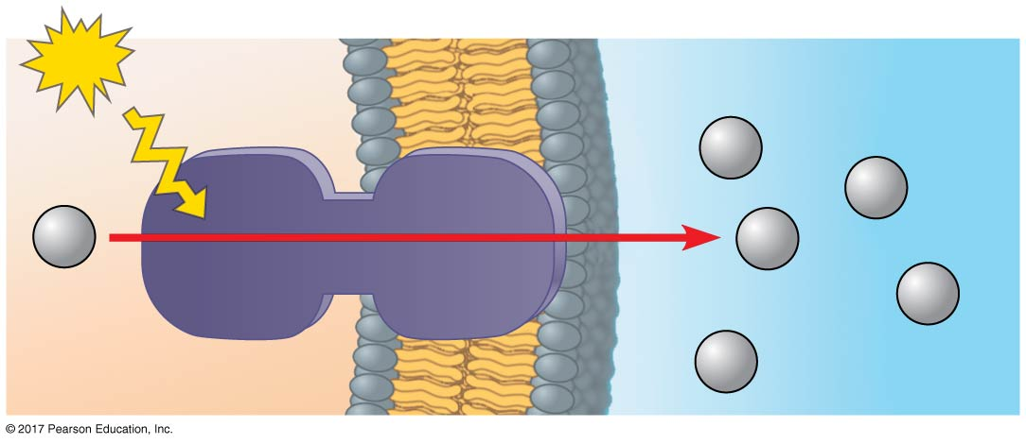
Figure 8.17
A proton pump
ATP
–
+
EXTRACELLULAR
FLUID
+
H⁺
H⁺
H⁺
H⁺
Proton pump
+
H⁺
CYTOPLASM
–
+
H⁺
© 2018 Pearson Education Ltd.
Notes:
Figure 8.17 A proton pump

Slide 58
Cotransport: Coupled Transport by a Membrane Protein
Cotransport occurs when active transport of a solute indirectly drives transport of other substances
The diffusion of an actively transported solute down its concentration gradient is coupled with the transport of a second substance against its own concentration gradient

Slide 59
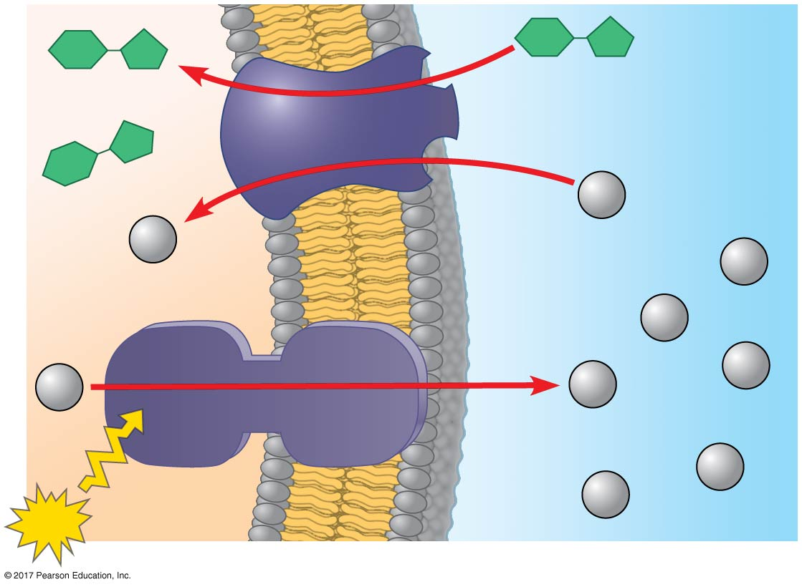
Figure 8.18
Cotransport: active transport driven by a concentration gradient
–
+
Sucrose
Sucrose
H⁺/sucrose
cotransporter
Diffusion of H⁺
+
H⁺
H⁺
–
H⁺
–
+
H⁺
H⁺
H⁺
H⁺
Proton pump
H⁺
–
+
H⁺
ATP
© 2018 Pearson Education Ltd.
Notes:
Figure 8.18 Cotransport: active transport driven by a concentration gradient

Slide 60
Concept 8.5: Bulk transport across the plasma membrane occurs by exocytosis and endocytosis
Small molecules and water enter or leave the cell through the lipid bilayer or via transport proteins
Large molecules, such as polysaccharides and proteins, cross the membrane in bulk via vesicles
Bulk transport requires energy

Slide 61
Exocytosis
In exocytosis, transport vesicles migrate to the membrane, fuse with it, and release their contents outside the cell
Many secretory cells use exocytosis to export their products

Slide 62
Endocytosis
In endocytosis, the cell takes in macromolecules by forming vesicles from the plasma membrane
Endocytosis is a reversal of exocytosis, involving different proteins
There are three types of endocytosis
Phagocytosis (“cellular eating”)
Pinocytosis (“cellular drinking”)
Receptor-mediated endocytosis

Slide 63
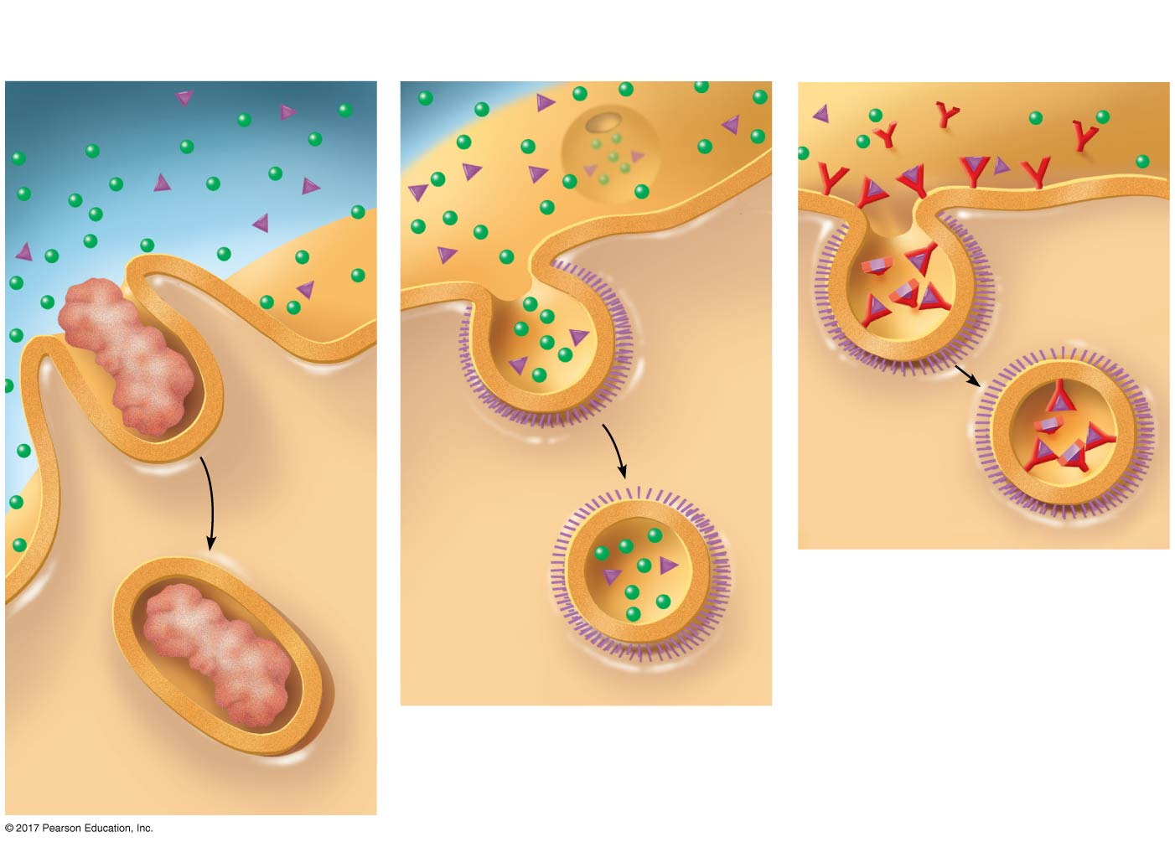
Figure 8.19
Receptor-Mediated
Phagocytosis
Pinocytosis
Endocytosis
EXTRACELLULAR
FLUID
Solutes
Solutes
Pseudopodium
Receptor
Plasma
membrane
Coat
protein
Food
or
other
particle
Coated
pit
Coated vesicle with
specific solutes
(purple) bound to
receptors (red)
Coated
vesicle
Food
vacuole
CYTOPLASM
© 2018 Pearson Education Ltd.
Notes:
Figure 8.19 Exploring endocytosis in animal cells

Slide 64
In phagocytosis, a cell engulfs a particle in a vacuole
The vacuole fuses with a lysosome to digest the particle

Slide 65
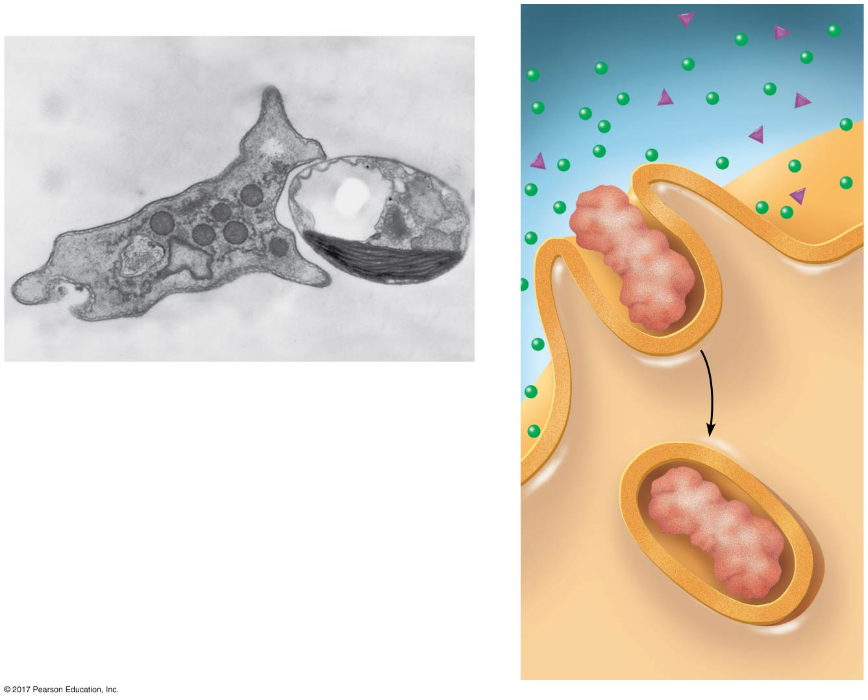
Figure 8.19a
Phagocytosis
EXTRACELLULAR
FLUID
Green
algal cell
Solutes
Pseudopodium
5 µm
Pseudopodium of amoeba
Food
or
other
particle
An amoeba engulfing a green algal
cell via phagocytosis (TEM)
Food
vacuole
CYTOPLASM
© 2018 Pearson Education Ltd.
Notes:
Figure 8.19a Exploring endocytosis in animal cells (part 1: phagocytosis)

Slide 66
In pinocytosis, molecules dissolved in droplets are taken up when extracellular fluid is “gulped” into tiny vesicles

Slide 67
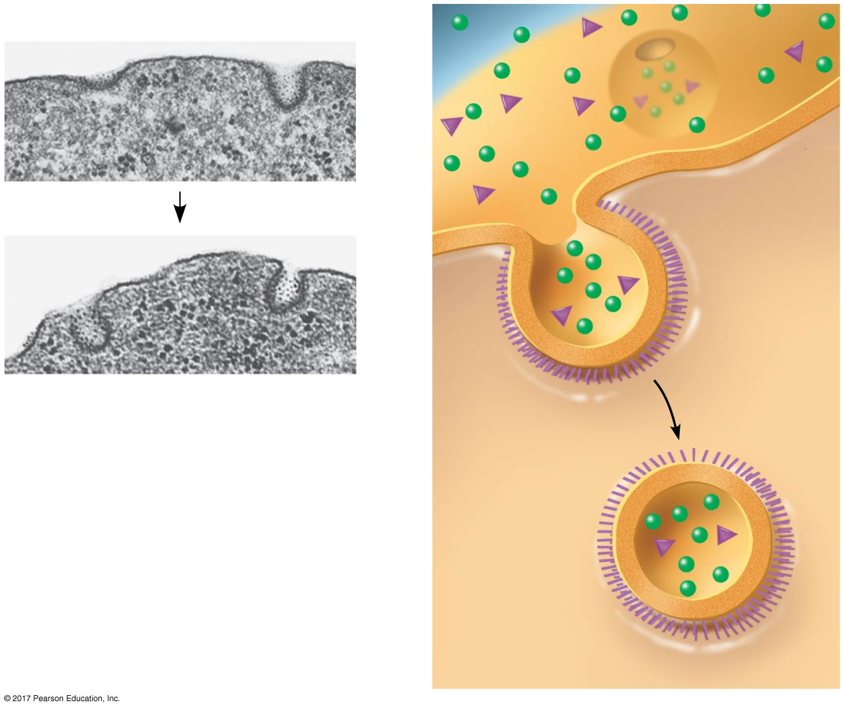
Figure 8.19b
Pinocytosis
Solutes
Plasma
membrane
Coat
0.25 µm
protein
Pinocytotic vesicles
forming (TEMs)
Coated
pit
Coated
vesicle
© 2018 Pearson Education Ltd.
Notes:
Figure 8.19b Exploring endocytosis in animal cells (part 2: pinocytosis)

Slide 68
In receptor-mediated endocytosis, binding of specific solutes to receptors triggers vesicle formation
Receptor proteins, receptors, and other molecules from the extracellular fluid are transported in the vesicles
Emptied receptors are recycled to the plasma membrane

Slide 69
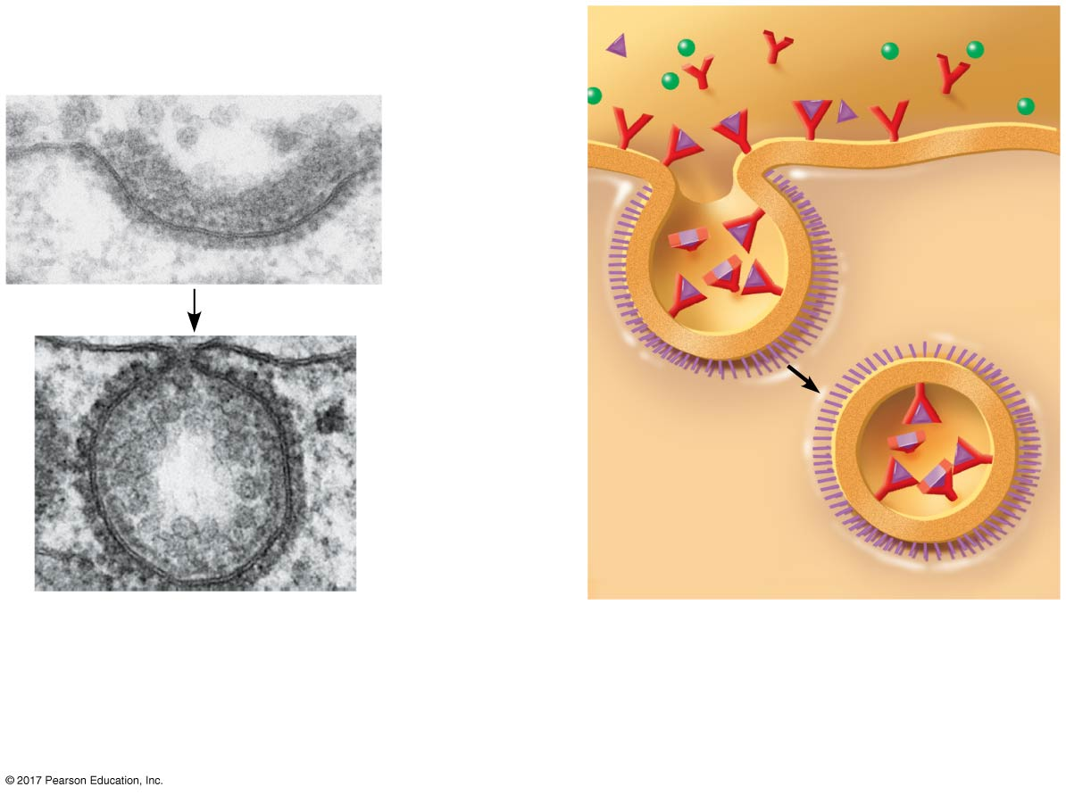
Figure 8.19c
Receptor-Mediated
Endocytosis
Plasma
membrane
Coat
protein
Receptor
Coated
vesicle
with specific
solutes
(purple) bound
to receptors (red)
0.25 µm
Top: A coated pit
Bottom: A coated vesicle
forming during receptor-
mediated endocytosis (TEMs)
© 2018 Pearson Education Ltd.
Notes:
Figure 8.19c Exploring endocytosis in animal cells (part 3: receptor-mediated endocytosis)

Slide 70
Human cells use receptor-mediated endocytosis to take in cholesterol, which is carried in particles called low-density lipoproteins (LDLs)
Individuals with the disease familial hypercholesterolemia高膽固醇血症have missing or defective LDL receptor proteins

Slide 71
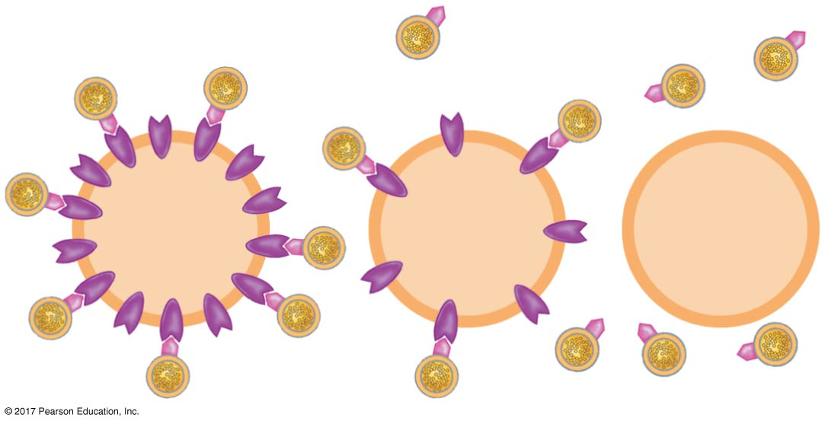
Figure 8.UN03
Hypercholesterolemia
LDL
LDL receptor
Normal
cell
Mild
disease
Severe
disease
© 2018 Pearson Education Ltd.
Notes:
Figure 8.UN03 In-text figure, hypercholesterolemia, p. 209

