Slide 1
Notes:
‹#›

Slide 2
The Fundamental Units of Life
All organisms are made of cells
The cell is the simplest collection of matter that can be alive
All cells are related by their descent from earlier cells
Cells can differ substantially from one another but share common features

Slide 3
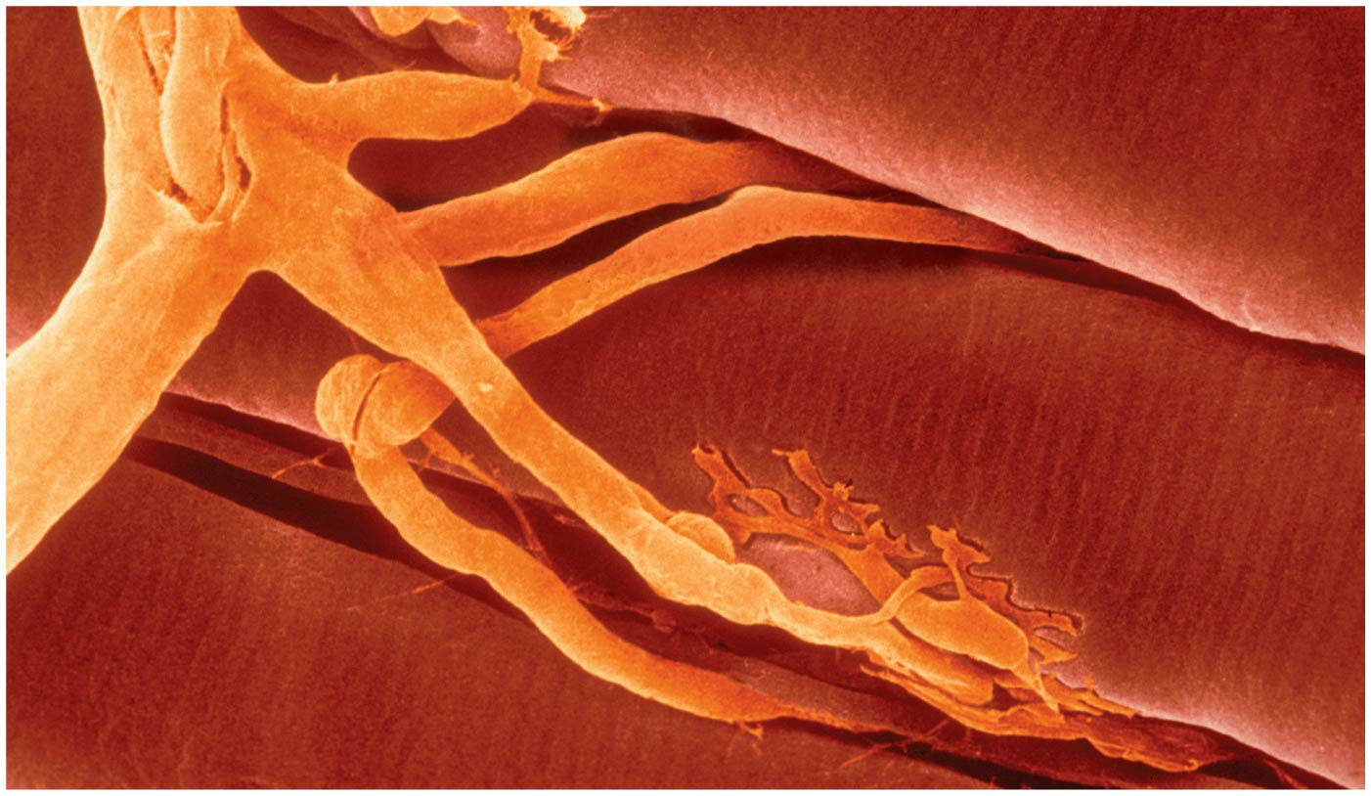
Figure 7.1
How do your cells help you learn about biology?
Notes:
Figure 7.1 How do your cells help you learn about biology?

Slide 4
Concept 7.1: Biologists use microscopes and the tools of biochemistry to study cells
Cells are usually too small to be seen by the naked eye

Slide 5
Microscopy
Microscopes are used to visualize cells
In a light microscope (LM), visible light is passed through a specimen and then through glass lenses
Lenses refract (bend) the light so that the image is magnified

Slide 6
Three important parameters of microscopy:
Magnification, the ratio of an object’s image size to its real size
Resolution, the measure of the clarity of the image, or the minimum distance of two distinguishable points
Contrast, visible differences in brightness between parts of the sample
Smallest 200nm

Slide 7
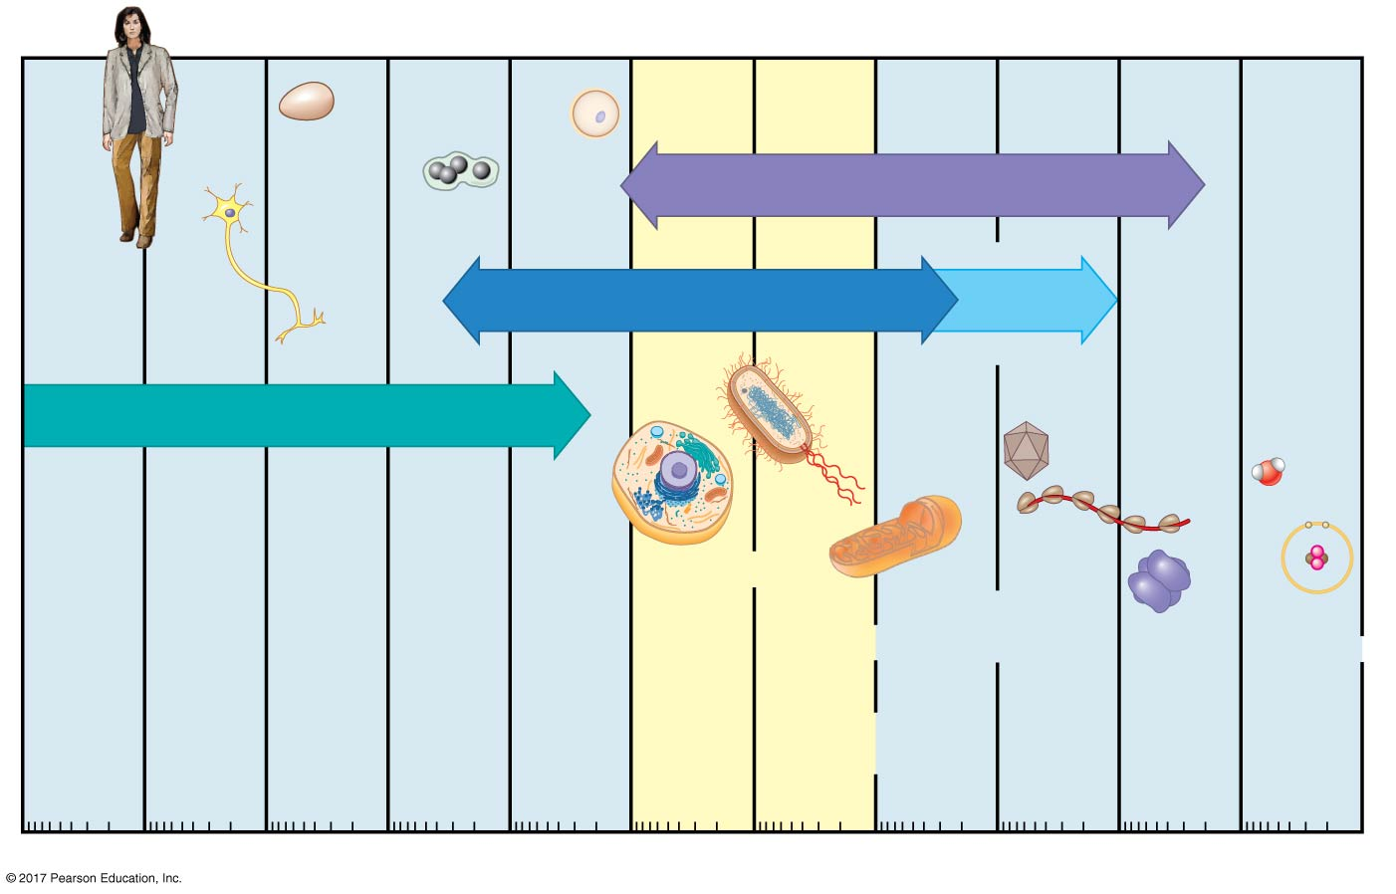
Figure 7.2c
The size range of cells
Electron microscopy
Super-
resolution
microscopy
Light microscopy
Unaided eye
Nucleus
Length
of some
nerve
and
muscle
cells
Most
bacteria
Smallest
bacteria
Small
molecules
Most
plant
and
animal
cells
Proteins
Viruses
Human
height
Chicken
egg
Frog
egg
Human
egg
Mito-
chondrion
Ribo-
somes
Lipids
Atoms
10 m
1 m
0.1 m
1 cm
1 mm
100 μm
10 μm
1 μm
100 nm
10 nm
1 nm
0.1 nm
Notes:
Figure 7.2c The size range of cells (part 3: horizontal version)

Slide 8
Light microscopes can magnify effectively to about 1,000 times the size of the actual specimen
Various techniques enhance contrast and enable cell components to be stained or labeled
The resolution of standard light microscopy is too low to study organelles(胞器), the membrane-enclosed structures in eukaryotic cells

Slide 9
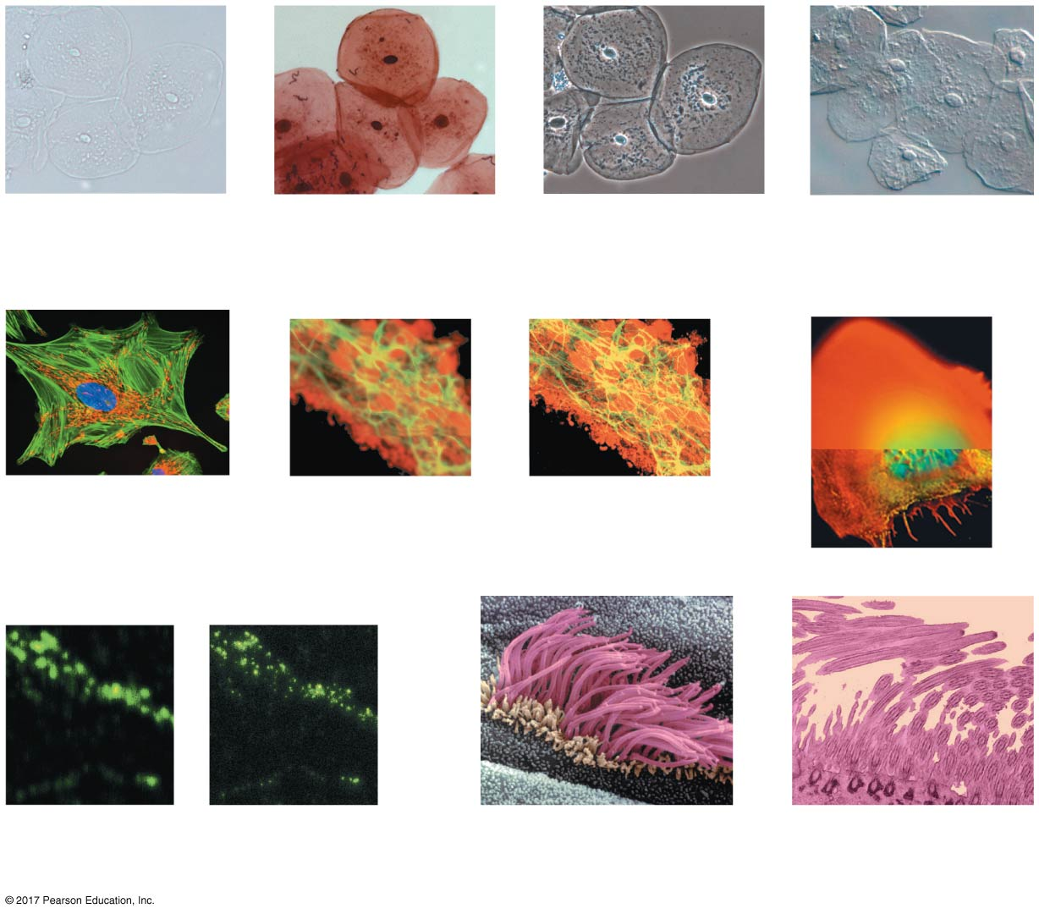
Figure 7.3
Brightfield
(unstained
specimen)
50 μm
Brightfield
(stained specimen)
Phase-contrast
Differential
interference contrast
(Nomarski)
50 μm
Fluorescence
10 μm
Confocal
(without)
Confocal (with)
10 μm
Deconvolution
1 μm
Super-resolution
(without)
Super-resolution
(with)
Scanning
electron
microscopy (SEM)
2 μm
Transmission
electron
microscopy (TEM)
2 μm
Notes:
Figure 7.3 Exploring microscopy

Slide 10
Two basic types of electron microscopes (EMs) are used to study subcellular structures
Scanning electron microscopes (SEMs) focus a beam of electrons onto the surface of a specimen, providing images that look 3-D
Transmission electron microscopes (TEMs) focus a beam of electrons through a specimen
TEMs are used mainly to study the internal structure of cells

Slide 11
Recent advances in light microscopy:
Labeling individual cells with fluorescent markers improve the level of detail that can be seen
Confocal microscopy and deconvolution microscopy provide sharper images of three-dimensional tissues and cells
New techniques for labeling cells improve resolution
Super-resolution microscopy allows one to distinguish structures as small as 10–20 nm across

Slide 12
Cell Fractionation
Cell fractionation :細胞分部分離takes cells apart and separates the major organelles from one another
Centrifuges離心分離機 fractionate cells into their component parts
Cell fractionation enables scientists to determine the functions of organelles
Biochemistry and cytology help correlate cell function with structure

Slide 13
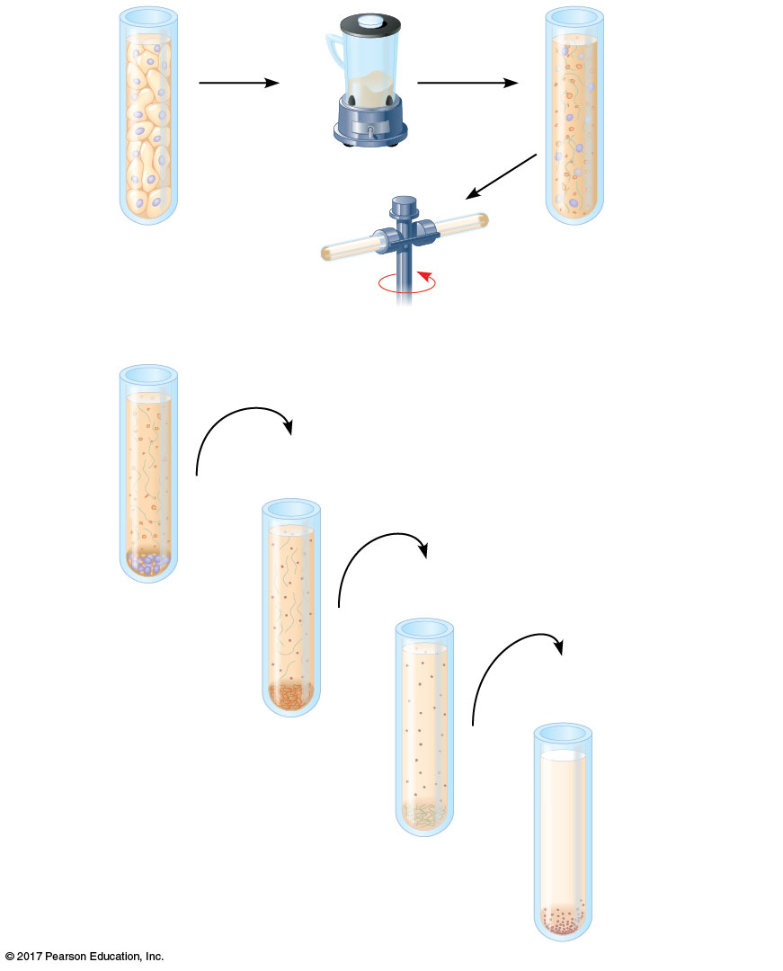
Figure 7.4
Cell fractionation
Homogenization
Tissue
cells
Homogenate
Centrifugation
1,000 g
Supernatant poured into next tube
10 min
20,000 g
20 min
80,000 g
Pellet rich in
nuclei and
cellular debris
60 min
150,000 g
3 hr
Pellet rich in
mitochondria
(and chloroplasts)
Pellet rich in
“microsomes”
Differential
centrifugation
Pellet rich in
ribosomes
Notes:
Figure 7.4 Research method: cell fractionation

Slide 14
Concept 7.2: Eukaryotic cells have internal membranes that compartmentalize their functions
The basic structural and functional unit of every organism is one of two types of cells: prokaryotic原核生物or eukaryotic真核細胞
Only organisms of the domains Bacteria and Archaea consist of prokaryotic cells
Protists, fungi, animals, and plants all consist of eukaryotic cells

Slide 15
Comparing Prokaryotic and Eukaryotic Cells
Basic features of all cells:
Plasma membrane
Semifluid substance called cytosol細胞質液
(cytoplasm(細胞質) = cytosol(細胞質液)和organelles(胞器) )
Chromosomes (carry genes)
Ribosomes (make proteins)

Slide 16
Prokaryotic cells are characterized by having
No nucleus
DNA in an unbound region called the nucleoid(擬核)
No membrane-bound organelles
Cytoplasm bound by the plasma membrane

Slide 17
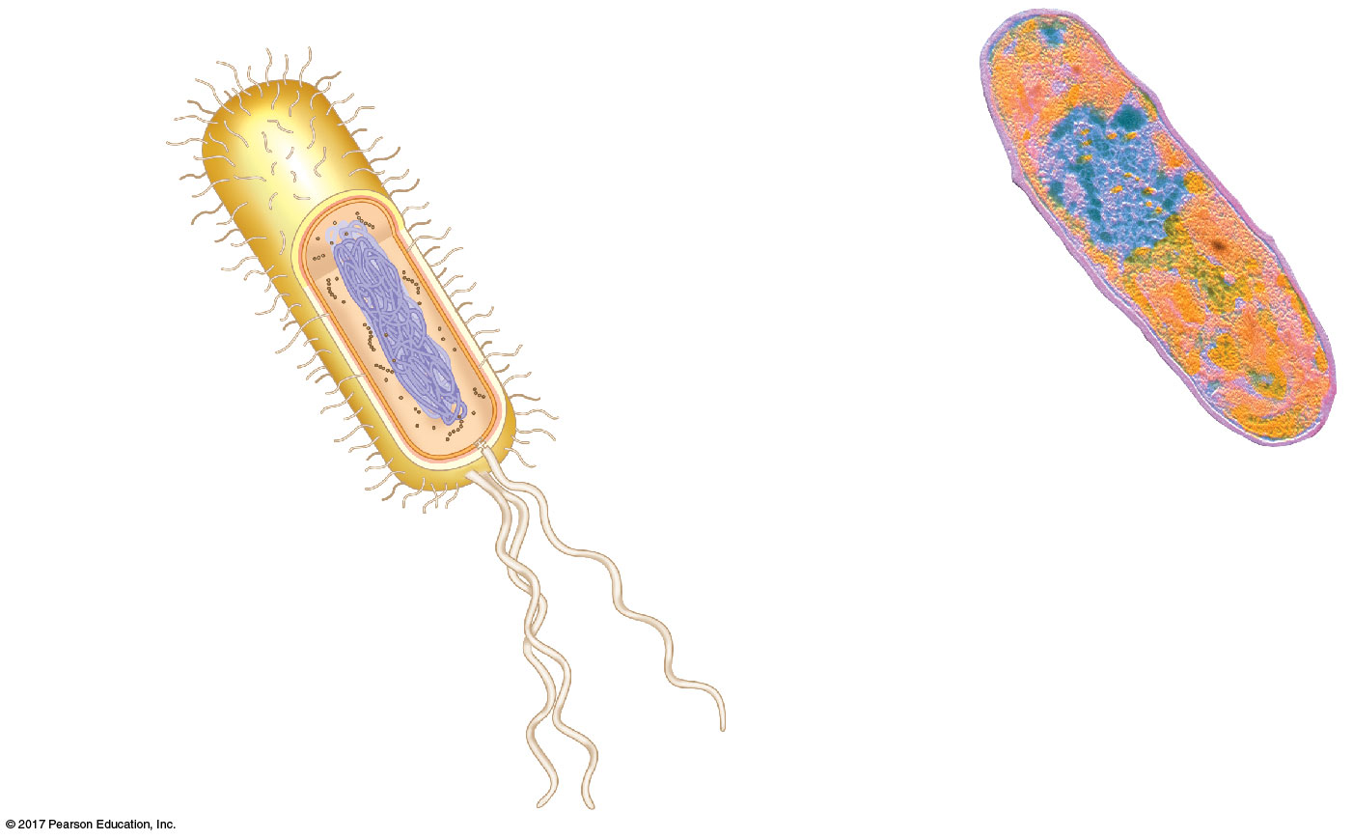
Figure 7.5
A prokaryotic cell
Fimbriae
Nucleoid
Ribosomes
Plasma membrane
Bacterial
chromosome
Cell wall
Glycocalyx
0.5 μm
Flagella
(a) A typical rod-shaped bacterium
(b) A thin section through the bacterium Corynebacterium diphtheriae (colorized TEM)
Notes:
Figure 7.5 A prokaryotic cell

Slide 18
Eukaryotic cells are characterized by having
DNA in a nucleus that is bounded by a double membrane
Membrane-bound organelles
Cytoplasm in the region between the plasma membrane and nucleus
Eukaryotic cells are generally much larger than prokaryotic cells

Slide 19
The plasma membrane(細胞膜)is a selective barrier that allows sufficient passage of oxygen, nutrients, and waste to service the volume of every cell

Slide 20
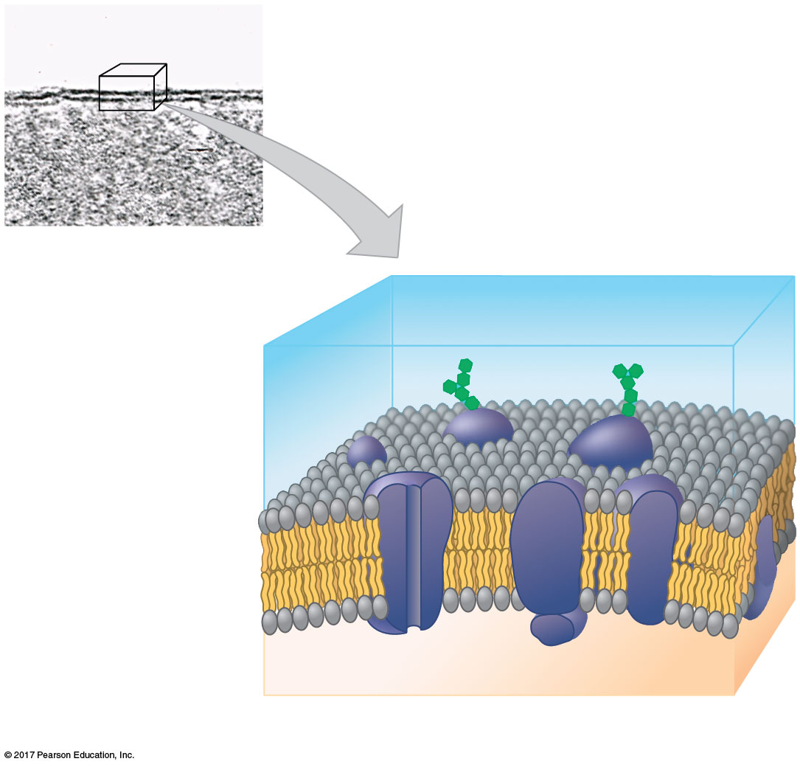
Figure 7.6
The plasma membrane
Outside of cell
(a) TEM of a plasma membrane
Inside
of cell
(cytoplasm)
0.1 μm
Carbohydrate side chains
Phospholipid
Hydrophilic
region
Hydrophobic
region
Hydrophilic
region
Proteins
(b) Structure of the plasma membrane
Notes:
Figure 7.6 The plasma membrane

Slide 21
Metabolic requirements set upper limits on the size of cells
The surface area to volume ratio of a cell is critical
As a cell increases in size, its volume grows proportionately more than its surface area

Slide 22
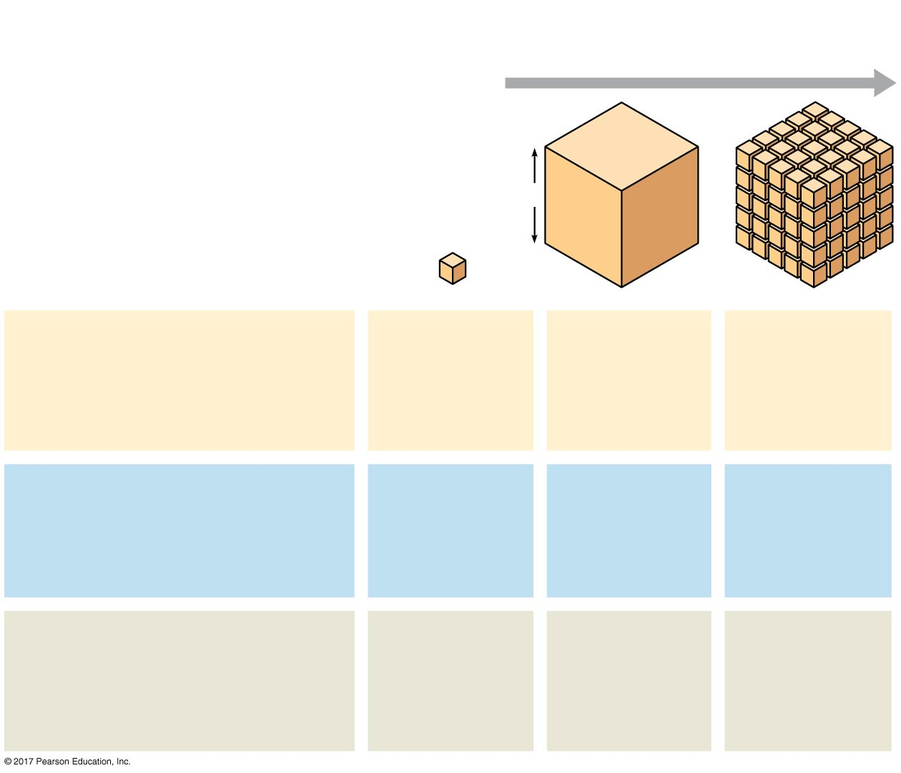
Figure 7.7
Surface area increases while
total volume remains constant
Geometric relationships between surface area and volume
5
1
1
Total surface area
[sum of the surface areas
(height × width) of all box
sides × number of boxes]
6
150
750
Total volume
[height × width × length
× number of boxes]
1
125
125
Surface-to-volume
(S-to-V) ratio
[surface area ÷ volume]
6
1.2
6
Notes:
Figure 7.7 Geometric relationships between surface area and volume

Slide 23
A Panoramic View of the Eukaryotic Cell
A eukaryotic cell has internal membranes that divide the cell into compartments—the organelles
The basic fabric of biological membranes is a double layer of phospholipids and other lipids
Plant and animal cells have most of the same organelles

Slide 24
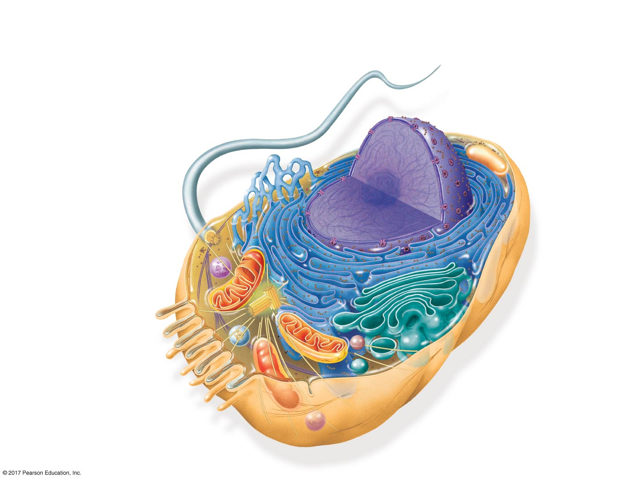
Figure 7.8a
Animal cell
ENDOPLASMIC
RETICULUM (ER)
Rough ER
Smooth ER
Nuclear
envelope
Nucleolus核仁
NUCLEUS
Flagellum (鞭毛)
Chromatin染色質
Centrosome中心體
Plasma
membrane
CYTOSKELETON:
Microfilaments微絲
Intermediate filaments中間絲
Microtubules 微管
Ribosomes (核醣體)
Microvilli微絨毛
Golgi apparatus 高基氏體
Peroxisome過氧
化物酶體
Lysosome溶酶体
Mitochondrion
Notes:
Figure 7.8a Exploring eukaryotic cells (part 1: animal cell cutaway)

Slide 25
BioFlix: Tour of an Animal Cell

Slide 26
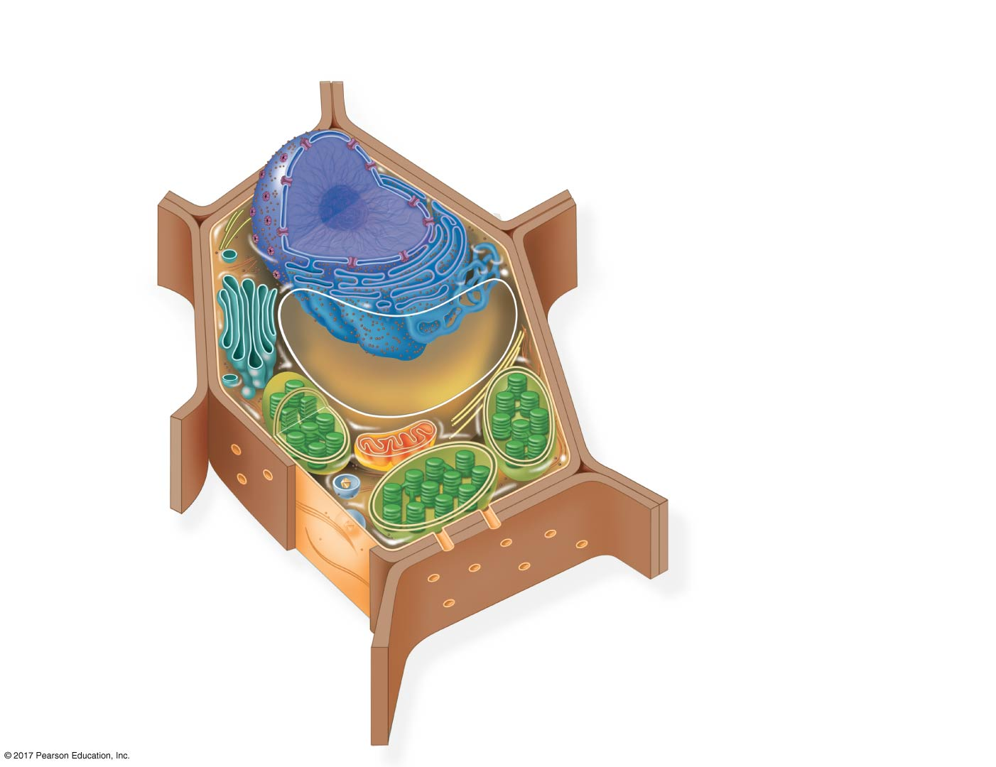
Figure 7.8b
Nuclear
envelope
Plant cell
NUCLEUS
Nucleolus
Rough ER
Chromatin
Smooth ER
Ribosomes
Golgi
apparatus
Central vacuole
Microfilaments
CYTOSKELETON
Microtubules
Mitochondrion
Peroxisome
Plasma
membrane
Chloroplast
Cell wall
Plasmodesmata
Wall of adjacent cell
Notes:
Figure 7.8b Exploring eukaryotic cells (part 2: plant cell cutaway)

Slide 27
BioFlix: Tour of a Plant Cell

Slide 28
Concept 7.3: The eukaryotic cell’s genetic instructions are housed in the nucleus and carried out by the ribosomes
The nucleus contains most of the DNA in a eukaryotic cell
Ribosomes use the information from the DNA to make proteins

Slide 29
The Nucleus: Information Central
The nucleus contains most of the cell’s genes and is usually the most conspicuous顯著的organelle
The nuclear envelope encloses the nucleus, separating it from the cytoplasm
The nuclear envelope is a double membrane; each membrane consists of a lipid bilayer

Slide 30
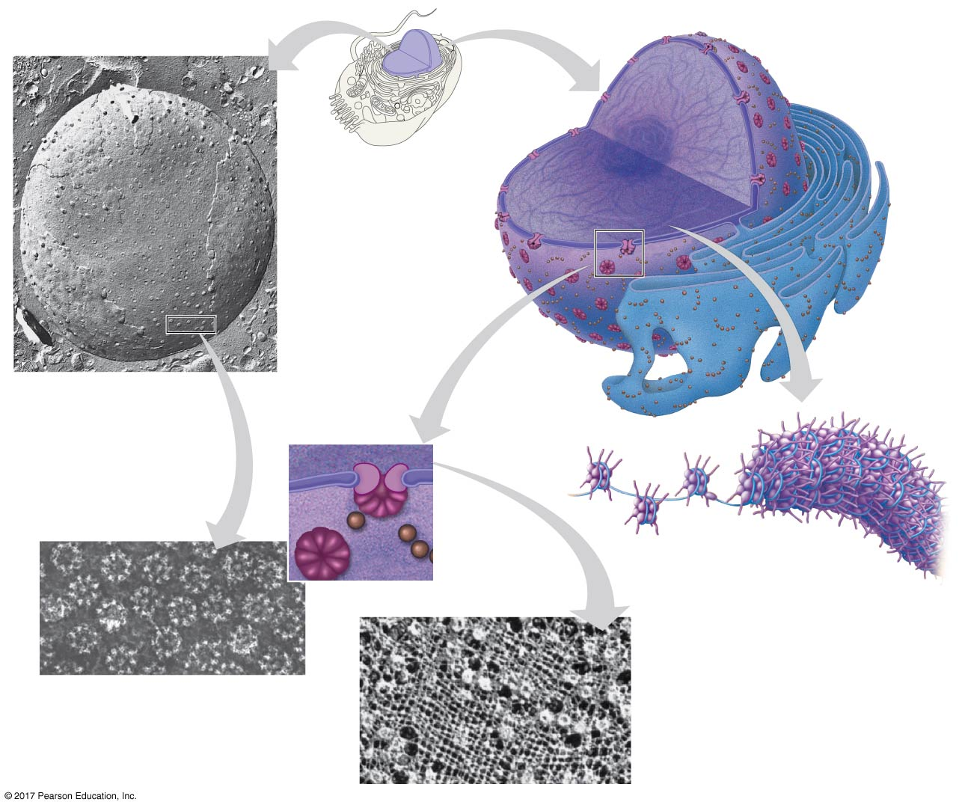
Figure 7.9
The nucleus and its envelope
1 μm
Nucleus
Nucleus
Nucleolus
Chromatin
Nuclear envelope:
Outer membrane
Inner membrane
Nuclear pore
Rough
ER
Surface of
nuclear envelope
(TEM)
Pore
complex
Ribosome
Close-up
of nuclear
envelope
Chromatin
0.25 μm
0.5 μm
Pore complexes (TEM)
Nuclear lamina (TEM)
Notes:
Figure 7.9 The nucleus and its envelope

Slide 31
Pores, lined with a structure called a pore complex, regulate the entry and exit of molecules from the nucleus
The nuclear size of the envelope is lined by the nuclear lamina(核纖層), which is composed of proteins and maintains the shape of the nucleus

Slide 32
In the nucleus, DNA is organized into discrete units called chromosomes
Each chromosome contains one DNA molecule associated with proteins, called chromatin染色質
Chromatin condenses to form discrete chromosomes as a cell prepares to divide
The nucleolus核仁is located within the nucleus and is the site of ribosomal RNA (rRNA) synthesis

Slide 33
Ribosomes: Protein Factories
Ribosomes are complexes made of ribosomal RNA and protein
Ribosomes carry out protein synthesis in two locations:
In the cytosol細胞質液(free ribosomes)
On the outside of the endoplasmic reticulum or the nuclear envelope (bound ribosomes)

Slide 34
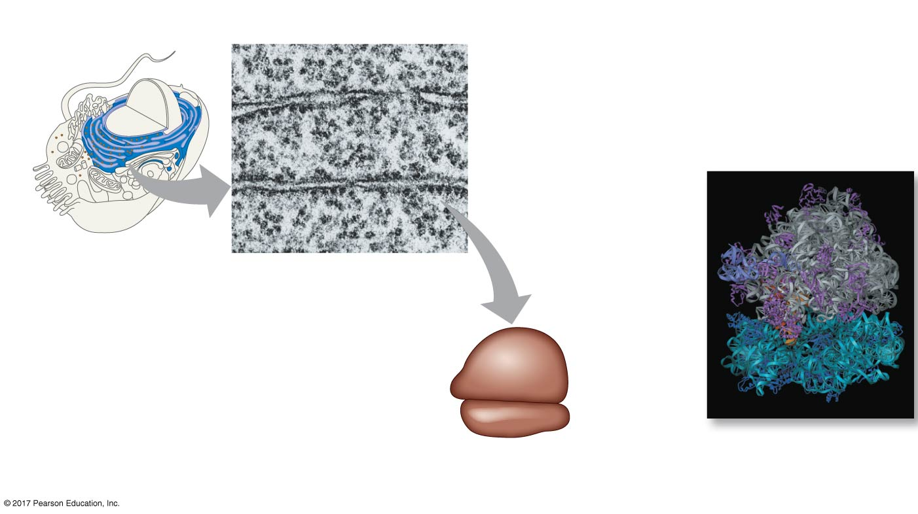
Figure 7.10
Ribosomes
0.25 μm
Free ribosomes in cytosol
Ribosomes
ER
Endoplasmic reticulum (ER)
Ribosomes
bound to ER
TEM showing ER
and ribosomes
Large
subunit
Small
subunit
Diagram of
a ribosome
Computer model
of a ribosome
Notes:
Figure 7.10 Ribosomes

Slide 35
Concept 7.4: The endomembrane system內膜系統regulates protein traffic and performs metabolic functions in the cell
The endomembrane system consists of
Nuclear envelope
Endoplasmic reticulum
Golgi apparatus
Lysosomes溶體
Vacuoles液泡
Plasma membrane
These components are either continuous or connected via transfer by vesicles囊泡

Slide 36
The Endoplasmic Reticulum: Biosynthetic Factory
The endoplasmic reticulum (ER) accounts for more than half of the total membrane in many eukaryotic cells
The ER membrane is continuous with the nuclear envelope
There are two distinct regions of ER:
Smooth ER, which lacks ribosomes
Rough ER, whose surface is studded with ribosomes

Slide 37
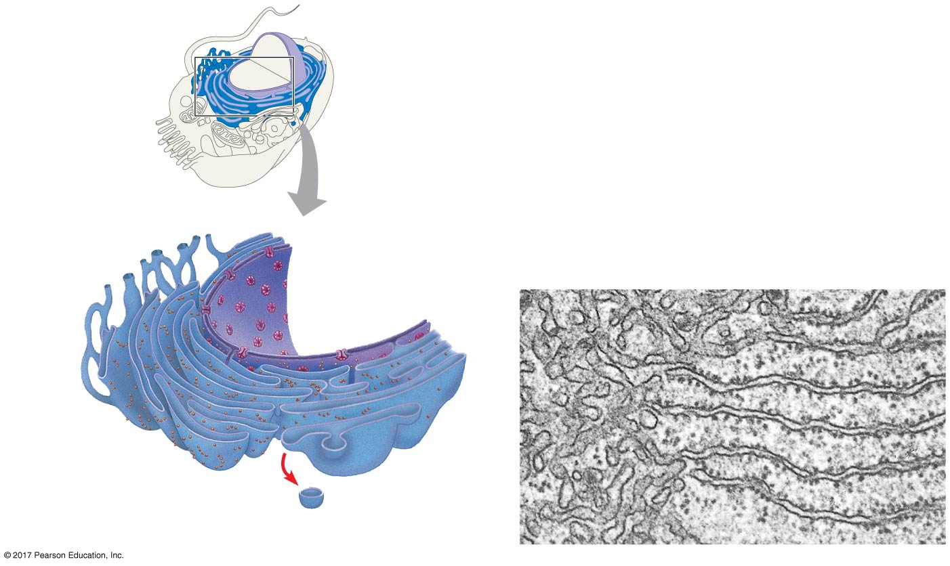
Figure 7.11
Endoplasmic reticulum (ER)
Smooth ER
Rough ER
Nuclear
envelope
Smooth ER
Rough ER
0.2 μm
ER lumen
Cisternae
Ribosomes
Transitional
ER
Transport vesicle
Notes:
Figure 7.11 Endoplasmic reticulum (ER)

Slide 38
Functions of Smooth ER
The smooth ER
Synthesizes lipids
Metabolizes carbohydrates
Detoxifies drugs and poisons
Stores calcium ions

Slide 39
Functions of Rough ER
The rough ER
Has bound ribosomes, which secrete glycoproteins糖蛋白 一種含有寡糖鏈的蛋白質，兩者之間以共價鍵相連(proteins covalently bonded to carbohydrates)
Distributes transport vesicles, secretory proteins surrounded by membranes
Is a membrane factory for the cell

Slide 40
The Golgi Apparatus: Shipping and Receiving Center
The Golgi apparatus consists of flattened membranous sacs called cisternae
The Golgi apparatus
Modifies products of the ER
Manufactures certain macromolecules
Sorts and packages materials into transport vesicles

Slide 41
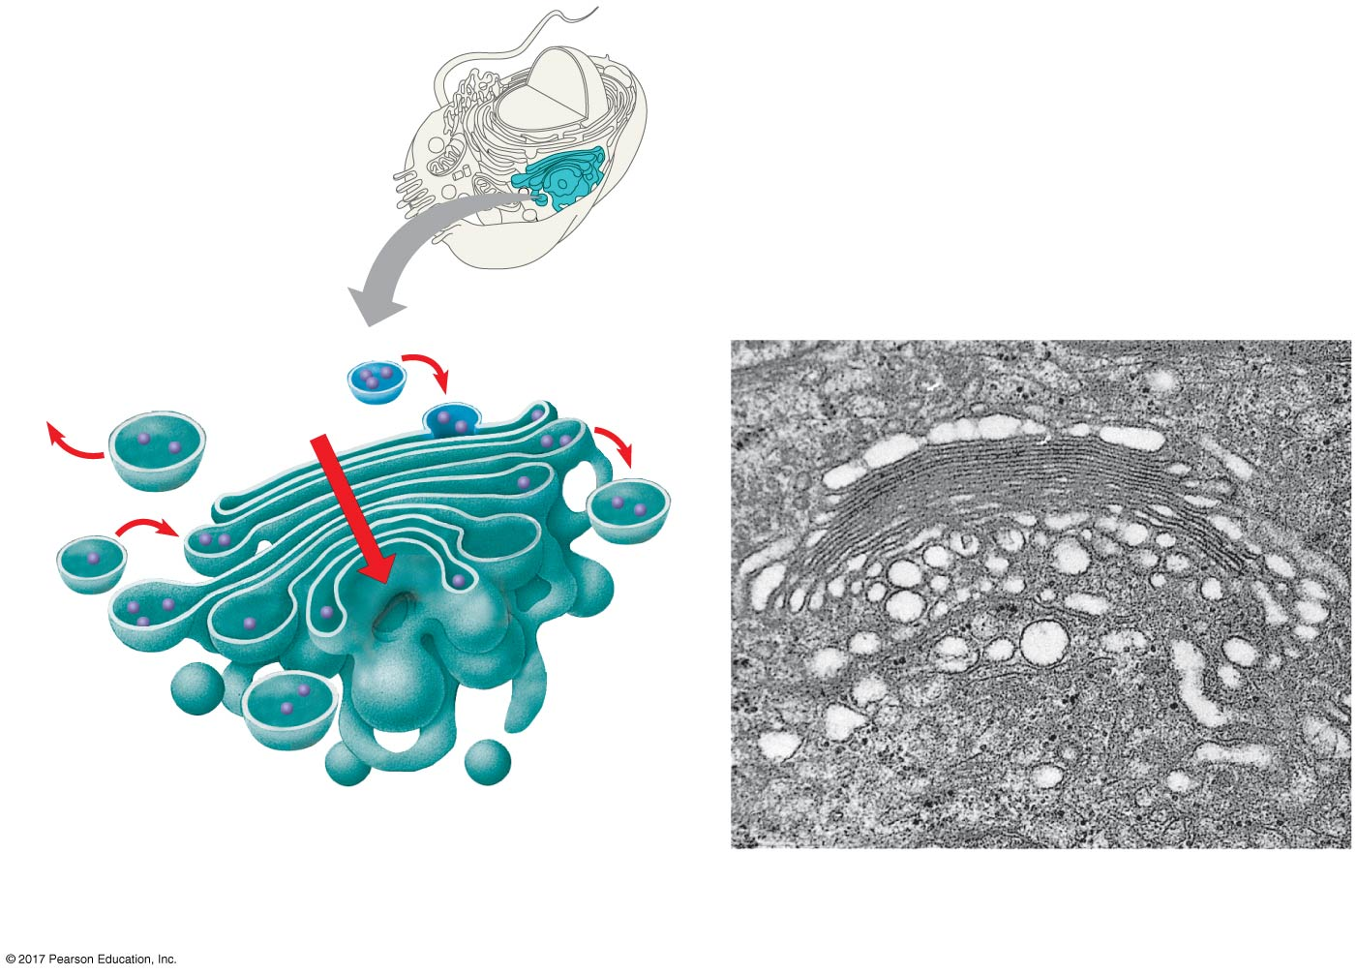
Figure 7.12
The Golgi apparatus
Golgi
apparatus
cis face
(“receiving” side of
Golgi apparatus)
0.1 μm
Cisternae
trans face
(“shipping” side of
Golgi apparatus)
TEM of Golgi apparatus
Notes:
Figure 7.12 The Golgi apparatus

Slide 42
Lysosomes: Digestive Compartments
A lysosome is a membranous sac of hydrolytic水解性的enzymes that can digest macromolecules
Lysosomal enzymes work best in the acidic environment inside the lysosome
Hydrolytic enzymes and lysosomal membranes are made by rough ER and then transferred to the Golgi apparatus for further processing

Slide 43
Some types of cell can engulf another cell by phagocytosis胞噬作用; this forms a food vacuole
A lysosome fuses with the food vacuole and digests the molecules
Lysosomes also use enzymes to recycle the cell’s own organelles and macromolecules, a process called autophagy自噬作用

Slide 44
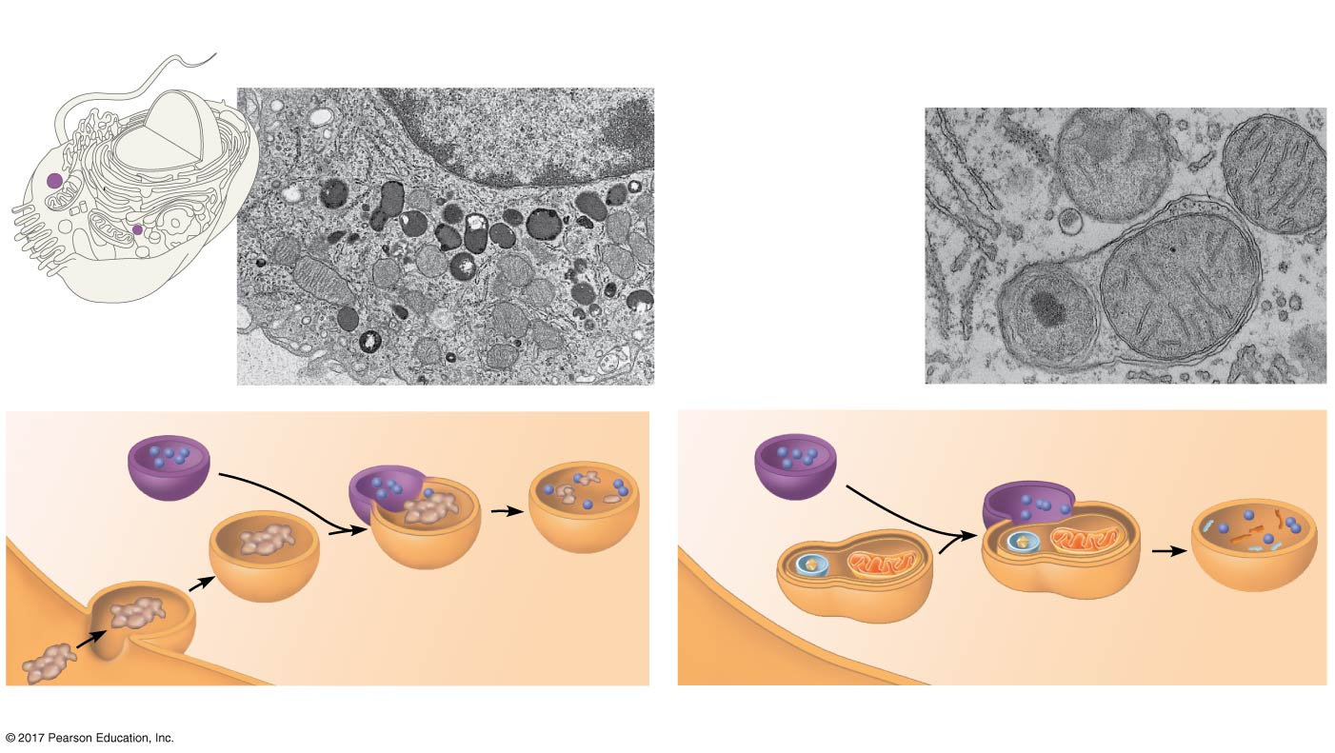
Figure 7.13
Lysosomes
Vesicle containing
two damaged
organelles
Nucleus
1 μm
1 μm
Mitochondrion
fragment
Peroxisome
fragment
Lysosome
Digestive
enzymes
Lysosome
Lysosome
Plasma
membrane
Peroxisome
Digestion
Food
vacuole
Mitochondrion
Digestion
Vesicle
(a) Phagocytosis
(b) Autophagy
Notes:
Figure 7.13 Lysosomes

Slide 45
Vacuoles: Diverse Maintenance Compartments
Vacuoles are large vesicles derived from the ER and Golgi apparatus
Vacuoles perform a variety of functions in different kinds of cells

Slide 46
Food vacuoles are formed by phagocytosis
Contractile vacuoles伸縮泡;, found in many freshwater protists, pump excess water out of cells
Central vacuoles中央液泡, found in many mature plant cells, hold organic compounds and water

Slide 47
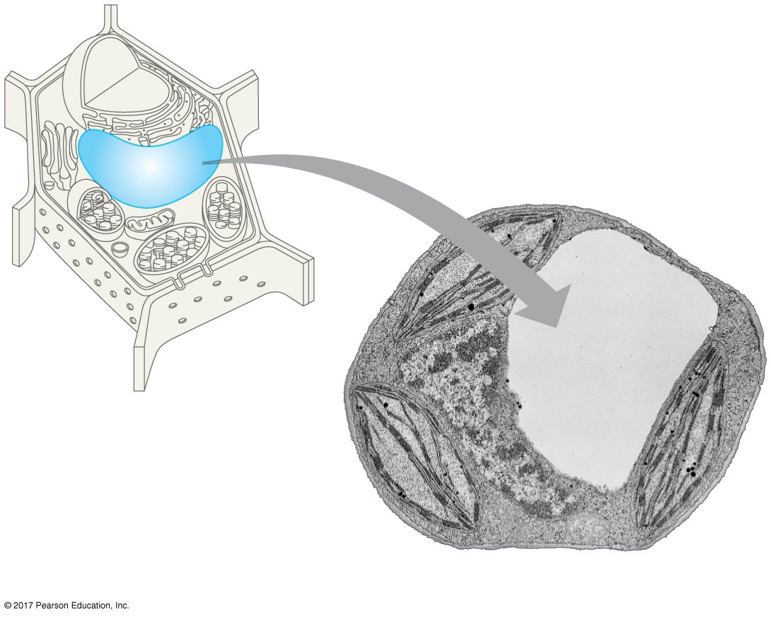
Figure 7.14
The plant cell vacuole
Central vacuole
Cytosol
Central
vacuole
Nucleus
Cell wall
Chloroplast
5 μm
Notes:
Figure 7.14 The plant cell vacuole

Slide 48
The Endomembrane System: A Review
The endomembrane system is a complex and dynamic player in the cell’s compartmental organization

Slide 49
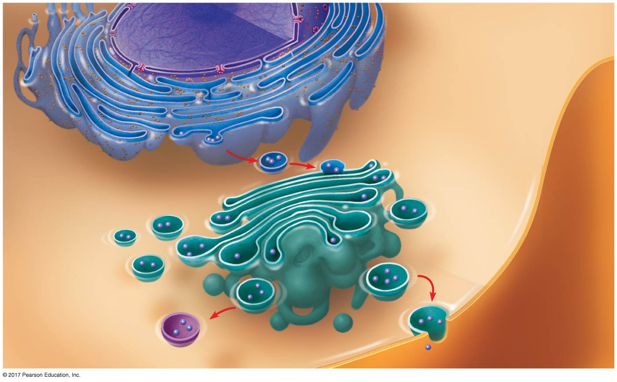
Figure 7.15
Review: relationships among organelles of the endomembrane system
Nucleus
Nuclear
envelope
Rough ER
Smooth ER
cis Golgi
Plasma
membrane
trans Golgi
Notes:
Figure 7.15 Review: relationships among organelles of the endomembrane system

Slide 50
Concept 7.5: Mitochondria and chloroplasts change energy from one form to another
Mitochondria are the sites of cellular respiration, a metabolic process that uses oxygen to generate ATP
Chloroplasts, found in plants and algae, are the sites of photosynthesis
Peroxisomes are oxidative organelles

Slide 51
The Evolutionary Origins of Mitochondria and Chloroplasts
Mitochondria and chloroplasts have similarities with bacteria:
Enveloped by a double membrane
Contain free ribosomes and circular DNA molecules
Grow and reproduce somewhat independently in cells
These similarities led to the endosymbiont theory內共生學說

Slide 52
The endosymbiont theory suggests that an early ancestor of eukaryotes engulfed an oxygen-using nonphotosynthetic prokaryotic cell
The engulfed cell formed a relationship with the host cell, becoming an endosymbiont
The endosymbionts evolved into mitochondria
At least one of these cells may have then taken up a photosynthetic prokaryote, which evolved into a chloroplast

Slide 53
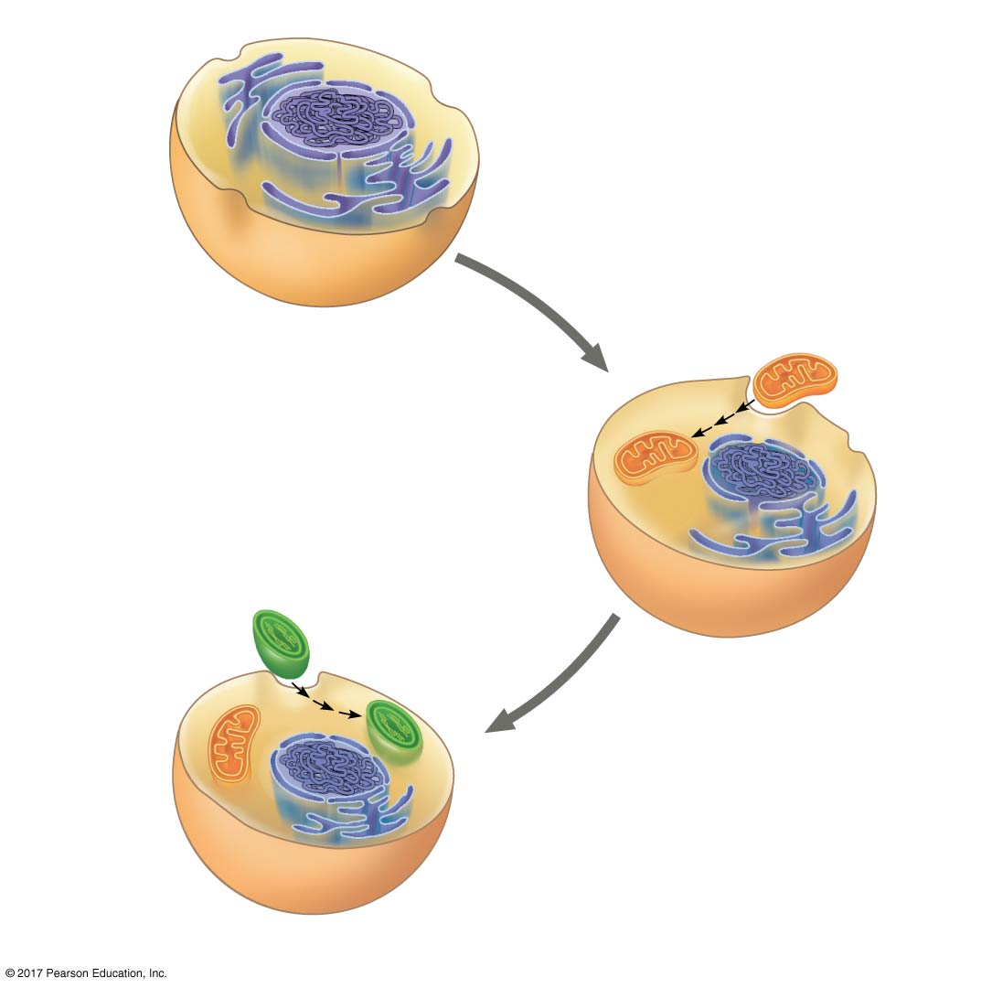
Figure 7.16
Endoplasmic
reticulum
Nucleus
Nuclear
envelope
Engulfing of oxygen-
using nonphotosynthetic
prokaryote, which
becomes a mitochondrion
Ancestor of
eukaryotic cells (host cell)
Mitochondrion
Engulfing of
photosynthetic
prokaryote
Chloroplast
At least
one cell
Mitochondrion
Nonphotosynthetic
eukaryote
The endosymbiont theory of the origins of mitochondria and chloroplasts in eukaryotic cells
Photosynthetic eukaryote
Notes:
Figure 7.16 The endosymbiont theory of the origins of mitochondria and chloroplasts in eukaryotic cells

Slide 54
Mitochondria: Chemical Energy Conversion
Mitochondria are found in nearly all eukaryotic cells
They have a smooth outer membrane and an inner membrane folded into cristae
The inner membrane creates two compartments: intermembrane space and mitochondrial matrix
Some metabolic steps of cellular respiration are catalyzed in the mitochondrial matrix
Cristae present a large surface area for enzymes that synthesize ATP

Slide 55
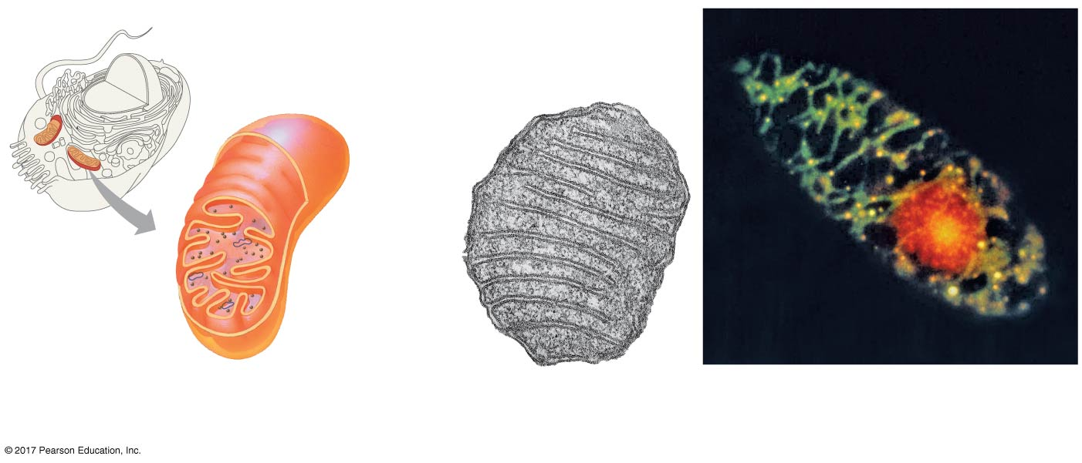
Figure 7.17
The mitochondrion, site of cellular respiration
Mitochondrion
10 μm
Intermembrane space
Mitochondria
Outer
membrane
DNA
Inner
membrane
Mitochondrial
DNA
Free
ribosomes
in the
mitochondrial
matrix
Cristae
Matrix
Nuclear DNA
0.1 μm
(a) Diagram and TEM of mitochondrion
(b) Network of mitochondria in Euglena (LM)
Notes:
Figure 7.17 The mitochondrion, site of cellular respiration

Slide 56
Chloroplasts: Capture of Light Energy
Chloroplasts contain the green pigment chlorophyll, as well as enzymes and other molecules that function in photosynthesis
Chloroplasts are found in leaves and other green organs of plants and in algae

Slide 57
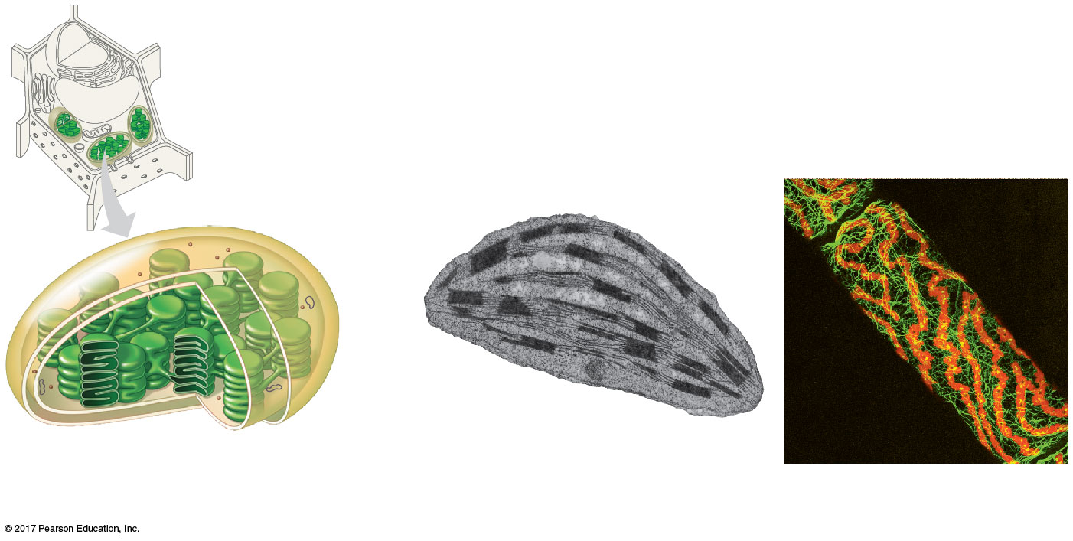
Figure 7.18
The chloroplast, site of photosynthesis
Chloroplast
Stroma
Ribosomes
Inner and outer
membranes
50 μm
Granum
DNA
Chloroplasts
(red)
Thylakoid
Intermembrane space
1 μm
(a) Diagram and TEM of chloroplast
(b) Chloroplasts in an algal cell
Notes:
Figure 7.18 The chloroplast, site of photosynthesis

Slide 58
Chloroplast structure includes
Thylakoids類囊體, membranous sacs, stacked to form a granum
Stroma, the internal fluid
The chloroplast is one of a group of plant organelles, called plastids

Slide 59
Peroxisomes: Oxidation
Peroxisomes are specialized metabolic compartments bounded by a single membrane
Peroxisomes produce hydrogen peroxide過氧化氫and convert it to water
Peroxisomes perform reactions with many different functions
How peroxisomes are related to other organelles is still unknown

Slide 60
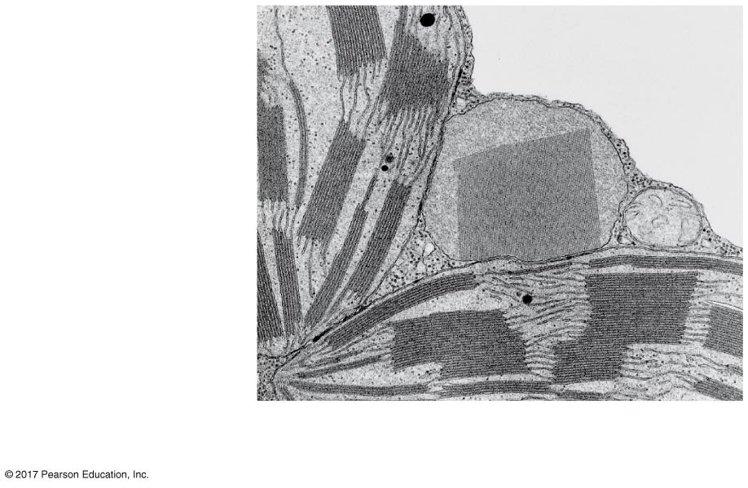
Figure 7.19
A peroxisome
Peroxisome
Mitochon-
drion
Chloroplasts
1 μm
Notes:
Figure 7.19 A peroxisome

Slide 61
Concept 7.6: The cytoskeleton is a network of fibers that organizes structures and activities in the cell
The cytoskeleton is a network of fibers extending throughout the cytoplasm
It organizes the cell’s structures and activities, anchoring many organelles
It is composed of three types of molecular structures
Microtubules
Microfilaments
Intermediate filaments

Slide 62
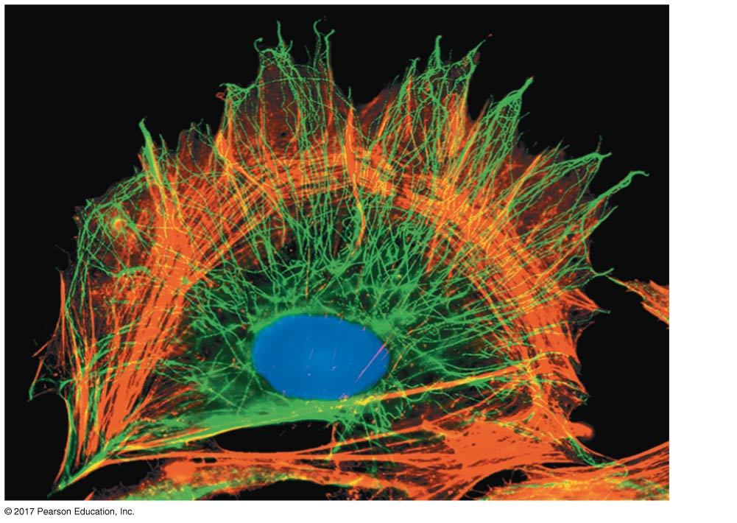
Figure 7.20
The cytoskeleton
10 μm
Notes:
Figure 7.20 The cytoskeleton

Slide 63
Roles of the Cytoskeleton: Support and Motility
The cytoskeleton helps to support the cell and maintain its shape
It interacts with motor proteins to produce cell motility
Inside the cell, vesicles can travel along tracks provided by the cytoskeleton

Slide 64
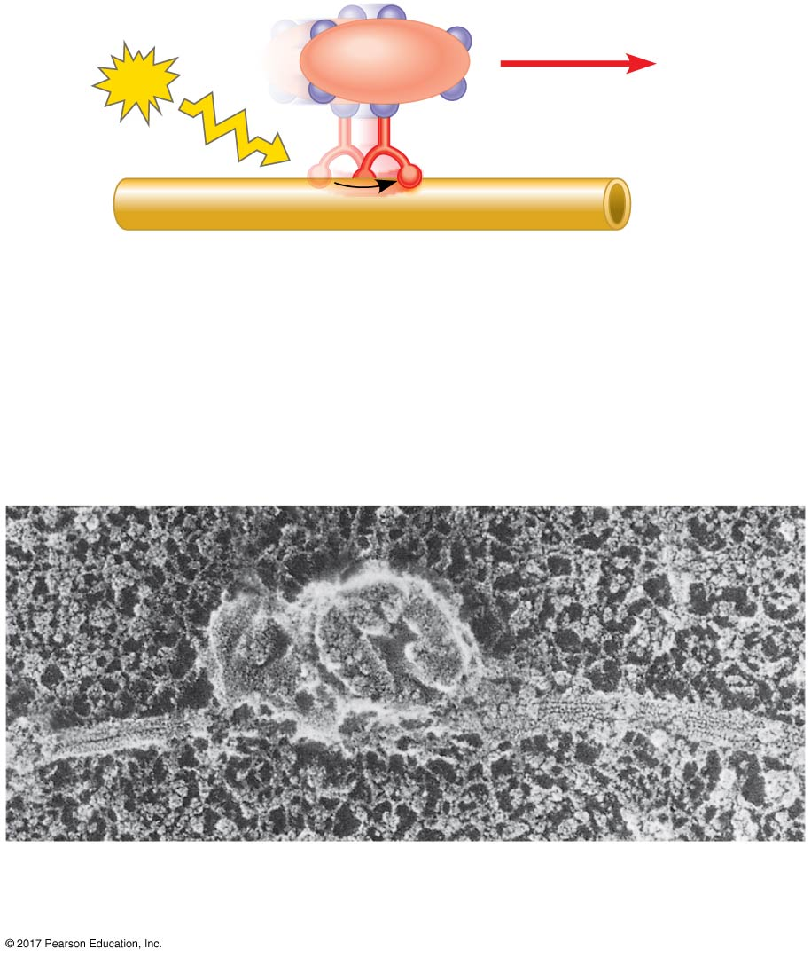
Figure 7.21
Motor proteins and the cytoskeleton
Vesicle
ATP
Receptor for
motor protein
Microtubule
of cytoskeleton
Motor protein
(ATP powered)
(a) Motor proteins “walk” vesicles along cytoskeletal fibers.
Microtubule
Vesicles
0.25 μm
(b) Two vesicles move along a microtubule toward the tip of an axon (SEM).
Notes:
Figure 7.21 Motor proteins and the cytoskeleton

Slide 65
Components of the Cytoskeleton
Three main types of fibers make up the cytoskeleton
Microtubules are the thickest of the three components of the cytoskeleton
Microfilaments微絲, also called actin filaments, are the thinnest components
Intermediate filaments中間絲are fibers with diameters in a middle range

Slide 66
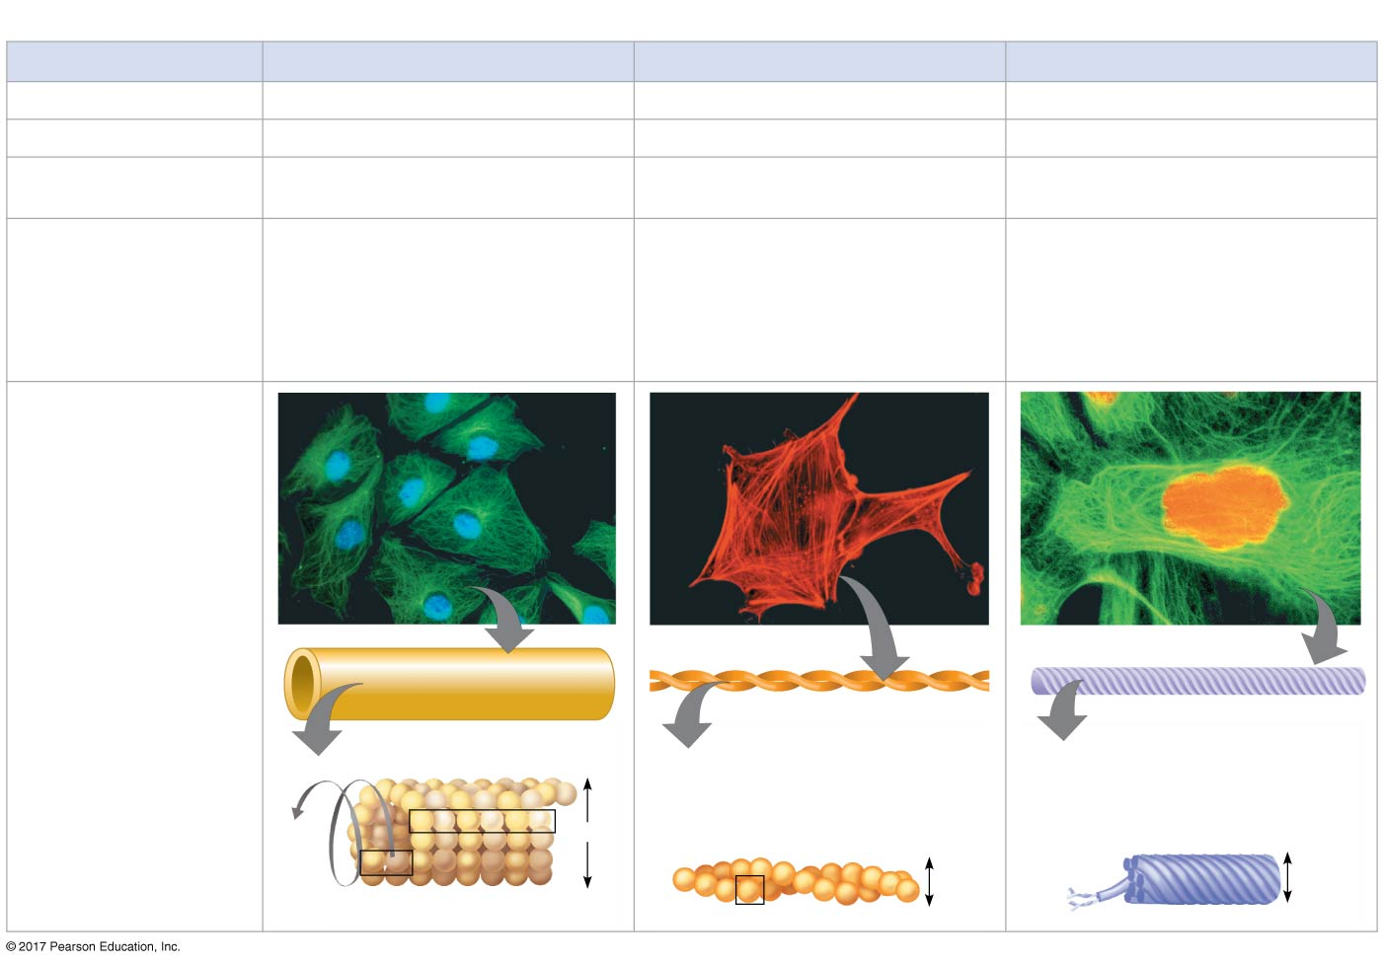
Figure 7.T01
The structure and function of the cytoskeleton (不考)
Table 7.1
The Structure and Function of the Cytoskeleton
Property
Microtubules (Tubulin Polymers)
Microfilaments (Actin Filaments)
Intermediate Filaments
Structure
Hollow tubes
Two intertwined strands of actin
Fibrous proteins coiled into cables
Diameter
25 nm with 15-nm lumen
7 nm
8–12 nm
Protein subunits
Tubulin, a dimer consisting of
α-tubulin and β-tubulin
Actin
One of several different proteins
(such as keratins)
Main functions
Maintenance of cell shape
(compression-resisting “girder”);
cell motility (as in cilia or flagella);
chromosome movements in cell
division; organelle movements
Maintenance of cell shape (tension-
bearing elements); changes in
cell shape; muscle contraction;
cytoplasmic streaming in plant
cells; cell motility (as in amoeboid
movement); division of animal cells
Maintenance of cell shape (tension-
bearing elements); anchorage of
nucleus and certain other organ-
elles; formation of nuclear lamina
Fluorescence micro-
graphs of fibroblasts.
Fibroblasts are a favor-
ite cell type for cell
biology studies because
they spread out flat and
their internal structures
are easy to see. In each,
the structure of interest
has been tagged with
fluorescent molecules.
The DNA in the nucleus
has also been tagged
in the first micrograph
(blue) and third micro-
graph (orange).
10 µm
10 µm
5 µm
Column of tubulin dimers
Keratin proteins
Actin subunit
Fibrous subunit (keratins
coiled together)
25 nm
7 nm
8–12 nm
α
β
Tubulin dimer
Notes:
Figure 7.T01 The structure and function of the cytoskeleton

Slide 67
Microtubules
Microtubules are hollow rods about 25 nm in diameter and about 200 nm to 25 microns long
Microtubules are constructed of dimers of tubulin
Functions of microtubules:
Shaping the cell
Guiding movement of organelles
Separating chromosomes during cell division

Slide 68
Centrosomes and Centrioles
In animal cells, microtubules grow out from a centrosome near the nucleus
In animal cells, the centrosome has a pair of centrioles, each with nine triplets of microtubules arranged in a ring

Slide 69
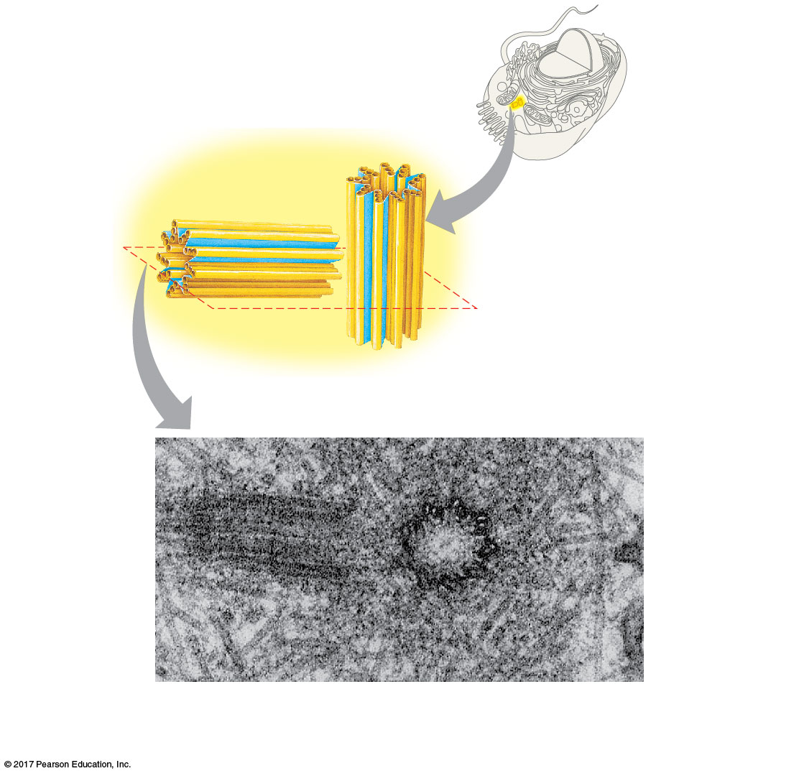
Figure 7.22
Centrosome containing a pair of centrioles
Centrosome
Microtubule
Centrioles
0.25 μm
Longitudinal section
of one centriole
Microtubules
Cross section
of the other centriole
Notes:
Figure 7.22 Centrosome containing a pair of centrioles

Slide 70
Cilia and Flagella
Microtubules control the beating of flagella(鞭毛) and cilia(纖毛), microtubule-containing extensions that project from some cells
Many unicellular eukaryotes are propelled through water by cilia or flagella
Cilia and flagella differ in their beating patterns

Slide 71
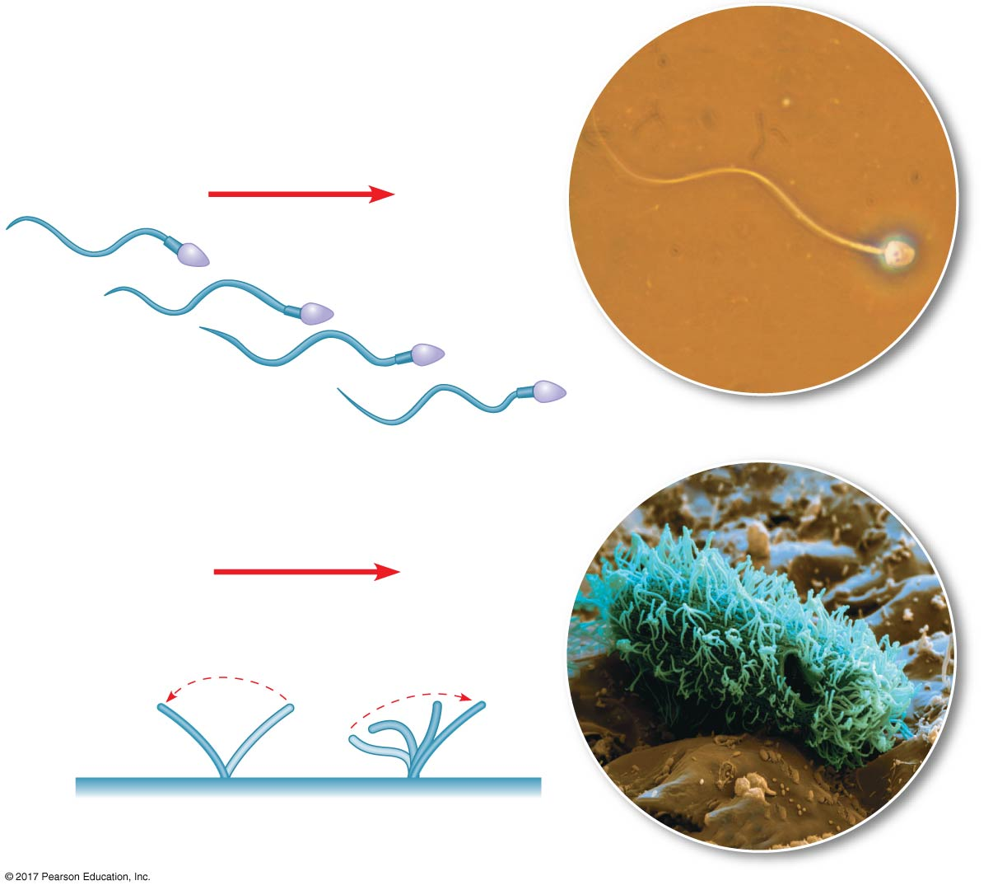
Figure 7.23
(a) Motion of flagella
Direction of swimming
5 μm
(b) Motion of cilia
Direction of organism’s movement
Power
stroke
Recovery
stroke
15 μm
Notes:
Figure 7.23 A comparison of the beating of flagella and motile cilia

Slide 72
Cilia and flagella share a common structure
A group of microtubules sheathed by an extension of the plasma membrane
A basal body基體that anchors the cilium or flagellum
A motor protein called dynein, which drives the bending movements of a cilium or flagellum

Slide 73
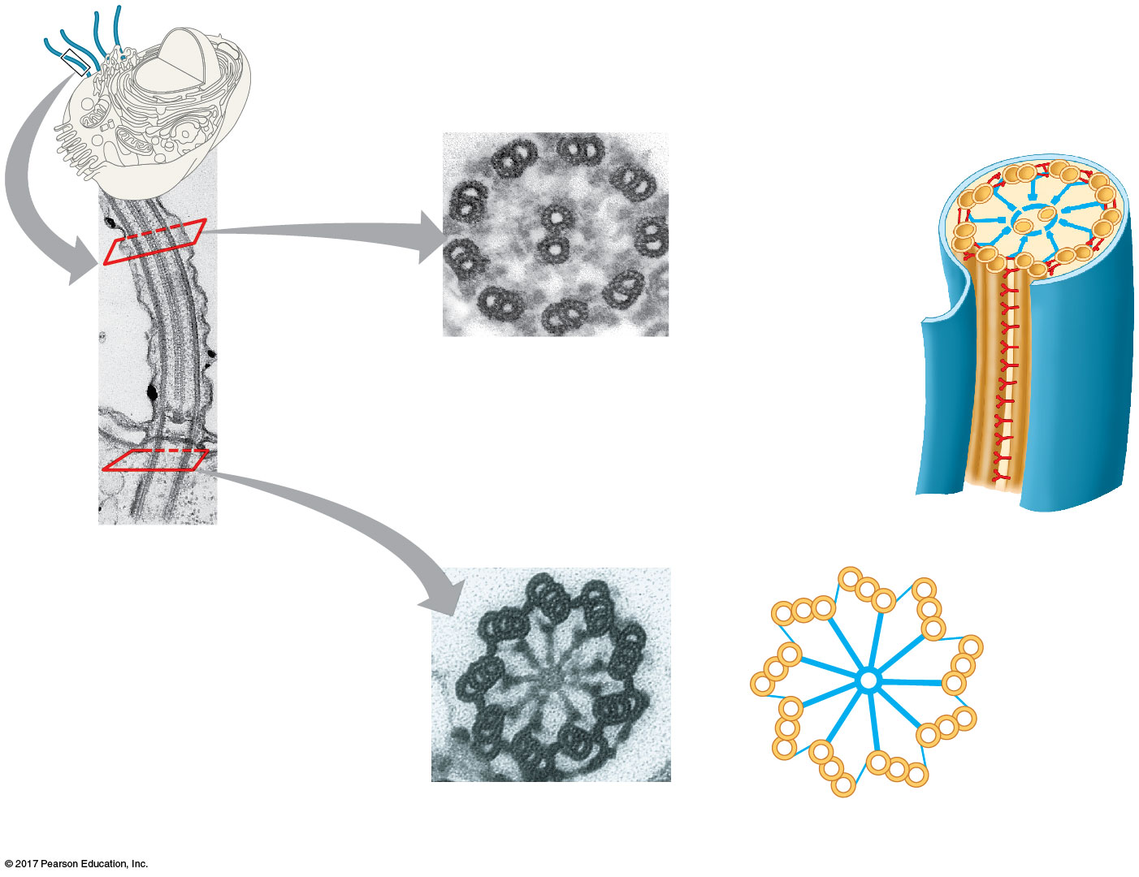
Figure 7.24
Structure of a flagellum or motile cilium
Plasma
membrane
Outer microtubule
doublet
0.1 μm
Motor proteins
(dyneins)
Central
microtubule
Microtubules
Radial spoke
(b) Cross section of motile cilium
Cross-linking
protein between
outer doublets
Plasma
membrane
Basal body
0.1 μm
0.5 μm
Triplet
(a) Longitudinal section of motile cilium
(c) Cross section of basal body
Notes:
Figure 7.24 Structure of a flagellum or motile cilium

Slide 74
Dynein has two “feet” that “walk” along microtubules
One foot maintains contact, while the other releases and reattaches one step farther along
Movements of the feet cause the microtubules to bend, rather than slide, because the microtubules are held in place

Slide 75
Microfilaments (Actin Filaments)
Microfilaments are solid rods about 7 nm in diameter, built as a twisted double chain of actin subunits
A network of microfilaments helps support the cell’s shape
They form a cortex just inside the plasma membrane to help support the cell’s shape
Bundles of microfilaments make up the core of microvilli of intestinal cells

Slide 76
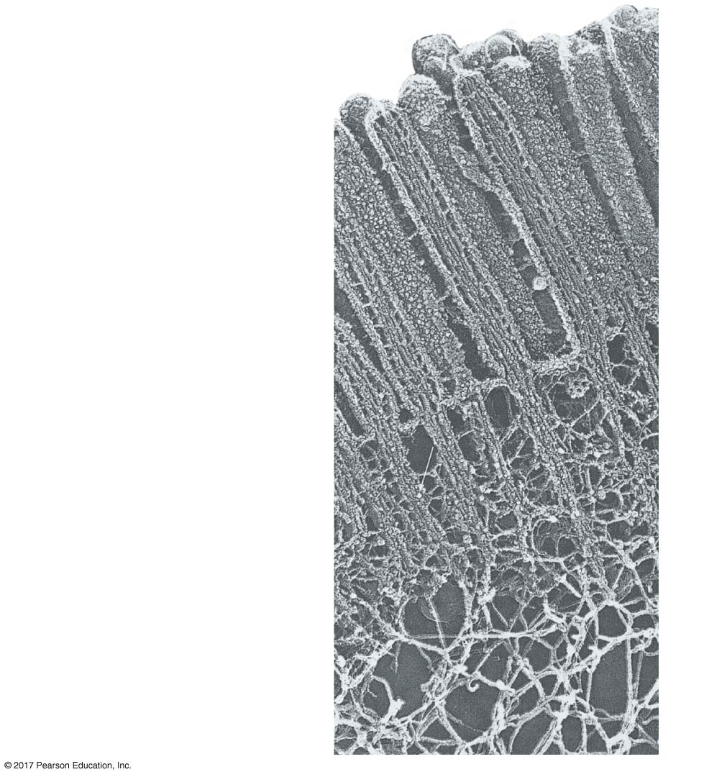
Figure 7.25
A structural role of microfilaments
Microvillus
0.25 µm
Plasma membrane
Microfilaments (actin
filaments)
Intermediate filaments
Notes:
Figure 7.25 A structural role of microfilaments

Slide 77
Microfilaments that function in cellular motility contain the protein myosin in addition to actin
Cells crawl along a surface by extending pseudopodia (cellular extensions) and moving toward them
Cytoplasmic streaming is a circular flow of cytoplasm within cells, driven by actin-myosin interactions

Slide 78
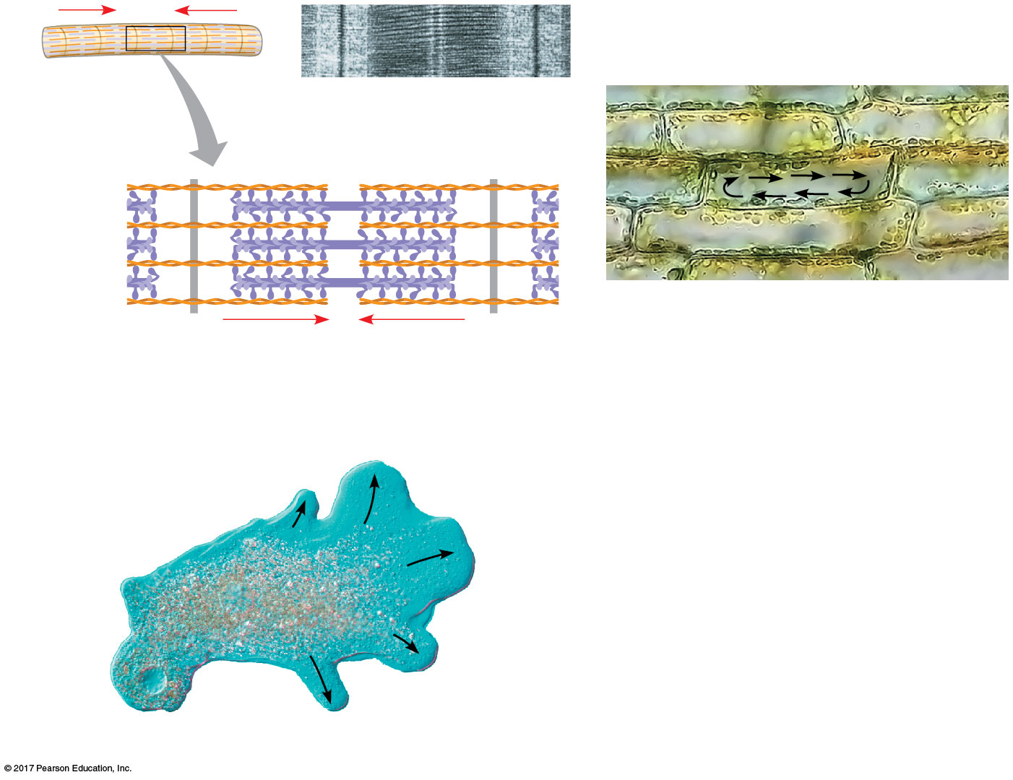
Figure 7.26
Microfilaments and motility
Muscle
cell
0.5 μm
Actin
filament
Myosin
filament
Myosin
head
30 μm
Organelles
(a) Myosin motors in muscle cell contraction
(c) Cytoplasmic streaming in plant cells
Cortex (outer cytoplasm):
gel with actin network
100 μm
Inner cytoplasm
(more fluid)
Extending
pseudopodium
(b) Amoeboid movement
Notes:
Figure 7.26 Microfilaments and motility

Slide 79
Intermediate Filaments
Intermediate filaments range in diameter from 8 to 12 nanometers, larger than microfilaments but smaller than microtubules
Intermediate filaments are more permanent cytoskeleton fixtures than the other two classes
They support cell shape and fix organelles in place

Slide 80
Concept 7.7: Extracellular components and connections between cells help coordinate cellular activities
Most cells synthesize and secrete materials that are external to the plasma membrane
These extracellular materials and structures are involved in a great many cellular functions

Slide 81
Cell Walls of Plants
The cell wall is an extracellular structure that distinguishes plant cells from animal cells
Prokaryotes, fungi, and some unicellular eukaryotes also have cell walls
The cell wall protects the plant cell, maintains its shape, and prevents excessive uptake of water
Plant cell walls are made of cellulose fibers embedded in other polysaccharides and protein

Slide 82
Plant cell walls may have multiple layers:
Primary cell wall: Relatively thin and flexible
Middle lamella: Thin layer between primary walls of adjacent cells
Secondary cell wall (in some cells): Added between the plasma membrane and the primary cell wall

Slide 83
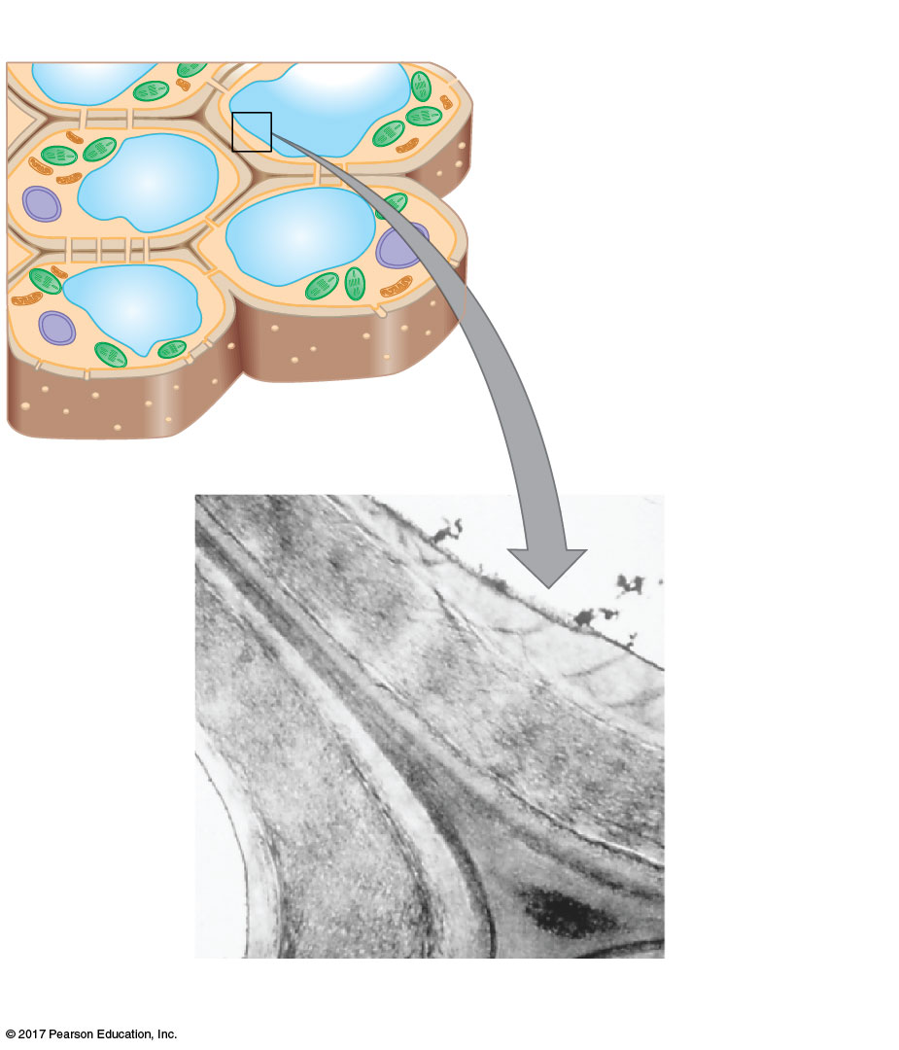
Figure 7.27
Plant cell walls
Central vacuole
Cytosol
Plasma membrane
Plant cell walls
Plasmodesmata
Secondary
cell wall
Primary
cell wall
Middle
lamella中膠層
1 μm
Notes:
Figure 7.27 Plant cell walls

Slide 84
The Extracellular Matrix (ECM) of Animal Cells
Animal cells lack cell walls but are covered by an elaborate extracellular matrix (ECM)
The ECM is made up of glycoproteins such as collagen, proteoglycans, and fibronectin
ECM proteins bind to receptor proteins in the plasma membrane called integrins

Slide 85
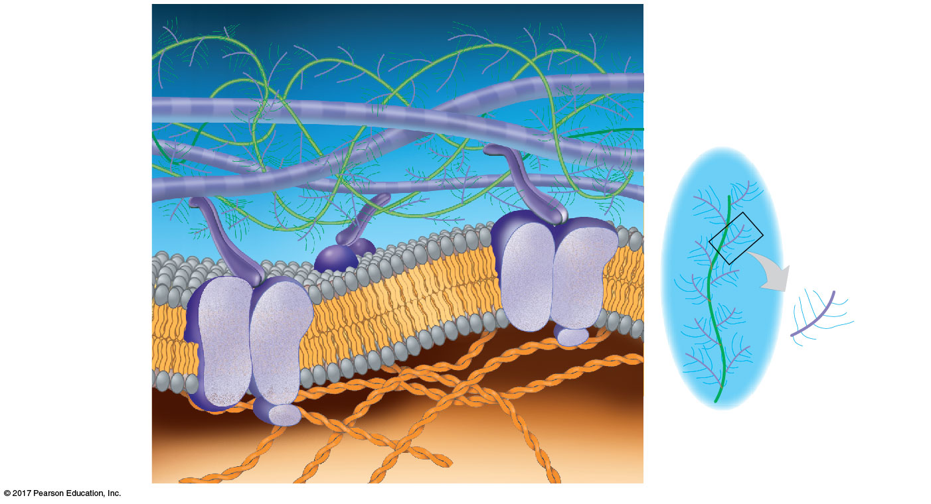
Figure 7.28
Extracellular matrix (ECM) of an animal cell
EXTRACELLULAR FLUID
A proteoglycan
complex:
Collagen 膠原蛋白
Polysaccharide
molecule
Carbo-
hydrates
Fibronectin纖維結合蛋白
Core
protein
Plasma
membrane
Proteoglycan
molecule
Microfilaments
Integrins
CYTOPLASM
Notes:
Figure 7.28 Extracellular matrix (ECM) of an animal cell

Slide 86
The ECM has an influential role in the lives of cells
ECM can regulate a cell’s behavior by communicating with a cell through integrins
The ECM around a cell can influence the activity of gene in the nucleus
Mechanical signaling may occur through cytoskeletal changes that trigger chemical signals in the cell

Slide 87
Cell Junctions
Neighboring cells in tissues, organs, or organ systems often adhere, interact, and communicate through direct physical contact

Slide 88
Plasmodesmata in Plant Cells
Plasmodesmata原生質絲are channels that perforate plant cell walls
Through plasmodesmata, water and small solutes (and sometimes proteins and RNA) can pass from cell to cell

Slide 89
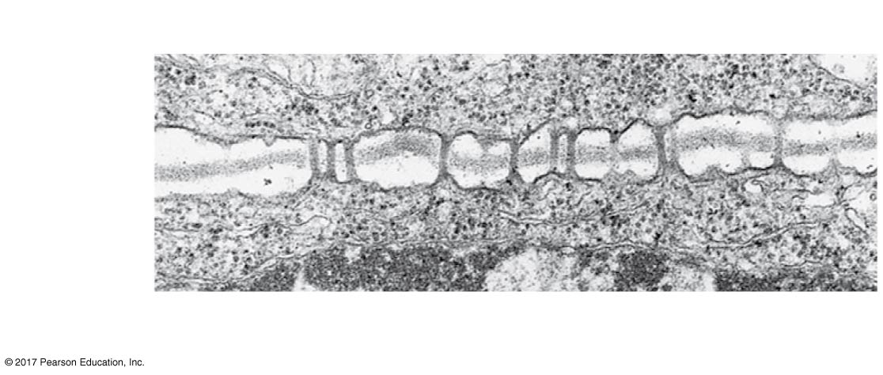
Figure 7.29
Plasmodesmata between plant cells
Cell walls
Interior
of cell
Interior
of adja-
cent cell
0.5 μm
Plasmodesmata
Plasma membranes
Notes:
Figure 7.29 Plasmodesmata between plant cells

Slide 90
Tight Junctions, Desmosomes, and Gap Junctions in Animal Cells
Three types of cell junctions are common in epithelial tissues
At tight junctions, membranes of neighboring cells are pressed together, preventing leakage of extracellular fluid
Desmosomes (anchoring junctions) fasten cells together into strong sheets
Gap junctions (communicating junctions) provide cytoplasmic channels between adjacent cells

Slide 91
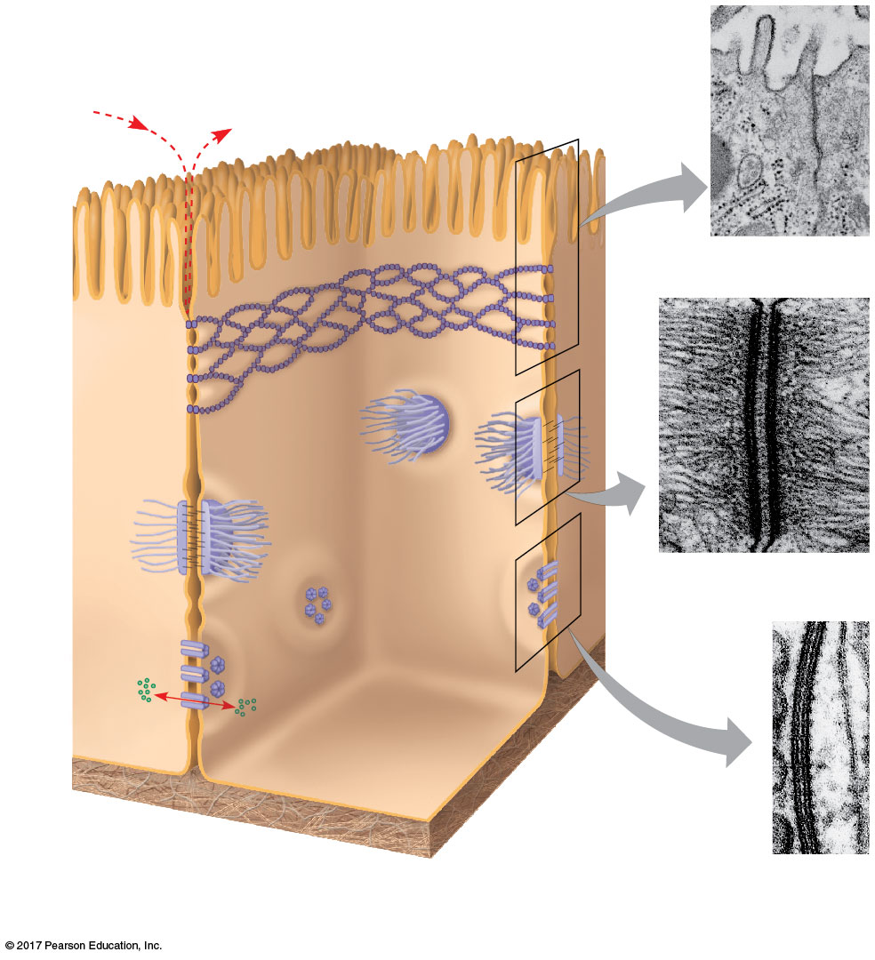
Figure 7.30
Cell junctions in animal tissues
Tight junctions prevent
fluid from moving
across a layer of cells.
Tight junction
TEM
0.5 μm
Tight junction
Intermediate
filaments
Desmosome
Desmosome
(TEM)
1 μm
Gap
junction
Ions or small
molecules
Extracellular
matrix
TEM
Plasma membranes
of adjacent cells
Space
between cells
0.1 μm
Gap junctions
Notes:
Figure 7.30 Exploring cell junctions in animal tissues

Slide 92
Concept 7.8: A cell is greater than the sum of its parts
Cells rely on the integration of structures and organelles in order to function
For example, a macrophage’s ability to destroy bacteria involves the whole cell, coordinating components such as the cytoskeleton, lysosomes, and plasma membrane

Slide 93
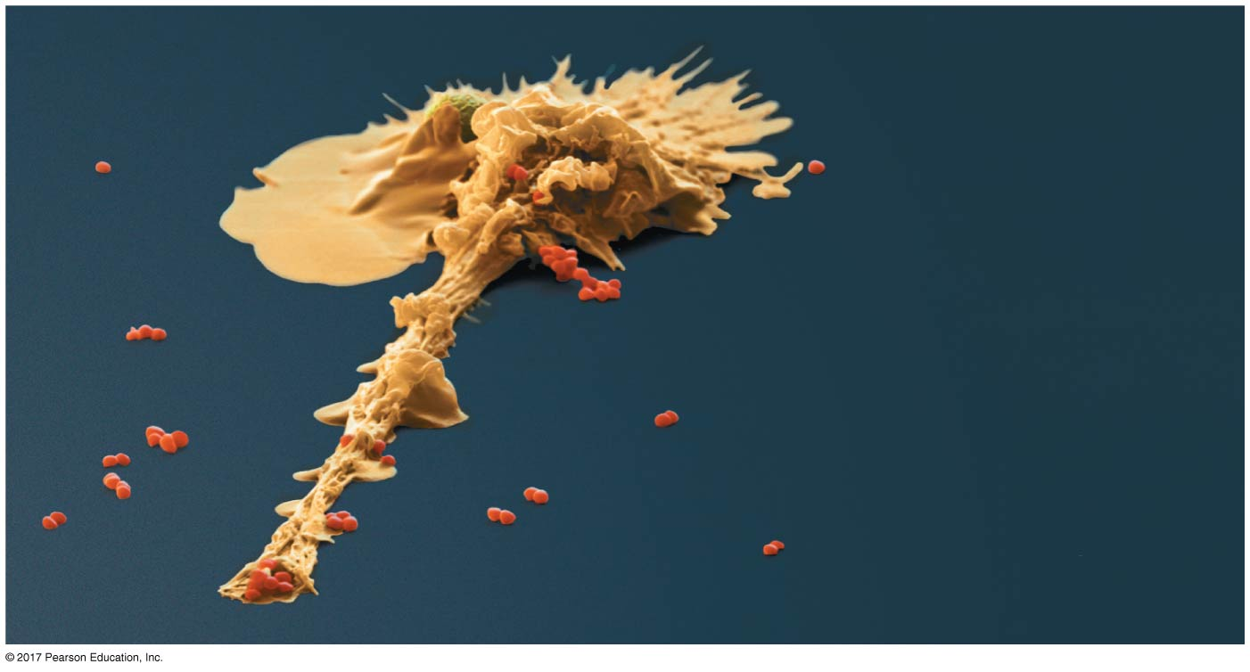
Figure 7.31
The emergence of cellular functions
Macrophage
Bacteria
Filopodium (extension
of the macrophage)
engulfing bacteria
10 μm
Notes:
Figure 7.31 The emergence of cellular functions

