Slide 1
Notes:
‹#›

Slide 2
The Molecules of Life
All living things are made up of four classes of large biological molecules: carbohydrates碳水化合物, lipids脂類, proteins, and nucleic acids核酸
Macromolecules大分子are large molecules and are complex
Large biological molecules have unique properties that arise from the orderly arrangement of their atoms

Slide 3
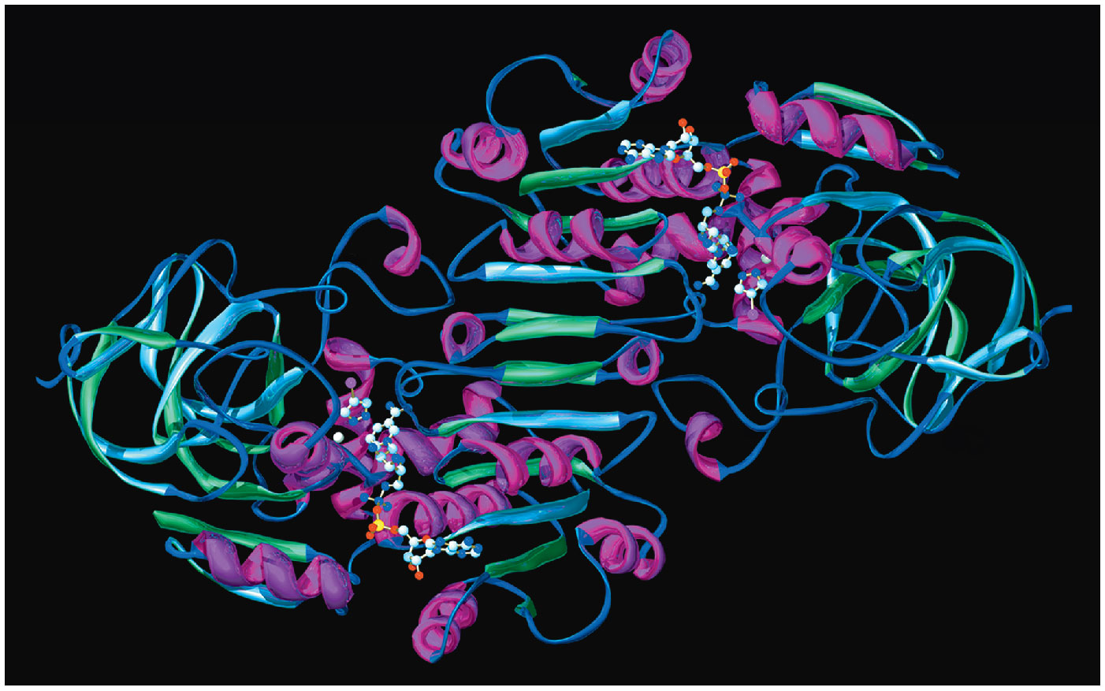
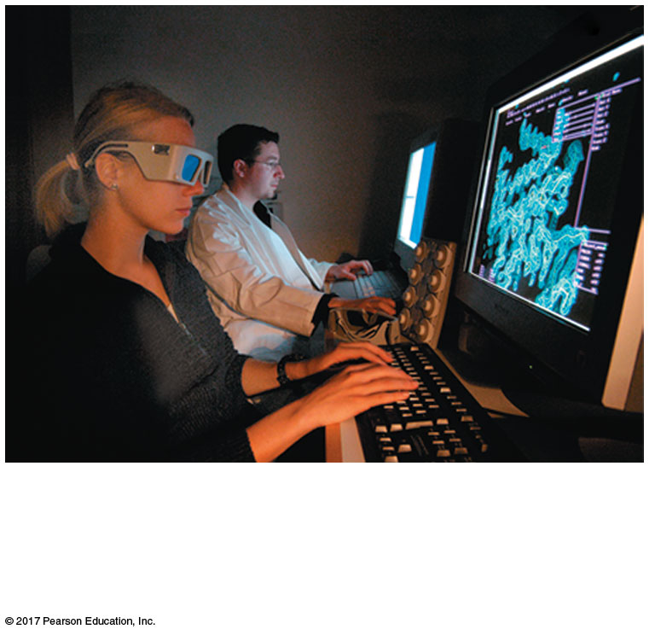
Figure 5.1a
Why is the structure of a protein important for its function?
The scientist in the foreground is using
3-D glasses to help her visualize the
structure of the protein displayed on her
screen.
Notes:
Figure 5.1a Why is the structure of a protein important for its function? (part 1: 3-D glasses)

Slide 4
Concept 5.1: Macromolecules are polymers, built from monomers
A polymer聚合物is a long molecule consisting of many similar building blocks
The repeating units that serve as building blocks are called monomers單體
Carbohydrates, proteins, and nucleic acids are polymers

Slide 5
The Synthesis and Breakdown of Polymers
Enzymes are specialized macromolecules that speed up chemical reactions such as those that make or break down polymers
A dehydration reaction occurs when two monomers bond together through the loss of a water molecule
Polymers are disassembled to monomers by hydrolysis 水解, a reaction that is essentially the reverse of the dehydration reaction

Slide 6
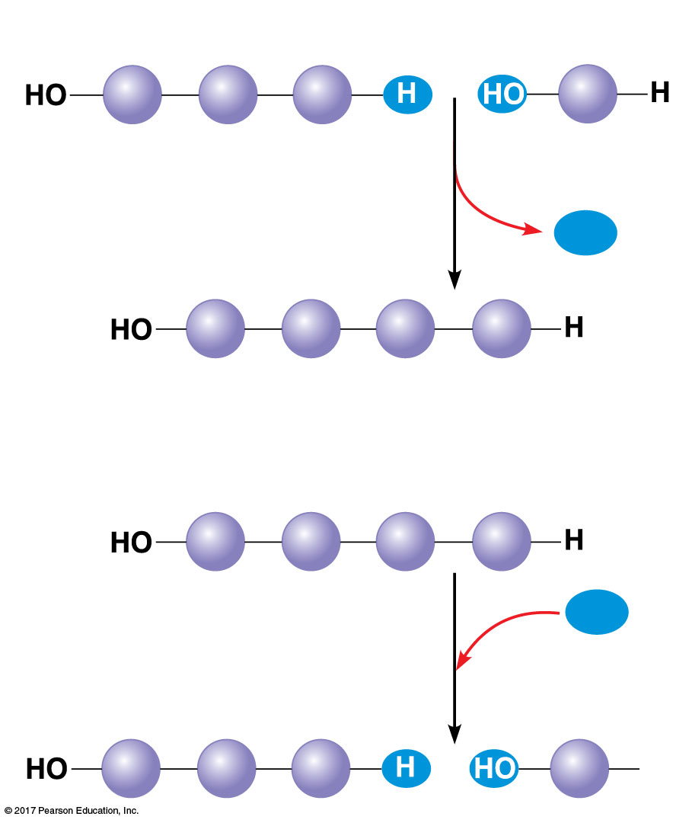
Figure 5.2
(a) Dehydration reaction: synthesizing a polymer
1
2
3
Short polymer
Unlinked
monomer
Dehydration removes a water
molecule, forming a new bond.
H₂O
1
2
3
4
Longer polymer
(b) Hydrolysis: breaking down a polymer
1
2
3
4
Hydrolysis adds a water
molecule, breaking a bond.
H₂O
1
2
3
H
Notes:
Figure 5.2 The synthesis and breakdown of polymers

Slide 7
The Diversity of Polymers
A cell has thousands of different macromolecules
Macromolecules vary among cells of an organism, vary more within a species, and vary even more between species
A huge variety of polymers can be built from a small set of monomers

Slide 8
Concept 5.2: Carbohydrates serve as fuel and building material
Carbohydrates include sugars and the polymers of sugars
The simplest carbohydrates are monosaccharides單糖, or simple sugars
Carbohydrate macromolecules are polysaccharides多醣, polymers composed of many sugar building blocks

Slide 9
Sugars
Monosaccharides have molecular formulas that are usually multiples of CH₂O
Glucose葡萄糖(C₆H₁₂O₆) is the most common monosaccharide
Monosaccharides are classified by
The location of the carbonyl group (as aldose or ketose)
The number of carbons in the carbon skeleton

Slide 10
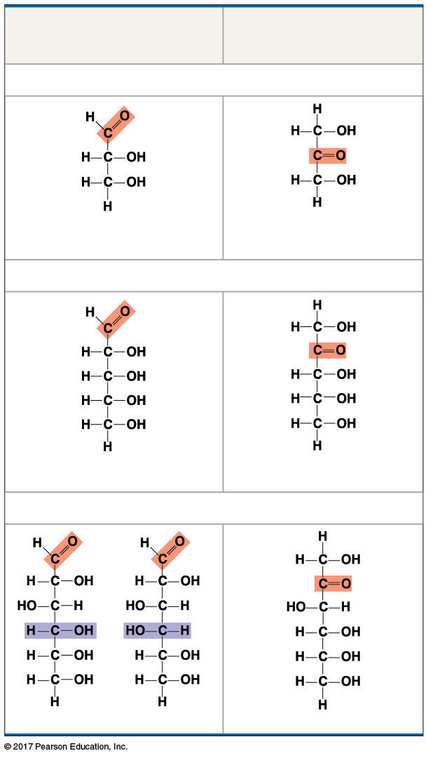
Figure 5.3
The structure of monosaccharides
Aldoses
(Aldehyde Sugars)
Ketoses
(Ketone Sugars)
Trioses: three-carbon sugars (C₃H₆O₃)
Glyceraldehyde甘油醛
Dihydroxyacetone
Pentoses: five-carbon sugars (C₅H₁₀O₅)
Ribose核糖
核酮糖
Hexoses: six-carbon sugars (C₆H₁₂O₆)
Glucose Galactose半乳糖
Fructose果糖
Notes:
Figure 5.3 The structure and classification of some monosaccharides

Slide 11
Though often drawn as linear skeletons, in aqueous solutions many sugars form rings
Monosaccharides serve as a major fuel for cells and as raw material for building molecules

Slide 12
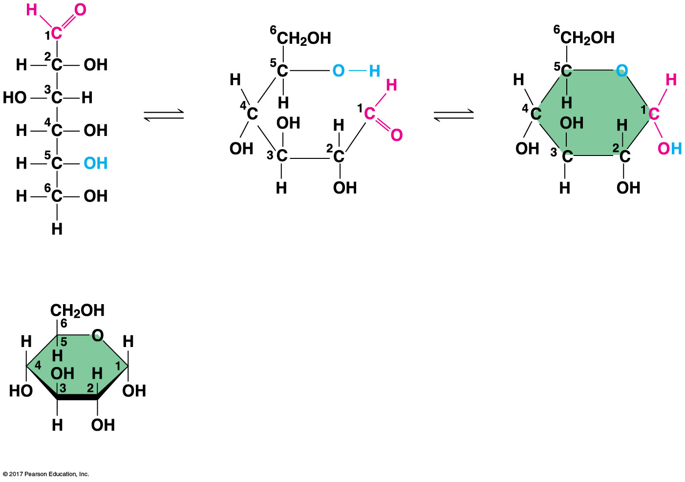
Figure 5.4
Linear and ring forms of glucose
(a) Linear and ring forms
(b) Abbreviated ring structure
Notes:
Figure 5.4 Linear and ring forms of glucose

Slide 13
A disaccharide雙糖is formed when a dehydration reaction joins two monosaccharides
This covalent bond is called a glycosidic linkage糖苷键

Slide 14
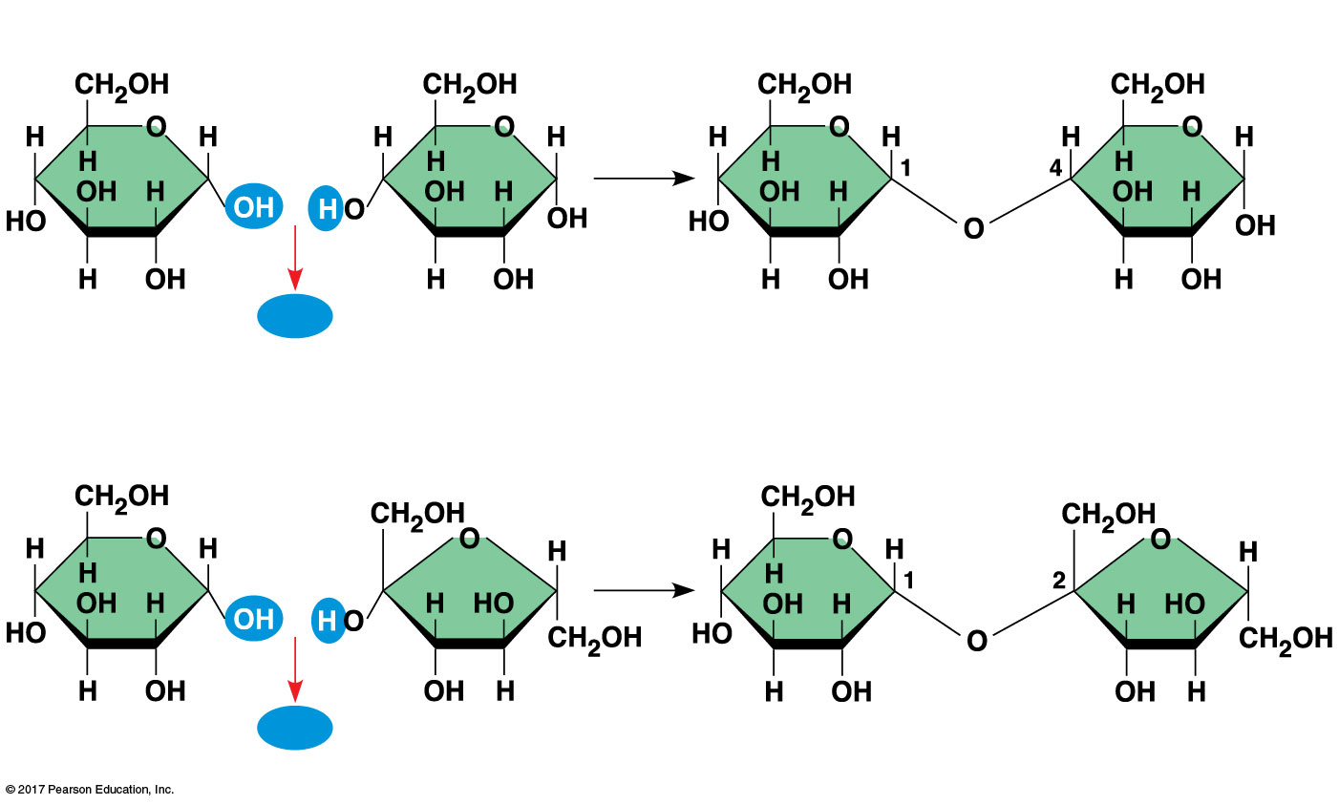
Figure 5.5
Disaccharide synthesis
(a) Dehydration reaction in the synthesis of maltose
1–4
glycosidic
linkage
H₂O
Glucose
Glucose
Maltose麥芽糖
(b) Dehydration reaction in the synthesis of sucrose
1–2
glycosidic
linkage
H₂O
Glucose
Fructose
Sucrose
Notes:
Figure 5.5 Examples of disaccharide synthesis

Slide 15
Polysaccharides
Polysaccharides多醣, the polymers of sugars, have storage and structural roles
The architecture and function of a polysaccharide are determined by its sugar monomers and the positions of its glycosidic linkages

Slide 16
Storage Polysaccharides
Starch澱粉, a storage polysaccharide of plants, consists of glucose monomers
Plants store surplus starch as granules顆粒within chloroplasts and other plastids色素體
The simplest form of starch is amylose直鏈澱粉：用熱水溶解澱粉時，可以溶解的那部分澱粉，稱為直鏈澱粉

Slide 17
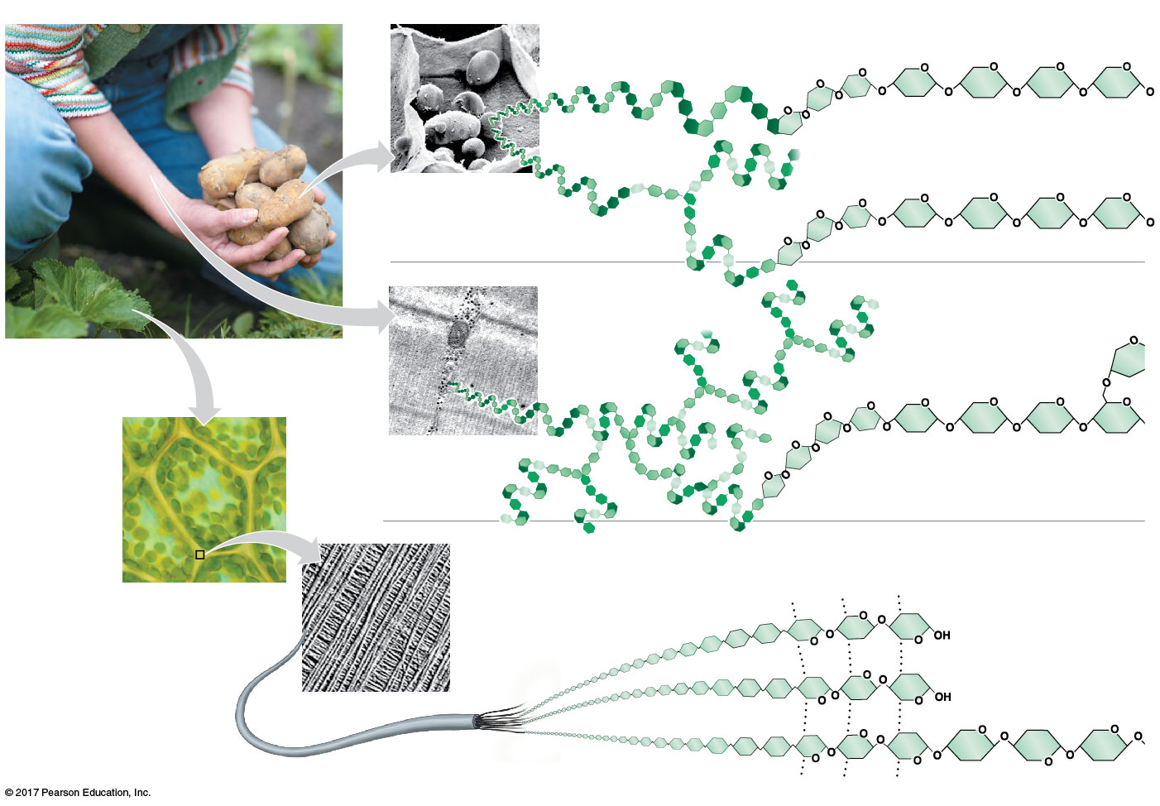
Figure 5.6
Polysaccharides of plants and animals
Storage structures (plastids)
containing starch granules
in a potato tuber cell
Amylose (unbranched)
Glucose
monomer
Amylopectin
(somewhat branched)
50 µm
Muscle
tissue
(a) Starch
Glycogen granules
stored in muscle
tissue
Glycogen (extensively
branched)
Cell
wall
1 µm
(b) Glycogen
Plant cell,
surrounded
by cell wall
Cellulose microfibrils
in a plant cell wall
Cellulose纖維素molecule
(unbranched)
10 µm
Hydrogen bonds
Microfibril
0.5 µm
(c) Cellulose
Notes:
Figure 5.6 Polysaccharides of plants and animals

Slide 18
Glycogen肝糖is a storage polysaccharide in animals
Glycogen is stored mainly in liver and muscle cells
Hydrolysis of glycogen in these cells releases glucose when the demand for sugar increases

Slide 19
Structural Polysaccharides
The polysaccharide cellulose纖維素is a major component of the tough wall of plant cells
Like starch, cellulose is a polymer of glucose, but the glycosidic linkages differ
The difference is based on two ring forms for glucose: alpha (α) and beta (β)

Slide 20
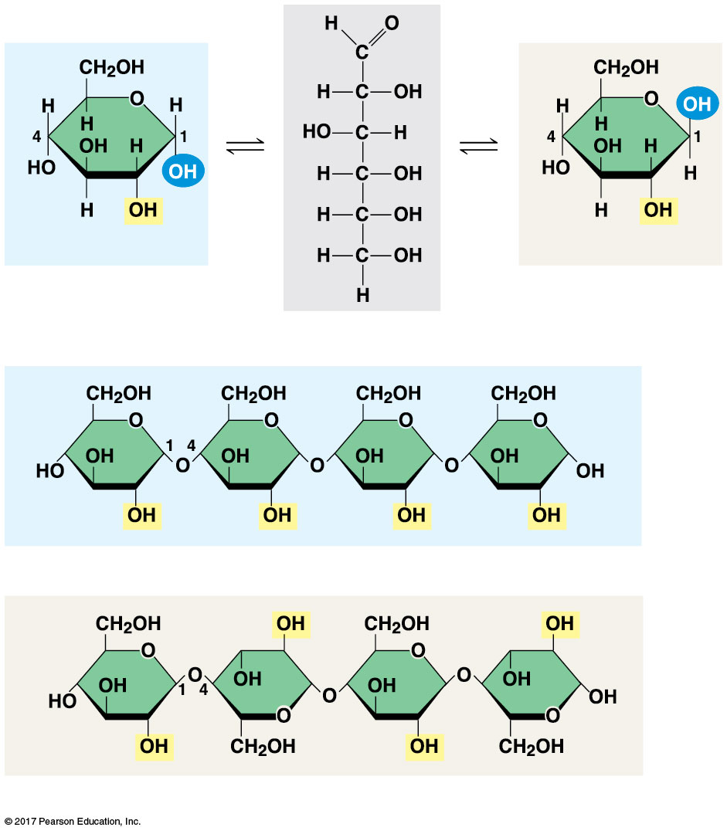
Figure 5.7
α Glucose
β Glucose
(a) α and β glucose ring structures
(b) Starch: 1–4 linkage of α glucose monomers
Starch and cellulose structures
(c) Cellulose: 1–4 linkage of β glucose monomers
Notes:
Figure 5.7 Starch and cellulose structures

Slide 21
Starch (α configuration) is largely helical螺旋狀的
Cellulose molecules (β configuration) are straight and unbranched
Some hydroxyl groups on the monomers of cellulose can hydrogen-bond with hydroxyls of parallel cellulose molecules

Slide 22
Enzymes that digest starch by hydrolyzing α linkages can’t hydrolyze β linkages in cellulose
The cellulose in human food passes through the digestive tract as “insoluble fiber”
Some microbes微生物use enzymes to digest cellulose
Many herbivores, from cows to termites, have symbiotic共生relationships with these microbes

Slide 23
Chitin幾丁質, another structural polysaccharide, is found in the exoskeleton of arthropods節肢動物
Chitin also provides structural support for the cell walls of many fungi

Slide 24
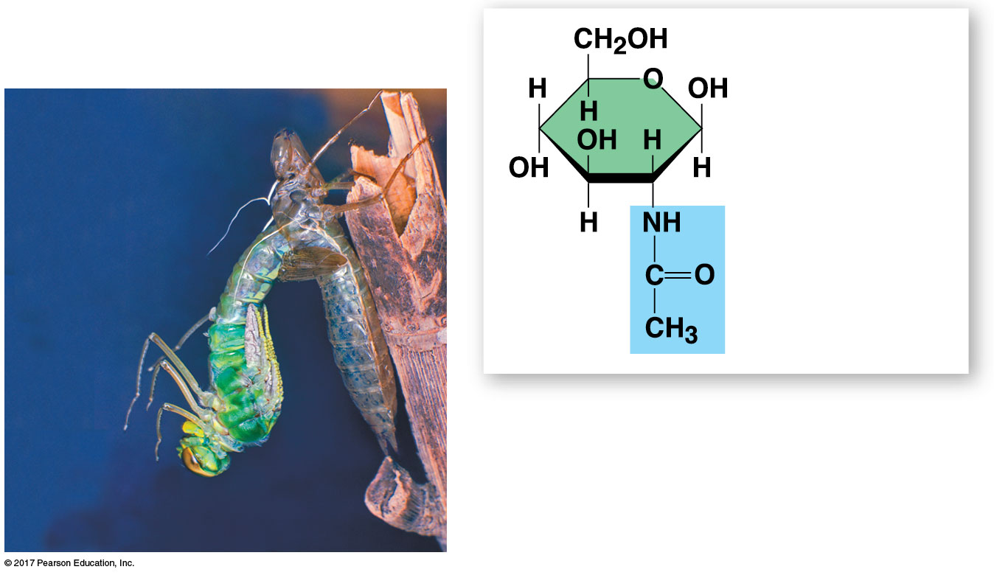
Figure 5.8
Chitin, a structural polysaccharide
The structure
of the chitin
monomer
Chitin, embedded in proteins,
forms the exoskeleton of
arthropods.
Notes:
Figure 5.8 Chitin, a structural polysaccharide

Slide 25
Concept 5.3: Lipids are a diverse group of hydrophobic molecules
Lipids脂類are the one class of large biological molecules that does not include true polymers
The unifying feature of lipids is that they mix poorly, if at all, with water
Lipids consist mostly of hydrocarbon烴regions
The most biologically important lipids are fats, phospholipids, and steroids

Slide 26
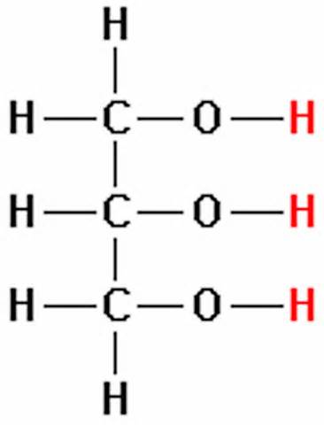
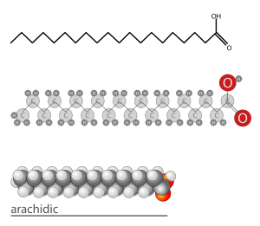
Fats
Fats are constructed from two types of smaller molecules: glycerol and fatty acids
Glycerol甘油 is a three-carbon alcohol with a hydroxyl group attached to each carbon
A fatty acid脂肪酸consists of a carboxyl羧基group attached to a long carbon skeleton

Slide 27
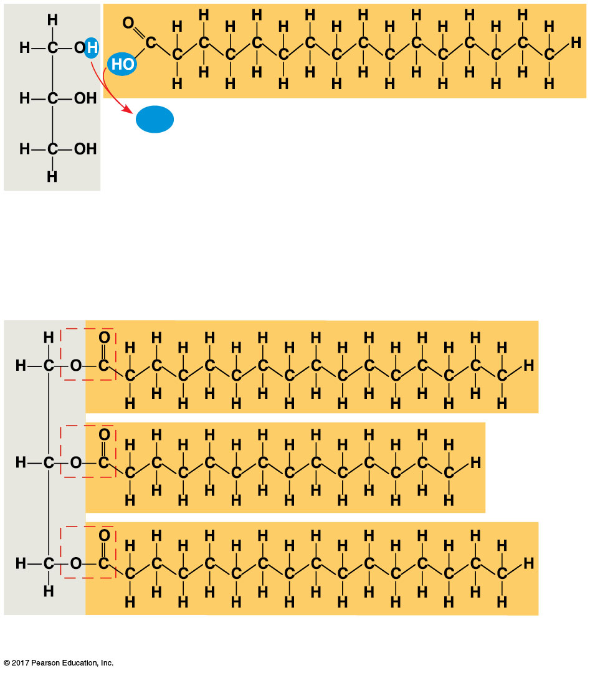
Figure 5.9
H₂O
Fatty acid
(in this case, palmitic acid)
The synthesis and structure of a fat, or triacylglycerol
Glycerol
(a) One of three dehydration reactions in the synthesis of a fat
Ester酯linkage
(b) Fat molecule (triacylglycerol)
Notes:
Figure 5.9 The synthesis and structure of a fat, or triacylglycerol

Slide 28
Fats separate from water because water molecules hydrogen-bond to each other and exclude the fats
In a fat, three fatty acids are joined to glycerol by an ester linkage, creating a triacylglycerol甘油三酸酯,or triglyceride
The fatty acids in a fat can be all the same or of two or three different kinds

Slide 29
Fatty acids vary in length (number of carbons) and in the number and locations of double bonds
Saturated fatty acids have the maximum number of hydrogen atoms possible and no double bonds
Unsaturated fatty acids have one or more double bonds

Slide 30
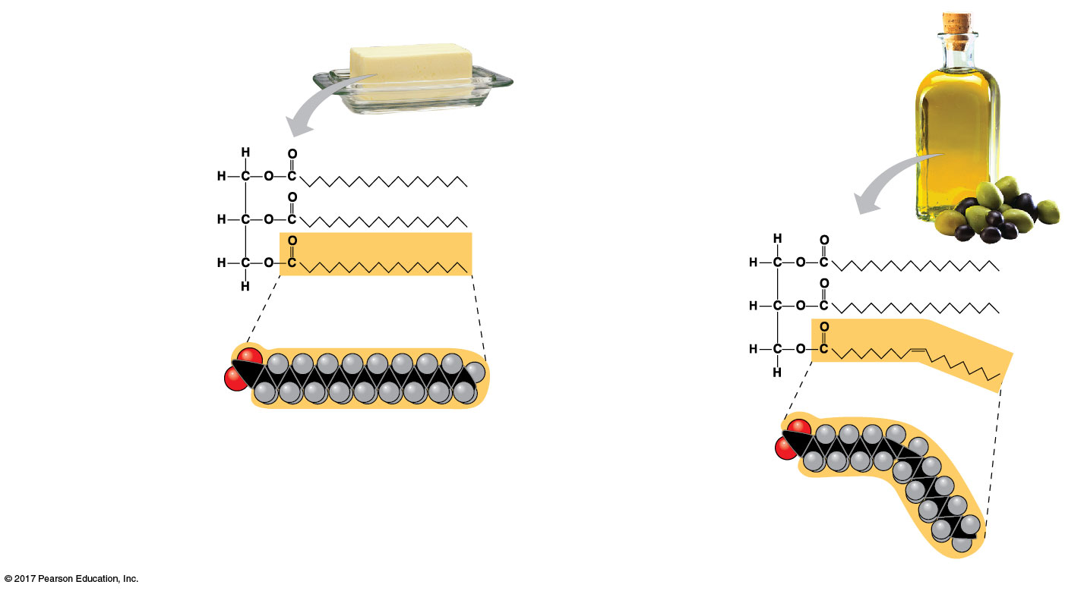
Figure 5.10
Saturated and unsaturated fats and fatty acids
(a) Saturated fat
(b) Unsaturated fat
Structural formula
of a saturated fat
molecule
Structural formula
of an unsaturated
fat molecule
Space-filling model
of stearic acid, a
saturated fatty acid
Space-filling model
of oleic acid, an
unsaturated fatty
acid
Cis double bond
causes bending.
Notes:
Figure 5.10 Saturated and unsaturated fats and fatty acids

Slide 31
Fats made from saturated fatty acids are called saturated fats and are solid at room temperature
Most animal fats are saturated
Fats made from unsaturated fatty acids are called unsaturated fats or oils and are liquid at room temperature
Plant fats and fish fats are usually unsaturated

Slide 32
A diet rich in saturated fats may contribute to cardiovascular disease through plaque deposits
Hydrogenation is the process of converting unsaturated fats to saturated fats by adding hydrogen
Hydrogenating vegetable oils also creates unsaturated fats with trans double bonds
These trans反 fats may contribute more than saturated fats to cardiovascular disease

Slide 33
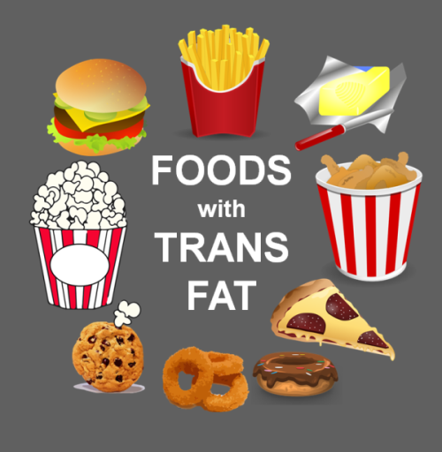

Slide 34
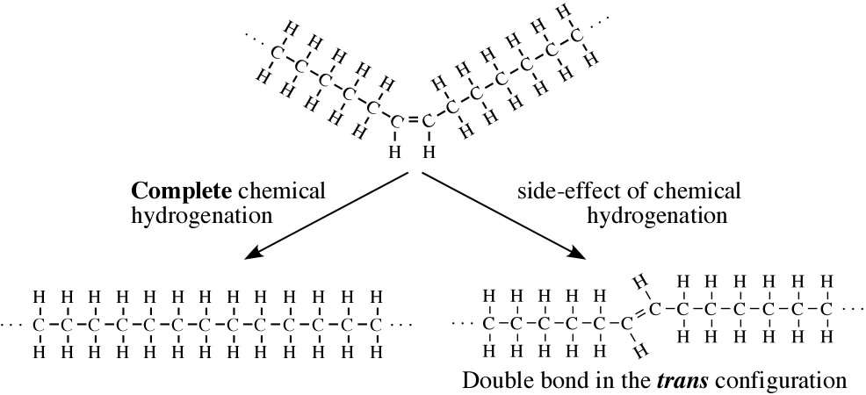
Both saturated fats and cis順-unsaturated fats are natural.
We produce the necessary enzymes to metabolize these. However, there is no evidence that we produce the enzymes to metabolize trans-fatty acids.

Slide 35
The major function of fats is energy storage
Humans and other mammals store their long-term food reserves in adipose脂肪cells
Adipose tissue also cushions vital organs and insulates the body

Slide 36
Phospholipids
In a phospholipid磷脂, two fatty acids and a phosphate group are attached to glycerol
The two fatty acid tails are hydrophobic, but the phosphate group and its attachments form a hydrophilic head

Slide 37
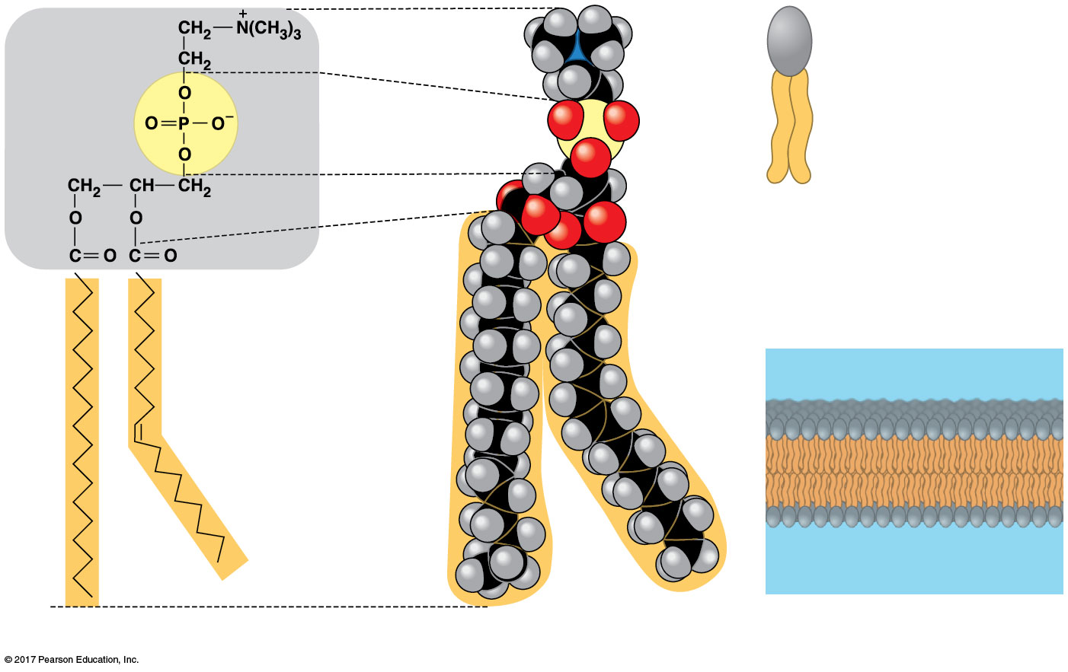
Figure 5.11
The structure of a phospholipid
Choline膽鹼
Hydrophilic
head
Hydrophilic head
Phosphate磷酸鹽
Hydrophobic
tails
Glycerol
(c) Phospholipid symbol
Fatty acids
Hydrophobic tails
Kink due to cis
double bond
(a) Structural formula
(b) Space-filling model
(d) Phospholipid bilayer
Notes:
Figure 5.11 The structure of a phospholipid

Slide 38
When phospholipids are added to water, they self-assemble into double-layered sheets called bilayers
At the surface of a cell, phospholipids are also arranged in a bilayer, with the hydrophobic tails pointing toward the interior
The phospholipid bilayer forms a boundary between the cell and its external environment

Slide 39
Steroids
Steroids類固醇are lipids characterized by a carbon skeleton consisting of four fused rings
Cholesterol膽固醇, a type of steroid, is a component in animal cell membranes and a precursor from which other steroids are synthesized
A high level of cholesterol in the blood may contribute to cardiovascular disease

Slide 40
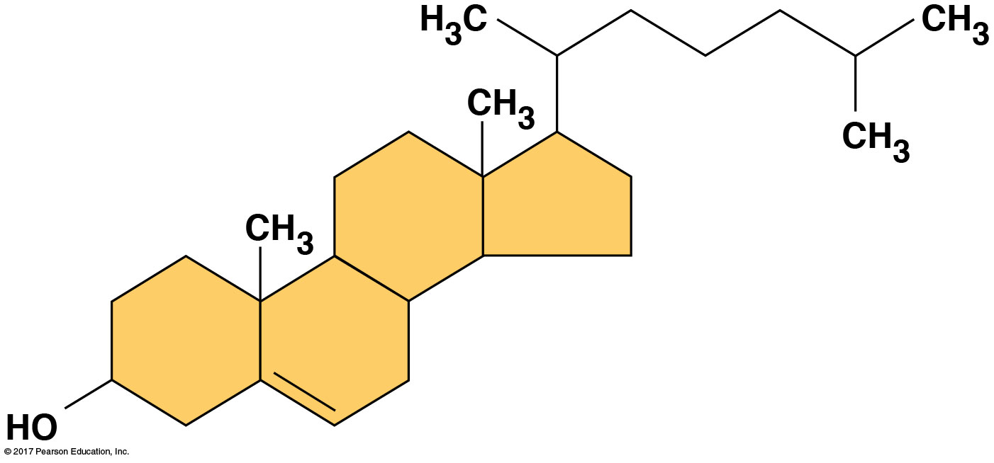
Figure 5.12
Cholesterol, a steroid
Notes:
Figure 5.12 Cholesterol, a steroid

Slide 41
Concept 5.4: Proteins include a diversity of structures, resulting in a wide range of functions
Proteins account for more than 50% of the dry mass of most cells
Some proteins speed up chemical reactions
Other protein functions include defense, storage, transport, cellular communication, movement, and structural support

Slide 42
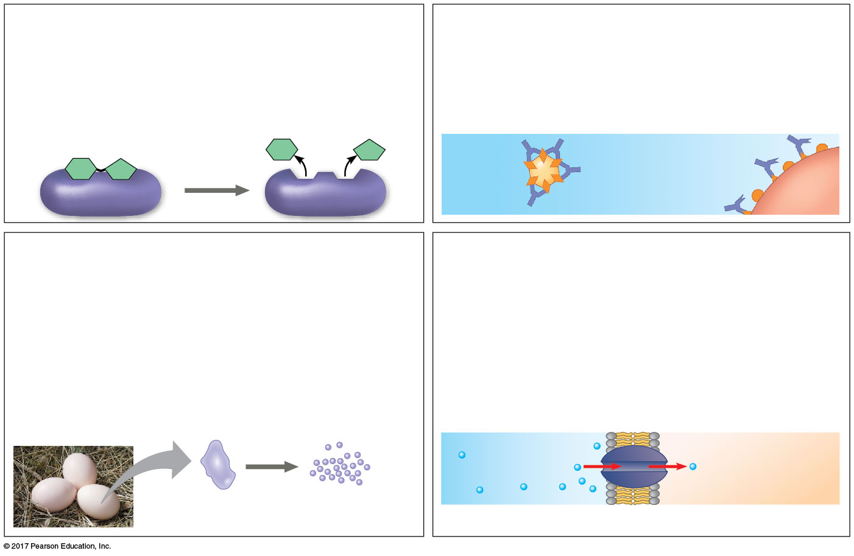
Figure 5.13a
An overview of protein functions
Enzymatic proteins
Defensive proteins
Function: Selective acceleration of
chemical reactions
Function: Protection against disease
Example: Antibodies inactivate and help
destroy viruses and bacteria.
Example: Digestive enzymes catalyze the
hydrolysis of bonds in food molecules.
Antibodies
Enzyme
Virus
Bacterium
Storage proteins
Transport proteins
Function: Storage of amino acids
Function: Transport of substances
Examples: Casein, the protein of milk, is
the major source of amino acids for baby
mammals. Plants have storage proteins in
their seeds. Ovalbumin is the protein of
egg white, used as an amino acid source
for the developing embryo.
Examples: Hemoglobin, the iron-containing
protein of vertebrate blood, transports
oxygen from the lungs to other parts of the
body. Other proteins transport molecules
across membranes, as shown here.
Transport
protein
Ovalbumin
Amino acids
for embryo
Cell membrane
Notes:
Figure 5.13a An overview of protein functions (part 1)

Slide 43
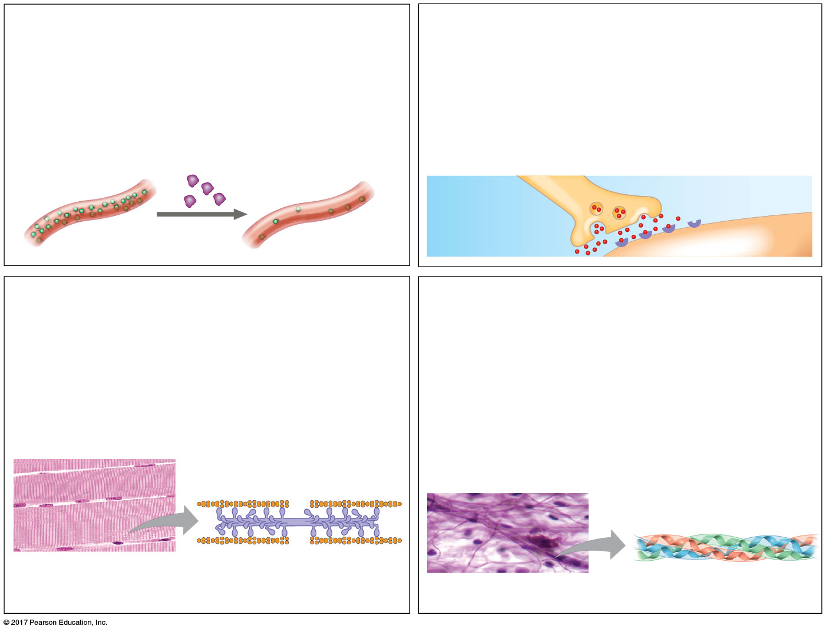
Figure 5.13b
Hormonal proteins
Receptor proteins
Function: Coordination of an organism’s
activities
Function: Response of cell to chemical
stimuli
Example: Insulin, a hormone secreted by
the pancreas, causes other tissues to take
up glucose, thus regulating blood sugar
concentration.
Example: Receptors built into the
membrane of a nerve cell detect signaling
molecules released by other nerve cells.
Receptor
protein
High
blood sugar
Insulin
secreted
Normal
blood sugar
Signaling
molecules
Contractile收縮and motor proteins
Structural proteins
Function: Movement
Function: Support
Examples: Motor proteins are responsible
for the undulations of cilia and flagella.
Actin and myosin proteins are responsible
for the contraction of muscles.
Examples: Keratin is the protein of hair,
horns, feathers, and other skin appendages.
Insects and spiders use silk fibers to make
their cocoons and webs, respectively.
Collagen and elastin proteins provide a
fibrous framework in animal connective
tissues.
Actin
Myosin
Collagen
Muscle
tissue
30 µm
Connective
tissue
60 µm
Notes:
Figure 5.13b An overview of protein functions (part 2)

Slide 44
Enzymes are proteins that act as catalysts to speed up chemical reactions
Enzymes can perform their functions repeatedly, functioning as workhorses that carry out the processes of life

Slide 45
Proteins are all constructed from the same set of 20 amino acids
Polypeptides多肽are unbranched polymers built from these amino acids
A protein is a biologically functional molecule that consists of one or more polypeptides

Slide 46
Amino Acid Monomers
Amino acids胺基酸are organic molecules with amino and carboxyl groups
Amino acids differ in their properties due to differing side chains, called R groups

Slide 47
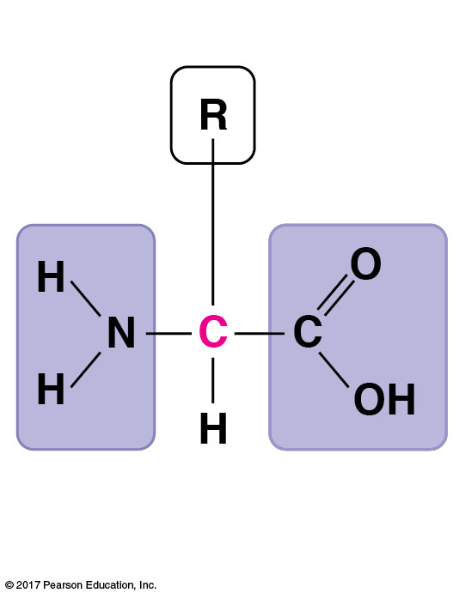
Figure 5.UN01
Amino acid monomer
Side chain (R group)
α carbon
Amino
group
Carboxyl
group
Notes:
Figure 5.UN01 In-text figure, amino acid monomer, p. 123

Slide 48
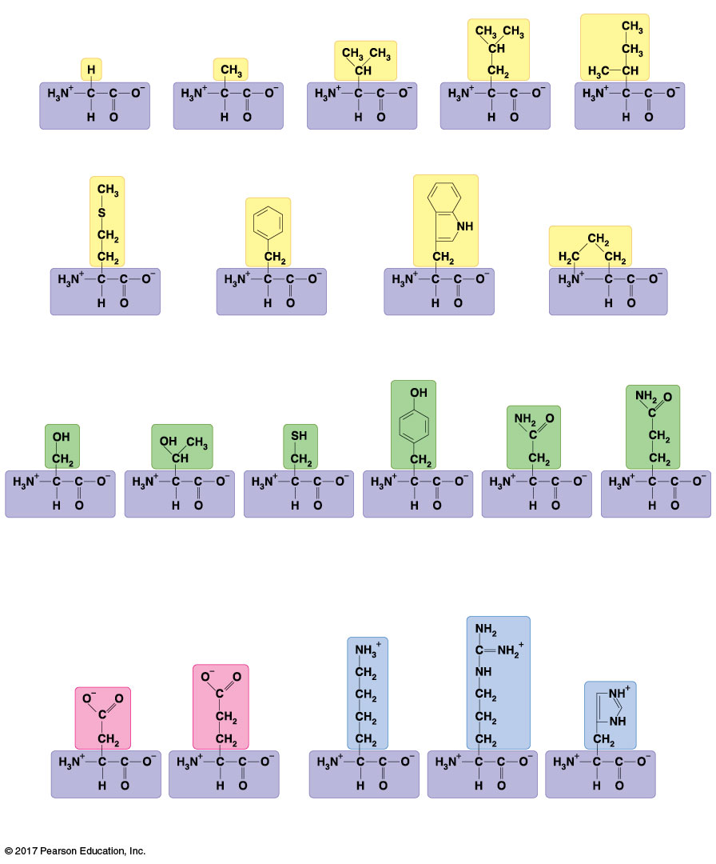
Figure 5.14
Nonpolar side chains; hydrophobic
Side chain (R group)
Glycine
(Gly or G)
Alanine
(Ala or A)
Valine
(Val or V)
Leucine
(Leu or L)
Isoleucine
(Ile or I)
The 20 amino acids of proteins
Methionine
(Met or M)
Phenylalanine
(Phe or F)
Tryptophan
(Trp or W)
Proline
(Pro or P)
Polar side chains; hydrophilic
Serine
(Ser or S)
Threonine
(Thr or T)
Cysteine
(Cys or C)
Tyrosine
(Tyr or Y)
Asparagine
(Asn or N)
Glutamine
(Gln or Q)
Electrically charged side chains; hydrophilic
Basic (positively charged)
Acidic (negatively charged)
Aspartic acid
(Asp or D)
Glutamic acid
(Glu or E)
Lysine
(Lys or K)
Arginine
(Arg or R)
Histidine
(His or H)
Notes:
Figure 5.14 The 20 amino acids of proteins

Slide 49
Polypeptides (Amino Acid Polymers)
Amino acids are linked by covalent bonds called peptide bonds肽鍵
A polypeptide is a polymer of amino acids
Polypeptides range in length from a few to more than 1,000 monomers
Each polypeptide has a unique linear sequence of amino acids, with a carboxyl end (C-terminus) and an amino end (N-terminus)

Slide 50
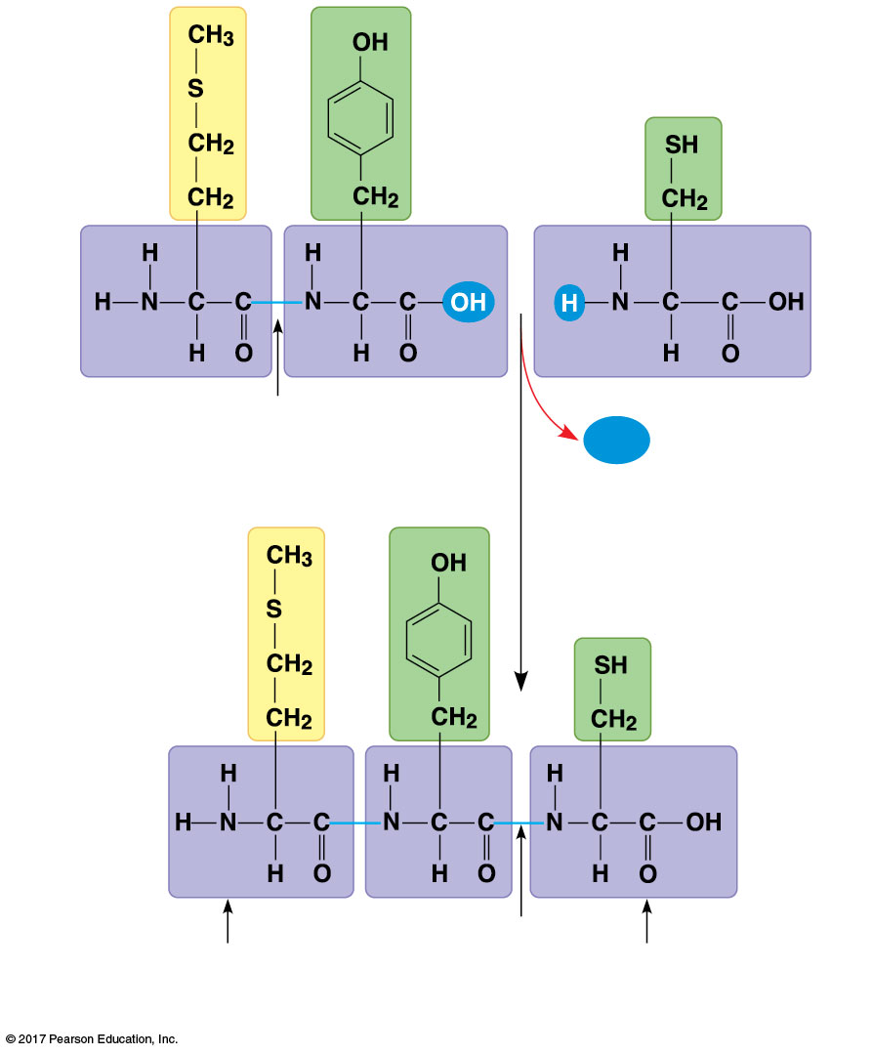
Figure 5.15
Making a polypeptide chain
Peptide bond
H₂O
New peptide
bond forming
Side
chains
(R
groups)
Back-
bone
Peptide
bond
Amino end
(N-terminus)
Carboxyl end
(C-terminus)
Notes:
Figure 5.15 Making a polypeptide chain

Slide 51
Protein Structure and Function
The specific activities of proteins result from their intricate three-dimensional architecture
A functional protein consists of one or more polypeptides precisely twisted, folded, and coiled into a unique shape

Slide 52
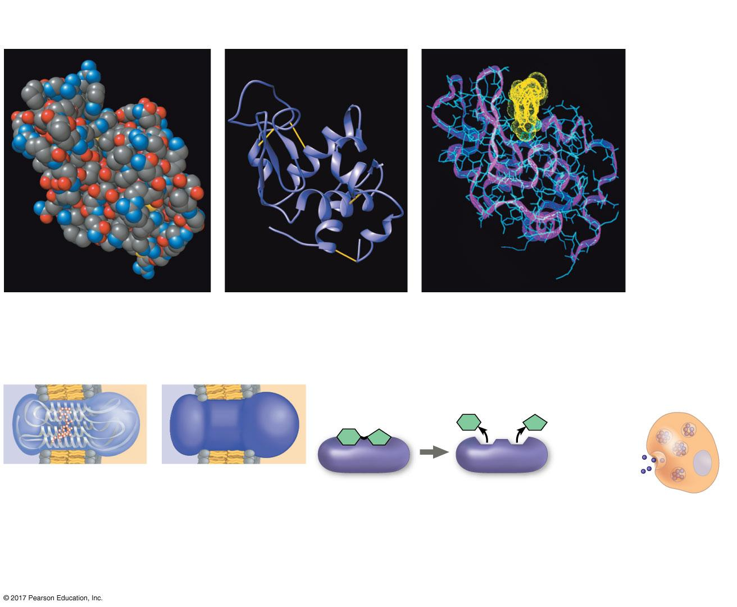
Figure 5.16
Structural Models
Target molecule (on bacterial
cell surface) bound to lysozyme
Space-filling model
Ribbon model
Wire-frame model (blue)
Simplified Diagrams
Insulin-producing cell
in pancreas
Enzyme
Insulin
A transparent
shape shows the
overall shape of
the molecule
and some
internal details.
A solid shape is
used when
structural details
are not needed.
A simple shape is used
here to represent a
generic enzyme.
A protein can be
represented simply
as a dot.
Notes:
Figure 5.16 Visualizing proteins

Slide 53
The sequence of amino acids determines a protein’s three-dimensional structure
A protein’s structure determines how it works
The function of a protein usually depends on its ability to recognize and bind to some other molecule

Slide 54
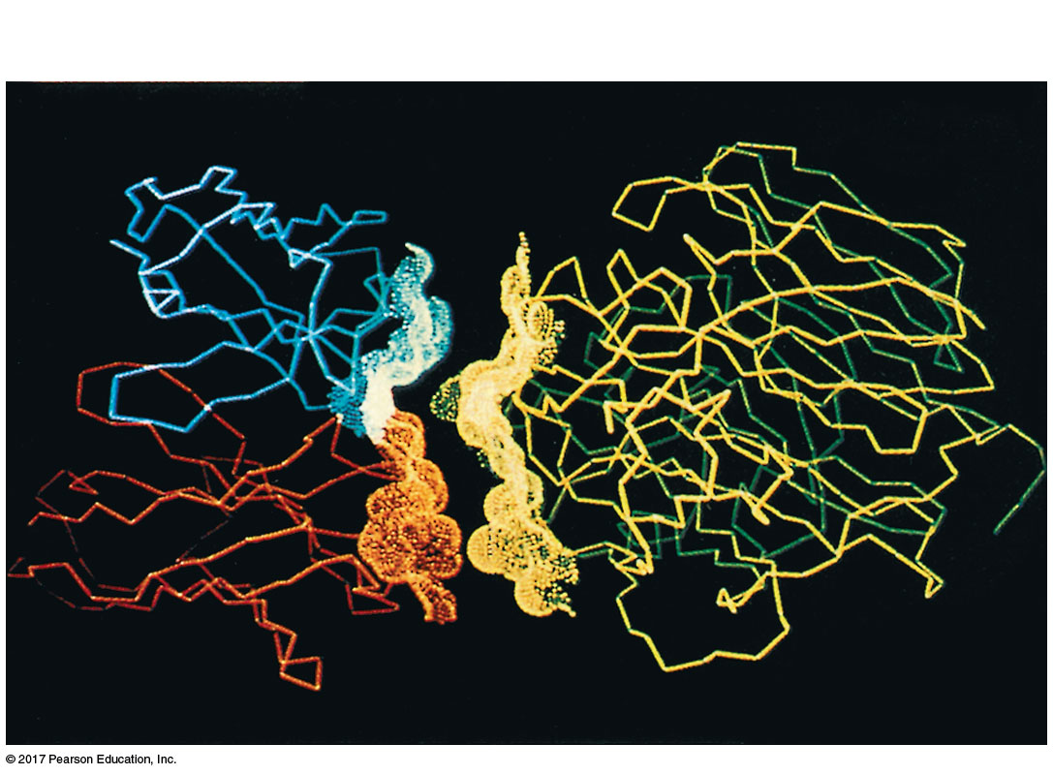
Figure 5.17
Complementarity of shape between two protein surfaces
Antibody protein
Protein from flu virus
Notes:
Figure 5.17 Complementarity of shape between two protein surfaces

Slide 55
Four Levels of Protein Structure
The primary structure of a protein is its unique sequence of amino acids (一條肽鍊)
Secondary structure, found in most proteins, consists of coils and folds in the polypeptide chain (氫鍵造成摺疊或螺旋)
Tertiary structure is determined by interactions among various side chains (R groups) (R基、離子鍵、SS鍵、疏水性、凡德瓦力建立3D圖形)
Quaternary structure results when a protein consists of multiple polypeptide chains (很多個肽鍊組成)

Slide 56
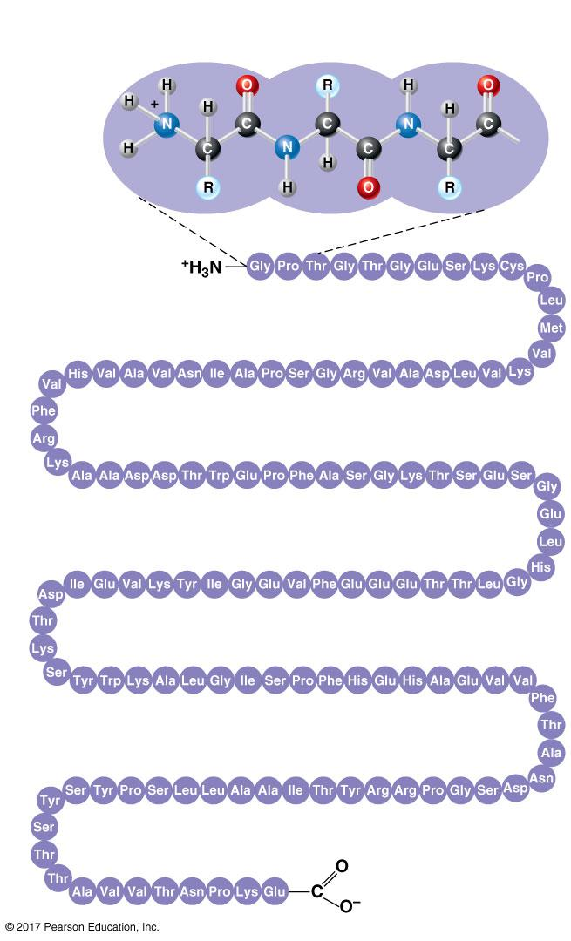
Figure 5.18a
Primary Structure
Amino
acids
1
5
10
Amino end
30
25
20
15
35
40
45
50
Primary structure of transthyretin
70
65
60
55
75
80
85
90
95
115
110
105
100
120
125
Carboxyl end
Notes:
Figure 5.18a Exploring levels of protein structure (part 1: primary)

Slide 57
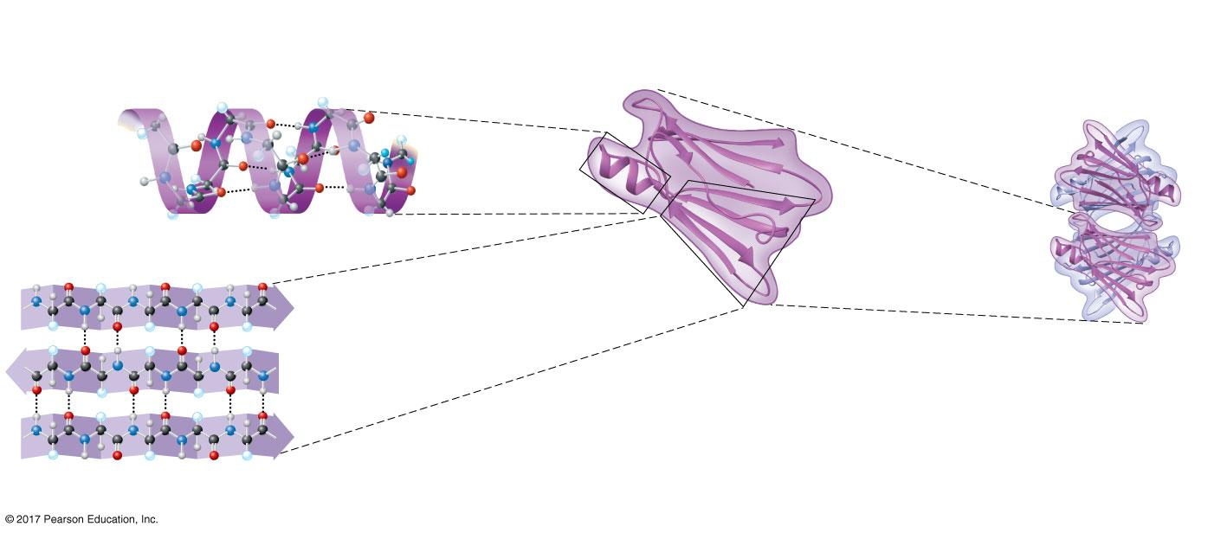
Figure 5.18b
Secondary
Structure
Tertiary
Structure
Quaternary
Structure
α helix
α helix
Single
polypeptide
subunit
Hydrogen bond
β pleated
sheet
β strand
Hydrogen
bond
Transthyretin
polypeptide
Transthyretin
protein
β pleated sheet
Notes:
Figure 5.18b Exploring levels of protein structure (part 2: secondary through quaternary)

Slide 58
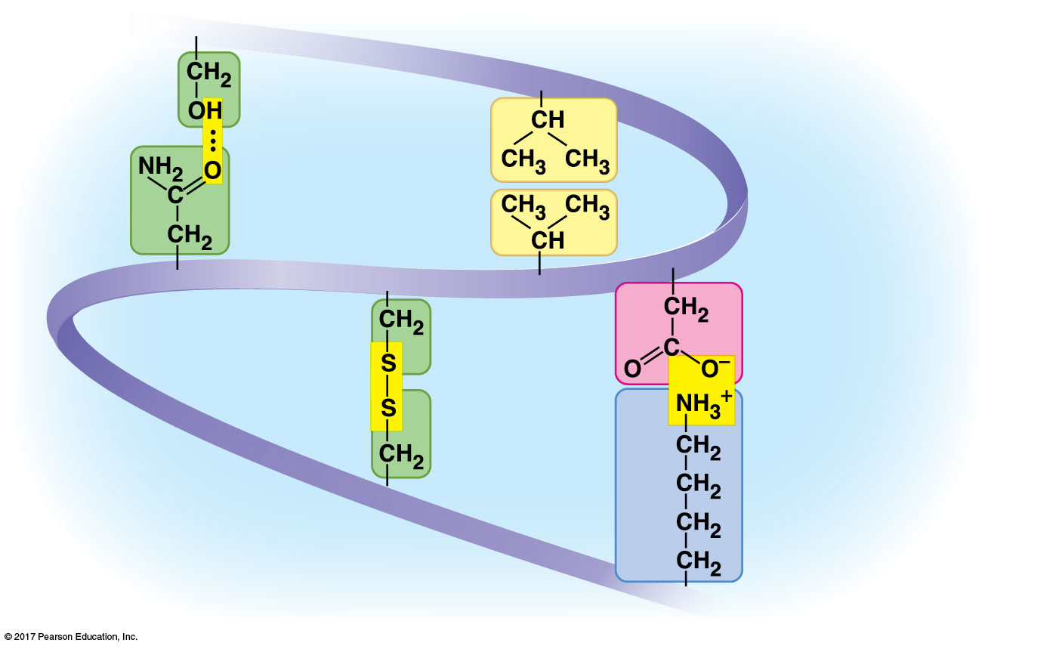
Figure 5.18d
Tertiary stabilization
Hydrogen
bond
Hydrophobic
interactions and
van der Waals
interactions
Disulfide
bridge
Ionic bond
Polypeptide
backbone
Notes:
Figure 5.18d Exploring levels of protein structure (part 4: tertiary stabilization)

Slide 59
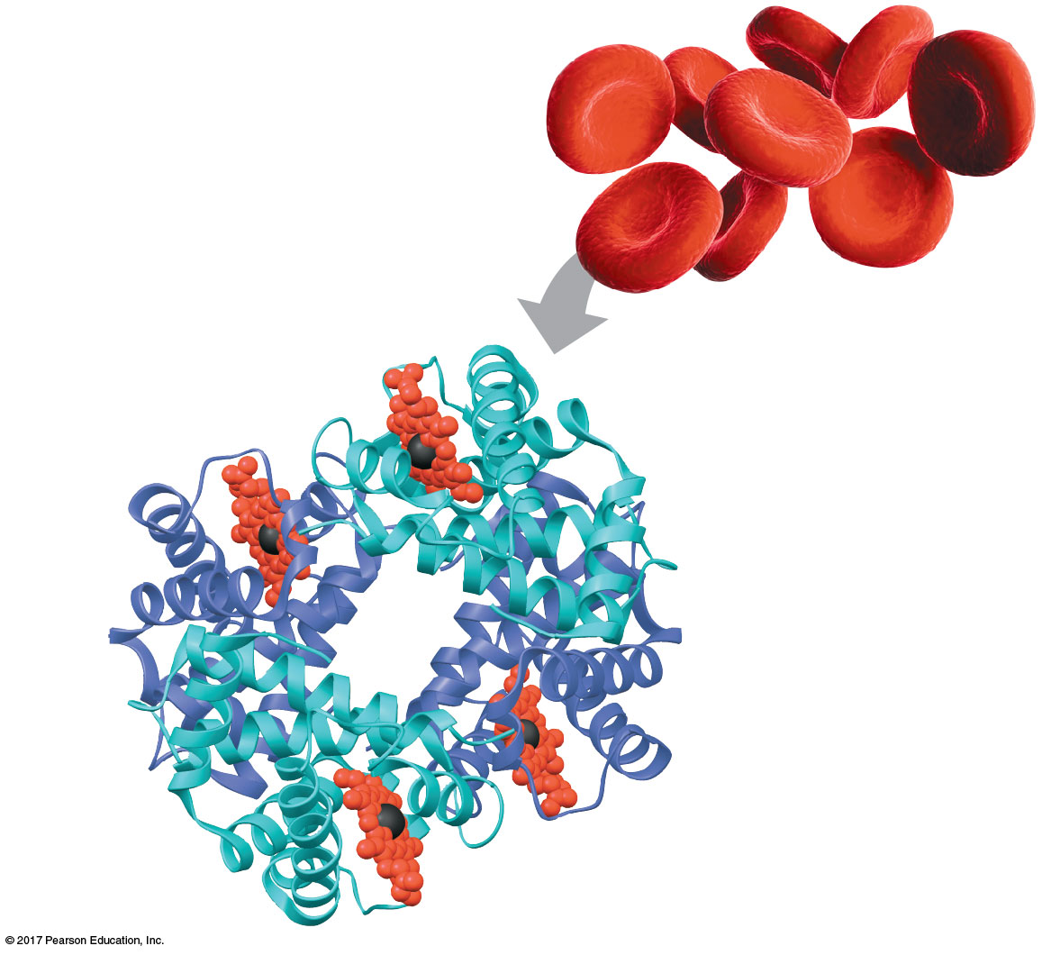
Figure 5.18f
Quaternary interaction
Heme
Iron
β subunit
α subunit
α subunit
β subunit
Hemoglobin
Notes:
Figure 5.18f Exploring levels of protein structure (part 6: hemoglobin)

Slide 60
The primary structure of a protein is its sequence of amino acids
Primary structure is like the order of letters in a long word
Primary structure is determined by inherited genetic information

Slide 61
The coils and folds of secondary structure result from hydrogen bonds between repeating constituents of the polypeptide backbone
Typical secondary structures are a coil called an α helix and a folded structure called a β pleated sheet

Slide 62
Tertiary structure, the overall shape of a polypeptide, results from interactions between R groups, rather than interactions between backbone constituents
These interactions include hydrogen bonds, ionic bonds, hydrophobic interactions, and van der Waals interactions
Strong covalent bonds called disulfide bridges雙硫鍵may reinforce the protein’s structure

Slide 63
Quaternary structure results when two or more polypeptide chains form one macromolecule
Collagen is a fibrous protein consisting of three polypeptides coiled like a rope
Hemoglobin is a globular protein consisting of four polypeptides: two α and two β subunits

Slide 64
Sickle-Cell Disease: A Change in Primary Structure
A slight change in primary structure can affect a protein’s structure and ability to function
Sickle-cell disease鐮刀型紅血球疾病, an inherited blood disorder, results from a single amino acid substitution in the protein hemoglobin
The abnormal hemoglobin molecules cause the red blood cells to aggregate into chains and to deform into a sickle shape

Slide 65
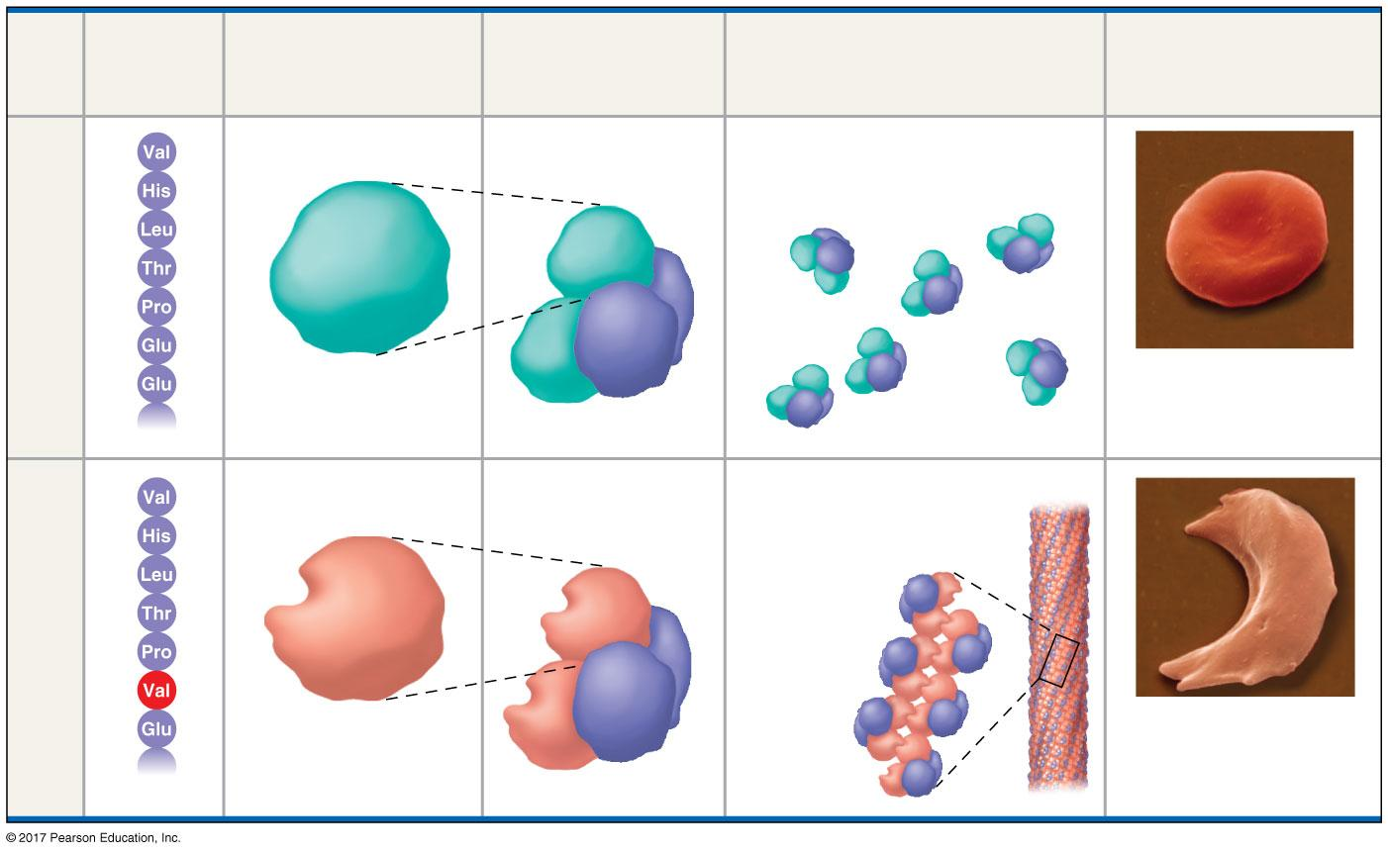
Figure 5.19
A single amino acid substitution in a protein causes sickle-cell disease
Primary
Structure
Secondary
and Tertiary
Structures
Quaternary
Structure
Red Blood Cell
Shape
Function
1
Normal β
subunit
Normal
hemoglobin
Proteins do not associate
with one another; each
carries oxygen.
2
3
β
Normal
4
α
5
6
7
β
α
5 µm
1
Sickle-cell β
subunit
Sickle-cell
hemoglobin
Proteins aggregate into a
fiber; capacity to
carry oxygen
is reduced.
2
3
β
Sickle-cell
4
5
α
6
7
5 µm
β
α
Notes:
Figure 5.19 A single amino acid substitution in a protein causes sickle-cell disease

Slide 66
What Determines Protein Structure?
In addition to primary structure, physical and chemical conditions can affect structure
Alterations in pH, salt concentration, temperature, or other environmental factors can cause a protein to unravel
This loss of a protein’s native structure is called denaturation變性
A denatured protein is biologically inactive

Slide 67
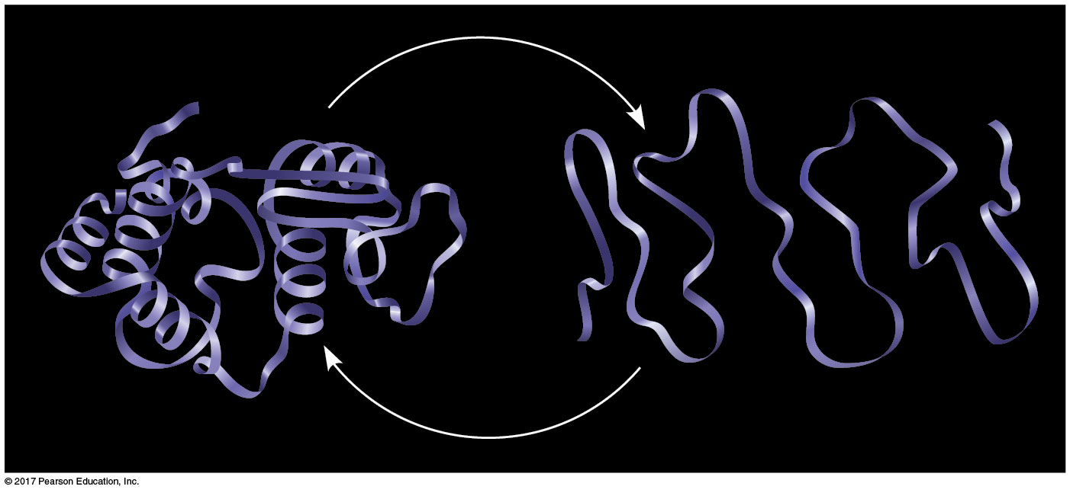
Figure 5.20
Denaturation and renaturation of a protein
Normal protein
Denatured protein
Notes:
Figure 5.20 Denaturation and renaturation of a protein

Slide 68
Protein Folding in the Cell
It is hard to predict a protein’s structure from its primary structure
Most proteins probably go through several stages on their way to a stable structure
Diseases such as Alzheimer’s, Parkinson’s, and mad cow disease are associated with misfolded proteins

Slide 69
Scientists use X-ray crystallography X射線晶體to determine a protein’s structure
Another method is nuclear magnetic resonance (NMR) spectroscopy, which does not require protein crystallization
Bioinformatics is another approach to prediction of protein structure from amino acid sequences

Slide 70
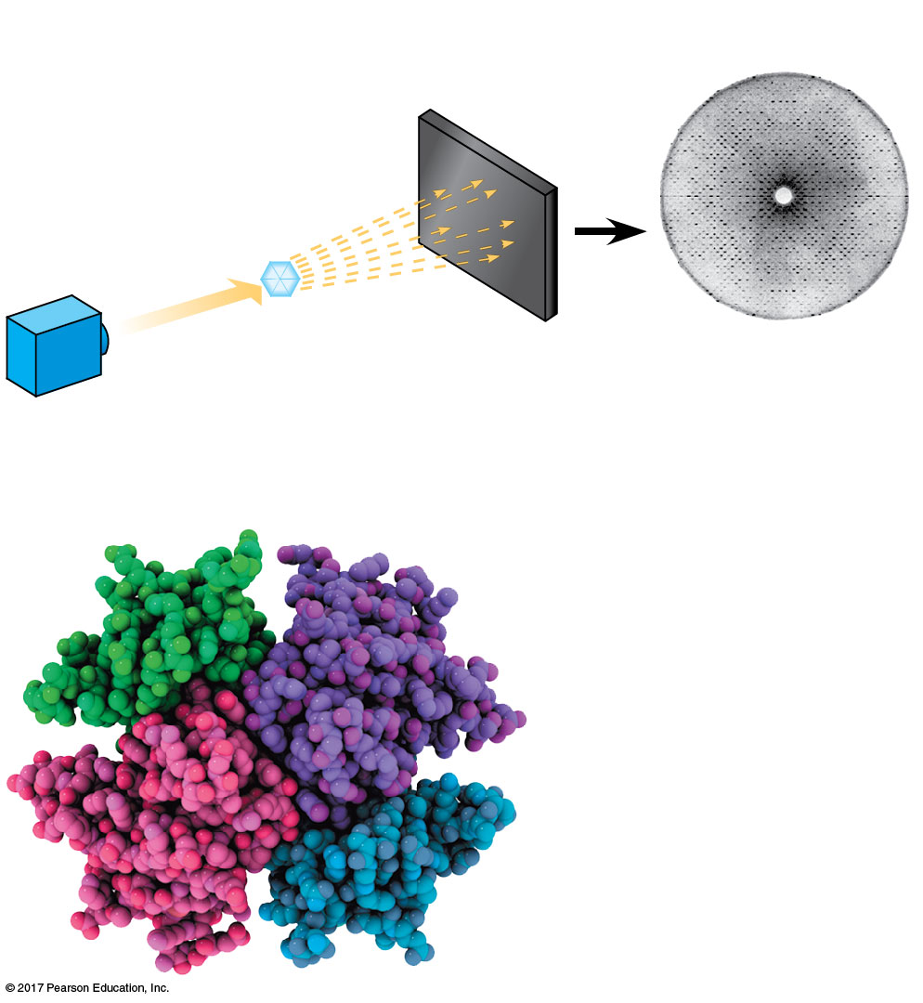
Figure 5.21
X-ray crystallography
Technique
Diffracted
X-rays
X-ray
source
X-ray
beam
Crystal
Digital
detector
X-ray diffraction繞射
pattern
Results
Notes:
Figure 5.21 Research method: X-ray crystallography

Slide 72
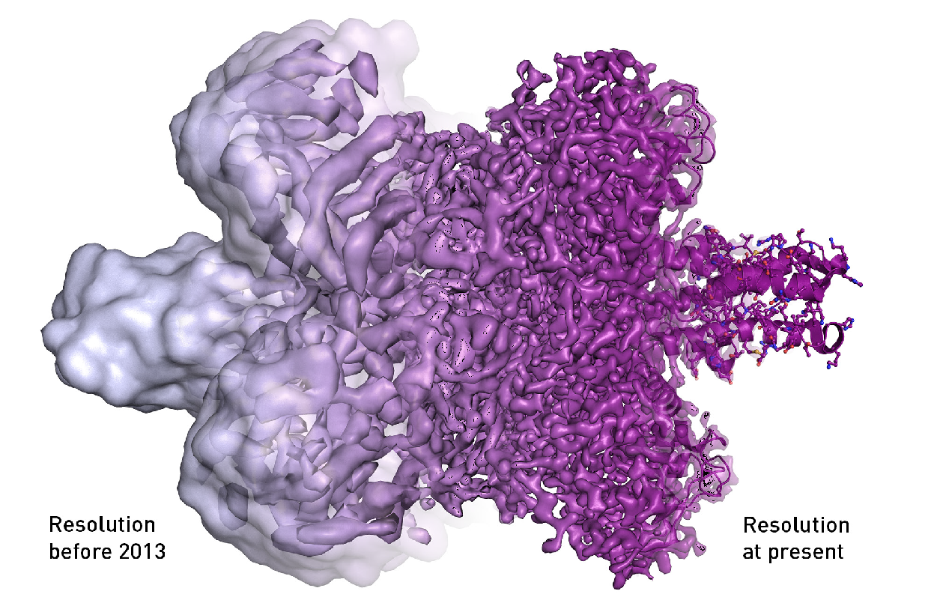
The electron microscope’s resolution has radically improved in the last few years, from mostly showing shapeless blobs to now being able to visualize proteins at atomic resolution

Slide 73
Concept 5.5: Nucleic acids store, transmit, and help express hereditary information
The amino acid sequence of a polypeptide is programmed by a unit of inheritance called a gene
Genes consist of DNA, a nucleic acid核酸made of monomers called nucleotides核苷酸

Slide 74
The Roles of Nucleic Acids
There are two types of nucleic acids
Deoxyribonucleic acid (DNA)
Ribonucleic acid (RNA)
DNA provides directions for its own replication
DNA directs synthesis of messenger RNA (mRNA) and, through mRNA, controls protein synthesis
This process is called gene expression

Slide 75
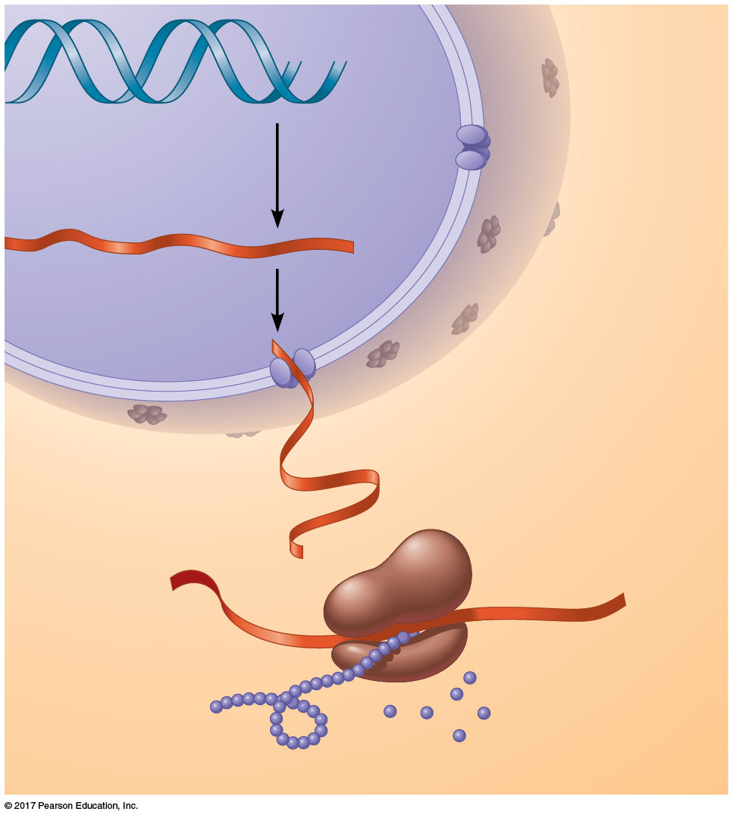
Figure 5.22_3
DNA
1
Synthesis of
mRNA
mRNA
NUCLEUS
CYTOPLASM
mRNA
2
Movement of
mRNA into
cytoplasm
Ribosome
3
Synthesis of
protein
Amino
acids
Polypeptide
Notes:
Figure 5.22_3 Gene expression: DNA → RNA → protein (step 3)

Slide 76
Each gene along a DNA molecule directs synthesis of a messenger RNA (mRNA)
The mRNA molecule interacts with the cell’s protein-synthesizing machinery to direct production of a polypeptide
The flow of genetic information can be summarized as DNA → RNA → protein

Slide 77
The Components of Nucleic Acids
Nucleic acids are polymers called polynucleotides聚核苷酸
Each polynucleotide is made of monomers called nucleotides
Each nucleotide consists of a nitrogenous base, a pentose sugar五碳糖, and one or more phosphate groups
The portion of a nucleotide without the phosphate group is called a nucleoside核苷

Slide 78
Nucleoside = nitrogenous base + sugar
There are two families of nitrogenous bases
Pyrimidines嘧啶(cytosine, thymine, and uracil) have a single six-membered ring
Purines嘌呤(adenine and guanine) have a six-membered ring fused to a five-membered ring
In DNA, the sugar is deoxyribose; in RNA, the sugar is ribose
Nucleotide = nucleoside + phosphate group

Slide 79
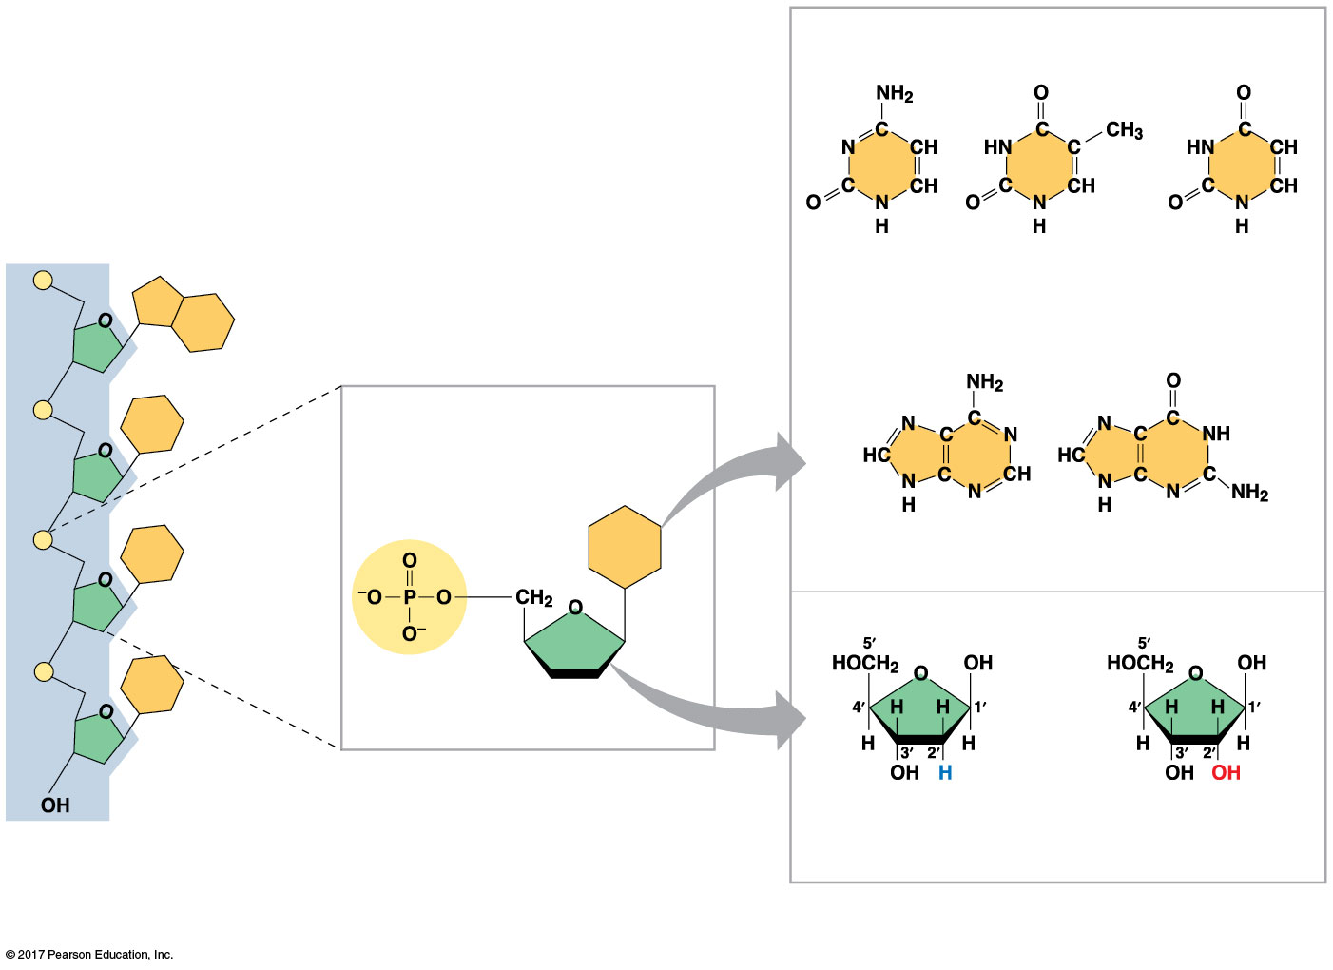
Figure 5.23
Components of nucleic acids
NITROGENOUS BASES
Pyrimidines
Sugar-phosphate backbone
(on blue background)
5′ end
Cytosine (C)
Thymine
(T, in DNA)
Uracil
(U, in RNA)
5′C
Purines
3′C
Nucleoside
Nitrogenous
base
Adenine (A)
Guanine (G)
5′C
SUGARS
1′C
Phosphate
group
3′C
5′C
Sugar
(pentose)
3′C
(b) Nucleotide monomer in a polynucleotide
Deoxyribose
(in DNA)
Ribose
(in RNA)
3′ end
(a) Polynucleotide, or nucleic acid
(c) Nucleoside components
Notes:
Figure 5.23 Components of nucleic acids

Slide 80
Nucleotide Polymers
Nucleotides are linked together by a phosphodiester linkage to build a polynucleotide多聚核苷酸 = 核酸
A phosphodiester linkage consists of a phosphate group that links the sugars of two nucleotides
These links create a backbone of sugar-phosphate units with nitrogenous bases as appendages
The sequence of bases along a DNA or mRNA polymer is unique for each gene

Slide 81
The Structures of DNA and RNA Molecules
DNA molecules have two polynucleotides spiraling around an imaginary axis, forming a double helix
The backbones run in opposite 5′ → 3′ directions from each other, an arrangement referred to as antiparallel
One DNA molecule includes many genes

Slide 82
Only certain bases in DNA pair up and form hydrogen bonds: adenine (A) always with thymine (T), and guanine (G) always with cytosine (C)
This is called complementary base pairing
This feature of DNA structure makes it possible to generate two identical copies of each DNA molecule in a cell preparing to divide

Slide 83
RNA, in contrast to DNA, is single-stranded
Complementary pairing can also occur between two RNA molecules or between parts of the same molecule
In RNA, thymine is replaced by uracil (U), so A and U pair
While DNA always exists as a double helix, RNA molecules are more variable in form

Slide 84
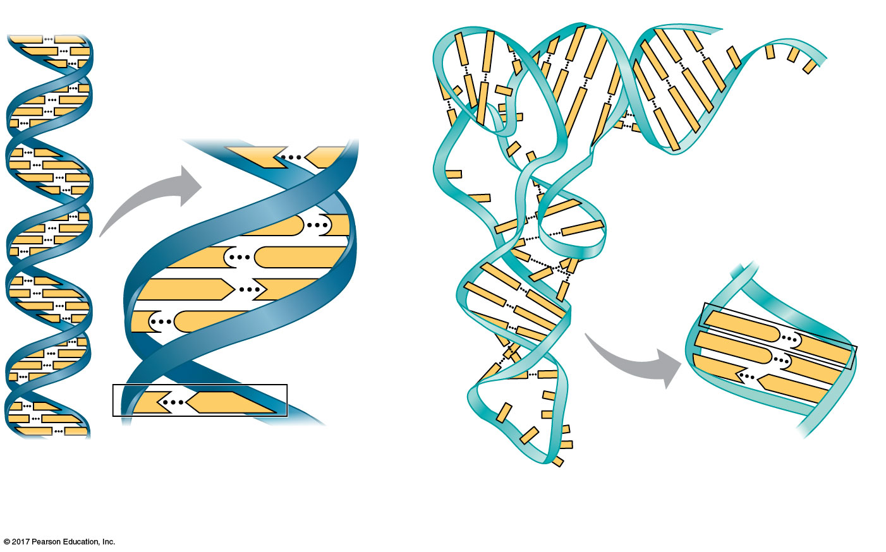
Figure 5.24
The structures of DNA and tRNA molecules
5′
3′
Sugar-phosphate
backbones
Hydrogen bonds
T
A
Base pair joined
by hydrogen bonding
G
C
C
G
A
T
C
G
G
G
C
U
C
A
T
A
3′
5′
Base pair joined
by hydrogen bonding
(a) DNA
(b) Transfer RNA
Notes:
Figure 5.24 The structures of DNA and tRNA molecules

Slide 85
Concept 5.6: Genomics and proteomics have transformed biological inquiry and applications
Once the structure of DNA and its relationship to amino acid sequence was understood, biologists sought to “decode” genes by learning their base sequences
The first chemical techniques for DNA sequencing were developed in the 1970s and refined over the next 20 years

Slide 86
It is enlightening to sequence the full complement of DNA in an organism’s genome
The rapid development of faster and less expensive methods of sequencing was a side effect of the Human Genome Project
Many genomes have been sequenced, generating large sets of data

Slide 87
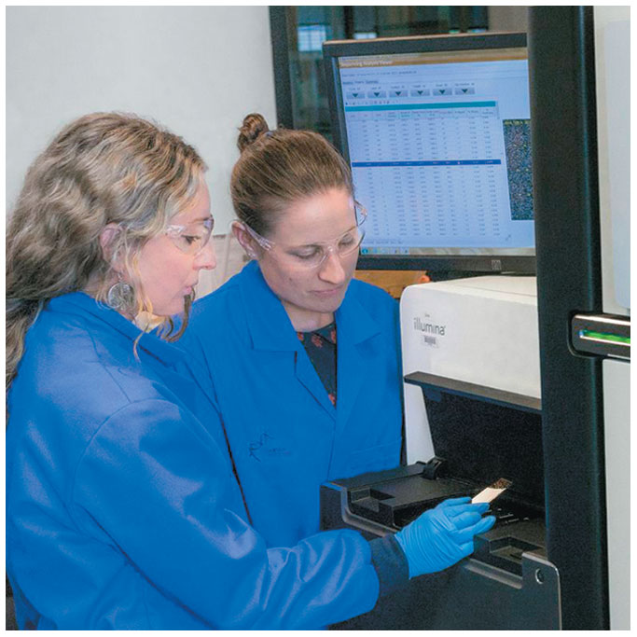
Figure 5.25
Automatic DNA sequencing machines and abundant computing power enable rapid sequencing of genes and genomes
Notes:
Figure 5.25 Automatic DNA sequencing machines and abundant computing power enable rapid sequencing of genes and genomes.

Slide 88
Bioinformatics生物資訊學uses computer software and other computational tools to deal with the data resulting from sequencing many genomes
Analyzing large sets of genes or even comparing whole genomes of different species is called genomics基因組學
A similar analysis of large sets of proteins including their sequences is called proteomics

Slide 89
Figure 5.26
MAKE CONNECTIONS:
Contributions of Genomics and Proteomics to Biology
Paleontology
Evolution
Hippopotamus
Short-finned pilot whale
Species
Interactions
Medical Science
Conservation Biology
Notes:
Figure 5.26 Make connections: contributions of genomics and proteomics to biology

Slide 90
DNA and Proteins as Tape Measures of Evolution
Sequences of genes and their protein products document the hereditary background of an organism
Linear sequences of DNA molecules are passed from parents to offspring
We can extend the concept of “molecular genealogy” to relationships between species
Molecular biology has added a new measure to the toolkit of evolutionary biology

Slide 91
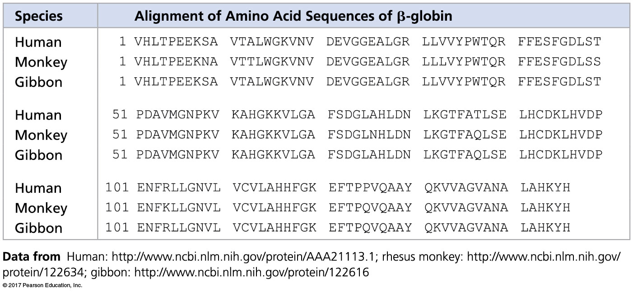
Figure 5.UN02a
Is monkey or gibbon closer to human?
Notes:
Figure 5.UN02a Skills exercise: analyzing polypeptide sequence data (part 1)

