Slide 1
EE 306001
Probability
Lecture 1: sample space
李祈均

Slide 2
Why probability
A systematic (mathematical) way of describing our ‘belief’ or the ‘likelihood’ of event occurrences that helps us make decisions
  Especially important in real life:
    Randomness, noise, unknown rule
  Engineering applications
    Detection (e.g., radar)
    Communication (e.g., noise effect)
    Prediction/recognition (e.g., statistical model)
  Other fields: almost everything in life
    Gambling
    Store management
    Economics
    Risk management
    etc

Slide 3
Lecture Outline
Reading: Section 1.1, 1.2
Probabilistic mathematical model for:
  Reasoning about uncertainty
  Developing approaches to inference problems
Probabilistic models
  Sample space
  Probability law
Axioms of probability
Simple examples

Slide 4
What is a sample space?
We do an (random) experiment ->
A list (set) of all possible things (outcomes) that may happen during this experiment
e.g., flipping a coin (H & T)

Slide 5
Sample Space Ω
“List” (set) of possible outcomes
Requirements:
  Mutually exclusive
  Collectively exhaustive
Art: to be at the “right” granularity
  Pick (decide) appropriate sample space for your problem
  Let’s think about ‘coin-flipping’ exp. again
  Real world, real life

Slide 6
Sample space: discrete example
Two rolls of a tetrahedral die (4-sided)
  Two rolls as 1 single experiment
Sample space of this experiment?
  Sample space: 16 elements – a finite set
Second roll
1
2
3
4
1
2
{2,2}
First roll
3
{3,2}
4

Slide 7
Tree-diagram of sample space
Sequential description
1
2
2,1
Relation to previous diagram?
Each outcome corresponds to each path (leaves) on the tree diagram
2,2
3
2,3
4
2,4
Subtly of wordings (‘result’ not ‘outcome’)
Outcome = (2, 1)
Experiment consists of ‘stages’

Slide 8

Sample space: infinite example
Darts-playing
Experiment:
Randomly fall inside the unit square only
Outcomes:
All possible point in unit square are possible outcomes
$$= \left\{0≤x,y≤1\right\}$$
y
1
{x₁,y₁}
{x₂,y₂}
x
Assign probabilities to individual outcome?
Not really
Any single point (real value) with infinite precision
Zero probability
1
A typical question raised:
Which outcome is more likely to occur compared to others?

Slide 9
Instead, assign probabilities to subsets of sample space
Ω
Assign a numerical number to represent our belief on how likely this subset would occur
Subset of sample space : EVENTS
Outcome is a ‘point’, and ‘random’,
  If occurred inside the event A , then event A occurred
Assign probability to events
How?

Slide 10
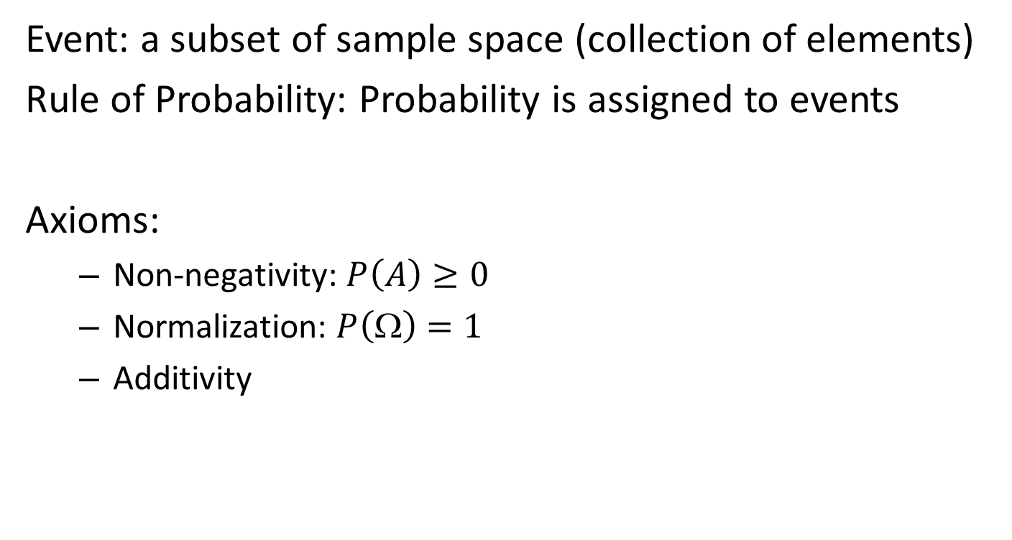
Axioms of probability
Event: a subset of sample space (collection of elements)
Rule of Probability: Probability is assigned to events
Axioms:
  Non-negativity: $P\left(A\right)≥0$
  Normalization: $P\left(Ω\right)=1$
  Additivity
Collectively exhaustive

Slide 11
A
B
Ω
The intersection of A and B
A ∩ B
An outcome falls in this regions:
Event A AND Event B has occurred
A
B
Ω
The union of A and B
A ∪ B
An outcome falls in this regions:
Event A OR Event B has occurred

Slide 12

Axiom 3
  Additivity
  If $AB= $, then $P\left(A∪B\right)=P\left(A\right)+P\left(B\right)$
  Imagining probability behaves like mass

Slide 13
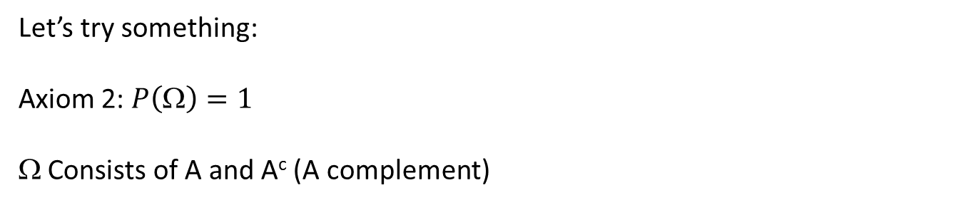



Interesting point
  No axiom on $P\left(A\right) ≤ 1$ ?
$$$$
Let’s try something:
  Axiom 2: $P\left(Ω\right)=1$
$$ Consists of A and A^{c} (A complement)
A^{c}
A
  Axiom 3: $P\left(Ω\right)=P\left(A\right)+P(A^{c})$ = 1
  Axiom 1: $P\left(A\right) ≥ 0$
  Now we get,
  $$P\left(A\right) ≤ 1$$

Slide 14
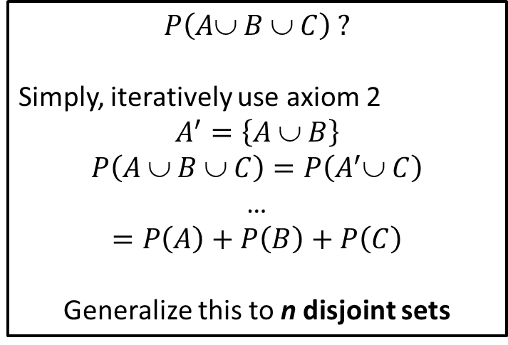

Trivial example
$$$$
A
B
C
$$P\left(A∪ B ∪ C\right) ?$$
Simply, iteratively use axiom 2
$$A^{′}=\left\{A \text{∪} B\right\}$$
$$P\left(A \text{∪} B ∪ C\right)=P\left(A^{′}∪ C\right)$$
…
$$=P\left(A\right)+P\left(B\right)+P\left(C\right)$$
Generalize this to n disjoint sets

Slide 15
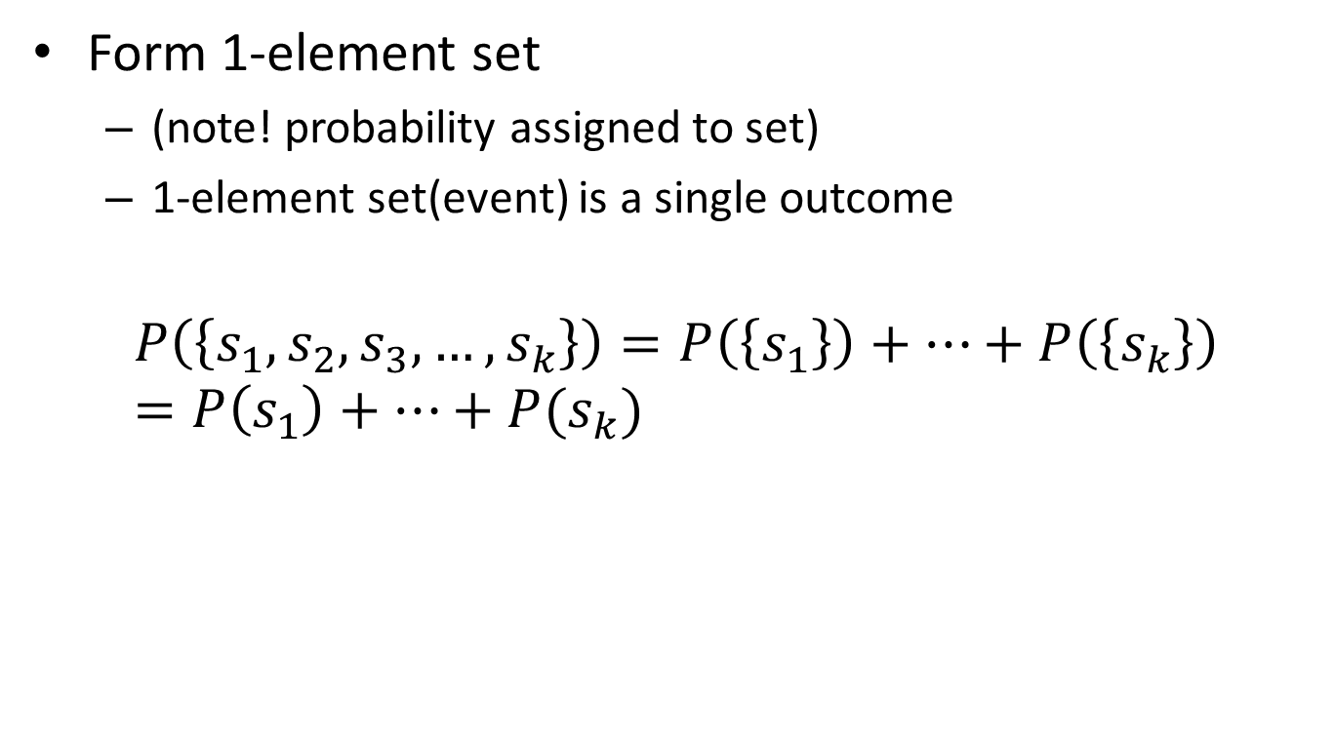
Special case of this axiom for finite set sample space
Form 1-element set
  (note! probability assigned to set)
  1-element set(event) is a single outcome
$$P\left(\left\{s_{1},s_{2},s_{3},…,s_{k}\right\}\right)=P\left(\left\{s_{1}\right\}\right)+…+P\left(\left\{s_{k}\right\}\right)=P\left(s_{1}\right)+…+P(s_{k})$$
Single element set
Individual outcome
Weird sets exist in a given sample space?
Yes, e.g., the square sample space
Non-visualizable, impossible to assign probability to it – very subtle mathematical point

Slide 16
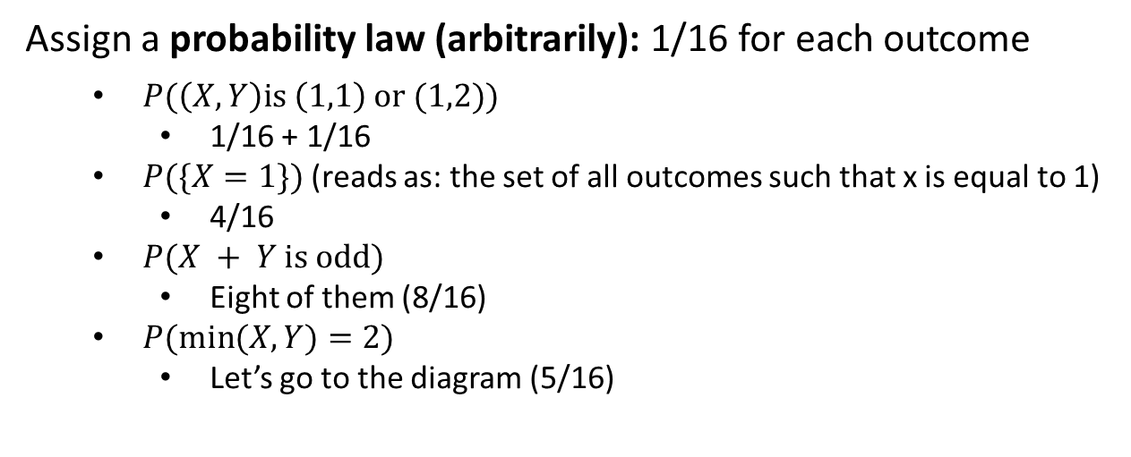
Probability law: assign probability to each outcome examples with finite sample space
1
2
3
4
1
2
3
4
Assign a probability law (arbitrarily): 1/16 for each outcome
  $P(\left(X,Y\right)\text{is} \left(1,1\right) \text{or}\text{ (1,2))}$
    1/16 + 1/16
  $P(\{X=1\text{\}}\text{)}$ (reads as: the set of all outcomes such that x is equal to 1)
    4/16
  $P(X + Y \text{is} \text{odd}\text{)}$
    Eight of them (8/16)
  $P(\text{min}(X, Y)=2\text{)}$
    Let’s go to the diagram (5/16)

Slide 17
Now you have learned it all:
Steps to make probabilistic reasoning
Setup sample space
Statement about probability law
Identify events, and calculate probability for those outcomes of interest
The previous example?
Discrete uniform probability law

Slide 18
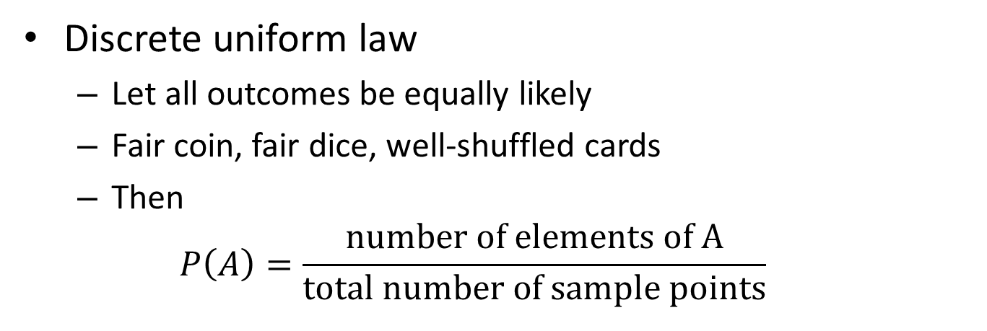
Discrete uniform law
  Boils down to counting
  Counting can be extremely complicated really fast
Discrete uniform law
  Let all outcomes be equally likely
  Fair coin, fair dice, well-shuffled cards
  Then
  $$P\left(A\right)=\frac{\text{number} \text{of} \text{elements} \text{of} \text{A}}{\text{total} \text{number} \text{of} \text{sample} \text{points}}$$

Slide 19
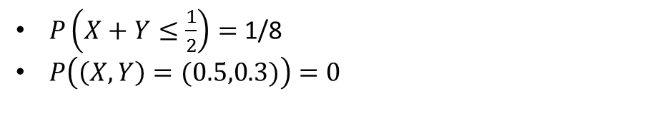
Continuous uniform law
Assign a probability law:
Probability law = area of interest
  This means:
  two subsets of sample space with equal area, it is equally likely that the outcome with fall into one area vs. the other area
y
1
$P\left(X+Y≤\frac{1}{2}\right)=$ 1/8
$P\left(\left(X,Y\right)=(0.5,0.3)\right)=0$
x
1
Moral of the story:
Once probability law in hand, it’s easy
The hard part really comes from calculus and algebra (not from probability)

Slide 20
Third axiom needs to be strengthened
Think of a new experiment:
  You keep flipping a coin and you wait until you obtain heads for the first time
Sample space:
  Outcomes of this experiment is integer (with no upper bounds)
  Set of all possible integers

Slide 21
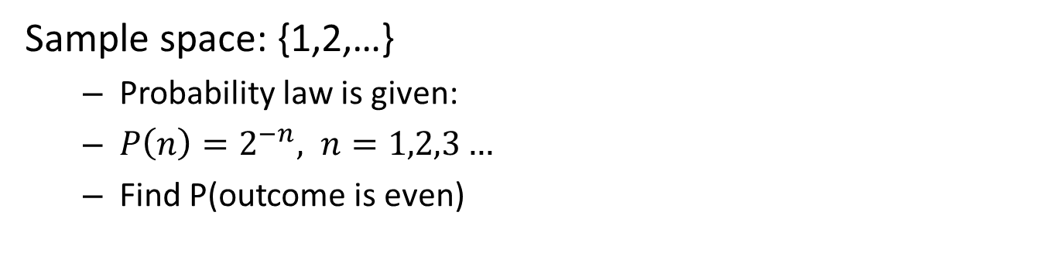
Let’s do this as example
Sample space: {1,2,…}
  Probability law is given:
  $P\left(n\right)=2^{−n}, n=1,2,3…$
  Find P(outcome is even)
p
1
2
3
4
Probability of subset that includes just even numbers
  e.g., 2, 4, 6, 8, …, so on
  Add up infinite geometric sequences: 1/3

Slide 22
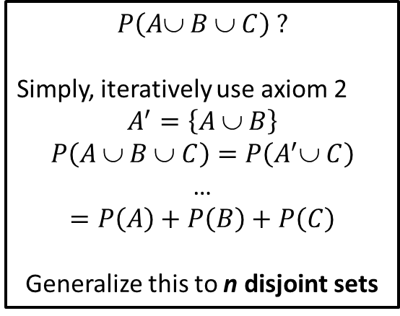
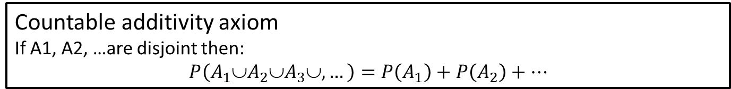
Can we do it directly from axiom 3?
Axiom 3 applies only for countable finite set of sample space
Here, infinite collections
Need one more,
$$P\left(A∪ B ∪ C\right) ?$$
Simply, iteratively use axiom 2
$$A^{′}=\left\{A \text{∪} B\right\}$$
$$P\left(A \text{∪} B ∪ C\right)=P\left(A^{′}∪ C\right)$$
…
$$=P\left(A\right)+P\left(B\right)+P\left(C\right)$$
Generalize this to n disjoint sets
Countable additivity axiom
If A1, A2, …are disjoint then:
$$P\left(A_{1}∪A_{2}∪A_{3}∪,…\right)=P\left(A_{1}\right)+P\left(A_{2}\right)+…$$
Sequence of sets (events), occurred in order, and countable, probability on sequence of sets getting smaller smaller (disjoint) -> you can just add

