Slide 1
TA Session
Carl Chao, Winnie Hong

Slide 2
Outline
Naïve Bayes
Cross Validation

Slide 3
Naïve Bayes

Slide 4
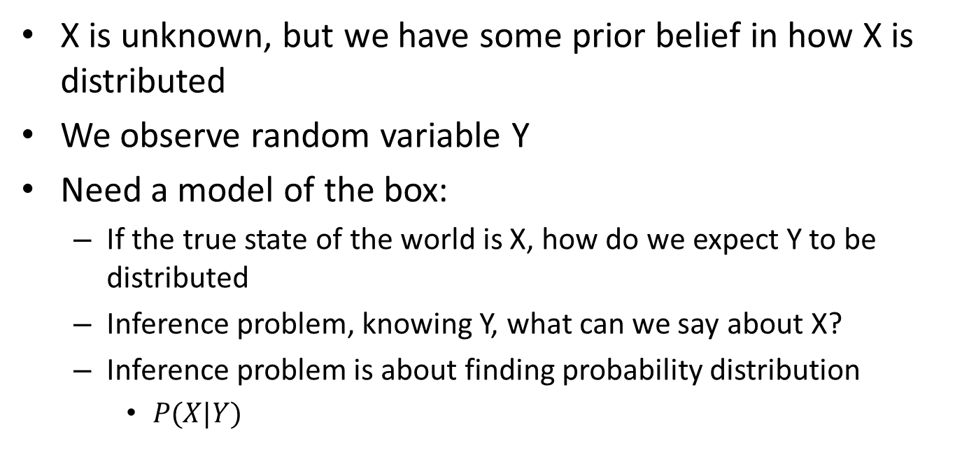
Variations in Bayes rule
X
Y
X is unknown, but we have some prior belief in how X is distributed
We observe random variable Y
Need a model of the box:
  If the true state of the world is X, how do we expect Y to be distributed
  Inference problem, knowing Y, what can we say about X?
  Inference problem is about finding probability distribution
    $P(X|Y)$

Slide 5
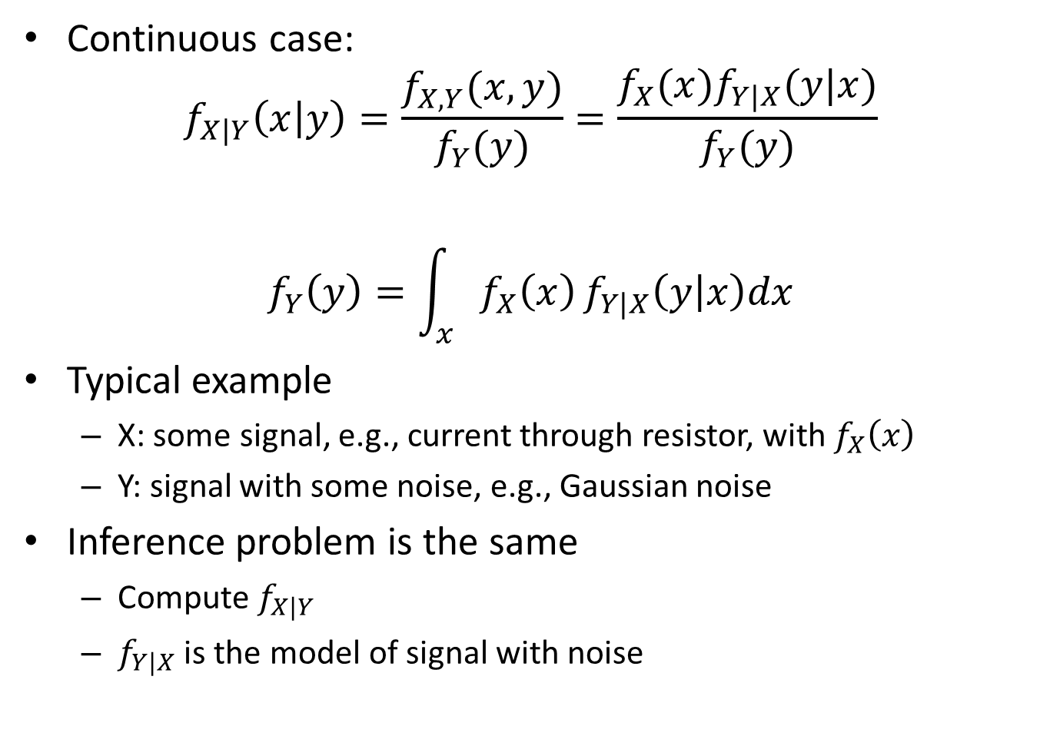
Continuous case:
$$f_{X|Y}\left(x | y\right)=\frac{f_{X,Y}(x,y)}{f_{Y}(y)}=\frac{f_{X}(x)f_{Y|X}(y|x)}{f_{Y}(y)}$$
$$f_{Y}\left(y\right)=\int_{x}{f_{X}\left(x\right)}f_{Y|X}\left(y | x\right)dx$$
Typical example
  X: some signal, e.g., current through resistor, with $f_{X}\left(x\right)$
  Y: signal with some noise, e.g., Gaussian noise
Inference problem is the same
  Compute $f_{X|Y}$
  $f_{Y|X}$ is the model of signal with noise

Slide 6
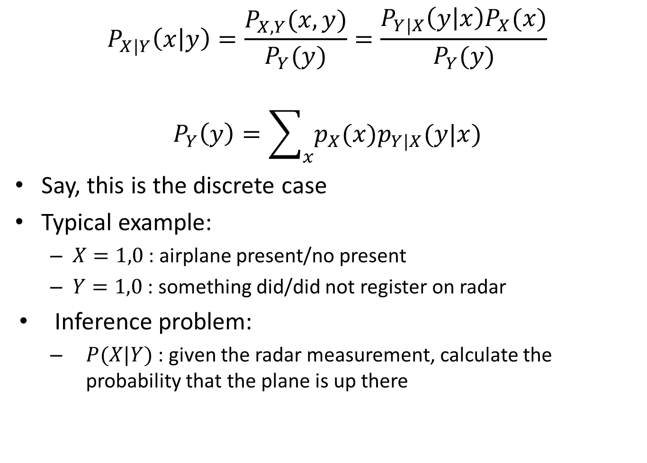
$$P_{X|Y}\left(x | y\right)=\frac{P_{X,Y}(x,y)}{P_{Y}(y)}=\frac{P_{Y|X}\left(y | x\right)P_{X}(x)}{P_{Y}(y)}$$
$$P_{Y}\left(y\right)=\sum_{x}{p_{X}(x)p_{Y|X}(y|x)}$$
Say, this is the discrete case
Typical example:
  $X=1,0$ : airplane present/no present
  $Y=1,0$ : something did/did not register on radar
Inference problem:
  $P(X|Y)$ : given the radar measurement, calculate the probability that the plane is up there

Slide 7
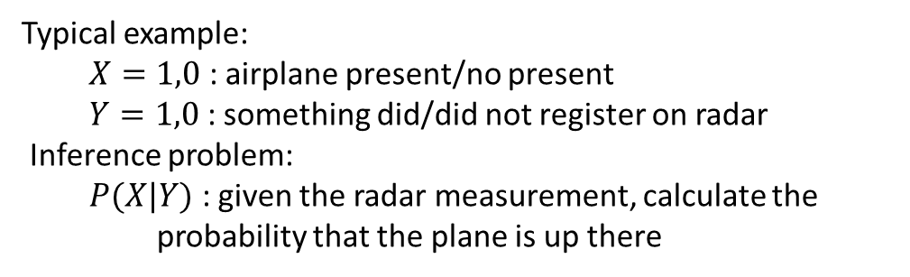
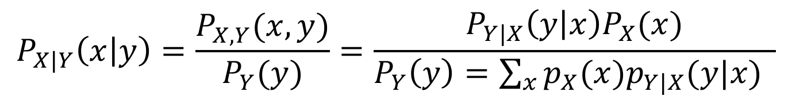
Posterior
Likelihood
Prior
$$P_{X|Y}\left(x | y\right)=\frac{P_{X,Y}(x,y)}{P_{Y}(y)}=\frac{P_{Y|X}\left(y | x\right)P_{X}(x)}{P_{Y}\left(y\right)=\sum_{x}{p_{X}(x)p_{Y|X}(y|x)} }$$
Observed Data Distribution (Constant)
Typical example:
  $X=1,0$ : airplane present/no present
  $Y=1,0$ : something did/did not register on radar
Inference problem:
  $P(X|Y)$ : given the radar measurement, calculate the probability that the plane is up there
X
Y

Slide 8
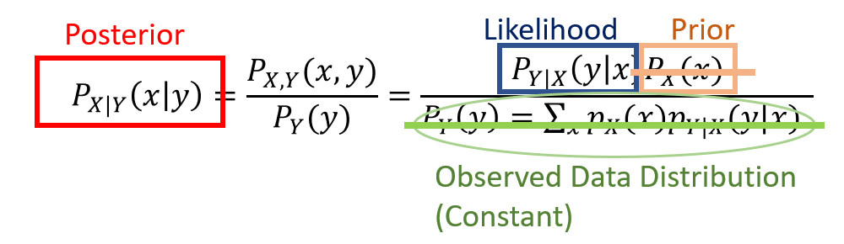
Example 1
 | 1 | 2 | 3 | 4 | 6 | 7 | 8 | 9 | 10
A | 50 | 100 | 1000 | 20 | 300 | 500 | 100 | 200 | 100
B | 100 | 20 | 30 | 3 | 0 | 500 | 200 | 100 | 50

Slide 9
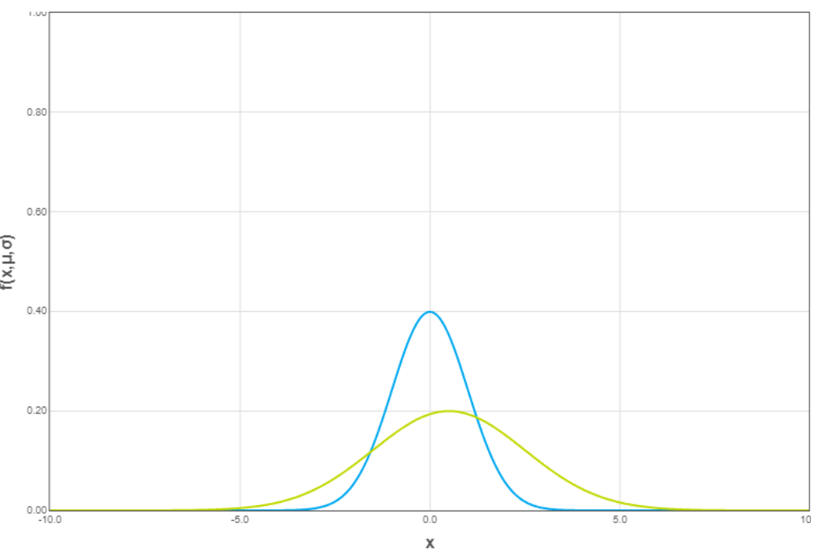

Example 1
 | 1 | 2 | 3 | 4 | 6 | 7 | 8 | 9 | 10
A | 50 | 100 | 1000 | 20 | 300 | 500 | 100 | 200 | 100
B | 100 | 20 | 30 | 3 | 0 | 500 | 200 | 100 | 50
 | Mean | Variance
A | 263.333 | 314
B | 111.445 | 158.914
$$P\left(A | 500\right)=N_{1}\left(500\right)=0.00095635$$
$$A$$
$$P\left(B | 500\right)=N_{2}\left(500\right)=0.00012635$$

Slide 10
Example 2
 | Money | 泡麵盒
A | N(263.333, 314) | N(0, 1)
B | N(111.445, 158.914) | N(5, 2)

Slide 11
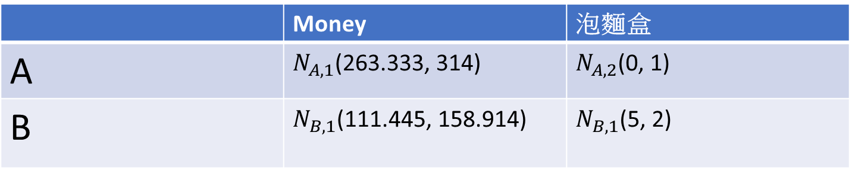

Example 2
 | Money | 泡麵盒
A | $N_{A,1}$(263.333, 314) | $N_{A,2}$(0, 1)
B | $N_{B,1}$(111.445, 158.914) | $N_{B,1}$(5, 2)
$P\left(A | 500, 5\right)=N_{A,1}\left(500\right)∗N_{A,2}\left(5\right)=0.00095635∗$0.00000149 = 1.42e-9
$P\left(B | 500, 5\right)=N_{B,1}\left(500\right)∗N_{B,2}\left(5\right)=0.00095635∗0.19947114=$1.90e-4
$$B$$

Slide 12
Cross Validation
Rotation estimation

Slide 13
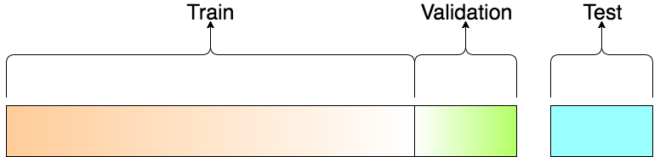
Evaluate
Train test data

Slide 14
Cross Validation: K-Fold
Data
#N
Data
Train
Data
Train
Divided into 5
Equal amount
Assign
Train& Test
Data
Train
Data
Train
Data
Test

Slide 15
Cross Validation: 5-Fold
Fold 1
Fold 2
Fold 3
Fold 4
Fold 5
Data
Test1
Train1
Train1
Train1
Train1
Data
Train2
Test2
Train2
Train2
Train2
Data
Train3
Train3
Test3
Train3
Train3
Data
Train4
Train4
Train4
Test4
Train4
Data
Train5
Train5
Train5
Train5
Test5

Slide 16
Cross Validation: K-Fold
Fold 1
Train1
Model (Classifier)
Train2
Training
Predict
Test5
Train3
Train4

Slide 17
Fold 1
Train
Model (Classifier)
Train
Test(1)
Train
Train

Slide 18
Fold 1
Train
Fold 2
Model (Classifier)
Train
Train
Model (Classifier)
Test(1)
Train
Train
Test(2)
Train
Train
Train

Slide 19
Fold 1
Train
Fold 2
Model (Classifier)
Train
Fold 3
Train
Model (Classifier)
Train
Test(1)
Train
Model (Classifier)
Train
Test(2)
Train
Train
Test(3)
Train
Train
Train
Train

Slide 20
Fold 1
Train
Fold 2
Model (Classifier)
Train
Fold 3
Train
Model (Classifier)
Train
Fold 4
Test(1)
Train
Model (Classifier)
Train
Train
Train
Test(2)
Model (Classifier)
Train
Test(3)
Train
Train
Train
Test(4)
Train
Train
Train
Train

Slide 21
Fold 1
Fold 2
Train
Train
Model (Classifier)
Fold 3
Train
Model (Classifier)
Train
Train
Fold 4
Model (Classifier)
Test(1)
Train
Train
Test(2)
Train
Fold 5
Train
Model (Classifier)
Train
Test(3)
Train
Train
Model (Classifier)
Train
Train
Test(4)
Train
Train
Train
Test(5)
Train
Train
Train

Slide 22
Predict (1)
Ground Truth(1)
Predict (2)
Ground Truth(2)
Evaluate
Predict (3)
Ground Truth(3)
Predict (4)
Ground Truth(4)
Predict (5)
Ground Truth(5)

Slide 23
Evaluation Metrics
P(positive): Predict YES
N(negative): Predict NO
Predict
T(True): Predict Correct
F(False): Predict False
 | Yes | No
Yes | TP (True Positive ) | FN (False Negative )
No | FP (False Positive ) | TN (True Negative )
Ground
Truth
Precision = TP/(TP+FP)
Recall = TP /(TP+FN)
Accuracy: (TP+FN)/(TP+FN+TN+FP)

Slide 24
Classification Problem (2 class)
(class1)Precision: 100%
(class1)Recall: 100%
(class2)Precision: 100%
(class2)Recall: 100%
--------------------------------------
Accuracy: 100%
UAR: (100%+100%)/2=100%
 | Class 1 | Class 2 | Recall
Class 1 | 100 | 0 | 100%
Class 2 | 0 | 100 | 100%
Precision | 100% | 100%
UAR: unweighted average recall
-> (Recall(class1)+Recall(class2))/2=UAR

Slide 25
Classification Problem (2 class)
 | Class 1 | Class 2 | Recall
Class 1 | 100 | 0 | 100%
Class 2 | 1 | 0 | 0%
Precision | 99% | 0%
(class1)Precision: 100%
(class1)Recall: 99%
(class2)Precision: 0%
(class2)Recall: 0%
--------------------------------------
Accuracy: 99%
UAR: (100%+0%)/2=50%

Slide 26
Python example (3.6)
Evaluation Metric
  Accuracy :
    from sklearn.metrics import accuracy_score
    accuracy_score(y_true, y_pred)
    http://scikit-learn.org/stable/modules/model_evaluation.html#accuracy-score
  UAR :
    from sklearn.metrics import recall_score
    recall_score(y_true, y_pred, average='macro')
    http://scikit-learn.org/stable/modules/generated/sklearn.metrics.recall_score.html
Cross Validation
  http://ogrisel.github.io/scikit-learn.org/sklearn-tutorial/modules/cross_validation.html
  sklearn.cross_validation
    K-Fold (k-fold cross validation)
    LOO (leave one out)
    LPO (leave p out)

Slide 27
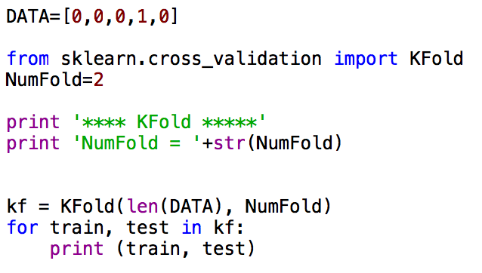
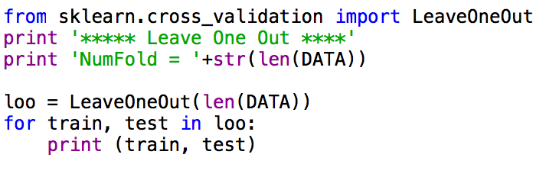
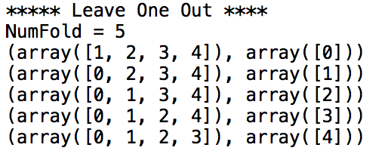
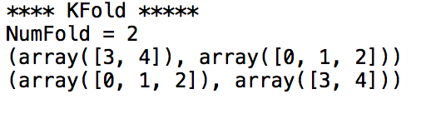
K-Fold or LeaveOneOut

Slide 28
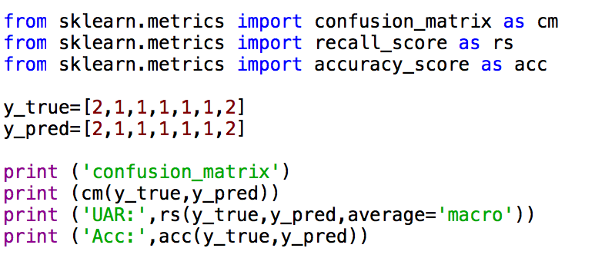
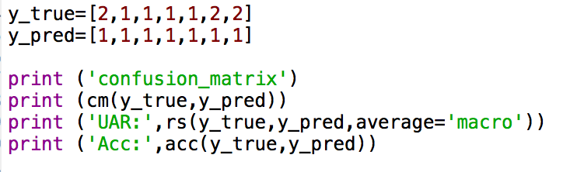
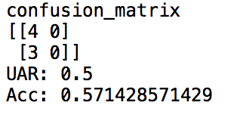
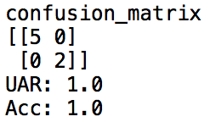
Confusion matrix & Evaluation Metric

Slide 29
Result & Evaluation

Slide 30
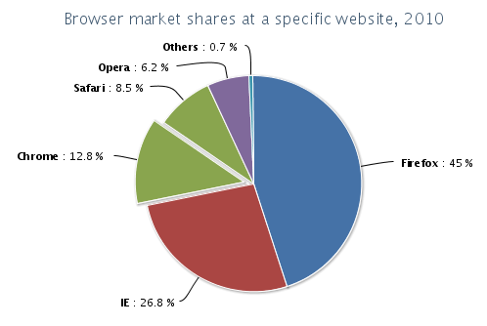
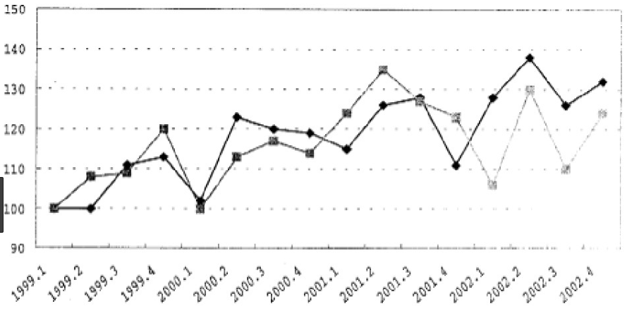
Required Result
Accuracy Table
Evaluation matrix (e.g. confusion matrix, F1 score, mean square error …)
  Evaluation matrix result
  How do you do that
Your conclusion! (complement with figure explanation would be recommended)
  Conclusion description (Is your model good enough? Is the result good or bad?)
  Figure explanation (optional): pie plot, histogram, line graph, etc.
Future work
  The problem remain to be solved
  How do you solve that in the future (Simply suggestion on implementation idea would be fine)

