Slide 1
CHAPTER
5
Thermally Activated Processes and Diffusion in Solids

Slide 2
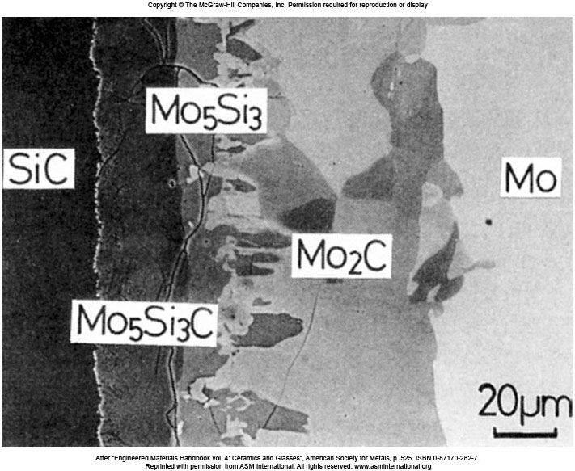
Interface of SiC/Mo
Interfacial microstructure of SiC/Mo after bonding at 1700 °C, 100 MPa, 1 h.

Slide 3
Rate Processes in Solids
Reactions occur in solid state resulting in more stable atomic arrangement.
Reacting atoms must have sufficient energy to overcome activation energy barrier.
At a given temperature, not all atoms have activation energy E*. It should be supplied to them.
活化能
E*
E_{r} = Energy of reactants
E* = Activation Energy Level
ΔE* = Activation Energy
E_{p} = Energy of Products
ΔE*
Activation Energy
E_{r}
Reactants
Energy released
Due to reaction
E_{P}
Products
Reaction Coordinate

Slide 4
Rate Process in Solids (Cont..)
As temperature increases, more and more atoms acquire activation energy level.
Probability of finding an atom/molecule with energy E* greater than average energy E of all atoms/molecules is given by
k = Boltzman’s Constant = 1.38 × 10⁻²³ J/atom⋅K.
T = Temperature in Kelvin.

Slide 5
Rate Process in Solids (Cont..)
The fraction of atoms having energies greater than E* in a system (when E* is much greater than average energy E) is given by
n = Number of molecules greater than energy E*
N_{total} = Total number of molecules
k = Boltzman’s Constant, 8.62 × 10⁻⁵ eV/K
C = Constant
T = Temperature in Kelvin.

Slide 6
Rate Process in Solids (Cont..)
The number of vacancies at equilibrium at a particular temperature in a metallic crystal lattice is given by
n_{v} = Number of vacancies per m³ of metal
E_{v} = Activation Energy to form a vacancy, eV
T = Absolute Temperature, K
k = Boltzman’s Constant, 8.62 × 10⁻⁵ eV/K
C = Constant

Slide 7
EP 5.1 Calculate (a) the equilibrium number of vacancies per cubic meter in pure copper at 500 °C and (b) the vacancy fraction at 500 °C in pure copper. Assume: E_{v} = 0.90 eV, C = 1, ρ = 8.96 ×10⁶ g/m³.
接近熔點1082 °C， n_{v}/N ≈ 4.5 × 10⁻⁴

Slide 8
Arrhenius Equation
The rate of chemical reaction is given by Arrhenius equation.
Rate of reaction = C e^{−Q/RT}
Q = Activation energy, J/mol or cal/mol
R = Molar gas constant, 8.314 J/mol⋅K, 1.987 cal/mol ⋅K
T = Temperature in Kelvin, K
C = Rate constant (Independent of temperature)
Rate of reaction depends upon number of reacting molecules that have activation energy of E* or greater.

Slide 9

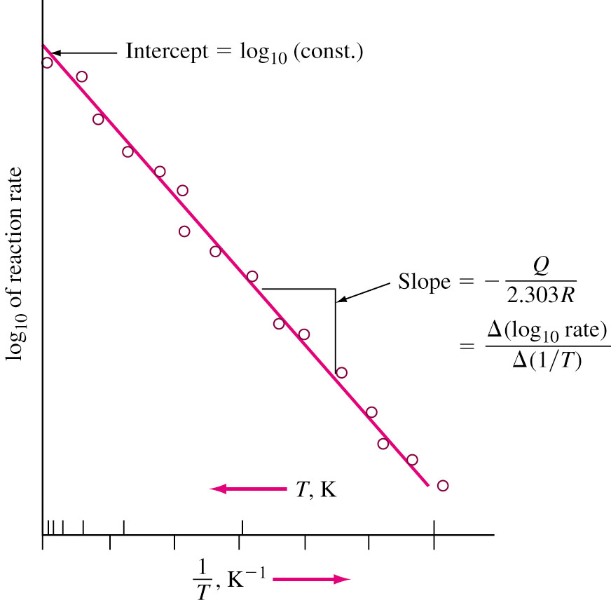
Arrhenius Plot
Arrhenius equation can also be written as
ln (rate) = ln C – Q/RT
or log₁₀ (rate) = log₁₀ C – Q/(2.303 RT)
Which is similar to
y = b + mx
Which is equation of a straight line
With y intercept as ‘b’ and slope ‘m’.
y Log₁₀(rate)
x (1/T)
b Log₁₀(C)
m −Q/2.303R
Arrhenius plot

Slide 10
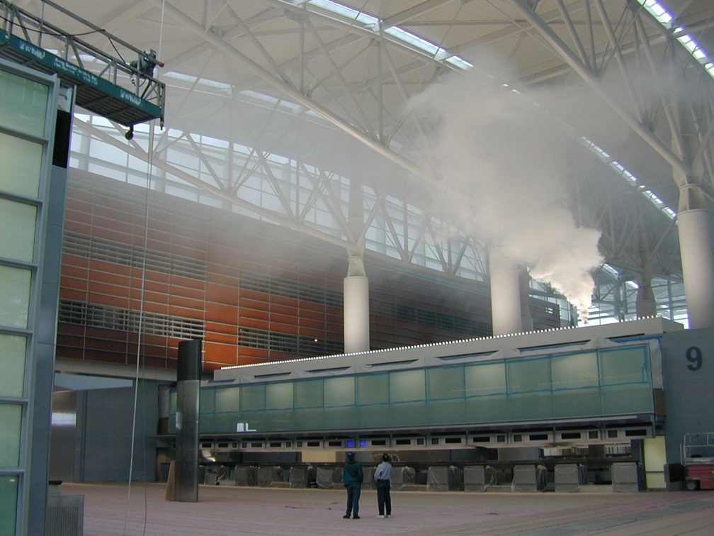
Atomic Diffusion in Solids
Diffusion 擴散 is a process by which a matter is transported through another matter.
Examples:
  Movement of smoke particles in air: Very fast.
  Movement of dye in water: Relatively slow.
  Solid state reactions:
  Very restricted move-
  ment due to bonding.
  e.g.:
  Precipitation (9.5.1)
  Recrystallization (6.8)
www.sandia.gov

Slide 11
Vacancy or Substitutional Diffusion
Two types of diffusion: (1) vacancy or substitu-tional mechanism (2) interstitial mechanisms.
Atoms diffuse in solids if
      Vacancies or other crystal defects are present
      There is enough activation energy
Atoms move into the vacancies present.
More vacancies are created at higher temperature.
Diffusion rate is higher at high temperatures.
Example: If atom ‘A’ has sufficient activation energy, it moves into the vacancy → self diffusion.
Table 5.1: As the melting point increases, activation energy also increases.
自擴散

Slide 12
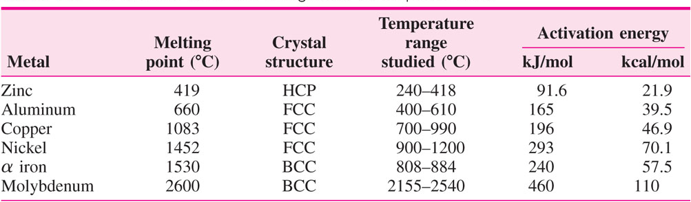
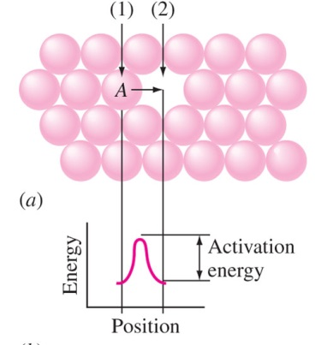
Substitutional Diffusion 置換型擴散
Activation
energy of
self diffusion
Activation
energy to
form a
vacancy
Activation
energy to
move a
vacancy
=
+
Because of the complex effects, substitution diffusion data must be obtained experimentally.

Slide 13
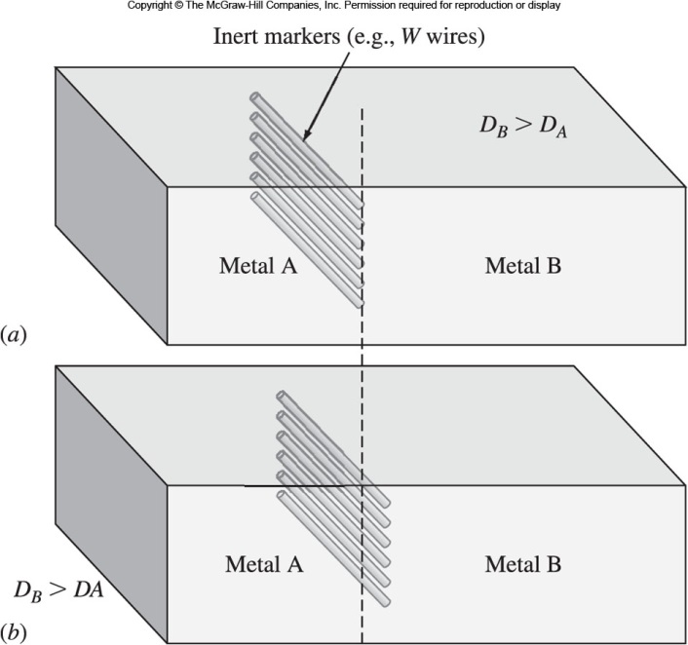
Kirkendall Effect 克肯岱爾效應
The markers at the diffusion interface moved slight in the opposite direction to the faster diffusing species.
Presence of vacancies allowed this phenomenon to occur.
Diffusion can also occur by the vacancy mechanism in solid solution.
Effective factors: atomic size, bonding energy.
D_{B} > D_{A}
Fig. 5.4 Experiment to illustrate the Kirkendall effect

Slide 14
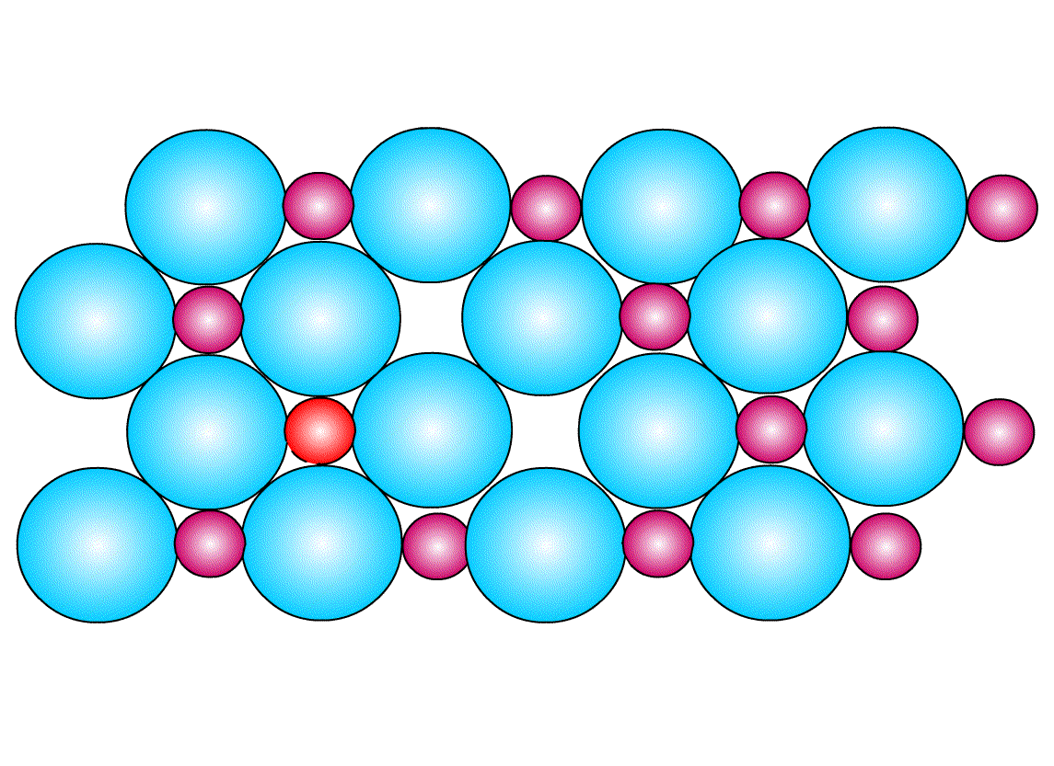
Interstitial Diffusion mechanism
間隙型擴散機制
Atoms move from one
interstitial site to another.
The atoms that move
be much smaller than the matrix atom such as: H, O, N, C
Example:
Carbon interstitially
diffuses into BCC (α) or FCC (γ) iron.
Interstitial atoms
Matrix
atoms

Slide 15
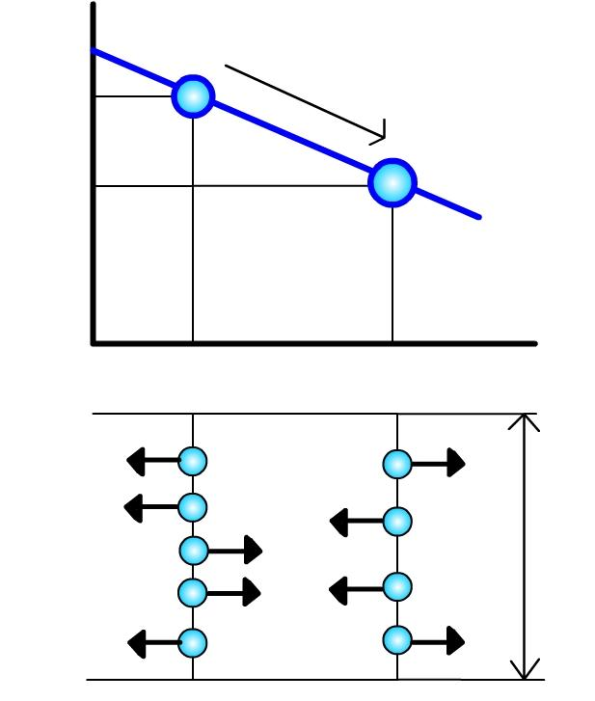
Steady State Diffusion
There is no change in concentration of solute atoms at different planes in a system, over a period of time.
No chemical reaction occurs. Only net flow of atoms.
C₁
Solute atom flow
Concentration
of diffusing
atoms
C₂
Distance x
Net flow of atoms
per unit area per
unit time = J
Diffusing
atoms
Unit
area

Slide 16
Fick’s First Law 費克第一定律
The flux or flow of atoms is given by
For steady state diffusion condition, the net flow of atoms by atomic diffusion is equal to diffusion coefficient (diffusivity) D times the concentration gradient dC/dx.
Example: Diffusivity of FCC iron at 500 °C is 5 × 10⁻¹⁵ m²/s and at 1000 °C is 3 × 10⁻¹¹ m²/s.
J = Flux or net flow of atoms
D = Diffusion coefficient
= Diffusivity
= Concentration Gradient

Slide 17
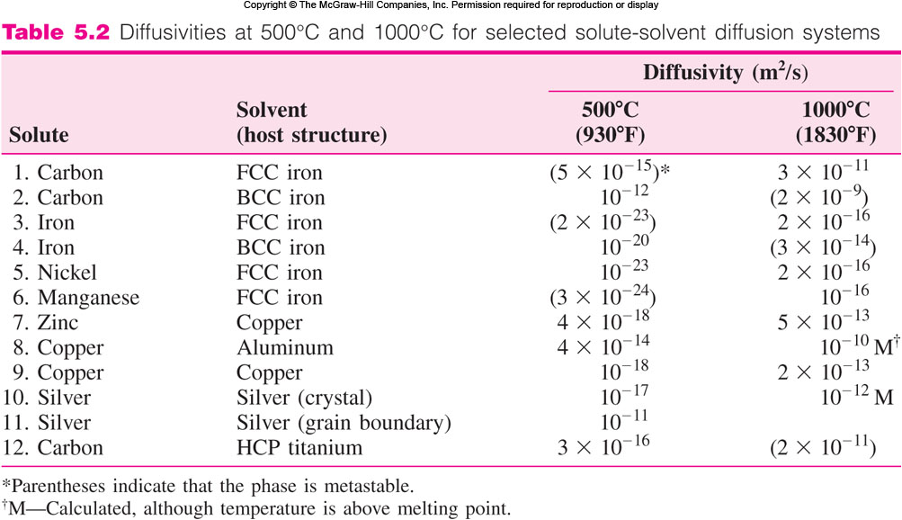
Diffusivities Data

Slide 18
Diffusivity 擴散率
Diffusivity depends upon
    Type of diffusion: Whether the diffusion is interstitial or substitutional.
    Temperature: As the temperature increases diffusivity increases. Melting point ↑ ⇒ Diffusivity ↓.
    Type of crystal structure: BCC crystal has lower APF than FCC and hence has higher diffusivity.
    Type of crystal imperfection: More open structures (grain boundaries) increases diffusion.
    The concentration of diffusing species: Higher concentrations of diffusing solute atoms will affect diffusivity.

Slide 19
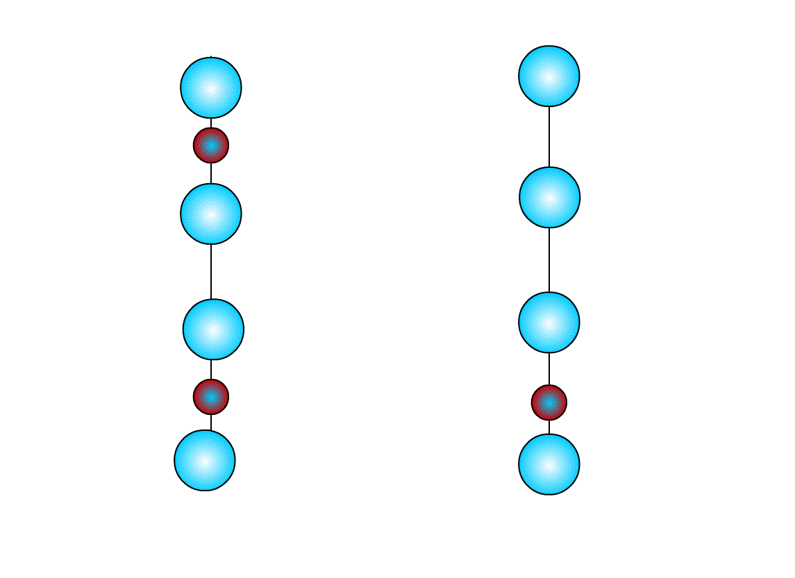
Non-Steady State Diffusion
Concentration of solute atoms at any point in metal changes with time in most case.
Fick’s second law: Rate of compositional change is equal to the rate of change of diffusivity times concentration gradient.
Plane 1
Plane 2
費克第二定律
Change of concentration of solute
atoms with change in time in different planes

Slide 20
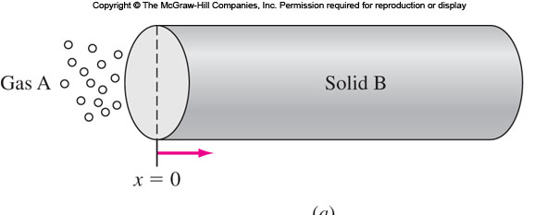
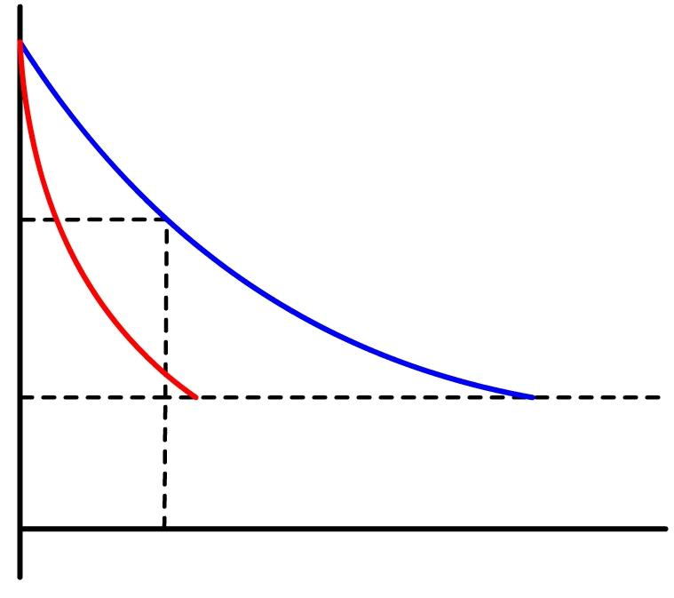
Fick’s Second Law – Solution
C_{s} = Surface concentration of
element in gas diffusing
into the surface.
C₀ = Initial uniform concentration
of element in solid.
C_{x} = Concentration of element at
distance x from surface at
time t₁.
x = distance from surface
D = diffusivity of solute
(independent of position)
t = time.
C_{s}
Time = t₂
C_{x}
Time = t₁
Time = t₀
C₀
x
Distance x

Slide 21
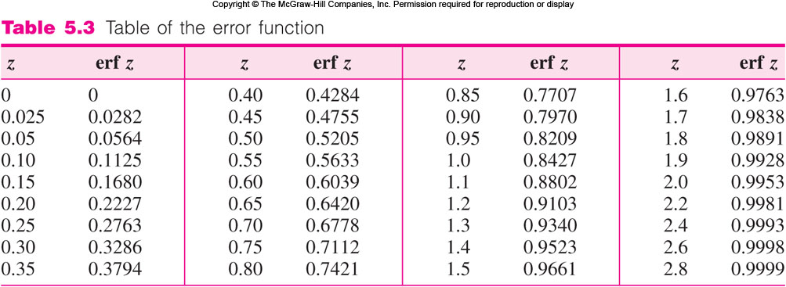
Error Function 誤差函數

Slide 22
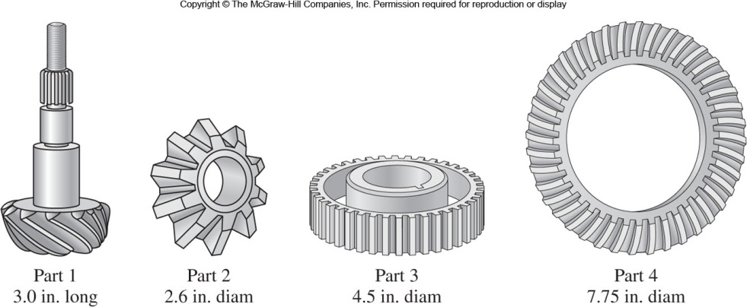
Case Hardening 表面硬化
Sliding and rotating parts (shafts or gears) need to have hard surfaces and tough inner core.
These parts are usually machined with low carbon steel (0.10-0.25 wt% C) as they are easy to machine.
Their surface is then hardened by carburizing. 滲碳

Slide 23
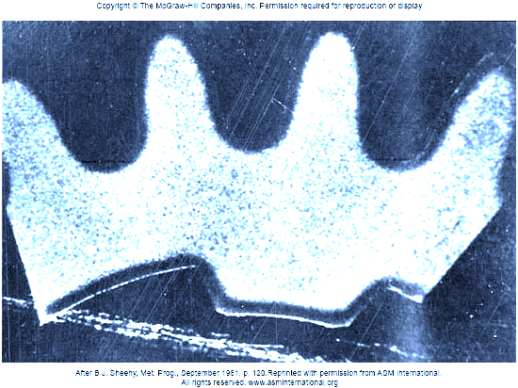
Gas Carburizing
Steel parts are placed at elevated temperature (927 °C) in an atmosphere of hydrocarbon gas (CH₄).
Carbon diffuses into iron surface and fills interstitial space to make it harder.
Fig. 5.9 Macro-section of nitrogen-methane-carburized SAE 8620 (Fe-0.20C-0.50Cr-0.80Mn-0.20Mo-0.55Ni-0.25Si-<0.035P-<0.04S) final-drive pinion gear.

Slide 24
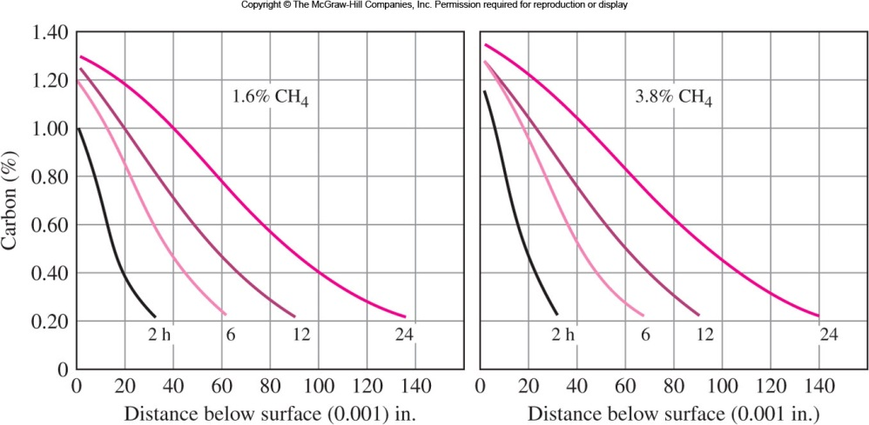
Gas Carburizing (Cont….)
2.5 mm
2.5 mm
Fig. 5.10 Carbon gradients in test bars of 1022 steel carburized at 918 °C in a 20%CO-40%H₂ gas with 1.6 and 3.8 % methane (CH₄) added.

Slide 25
EP 5.2 Consider the gas carburizing of a gear of 1020 steel at 927 °C. Calculate the time in minutes necessary to increase the carbon content to 0.40 % at 0.50 mm below the surface. C_{s} = 0.90 % C,
C₀ = 0.20 % C, D_{927°C} = 1.28 ×10⁻¹¹ m²/s.

Slide 26
Error Function 誤差函數

Slide 27
EP 5.3 As EP 5.2, only in this problem calculate the carbon content at 0.50 mm beneath the surface of the gear after 5 h carburizing time. C_{s} = 0.90 % C, C₀ = 0.20 % C, D_{927°C} = 1.28 ×10⁻¹¹ m²/s.

Slide 28
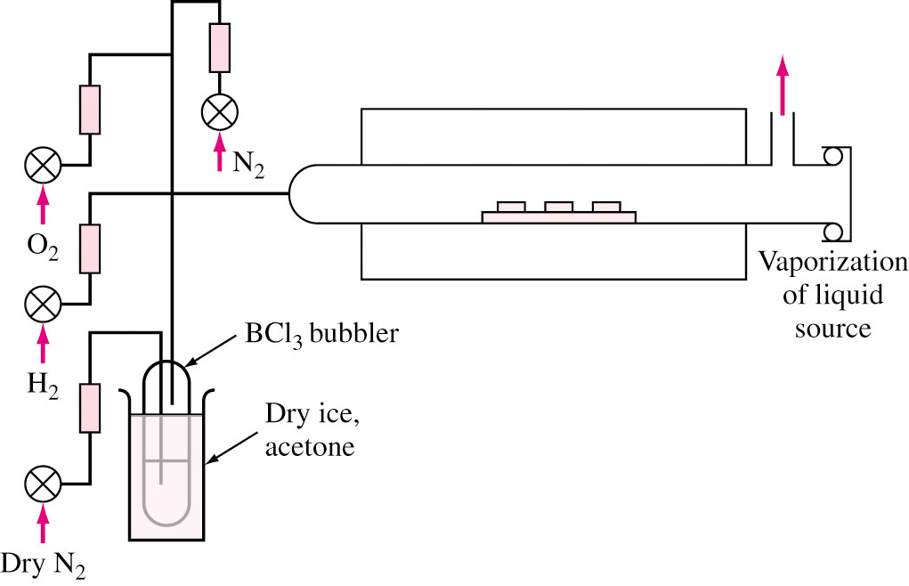
Impurity Diffusion into Silicon Wafer
Impurities are made to diffuse into silicon wafer to change its electrical characteristics.
Used in integrated circuits.
Silicon wafer is exposed to vapor of impurity at 1100 °C in a quartz tube furnace.
The concentration
impurity at any point
depends on depth and
time of exposure.
Diffusion depth:
A few micrometer
vs.
Wafer thickness:
~ 200-300 μm.

Slide 29
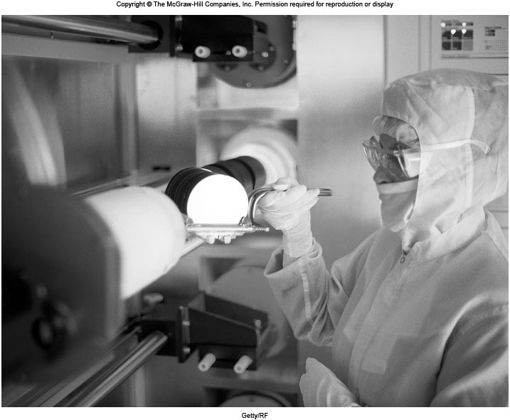
Loading for Impurity Diffusion
Fig. 5.12 Loading a rack of silicon wafers into a tube furnace for impurity diffusion

Slide 30
EP 5.4 Consider the impurity diffusion of gallium into a silicon wafer. If gallium is diffused into a silicon wafer with no previous gallium in it at 1100 °C for 3 h, what is the depth below the surface at which the concentration is 10²² atoms/m³ if the surface concen-tration is 10²⁴ atoms/m³ ? D_{1100°C} = 7.0 ×10⁻¹⁷ m²/s.

Slide 31
Effect of Temperature on Diffusion
Dependence of rate of diffusion on temperature is given by
D = Diffusivity, m²/s
D₀ = Proportionality constant, m²/s
Q = Activation energy of diffusing
species, J/mol
R = Molar gas constant = 8.314 J/mol⋅K
T = Temperature, K
or
or

Slide 32
Temperature Effect - Example
If diffusivity at two temperatures are determined, two equations can be solved for Q and D₀
Example:
The diffusivity of silver atoms in silver is 1 × 10⁻¹⁷ at 500 °C and 7 × 10⁻¹³ at 1000 °C. Therefore,

Slide 33
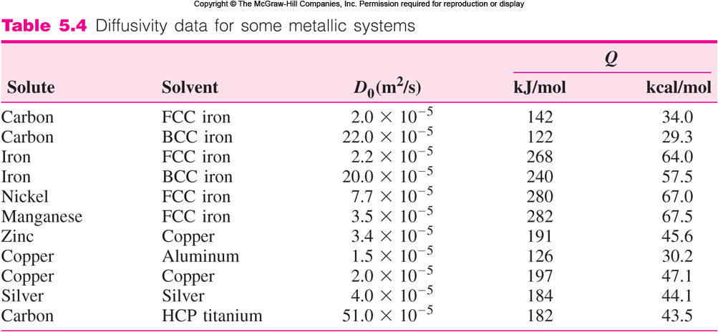
Diffusivity Data for Some Metals

Slide 34
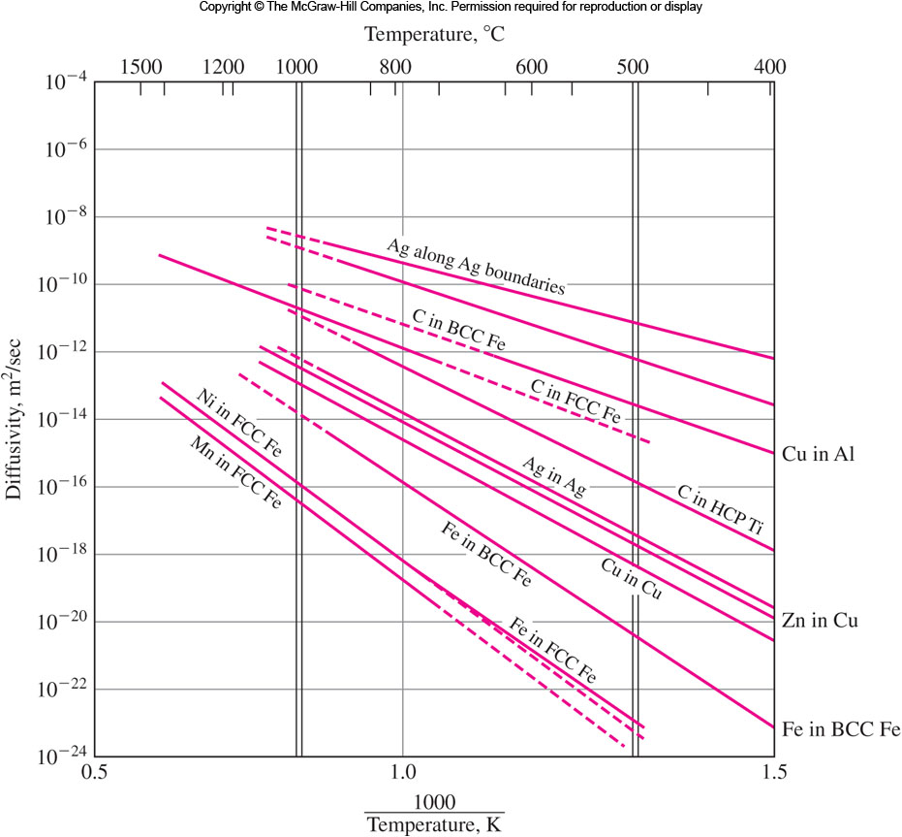
Arrhenius Plots of Diffusivity Data

Slide 35
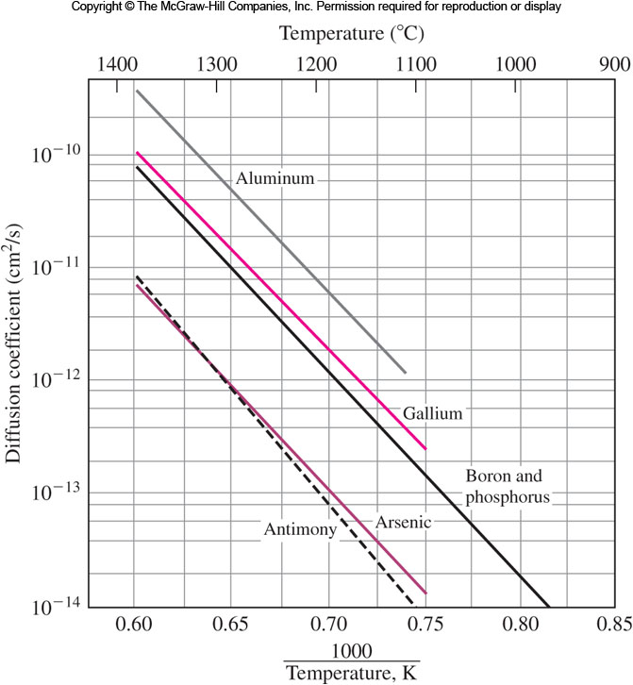
Impurity Diffusivity in Silicon

Slide 36
Summary
Substitution diffusion: atoms of about the same size jump from one position to another, using the vacant atomic sites.
Interstitial diffusion: small atoms move through the interstitial spaces between the larger matrix atoms.
Fick’s first law: for the steady-state conditions.
Fick’s second law: for the non-steady-state conditions.
Temperature dependence: D = D₀ e^{−Q/RT}
Applications: Gas-carburizing for surface hardening steel,
Impurity diffusion of silicon wafers for ICs.

