Slide 1
量測系統示意圖
Probe station
Amp amplifier
Drain-current amplify
Keithley 2400
Drain-voltage source
Keithley 2400
Gate-voltage source
Keithley 2000
Drain-current meter

Slide 2
二點探針量測 (Two-probe measurement)
N-type MOSFET
Source
Drain
Total Resistance = R_{total} = 2R_{c} + R_{s} + R_{p}
R_{c}
R_{c}
R_{c} = Contact resistance
R_{s} = Sample(Channel) resistance (P - Si)
R_{p} = Probe resistance (Probe, Al, N⁺ - Si)
Al
Al
Al
SiO₂
N⁺ - Si
P - Si
N⁺ - Si
R_{S}
V_{drain} = I_{drain}R_{total}
P - Si

Slide 3
MOSFET量測
N-type MOSFET
Source
Gate
Drain
Source
Gate
Drain
After gating
Al
Al
Al
Al
Al
Al
SiO₂
SiO₂
N⁺ - Si
P - Si
N⁺ - Si
N⁺ - Si
N⁺ - Si
N⁺ - Si
P - Si
P - Si

Slide 4
Flat-band
V_{g} induce band bending
Strong inversion
( P to N⁺ )
Metal
(Al)
Oxide
(SiO₂)
Semi.
(P - Si)
E_{C}
V_{g} > 0
V_{g} > V_{th}
E_{F}
E_{V}
Al
Metal (Al)
Metal (Al)
Al
Al
Al
Oxide (SiO₂)
Oxide (SiO₂)
N⁺ - Si
N⁺ - Si
V_{g} > V_{th}
N⁺ - Si
N⁺ - Si
N⁺ - Si
Semi.
(P - Si)
Semi.
(P - Si)

Slide 5
https://en.wikipedia.org/wiki/MOSFET

Slide 6
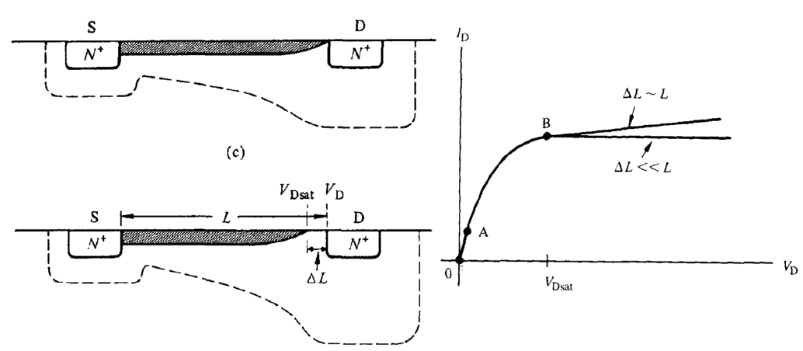
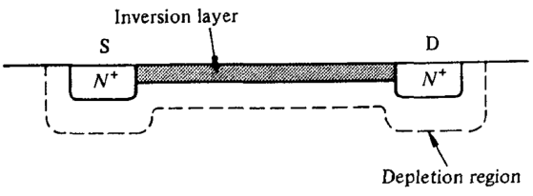

Slide 7
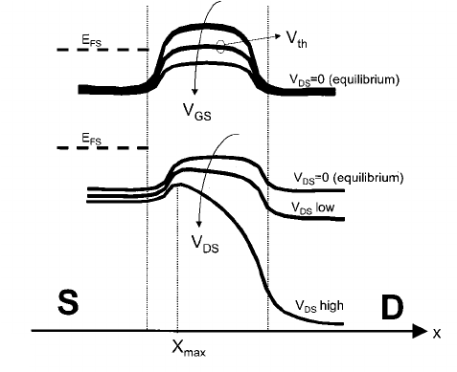
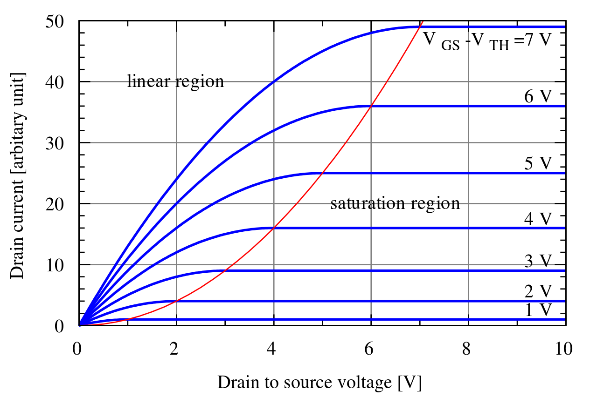
NMOS
Channel
Source
Drain (positive bias)

Slide 8
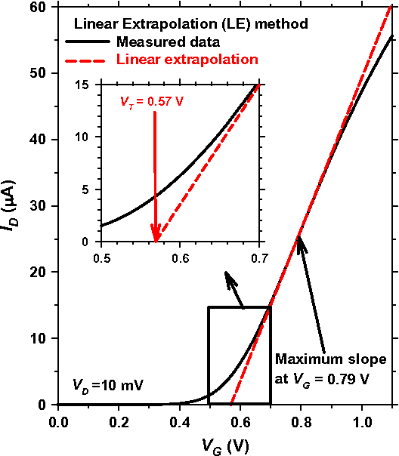
Threshold voltage and Carrier mobility
N-type device
Carrier mobility = μ = [dI_{D}/dV_{G}][L/(WC_{i}V_{D})]
dI_{D}/dV_{G} = Maximum slope
L/W = Channel length/width
V_{D} = Drain voltage
C_{i} = Capacitance (C_{i} = ɛ₀ɛ_{r}/d; ɛ_{r} = 3.9; d = 100 nm)
Unit of mobility = cm² V⁻¹ s⁻¹
https://www.semanticscholar.org/paper/Revisiting-MOSFET-threshold-voltage-extraction-Ortiz-Conde-Garc%C3%ADa-S%C3%A1nchez/e0fe6cc5e7b7841f16cbb149fd98b6e1179e5057

Slide 9
 | Wet Oxide | Ion Implantation | Dry Oxide | Channel length/width
製程參數 | SiO₂ : 500 nm | As : 1E15 cm² / 10 keV B : 1E15 cm² / 10 kev | SiO₂ : 100 nm | 40 μm / 20 μm

